Slide 1
Biological Opinion on the Continued Authorization of the Snapper-Grouper FMP
Jennifer Lee
Sea Turtles and Fisheries Coordination Branch
Protected Resources Division
Southeast Regional Office
December 5, 2016

Slide 2
Components of the Biological Opinion
Section 1: Consultation History (p. 8-11)
Section 2: Proposed Action (p. 11-35)
Section 3: Status Of the Species (p. 36-111)
Section 4: Environmental Baseline (p. 112-141)
Section 5: Effects of the Action (p. 142-202)
Section 6: Cumulative Effects (p. 203-204)
Section 7: Jeopardy Analysis (p. 205-229)
Section 8: Conclusion (p. 230)
Section 9: Incidental Take Statement (p. 231-237)
Section 10: Conservation Recommendations (p. 238-239)

Slide 3
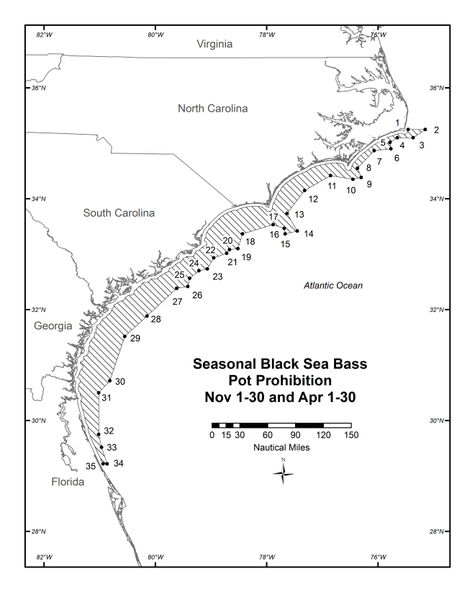
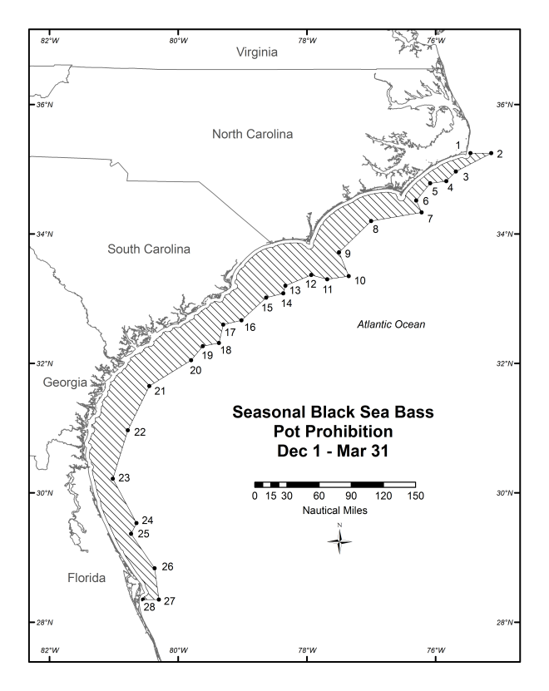
The Proposed Action
Describes the South Atlantic snapper-grouper fishery and proposed changes to the black sea bass (BSB) component of the fishery associated with Regulatory Amendment 16 (i.e., revised seasonal closures and gear marking)

Slide 4
Species Likely to be Adversely Affected/Status
North Atlantic right whales (E)
Sea Turtles:
Northwest Atlantic loggerhead DPS (T), North Atlantic green DPS (T), South Atlantic green DPS (T), Kemp’s ridley (E), hawksbill (E), and leatherback (E)
Smalltooth sawfish U.S. DPS (E)
Nassau Grouper (T)

Slide 5
Effects of the Action: Overall Approach (p. 142-144)
For each listed species likely to be adversely affected, we generally:
Examined the types of interactions that occur when exposed
Considered factors affecting the likelihood, frequency, and severity of exposure
Evaluated and quantifyed effects (i.e., number of individuals of each species and the fate) using the best available information.

Slide 6
Effects Analyses: NARWs
BSB trap/pot determined the only component likely to adversely affect NARWs; adverse effects via entanglements
Factors discussed potentially affecting the likelihood of NARW entanglements included soak times, spatial/temporal overlap, species morphology, behavior, and life stage
Estimated entanglements via a number of steps, including (but not limited to):
Estimated the number of NARWs anticipated to be the Southeast in any given calving season
Estimated trap entanglement rates: first as potentially reduced under Amendment 18A, and then the potential increase in entanglement rates due to the proposed action (Reg. Am. 16), with application of Farmer et al. 2016

Slide 7
Effects Analyses: NARWs
Estimated BSB pot entanglements that would result in mortality based on the number of serious injury and mortality events documented in Henry et al. (2015) and Waring et al. (2016) that were potentially associated with trap gear
Concluded that annual lethal takes from black sea bass trap pot/gear is between 0.02-0.04, equating to 1 estimated lethal entanglement approximately every 25 to 42 years
Concluded that the level of incidental take is very small and contributes only minimally to the overall mortality and is not reasonably expected to cause an appreciable reduction in the likelihood of both the survival and the recovery of the species

Slide 8
Effects Analyses: Sea Turtles
Adverse effects expected via hook-and-line interactions resulting in entanglement, hooking, trailing line, and forced submergence and via vessel strikes
Very little new data to assess; a lot of uncertainty in estimates
Bottom longline analysis relied on extrapolation of Gulf reef fish observed sea turtle capture rate to South Atlantic fishing effort reported via logbooks; all vertical line estimates are based on self-reported sea turtles in gear targeting Snapper-grouper FMU species
Jeopardy analysis concluded the proposed action’s effects are not reasonably expected to cause an appreciable reduction in the likelihood of both the survival and the recovery of the species

Slide 9
Effects Analyses: Smalltooth Sawfish
Hook-and-line gear is the only component of the fishery that may adversely affect smalltooth sawfish via entanglement, hooking, trailing line
Queried available databases (i.e., the supplemental discard data and the International Sawfish Encounter Database) to see if there were any new records of interactions between snapper-grouper hook-and-line gear and smalltooth sawfish.
Only a very small number of captures are anticipated and are based on captures documented in the hook-and-line gear component of the Gulf reef fish fishery
Jeopardy analysis concluded the proposed action’s effects are not reasonably expected to cause an appreciable reduction in the likelihood of both the survival and the recovery of the species

Slide 10
Effect Analyses: Nassau grouper
Hook-and-line gear determined to be the only fishery component likely to adversely affect via hooking
Factors discussed potentially affecting the likelihood of hooking included gear characteristics and fishing techniques and spatial overlap
Captures estimated via SDDP logbook data and effort (Commercial and MRIP-based Recreational ACL database, Headboat Survey Logbook Program, and SDDP)
Estimated post-release mortality using red grouper post-release mortality as a proxy, given their similarity (appearance, behavior, phylogeny) and applying the SEDAR Commercial and recreational workgroup/assessment recommendation for that species (20%)
Jeopardy analysis concluded the proposed action’s effects are not reasonably expected to cause an appreciable reduction in the likelihood of both the survival and the recovery of the species

Slide 11
Incidental Take Statement (ITS): Anticipated Take
Anticipated triennial amount of incidental take by species, except NARWs
No more than 921 hardshell sea turtles all combined are anticipated and therefore authorized (i.e., sum of individual sea turtle take by species ≠ total take allowed)
Nassau grouper takes are not prohibited at this time under the ESA so do not need an exemption, but are included in the table for tracking and reinitation triggers.
Species | Take Type | Total
NWA DPS Loggerhead Sea Turtles | Total | 629
 | Lethal | 208
Kemp’s Ridley Sea Turtles | Total | 180
 | Lethal | 59
Leatherback Sea Turtles | Total | 6
 | Lethal | 5
NA DPS Green Sea Turtle | Total | 111
 | Lethal | 42
SA DPS Green Sea Turtles | Total | 6
 | Lethal | 3
Hawksbill Sea Turtles* | Total | 6
 | lethal | 4
Smalltooth Sawfish | Total | 8
 | Lethal | 0
Nassau Grouper | Total | 4,161
 | Lethal | 846

Slide 12
ITS: NARWs
An incidental take authorization for NARWs is NOT issued for NARWs because
(1) an incidental take statement cannot be lawfully issued under the ESA for a marine mammal unless incidental take authorization exists for that marine mammal under the MMPA (see 16 U.S.C. § 1536(b)(4)(C)) and
(2) the incidental take of ESA-listed whales by the Snapper-Grouper fishery has not been authorized under section 101(a)(5) of the MMPA. Because no ITS is included, no incidental take by the snapper-grouper fishery is authorized under the ESA.
A numerical “trigger” for reinitiation of ESA section 7 consultation is specified:, reinitiation will occur if greater than one NARW is entangled in BSB trap/pot gear or gear consistent with BSB trap/pot over the next 25 year period.

Slide 13
ITS: Reasonable and Prudent Measures (RPMs)
RPM 1 - Minimizing Stress and Increasing Survival Rates Through Best Handling Practices: NMFS must ensure that caught sea turtles, Nassau grouper, or smalltooth sawfish are handled in a way that minimizes adverse effects (e.g., stress) to the animal and increases the likelihood of their survival.
RPM 2 - Monitoring the Frequency and Magnitude of Incidental Take: NMFS must ensure that monitoring and reporting: (1) detects and documents any adverse effects resulting from the South Atlantic snapper-grouper fishery; (2) assesses the actual level of incidental take in comparison with the anticipated incidental take documented in the Opinion; (3) detects when the level of anticipated take is exceeded; and (4) collects improved data.

Slide 14
T&Cs Pertaining to Snapper-Grouper Management
RPM 1,T/C 2: NMFS must examine ways to reduce mortality of Nassau grouper. This includes, but is not limited to, examining possible modifications to fishing practices that can be adopted through changes in fishery management plan related regulations, as well as recommended best fishing practices. NMFS must assess:
(a) the potential effectiveness of non-stainless steel circle hooks on reducing injury and mortality to Nassau grouper. If deemed an effective measure, NMFS shall consider revision of regulations to expand their current use to include areas south of 28° N. lat. for fishing activities that could incidentally capture Nassau grouper.
(b) the potential effectiveness of fishing practices after fish are captured that could reduce and minimize the effects of fishing. This includes, but is not limited to 1) de-hooking and 2) treatment for barotrauma, e.g., the possible use of “descender” devices. If deemed effective, NMFS shall consider revision of regulations to implement their use for incidentally caught Nassau grouper

Slide 15
T&Cs Pertaining to Snapper-Grouper Management
RPM 2, T/C 3: NMFS must review and/or continue to review all available data sources (e.g., logbook, observer, STSSN, ISED) for observed documented take sea turtles, smalltooth sawfish and Nassau grouper in the South Atlantic snapper-grouper fishery to monitor their incidental take.
RPM 2, T/C 4: NMFS must work with the SAFMC in developing its Bycatch Reporting Amendment to evaluate the current standardized bycatch reporting methodologies under the Snapper-Grouper FMP.
As part of this evaluation, NMFS and the SAFMC must consider increasing the self-reporting of sea turtles, Nassau grouper, and smalltooth sawfish captures in commercial hook-and-line gear targeting snapper-grouper from the current 20% under the SDDP to 100% as one option.

Slide 16
Conservation Recommendations
CR7: NMFS should promote the use of ropes with breaking strengths equal to or less than 1700 lb for the BSB trap/pot fishery. New research suggests that if fisheries were to utilize ropes with breaking strengths less than or equal to 1700-lb breaking strength, the number of life-threatening entanglements for large whales would decrease by at least 72% (Knowlton et al. 2015).

Slide 17
Future Questions?
For additional information:
Jennifer Lee
Email: Jennifer.Lee@noaa.gov
Phone: (727) 551-5778

