Slide 1

Sea turtle research in support of bycatch mitigation and evaluating potential climate change effects
Larisa Avens
Sea Turtle Branch
Marine Mammal & Turtle Division
Southeast Fisheries Science Center

Slide 2
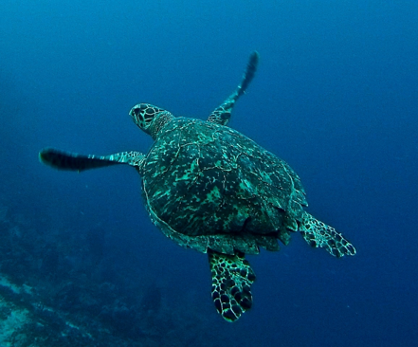
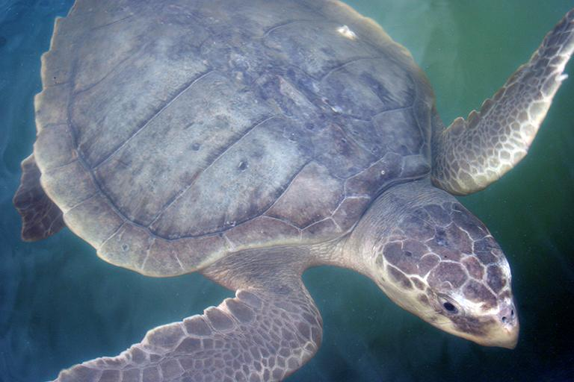
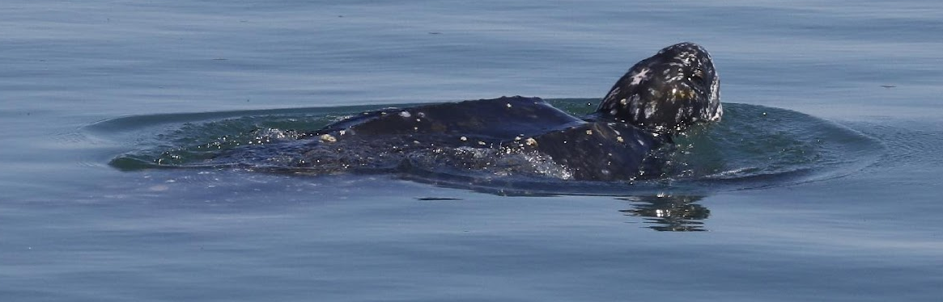
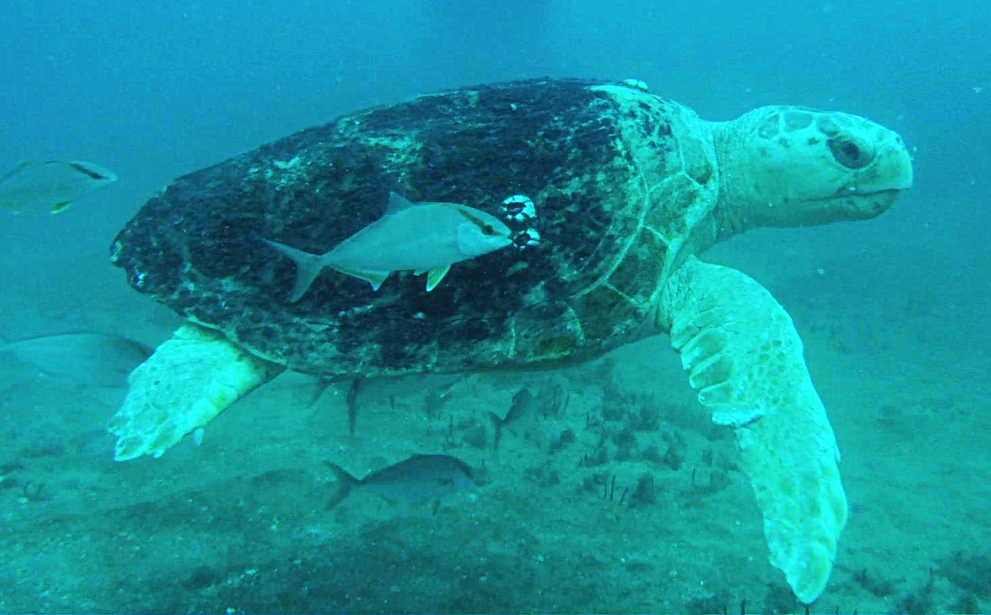
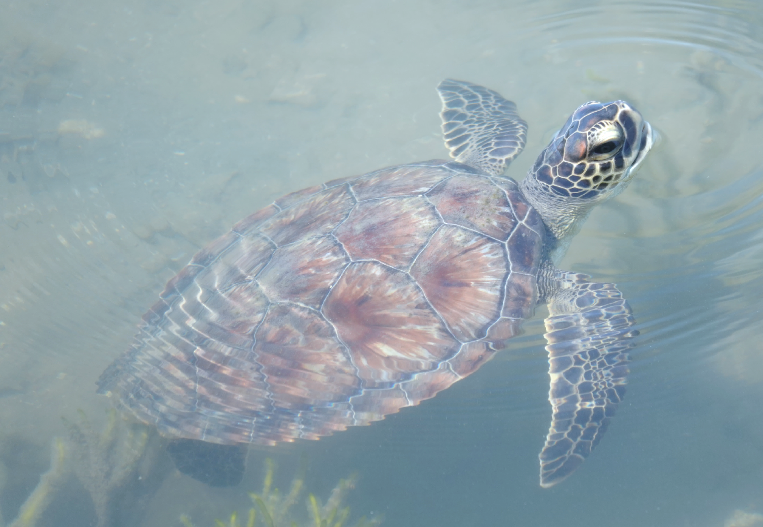
SEFSC Sea Turtle Branch
Hawksbill
Five Endangered Species Act (ESA)-listed sea turtle species in the southeast region
Research focused on evaluating:
    population status relative to ESA recovery goals
    impacts of direct threats
    effects of climate change-related factors
Photo E. Simmons
Kemp’s ridley
Photo L. Goshe
Leatherback
Loggerhead
Green turtle
Photo H. Haas
Photo NMFS SEFSC
Photo D. Madden
NMFS ESA permit 21233

Slide 3
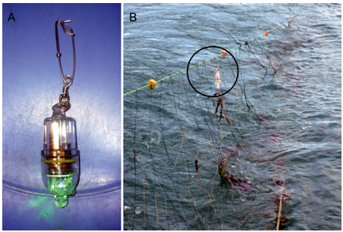
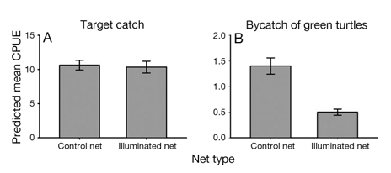
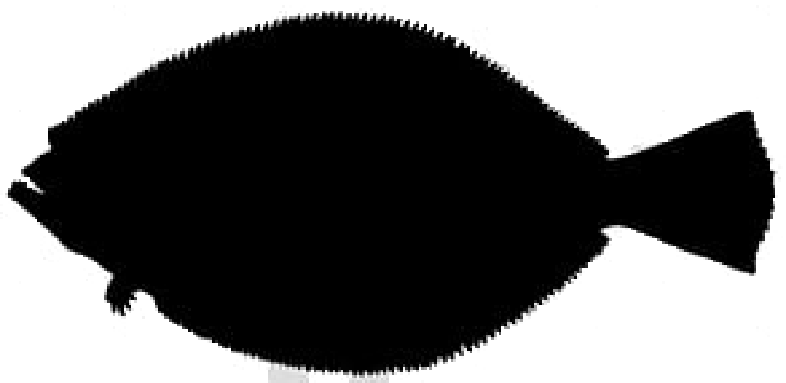

Bycatch mitigation – visual deterrents (LEDs)
Battery-powered LED
Fishery interactions with bycaught species (e.g., sea turtles)
Current focus: coastal net fisheries
Potential bycatch reduction with light (LED) deterrents
Target catch
Bycatch of green turtles
Predicted mean
Catch per Unit Effort (CPUE)
64%
decrease
Control
LED
Control
LED
Peruvian bottom-set gillnet fishery
Ortiz et al. (2016)

Slide 4
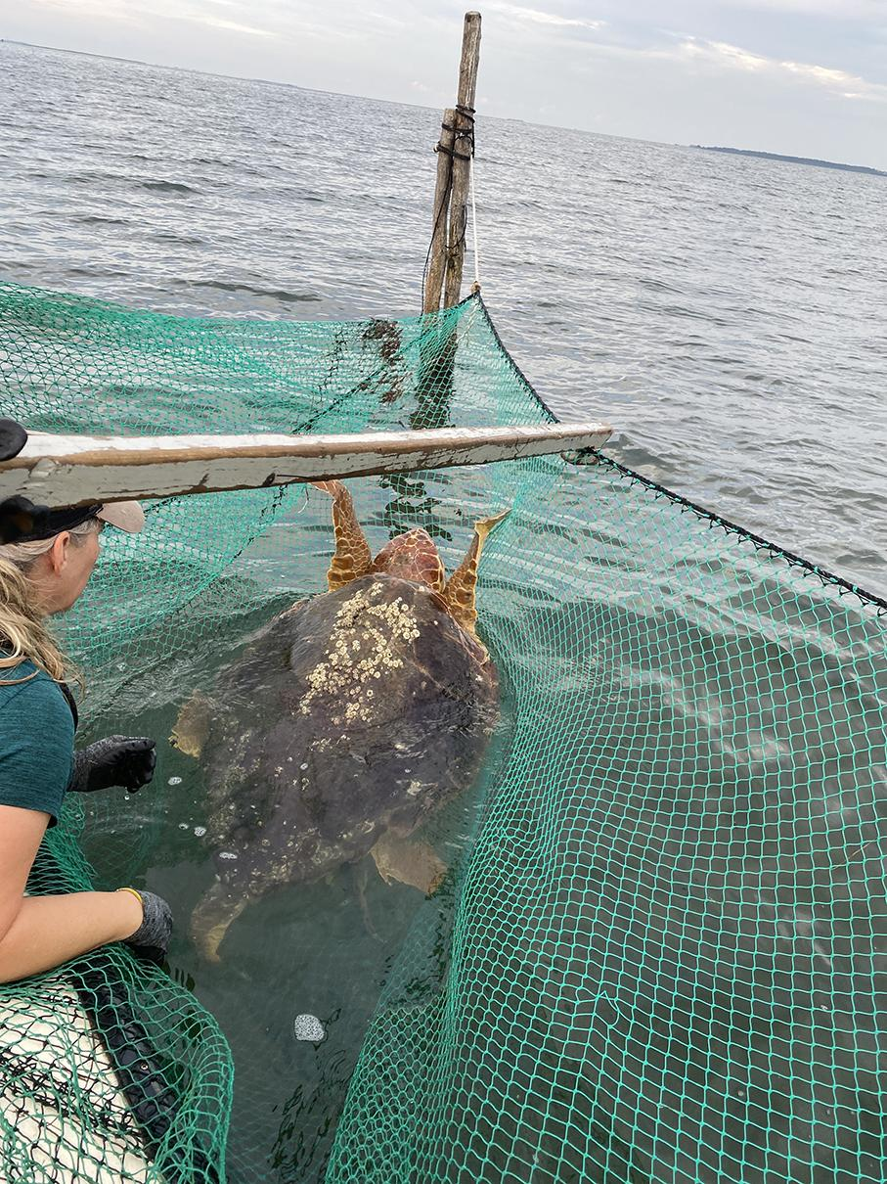
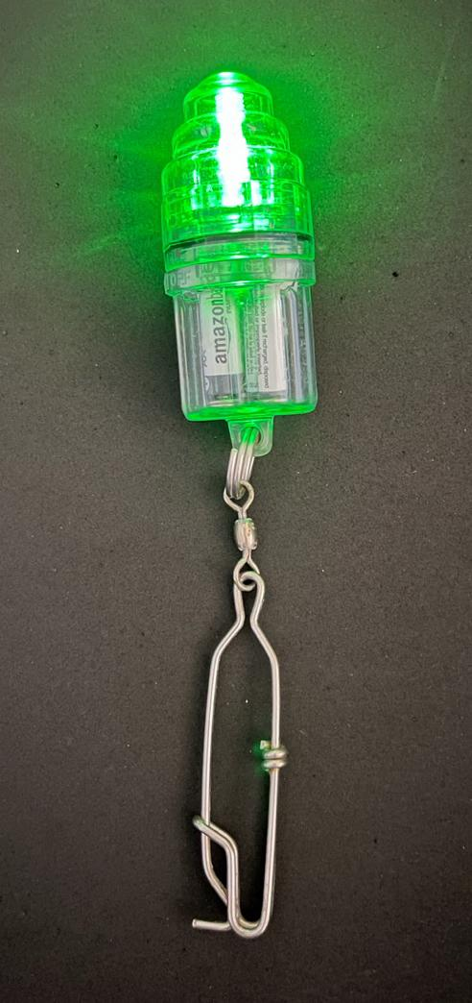
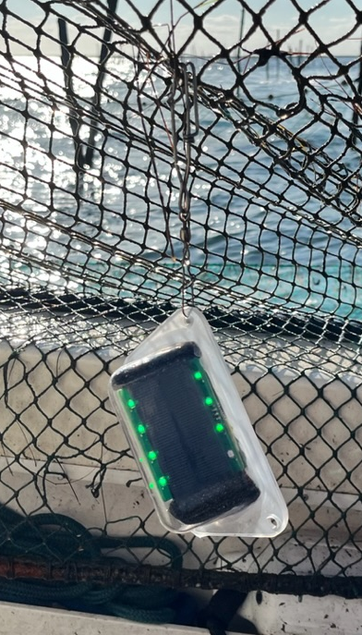
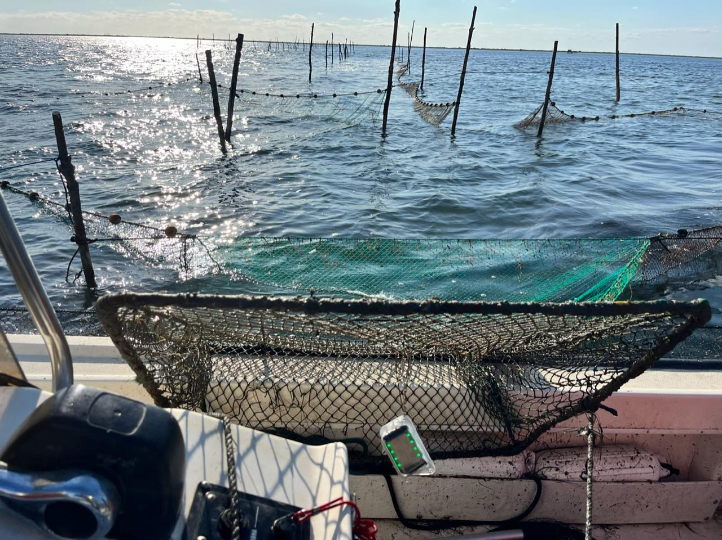
Bycatch mitigation – visual deterrents (LEDs)
(local fishers; Arizona State University; NMFS OPR, PIFSC)
Testing battery- and solar-powered LEDs in pound net fishing gear
Battery-powered LED
Solar-powered LED
Photo J. Senko
Photo M. Cook
Net deployment and trials authorized by NMFS ESA permit 21233 issued to the SEFSC

Slide 5
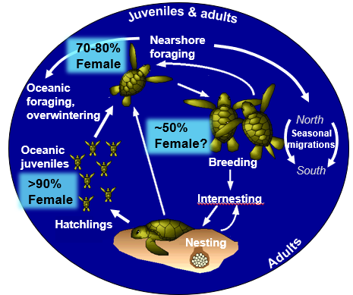
Climate change and sea turtle population sex ratios (NC State University, PIFSC, NEFSC, SWFSC)
Recent study: juvenile green turtles >99% female (Jensen et al. 2018; Australia)
Important to monitor juvenile sea turtle sex ratio trends
Challenges:
long juvenile life stages (10-30 years)
no external sex-specific features
100% female
0% female
Low
High
Egg incubation temperature

Slide 6
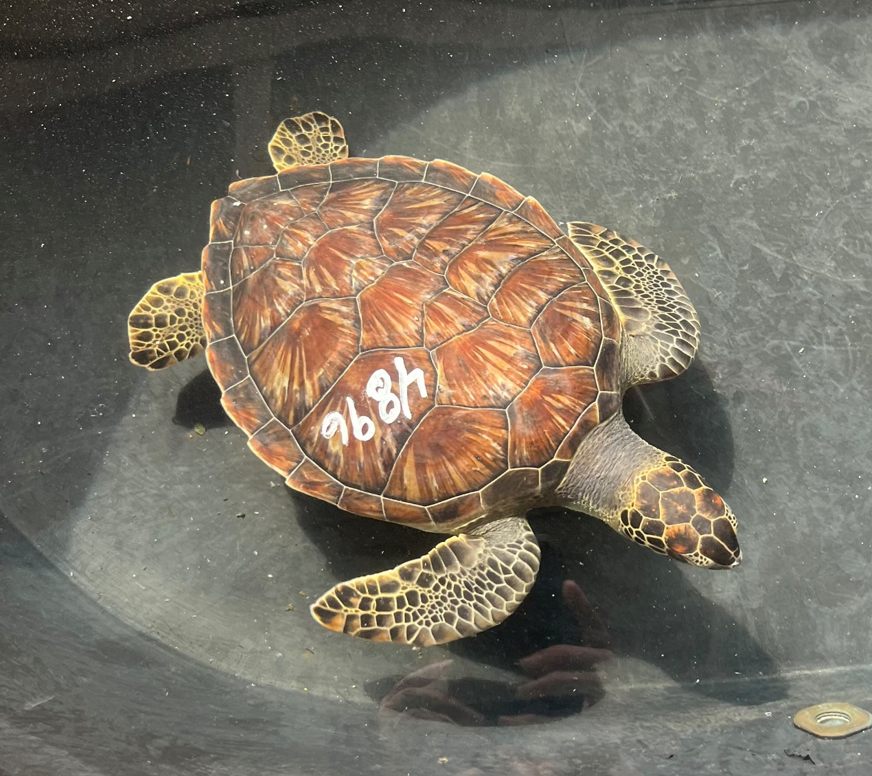
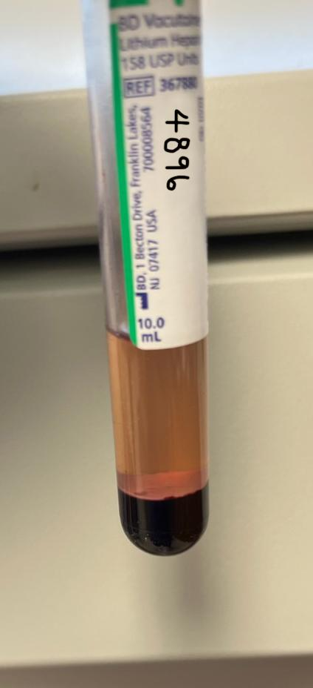
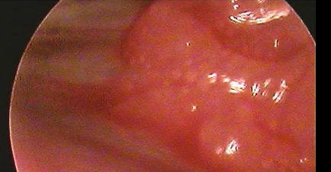
Climate change and sea turtle population sex ratios
(NC State University, PIFSC, NEFSC, SWFSC)
Juvenile green turtle ID 4896
Accessing traditional analytical methods can be challenging:
    laparoscopic surgery
    specialized blood testosterone analyses
Current research: validating new, commercially-available blood testosterone analysis using traditional methods
Goal: increase accessibility and capacity to track juvenile population sex ratio trends
Green turtle 4896 Laparoscopy =
female
Green turtle 4896 Blood sample = low testosterone
ovarian
follicles
NMFS SEFSC
NMFS ESA permit 21233

Slide 7
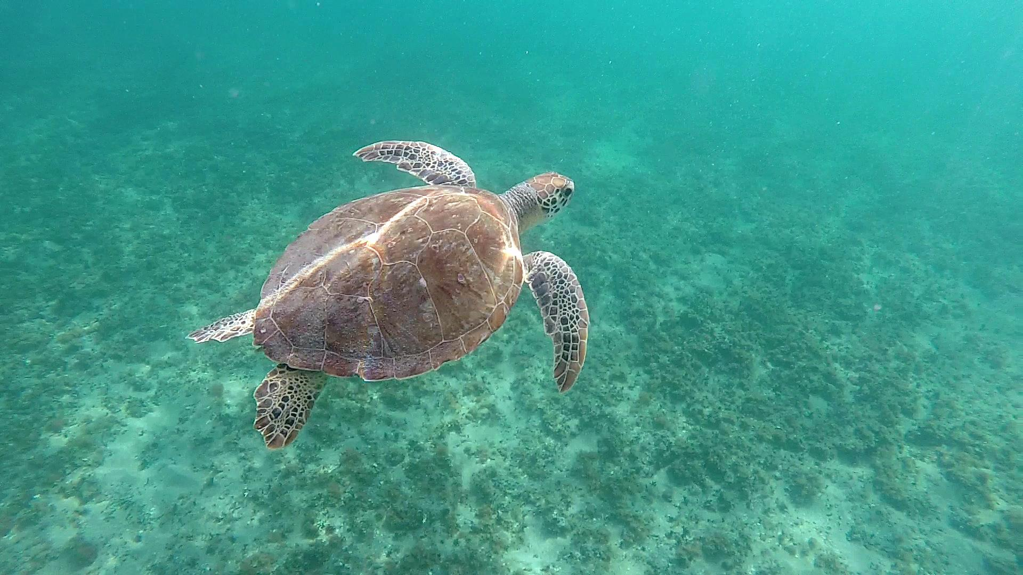
Questions?
Photo L. Stokes
larisa.avens@noaa.gov

