Slide 1
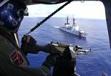
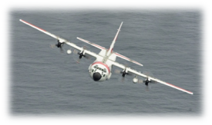
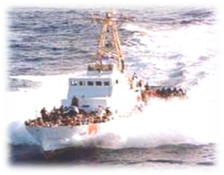
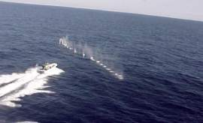
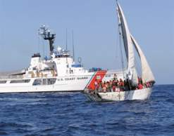
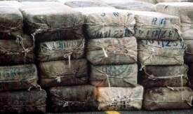
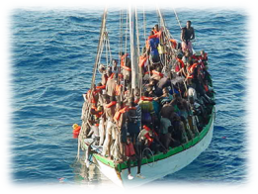
Overall Classification // UNCLASSIFIED
U.S. Coast Guard District Seven
MPA Overview
14 June 2012
UNCLASSIFIED

Slide 2
UNCLASSIFIED
Coastal Sectors
Sector Commands
  Charleston
  Jacksonville
  Miami
  Key West
  St. Petersburg
  San Juan
  OPBAT
Air Station Commands
  Savannah
  Clearwater
  Miami
  Borinquen
OPBAT
UNCLASSIFIED
Notes:
18K miles of coastline
2

Slide 3
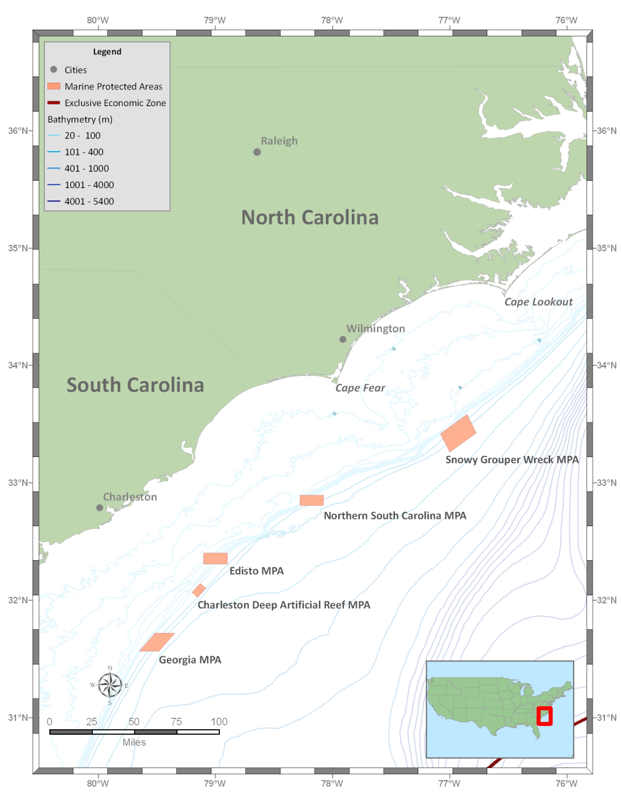
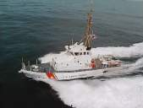
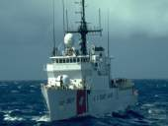
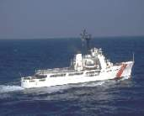
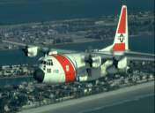
UNCLASSIFIED
MARINE PROTECTED AREAS
WMEC-270
WMEC-210
C-130 “HERCULES”
UNCLASSIFIED
Notes:
3

Slide 4
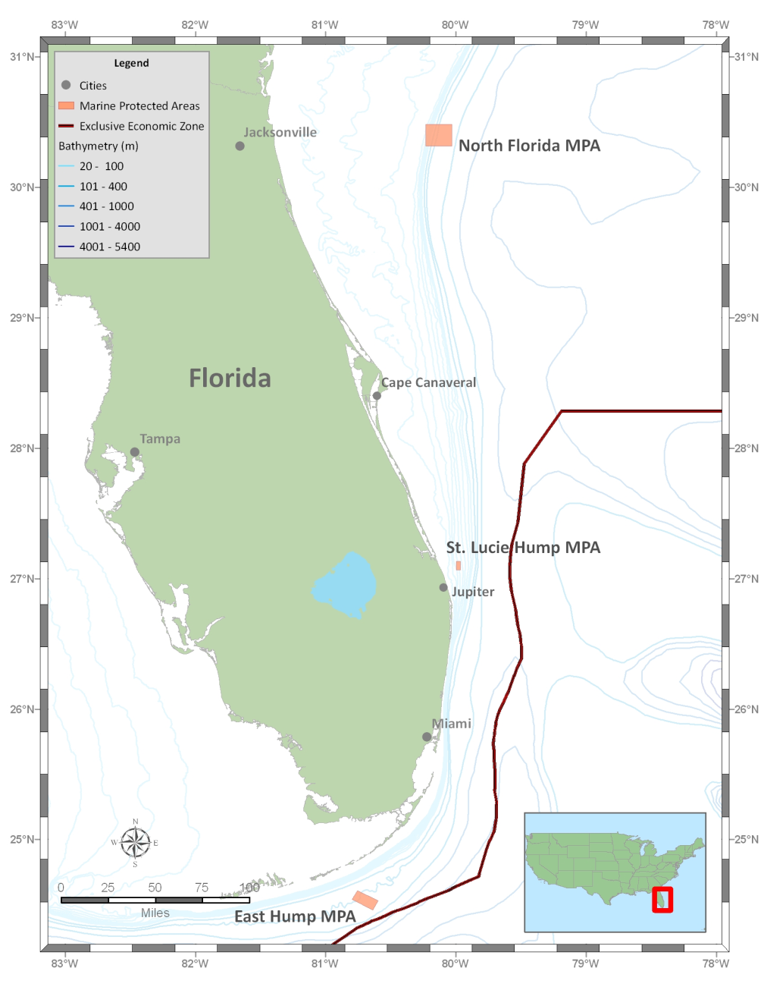

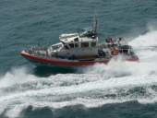
UNCLASSIFIED
MARINE PROTECTED AREAS
SPC-LE
WMEC-270
WMEC-210
45-FT RBM
UNCLASSIFIED
Notes:
4

Slide 5
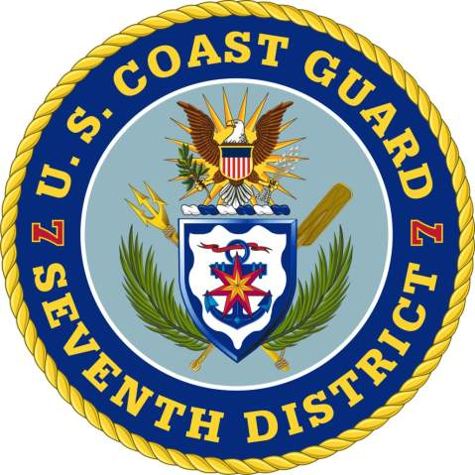
Notes:
5

