Slide 1
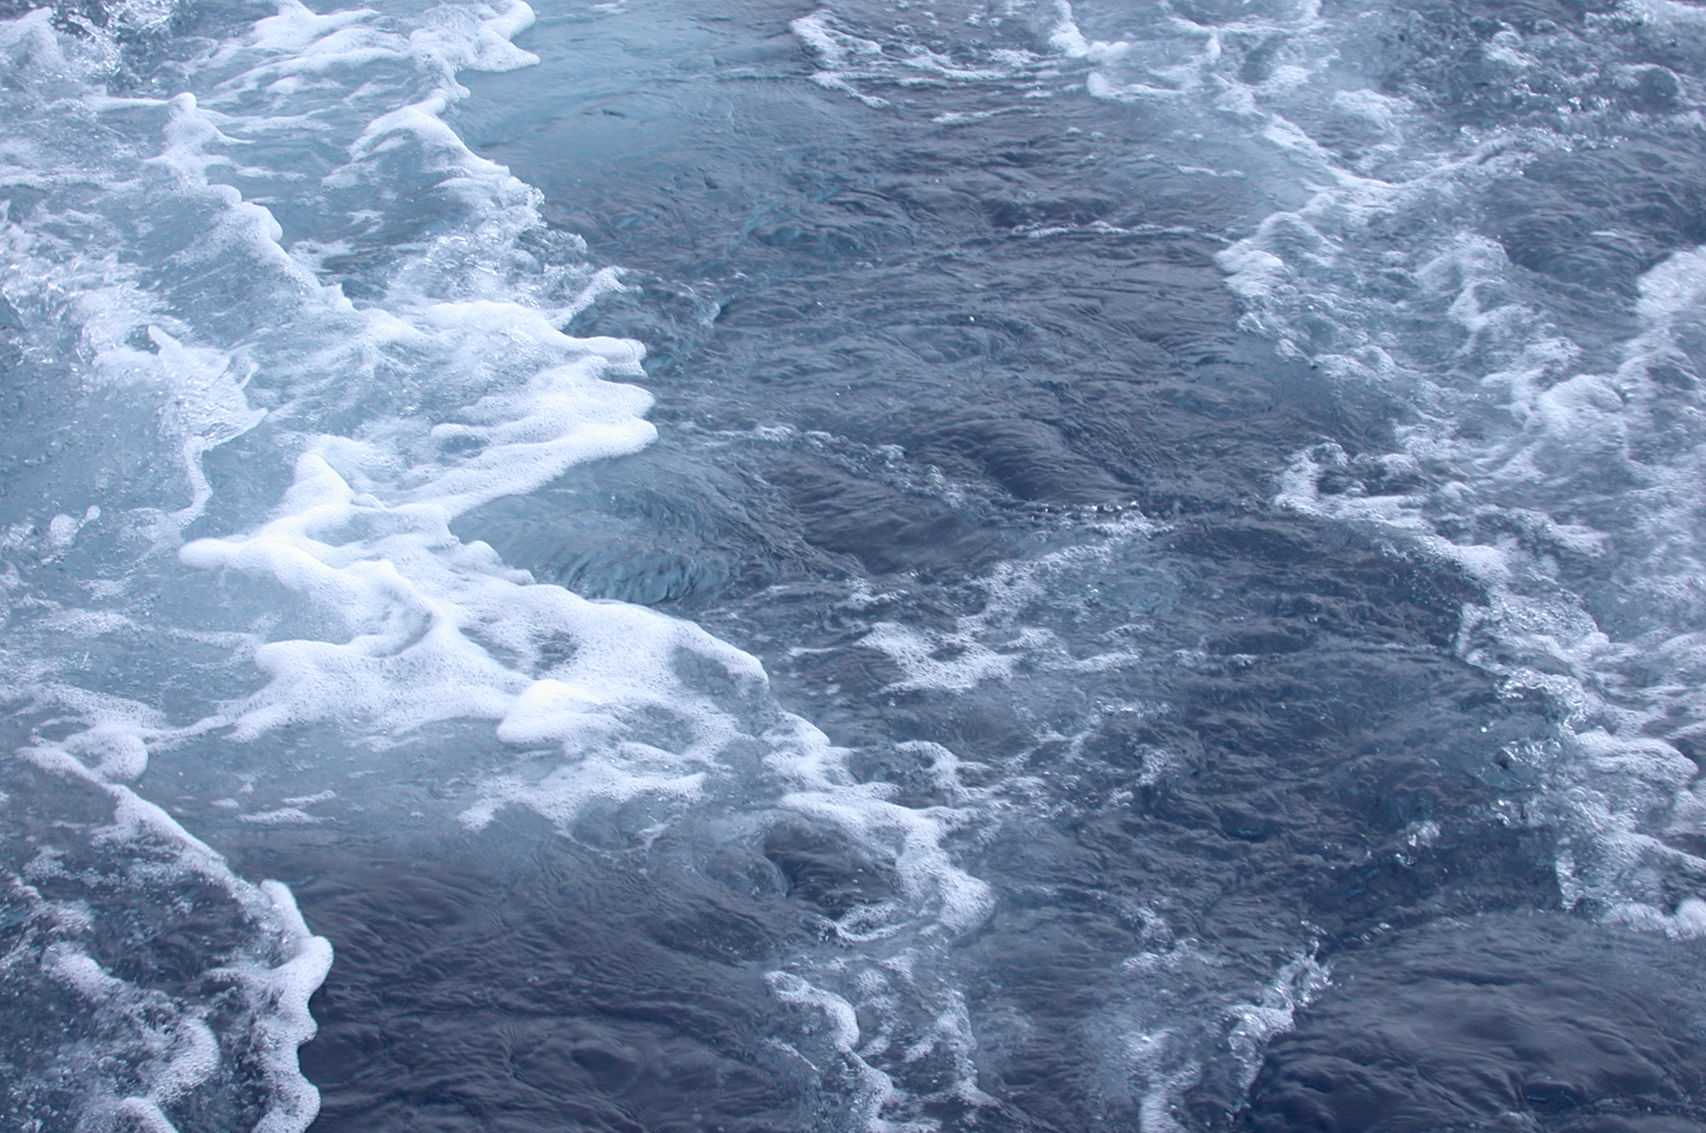
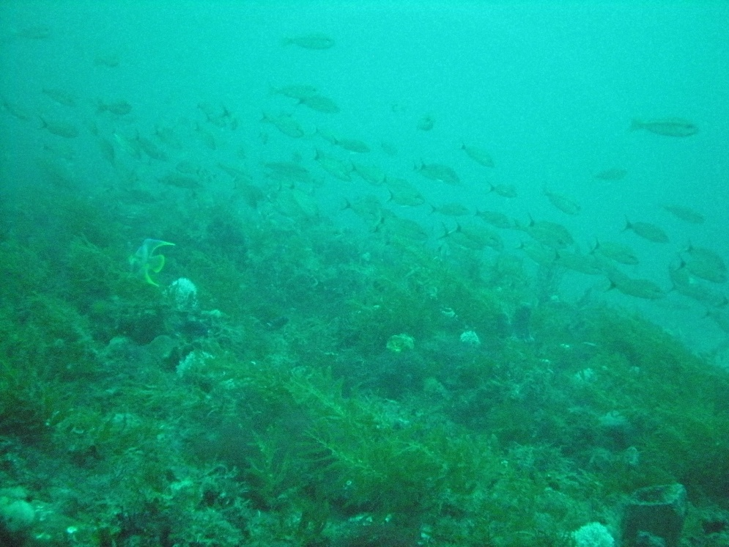
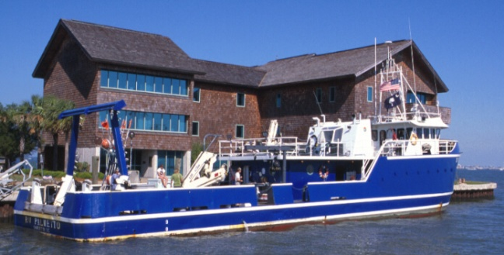
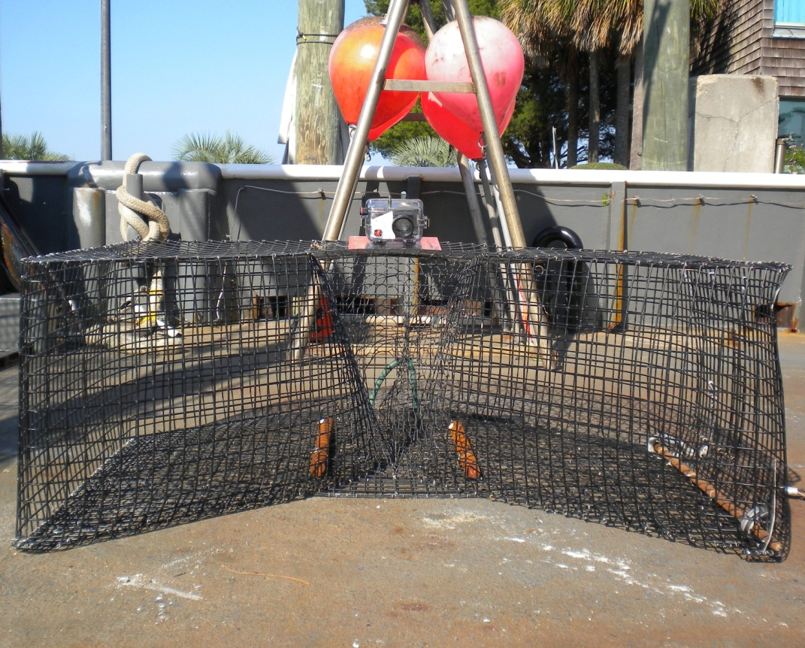
The MARMAP/SEAMAP/SEFIS
Reef Fish Monitoring Program
Update 2012
sampling activities and trap CPUE.
SSC meeting 2013

Slide 2
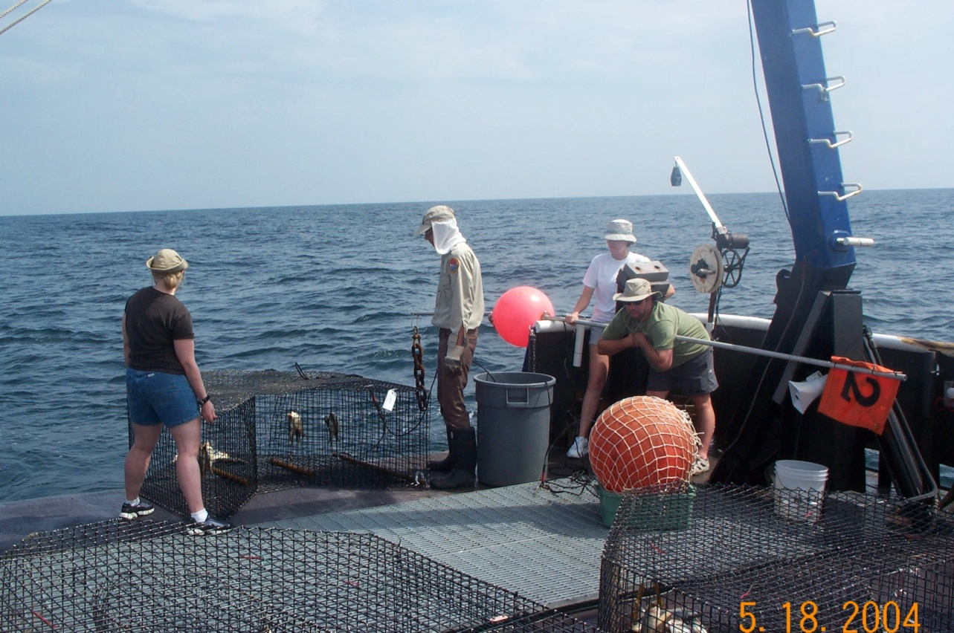
- MARMAP since 1972, with reef fish sampling since late 70’s
- SEAMAP-SA since 1986, with reef fish sampling since 2009
- SEFIS since 2010
- Live-bottom habitat sampling using fish traps since 1978
R/V Palmetto
MArine Resources Monitoring, Assessment and Prediction
South East Area Monitoring and Assessment Program (South Atlantic)
South East Fishery Independent Survey

Slide 3
Primary tasks:
- Monitor abundance of reef fishes (various gears incl. traps and video)
Conduct life history studies
Conduct research and provide data and analyses in support
of stock assessments and fisheries management
- Investigate and map bottom habitat
scamp

Slide 4
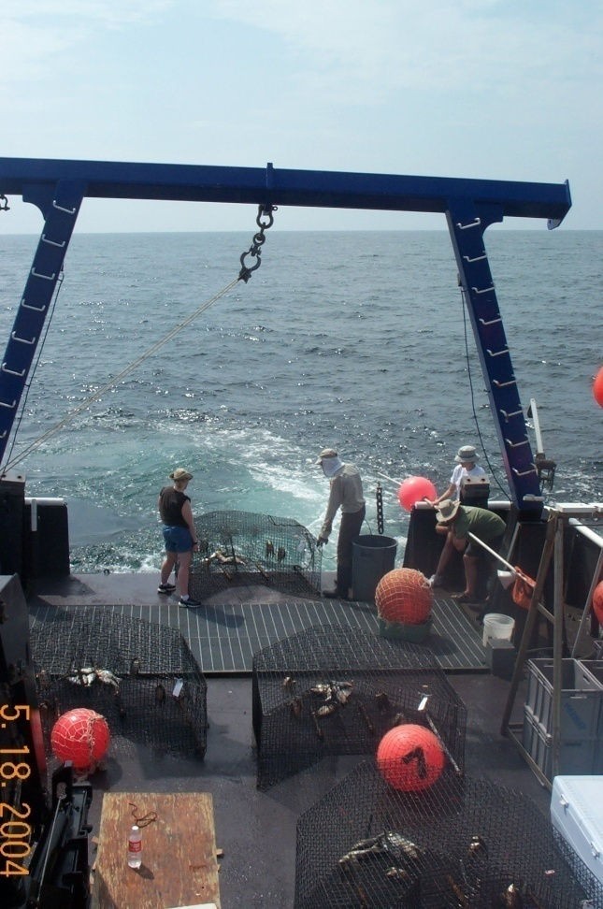
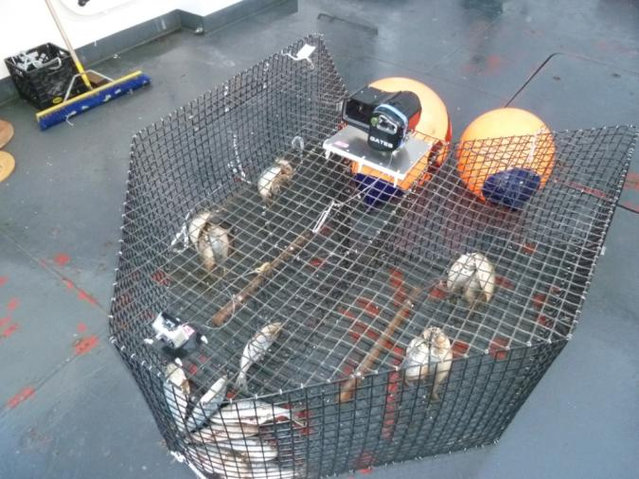
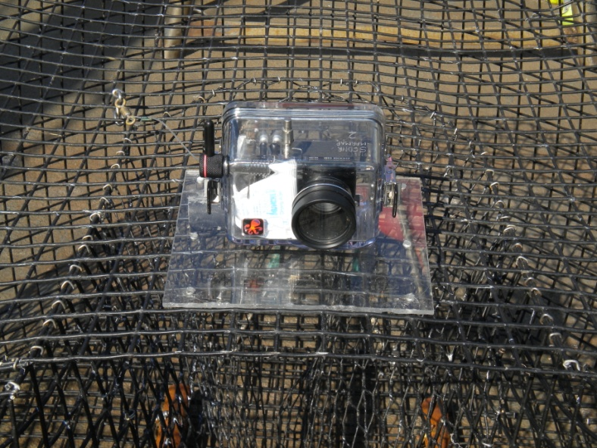
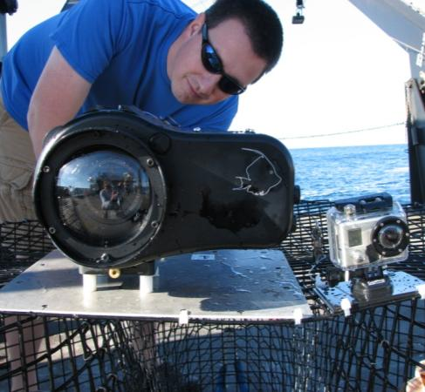
Current primary gear: Chevron trap
Consistent and standardized use since 1990
Deployed in depths to ≈120 m
Soak time ≈ 90 minutes
Baited with clupeids
Digital still camera (1 pict./5 min.) since 2008
Video cameras since 2010

Slide 5
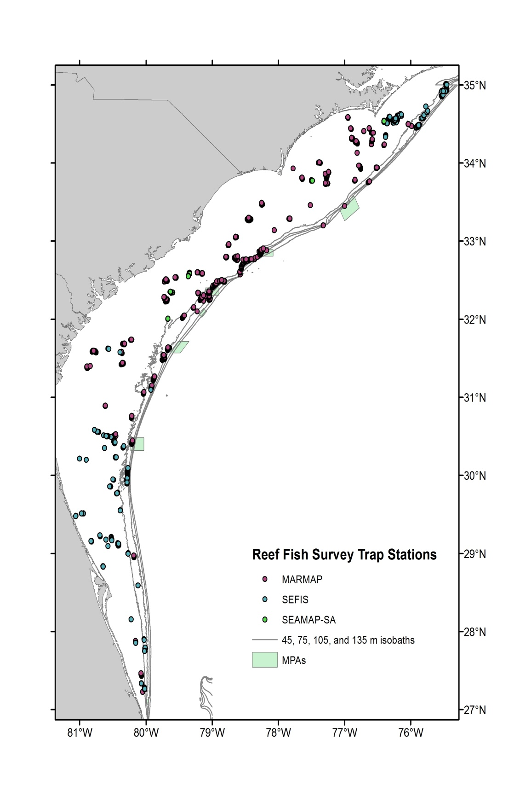
Contemporary Sampling design
2,685 sampling stations with
known live-bottom habitat
Random selection of these stations
distance at least 200m
Sampling
MARMAP/SEAMAP-SA: NC and SC
SEFIS: GA and FL
Data processing
MARMAP/SEAMAP-SA:
All life history processing & analyses
SEFIS
All video processing & analyses
Data
Will be one combined in comprehensive
data base, managed in collaboration
Notes:
Live bottom habitat based on fishermen information, video surveys, catches, etc.

Slide 6

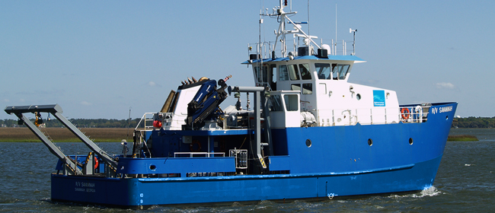
R/V Palmetto
MARMAP/SEAMAP-SA
SC-DNR
R/V Savannah
SEFIS
SKIO
35 - 60 days at sea per vessel
5 -12 days per cruise

Slide 7
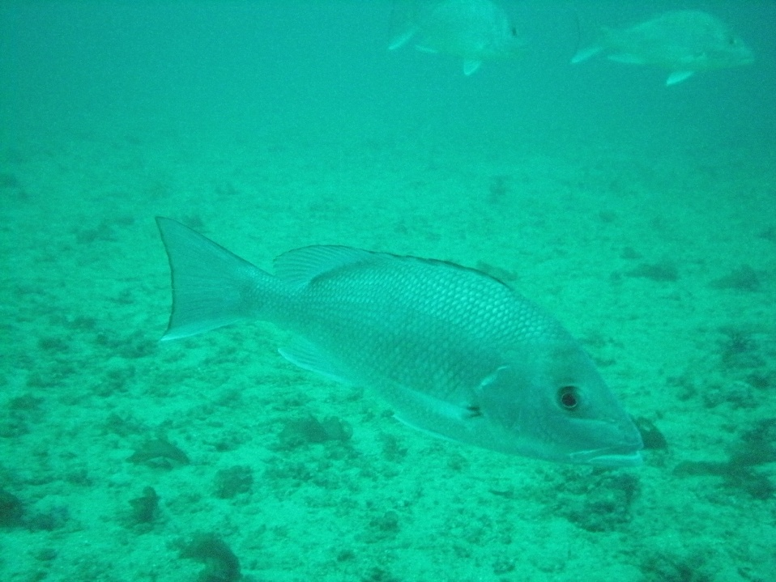
MARMAP/SEAMAP-SA
2006 – 2009:
690 traps deployed annually
MARMAP/SEAMAP-SA/SEFIS
2010 – 2012:
≈ 1,100 - 1,400 traps deployed annually
MARMAP budget reduction in 2012 affected sampling:
Reduction in sea days and processing staff.
Halting short and long bottom long line surveys
(affecting data collection for species such as snowy grouper and tilefish)

Slide 8
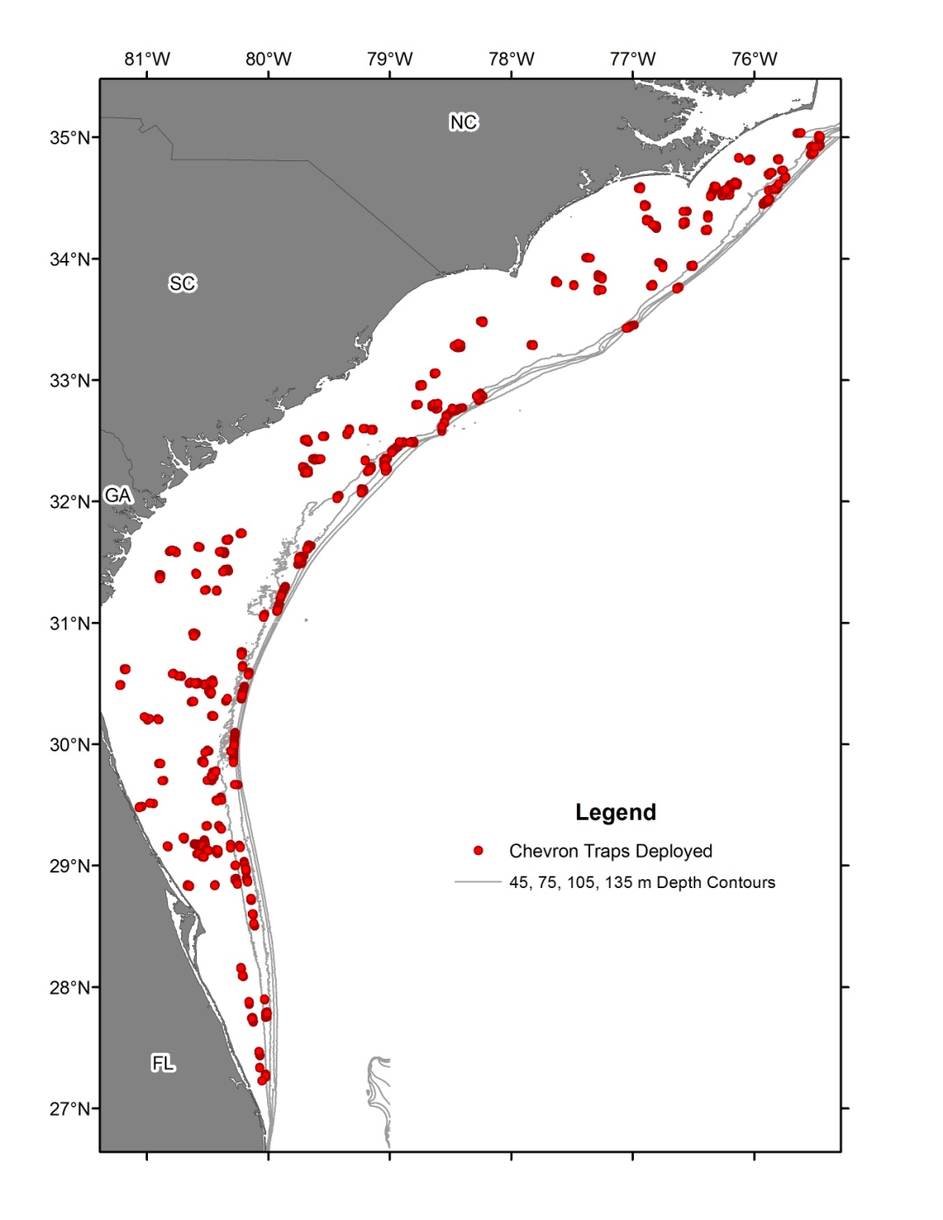
2012 Summary
1,393 traps deployed, incl. recon.
All with video camera(s)
458 other gear deployments
(CTD, H&L, etc.)
74 species - 40,400 fish collected,
identified, weighed & measured
Life history (trap catches):
32 species and 8,690 fish kept
(age, reproduction)
Diet studies:
Completed sampling: red porgy,
vermilion snapper, gray triggerfish
Ongoing: groupers, red snapper,
squirrelfish
Notes:
Total species kept for LH using all gears and surveys: 40 with 9,359 fish processes.

Slide 9
2012 Reef Fish Survey catches - Most common species
Common_Name | Scientific_Name | Other gear | Chevron trap | total
Black sea bass | Centropristis striata |  | 20,361 | 20,361
Tomtate | Haemulon aurolineatum | 2 | 7,526 | 7,528
Scup and longspine porgy | Stenotomus sp. |  | 4,139 | 4,139
Red porgy | Pagrus pagrus | 8 | 2,331 | 2,339
Gray triggerfish | Balistes capriscus |  | 1,148 | 1,148
Vermilion snapper | Rhomboplites aurorubens | 78 | 1,095 | 1,173
Bank sea bass | Centropristis ocyurus |  | 1,053 | 1,053
Sand perch | Diplectrum formosum |  | 433 | 433
Red snapper | Lutjanus campechanus | 38 | 429 | 467
White grunt | Haemulon plumierii | 6 | 351 | 357
Spottail pinfish | Diplodus holbrookii |  | 300 | 300
Pinfish | Lagodon rhomboides |  | 177 | 177
Planehead filefish | Stephanolepis hispidus |  | 105 | 105
Knobbed porgy | Calamus nodosus |  | 66 | 66
Scamp | Mycteroperca phenax | 17 | 63 | 80
Cubbyu | Pareques umbrosus |  | 55 | 55
Jacknife fish | Equetus lanceolatus |  | 54 | 54
Gag | Mycteroperca microlepis | 25 | 47 | 72
Snowy grouper | Epinephelus niveatus | 76 | 44 | 120
Red grouper | Epinephelus morio | 3 | 39 | 42
Blueline tilefish | Caulolatilus microps | 11 | 32 | 43
Notes:
Vast majority is BSB.
Other managed species: red porgy, gray triggerfish and vermilion snapper good numbers.
Red snapper 9th most abundant species.

Slide 10
2012 total # of life history samples collected (incl. FD)
common name | Scientific name | Other gear | Chevron trap | Total
Black sea bass | Centropristis striata |  | 4,829 | 4,829
Red porgy | Pagrus pagrus | 60 | 1,700 | 1,760
Vermillion snapper | Rhomboplites aurorubens | 113 | 514 | 627
Gray triggerfish | Balistes capriscus |  | 505 | 505
Red snapper | Lutjanus campechanus | 96 | 430 | 526
White grunt | Haemulon plumierii | 3 | 331 | 334
scamp | Mycteroperca phenax | 93 | 62 | 155
Gag | Mycteroperca microlepis | 79 | 47 | 126
Snowy grouper | Epinephelus niveatus | 123 | 44 | 167
Red grouper | Epinephelus morio | 28 | 41 | 69
Blueline tilefish | Caulolatilus microps | 11 | 32 | 43
Squirrelfish | Holocentrus adscensionis | 12 | 22 | 34
Silk snapper | Lutjanus vivanus |  | 16 | 16
Rock hind | Epinephelus adscensionis | 4 | 5 | 9
Lane snapper | Lutjanus synagris |  | 5 | 5
Graysby | Cephalopholis cruentata |  | 4 | 4
Almaco jack | Seriola rivoliana |  | 3 | 3
Speckled hind | Epinephelus drummondhayi |  | 2 | 2
Warsaw grouper | Epinephelus nigritus |  | 2 | 2
Greater amberjack | Seriola dumerili | 25 | 2 | 27
Banded rudderfish | Seriola zonata |  | 2 | 2
Notes:
Numbers for some species may be higher than those collected through fishery independent survey as we sometimes add samples from fishery dependent sources, but vast majority is our own sampling.
Red snapper: other gear includes the fishery dependent sampling efforts as part of the red snapper opening. MARMAP aged SC samples.
Note that some data in table are still undergoing final stages of QC process.

Slide 11
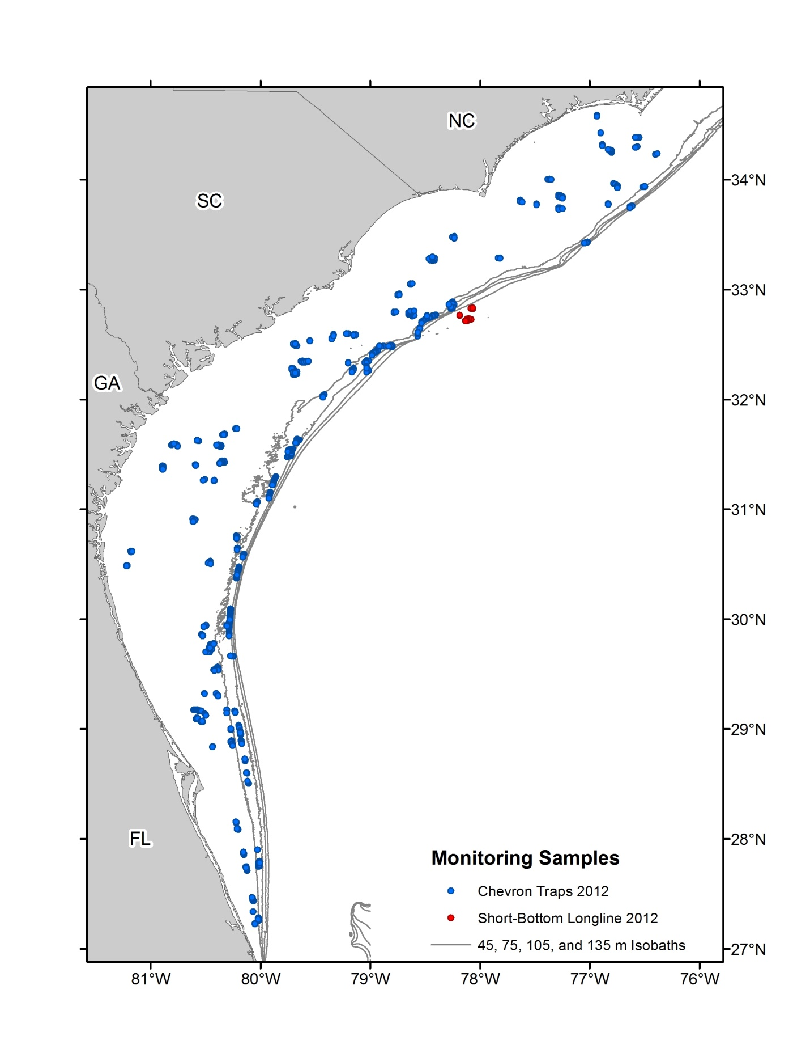
Overview CPUE:
Chevron traps data only
Monitoring stations only
Selected species depth ranges
Soak times: 45-150 minutes
Time series:1990 – 2012
CPUE in fish per trap * hour
Delta GLM standardized and Nominal CPUE
Normalized to long term average
Error bars are ± 1 SE
Notes:
Monitoring only: No recon. Inclusion into index has been considered, but was historically not done
Depth ranges: over which between 95 and 100% of specimens are caught
CPUE: Other methods and analyses in consideration, such as zero inflated, taking trap saturation into account, habitat considerations, and others.

Slide 12
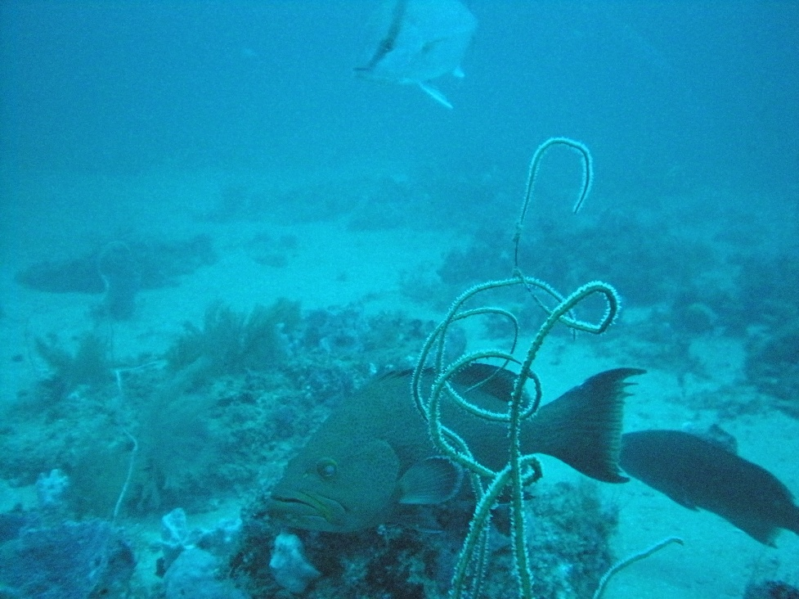
Caveats
Summary overview, not an update of stock status,
Constraints and stratification for CPUE may be different from those used in (SEDAR) stock assessments
Many species have not been assessed or updated through SEDAR process and not all trends and analyses have been discussed in SEDAR framework.

Slide 13
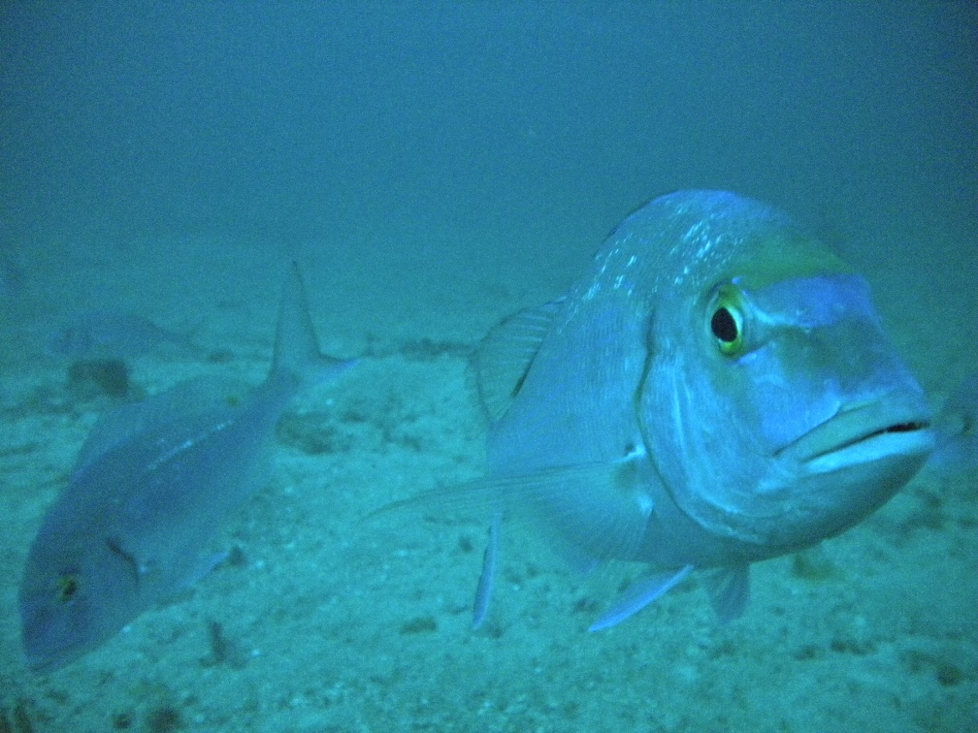
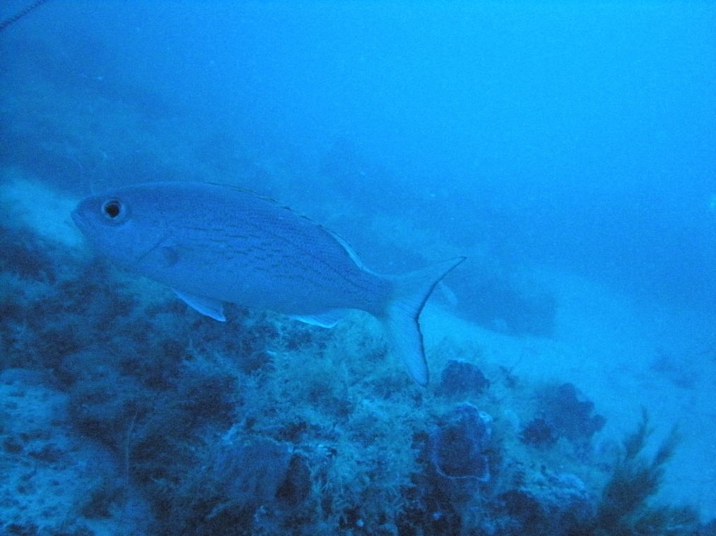
OVERVIEW
SELECTED SPECIES
Notes:
Overview of 23 species available in annual report.

Slide 14
Chevron trap CPUE
Red porgy

Slide 15
Chevron trap CPUE
Red snapper

Slide 16
Chevron trap CPUE
Vermilion snapper

Slide 17
Chevron trap CPUE
White grunt

Slide 18
Chevron trap CPUE
Scamp

Slide 19
Chevron trap CPUE
Knobbed porgy

Slide 20
Chevron trap CPUE
Tomtate

Slide 21
2013 Reef Fish Monitoring
Sampling season :
  May – September (April 22 – October 18)
Gears:
Chevron traps with 2 video cameras
CTD & hook & line (SEAMAP-SA diet studies)
No long bottom long-line (e.g. tilefish)?
No or limited short bottom long-line (e.g. snowy grouper)?

Slide 22
Acknowledgements:
MARMAP/SEAMAP-SA/SEFIS
Staff and students
Research Vessel Crews

