Slide 1
The adopted ICCAT Bluefin Management Procedure, seeing the MSE to its end
Cassidy Peterson & John Walter
SAFMC December Meeting
https://iccat.github.io/abft-mse/

Slide 2
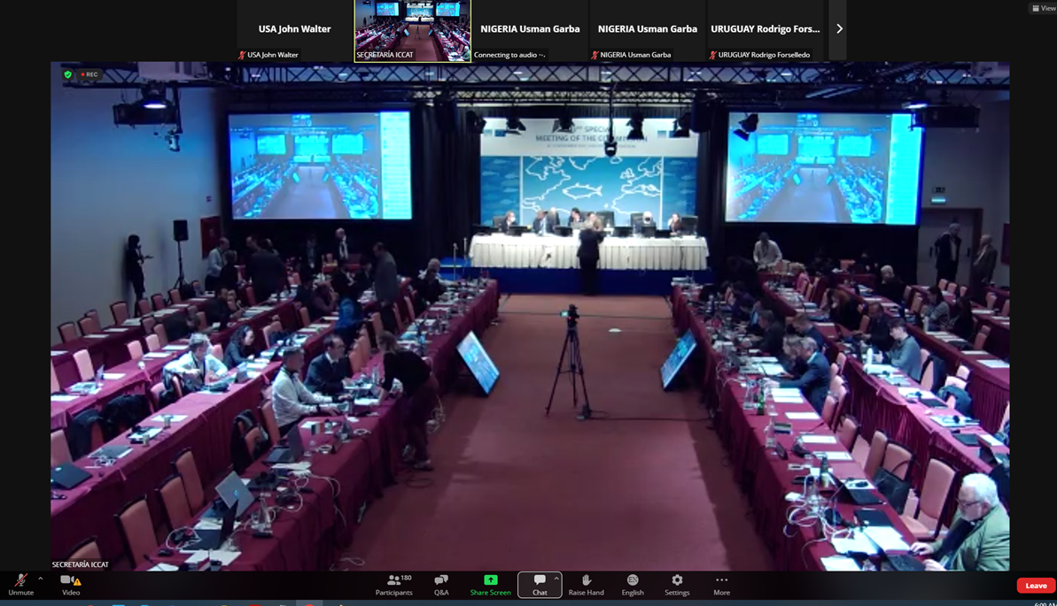
REC 22-09 RECOMMENDATION BY ICCAT ESTABLISHING A MANAGEMENT PROCEDURE FOR ATLANTIC BLUEFIN TUNA TO BE USED FOR BOTH THE WESTERN ATLANTIC AND EASTERN ATLANTIC AND MEDITERRANEAN MANAGEMENT AREAS
Notes:
goal of MSE is to develop and test an MP (recipe for specifying catch limits for a fishery) Adoption of ABFT Butterworth-Rademayer MP at the 2022 Commission meeting in Portugal and adoption of exceptional circumstances protocols in 2023 in Egypt.

Slide 3
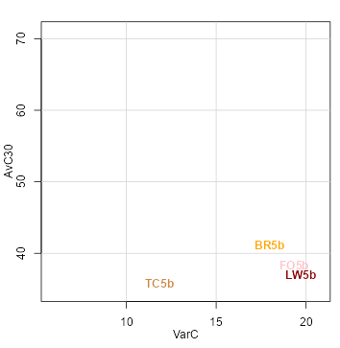
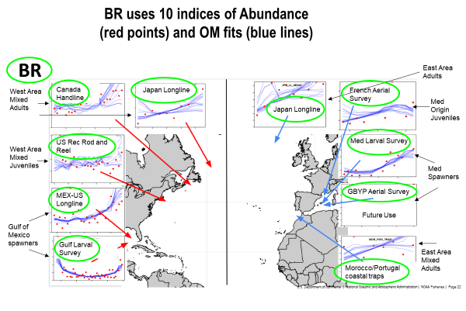
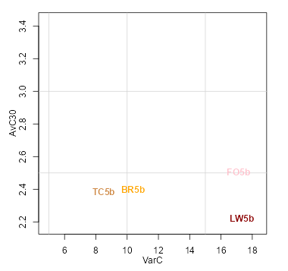
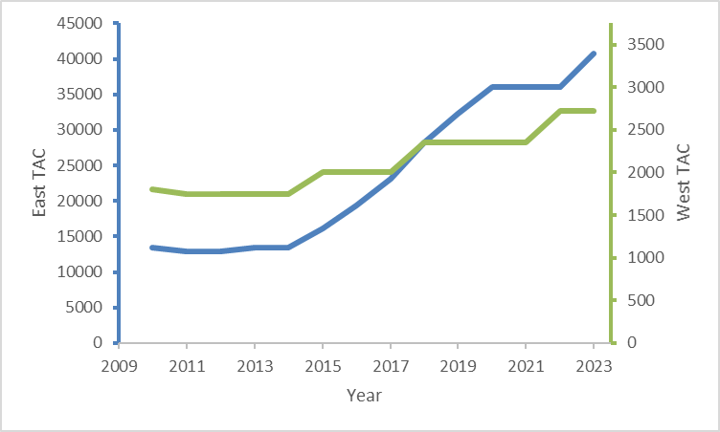
MP Selection
Top performing cMPs were presented
Stock status, stock safety, fishery stability, and fishery yield
Butterworth Rademeyer (BR) MP Adopted in Nov 2022
Empirical (indicator-based) MP
Weighted average of 5 west and 5 east indices
Fixed Proportion MP
2023-2025 Eastern TAC: 40,750 mt (13% increase)
2023-2025 Western TAC: 2,726 mt (no increase)
https://iccat.github.io/abft-mse/CMP/SCRS_2022_154_Butterworth_Rademeyer.pdf
Notes:
9 teams competitively developed candidate MPs.
also accounted for intangibles: more indices, induced redundancy, etc. Phase-in to ensure no MP was a cliff jump
timeseries of historical w MP TACs
3 year implementation cycle
Tuned to achieve a probability of being in the green quadrant of the Kobe plot of 60% after 30 projection years
: configured to remove a constant proportion of available abundance
Bells and whistles
20% upward and 30% downward allowable annual change in TAC
3-year “phase-in” where annual changes were further restricted
Damping in year-to-year TAC variability

Slide 4
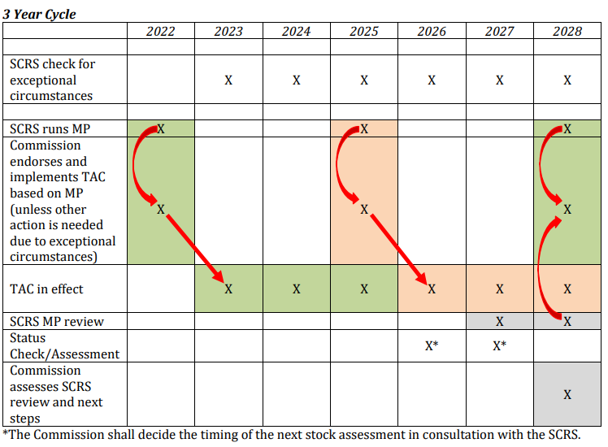
ICCAT BFT Management procedure schedule
MP sets TACs for 3 years for both East and West by modifying previous TACs based on recent indices
MP review/revision and MSE ‘reconditioning’ 2027
Less frequent stock assessments will occur as ‘health or status’ checks
Exceptional circumstance provisions specify situations when MP can be overridden, e.g. index outside range tested, inability to update an index for multiple years, natural disasters, etc.
https://www.iccat.int/Documents/Recs/compendiopdf-e/2022-09-e.pdf

Slide 5
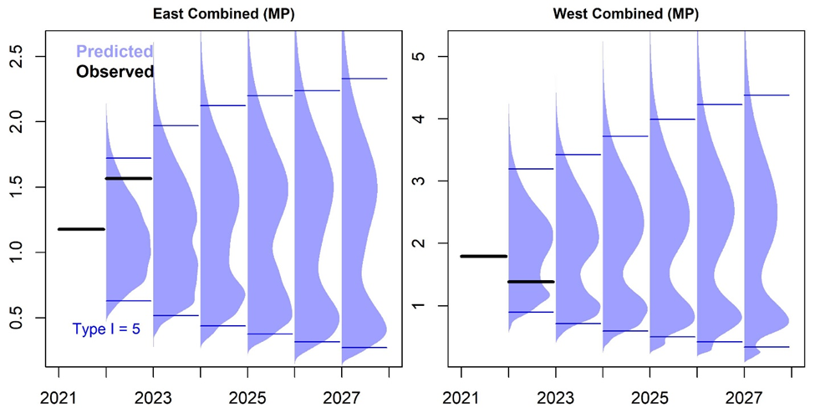
Exceptional Circumstances
Observed index values (black bars) compared to the distribution of simulation-tested future indices (blue distribution) for the MSE. Blue bars represent the 95% intervals.
Notes:
Key is to highlight ECP is 2-step process; SCRS evaluate the severity of ECs
Combined index should not fall outside the 95th prediction interval
3 or more missing values
International commission for the conservation of Atlantic tunas | Standing Committee on Research and STatistics

Slide 6
https://safmc.net/events/seminar-series-iccat-bluefin-tuna-management-strategy-evaluation-and-management-procedures/
(or Google “SAFMC bluefin tuna MSE”)

