Slide 1
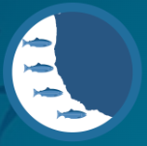
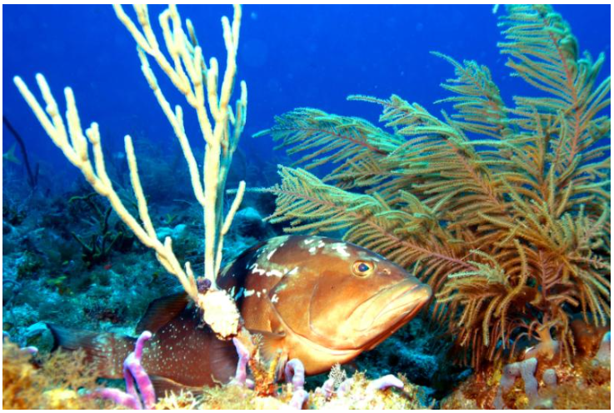
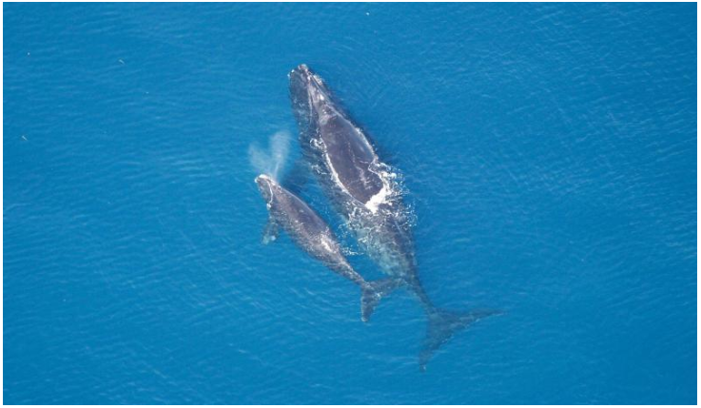
NMFS Climate Vulnerability Assessment Tool & NMFS Distribution Mapping & Analysis Portal (DisMAP)
Dr. Roldan C. Muñoz & Dr. J. Kevin Craig
NMFS Southeast Fisheries Science Center
SAFMC Meeting
December 5, 2023

Slide 2
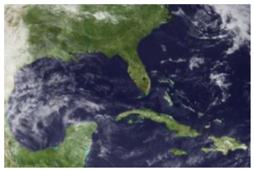
New Climate Vulnerability Assessment (CVA) Tool
  Intended as a quick and user-friendly approach to better understand climate impacts
  Identify species, habitats, and ecosystems most vulnerable to climate change
  NMFS CVAs: Biological-based Sensitivity + physical/environmental-based Exposure = Overall Vulnerability
  Will be updated with new assessments as available (sea turtles, Atlantic HMS, Pacific Islands)
https://www.fisheries.noaa.gov/data-tools/climate-vulnerability-assessment-tool

Slide 3
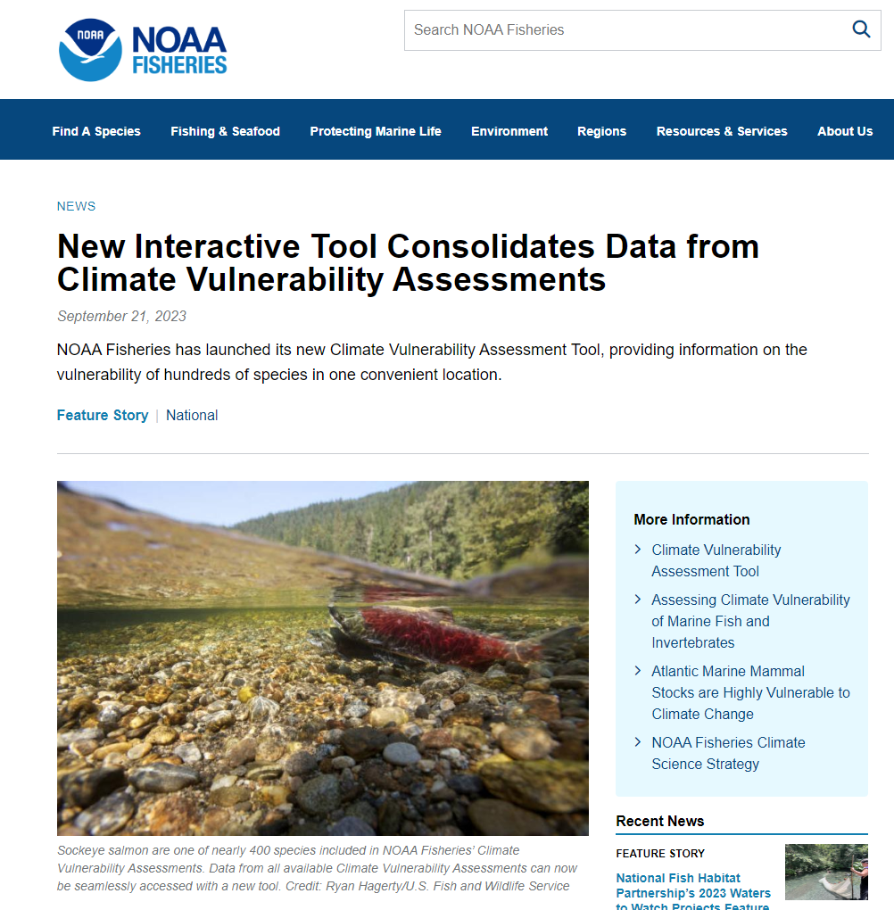
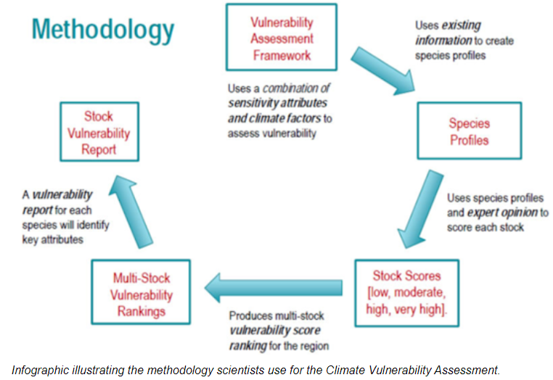
New CVA Tool Highlights
  Consolidates data from climate vulnerability assessments (CVAs)
  Vulnerability information on nearly 400 species & habitats in one location
  Marine-related fish stocks, protected species, habitats
  Eight different regional data sets
  NE habitat
  NE fish & shellfish
  Marine mammals
  Bering Sea
  West Coast salmon
  West coast
  US South Atlantic
  Gulf of Mexico
https://www.fisheries.noaa.gov/resource/document/climate-vulnerability-assessment-fish-and-invertebrates-united-states-south

Slide 4
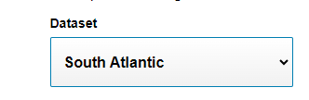

CVA Tool Example
1
2
Choose a dataset
Choose a functional group (9)
SA Functional Group: Coastal pelagic, diadromous, forage, coastal, elasmobranchs, reef fish, invertebrate, deep water reef, pelagics

Slide 5
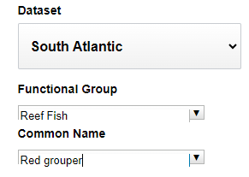
CVA Tool example
1
2
3
Choose a dataset
Choose a functional group (9)
Choose species of interest (23 reef fish)

Slide 6
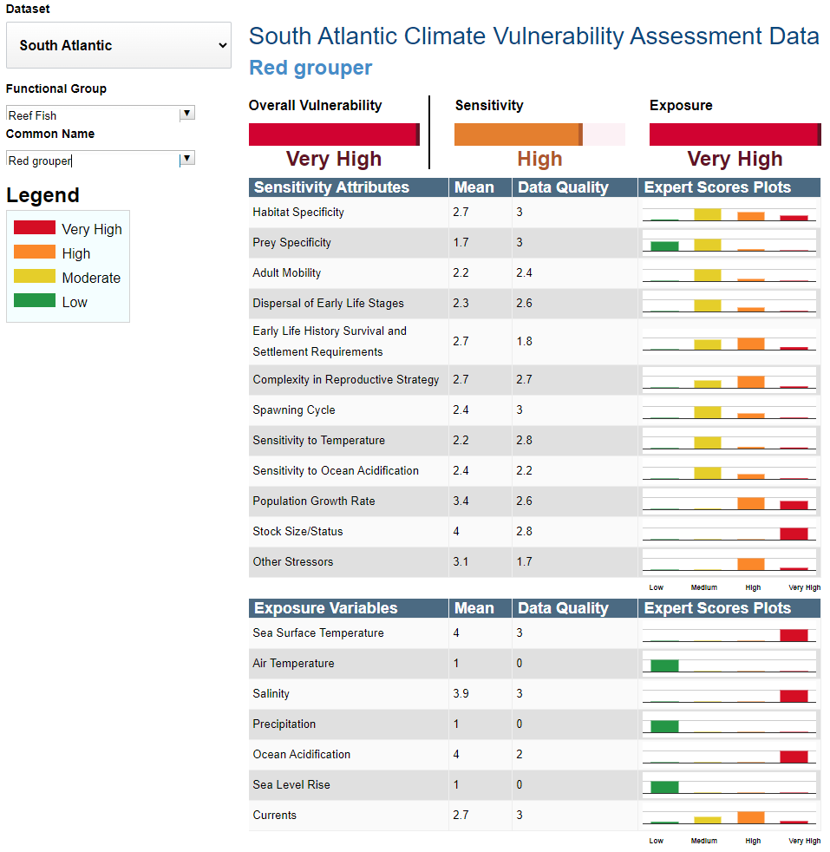
CVA Tool example

Slide 7
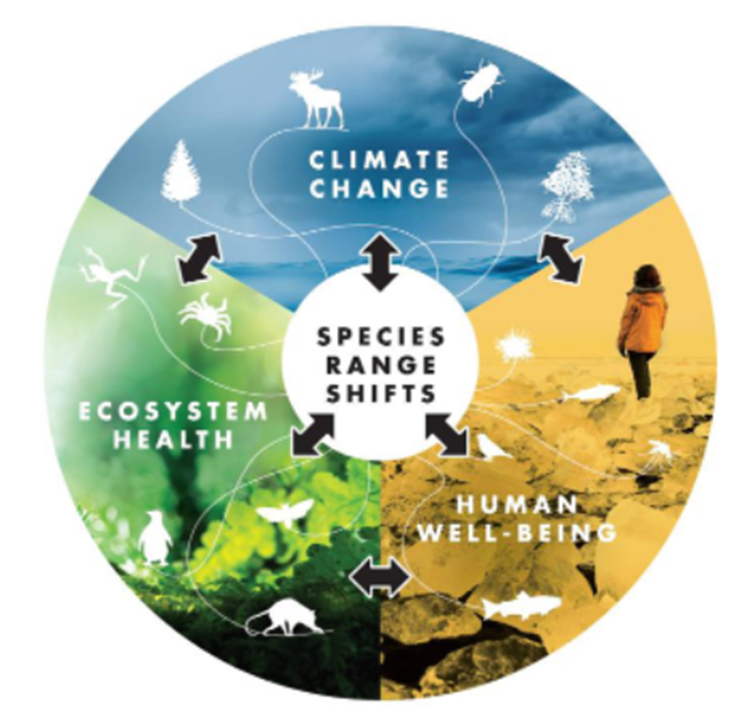
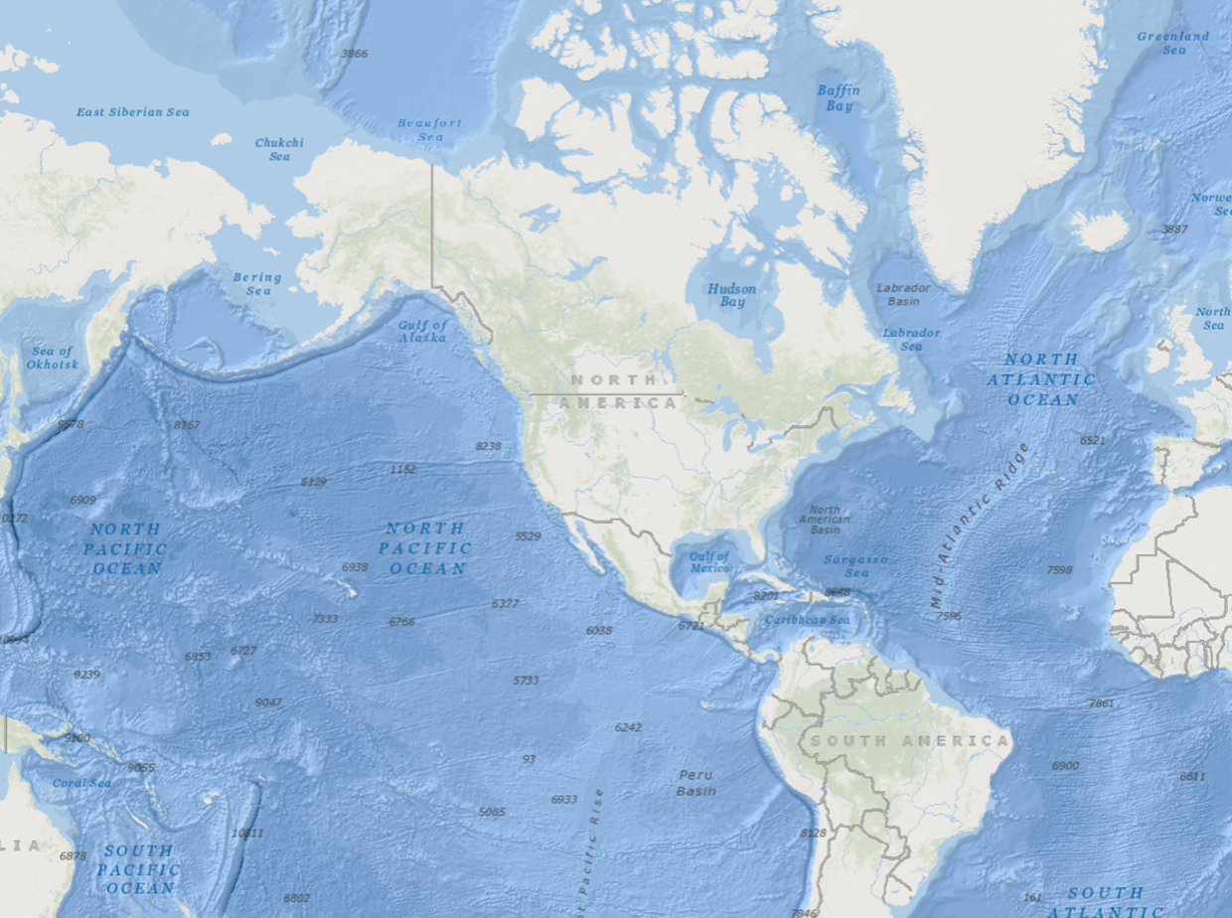


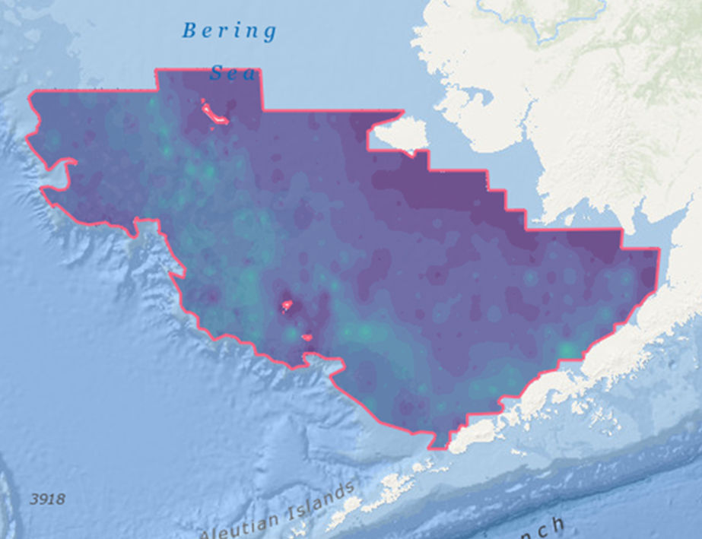
Distribution Mapping & Analysis Portal (DisMAP)
A user friendly and interactive tool to track, understand, and respond to shifting distributions of marine species
Easy access and exploration of species distribution data from different regions
Support managers by informing decisions related to stock boundaries, catch allocations, and marine protected areas
Including more data from the South Atlantic
(e.g, SERFS trap-video) is a 2024 priority
https://apps-st.fisheries.noaa.gov/dismap/index.html
Notes:
-The Distribution Mapping and Analysis Portal (or DisMAP) is another web-based tool intended to facilitate the understanding of shifts in species distributions in relation to climate and other factors.

Slide 8
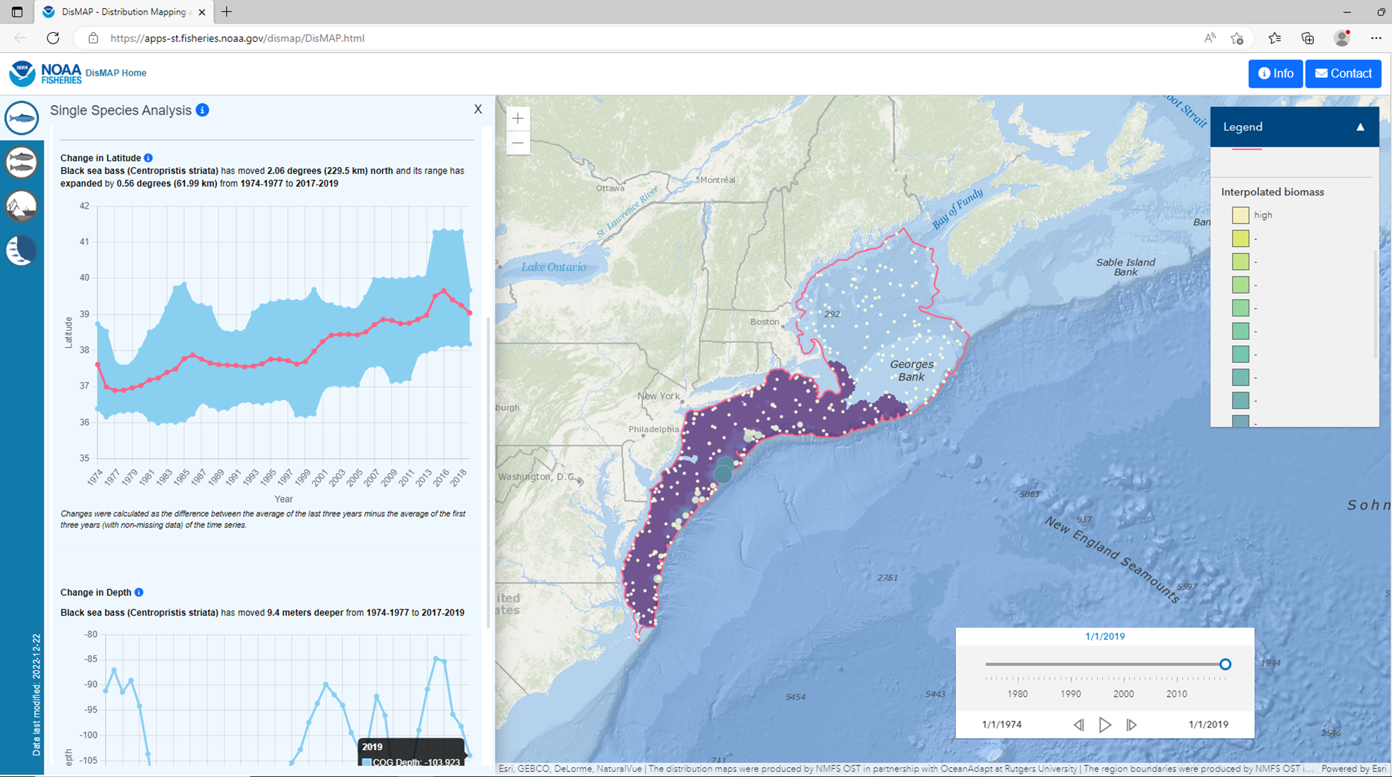
DisMAP Online Tool
Select species and region (e.g, black sea bass in Mid-Atlantic)
View distribution map, animation over time, and metrics
Forthcoming in 2024 for South Atlantic region
Distribution Metrics
Distribution Map
Animation Tool
Notes:
-As for the CVA tool, the user can select a particular species and region.
-This example is for Black Sea Bass in the Mid-Atlantic
-The tool provides a map of the spatial distribution of the species, as well as an animation of how distribution has changed over time, plus metrics.
-under development, may add spp with overlap; started with trawl data, will add other fish indep data, then maybe fish dependent data?; Natl working group
-In addition metrics such as the Center of Gravity and how it has changed over time are also displayed.

Slide 9
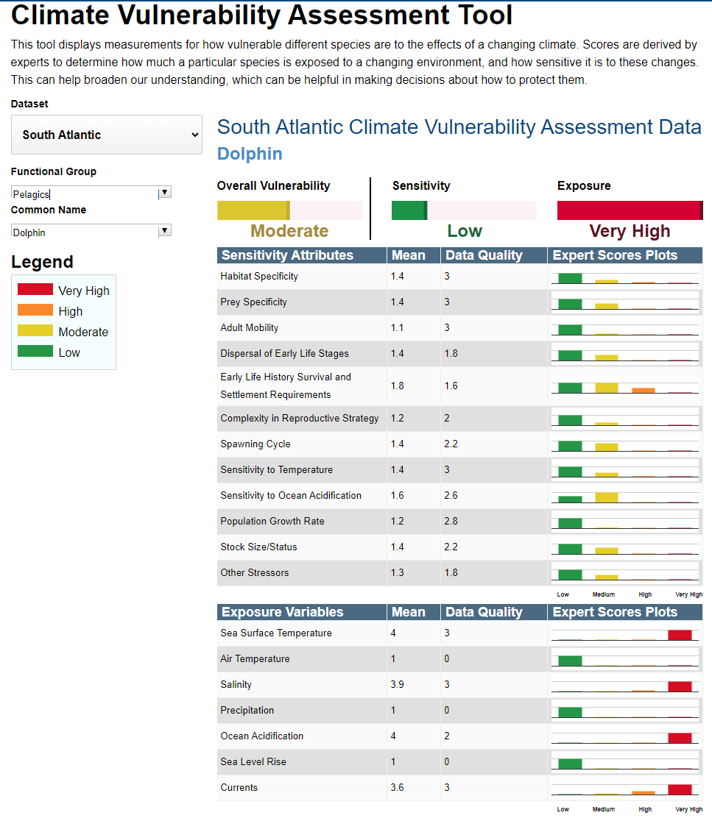
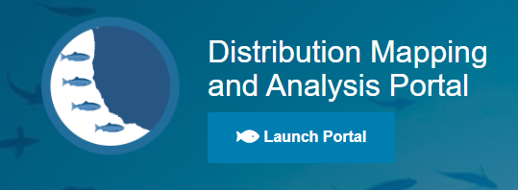
Questions?
  DisMAP Home Page: https://apps-st.fisheries.noaa.gov/dismap/
  DisMAP technical report: https://apps-st.fisheries.noaa.gov/dismap/docs/DisMAP_Tech_Report_with_Table_04_2023.pdf
  CVA Tool: https://www.fisheries.noaa.gov/data-tools/climate-vulnerability-assessment-tool

Slide 10
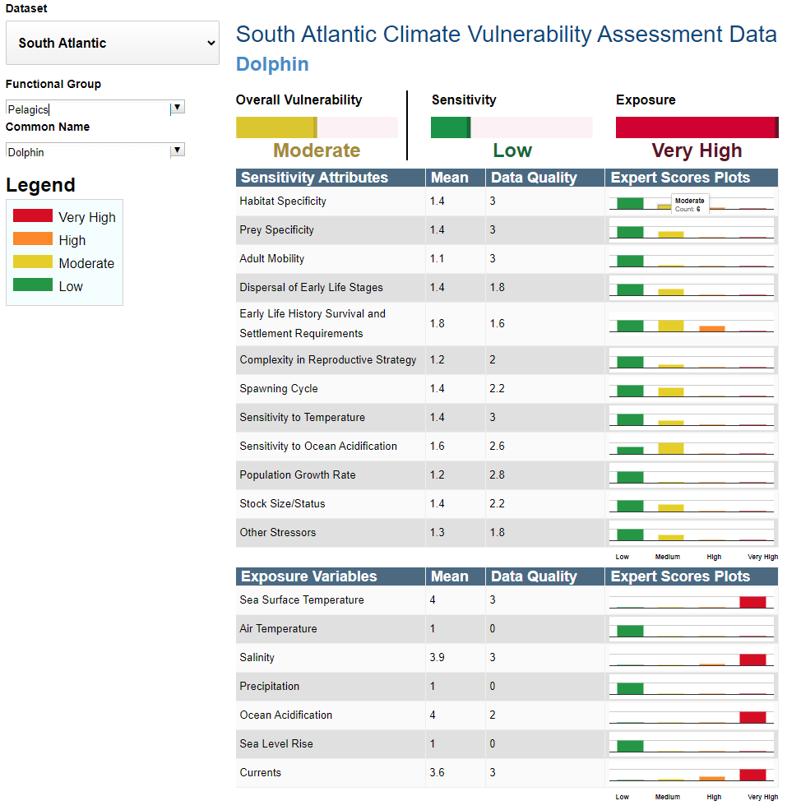
CVA Tool example

