Slide 1
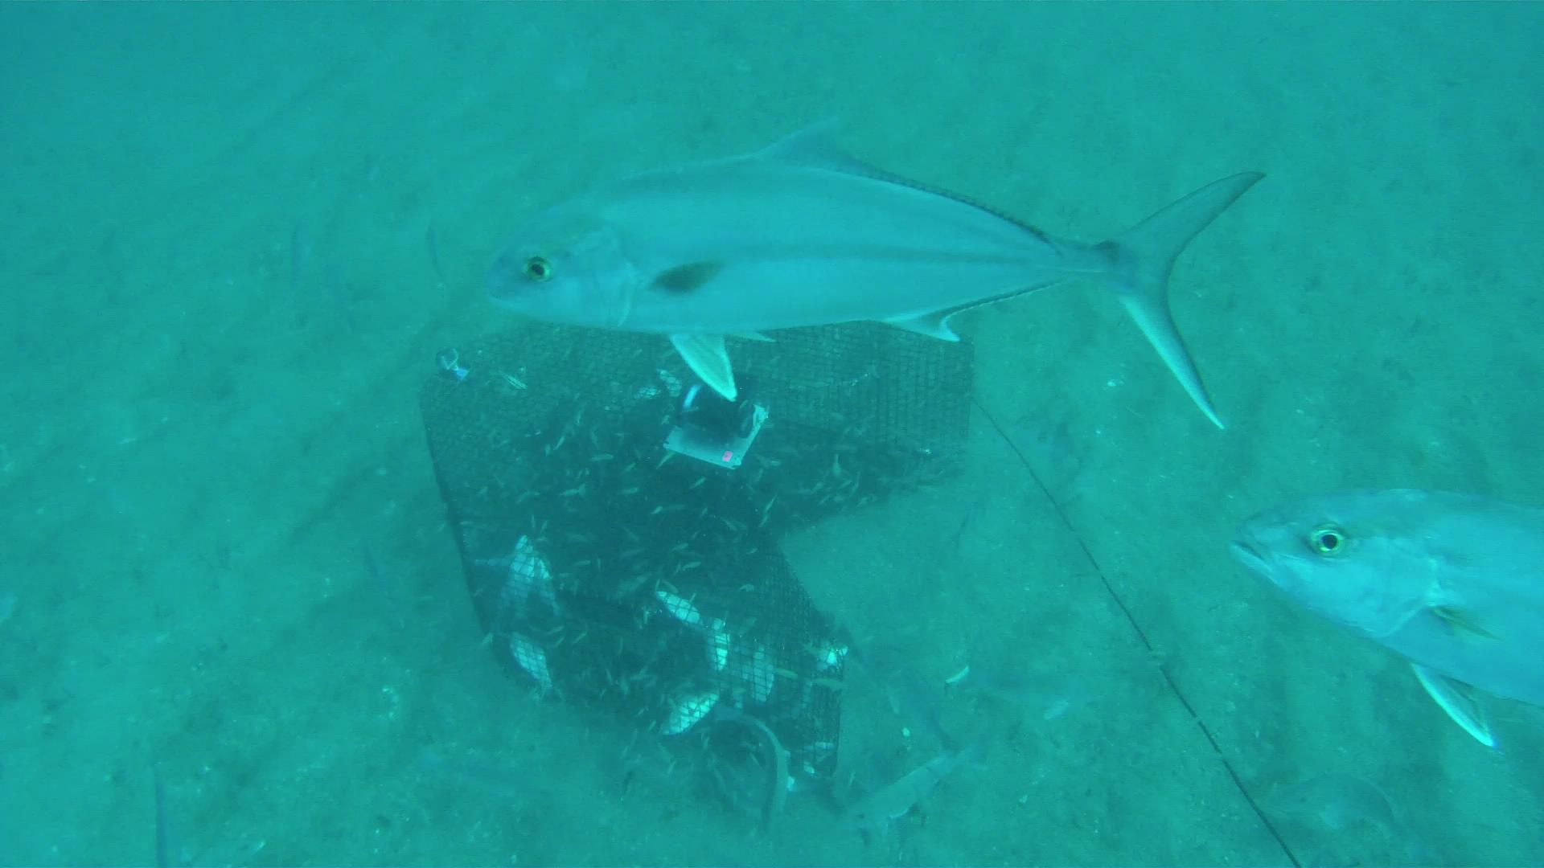
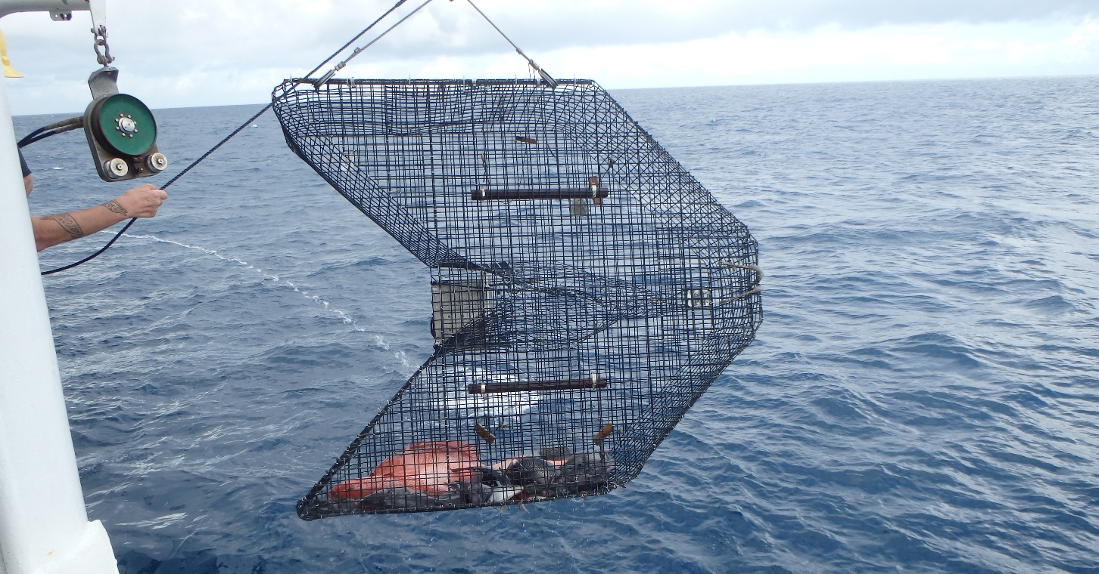
Trends in South Atlantic fish stocks and online index tool
Nate Bacheler, Southeast Fisheries Science Center, National Marine Fisheries Service, Beaufort, North Carolina, nate.bacheler@noaa.gov

Slide 2
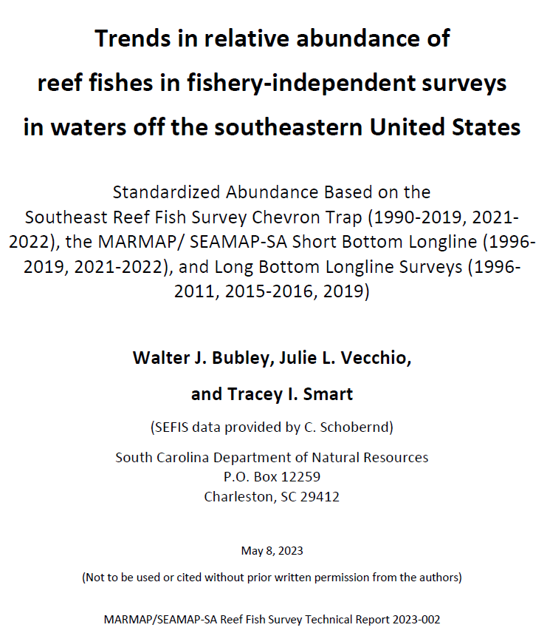
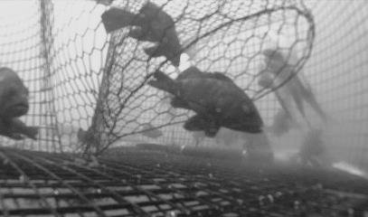
Southeast Reef Fish Survey
Large-scale baited trap and video survey
Collaboration between SCDNR, NMFS Beaufort
Targets reef habitats 15-115 m deep
Approx. 1,500 stations sampled each year
Indices of abundance, age/length/repro
SCDNR “trends report” describes trap data
Until 2022, no comparable “video trends report”

Slide 3
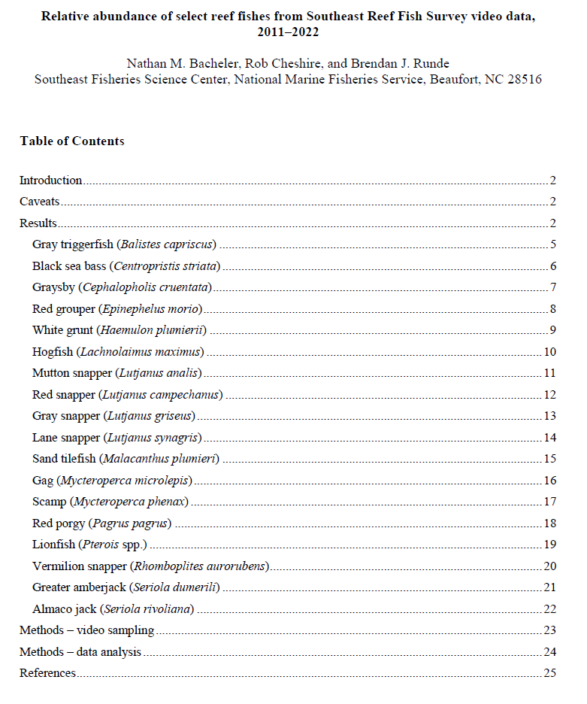
SERFS video trends report
One year delay for video reading
Statistical standardization
18 species
Expected late summer each year

Slide 4
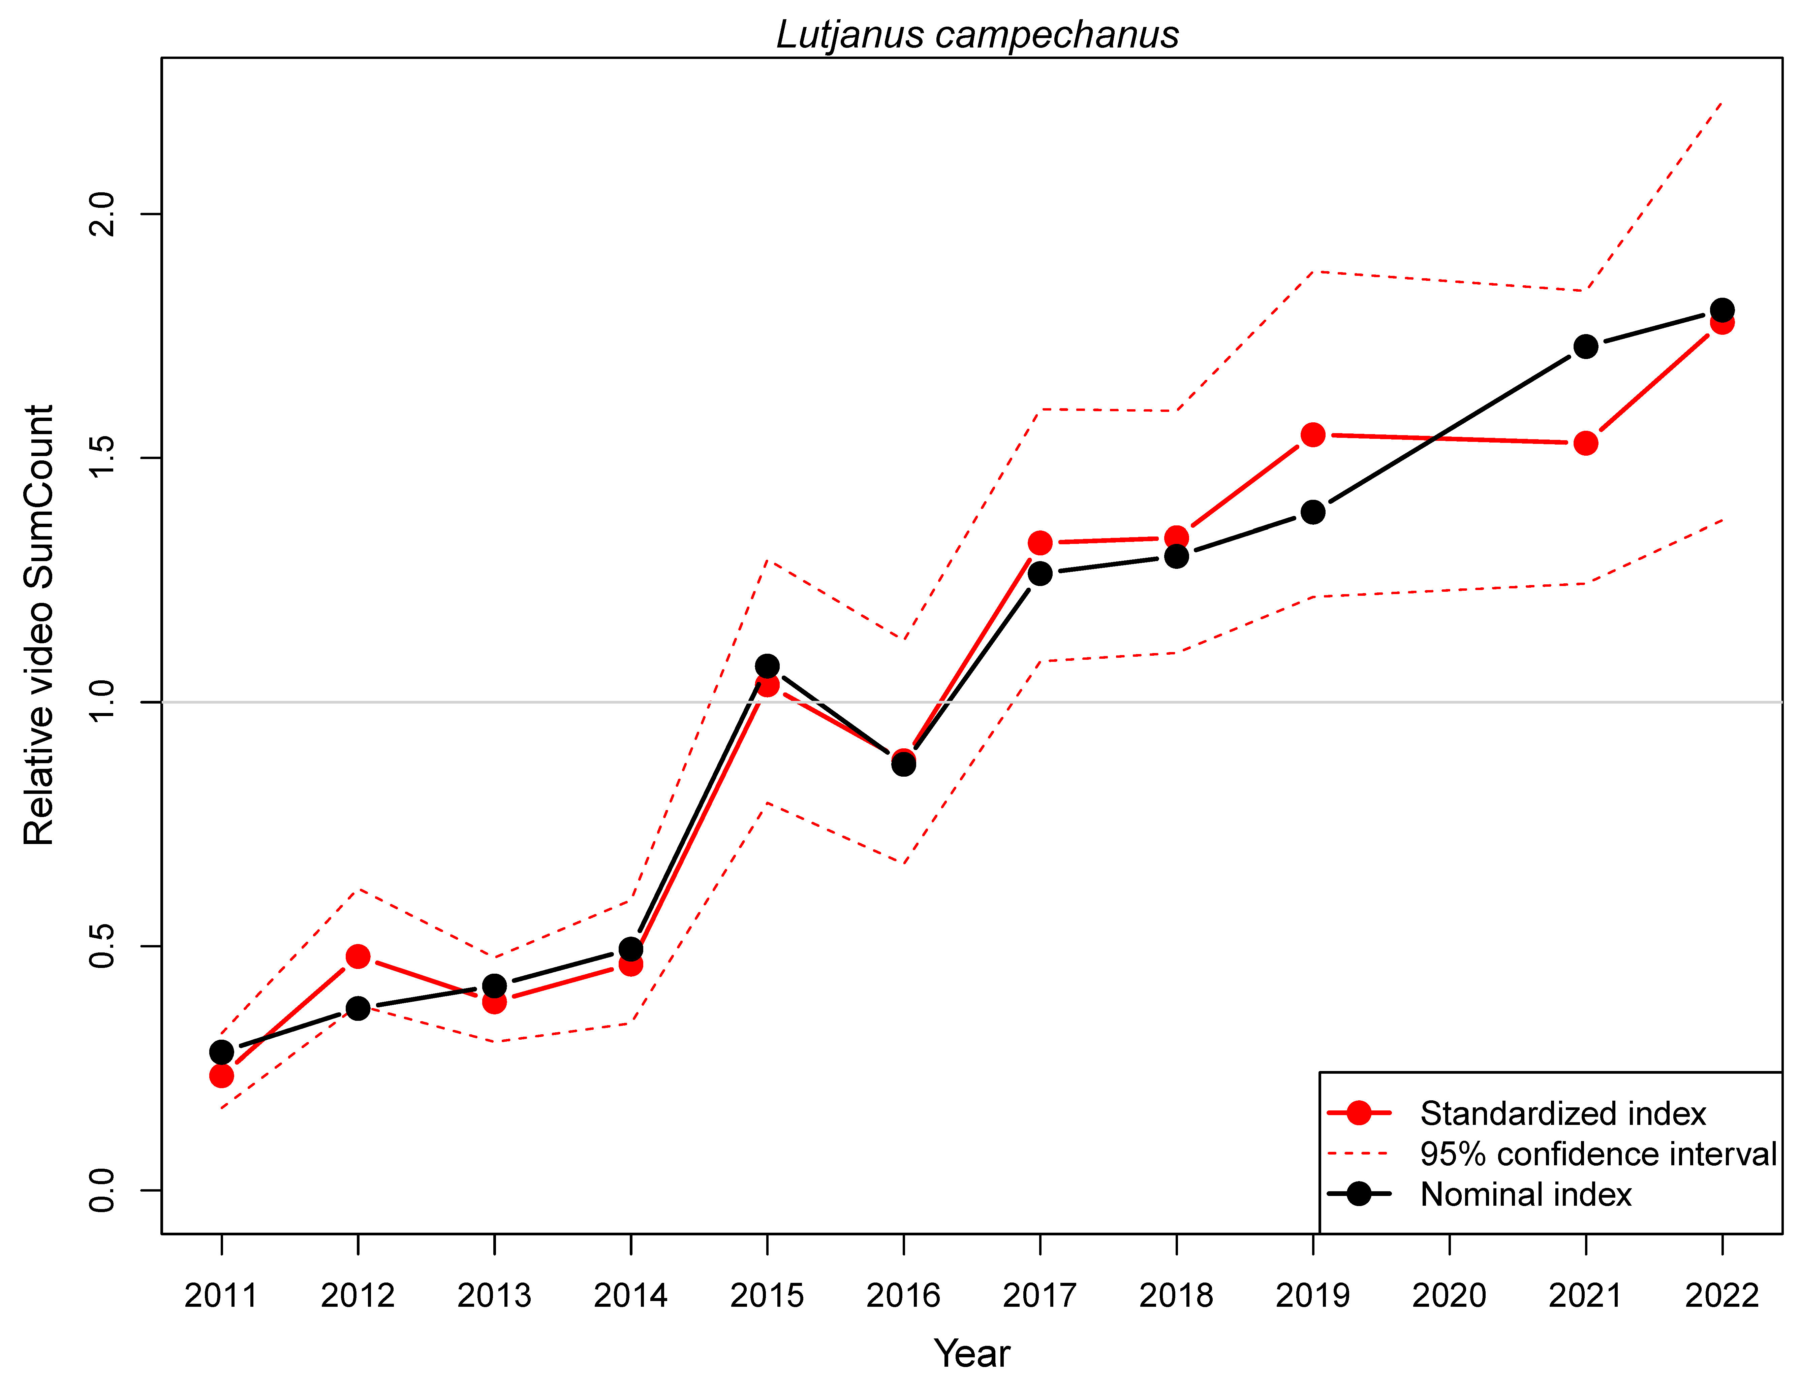
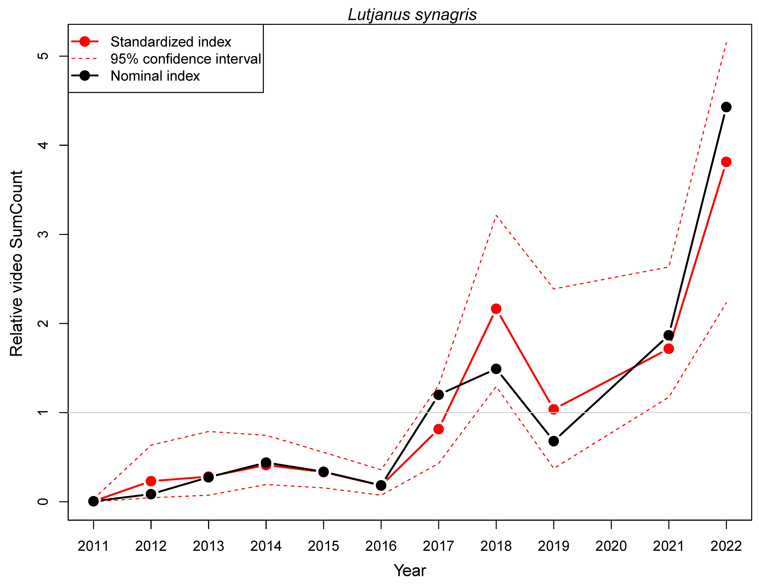
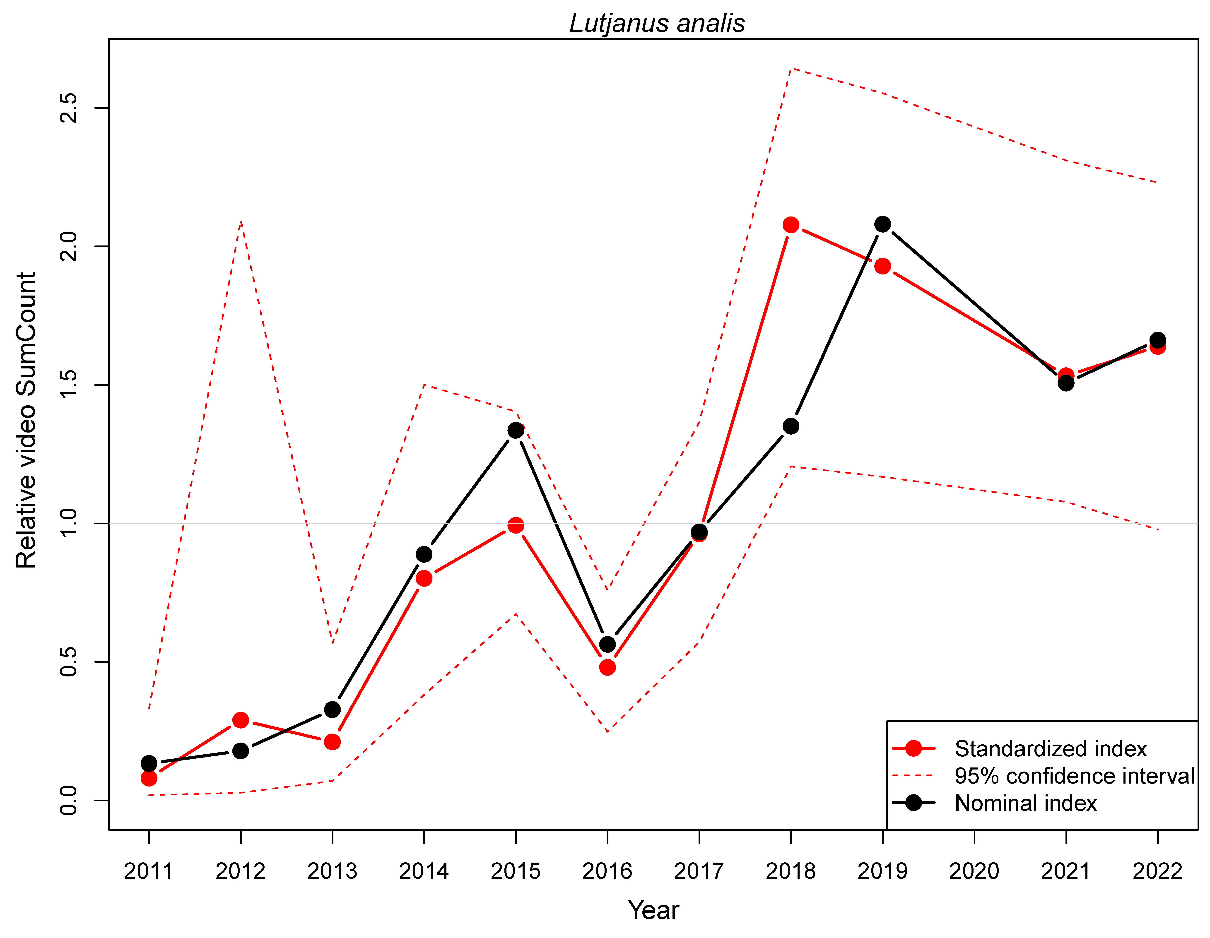
SERFS video trends report - increasing
Red snapper Lane snapper Mutton snapper
Relative abundance
Year

Slide 5
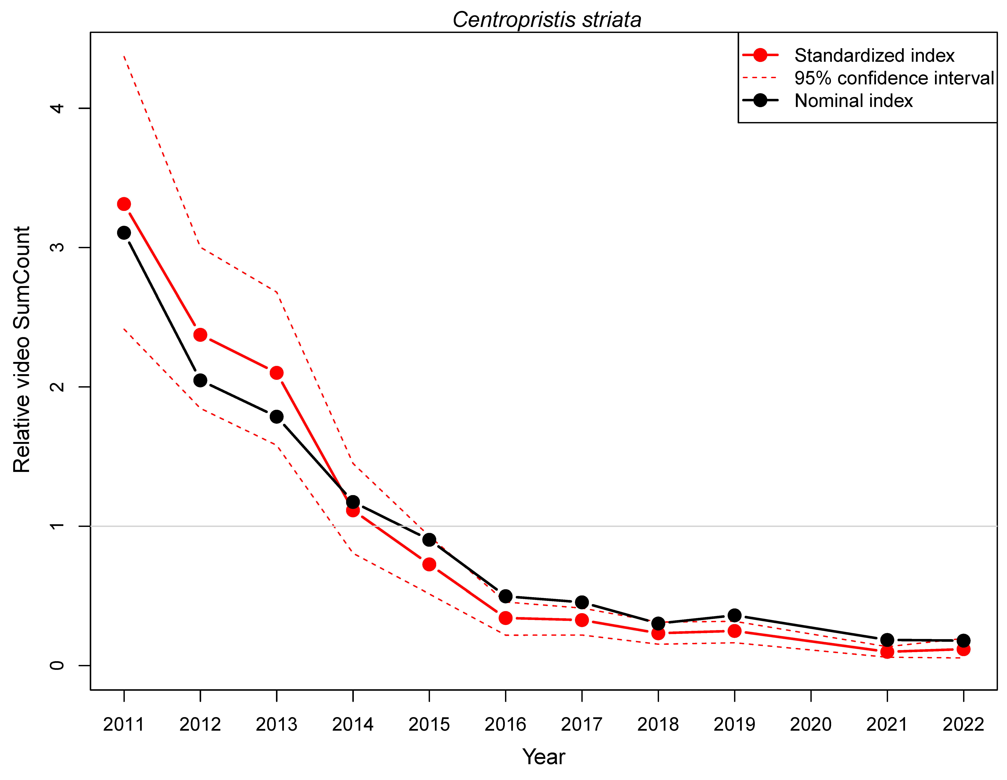
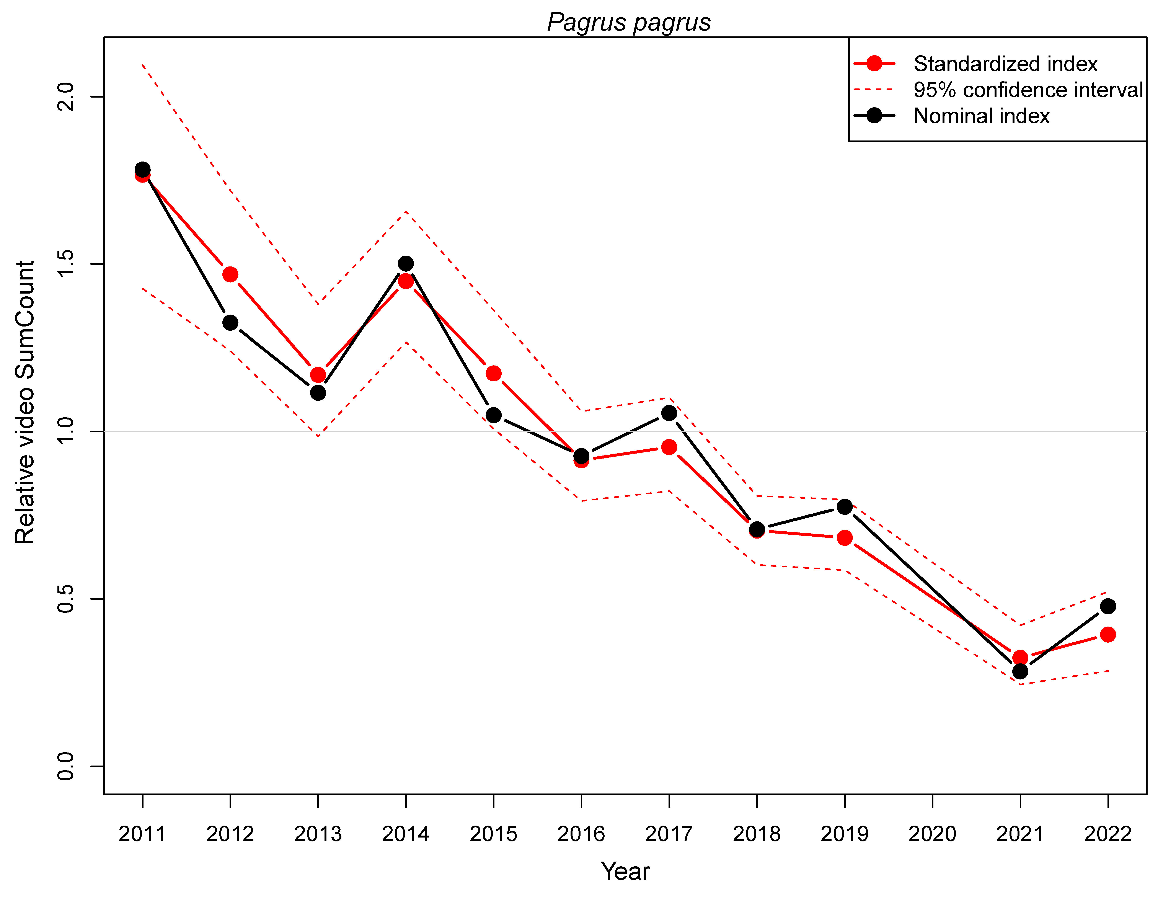
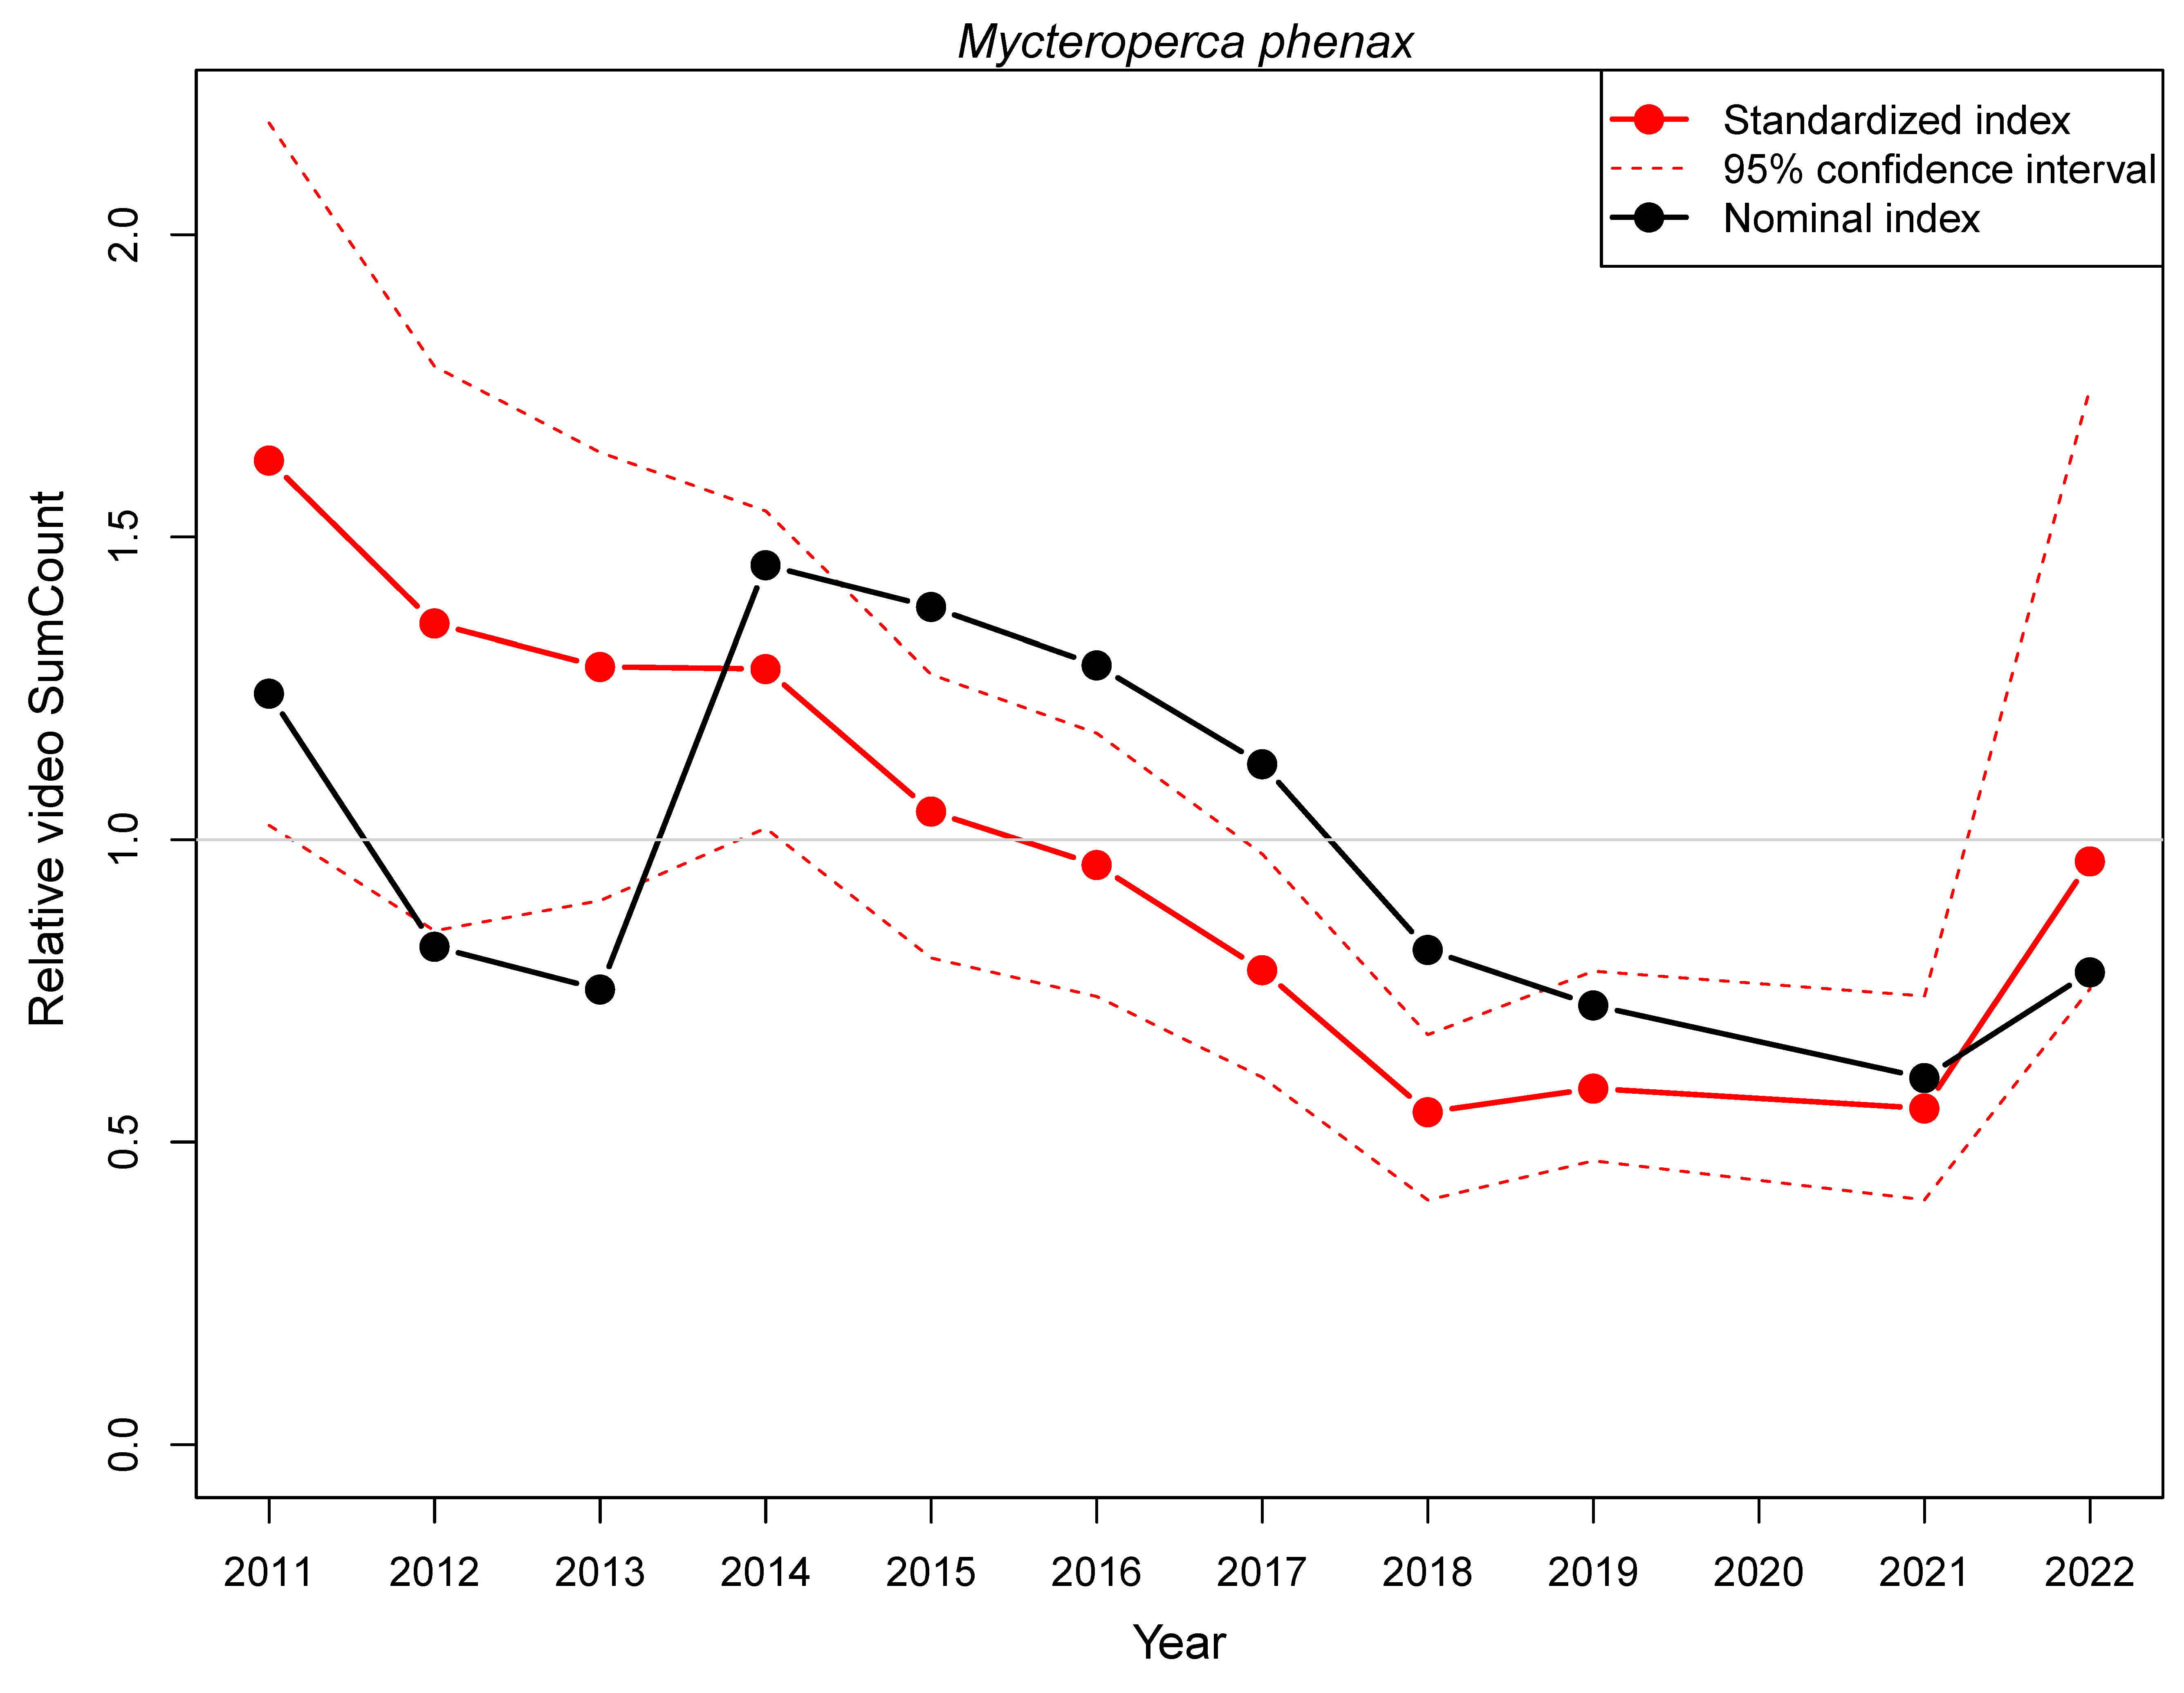
SERFS video trends report - decreasing
Black sea bass Red porgy Scamp
Relative abundance
Year

Slide 6
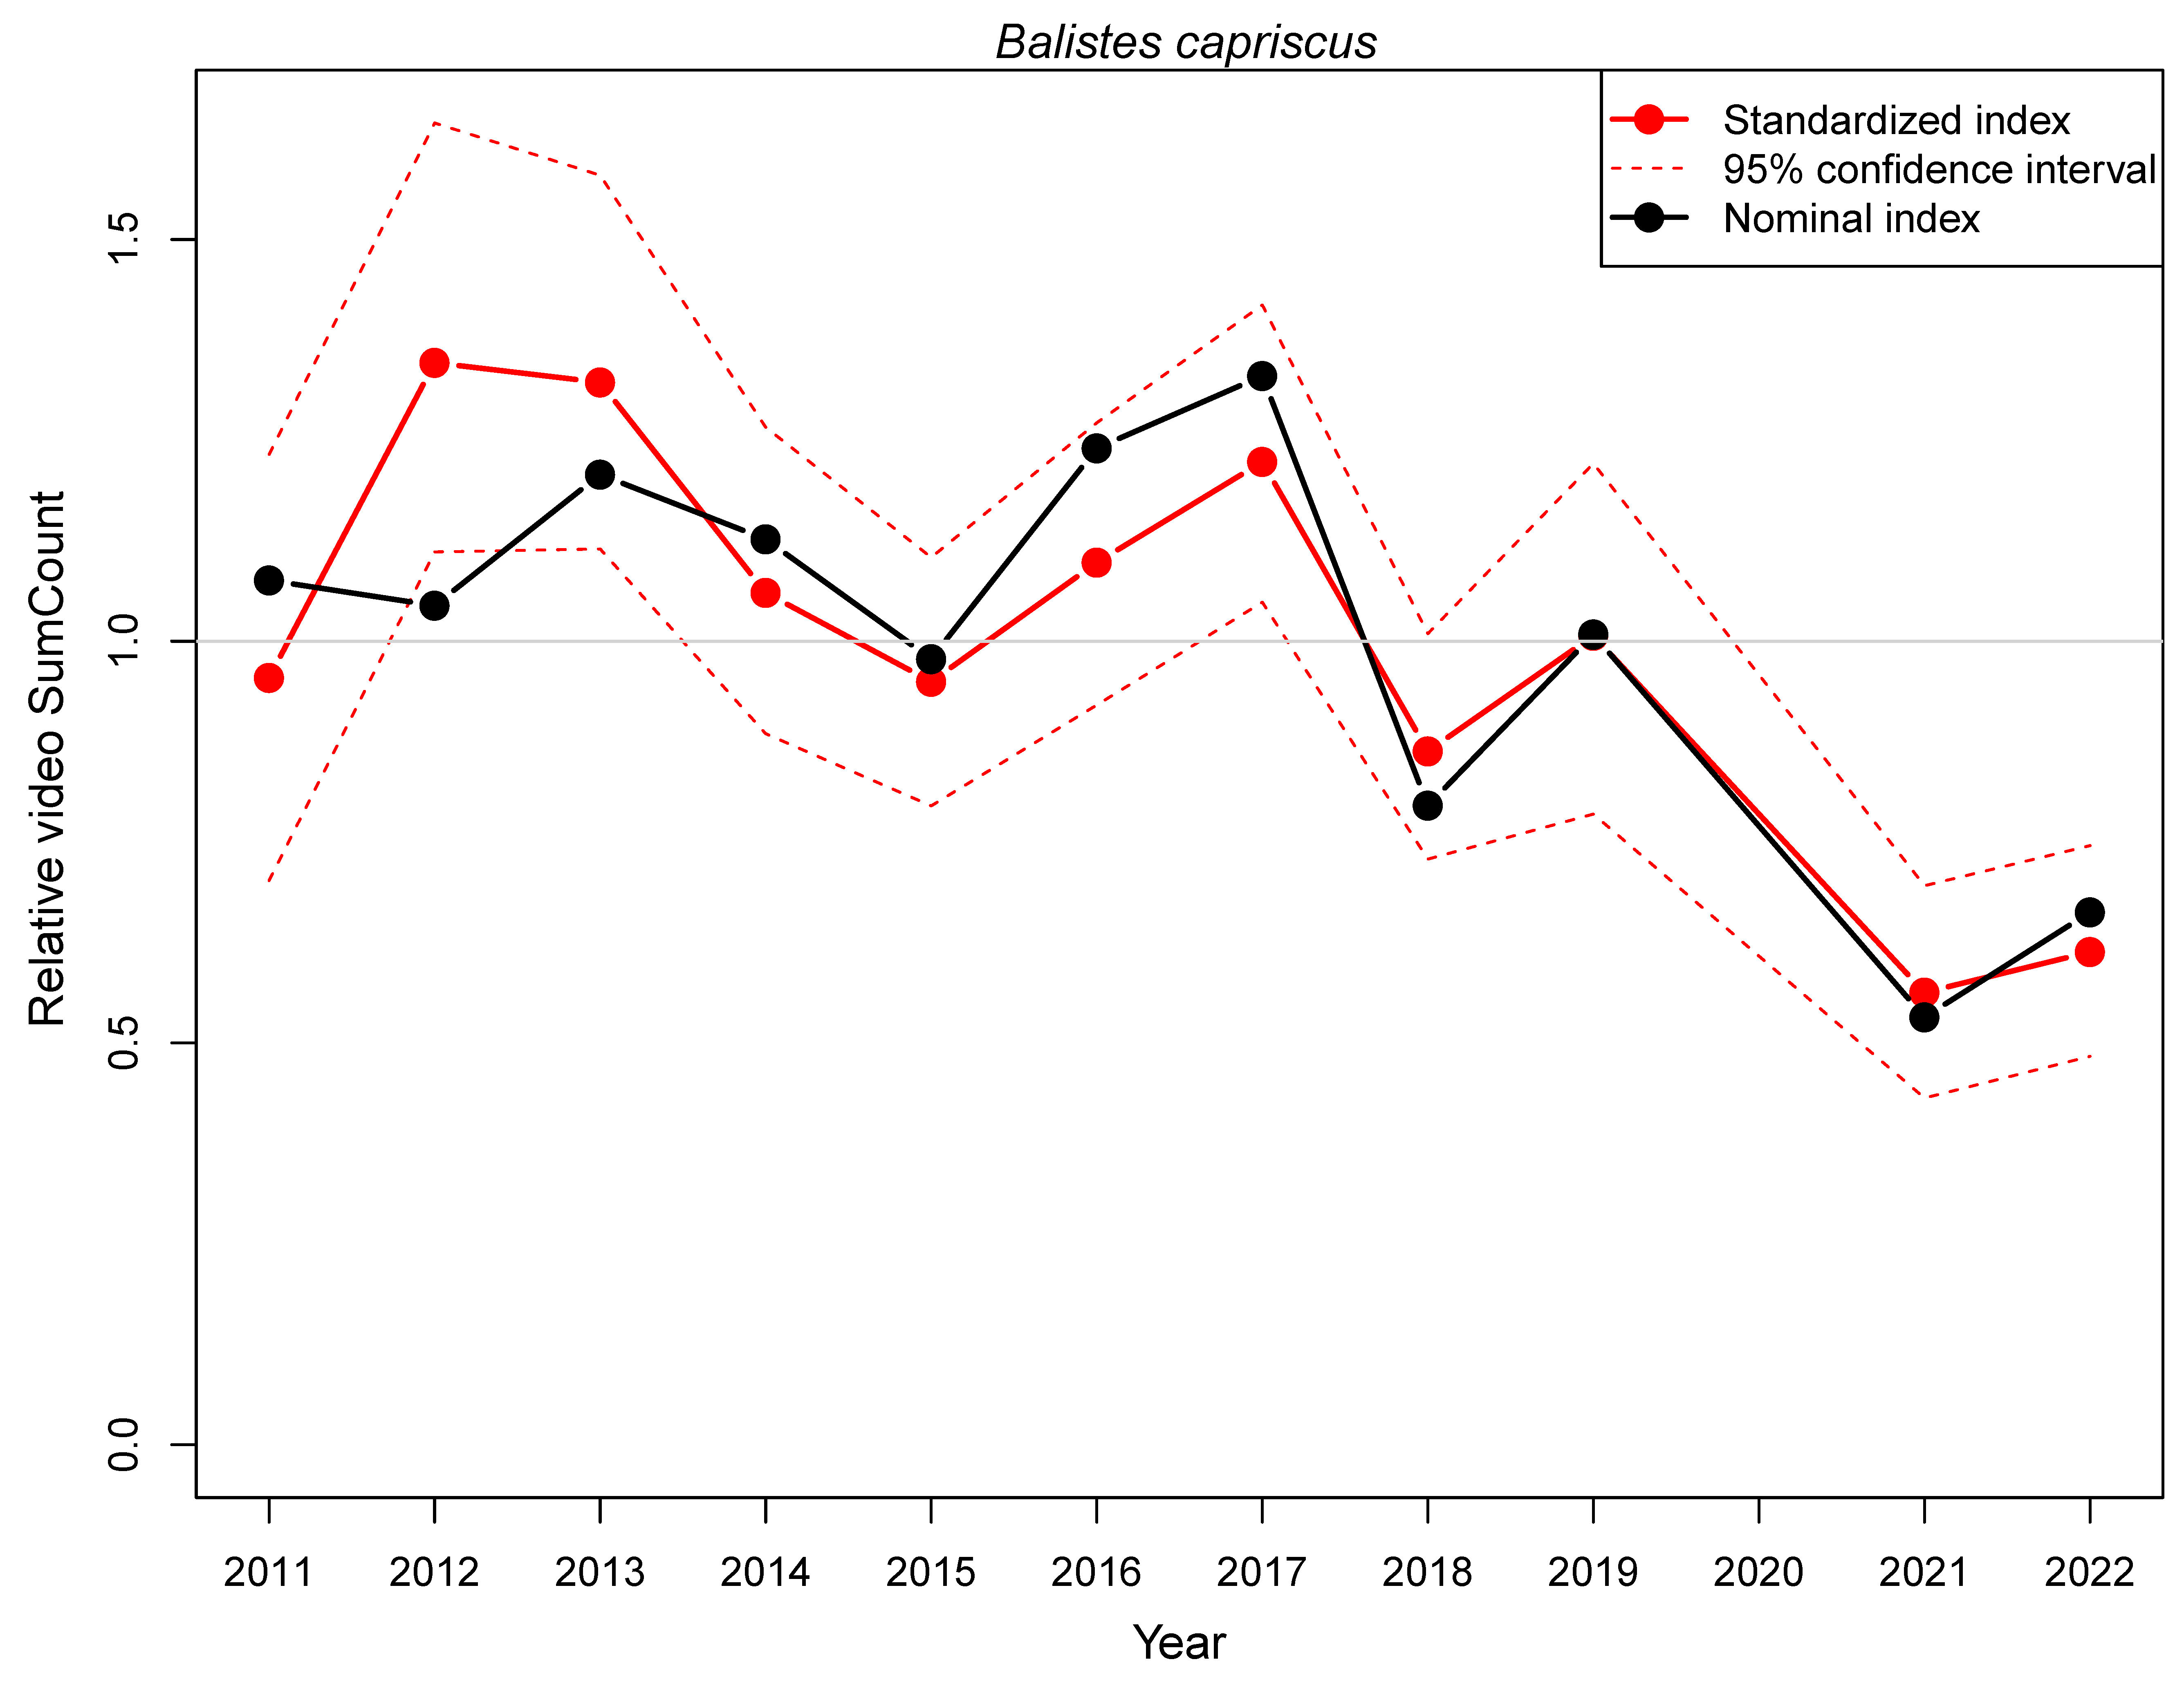
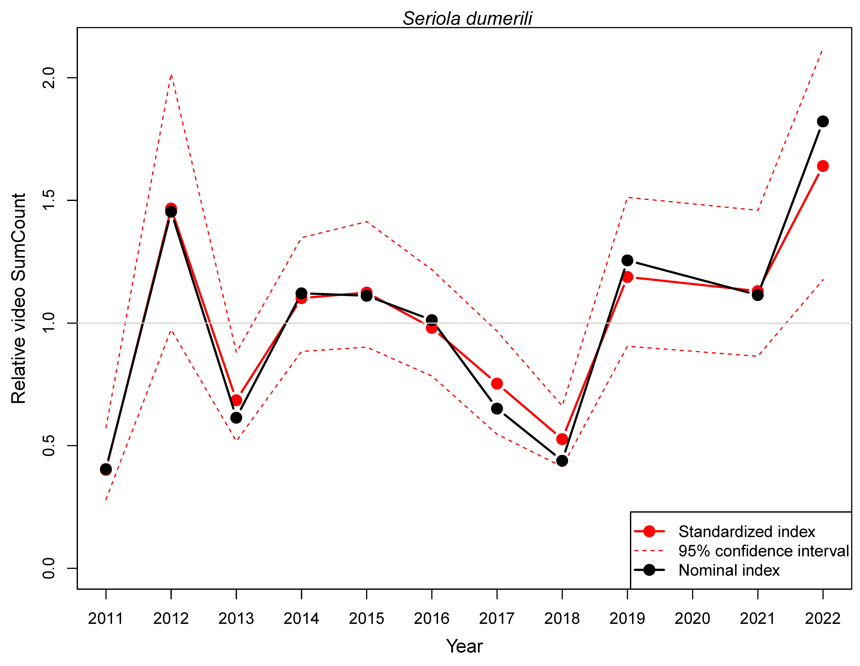
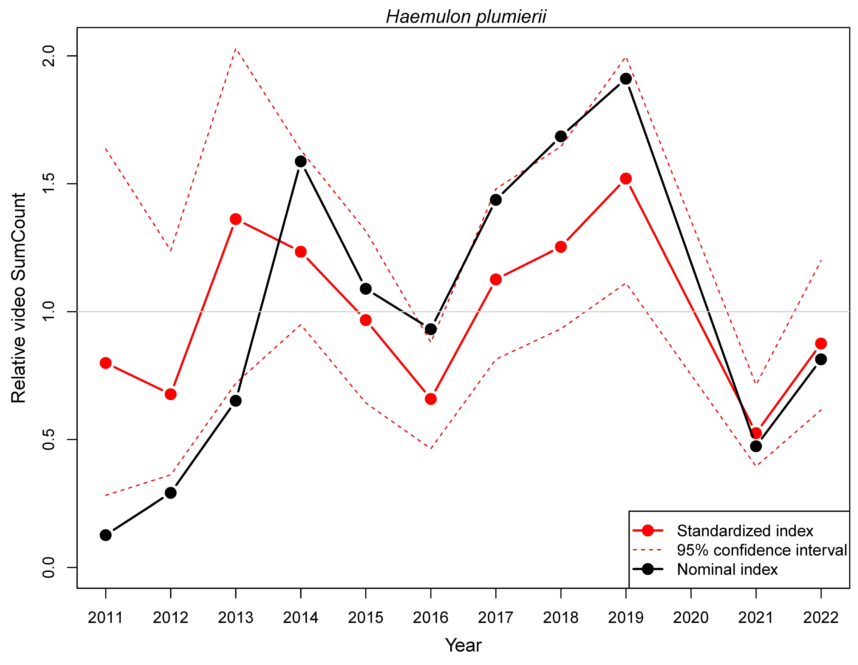
SERFS video trends report – variable
Gray triggerfish Greater amberjack White grunt
Relative abundance
Year

Slide 7
Developing and communicating abundance indices
Trap and video trends reports
Will also be hosted online
Coming soon!

Slide 8
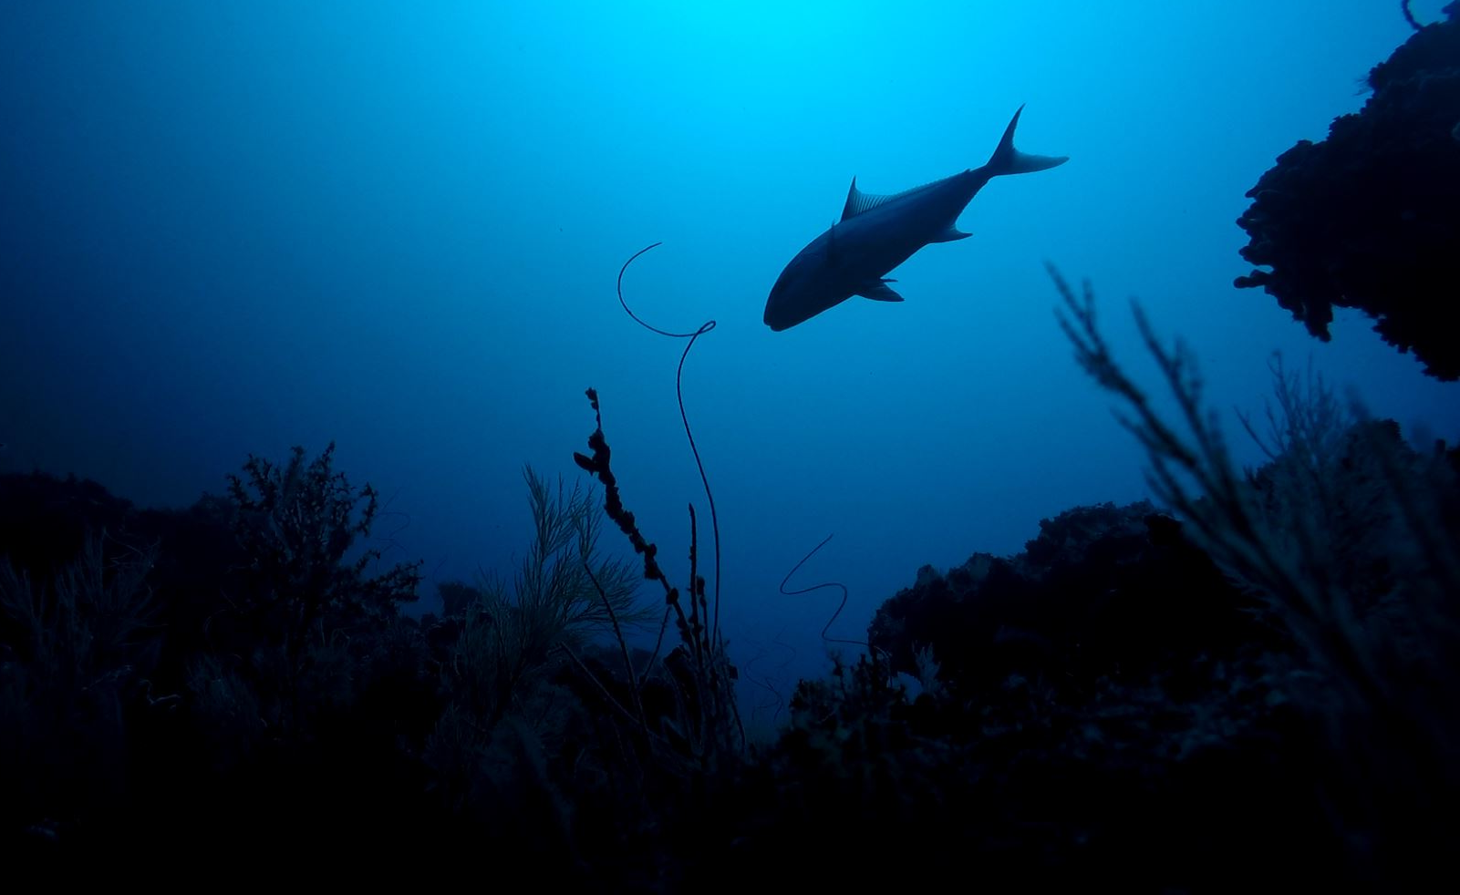
Questions?

