Slide 1
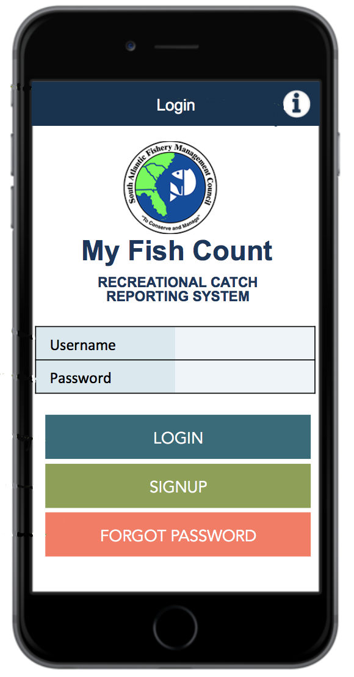
Snapper Grouper Permit & Recreational Reporting App
Kelsey Dick
Fishery Outreach Coordinator
South Atlantic Fishery Management Council Staff
Notes:
Introduce yourself. Going to be speaking and giving an update on the snapper grouper permit and recreational reporting app.

Slide 2
Background
Amendment 43
1 Action
-Revise ACL for 2018
August 2017
Amendment 43
March 2017
Amendment 46
Include Previous Actions
-Improve Recreational Reporting
-Best Fishing Practices
Coming Soon
12 Actions Included
Notes:
Originally amendment 43 to the snapper grouper fishery management plan, included 12 actions. Those included the ACL and measures to promote best fishing practices and recreational reporting. Since _____ the actions have been divided into two separate amendments. Amendment 43 includes the revision to the ACL and Amendment 46 includes the previous action of improving recreational reporting and best fishing practices. Amendment 46 → Improve recreational reporting

Slide 3
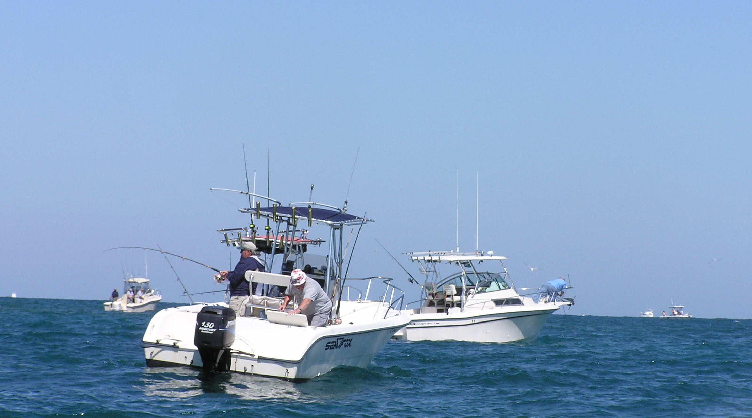
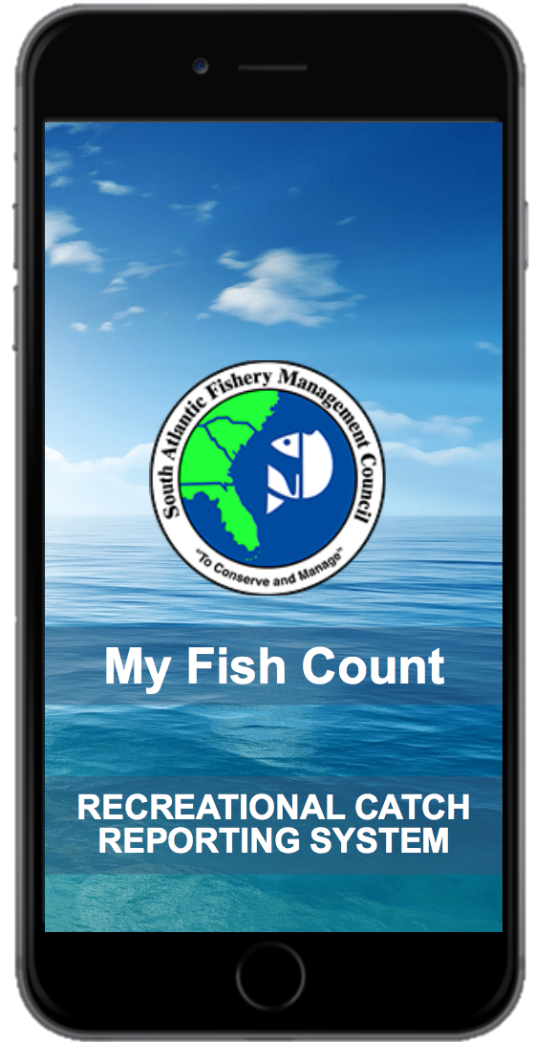
Goal: Develop an electronic permitting and reporting app for private recreational snapper grouper anglers
Notes:
In order to improve recreational reporting included in amendment 46 we are developing an electronic permitting and reporting app. Part of this project we are conducting a pilot study The goal of the study is to develop an application that would enable a permit to be issued to individual fishers and have a reporting system to collect data on catch and effort.

Slide 4
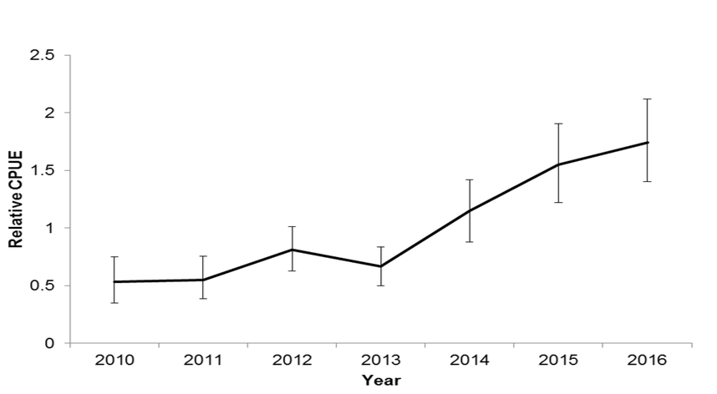
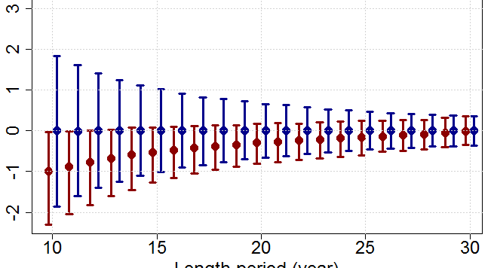
Catch
Report
Improve Landings Estimates
Notes:
The intention of the app is to allow anglers to report their catch and to ultimately improve landings estimates

Slide 5
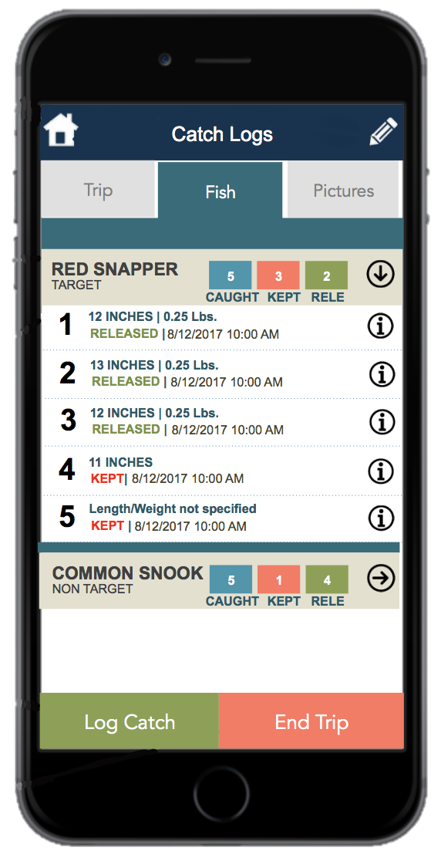
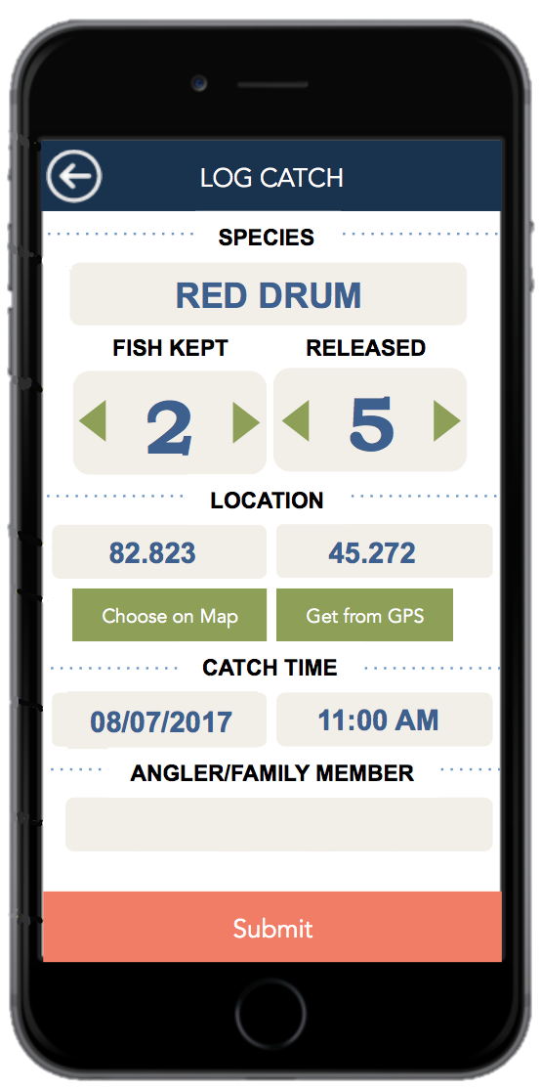
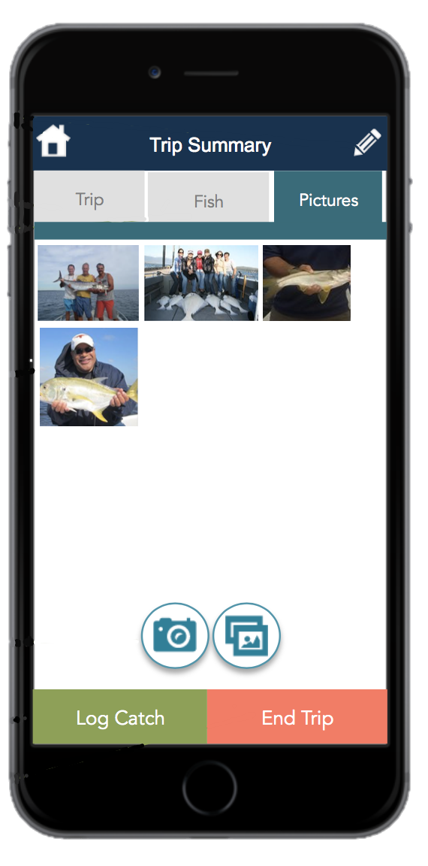
My Fish Count App Features
Collect data on catch and effort
Store pictures of caught/released fish
Size and identification
Geofence feature
Allow anglers to record and access past trips
Web portal
Notes:
To give you an idea of some of the features of the app. Listed here are some of the capabilities.

Slide 6
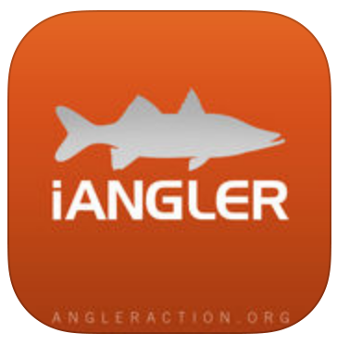
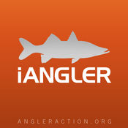
Partners
Notes:
Here are some of the partners on this project. Snook and game fish, elemental methods. If you are familiar these partners created the app iangler with some of you may have used. Accsp, National Marine Fisheries Service, the South Atlantic Fishery Management Council, and

Slide 7
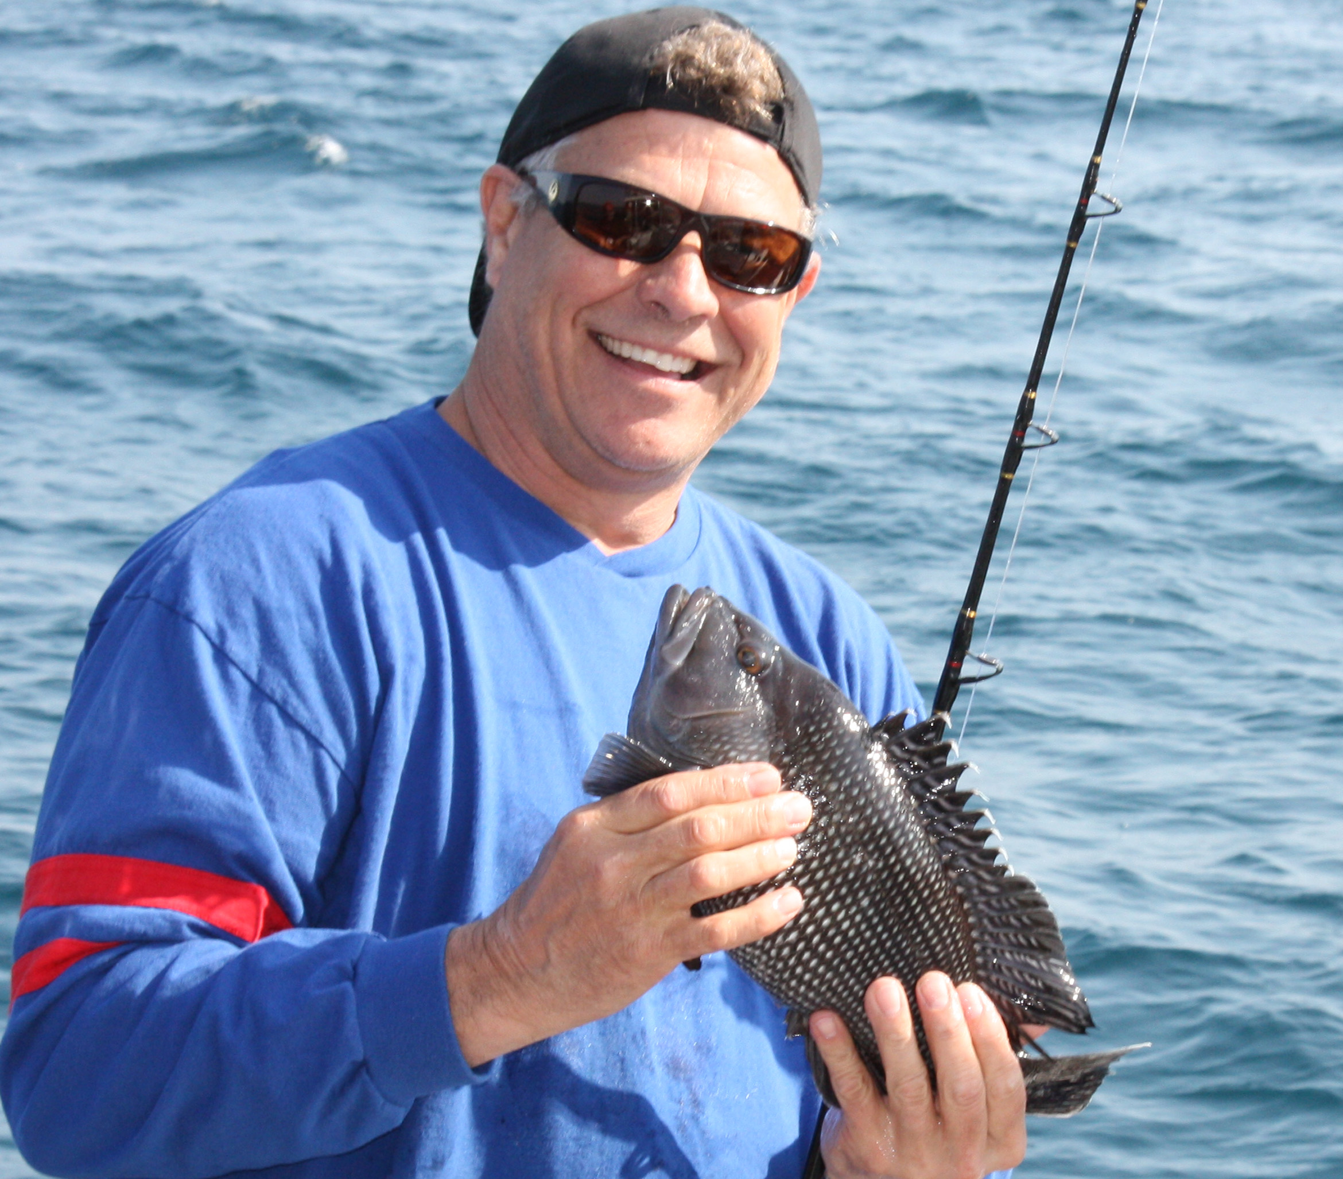
Partners: Recreational Anglers in South Atlantic
Notes:
And as part of this project we will be working with recreational snapper grouper anglers in the south Atlantic. If you have any interest in participating in the pilot project please come and see me.

Slide 8
Project Timeline
Grant to be completed within 18 months and final submission afterward
Pre-Grant Discussion
Application Development and Database Coordination
Hire Staff for Outreach
Develop outreach material
Identify fishermen to participate in project
Pilot application with fishermen (Starting Winter 2018)
Modify the application based on pilot
Have permit and reporting application available for up-scaled usage
Notes:
Should we change this to the more specific timeline?
Here is the project time line. Currently we have designed the app, and are in the process of identifying anglers to pilot the project. The pilot phase of the project will take place in Winter of 2018. Based on the results of the pilot study and the feedback from anglers, we will modify the app.

Slide 9
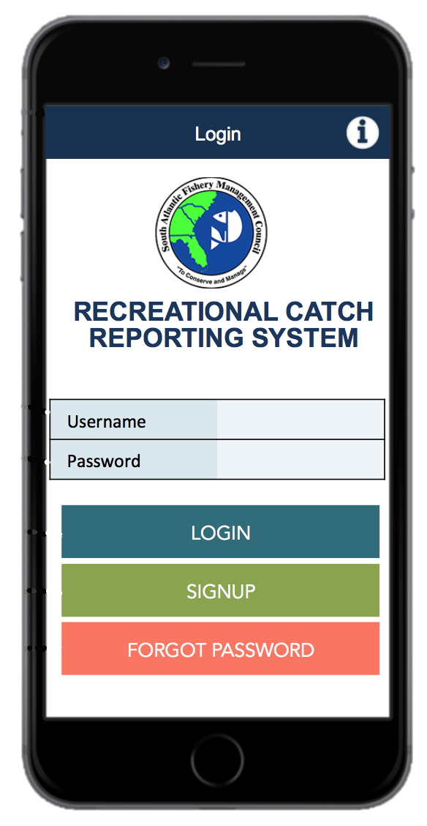
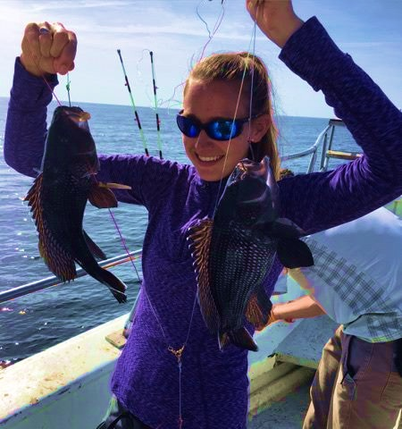
Questions?
More Information or
To Get Involved
Contact:
Kelsey Dick
Kelsey.dick@safmc.net
843-725-7580
Notes:
Put the app, and the name

