Slide 1
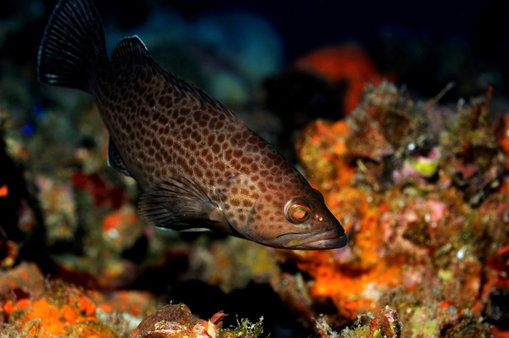
Vision Blueprint for the Snapper Grouper Fishery of the South Atlantic Region, 2016-2020
Annual Evaluation
Prepared by Myra Brouwer & Amber Von Harten December 2016

Slide 2
Outline
The Vision Blueprint – background
Evaluation Plan Objectives
Progress on prioritized activities under each of the four goals
Science
Management
Communication
Governance

Slide 3
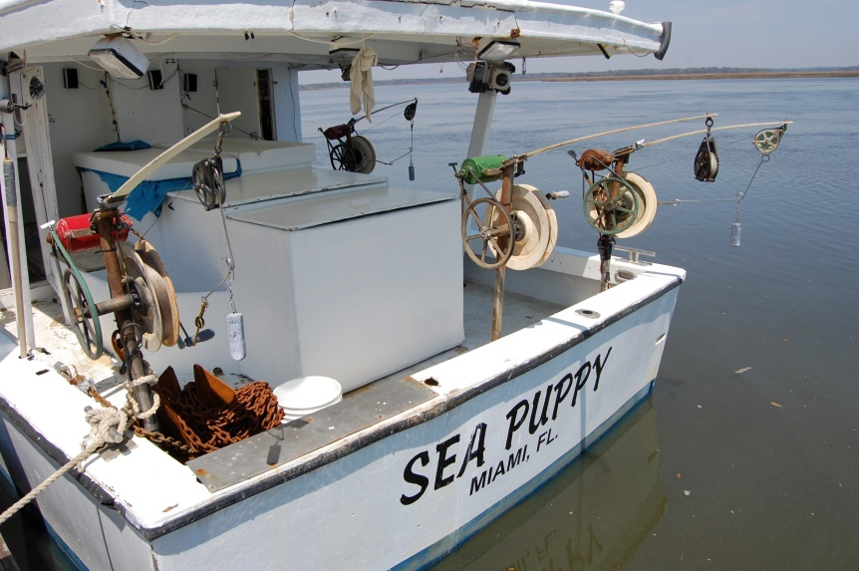
The Vision Blueprint
Serves as a “living document” to help guide future management of the snapper grouper fishery
Informs management of the snapper grouper fishery from 2016-2020
Builds upon stakeholder and Council member input on how the fishery could be managed in the future

Slide 4
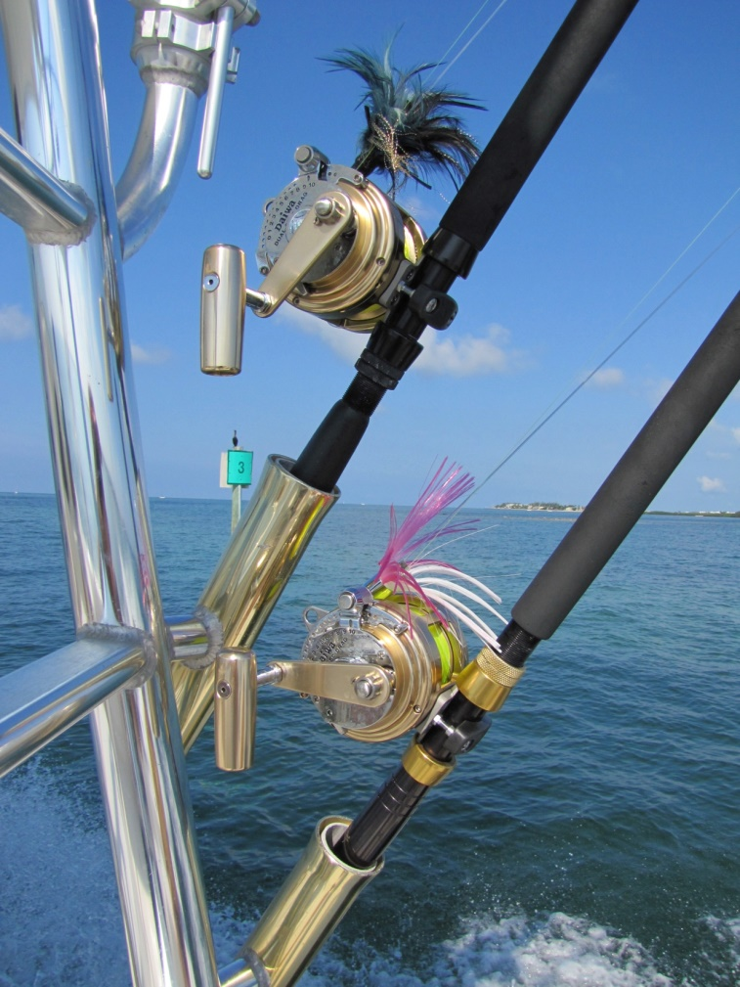
The Vision Blueprint
Guides development of new amendments that address priority objectives and strategies
Illustrates actions that could be used for management and would be developed through the regular amendment process
Was approved in December 2015 and will be updated in 2020

Slide 5
Objectives of the Evaluation & Review
Ensure management actions are achieving the Vision for the snapper grouper fishery.
Allow flexibility to adapt management to changes in the fishery.
Continue stakeholder engagement with the Vision Blueprint process.
Allow new Council members to become familiar with the Vision Blueprint.
Notes:
Consider stakeholder support on short-term action items (2016-2017) and impact on stakeholders.
Consider stakeholder feedback on long-term action items.
Removed above objectives from presentation since we are not asking for public input

Slide 6
SCIENCE

Slide 7
Data Collection
Priority Action | 2016 Activity
Support efforts to create a uniform, efficient reporting mechanism for trip tickets and logbooks | For-hire reporting amendment and pilot for e-reporting for charter vessels
Validate data collection programs | X*
ID sampling resources needed to support data programs | X*
*Need additional guidance from Council

Slide 8
Cooperative Research/ Citizen Science
Priority Action | 2016 Activity
Use fishing vessels and captains as alternative data collection platforms | Charter vessels participating in pilot; cooperative research on red snapper
Identify sources of funding for cooperative research and surveys | Research planning meetings for spawning SMZs; Identifying NOAA funding opportunities to support research and monitoring needs for South Atlantic fisheries
Improve partnerships between potential researchers and fishermen | SAFMC Citizen Science Initiative (January 2016 workshop)

Slide 9
Cooperative Research/ Citizen Science (continued)
Priority Action | 2016 Activity
Support partnerships to enhance habitat and ecosystem mapping in the region | Initiated development of a South Atlantic Regional Mapping Strategy as one of the support tools for FEP II
 | Continued to integrate all map products into the regional repository of the Habitat and Ecosystem Atlas as provided by NOAA and other regional partners
 | Planning initiated for test of mapping and monitoring capabilities in conjunction with a future SEAMAP/MARMAP cruise

Slide 10
Hot Topics – Science Goal
Priority Action | 2016 Activity
Recreational fishing stamp/permit | Action included in Amendment 43
Improvements to existing logbook programs | X*
Work with management partners to secure long-term funding for MARMAP | X*
Increase bycatch/discard reporting | Action(s) in Amendment 43; NOAA FIS grant proposals submitted on electronic reporting (scamp discard project and red snapper recreational reporting)
*Need additional guidance from Council

Slide 11
management

Slide 12
2016-2017 Activities Addressing Vision Blueprint
Priority items for the Management Goal are being addressed in three amendments:
Vision Blueprint Recreational Regulatory Amendment 26
Vision Blueprint Commercial Regulatory Amendment 27
Amendment 43
Notes:
The Council prioritized items for the Management Goal via two surveys in 2015 (?).
Rec and commercial amendments, both address priority items in VB intended to address fishery seasonality and retention.
Amendment 43 considers management measures for red snapper but Council wants to develop adaptive management approach that would address other issues in the fishery such as improving reporting, and possible fishing seasons and allowable fishing areas for snapper grouper species.
All three amendments will be developed in 2017.

Slide 13
Vision Blueprint Recreational Regulatory Amendment 26
Re-consideration of the aggregate bag limits
Re-evaluation of the shallow water grouper closure
Modification of the minimum size limit for black sea bass
Removal of recreational minimum size limits for deepwater species (silk snapper, queen snapper, and blackfin snapper)

Slide 14
Vision Blueprint Commercial Regulatory Amendment 27
Split seasons for deepwater species and “small-mouthed” species.
Trip limits and step-downs –
as they pertain to “traditional bandit boats”?
lower vermilion trip limit in second season?
trip limits by time-period (i.e., week or month)?
Re-evaluate shallow water grouper closure
Fishing year changes (i.e., golden tilefish hook-and-line)

Slide 15
Amendment 43
Actions 1-5 – Biological benchmarks, Annual Catch Limits and Recreational Annual Catch Target
Action 6 – Closed area to reduce bycatch of red snapper
Action 7 – Commercial management measures
Action 8 – Recreational management measures
Action 9 – Permit for private recreational sector
Action 10 – Reporting requirement for private recreational
Action 11 – Accountability Measures and adaptive management
Action 12 – Best fishing practices

Slide 16
COMMUNICATION

Slide 17
Better Understanding of Fishery Science
Priority Action | 2016 Activity
Develop recreational angler education programs about how to reduce discards (i.e. baurotrauma, best fishing practices for handing/releasing fish, descending devices, etc.) | I&E AP and Snapper Grouper AP provided input on these items in Snapper Grouper Amendment 43 at Fall 2016 AP meetings
Develop training for new AP members | X*
Continue Council support of MREP Southeast | Council staff serve on steering committee and routinely provide curriculum development and delivery for workshops
Expand the use of educational webinars to convey information about stock assessments, data collection, and other fishery science concepts | I&E AP and the Council’s I&E Committee provided input on approaches for developing and delivering educational webinars in 2017
*Need additional guidance from Council

Slide 18
Streamlined/Timely Communication Approaches
Priority Action | 2016 Activity
Continue Q & A webinars with Council staff to discuss upcoming Amendments for public hearings and scoping | Five Q&A webinars were held in 2016
Incorporate a real time calendar that displays current fishery closures for each sector | The Council’s website hosts a page with current fishery closures in each sector and will continue to work on a real-time calendar in 2017.
Work with NOAA/SERO to provide information about historical closure dates and advance notification of ACL monitoring | X*
*Need additional guidance from Council

Slide 19
Streamlined/Timely Communication Approaches (continued)
Priority Action | 2016 Activity
Utilize remote listening stations for public hearings and educational meetings to increase participation from remote groups of stakeholders | Listening station approach was used in 2015 & 2016 for snapper grouper related items (hogfish, mutton snapper)
Support more informal port meetings for educational purposes on relevant fishery issues/topics to include current and upcoming management issues | I&E AP and the Council’s I&E Committee provided input on approaches for developing and delivering educational webinars in 2017
Diversify the locations of in-person meetings (public hearings, scoping, etc.) to allow for one on one interaction with Council members | Locations of in-person meetings have been tailored based on amendment; Council members attend each of these meetings.

Slide 20
Hot Topics – Communication Goal
Priority Action | 2016 Activity
Consider use of direct mailings/other communication strategies targeting SG permit holders for significant management/regulatory actions | X*
Utilize web-based tools (webinars, video conferencing, etc.) and other technology to collect public comment and provide educational workshops | New public comment approach using online comment form on the Council’s website was adopted in 2016 and is working well.
Develop one page fishery management resources (print and electronic) for distribution to targeted audiences/sectors | Continue to provide summaries of regulations (snapper grouper, coastal migratory pelagics, joint rack card with FL FWC on bringing fillets back from The Bahamas; December 2016 - booklet summarizing commercial black sea bass pot regulations to support Snapper Grouper Regulatory Amendment 16.
*Need additional guidance from Council

Slide 21
GOVERNANCE

Slide 22
Streamlined Management/Better Coordination with Partners
Priority Action | 2016 Activity
Strengthen relationships with existing fishery management partners to clearly establish roles and responsibilities and accountability systems | X*
Identify non-traditional partnerships and sources of funding to support fisheries science, research and management activities (industry, NGO-supported, etc.) | Contracted with Harbor Lights for charter ER pilot; worked with PEW & Dr. Will Heyman on spawning SMZs research; Sea Grant support for Citizen Science Workshop.
*Need additional guidance from Council

Slide 23
Accountable/Flexible Decision-Making Process
Priority Action | 2016 Activity
Consider alternative methods for collecting public input on proposed management actions | Adopted new web-based method in 2016; working on development of online forum for permit holders to informally discuss issues.
Hot Topics - Governance
Priority Action | 2016 Activity
Provide information to stakeholders that is timely and in an appropriate format about proposed management actions | Story maps meeting summaries after each council meeting; story maps prior to public hearings/ scoping meetings.

Slide 24
Citizen Science Initiatives
Progress:
January 2016 Citizen Science Program Design Workshop
Development of kickstarter project idea– scamp grouper discard characterization
Spawning Special Management Zone research and monitoring

Slide 25
2016 Progress Summary
Science Goal
Initiated 9 of 13 priority items; progress ongoing
Management Goal
Initiated 3 Amendments addressing several actions; progress ongoing
Communication Goal
Initiated 10 of 13 priority items; progress ongoing
Governance Goal
Initiated 3 of 4 priority items; progress ongoing
**Several priority items need additional guidance from
Council for 2017 and beyond action

Slide 26
Additional Information:
Visioning Project
http://safmc.net/useful-info/council-visioning-project/
Staff Contacts:
Myra Brouwer – myra.brouwer@safmc.net
Amber Von Harten – amber.vonharten@safmc.net
843-571-4366

