Slide 1

CCC Habitat Workgroup
Report from
Council/NOAA Fisheries EFH Consultation and Regional Innovations Workshop
August 20-22, 2019
SAFMC Habitat Protection and Ecosystem Based Management Advisory Panel Webinar
April 22, 2020
Roger Pugliese, Work Group Chair
South Atlantic Fishery Management Council

Slide 2
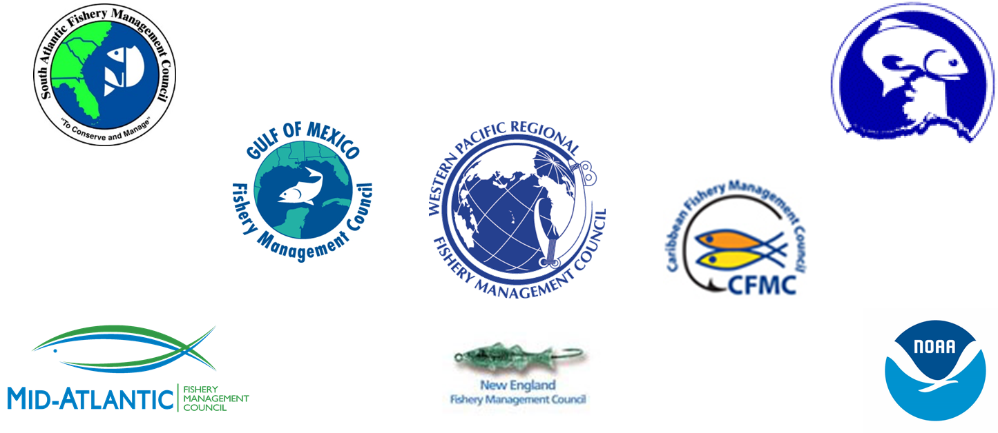
CCC Habitat Workgroup:
EFH Consultation Workshop Overview and Next Steps

Slide 3

CCC Habitat Workgroup
Workshop Sessions
Contextual bridge from the 2016 EFH Summit
EFH consultation process
Habitat goals, Council policy statements
Offshore marine planning and regional issue coordination
Fishery Science Center engagement
Tools and technology
Obtaining and sharing data to refine EFH designations

Slide 4
CCC Habitat Workgroup
Session 2: EFH consultation process: How Councils and Regional Offices communicate and collaborate
Councils should develop habitat goals and where appropriate develop policy statements that articulate the Council’s standing guidance and clear direction on non-fishing activities the Council wishes to engage in.

Slide 5
CCC Habitat Workgroup
Session 3: How can articulating habitat goals assist Councils in effectively using EFH authorities?
Habitat goals serve to inform action agencies and developers about the role of habitat in fisheries, and the need for conservation measures that support healthy fisheries and coastal and ocean economies they support. A better understanding and early coordination will reduce impacts, help prioritize restoration and conservation activities, and encourage grant opportunities to better understand these complex systems.

Slide 6
CCC Habitat Workgroup
Session 4: Council policy statements to provide standing guidance for EFH consultation and habitat conservation efforts
Policy statements provide Councils an opportunity to provide their standing policies articulating their concerns about non-fishing activities that may affect fish habitats in a clear, outward-facing, and easily shareable manner. They can constitute best practices for habitat conservation, highlighting habitat protection, and operational policies for Council engagement which benefit both the Council and NOAA.

Slide 7
CCC Habitat Workgroup
Session 5: Offshore marine planning and regional issues
Provided a view of how groups intersect and coordinate on cross-cutting and region-wide issues and what practices may be useful for enhancing the Council’s contributions to the consultation process, either directly or indirectly, with limited availability of time and resources for all involved. This session also highlighted the need and benefits of coordinated tracking of these major activities among the Councils and their NOAA Fisheries partners.

Slide 8
CCC Habitat Workgroup
Session 6: Fishery Science Center engagement in EFH consultation work
Identified opportunities to improve FSC engagement.
Short-term recommendations: distribute list of habitat contacts; provide Council EFH briefings; share examples where habitat science improved consultations; and identify experts for Council regional plan teams/advisory committees.
Long-term recommendations: improve FSC understanding of EFH consultation; regional input on national science initiatives to improve alignment with regional priorities; identify how regional strategic plans priorities feed into work plans; and identify funding opportunities that might be available for Councils.

Slide 9
CCC Habitat Workgroup
Session 7: Tools and technology to aid Councils and Regional Offices in providing access to and use of EFH information in consultations
EFH designations should be easy to find, with links on Council habitat pages and NOAA Fisheries EFH consultation pages, and including a Council summary document listing all designations. In addition, each Council should have a document or single area of its website for materials related to EFH designation. A regional EFH user guide could be developed in collaboration with NOAA Fisheries.

Slide 10
CCC Habitat Workgroup
Session 8: Approaches and best practices for obtaining and sharing data to refine EFH designations
Shared experiences with data collection and identified challenges to addressing data needs resulted in common themes across regions. Effective data collection requires continued partnership across a number of scientific partners; continued robust collection of level 1 and 2 EFH information (presence/absence and relative abundance data) is imperative for describing potential changes in fish habitat use over time, and constructing more complex ecosystem-based spatial models.

Slide 11
CCC Habitat Workgroup
Toolkit for EFH Coordination/ Collaboration
Tools for keeping Councils informed about types of projects on which NOAA Fisheries is consulting
Tools for identifying Councils’ key issues/major areas of concern
Tools for Councils to provide comments
Tools Councils can use that NOAA Fisheries is not able to (Council added value)
Tools to address constraints of timeliness

Slide 12
CCC Habitat Workgroup
Conclusions and Next Steps
Regional workshop participants and their colleagues have scoped work plans (contained in the workshop report), and will initiate potential tasks identified during the workshop.
Straightforward, near-term initiatives such as better communication of EFH information are already underway; other longer-term coordination work will require additional planning and organizational buy-in.
During 2020 and beyond, the CCC Habitat Work Group intends to continue work on specific initiatives scoped at this workshop, under the guidance of the CCC.

Slide 13
CCC Habitat Workgroup
Possible Future CCC Actions Suggested by Workshop Participants
The CCC could support coordinated outreach to action agencies to remind them of the important role that Councils play as fishery management partners, and Congressional mandates to address impacts on EFH designated by the Councils. While NOAA Fisheries conducts EFH consultations, action agencies are encouraged to coordinate around actions that will impact EFH designated by the Councils.
The CCC could identify habitat science priorities that are shared across regions and Councils and communicate them to NOAA Fisheries Leadership at both the ROs and FSCs. Shared science and research objectives can provide a foundation for work that could be done across FSCs and would benefit multiple Councils and their habitat conservation initiatives.

Slide 14
CCC Habitat Work Group

