Slide 1
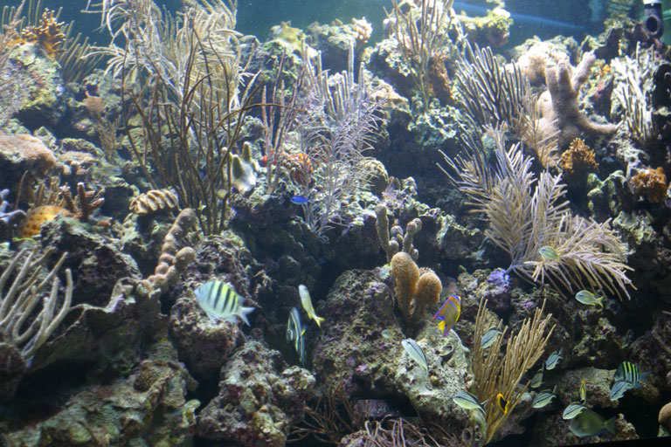
The South Atlantic Octocoral Fishery
Presentation to the SSC
April 2010

Slide 2
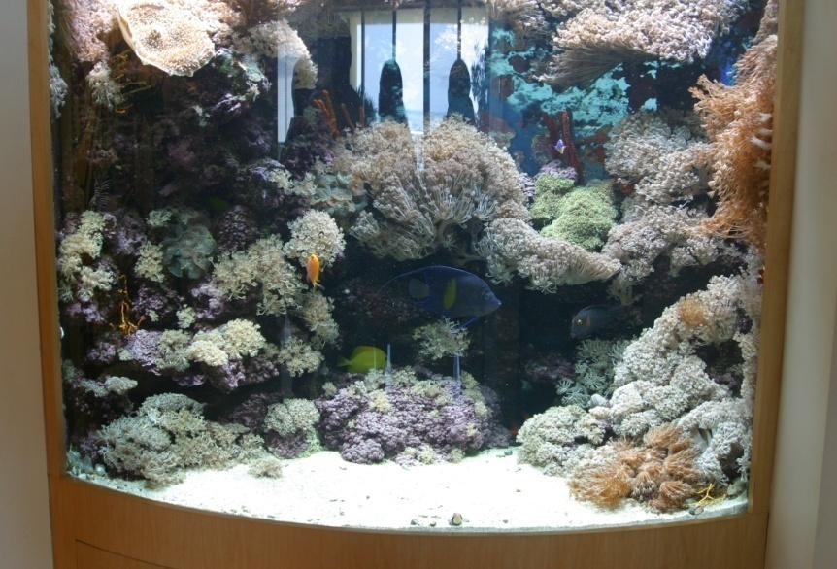
Background
Organisms are caught and sold live to wholesale and retail dealers and aquarium owners.
SA and GOM Councils were first to describe the fishery in the 1982 Coral FMP.
Amendment 1 (1990) established a commercial joint quota of 50,000 colonies.

Slide 3
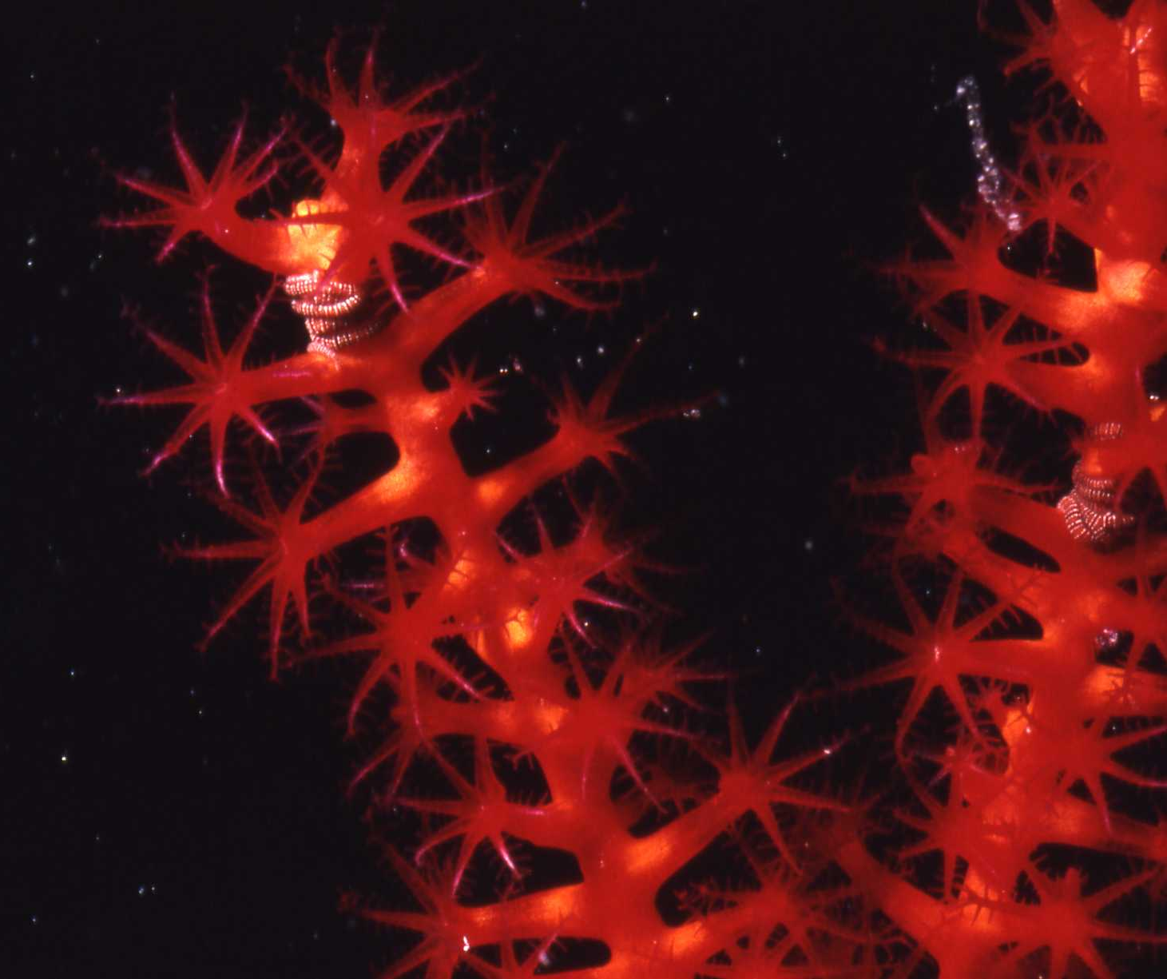
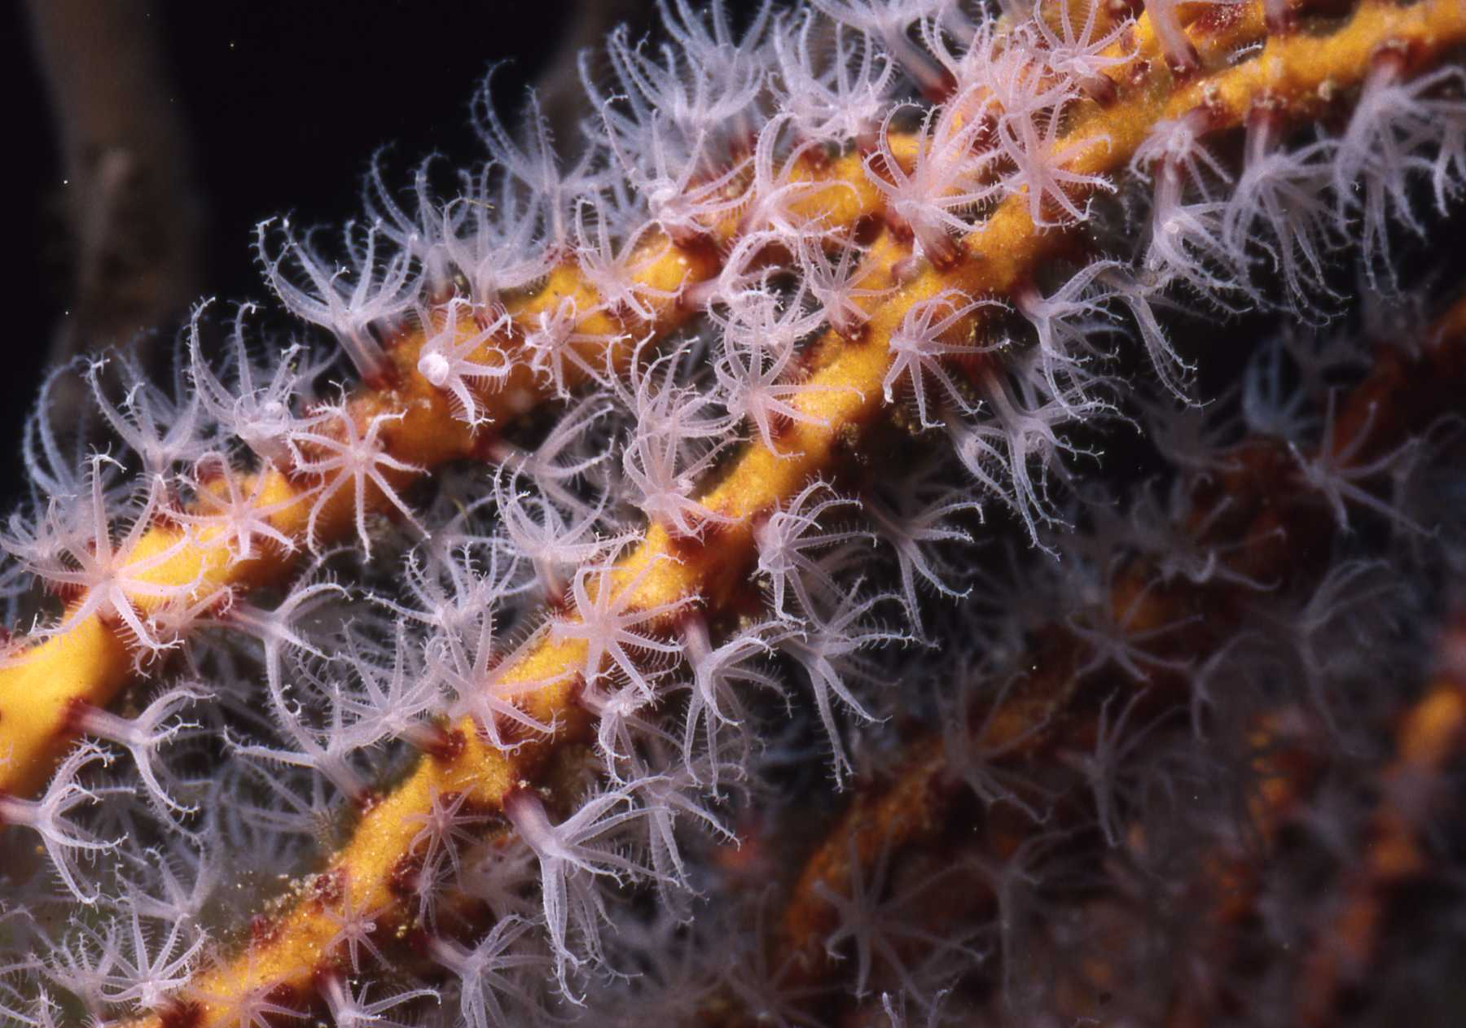
Background
Florida FWC ruled that octocoral harvest in FL waters would be unlimited until quota in Federal waters was met.
Federal quota has never been met; majority of harvest in State waters.
No stock assessment has been done.
Mostly a Florida Keys based fishery.

Slide 4
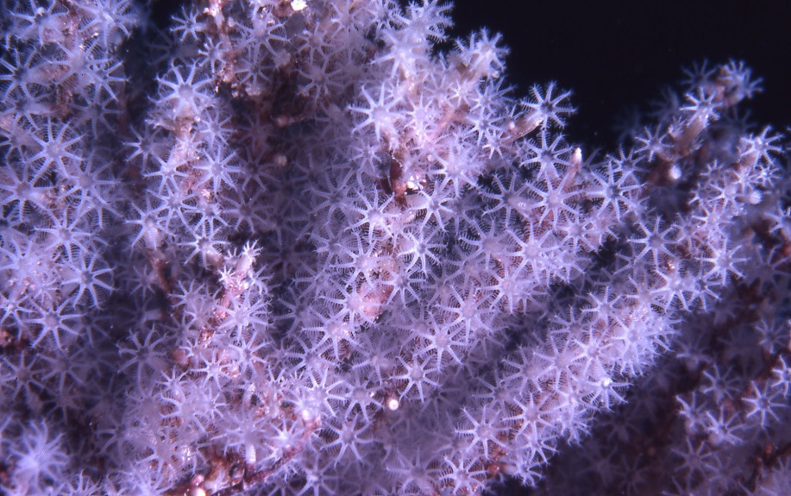
Background
Octocorals are designated Essential Fish Habitat.
Council is considering setting ACL = 0.
Council is considering delegating management authority of the octocoral fishery to Florida.

Slide 5
Data
Landings 2000-2008 obtained from FWRI in summer 2009.
Coral AP met in September 2009 and recommended fishing levels based on FWRI data.
FWRI provided updated dataset in February 2010.
Coral AP recommendations were revised to reflect the new numbers (lower than previous recommendations).

Slide 6
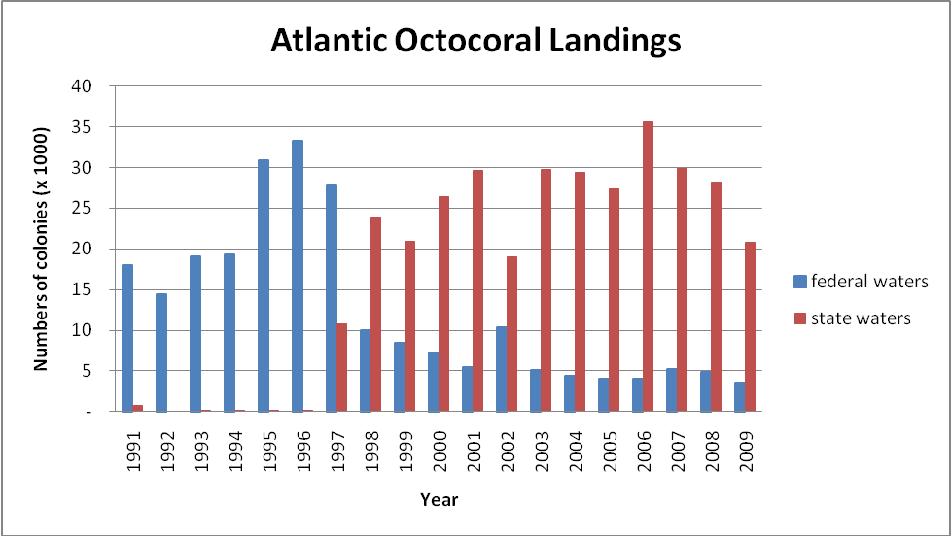

Slide 7
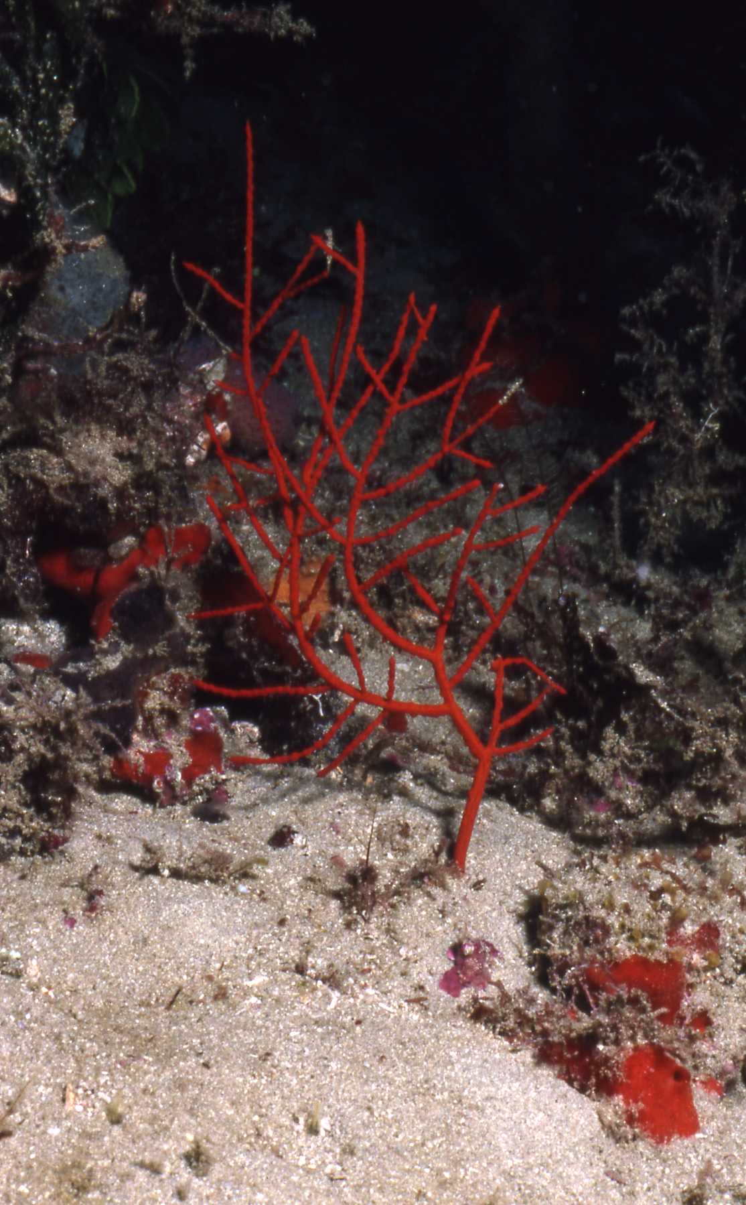
Landings 2000-2009
Federal waters
Total = 54,232
Mean = 5,423
Median = 4,970
Max = 10,407
Min = 3,509
State waters
Total = 275,882
Mean = 27,588
Median = 28,785
Max = 35,589
Min = 18,968

Slide 8
Coral AP Recommendations - MSY
Option 1. MSY = 5,000 colonies (just above median of annual harvest for 2000 – 2009).
Option 2. MSY = 29,200 colonies (50K colonies proportionally split between GOM and SA based on percentage of average annual harvest 2000-2009).
Option 3. MSY = 21,000 colonies (approximately twice the maximum annual harvest for 2000-2009).

Slide 9
Coral AP Recommendations - OFL
Option 1. OFL = MSY
Option 2. OFL = 10,407 colonies (maximum annual harvest for 2000-2009).
Option 3. OFL = 20,814 colonies (double the maximum annual harvest for 2000-2009).

Slide 10
Coral AP Recommendations - ABC
Option 1. ABC = OFL
Option 2. ABC = 10,407 colonies (maximum annual harvest for 2000-2009).
Option 3. ABC = 20,814 colonies (double the maximum annual harvest for 2000-2009).

