Slide 1
SAFMC Citizen Science Initiative: Program Development Update
December 8, 2016
SAFMC December 2016Meeting
Notes:
Title slide

Slide 2
SAFMC Citizen Science Program
Working definition for SAFMC:
“ A growing field in which trained members of the public collaborate and engage with scientists in the inquiry and discovery of new knowledge.”
Vision Statement:
“more collaboration + more data + more trust = better management”
Mission Statement:
“Improve fisheries management through collaborative science”

Slide 3
2016 – Program Development
January 2016:
SAFMC Citizen Science Program Design Workshop
Council Cit Sci Organizing Committee drafts Blueprint
March 2016:
Council Reviews and Adopts SAFMC Citizen Science Program Blueprint
May 2016:
Council Staff Present Citizen Science Program Development Efforts for NMFS QUEST Webinar Series

Slide 4
2016 – Program Development (cont.)
July 2016:
Council Cit Sci Organizing Committee present Council’s work at International Marine Conservation Congress
September 2016:
Citizen Science Council Committee is initiated
November 2016:
NMFS Grant Opportunity – kickstarter project

Slide 5
2016 – Council Investment
Total Investment To-Date: $110,000
Staff time for coordinating 2015-2016 activities -
3 primary staff; other staff support: $37,000
Sampling with scientists/fishermen - $28,000
January 2016 Workshop - $35,000 (plus Sea Grant support)
IMCC Participation (2 staff and 1 Council member) - $10,000

Slide 6
SAFMC Citizen Science Program –
Needs
Dedicated Council staff (FTE) to operate program
Objectives/Activities
Long term –
Implement/organize a program based on blueprint
Short term –
Support projects that will become inclusive of providing program support;
Initiate a kickstarter project;
Develop program partnerships - engage other organizations and agency partners on a successful project

Slide 7
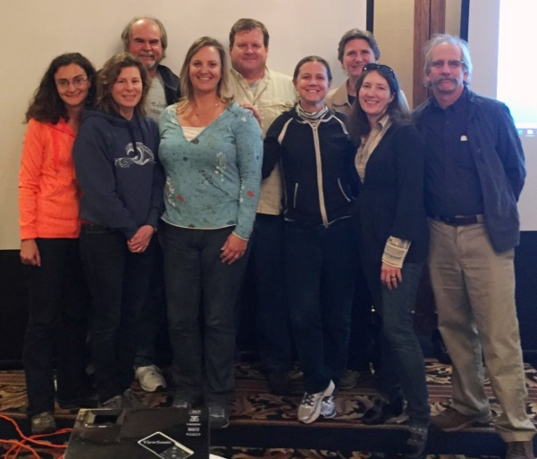
Tiered Program Structure*:
**Organizing Committee members are expected to continue to serve key roles in various bodies of the permanent infrastructure.
Oversight Board
Operations Committee
Advisory Committee
Program
“A-Teams”
Volunteer
Data
Management
Projects/Topics Management
Communication/ Outreach/Education
Finance
Notes:
Oversight – provides general program governance - approve policies, provide program direction/multi-partner support, develop program budgets; and advised by the Operations committee;
Operations – Smaller group of advisors that develop program recommendations for the Oversight Board to consider; Draft SOPPS and policies for Oversight Board approval; coordinates with A-Teams
Advisory – Works in conjunction with the Operations Committee to develop recommendations for the Oversight Board; function similarly to Council APs and allows opportunity for citizens to be involved at a programmatic level;
-Serve as outreach ambassadors
-Assist with developing strategies for recruiting and training volunteers
-Identify research and data needs
-Serve in some capacity during the proposal review process
A-teams – Task force of sorts initially set up to develop program components; address start up issues and long-term care and feeding of the program; grassroots boots on the ground folks that will be making aspects of the program become a success both in the short and long-term.

Slide 8
SAFMC Citizen Science Program –
Challenges
Funding –
Opportunities to directly receive funding are limited (can only receive direct funds from NMFS)
Program will need to be creative on this front (partnerships will be key)
Program Staff –
No dedicated staff to pursue program level support or project funding and general organization
Initial Project –
Need for a successful project that is applied directly to the science and management used by the Council;
Risk - if first project fails, the program is at risk of failing.

Slide 9
SAFMC Citizen Science Program –
Pursuit of Funding
2016 Efforts:
Initial budget request to NMFS ($173,000)
Exploration of other program partnerships and project-level funding opportunities
Partners begin approaching Council staff about engagement on Citizen Science projects
Internal NMFS grant opportunity – Fishery Information System program focused on Electronic Reporting/Monitoring projects
Submission of citizen science program kickstarter project idea – scamp grouper discard proposal

Slide 10
Options for Pursuing Kickstarter Project
 | OPTION #1: No Program/ Staff Support | OPTION #2: Temporary Staff Support | OPTION #3: Full Time Staff Support
Activity: | Build mobile app/database to receive data Project is open to anyone; no oversight | Build mobile app/ database Temporary staff for project oversight | Build mobile app/ database Permanent FTE to develop program and manage project
Benefits: | Low cost Mobile app is built | Moderate cost Temporary staff | Program has support to get off the ground
Risks: | Success rate is low No dedicated staff Project disorganized & participants not satisfied Less chance data could be used | Success rate is moderate Staff time/ availability limited Buy-in limited Temporary staff requires supervision Data may not be available in time | Success rate is high Cost is also high

Slide 11
Items to Consider for Next Steps:
Existing staff time/resources to work on program – not sustainable
Budgeting for full-time dedicated program staff with existing resources
Kickstarter project funding
Risk of losing stakeholder support and program development momentum
Missed opportunities for partnership development

Slide 12
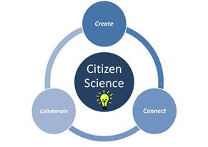
http://www.safmc.net/citizen-science-initiative
Notes:
ADD our contact info

