Slide 1

Perspectives on Modeling for EBFM
Howard Townsend, Ph.D.
NMFS Ecosystem Modeling Coordinator
SAFMC SSC
October 26, 2016
Notes:
- NMFS Ecosystem Modeling Coordinator - "Ecosystem Modeling" writ large
- coordinate among NMFS Science Centers/labs, Regions, and Councils to develop EM capacity, ensure use of best practices (e.g., dealing with uncertainty, using multiple models), develop some review standards so that EMs can be used operationally for EBFM

Slide 2
Overview
Background on EBFM Road Map and the need for Ecosystem/Multi-species Models
Where we’ve been
  S&T efforts to coordinate Ecosystem Modeling
  Science Center efforts to apply EM - highlights
What’s next for EM and EBFM
  Broadly across NMFS
  How we can help with SAFMC efforts
Notes:
Systems thinking
Multiple e.g.s
Stability of biomass, ecology leading to mgt, regulatory and business planning
Tradeoffs across multiple objectives

Slide 3
Background
EBFM Road Map and Ecosystem Modeling

Slide 4



Why EBFM
Advice could suffer with
  Climate Change
Triage & Prioritization
Increased Stability
Address Tradeoffs
Precision important
but Accuracy even more so
Notes:
Systems thinking
Multiple e.g.s
Stability of biomass, ecology leading to mgt, regulatory and business planning
Tradeoffs across multiple objectives

Slide 5
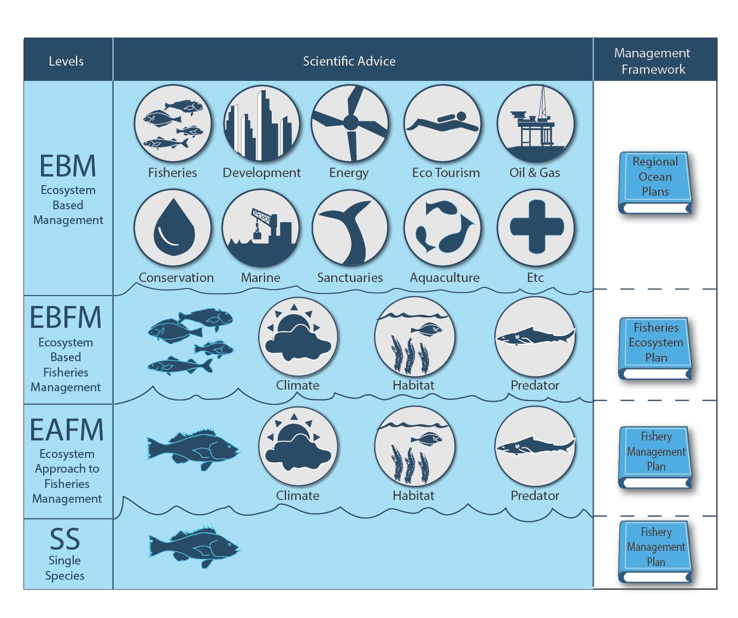
Notes:
Different levels of EBM for different emphases and different kinds of inclusion.
Focusing the right type of effort in the right place has been a challenge, even just linguistically. Here we use this schematic to note how we’re clarifying some of our efforts.
There are cross-cutting efforts and programs to address each of these.

Slide 6

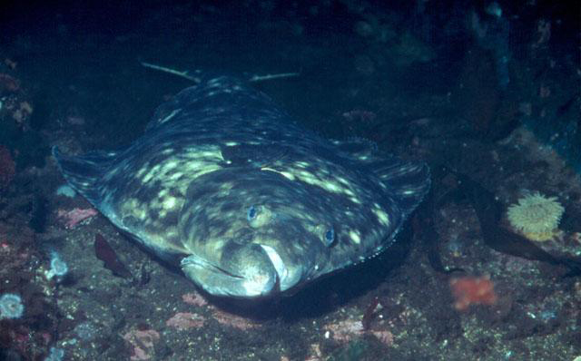
Why an EBFM Road Map?
Guides implementation of the Final EBFM Policy
Incorporates the menu of options for implementation and benchmarks for NMFS
Key Questions:
What does successful EBFM look like?
What do we need for successful implementation of EBFM?
How do we measure completion and success of EBFM?
Notes:
We hope that the Road Map and Final Policy answer these important questions.
If not, we hope that you will provide comments on where we can improve the Road Map.

Slide 7
Road Map
Intended to build on current efforts
Intended to guide the implementation of the EBFM Policy over the next 5-years
Describes recommended Actions to address each of the Policy’s six Guiding Principles for near-term work
We will review our progress and revise road map after 5 yrs

Slide 8
6 Guiding Principles, with Core Components are:
1. Implement ecosystem-level planning
• Engagement Strategy
• Fishery Ecosystem Plans
2. Advance our understanding of ecosystem processes
• Conduct Science to Understand Ecosystems
• Ecosystem Status Reports
3. Prioritize vulnerabilities and risks of ecosystems and their components
• Ecosystem-level Risk Assessment
• Managed Species, Habitats & Communities Risk assessment
4. Explore and address trade-offs within an ecosystem
• Modeling Capacity
• Management Strategy Evaluations
5. Incorporate ecosystem considerations into management advice
• Ecosystem-level Reference Points
• Incorporate Ecosystem Considerations for Living Marine Resources
• Systematic Advice for Other Management Considerations
6. Maintain resilient ecosystems
• Evaluate Resilience
Notes:
This is an area that comments from the Councils would help us.

Slide 9
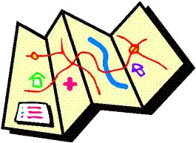
EBFM Road Map
2.4.a Analyze trade-offs for optimizing benefits from all fisheries within each ecosystem or jurisdiction, taking into account ecosystem-specific policy goals and objectives, cognizant that ecosystems are composed of interconnected components
Notes:
There are a wide range of modeling tools available, ranging from qualitative mental modeling to fully and highly quantitative end-to-end models. Before establishing reference points against which objectives can be measured, and before establishing MSE protocols and processes, the analytical basis for exploring ecosystem dynamics is required.

Slide 10
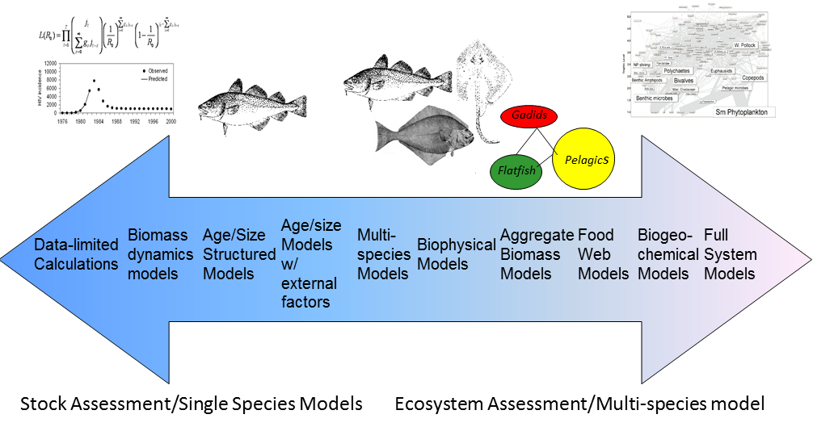
Ecosystem Modeling:
Living Marine Resource Management
Notes:
A spectrum of models can be used for LMR mgmt – from traditional single/species models to more complex, end-to-end models such as Atlantis models

Slide 11
Onion of Model Simplifications
CLIMATE
SPATIAL
FOOD WEB
HABITAT
AGE-STRUCTURED
(recruitment, nat. mort., selectivity)
OCEAN
BIOMASS DYNAMICS
B_{t+1} = f(B_{t})-C_{t}+e_{t}
DATA-LIMITED
Source:
R. Methot, NMFS 2015
Notes:
*The range of models we are talking about get at the same questions, but level of model complexity depends on complexity of manager questions about factors influencing lmr stocks/populations as well as the data and information available to address those questions.
All models are simplifications
Some factors, F_{t}, are inside the system being modeled and we seek to measure this factor
Other factors, e.g. M, are also inside the system. By holding it constant, we simplify the system and allows for estimation of F, conditional on M.
In reality, M is controlled by factors, E, outside of the system.
Stock assessment models estimate the time series of absolute stock abundance and fishing mortality and productivity parameters that determine sustainable harvest rates.
These estimates are conditioned on simplifying assumptions about the constancy of parameters that govern the productivity and natural mortality of the stock.
From an ecological perspective, a stock’s carrying capacity, productivity and natural mortality are not just functions of the stock’s characteristics. These factors are functions of a stock’s interactions with its predators, prey, competitors, habitat and environment.
In a fished ecosystem, many stocks are fished and reduced in abundance, so these interactions will change over time. From this perspective, the need for coordination of single species models and ecosystem models emerges.
Ecosystem models provide more comprehensive evaluation of the effects of fishing across a range of managed stocks
Single species models can provide better tactical estimation and short-term forecasting of stock abundance to feed into control rules that are MSE tested with against ecosystem-based operating models

Slide 12
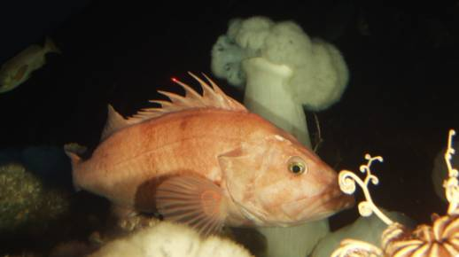
Single Species Models in Fisheries
Intended Purpose:
  Assess the status of fishery stocks
Pros:
  Classical approach in fisheries
  Well established models & approaches
Cons:
  “Precision v. Accuracy” issue- may miss other influencers on stocks
Data Needs:
  Standard- (i.e. landings, bycatch, survey abundance/biomass; maybe size/age structure)
Cowcod (Sebastes levis) stock assessment- a very data poor stock

Slide 13
Single Species Models in Fisheries
Intended Purpose:
  Assess the status of fishery stocks
Pros:
  Classical approach in fisheries
  Well established models & approaches
Cons:
  “Precision v. Accuracy” issue- may miss other influencers on stocks
Data Needs:
  Standard- (i.e. landings, bycatch, survey abundance/biomass; maybe size/age structure)

Slide 14
Single Species with Add-ons Models in Fisheries
Intended Purpose:
  Assess the status of fish stocks with additional factors added in
  Aka MRMs
Pros:
  Enhanced biological/ecological/ environmental realism
  Same model outputs as std fisheries models
Cons:
  Extra data requirements
  Harder to insert into mgt process
Data Needs:
  Standard plus stomach or environmental

Slide 15
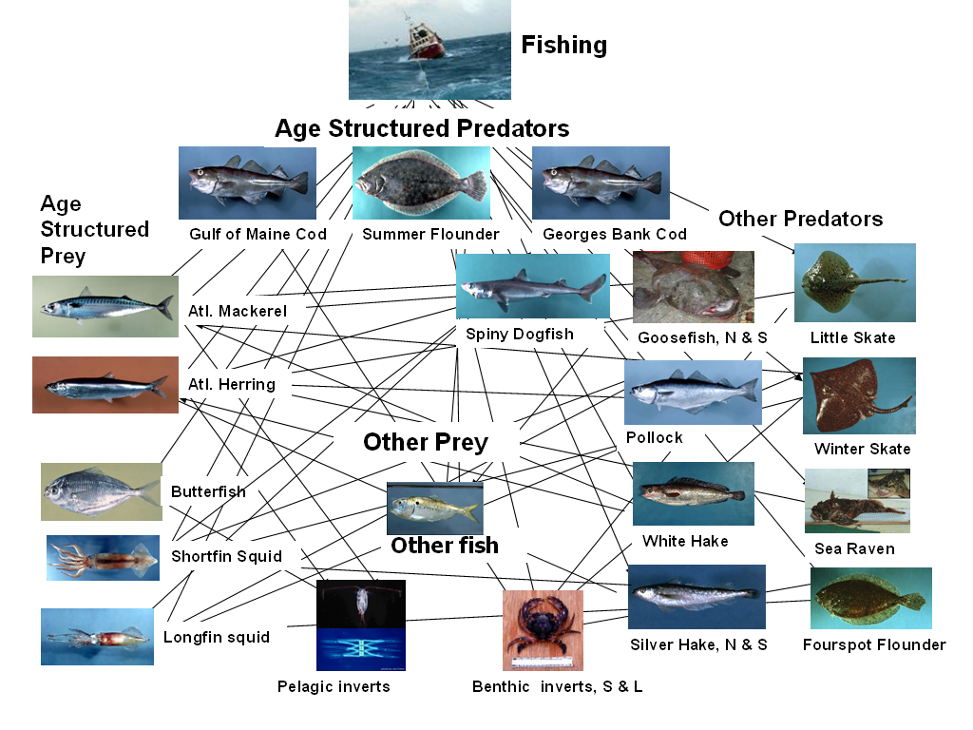
Multi-Species Models in Fisheries
Intended Purpose:
  Assess the status of stocks simultaneously, usually with some form of interactions among spp, gear, etc.
Pros:
  Improvement over MRMs as additional factors are modeled concurrently
  Model outputs are still in familiar form
Cons:
  Functional form of several interactions debated
  Even additional data requirements
  May still miss other key factors
Data Needs:
  Standard plus stomach

Slide 16
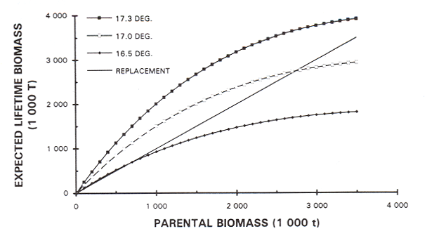
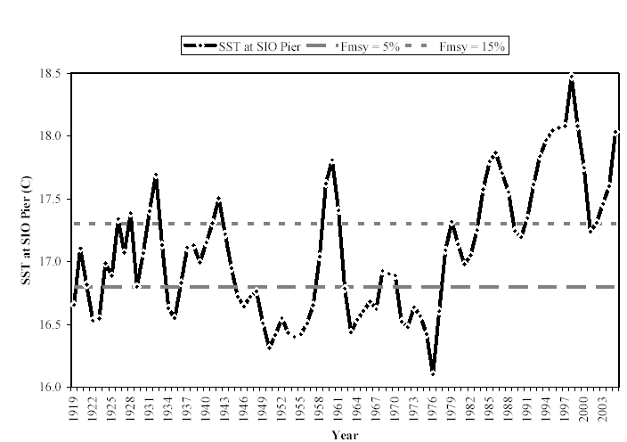
Biophysical Models in Fisheries
Intended Purpose:
  Evaluate how physical conditions alter stocks (more than SS add-ons)
Pros:
  Enhanced environmental realism
Cons:
  Often uncertain or solely correlative relationship between env. and stocks
  How to handle model outputs
Data Needs:
  Physical oceanographic or limnological conditions
  Known or estimated responses of fish to env. conditions
Scripps Pier, La Jolla SST

Slide 17
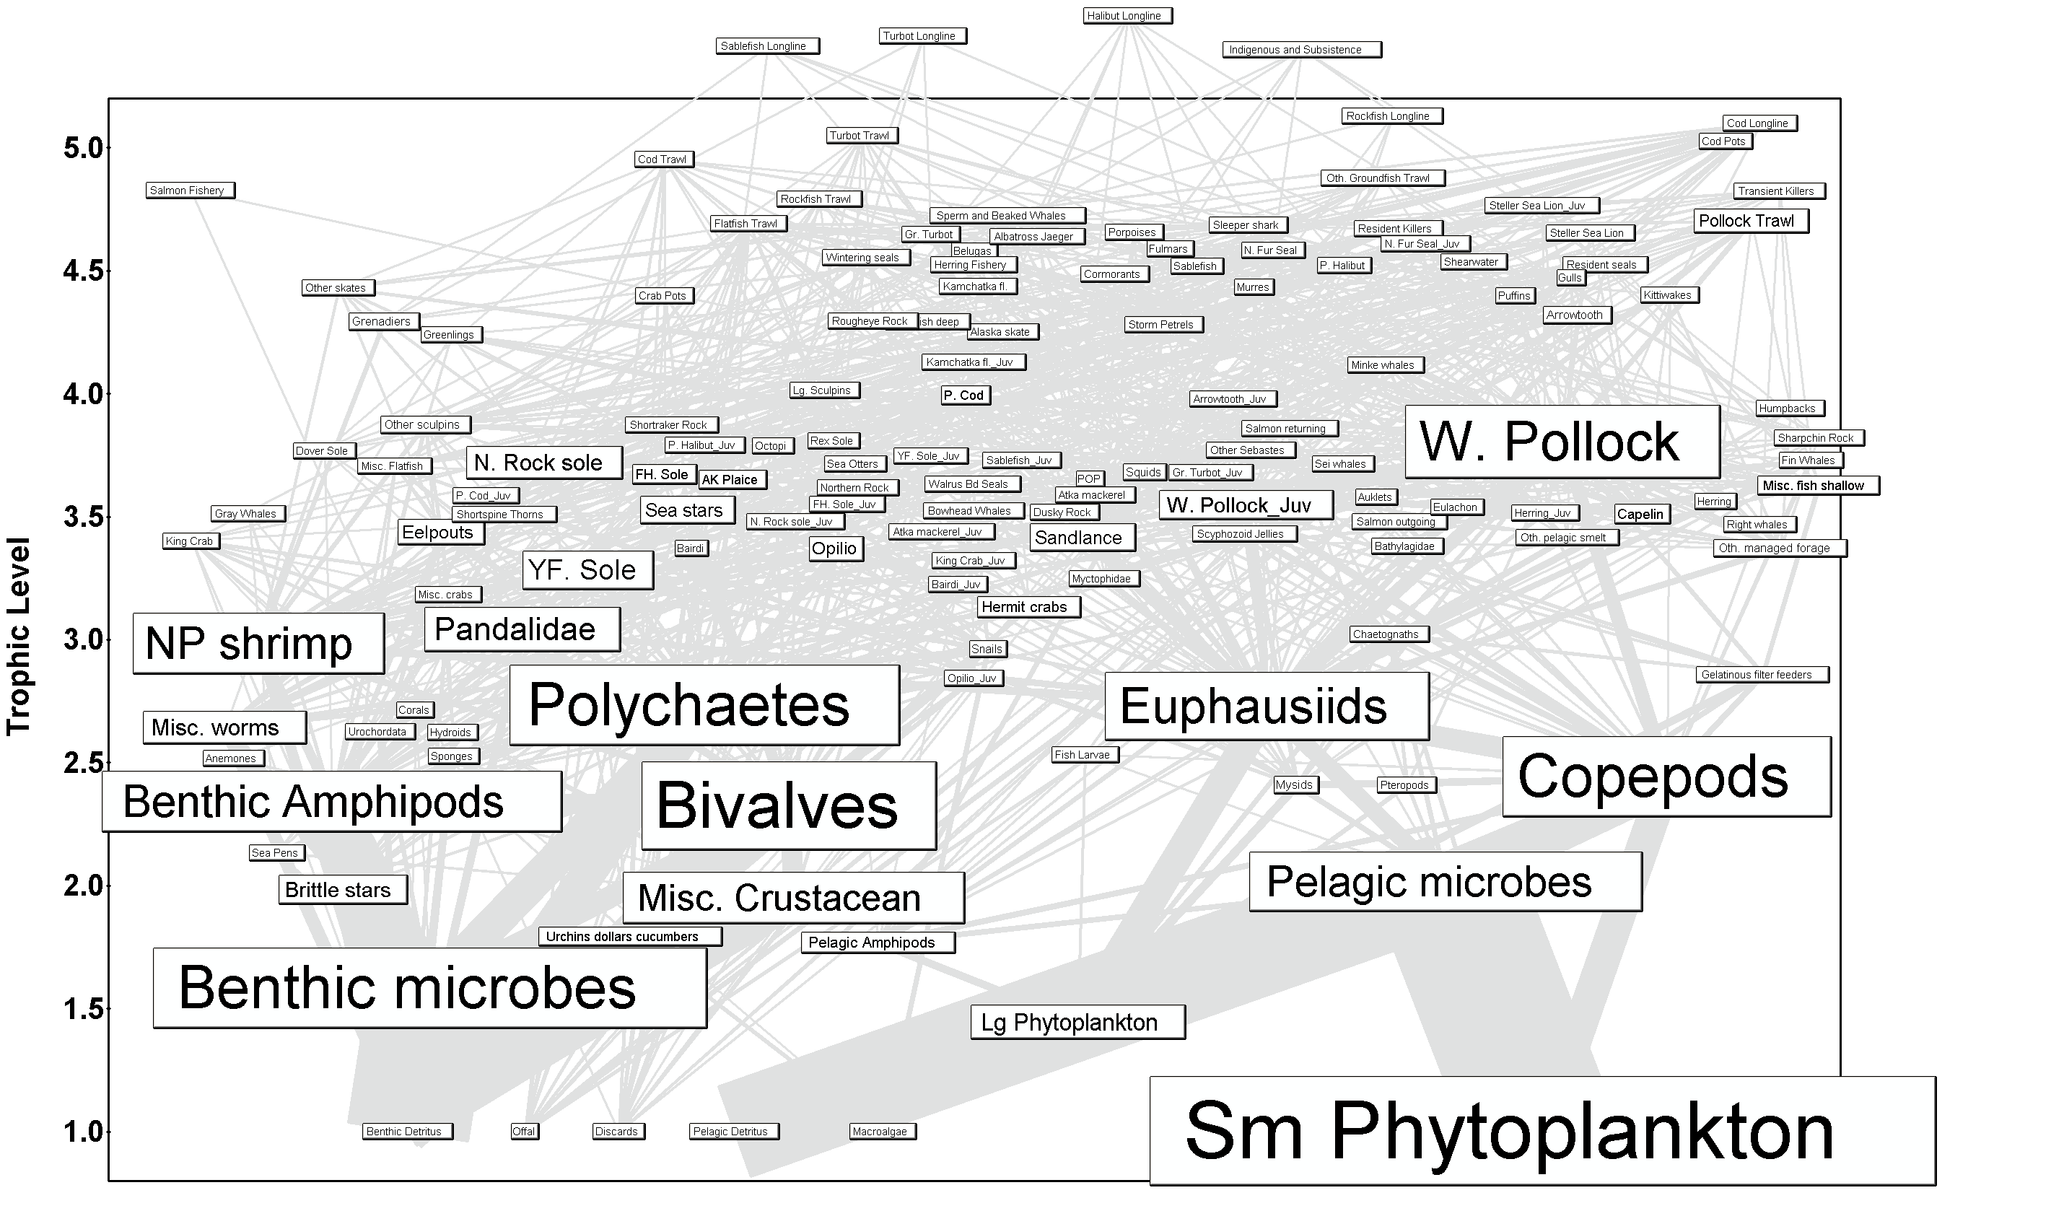
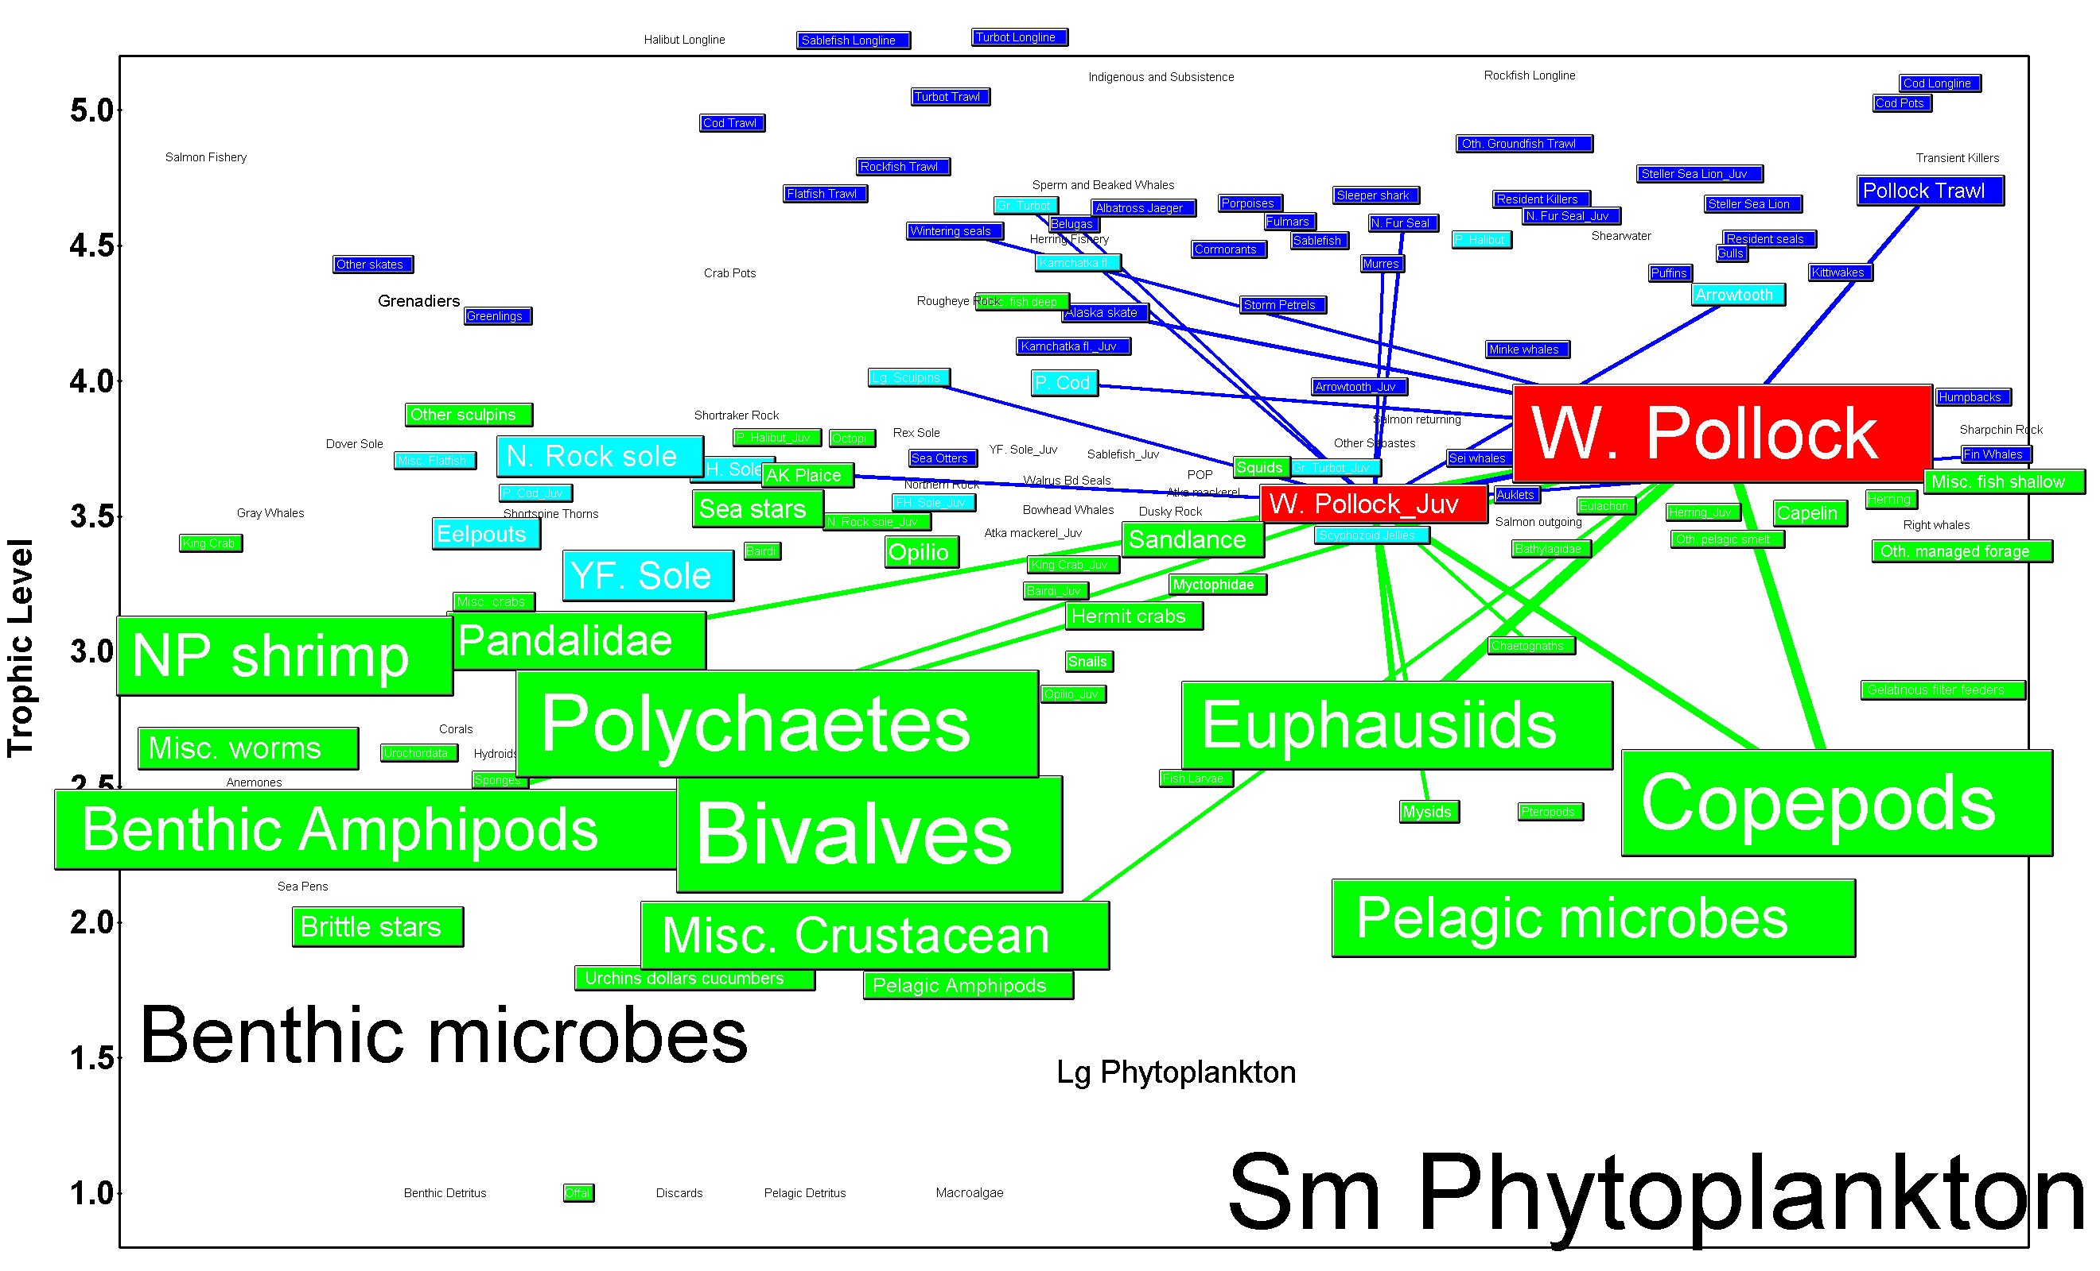
Food Web Models in Fisheries
Intended Purpose:
  Evaluate species interactions, energy flows, and network structure of system surrounding fishery stocks
Pros:
  Enhanced ecological realism
  Establishes ability to address trade-offs among fisheries
  Often serves as a catalog for future work
Cons:
  Transparency of models
  Assumptions of functional forms
  Model outputs atypical for historical fisheries context
Data Needs:
  Std plus stomach, many vital rates, many more taxa groups than just targeted spp
  Flows among compartments and rates within compartments

Slide 18
Aggregate Biomass Models in Fisheries
Intended Purpose:
  Assess the status of resources as major groups or clusters (e.g. guilds, taxa, etc.), not as individual stocks
Pros:
  Establishes ability to address trade-offs among fisheries
  Built in precautionary approach
  Model outputs are still in familiar, albeit aggregated, form
Cons:
  Minimizes stock specific information
  Assumptions of amalgamated vital rate parameters across groups of diverse spp & life histories
Data Needs:
  Std, maybe some stomach, but clustered
  Some flows among groups
250
Guild Biomass- Scenario 3
200
150
100
50
0
0
2
4
6
8
10
12
14
16
18
20
22
24
26
28
30
Time
Benthivores
Planktivores
Shrimp-Amphipods
Shrimp-Fish
Piscivores

Slide 19
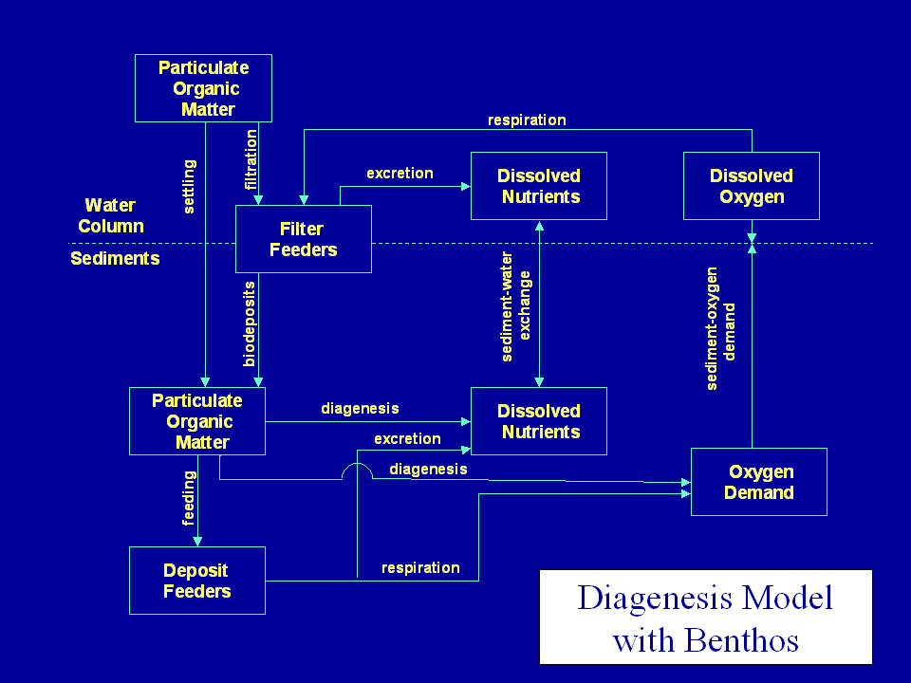
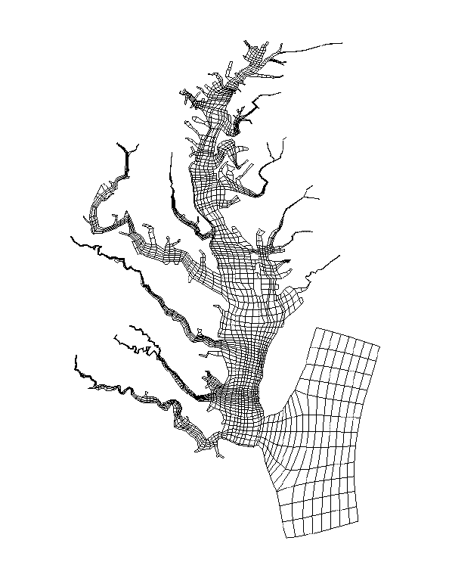
Biogeochemical Models in Fisheries
Intended Purpose:
  Evaluate fish in the context of broader material/elemental fluxes in a system
Pros:
  Places fish in broader systemic context
  Particularly helpful for chemical (heavy metal or organic toxin) accumulation modeling
Cons:
  Not routinely used in typical fishery modeling contexts
Data Needs:
  Elemental composition, flows among compartments and rates within compartments

Slide 20
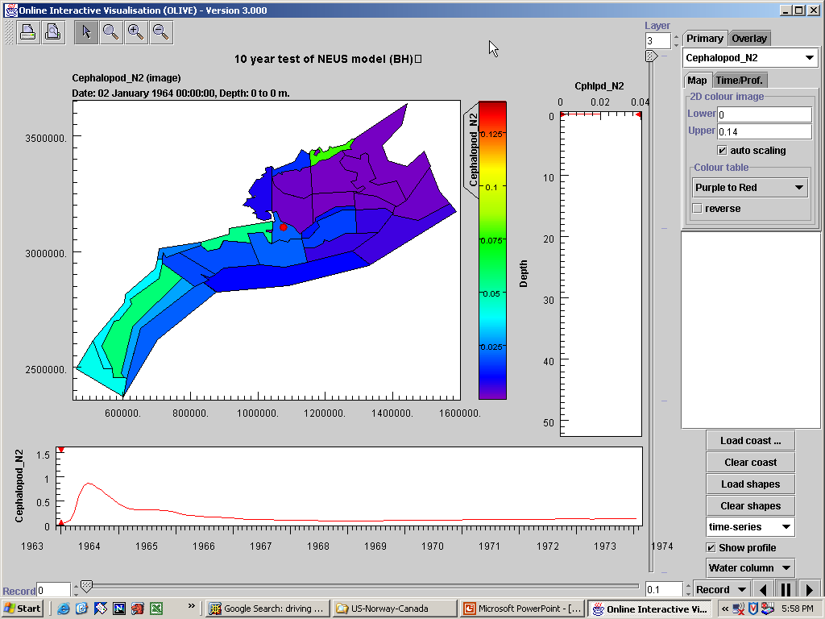
Full System Models in Fisheries
Intended Purpose:
  Evaluate fish in context of all the potential uses of an ecosystem
Pros:
  Inclusive of effectively every possible factor that can influence fish stocks
  Excellent for strategic, multiple sector mgt
Cons:
  Models quickly become unwieldy
  Multiple functional forms to choose from
  Model outputs may or may not be familiar
Data Needs:
  Std plus stomach, many vital rates, many more taxa groups than just targeted spp
  Flows among compartments and rates within compartments
  Economic, socioeconomic and governance drivers

Slide 21

Ecosystem Modeling:
Living Marine Resource Management
The primary reason to use
Ecosystem Modeling (EM)
is to better account for ecosystem and systemic, cumulative features when providing advice for stock, protected resource, habitat or Integrated Ecosystem Assessments
Application as operating models for Management Strategy Evaluation and skill assessment.
Application of a range of models for multiple model inference to deal with uncertainty
Application for risk assessment and trade-off evaluation in a bioeconomic context.
Notes:
More detail:
Establishment of a transparent connection between single species and ecosystem-based advice using EM
Application as operating models to test assessment models and candidate management procedures – management strategy evaluation,
Application of assessment models spanning a spectrum of complexity to evaluate the issue of model uncertainty,
Application of formal strategies of multimodel inference in applying results from the multispecies assessment models,
Use of these results to assess uncertainty and risk, and
Evaluation of tradeoffs in a bioeconomic context.

Slide 22
Levels of Information Use in Fisheries Mgt
Heurism
Tactical
Strategic
Notes:
Center has done a lot of work in this area

Slide 23
Heurism
Understanding Ecosystem Functioning
Relative Importance of Different Processes
Advancing Scientific Theory
Notes:
Center has done a lot of work in this area

Slide 24
Tactical Management
Revised Stock Assessments
  Yield Adjustments
  Altered Biological Reference Points, etc.
Specific Impacts on Non-Target Species, Habitat
Specific “What If” Scenarios and Gaming
BINDING IN SCOPE

Slide 25

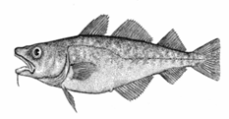
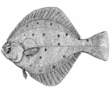
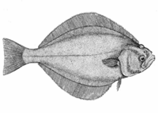
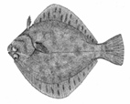
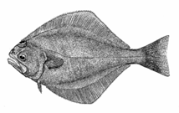

What difference does it make? Tactically: BRPs
From Aydin et al

Slide 26
Strategic Management
Assessing Biomass Tradeoffs
  System Level Emergent Properties & RPs
  Evaluating Alternate Stable States
Cumulative Impacts on Non-Target Species, Habitat
General “What If” Scenarios and Gaming, Long Term Trends
BOUNDING IN SCOPE

Slide 27
What difference does it make? Strategically: Tradeoffs
Mammals
Option 1-
Balance
Option 2-
GB Now
Elasmobranchs
Groundfish
Pelagics
Decapods & Molluscs
Junk Fish
Option 3-
Whale Hugger
Option 4-
GB 1950s
Option 5-
Rape & Pillage

Slide 28
Where we’ve been
S&T and Science Center Efforts to Apply EM

Slide 29


(Finding) NEMoW
A proposal for a:
National Ecosystem Modeling Workshop
Jason Link, Howard Townsend, Kerim Aydin
Notes:
In 2006 we pitched this to the science board
Actually happened while I was on a bear hunt in Canada…
First NEMoW in 2007

Slide 30
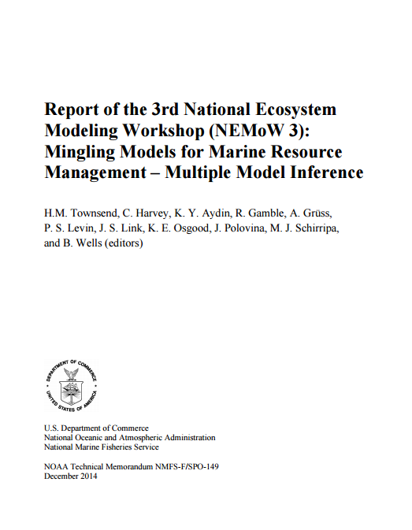
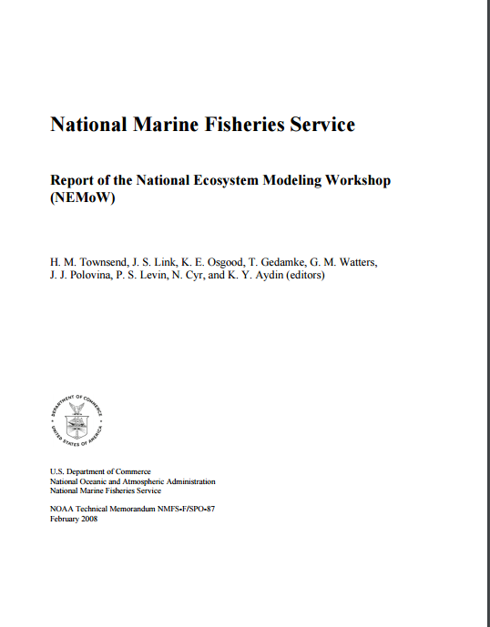
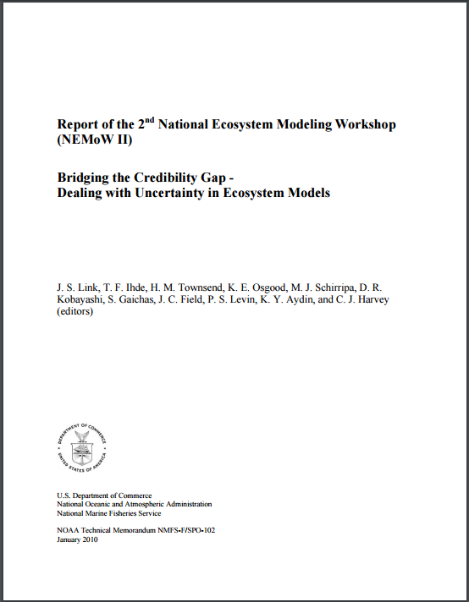
EM Coordination Efforts To Date
Primarily effort
has been through National Ecosystem Modeling Workshops (NEMoWs) in 2007, 2010, 2014, and 2017.
NEMoW was designed as a NMFS-wide, national workshop to examine NMFS ecosystem, bio-physical and multispecies modeling approaches to explore the establishment of ecosystem modeling standards of use and review for living marine resource management applications.
Notes:
. NEMoW was held as a national workshop analogous to National Stock Assessment Workshops and National Economists Meetings
Report of the National Ecosystem Modeling Workshop (NEMoW)
http://spo.nmfs.noaa.gov/tm/tm87.pdf
Report of the 2nd National Ecosystem Modeling Workshop (NEMoW II) Bridging the Credibility Gap - Dealing with Uncertainty in Ecosystem Models
http://spo.nwr.noaa.gov/tm/TM102.pdf
Report of the 3rd National Ecosystem Modeling Workshop (NEMoW 3): Mingling Models for Marine Resource Management – Multiple Model Inference
http://spo.nmfs.noaa.gov/tm/TM149.pdf

Slide 31
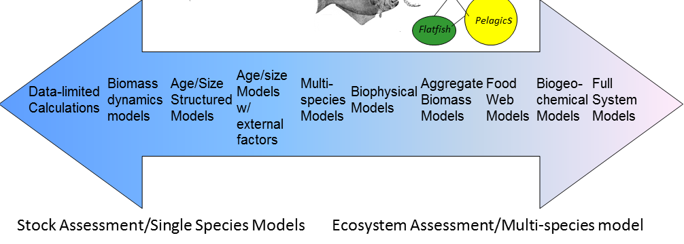
1st National Ecosystem Modeling Workshop
Initiate development of a standardized approach
for EM across NMFS and examine:
Software packages
Recommendations for use and data requirements
Parameterization protocols
Validation protocols and verification of model results

Slide 32
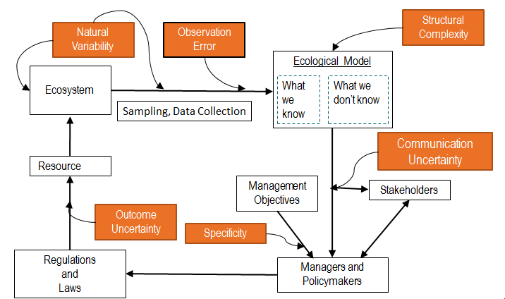
NEMoW 2 – Dealing with Uncertainty
Key for EMs
to be used
in providing
ecosystem-based LMR management advice is to ensure that all stakeholders, reviewers, managers and scientists using them have full confidence in what the models are doing in general and that the models have been applied appropriately
in specific instances.

Slide 33
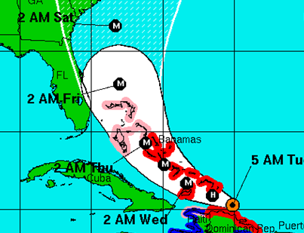
NEMoW 3 - Multiple Model Inference
Evaluating methods, rationales, and communication methods for using MMI in an LMR context in an effort to reduce uncertainty
Drew on expertise
from other disciplines
Notes:
Note: Many stock assessor were also present for this NEMoW

Slide 34
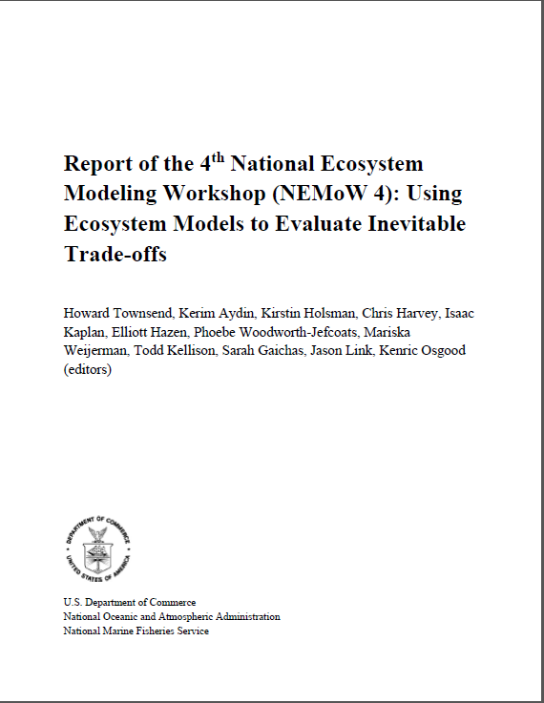
National Ecosystem Modeling Workshop 4
Evaluate best practices for using ecosystem models to address trade-offs inherent in ecosystem-based management of living marine resources
Outline and review trade-offs being addressed
Review common novel tools for modeling and communicating trade-offs
Understand management implications for trade-offs
Summarize best practices for addressing trade-offs using EM

Slide 35
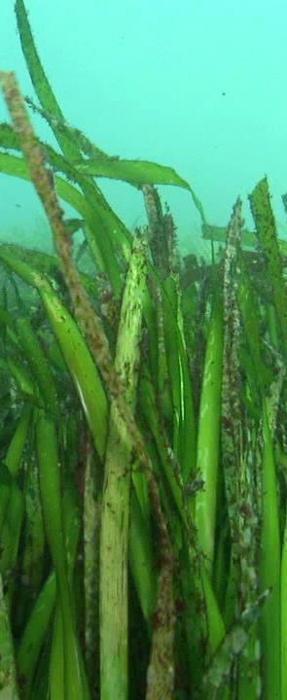
Major Recommendations from NEMoWs
Formally support/expand dedicated EM efforts at Centers
Adopt a National Standards of EM use
Establish regular NEMoWs
Identify and note sources of EM uncertainty as a must for EM use and review
Adopt Multiple Model Inference (MMI) best practices
Perform simulation studies to evaluate the skill of models to be used for MMI
Engage with stakeholders early and often

Slide 36
Major Outcomes from NEMoWs
Networking and swapping
of best practices
Vehicle
to advance
ecosystem modeling
and ecosystem-oriented
efforts
During NEMoW
1, 2 out of 7 Centers
(and Habitat Conservation Office)
had dedicated EM efforts/groups,
there are now 4.5(+)
out of 7 such groups
At least 3 centers
have had
formal review
of ecosystem models
so that Councils can
use the EMs

Slide 37
Goals for Ecosystem Modeling Coordination
Conduct science to understand ecosystems
Modeling the processes, drivers, threats, status, and trends of our ecosystems
Explore and address trade-offs within an ecosystem
Establish sufficient EBFM modeling capacity to analyze trade-offs
Develop Management Strategy Evaluation capabilities to better conduct ecosystem-level analyses to provide ecosystem-wide management advice
Incorporate ecosystem considerations into management advice
Develop and monitor Ecosystem-Level Reference Points
Incorporate ecosystem considerations into appropriate LMR assessments, control rules, and management decisions
Provide systematic advice for other management considerations, particularly applied across multiple species within an ecosystem
Notes:
Ecosystem Modeling coordination activity now has dedicated staff for S&T. Goals are clearly laid out in the EBFM Road Map

Slide 38
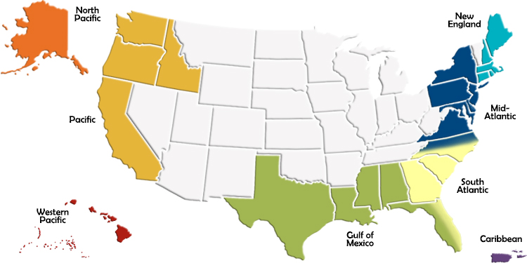
Integration and Addressing Needs
MAJOR GOALS OF ECOSYSTEM MODELING COORDINATION
1
Ensuring Centers have adequate capacity for developing and applying models.
2
Ensuring uptake by regional management bodies.
Notes:
Identifying and filling EM gaps at science centers
Facilitating EM interchange among the centers
Create EM toolbox
Establish an EM review process for the centers/Councils and other regional management bodies
Conduct marine ecosystem modeling research to better parameterize, calibrate, validate and operationalize ecosystem models.

Slide 39
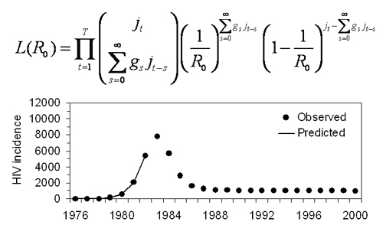
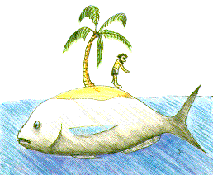


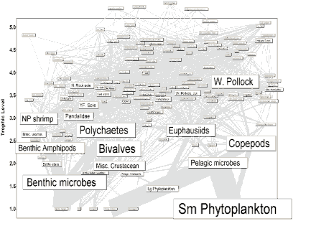
Addressing Priorities
Cataloging
EM activities
at Centers
Consulting
with Centers
on EM priorities
Developing Toolbox
so models can be
more readily
applied and reviewed
Gadids
Flatfish
Pelagics
MSVPA-X

Slide 40
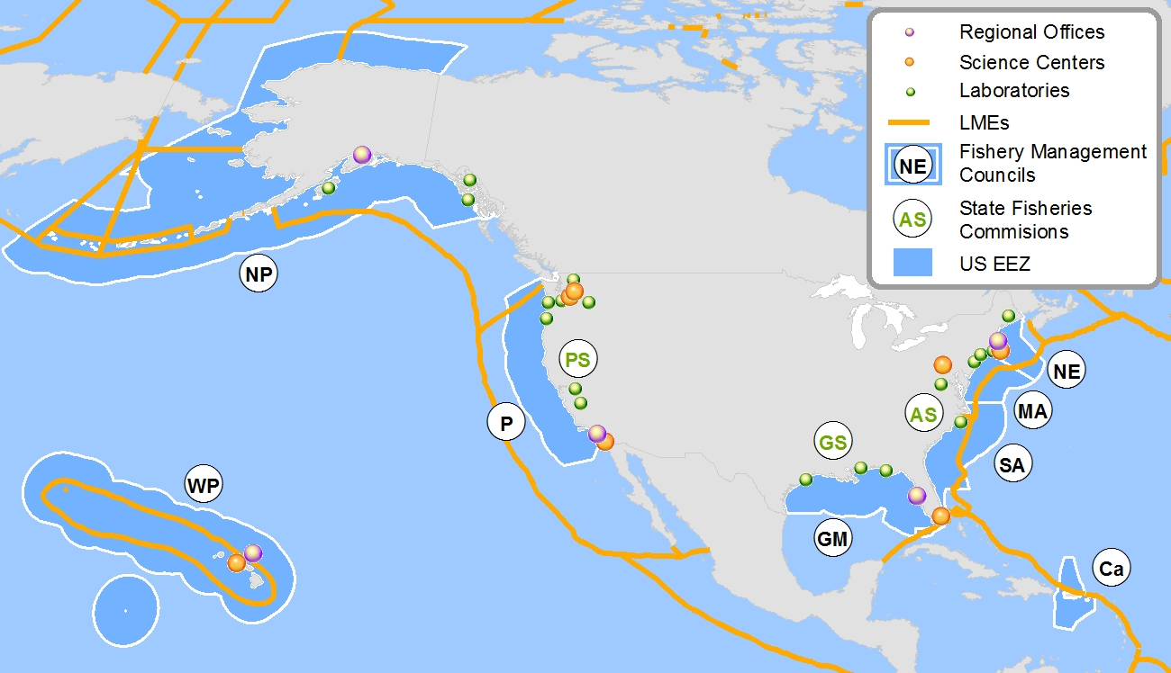
AkSRG
Territories
PaSRG
Antarctica
AtSRG
Notes:
Plus all the RFMOs
Other Territories, etc.
US EBFM Jurisdictions
8 FMCs
(Northeast, Mid Atlantic, South Atlantic, Caribbean, Gulf of Mexico, Pacific, North Pacific, West Pacific)
4 SMFCs – State Partners
(Atlantic, Pacific, Gulf, Great Lakes)
3 SRGs
(Pacific, Atlantic, Gulf, plus MMC)
150 Estuaries – Local & State Partners
(Major estuaries)
11 LMEs – International Partners
(Antarctic, Beaufort, Chukchi, Eastern Bering Sea [Aleutians], Gulf of Alaska, California Current, Insular Pacific/Hawaiian, Gulf of Mexico, SEUS, NEUS, Caribbean)
7 main RFMO/RMOs – International Partners
(CCAMLR, CCAS, IPHC, IWC, ICCAT, NASCO, NAFO, WECAFC, ITTAC, PSC, NPAFC, WCPFC, AIDCP, IOTC, IOSEA, IAC, ACAP, CBD, CITES, UNFSA, COFI; quota setting bodies emboldened)
8 IEA Regions
(California Current, Pacific Islands-Kona, Alaska Complex, Gulf of Mexico, NE Shelf, Southeast Shelf, Caribbean, Great Lakes),

Slide 41
AKFSC
Ecosystem models by region
 | EBS | GOA | AI | ARCTIC
ROMS/NPZ | * | o |  | ?
Enhanced assessment | * | * | *
Food web | * | + | + | o
Multispecies statistical | * | ? | o
FEAST-spatial | +
Size Spectrum | o
Qualitative network | o | o
* Annual or biennial part of assessment, requested or required by Council.
+ Up-to-date for providing issue-specific advice.
O Under active development.
? Proposed.

Slide 42
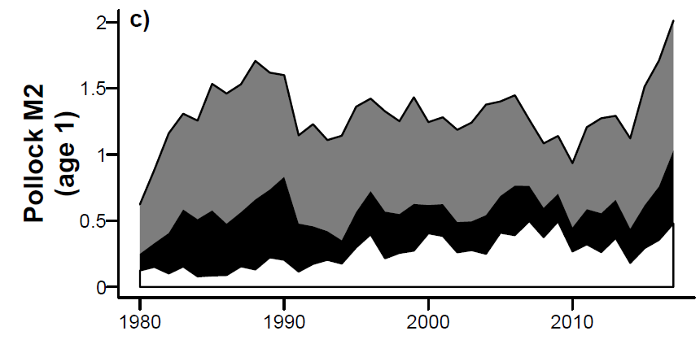
SSC Comments – December 2016
“There are several reasons that justify taking a precautionary approach when setting the ABC […] Our current understanding of pollock early life dynamics suggests that recent survival from age-0 to age-1 may be low due to low availability of suitable prey. Combined with increased predation, as suggested by the multi-species model CEATTLE and other evidence, strength of the 2015 and 2016 year classes is expected to be lower than average.”

Slide 43
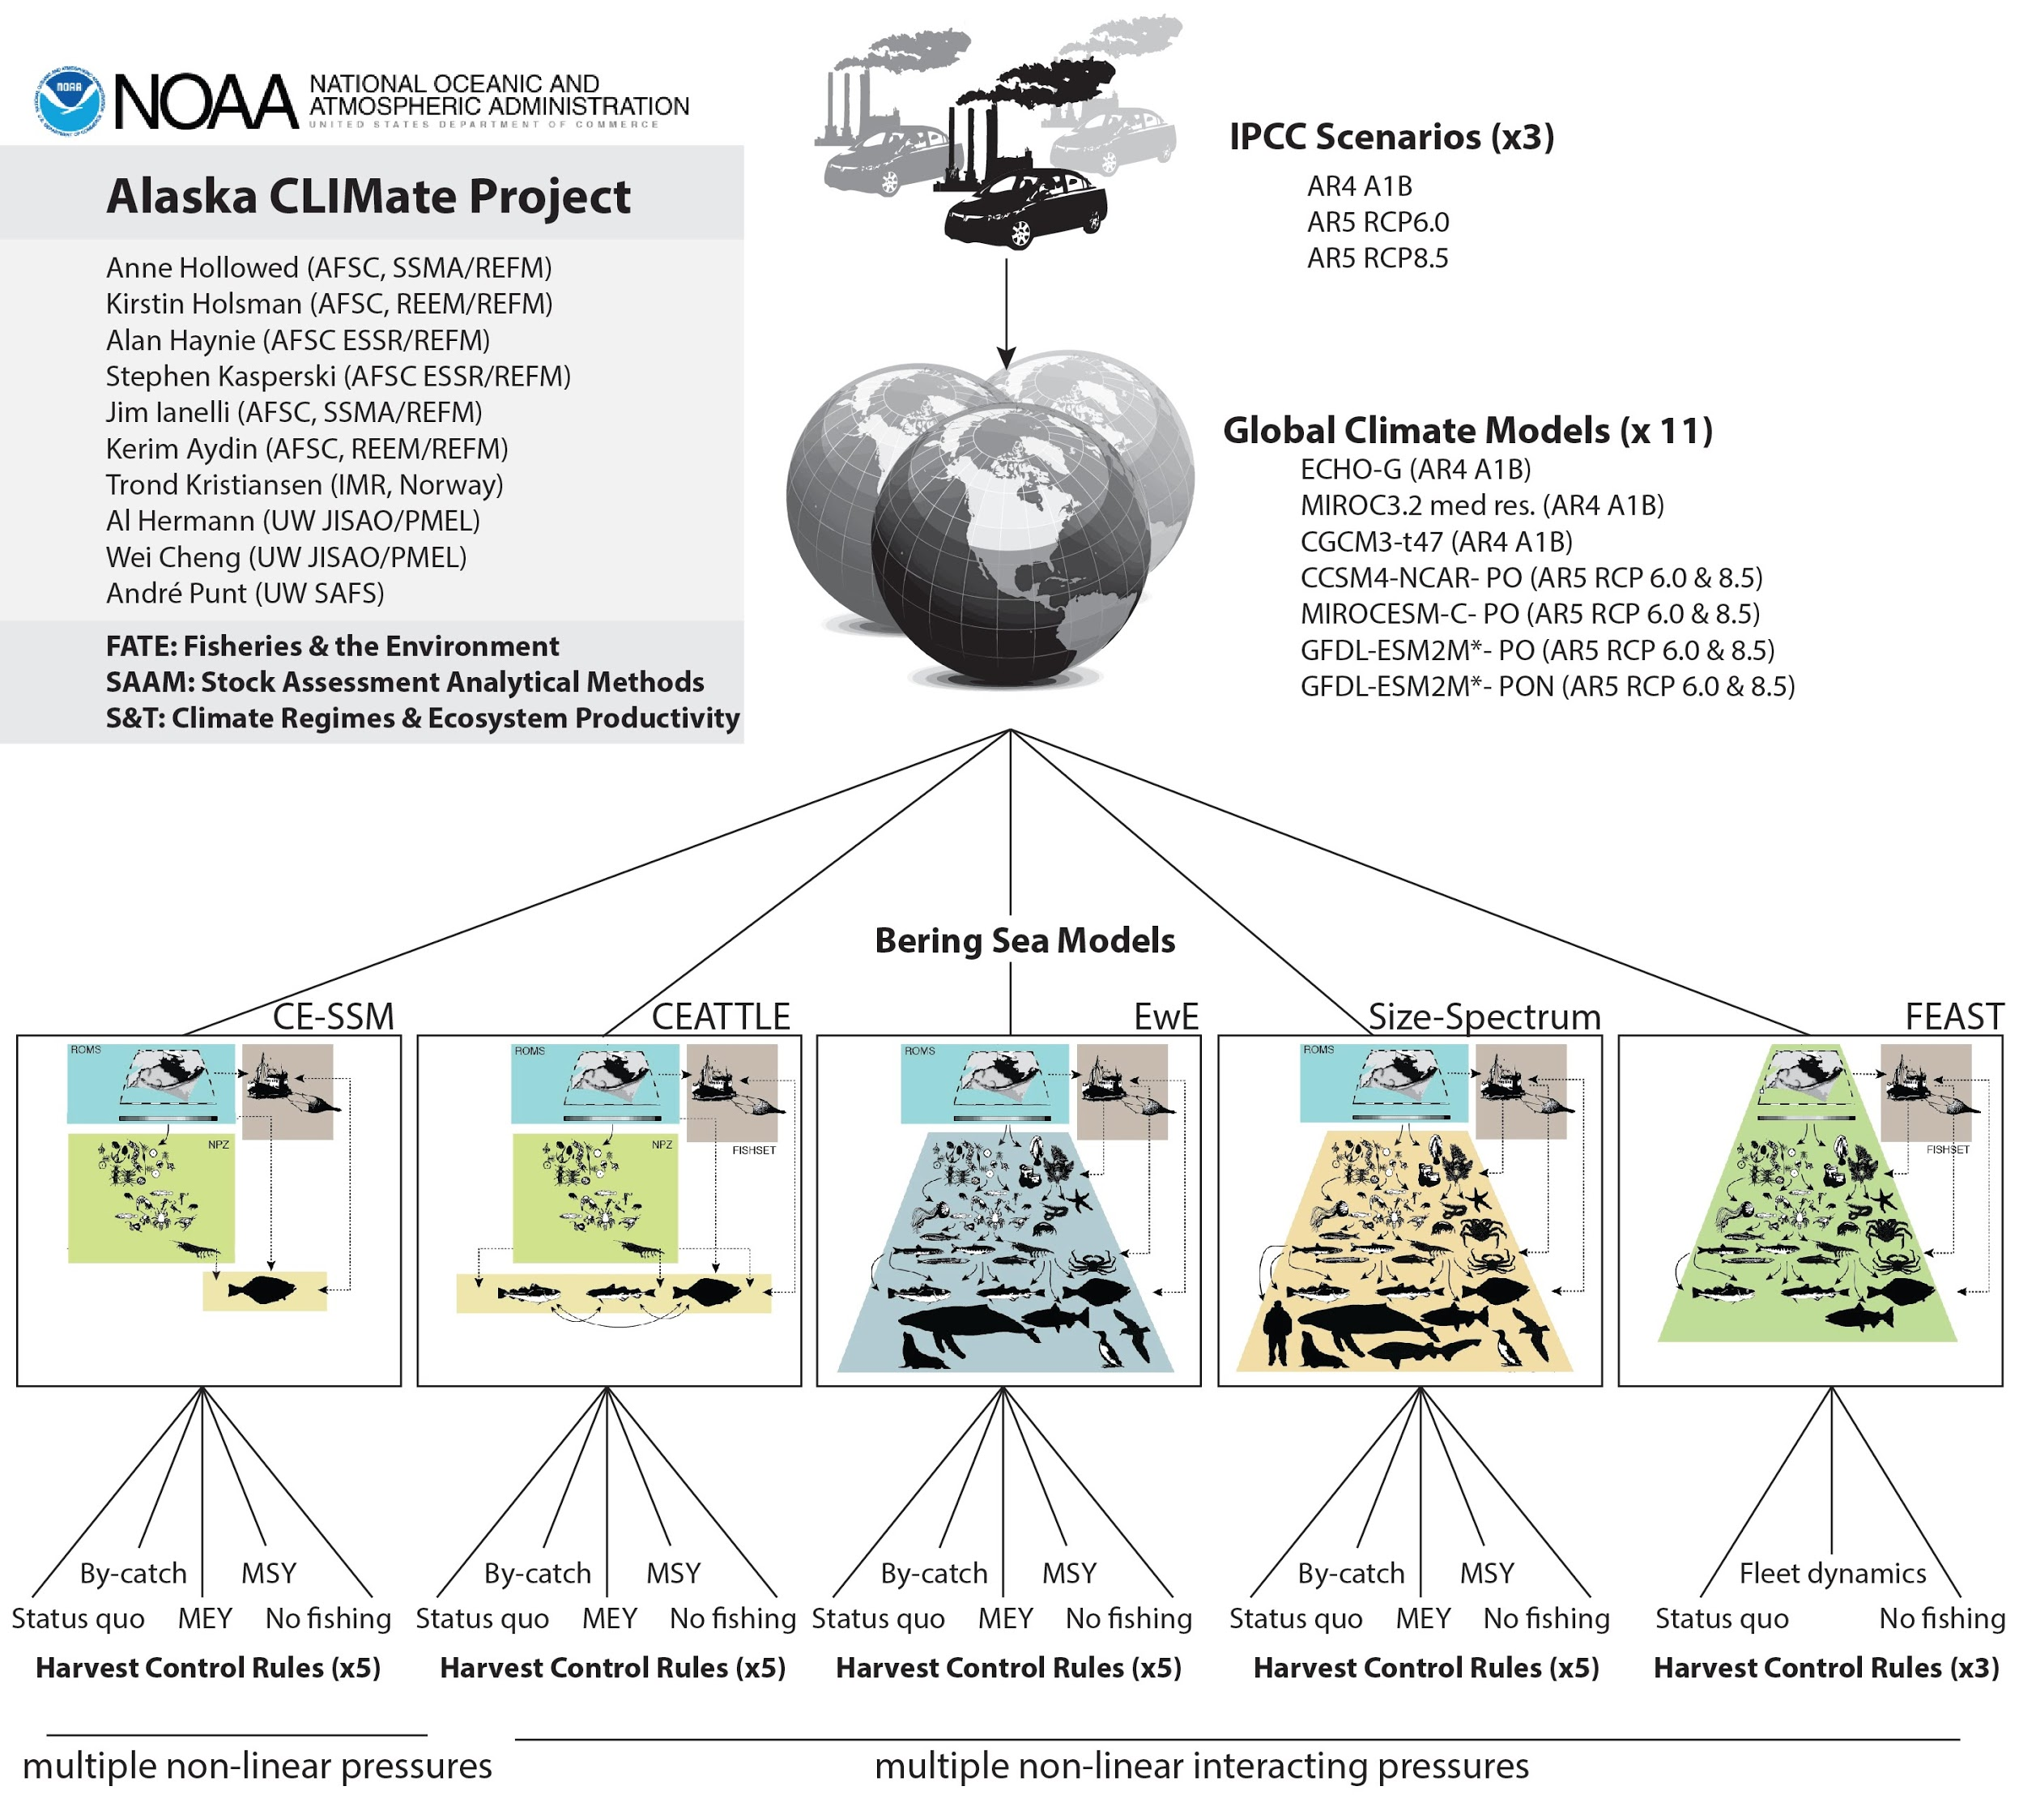



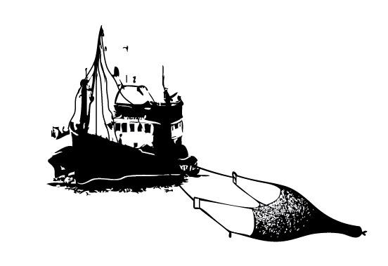
Future
Climate Scenarios
Climate-enhanced
Biological Models
Fishing Scenarios
Notes:
Finally, this fall we are using some of our most sophisticated scientific tools to conduct a collaborative study to evaluate climate change impacts on AK fisheries. We formed a cross agency research team with university partnership –
This is essentially a simulated stress test for our fisheries management, to ensure our that what we have in-hand is climate ready and to develop management tools that will allow us to adapt to climate-driven changes in AK.
Funded by
Fisheries and the Environment (FATE)
Stock Assessment Analytical Methods (SAAM)
S&T: Climate Regimes and Ecosystem Productivity

Slide 44
NEFSC: Multispecies/Ecosystem Models
Model name | Reference | Development
MS-PROD | Gamble and Link 2009, Gaichas et al. 2012 | Published
Kraken | Gamble et al. In Prep, based on Gamble and Link 2009 | Ongoing, Performance testing initiated
MS Delay Difference | In prep | Ongoing, Performance testing initiated
MS Statistical Catch-at-age | Curti et al. 2013 | Published
MSVPA-X | Tyrell et al. 2008, Garrison et al. 2010 | Published
Qualitative Network Model | DePiper et al accepted | Ongoing
EMAX | Link et al. 2006, 2007, 2008, 2009 | Published
Rpath | Lucey et al. In Prep | Ongoing, Parameterizing GB
Hydra | Gaichas et al 2016, based on Hall et al. 2006 | Ongoing
Atlantis | Link et al. 2010, 2011 | V1.0 published, v1.5 in development

Slide 45
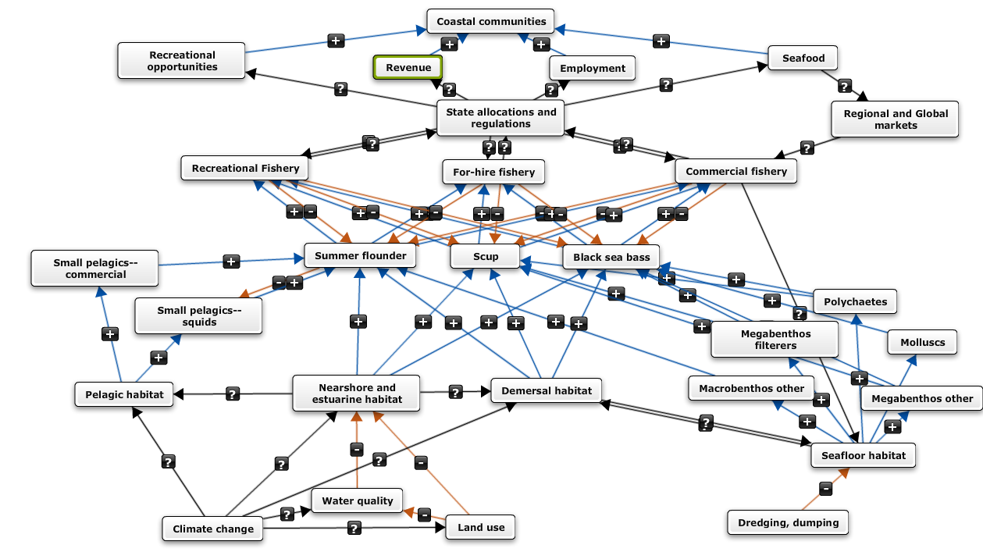
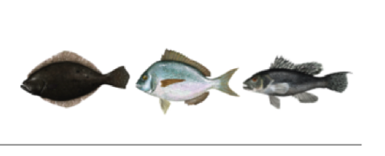
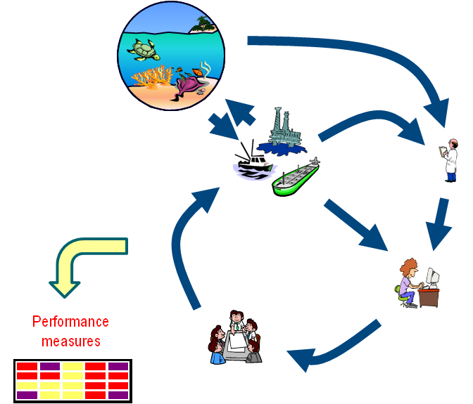
Council/stakeholder process
Specifies MSE objectives,
Performance measures,
Range of strategies
Scientists
develop tools
Council Decision Support:
Tradeoffs between objectives
Potential management strategy performance considering
  key interactions
  risks
  uncertainties
Notes:
"What management structure provides the flexibility necessary to absorb the impacts of climate change?”
Use experimental economics to understand the magnitude of both the intended and unintended consequences of management decisions
Use participatory modeling and management strategy evaluation with the Council and stakeholders inform potential outcomes of alternatives during the design of alternatives
"What management structure provides the flexibility necessary to absorb the impacts of climate change?”
Were the intended and unintended consequences of management decisions predicted accurately?
Are performance measures for the management strategy met? If not, why not?
Make better use of real-time observing systems for climate, habitat, and cooperative research

Slide 46
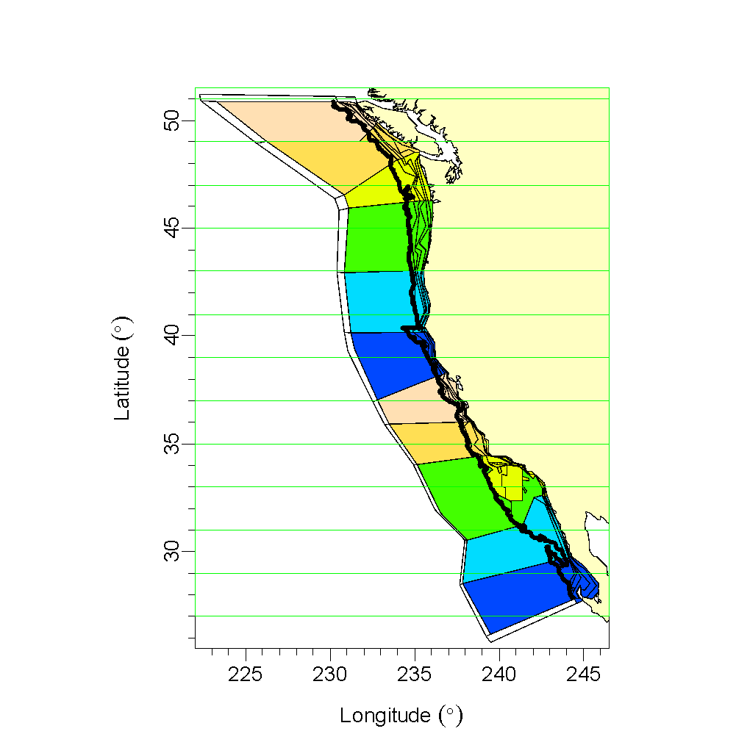
NWFSC: Multi-model approach: MICE, Atlantis, and Ecopath
A Multi-Model approach
MICE 13
MICE 12
Atlantis 1-6
MICE 11
Atlantis 7-12
MICE bins are divisions from 27-53N at 2 degrees of latitude.
MICE 10
Atlantis 13-18
MICE 9
Atlantis 19-24
MICE 8
Atlantis 25-30
MICE 7
Atlantis 31-36
Atlantis polygons are assigned to MICE latitudinal bins.
MICE 6
Atlantis 37-42
MICE 5
Atlantis 43-48
MICE 4
Atlantis 49-56,58,59
EcoPath domain:
2000 m isobath
MICE 3
Atlantis 57,60,61
MICE 2
Atlantis 62-67
MICE 1
Atlantis 68-75

Slide 47
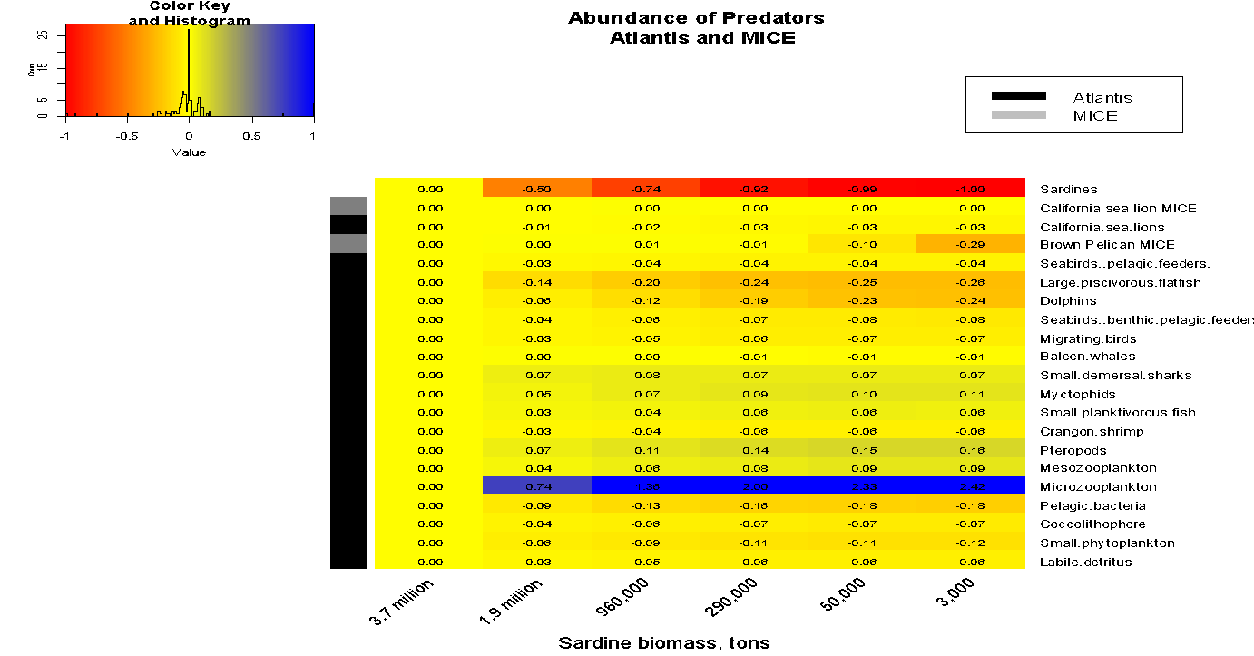
Models predict impacts on brown pelican; lesser impacts on sea lions; model structure dictates strength of response
A
Notes:
Auklets, murres, pelicans= pelagic feeders
Cormorancant and gulls -= benthic and pelagic fieeder
Migrating birds are shearwaters
TITLE: “How do predators respond to sardine abundance ?”
FVO
Migrating birds
1604
Black footed/Laysan albatross
227
0.14
black-legged kittiwake
38
0.02
Sooty shearwater and pinkfooted shearwatters (All Shearwaters)
1098
0.68
Northern fulmar
73
0.05
Phalaropes
67
0.04
Black-vented shearwater
65
0.04
Black storm petrel
36
0.02
SB
Seabirds (pelagic feeders)
1600
Cassin's auklet
226
0.14
Common murre
988
0.62
Rhinoceros auklet
51
0.03
Tufted puffin
29
0.02
Marbeled Murrelet
8
0.01
Caspian tern
28
0.02
Brown pelican
89
0.06
Leach's storm petrel
180
0.11
SP
Seabirds (benthic and pelagic feeders)
729
Pigeon guillemot
29
0.04
Brandt's cormorant
220
0.30
Pelagic cormorant
80
0.11
Double-crested cormorant
110
0.15
Western gull
291
0.40

Slide 48
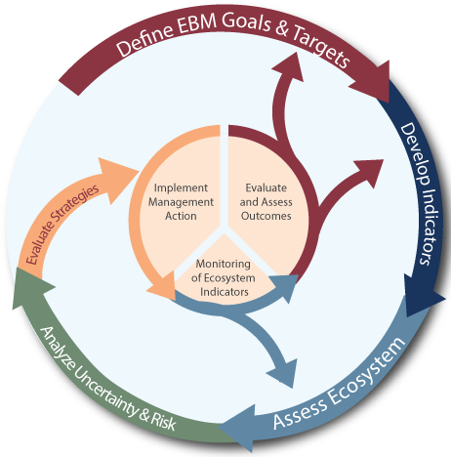
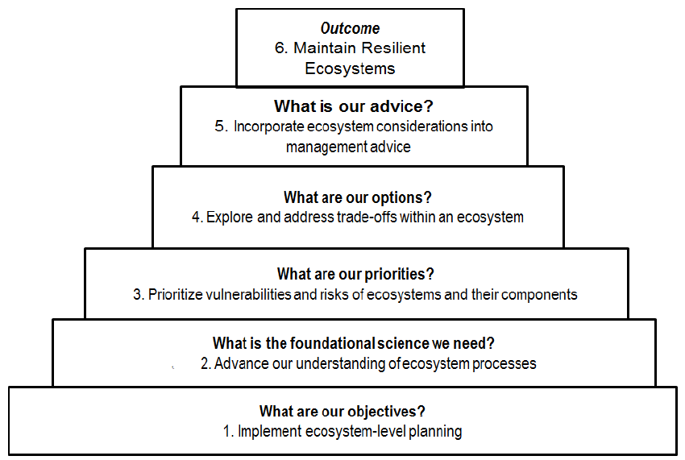
Using Ecosystem Models in EBM:
Aims at NWFSC
Ecosystem models can inform the IEA process (loop at upper right) and support NOAA EBFM efforts (pyramid at lower right) by:
    Synthesizing available data to help us understand and assess system dynamics
    Scenario tests of the risk of key species to top-down or bottom-up mediated stressors
    Scenario tests of the effectiveness and tradeoffs of management strategy alternatives
3
1
2
3
2
1

Slide 49
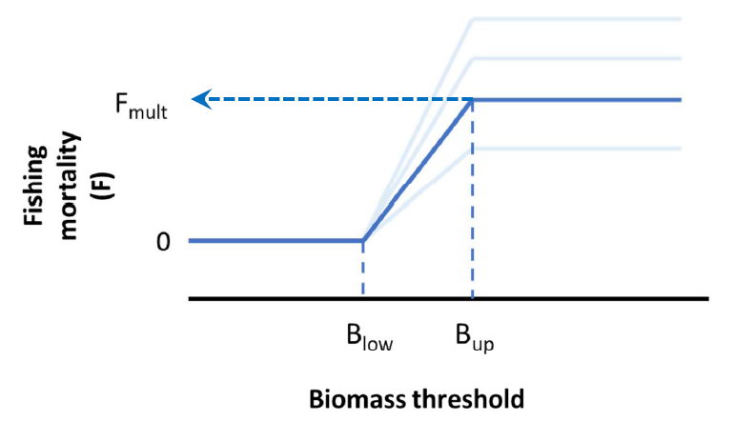
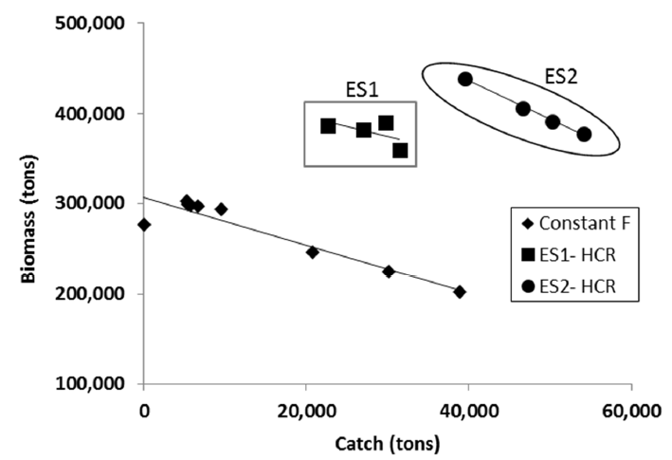
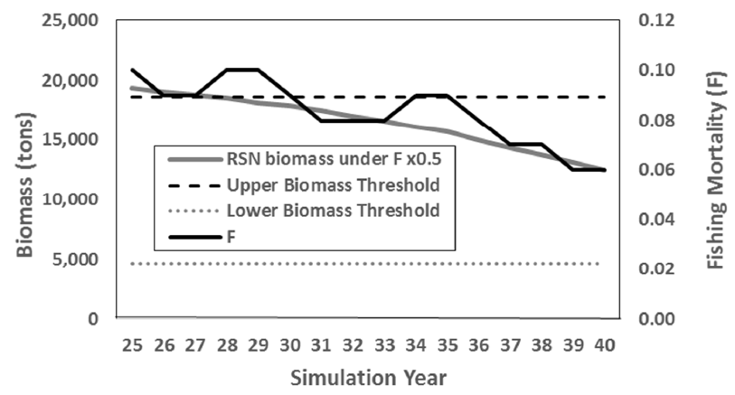
SEFSC/Gulf of Mexico MSE (Masi et al. in review)
Compared 2 point harvest control rule with constant F
Closed-loop management strategy evaluation
HCR more Pareto efficient tradeoff; higher biomass, catch & biodiversity
HCR
Pareto efficient alternative stable states
F responds to biomass
Masi, M., Ainsworth, C., Kaplan, I., Schirripa, M. Evaluation of robust single-species harvest control rules for managing reef fish in the Gulf of Mexico. Mar. Coast. Fish. (in review)

Slide 50
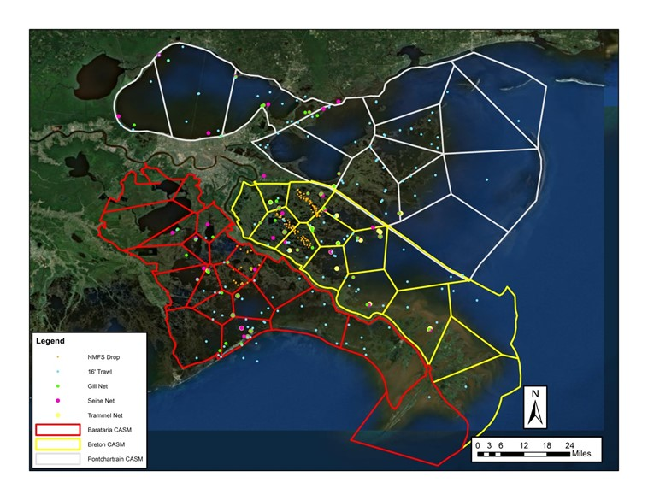
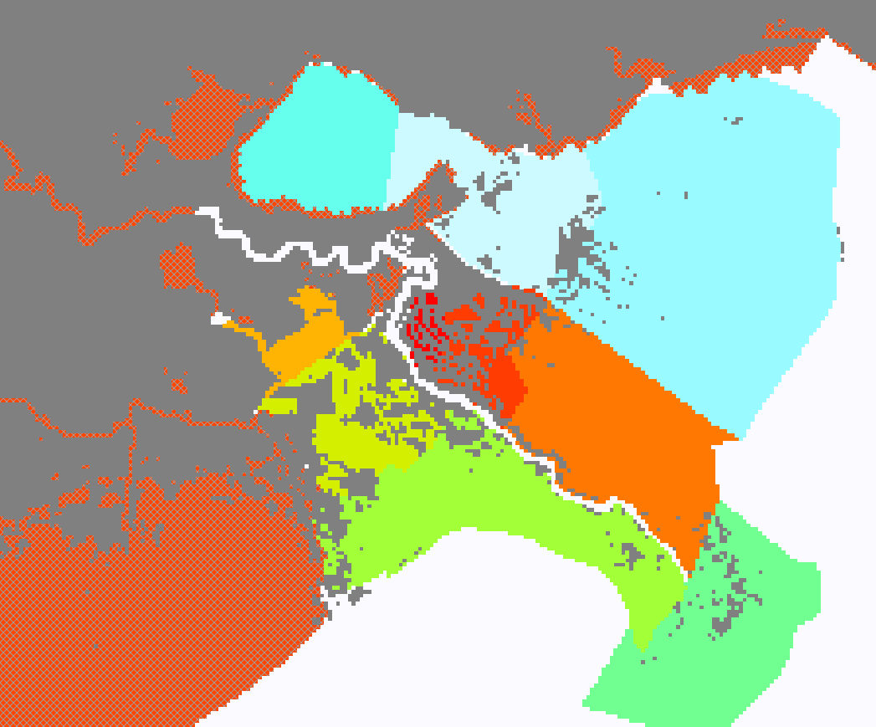
Coastal Louisiana Restoration – Multiple Ecosystem Models
Ecopath with Ecosim (EwE)/Ecospace
Complex Aquatic System Model (CASM)
Source: Sable – Dynamic Solutins, LLC ; de Mutsert - GMU

Slide 51
Where we’ve been
S&T and Science Center Efforts to Apply EM

Slide 52
Where we’ve been
S&T and Science Center Efforts to Apply EM

Slide 53
Where we’re going with Ecosystem Modeling
MSEs
Quantitative tradeoff evaluations
ELRPs
Standardized tools, more operational use
c.f. EBFM Road Map

Slide 54
Strengths
Strong
ecosystem modeling programs
at some
Centers
NEMoW:
History of collaborative
and collegial interactions
across Centers
Clear
direction
and goals
in the
EBFM
Road Map

Slide 55
Broad Challenges and Possible Solutions
Challenges | Possible Solutions
Not all Centers have dedicated EM staff or Models in place to meet LMR management needs | Staff; S&T EM coordinator collaborations; coordination with existing programs
Few Councils and Regional Management Bodies have used EM for decision-making | Focused effort on developing ecosystem-level reference points; Development of FEPs; NEMoW to swap ideas on application & operational EMs to address LMR issues
Lack of standard peer-review process for EM | Development of EM Toolbox and review guidelines for tool

Slide 56
SA EwE Model is proceeding well
Larger holistic ecosystem model, like EwE, can be useful for organizing the big picture of the ecosystem, answer heuristic and strategic questions, and "hanging" new data and research on
  other more specific models may be more useful for specific tactical questions (Ecosystem Modeling Workgroup)
Modeling for EBFM should be a guided by an iterative, two-way flow – often includes ecosystem “stuff” besides models (e.g., Ecosystem Status Reports)

Slide 57
As the SA EM efforts moves forward…
NMFS can help with
  Support from NMFS Ecosystem Modeling Coordinator
  Draw on expertise from NMFS Science Centers
  Assistance with EM model review
  Other items in the EBFM Road Map

