Slide 1


SAFMC Citizen Science Program: Update
Amber Von Harten,
Citizen Science Program Manager
October 2017
Information & Education Advisory Panel Meeting
Notes:
Title slide

Slide 2
Program Initiation
Jan-Mar 2016
Feb-Jul 2016
Cit Sci Workshop & Blueprint
Program Manager starts
Jan 2017
Council supports FTE position
Dec 2016
Council Cit Sci Committee formed
Sept 2016
Promotion/ feedback on efforts
Focus for 2017
Build initial program infrastructure
Citizen Science Advisory Panel Pool
Topical Action Teams
Partnership Development
Program and project-level funding opportunities
Pilot Project
Seeking support for a citizen science program pilot project idea

Slide 3
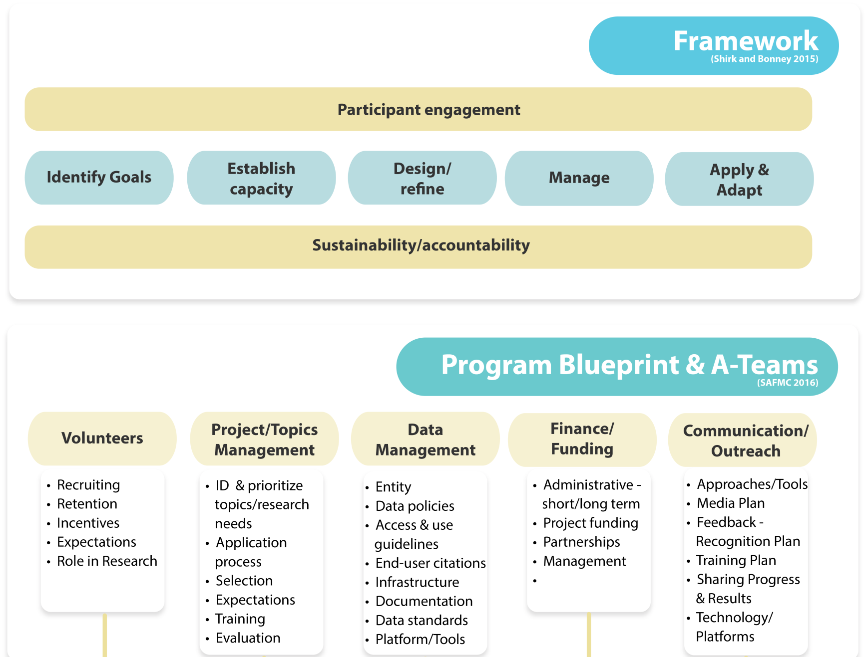
Program Development

Slide 4
SAFMC Citizen Science Program –
Citizen Science Advisory Panel Pool
Cit Sci AP Pool
Operates similarly to the SEDAR Pool (pool of individuals to serve on specific teams)
Existing AP members, workshop participants, and others considered for pool
Action Teams
Members appointed, as needed
Volunteers, Data Management, Project/Topics Management, Funding, Communication/Outreach/Education
ROLE: Use task list to develop recommendations for program operating policies

Slide 5
Action Team –
Volunteers
FOCUS:
How to work with volunteers on citizen science projects
Volunteers
Recruiting/Retention
Training
Incentives
Role in project ID & research needs
Expectations
A-Team Members
Trip Aukeman | Coastal Conservation Association
Courtland Babcock III | Fisherman
William Gorham | Fisherman/Mackerel Cobia AP member
Frank Helies | NOAA SERO
Shelly Krueger | FL Sea Grant
Robert Lorenz | Fisherman/Snapper Grouper AP member
Sara Mirabilio | NC Sea Grant
Michelle Ryan | Stakeholder
Dave Snyder | Fisherman/Snapper Grouper AP member
Mimi Stafford | Fisherman/Spiny Lobster AP member

Slide 6
Action Team –
Data Management
FOCUS:
How to effectively manage citizen science data and create data standards and policies
Data Management
Managing entity
Data Life Cycle
Data Policies
Access
End-user citations
Validation
Use guidelines
Infrastructure
Electronic tools
Data documentation
Applicable data standards
Platforms for data
Presentation & marketing
A-Team Members
Luiz Barbieri | FL Fish & Wildlife Conservation Commission/ SAFMC SSC member
Michael Burton | NOAA SEFSC Beaufort lab
Brett Fitzgerald | Snook & Gamefish Foundation
Rusty Hudson | Fisherman/Snapper Grouper AP member
James Morley | Researcher
Joe Myers | ACCSP
Greg Peralta | Fisherman/Mackerel Cobia AP member
Tracey Smart | SC Department of Natural Resources
Scott Smith | NC Division of Marine Fisheries

Slide 7
Action Team–
Projects/Topics Management
FOCUS:
How to select citizen science topics for the program and ways to develop, solicit, and manage citizen science projects under the program
Projects-Topics Management
ID topics/research needs
Application process
Approving/endorsing projects:
Prioritization of needs
Selecting projects for support, endorsement
Soliciting ideas
Outlining project expectations
Training for science methods in citizen science
Evaluation of projects
A-Team Members
Scott Baker | NC Sea Grant
Walter Bubley | SC Department of Natural Resources
Robert Crimian | The Nature Conservancy
Jimmy Hull | Fisherman/Snapper Grouper AP member
Ira Laks | Fisherman/Cobia Mackerel AP Chair
Richard Merrick | Scientist Emeritus, NE Fisheries Science Center
Trish Murphey | NC Division of Marine Fisheries
Paul Rudershausen | Researcher
Beverly Sauls | FL Fish & Wildlife Conservation Commission
George Sedberry | NOAA National Marine Sanctuary
Erik Williams | SEFSC-Beaufort Lab

Slide 8
Action Teams–
Finance & Infrastructure
FINANCE
FOCUS:
How to identify and pursue resources and funding to support the program and citizen science projects
Administrative funding
Project funding
A-Team Members
Leda Cunningham | The Pew Charitable Trust
Kathy Knowlton | GA Department of Natural Resources
Laura Leach | Atlantic Coast Cooperative Statistics Program

Slide 9
Action Teams–
Communication/Outreach/Education
Communication-Outreach-Education
FOCUS:
How to provide outreach, training, and communication about the program and projects under the program
Approaches & Tools
Media Plan
Feedback-Recognition Plan
Training Plan
Newsletters/Reports:
Technology Platforms
A-Team Members
Holly Abeels | FL Sea Grant
Bruce Buckson | SAFMC Law Enforcement Advisory Panel member
Lora Clarke | Pew Charitable Trusts
Bryan Fluech | UGA Marine Extension/ Sea Grant
William Heyman | Researcher/ LGL Ecological Associates
Ryan Jiorle | Virginia Marine Resources Commission
Chris McHan | Gulf of Maine Research Institute/ Marine Resource Education Program
Laura Oremland | NOAA
Tom Roller | Fisherman & Mackerel Cobia AP member

Slide 10
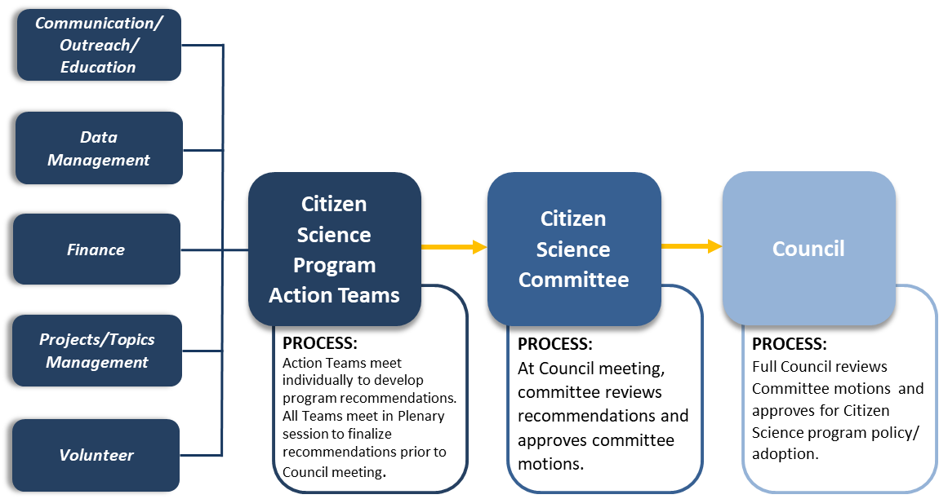
Action Team Work Flow Process

Slide 11
Action Teams–
Anticipated Timeline & Deliverables
Timeline | Deliverable
Aug 2017 | Action Team meetings; appoint chairs; TORs; work plan
Sept 2017 | Action Team meetings; work on TORs
Oct 2017 | Action Team meetings; work on TORs; draft initial recommendations
Nov 2017 | Plenary Action Team meeting; finalize recommendations
Dec 2017 | Citizen Science Committee reviews recommendations
2018 | Continue work on TORs

Slide 12
Stay Tuned!
Action Teams
Monthly webinar meetings; open to public
First recommendations to Council in December 2017
Join us on an A-Team!
Pilot Project
Coming Soon!
Partnership Opportunities
Contact us!

Slide 13
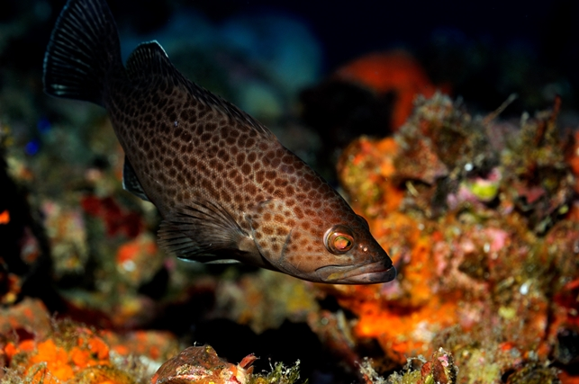
For more information:
http://www.safmc.net/citizen-science-initiative
Contact
Amber Von Harten,
amber.vonharten@safmc.net / 843.302.8443
Photo credit: Don DeMaria
Notes:
ADD our contact info

