Slide 1
Amendment 5 to the 2006 Consolidated Atlantic Highly Migratory Species Fishery Management Plan: Issues and Options
Highly Migratory Species
Management Division
NMFS/NOAA
October 2011

Slide 2
Overview
Need for Action
Recent Shark Stock Assessments
Scalloped Hammerhead
Dusky
Sandbar
Blacknose
Possible Management Alternatives
Request for Comments

Slide 3
Need for Action
New/updated stock assessments for scalloped hammerhead, dusky, sandbar, and blacknose sharks (76 FR 62331) indicate management measures are necessary to end overfishing and rebuild these stocks
New management measures must be implemented by April 28, 2013 (2 years from the overfished/overfishing declaration for scalloped hammerhead sharks)

Slide 4
Stock Status
Shark Species | Overfished | Overfishing
Scalloped Hammerhead | Yes* | Yes*
Dusky | Yes | Yes
Sandbar | Yes | No⁺
Blacknose: South Atlantic | Yes* | Yes*
Blacknose: Gulf of Mexico | Unknown* | Unknown*
*New stock status
+Improved stock status from previous assessment

Slide 5
Scalloped Hammerhead Shark
2011 Determination: Overfished; Overfishing occurring
Scalloped hammerhead sharks determined to be overfished (45% of B_{MSY}) with overfishing occurring (129% of FMSY) by NMFS on April 28, 2011 (76 FR 23794)
Determination based on Hayes et al., 2009
Stock is estimated to be 17% of virgin stock size
An annual TAC of 2,853 sharks is estimated to allow a 70% probability to rebuild the stock in 10 years
20% mortality reduction from 2009 commercial landings, recreational landings, and dead discards

Slide 6
Dusky Shark
2011 Final SEDAR stock assessment: Overfished; Overfishing occurring
Dusky sharks continue to be overfished (44% of B_{MSY}) with overfishing occurring (159% of F_{MSY})
Results based on 2010/2011 Final SEDAR assessment; previous assessment conducted in 2006
An estimated fishing mortality rate of 0.02 may provide a 70% chance of rebuilding by 2099 (F₂₀₀₉=0.06); previous assessment estimated rebuilding by 2400
2/3 reduction in fishing mortality relative to 2009
Current fishing mortality is estimated to have a low probability (11%) of rebuilding the stock by 2408
TAC ≤ 9.1 mt dw

Slide 7
Sandbar Shark
2011 Final SEDAR stock assessment:
Overfished; Overfishing not occurring
Sandbar sharks continue to be overfished (65% of B_{MSY})
Overfishing is no longer occurring (62% of F_{MSY})
Results based on 2010/2011 Final SEDAR stock assessment; update of 2005/2006 SEDAR 11 assessment
Year_{rebuild} improved from the previous assessment from 2070 to 2066, but stock is slightly more overfished ( 72% to 65% of B_{MSY})
There is a greater than 70% probability that the stock will rebuild by 2070 with a 2009 TAC (220 mt)

Slide 8
Atlantic Blacknose Shark
2011 Final SEDAR stock assessment: Overfished; Overfishing occurring
Atlantic blacknose sharks are overfished (60% of B_{MSY})
Overfishing is occurring (>500% of FMSY)
Results based on 2010/2011 Final SEDAR assessment, now assessed as two stocks (Atlantic and Gulf of Mexico); 2007 assessment assessed as one stock
An annual TAC of 7,300 sharks allows for a 70% probability to rebuild the stock by 2043
Current TAC is 19,200 sharks for the Atlantic and Gulf of Mexico combined. (current rebuilding estimated at 70% probability by 2027)
Notes:
8

Slide 9
Gulf of Mexico Blacknose Shark
2011 Final SEDAR stock assessment: Overfished Unknown; Overfishing Unknown
2010/2011 Final SEDAR assessed as two stocks (Atlantic and Gulf of Mexico), the previous assessment in 2007 assessed the stock as one population
In the final assessment the model was unable to fit trends in some abundance indices
Fundamental lack of fit of some of the input data to the model
Review Panel did not accept the stock assessment for Gulf of Mexico blacknose sharks, therefore stock status has been determined to be unknown
Current TAC is 19,200 sharks for the Atlantic and Gulf of Mexico combined. (current rebuilding estimated at 70% probability by 2027)
Notes:
9

Slide 10
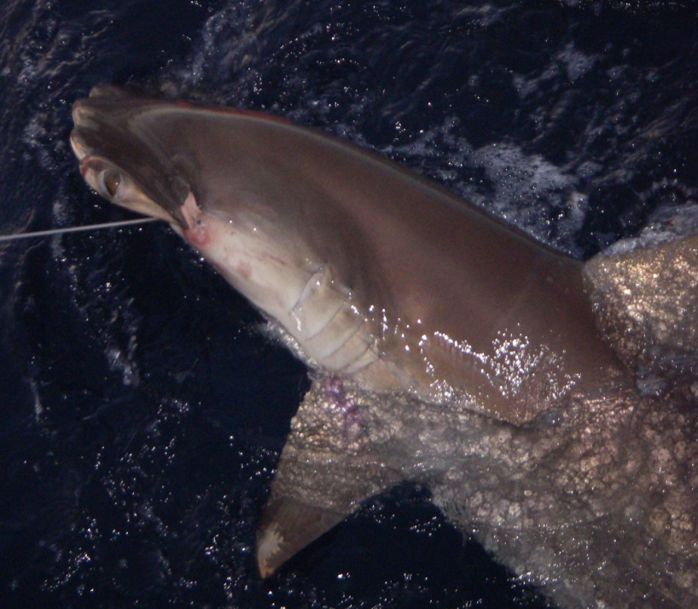
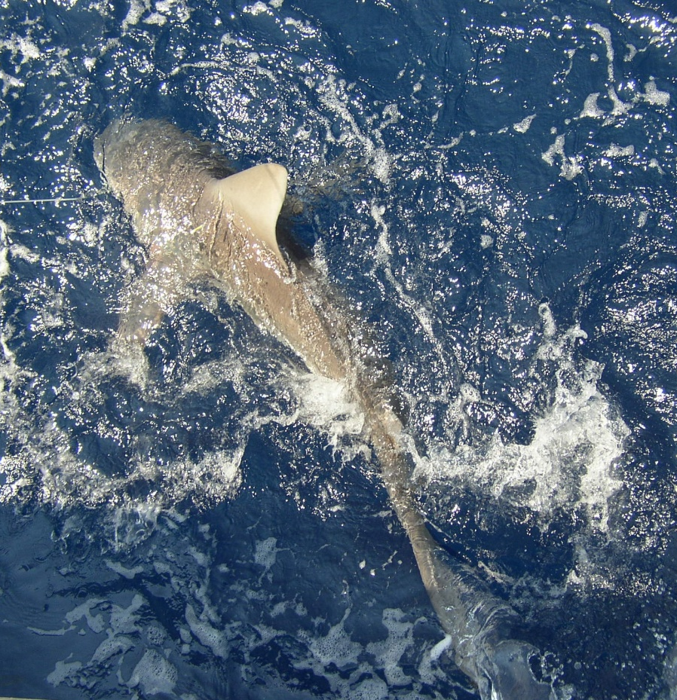
Possible Management Measures
Notes:
10

Slide 11
Scalloped Hammerhead Shark
Overfished; Overfishing occurring
Challenges:
Overfished with overfishing occurring, yet generally not directly targeted in commercial shark fisheries
Extremely high at-vessel mortality level in the bottom longline shark fishery (>90%).
Recreational landings estimates of scalloped hammerheads averaged ~1,000 sharks per year from 2006-2009
At-vessel mortality rate in the shark gillnet fishery is estimated to be ~75%
Retention in ICCAT fisheries (com and rec) is now prohibited (Sept. 28, 2011)
Notes:
11

Slide 12
Scalloped Hammerhead Shark
Overfished; Overfishing occurring
Potential Measures:
Development of a TAC and ACL for scalloped hammerhead sharks, and creating appropriate quotas
Gear restrictions (e.g., limits on BLL mainline length, number of hooks, soak time)
Time/area closures – commercial and/or recreational?
Gear tending requirements
Individual commercial quota for scalloped hammerhead sharks – linked or not linked with non-sandbar LCS quota?
Bag/Trip limits for commercial and/or recreational fisheries
Gear technology (e.g., weak hooks, electropositive metals)
Retention prohibition
Add to research fishery priorities
Others?
Notes:
12

Slide 13
Dusky Shark
Overfished; Overfishing occurring
Challenges and Potential Measures:
Prohibited from commercial and recreational harvest, but F needs to be reduced by 2/3 to reach rebuilding goals
Prohibited species that is not targeted
Generally have a high at-vessel mortality rate (~75% on bottom longline gear; ~50% on pelagic longline gear)
Time/Area closures, gear and soak time restrictions, gear technology may be able to reduce F
Other suggestions?
Notes:
13

Slide 14
Sandbar Shark
Overfished; Overfishing not occurring
Challenges and Potential Measures:
Currently prohibited from recreational harvest; commercial harvest limited to the shark research fishery
Current TAC has >70% probability of rebuilding the stock by 2070
Need to take additional measures?
Notes:
14

Slide 15
Blacknose Shark
Atlantic: Overfished; Overfishing occurring
Gulf of Mexico: Overfished Unknown; Overfishing Unknown
Challenges and Potential Measures:
Final assessment has split the stocks
Two different stock status results to address
Options for TAC allocations under this scenario:
Consider regional allocations based on current TAC and recommended Atlantic blacknose TAC
Reconsider linking blacknose quota to SCS commercial quota
Reconsider recreational size/bag limits
Consider blacknose a priority in the research fishery
Notes:
15

Slide 16
Request for Comments
Please submit comments to:
http://www.regulations.gov
Keyword - “NOAA-NMFS-2011-0229”
Comments can also be submitted via fax:
301-713-1917, Attn: Peter Cooper
Or Mail:
NMFS SF1, 1315 East-West Highway, Silver Spring, MD 20910
Please identify comments with: “Scoping Comments on Amendment 5 to the HMS FMP” For more information go to: http://www.nmfs.noaa.gov/sfa/hms/FMP/AM5.htm

Slide 17
Scoping Meetings
Date | Time | Location | Address
October 11 | 7 - 9 p.m | Dolce Seaview Resort | 401 South New York Road, Galloway, NJ
October 26 | 5 - 7 p.m | Belle Chasse Auditorium | 8398 HWY. 23 Belle Chasse, LA
November 2 | 4:30 - 6:30 p.m | SEFSC Panama City Laboratory | 3500 Delwood Beach Drive, Panama City, FL
November 3 | 4:30 - 6:30 p.m | Fort Pierce Branch Library | 101 Melody Lane, Fort Pierce, FL
December 7 | 4:30 - 6:30 p.m | NCDMF Central District Office | 5285 HWY. 70 West/Arendell Street, Morehead City, NC
December 15 | 2 - 4 p.m | Conference Call | Call: 888-989-7538; Passcode: 3994893

Slide 18
Amendment 5 Timeline
Comment period for scoping: Dec. 31, 2011
Predraft to AP: Early 2012
Proposed Rule and EIS: Mid-2012
Final EIS: Late 2012 / Early 2013
Final Rule: Early 2013

