Slide 1
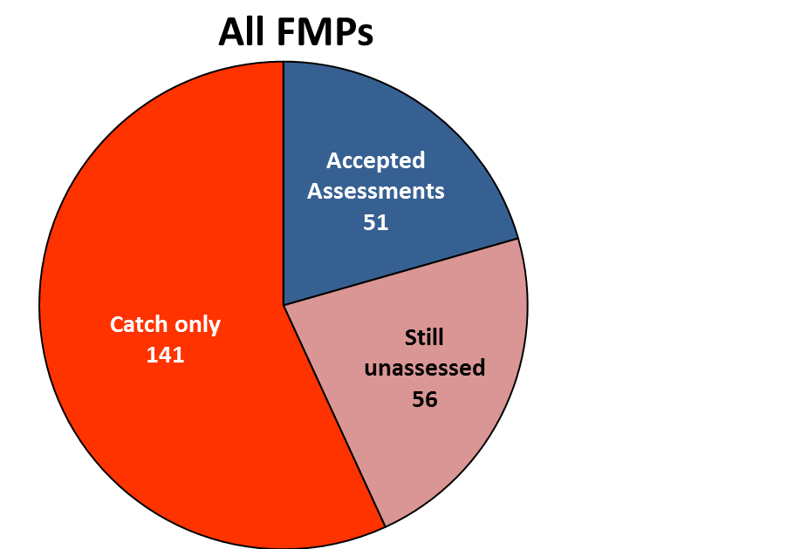
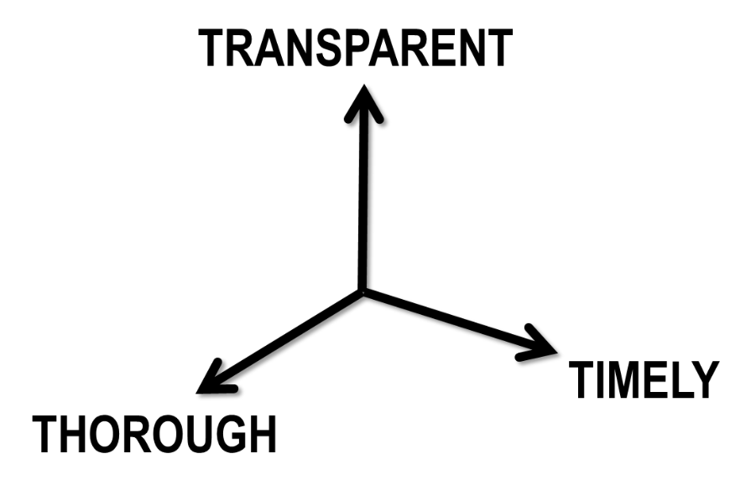
The problem: Balancing the three T’s
  Existing combination of benchmark, standard and update assessments is very transparent, reasonably thorough, but too slow for the demand

Slide 2
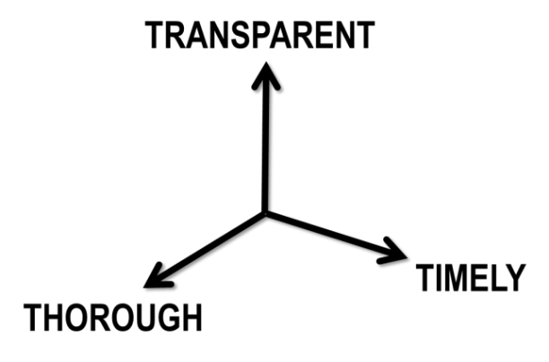
Balancing the three T’s
  Potential assessment leads: 20 people
  Stocks that can be assessed: 107
  Assessment rate in current processes: 1 pyr⁻¹
  Average time between assessments: 5.3 years

Slide 3
Existing process
  Benchmark
  Intended to complete a thorough evaluation that accommodates the input of stakeholders and reviewers while under strict deadlines for providing management advice
  Standard
  Address specific concerns (expressed in the TORS) without deviating too much from previous benchmark
  Update
  Deviates as little as possible from previous benchmark

Slide 4
Existing process
  Benchmark
  Intended to complete a thorough evaluation that accommodates the input of stakeholders and reviewers while under strict deadlines for providing management advice
  Standard
  Address specific concerns (expressed in the TORS) without deviating too much from previous benchmark
  Update
  Deviates as little as possible from previous benchmark
Data providers have difficulty meeting deadlines because key decisions made along the way can change what is required
Results often criticized by reviewers, but there is little time to address their concerns
Deadlines are pushed and often missed
Word “benchmark” implies “best” to many when in fact it is the first time some components have been examined and implemented

Slide 5
Existing process
  Benchmark
  Intended to complete a thorough evaluation that accommodates the input of stakeholders and reviewers while under strict deadlines for providing management advice
  Standard
  Address specific concerns (expressed in the TORS) without deviating too much from previous benchmark
  Update
  Deviates as little as possible from previous benchmark
Data providers have difficulty
Can’t address suggestions
Deadlines pushed or missed
Loaded language (Benchmark)
Reasonably fast, but sometimes criticized by stakeholders who think a “benchmark” is better
Fast, but often criticized by stakeholders who think a “benchmark” is better and would like more involvement.

Slide 6
Existing process Proposed
  Benchmark
  Intended to complete a thorough evaluation that accommodates the input of stakeholders and reviewers while under strict deadlines for providing management advice
  Standard
  Address specific concerns (expressed in the TORS) without deviating too much from previous benchmark
  Update
  Deviates as little as possible from previous benchmark
  Research Cycle
  Like a Benchmark, but not intended to produce assessment results for immediate advice to management. The goal is to build a robust tool that will be used to develop timely advice.
  Operational Assessment
  May follow existing Standard or Update Processes: Designated analysts apply the tool developed by the Research Assessment to the most recent data sets to produce timely management advice.

Slide 7
Research Cycle
  Test, document and review assessment approaches, incorporate new research findings, and evaluate new data streams,
  Conducted similar to current benchmark process with an assessment panel, IPT-style communication and 1-2 workshops
  Review panel meeting with independent external participants (e.g., CIE)
  Findings thoroughly documented as an assessment report, and possibly a NOAA Tech Memo or journal publication commensurate with the degree of novelty of the methods.
  Unresolved issues and ideas for future improvements reported to begin the next cycle of research.
  Not intended to produce assessment results for immediate advice to management, but once vetted, will be operationalized

Slide 8
Operational assessments
  Produce timely advice to management
  Conducted by designated analysts using a suite of previously reviewed procedures and data sets, in consultation with an advisory body comprised of scientists and stakeholders with local expertise
  Minor changes to previous approaches may be considered, if agreed to by the SSC as part of the TORs.
  Findings documented succinctly with an executive summary that makes fishery management advice clearly and quickly accessible
  Anomalies, concerns and research recommendations are documented and made available for future considerations

Slide 9
Advantages of new approach
  During research cycles
    Analysts can focus on more thoroughly addressing the major concerns of scientists and stakeholders without the conflicting pressure of finishing the assessment in time for management deadlines
    Suggestions from reviewers can be incorporated and used in the operational phase
    Data providers are not under pressure to provide the most recent data or repeatedly revise inputs
    More opportunities for scientific research that advance the state of the art
  During operational assessments
    Standardized, pre-approved approaches will be used such that
      Implementation errors will be reduced and throughput increased (analysts can focus on updating inputs, implementing only minor changes, and model diagnostics)
      Assessments will be more reproducible and require less advanced technical skills
      Data providers will be able to produce inputs more quickly and with minimal effort
    Emphasis will be placed on succinct communication of management advice in plain language (rather than the details of the assessment)

