Slide 1
Mr. Michael Cahall Director, ACCSP
Who We Are & What We Do:
Good Data, Good Decision
Notes:
The ACCSP is the Atlantic Coastal Cooperative Statistics Program.

Slide 2
OVERVIEW
History
Standards
Program Projects
SAFIS
Data Warehouse
Case Studies
Questions

Slide 3
HISTORY
Notes:
You can’t understand what we do now, without understanding where we came from

Slide 4
What is the ACCSP?
A cooperative state-federal program to design, implement, and conduct marine fisheries statistics data collection programs and to integrate those data into a single data management system that will meet the needs of fishery managers, scientists, and fishermen.

Slide 5
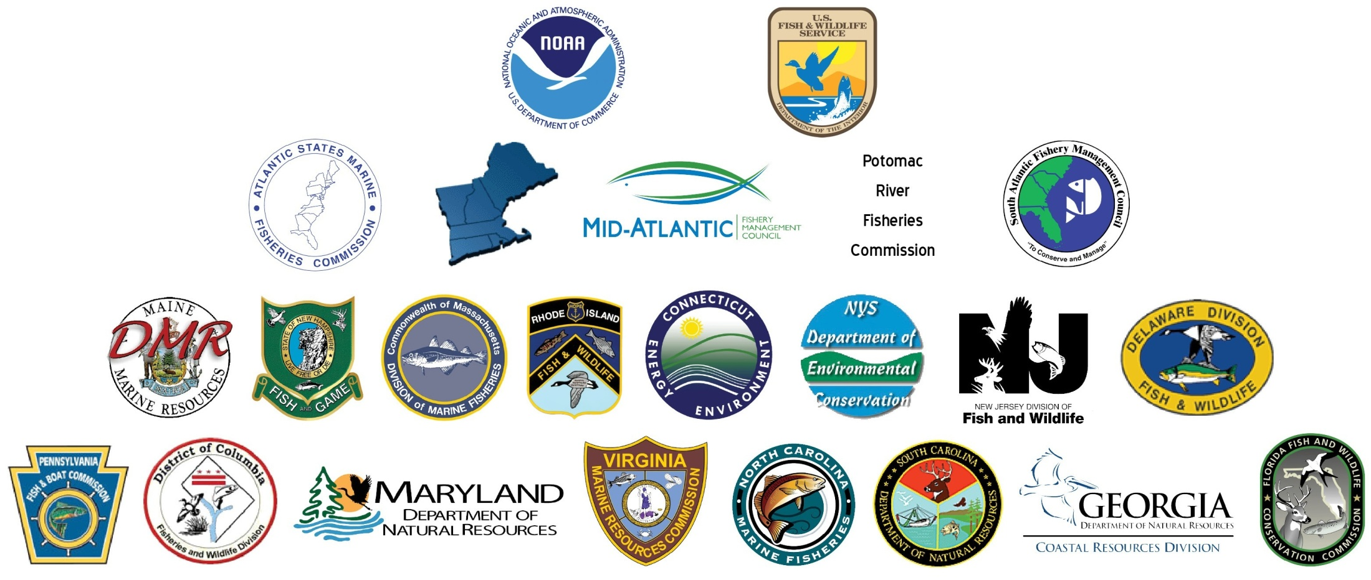
PROGRAM PARTNERS
Notes:
In 1995, the Atlantic States Marine Fisheries Commission, the three Atlantic fishery management councils, the 15 Atlantic states, the Potomac River Fisheries Commission, the D.C. Fisheries and Wildlife Division, NOAA Fisheries, and the U.S. Fish & Wildlife Service became the 23 program partners of the Atlantic Coastal Cooperative Statistics Program.
The Program’s 23 state and federal partner agencies had long recognized the need for complete, accurate, and timely fishery data.
Partners especially wanted standardized fishery-dependent data, those collected on commercial, for-hire, and recreational fishing activity. When they signed the MOU, it was not yet clear which partner would provide the ACCSP with administrative support. In the mid-to-late 1990s, funds from partner contributions from the ACFCMA provided for a single employee and some committee work to design the program. The Atlantic States Marine Fisheries Commission (ASMFC) volunteered to host the staff and conduct the required meeting planning. The other partners agreed that ASMFC was the ideal choice since it had the flexible infrastructure to support the program.

Slide 6
Vision
To be the principal source of fisheries dependent information on the Atlantic coast through the cooperation of all program partners in the collection and processing of common fisheries data, and dissemination of the information for purposes of fisheries science and management.

Slide 7
Mission
Produce dependable and timely marine fishery statistics for Atlantic coast fisheries that are collected, processed and disseminated according to common standards agreed upon by all program partners.

Slide 8
WHO WE ARE, WHAT WE DO
The Atlantic Coastal Cooperative Statistics Program (ACCSP) established four basic principles to ensure that fishery-dependent statistics are complete, accurate, consistent, and compatible:
1. Cooperative development and implementation across jurisdictional lines
2. Coastwide data collection standards and a single, integrated data management system
3. Data on all fishing activities (e.g., commercial, recreational, and for-hire fisheries)
4. Modular design for data collection and data management projects
Notes:
The ACCSP was established in 1995 through a Memorandum of Understanding (MOU) to address data deficiencies that constrained the management of fisheries along the Atlantic coast. These deficiencies included incompatibilities between state and federal data systems, a lack of standardized trip-level catch and effort reporting, a lack of universal permit and vessel registration data, and a general need for more and better data to support emerging fisheries management initiatives. The Program established four basic principles to ensure that fishery-dependent statistics are complete, accurate, consistent, and compatible:
1. Cooperative development and implementation across jurisdictional lines
2. Coastwide data collection standards and a single, integrated data management system
3. Data on all fishing activities (e.g., commercial, recreational, and for-hire fisheries)
4. Modular design for data collection and data management projects
What ACCSP is not:
1. ACCSP is NOT a state program!
2. NOAA Fisheries actively participates
3. ACCSP projects directly benefit NOAA Fisheries
SAFIS
Standardized data reporting
- Improved state data collection
- Relieve NMFS data burden

Slide 9
A DEVELOPING PROGRAM
1995: ACCSP officially began with funding from ACFCMA
1999: First set of data standards completed and first permanent staff hired
2002: First Director was hired and Data Warehouse is launched
2003: Standard Atlantic Fisheries Information System (SAFIS) is launched
Notes:
In the mid-to-late 1990s, after the Program officially began, funding from ACFCMA contributions supported the establishment of committees to develop the first edition of the program design. The committees also created minimum standards and operating procedures. These committees included a variety of technical committees, an advisory committee, a steering committee (named the Operations Committee), and a policy level committee (named the Coordinating Council). The minimum standards that the committees were instructed to develop were based on needs for fisheries stock assessments and management. The committees were also instructed to evaluate current practices, not necessarily preserve the status quo, and were asked to give little weight to possible cost implications. New minimum standards included the type and resolution of data that should be collected, minimum data elements with standard codes, improved timeliness of data submissions, and quality control and assurance practices.
By 1999, data collection standards were nearly complete, and partners submitted their first funding proposals for implementing program standards. An increase in funding allowed the program and partners to begin implementation. ASMFC hired permanent staff to coordinate data collection programs, continue the evolution of standards, and create and operate the Data Warehouse. Projects were also outlined for areas where standards needed additional research. As the ACCSP and its federal appropriations continued to grow and with increased outreach efforts, the public became more aware of it. The Coordinating Council wished to address public concerns regarding the integrity of data collected by the same entities using it for fisheries management. Separation of the ACCSP from regulatory bodies, to the extent practical, was seen to help address those perception problems.
In 2001, the program partners recognized the need for stronger leadership at the staff level. The Coordinating Council voted to hire a Director. The Director, under the guidance of the Coordinating Council, would be given executive authority to manage ongoing development and operation of the program’s standards and responsibility for day-to-day operations and staff oversight. Also in 2002, partners responded to fishing constituents’ growing demand for landings data. The ACCSP announced the opening of the online Data Warehouse, which provided users with data contributed by partners that had implemented catch and effort data standards. Public users were allowed access to non-confidential summary data
Several state partners still lacked the resources to implement the Program’s commercial data collection standards, and with only $3.5 million to be shared by all 23 partners, a more efficient and economical solution was needed. In response, the program partners and staff developed SAFIS, a real-time, web-based data entry system for all catch and effort landings. SAFIS meant program partners could collect data from fishing constituents without the associated printing, mailing, and data entry costs. It also broadened the Program’s scope would be broadened from a data storage entity to a data collection entity. While SAFIS allowed centralized data collection, those data were, and are, still collected under the authority of the associated program partners. Moreover, those partners check and approve their data before it is transferred, ensuring that the information found in the Data Warehouse are the best available data on the Atlantic coast (See page 24 for more on the Data Warehouse).
Beginning in 2007, the Program began working in cooperation with NOAA Fisheries to bring together commercial landings data from many program partners for inclusion in the annual publication Fisheries of the United States (FUS).

Slide 10
ATLANTIC COAST FISHERIES DATA COLLECTION STANDARDS
Notes:
This is the backbone of everything ACCSP does – data storage to data collection

Slide 11
Standards Creation
ACCSP and Gulf States worked together to create consistent standards
Program created in 1995
First set published in 1998
Revised in 2004
Revised again in 2012
Data elements and collection methods for all modules

Slide 12
Standards Scope
Catch and Effort
Dealer Reporting (includes Charter/Headboat)
Trip Reporting
Recreational Reporting
Biological
Dealer and Trip Reporting
At-Sea Observations
Recreational
Other
Confidentiality
Quality Control

Slide 13
Standards Scope
Protected Species Interactions and Bycatch
Dealer Reporting
Trip Reporting
Recreational Reporting
Social and Economic
Commercial
Recreational
Metatdata

Slide 14
A PROGRAM DESIGNED TO EXCEL
Approved May 2012, major updates of this third edition of the Program standards include a call for more timely data, specifically:
Changing the frequency of calculating catch and effort estimates within the recreational (private and rental boat and shore-based fisheries) and for-hire fisheries to a 1 month collection period versus the current 2 month collection period.
Accelerating data availability (data collection and processing prior to initial review) for the recreational and for-hire fisheries to 38 days (preferably 30 days) versus the current recommendation of 45 days.
Collecting biological data every 30 days versus the current 6 month cycle.
Notes:
In May 2012, the Program released the latest edition of the Atlantic Coast Fisheries Data Collection Standards. This document is considered the blueprint for ACCSP and will be used to direct partner data collection over the next several years. Mark Alexander (CT DEEP), Chair of the Coordinating Council, had this to say about the process "The Atlantic Coast Fisheries Data Collection Standards are significant because they’ve been compiled by all of the Atlantic coast federal, state, and regional fisheries agencies. This collaboration speaks to the comprehensive nature of the data collection standards. We hope that all data collectors will use this document as a guide to collect information that can be used to make sound and thorough fisheries management decisions."
Major updates of this third edition of the Program standards include a call for more timely data, specifically:
• Changing the frequency of calculating catch and effort estimates within the recreational (private and rental boat and shore-based fisheries) and for-hire fisheries to a 1 month collection period versus the current 2 month collection period.
• Accelerating data availability (data collection and processing prior to initial review) for the recreational and for-hire fisheries to 38 days (preferably 30 days) versus the current recommendation of 45 days.
• Collecting biological data every 30 days versus the current 6 month cycle.
The Atlantic Coast Fisheries Data Collection Standards can be found at www.accsp.org/programdocument.htm.

Slide 15
PROGRAM PROJECTS

Slide 16
Competitive Funding Process
Approximately $2M annually
Organized/prioritized by module: Catch/Effort, Biological, Protected Species & Bycatch, Social & Economic, Metadata
Objectives include: Expanding data collection, obtaining data, increasing sampling, and promoting compliance of fishermen and dealer reporting.

Slide 17
SAFIS

Slide 18
BENEFITS
Up-to-date information on species caught and their impact on fisheries and quotas
Confidential access to data-of-record by fishermen and dealers;
Access to state and federal reporting requirements through online data entry that eliminates duplicative reporting
Integrated highly migratory species reporting
Automatically generated pricing information
Flexibility in creating favorites (e.g., species, gears, fishermen, dealers, and disposition) so reporting is quick and easier than ever;
Management tools to facilitate maintenance of partner-owned data such as participants, online permits, and vessels
Notes:
In the past ten years, the ACCSP has made significant advances in electronic reporting on the Atlantic coast. In 2003, ACCSP created the Standard Atlantic Fisheries Information System (SAFIS), an online electronic reporting system designed to meet the increasing need for real-time commercial landings data. In 2004, NOAA Fisheries Northeast Region adopted SAFIS for federally permitted seafood dealers, encompassing dealers from Maine to North Carolina. Over time, the use of SAFIS has expanded throughout the Northeast (implemented by Maine, New Hampshire, Massachusetts, Rhode Island, Connecticut), the Mid-Atlantic (New York, New Jersey, Delaware and Maryland) and South Atlantic (South Carolina and Georgia) to become the de-facto dealer reporting system.
Initially developed as a dealer reporting system, SAFIS has grown to include five distinct applications, and not just for commercial landings, but also recreational. These five SAFIS applications (eDR, eTRIPS, e-1 Ticket, eLogbook, and SMS) function independently, but all are maintained within the same database and share standards and codes that are ACCSP compliant. To date, SAFIS includes over four million dealer records, approximately 465,000 trip records, and over 6,700 volunteer angler records.
In 2010, ACCSP launched a completely revised version of SAFIS. Staff and program partners listened to the needs of users for the updated system to be faster and more flexible. Some of the major enhancements included the ability to collect highly migratory species data; a much faster interface; automatically generated pricing information; flexibility in creating favorites (species, gear, fishermen, dealers, disposition); and overall improved reporting capabilities.
Benefits SAFIS provides to the state, regional, and federal partners on the Atlantic coast include:
Up-to-date information on species caught and their impact on fisheries and quotas;
Confidential access to data-of-record by fishermen and dealers;
Access to state and federal reporting requirements through online data entry that eliminates duplicative reporting;
Integrated highly migratory species reporting;
Automatically generated pricing information;
Flexibility in creating favorites (e.g., species, gears, fishermen, dealers, and disposition) so reporting is quick and easier than ever; and
Management tools to facilitate maintenance of partner-owned data such as participants, online permits, and vessels.

Slide 19
APPLICATIONS
Electronic dealer reporting (eDR): Over 4 million dealer records
Electronic trip reporting (eTRIPS) and E-1 Ticket: Over 465,000 trip records
Voluntary logbook (eLogbook): Over 6,700 angler records
Notes:
1. Electronic Dealer Reporting (eDR)
The electronic dealer reporting application was the first application developed and implemented. It was first launched in the Northeast Region for federal fisheries. This application is now employed by Maine, New Hampshire, Massachusetts, Rhode Island (the first state to implement eDR), Connecticut, New York, Delaware, New Jersey, Maryland, and NOAA Fisheries– NE and SE. Fields that must be entered for a completed report include fisherman, port, date landed, time landed, date purchased, vessel number, species, disposition, gear, quantity, and price.
2. Electronic Trip Reporting (eTRIPS)
eTRIPS was developed to meet the complex needs of collecting catch and effort data from fishermen. This application is now employed by Massachusetts, Rhode Island, Connecticut, New York, New Jersey and Maryland. These trip reports, or log books in some fisheries, provide catch and effort data from a permitted fishing entity (fishermen or a vessel) or a single vessel. Trips may be categorized as commercial, party/charter, or recreational.
This application allows fishermen to create trip reports after entering in the required fields in the trip, effort and catch categories. Similar to the eDR application, interactive reports can be made to illustrate progress and history of catch and effort.
Currently the ACCSP is engaged in developing a Mobile App version of the eTrips system designed to run on tablet computers and smart phones. This should greatly reduce the reporting burden on fishermen, improve data accuracy, and result in timelier reporting.
3. Voluntary Recreational Logbooks (eLogbook)
eLogbook was first developed as a part of the Striped Bass Bonus Program in New Jersey. This application is now employed by Massachusetts, Rhode Island, New York, Connecticut, and Delaware. This application is a powerful way to empower anglers in the data collection process. eLogbook formulates summaries of information on all species caught by the angler. This valuable tool is a way to provide narrow strategies for any given set of conditions and is a more efficient way for anglers to take a look at the past and save the daily entries.
4. Single Trip Ticket Reporting (e-1Ticket)
South Carolina, Georgia, and NMFS – SE are currently employing the e-1Ticket application. e-1Ticket combines elements of both trip (vessel and/or fisherman) and dealer reporting into a single application that emulates the standard practice in the southeast.
5. SAFIS Management System (SMS)
SMS is a web-based application providing administrative tools to SAFIS administrators for management of information such as user accounts, participants, or permits. It is often used to monitor quotas.

Slide 20
SAFIS Today
All NE dealers report through SAFIS
Online interface, file upload, or PC based software (Bluefin)
SE Dealers in SC and GA report through SAFIS
SAFIS is the hub for HMS reporting
Collects HMS specific data elements
Pulls data from Gulf and SE
Pushes data in HMS Edealer system (hosted by ACCSP)
Notes:
In the past ten years, the ACCSP has made significant advances in electronic reporting on the Atlantic coast. In 2003, ACCSP created the Standard Atlantic Fisheries Information System (SAFIS), an online electronic reporting system designed to meet the increasing need for real-time commercial landings data. In 2004, NOAA Fisheries Northeast Region adopted SAFIS for federally permitted seafood dealers, encompassing dealers from Maine to North Carolina. Over time, the use of SAFIS has expanded throughout the Northeast (implemented by Maine, New Hampshire, Massachusetts, Rhode Island, Connecticut), the Mid-Atlantic (New York, New Jersey, Delaware and Maryland) and South Atlantic (South Carolina and Georgia) to become the de-facto dealer reporting system.
Initially developed as a dealer reporting system, SAFIS has grown to include five distinct applications, and not just for commercial landings, but also recreational. These five SAFIS applications (eDR, eTRIPS, e-1 Ticket, eLogbook, and SMS) function independently, but all are maintained within the same database and share standards and codes that are ACCSP compliant. To date, SAFIS includes over four million dealer records, approximately 465,000 trip records, and over 6,700 volunteer angler records.
In 2010, ACCSP launched a completely revised version of SAFIS. Staff and program partners listened to the needs of users for the updated system to be faster and more flexible. Some of the major enhancements included the ability to collect highly migratory species data; a much faster interface; automatically generated pricing information; flexibility in creating favorites (species, gear, fishermen, dealers, disposition); and overall improved reporting capabilities.
Benefits SAFIS provides to the state, regional, and federal partners on the Atlantic coast include:
Up-to-date information on species caught and their impact on fisheries and quotas;
Confidential access to data-of-record by fishermen and dealers;
Access to state and federal reporting requirements through online data entry that eliminates duplicative reporting;
Integrated highly migratory species reporting;
Automatically generated pricing information;
Flexibility in creating favorites (e.g., species, gears, fishermen, dealers, and disposition) so reporting is quick and easier than ever; and
Management tools to facilitate maintenance of partner-owned data such as participants, online permits, and vessels.

Slide 21
SAFIS Data
All partner data stored together
All agencies able to access appropriate data in real time
NMFS need state data
States need NOAA Fisheries data
NE, SE, and Science Centers directly access database and pull data as needed
Warehouse loaded directly for many partners
Notes:
1. Electronic Dealer Reporting (eDR)
The electronic dealer reporting application was the first application developed and implemented. It was first launched in the Northeast Region for federal fisheries. This application is now employed by Maine, New Hampshire, Massachusetts, Rhode Island (the first state to implement eDR), Connecticut, New York, Delaware, New Jersey, Maryland, and NOAA Fisheries– NE and SE. Fields that must be entered for a completed report include fisherman, port, date landed, time landed, date purchased, vessel number, species, disposition, gear, quantity, and price.
2. Electronic Trip Reporting (eTRIPS)
eTRIPS was developed to meet the complex needs of collecting catch and effort data from fishermen. This application is now employed by Massachusetts, Rhode Island, Connecticut, New York, New Jersey and Maryland. These trip reports, or log books in some fisheries, provide catch and effort data from a permitted fishing entity (fishermen or a vessel) or a single vessel. Trips may be categorized as commercial, party/charter, or recreational.
This application allows fishermen to create trip reports after entering in the required fields in the trip, effort and catch categories. Similar to the eDR application, interactive reports can be made to illustrate progress and history of catch and effort.
Currently the ACCSP is engaged in developing a Mobile App version of the eTrips system designed to run on tablet computers and smart phones. This should greatly reduce the reporting burden on fishermen, improve data accuracy, and result in timelier reporting.
3. Voluntary Recreational Logbooks (eLogbook)
eLogbook was first developed as a part of the Striped Bass Bonus Program in New Jersey. This application is now employed by Massachusetts, Rhode Island, New York, Connecticut, and Delaware. This application is a powerful way to empower anglers in the data collection process. eLogbook formulates summaries of information on all species caught by the angler. This valuable tool is a way to provide narrow strategies for any given set of conditions and is a more efficient way for anglers to take a look at the past and save the daily entries.
4. Single Trip Ticket Reporting (e-1Ticket)
South Carolina, Georgia, and NMFS – SE are currently employing the e-1Ticket application. e-1Ticket combines elements of both trip (vessel and/or fisherman) and dealer reporting into a single application that emulates the standard practice in the southeast.
5. SAFIS Management System (SMS)
SMS is a web-based application providing administrative tools to SAFIS administrators for management of information such as user accounts, participants, or permits. It is often used to monitor quotas.

Slide 22
THE FUTURE OF SAFIS
eDR Redesign
Hand held dealer reporting project approved
eTRIPS roll-out to CT, NY and MD
Hand held reporting under development
Enhanced Biological Tracking
Ancillary application being developed
ASMFC lobster trap transferability
Tracks trap quotas and allocation
Manages transfers

Slide 23
Recreational Data
Previous standard was MRFSS
Now needs based
Working closely with MRIP
Developing PSE based standard
Looking at charter/headboat reporting
State conduct on the Atlantic coast

Slide 24
DATA WAREHOUSE FAQs

Slide 25
INVENTORY
Commercial Catch & Effort: 1950 annual summaries and since 2007 all partners supply trip reports to ACCSP
Recreational Catch & Effort: Final 2012 recreational data from fed (finer level of detail)
Biological: American lobster (1981 – 2007) and Atlantic herring (2002 - 2010)
Notes:
Commercial Catch & Effort
The goal of program partners is to advance the implementation and maintenance of trip-level reporting for all fisheries. At this time, the catch and effort data module is the most complete.
The broadest level of catch and effort data in the Data Warehouse is annual summaries dating back to 1950.
The Program began receiving all data directly from partners in 2007.
Recreational Catch & Effort
Data Warehouse users can also query or request recreational catch and effort data. The most recent data includes wave 6 (November - December) for 2012. The 2004 - 2012 data have been updated in conjunction with the new MRIP estimation methodology released in early 2012. This includes both the public estimates and the advanced queries for bag limit analysis and directed trips.
Biological Data
Additionally, users have access to available biological data. This biological data includes information on American lobster from 1981 - 2007 and Atlantic herring from 2002 - 2010. Currently, this information is only available through a custom data request.

Slide 26
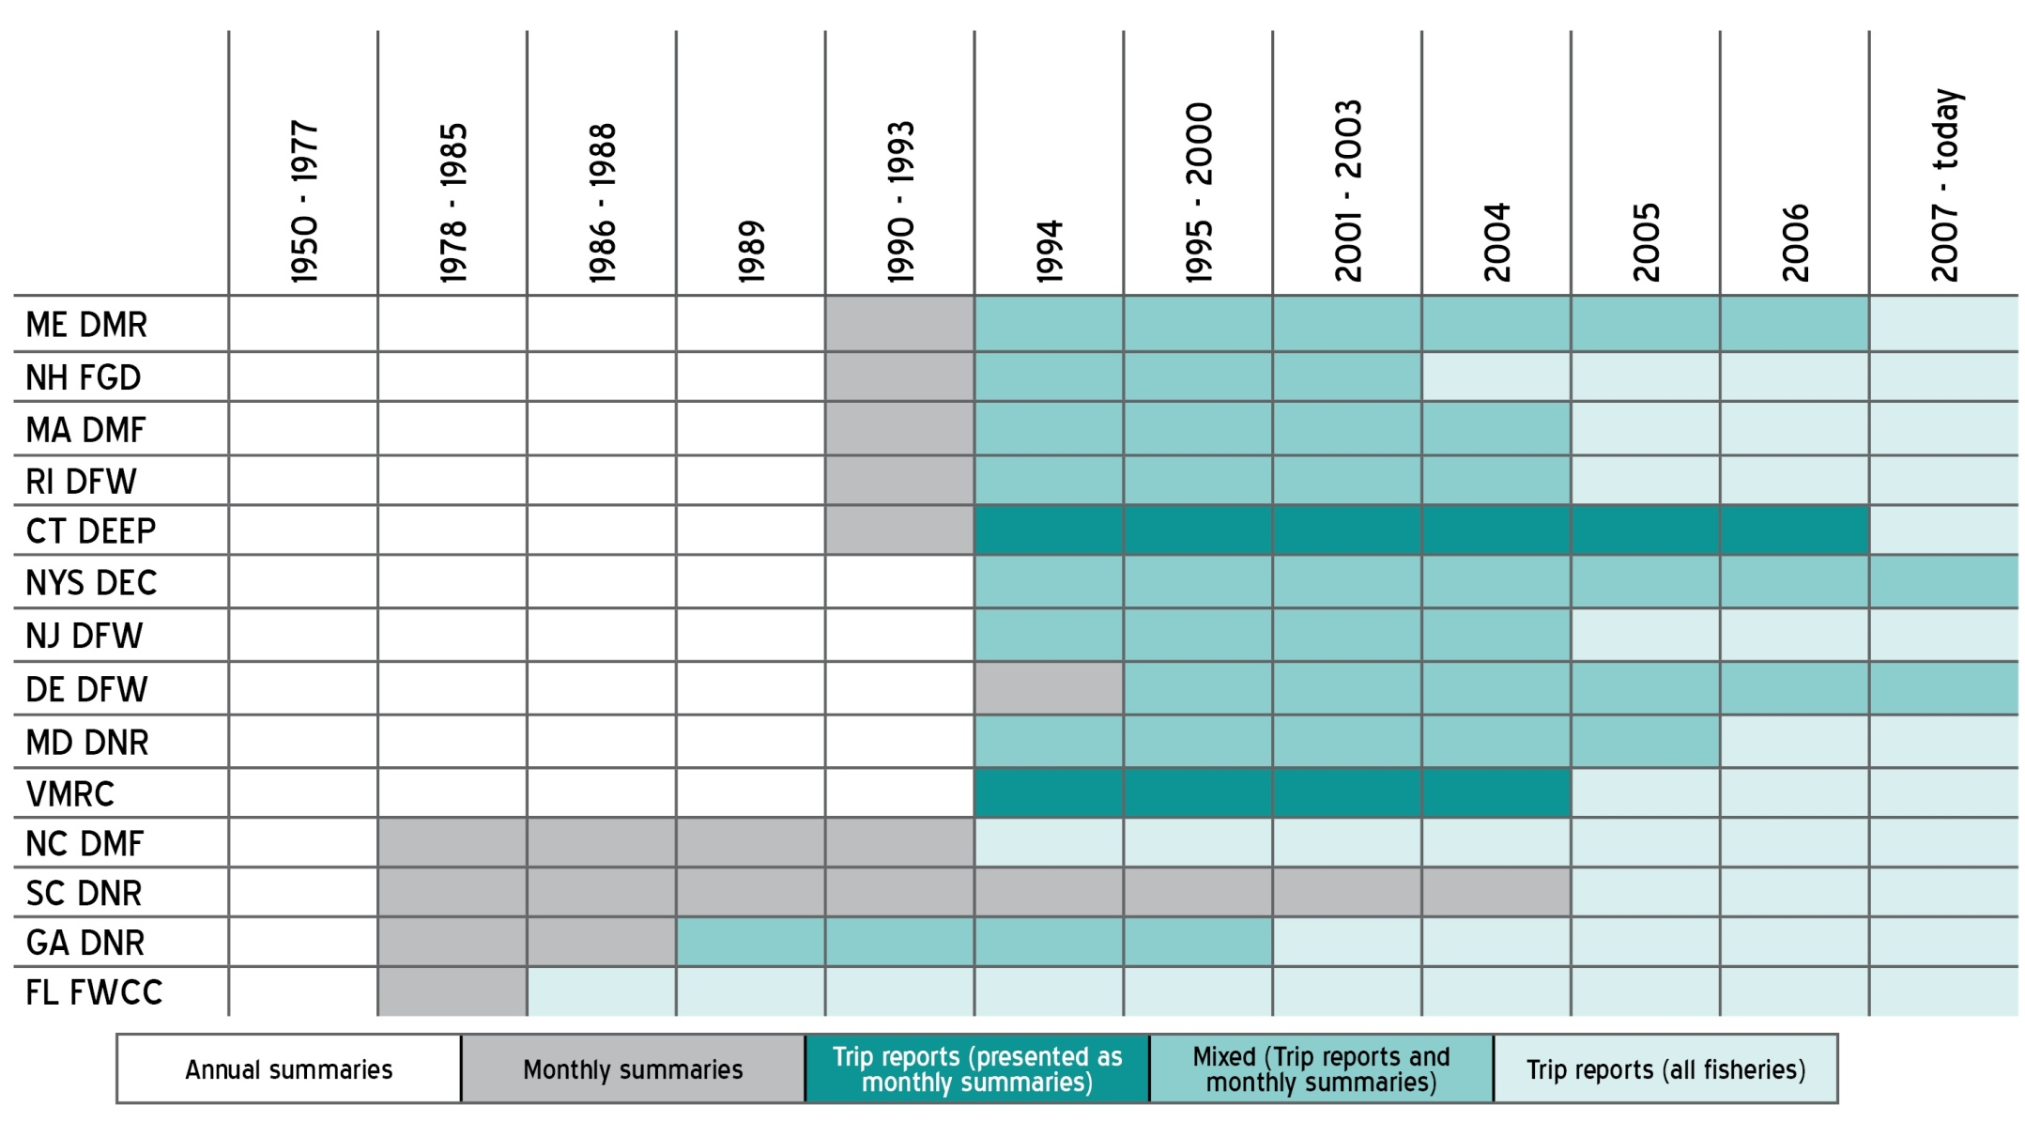
CURRENT STATUS OF AVAILABLE DATA
Notes:
You’ll want to explain where our national partners are as well. (Based on what John emailed about the other day … which we still haven’t heard on)

Slide 27
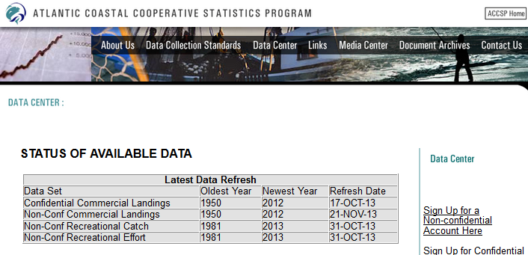
CURRENT STATUS OF AVAILABLE DATA
http://mahi.accsp.org:8080/myJSPs/SOAD.jsp
Notes:
You’ll want to explain where our national partners are as well. (Based on what John emailed about the other day … which we still haven’t heard on)

Slide 28
DATA LOAD PROCESS
Notes:
Annual Commercial Catch & Effort Data Load Commercial catch and effort data are loaded into the Data Warehouse twice a year. The preliminary load of the previous year’s data occurs from February through April. These data are considered incomplete data due to known late reporting issues, but are still a good measure of landings. During the final load of the previous year’s data, from August through September, updates are made to prsubmitted data sets and late reports are added. Once this final load process is complete in September, the previous year’s data is a robust and complete measure of landings. Step 1 - Identify Data Sets & Consolidate Participant Files: The data load process begins each year when approximately 30 data sets are identified and individual participant files (e.g., dealers, fishermen, vessels) are submitted to ACCSP staff by the program partners. Staff then load the participant files for each data source and merge those data to remove duplicate entries and maintain a history of the individual permits. Step 2 - Load Initial Data: Next, program partners submit trip-level data sets including dealer landings, as well as harvester and fishermen catch records. Before data submission, program partners are responsible for the first round of quality assurance and control measures. Each partner has its own unique set of measures. These submitted trip-level data sets include references to the previously loaded participant files (see Identify Data Sets & Consolidate Participant Files). At this point, the Data Team completes an initial load of the data sets. If the participant information is not linked, the landings are entered as “unknown”. During this step, data sets are considered initial because there may be records that indicate dealer and fishermen information for the same fish being landed. However, this information is merged in the next step. Step 3- Merge Dealer and Fishermen Data & Load Secondary Data: Due to variations in reporting requirements along the coast, in some cases the most accurate accounting for landings is a combination of dealer and fisherman reports. Therefore, the Data Team has written software (customized to program partner requests) to merge records for six states that have both ﬁshermen and dealer data reporting requirements. During this step, the Data Team completes a secondary load of all of the merged data. Also, there is a second round of quality assurance and control measures, as ACCSP staff validates poundage, price, and conversion factors. If any program partners have resubmitted data, it will be updated at this time. Final Product - Data Warehouse Views are Refreshed: Once the process is complete, there is a refresh of the Data Warehouse including the preliminary data sets from the previous year conducted in April and then again in September incorporating final data sets from the previous year. At either point in the process, confidential and non-confidential account holders can view the previous year’s consolidated data sets in the Data Warehouse. Both the preliminary and final data sets are submitted to NOAA Fisheries for inclusion within the fisheries databases of the Northeast Fisheries Science Center, Southeast Fisheries Science Center, and Headquarters. The data are also incorporated in the annual Fisheries of the United States document. Once preliminary or final data sets are uploaded to the Data Warehouse, quality assurance and control queries can be run by members of the ACCSP Commercial Technical Committee. If it turns out that partner data sets from any year need to be updated, those new data sets are integrated into the Data Warehouse after merges. If significant changes are incorporated to data sets, a refresh to the Data Warehouse will occur and partners are notified so that they can update the data in their systems. Annual Recreational Catch & Effort Data Load The data set for the recreational catch and effort data is the information gathered from the Marine Recreational Information Program (MRIP). Recreational catch and effort data is loaded into the Data Warehouse by the Data Team one week after it is released by MRIP. MRIP releases data 45 days after each collection period, known as a “wave” is complete. Each wave is a two month interval (i.e., January and February = wave 1, March and April = wave 2, May and June = wave 3, July and August = wave 4, September and October = wave 5, November and December = wave 6). While the Data Warehouse stores the same information as MRIP, ACCSP provides added value to that information with time-saving tools (such as exporting pivot tables and the ability to email workbooks), attractive reports tailored to your needs, and the ability to create a query with a uniquely fine-tuned level of detail for Atlantic coast fisheries. June: Load preliminary estimates from January - April August: Load preliminary estimates from May - June and any updates to previous months October: Load preliminary estimates from July - August and any updates to previous months December: Load preliminary estimates for September - October and any updates to previous months February: Load preliminary estimates for November - December Final Product - April: Load final estimates from previous year For more information on the Data Warehouse, please visit http://www.accsp.org/dataware.htm. For the most up to-date snapshot of available commercial and recreational catch and effort data in the Data Warehouse, please visit http://grouper.accsp.org:8080/myJSPs/SOAD.jsp.

Slide 29
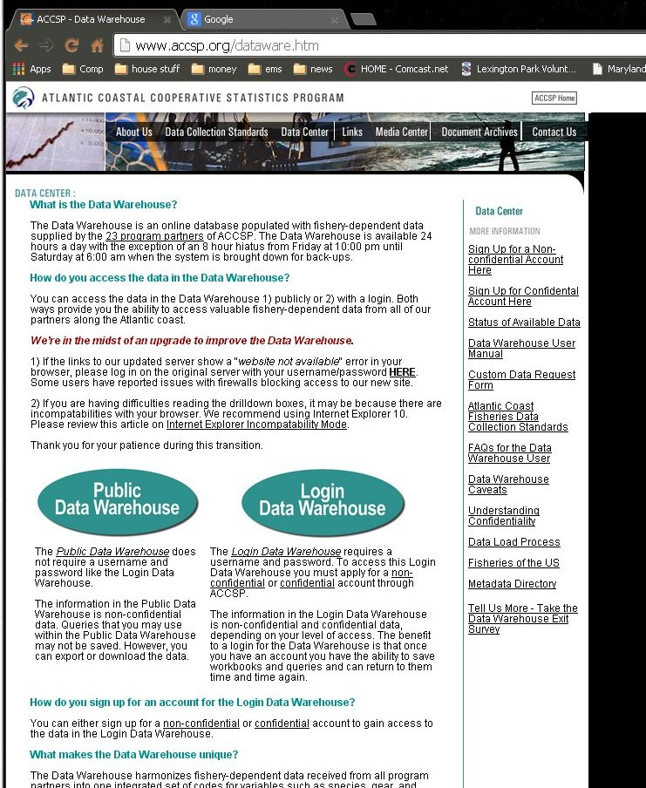
Getting the Data
On-line access provided
Custom data requests

Slide 30
PUBLIC VS. LOGIN
Both ways provide you the ability to access valuable fishery-dependent data from all of our partners along the Atlantic coast.
Notes:
The Public Data Warehouse does not require a username and password like the Login Data Warehouse.
The information in the Public Data Warehouse is non-confidential data. Queries that you may use within the Public Data Warehouse may not be saved. However, you can export or download the data. The Login Data Warehouse requires a username and password. To access this Login Data Warehouse you must apply for a non-confidential or confidential account through ACCSP.
The information in the Login Data Warehouse is non-confidential and confidential data, depending on your level of access. The benefit to a login for the Data Warehouse is that once you have an account you have the ability to save workbooks and queries and can return to them time and time again.

Slide 31
BENEFITS
Access valuable and time-saving tools such as exporting pivot tables
Access attractive graphical reports tailored to your needs
Drill down creating a query with a unique level of detail for Atlantic coast fisheries
Notes:
What is the Data Warehouse? The Data Warehouse is an on-line database populated with fishery-dependent data supplied by the 23 program partners of ACCSP. The Data Warehouse is available 24 hours a day with the exception of an 8 hour hiatus from Friday at 10:00 pm until Saturday at 6:00 am when the system is brought down for back-ups. What makes the Data Warehouse unique? The Data Warehouse harmonizes fishery-dependent data received from all program partners into one integrated set of codes for variables such as species, gear, and fishing area. The benefits for using the Data Warehouse are that you have the ability to 1) access valuable and time-saving tools such as exporting pivot tables, 2) access attractive graphical reports tailored to your needs, and 3) drill down creating a query with a unique level of detail for Atlantic coast fisheries.

Slide 32
CONFIDENTIALITY
Program follows strict ‘rule of three’
Public access provides only non-confidential data
Login access provides confidential data
Controlled to the partner level
Approved and monitored by Partner representatives

Slide 33
THE FUTURE OF THE DATA WAREHOUSE
Creating Inventory of biological data sets
Prioritize and upload
Create on-line queries
Looking at creating indexes
Creating Inventory of observer data sets

Slide 34
QUOTA MONITORING
SAFIS provides automated notification of quota monitored species
Used primarily by ASMFC and states
Data are pulled daily by NE and SE Science Centers
Integrated into local processes

Slide 35
SC DNR
Data are collected using the SAFIS E-1ticket application
Data may be key entered or uploaded
Quota and Compliance monitoring
Made available immediately thru SAFIS to SC DNR and SEFSC
Also pushed to HMS eDealer system
Notes:
The objective of this project is to collect and integrate trip-level catch and effort reporting for all South Carolina commercial fisheries. The 100% collection efforts for trip-level commercial landings data continued throughout 2012. Licensed wholesale dealers are required to report complete and accurate ACCSP compliant commercial fisheries data through state-provided trip ticket logbooks. These logbooks require the dealers to provide landings and price data, and collect effort data from the commercial fisherman at the time of the purchase. Dealers are tracked for monthly compliance of reporting deadlines, and those that are delinquent receive a warning letter with a secondary deadline to submit late trip tickets. If they fail to comply, SC DNR Law Enforcement is notified; the dealer may be cited, fined, or, if convicted, could have his license suspended for failure to report. Staff has taken a more proactive approach to communicate with dealers and fishermen about the importance of accurate and timely reporting, the consequences of failing to report, as well as identifying possible non-reporting issues.
Throughout 2012, data entry has continued and timeliness has improved. Staff continues to track compliance and code, enter, and edit data. The data from 2012 has been entered, verified, and submitted to the ACCSP by the March 1, 2013 deadline. These data are used to aid in the management of Atlantic coast fisheries.

Slide 36
SC DNR
SAFIS data treated as preliminary
Does not contain state landings (paper)
Data Warehouse receives feed from SC as part of yearly load process

Slide 37
FL FWCC
Data collected via paper or pc-based reporting
Key entered or uploaded into FL system (MRIS)
PC based data transmitted simultaneously to FL, SE and NE
SAFIS pulls data from NE and provides to HMS
Quota and compliance monitoring based on local data sets
Data Warehouse receives roughly quarterly transmissions
Notes:
In January 2008, the Maine Department of Marine Resources (ME DMR) began mandatory trip-level dealer reporting - a project funded by the ACCSP. For the first time detailed data were collected on all of Maine’s commercial fisheries. The objective of this project is 100% dealer reporting in Maine for all 680 dealers that buy directly from harvesters.
In order to accomplish this objective, staff focused on data entry and outreach. As a part of the data entry, staff work to enter positive trip records into SAFIS and MARVIN (the database that houses all catch and sampling data for ME DMR). These data are uploaded to the Data Warehouse twice a month in order for the information to be shared with all program partners. Staff also work vigorously to maintain the accuracy of the data by checking for unknown harvesters, weights that exceeded a trip limit, high and low prices, wrong species-gear-disposition combinations, species caught outside of the season, and dealers who reported buying from unlicensed harvesters. Lastly, in order to help industry understand the importance of accurate and timely reporting, staff work with dealers to discuss options and provide training on software. Electronic reporting is encouraged for those still opting to report on paper. These data also are available to scientists, private organizations, industry, academia, and/or media that may have a specific question, or custom data request, on fisheries data in Maine.
This project helps ensure that fisheries managers have the most accurate and timely information available when fisheries-related decisions are made. A preliminary report issued by ME DMR in February 2013 showed that:
1. In 2012, Maine’s commercially harvested marine resources exhibited a 10 percent increase in pounds landed and a 20 percent increase in value over 2011.
2. There were 7,266 active Maine commercial fishermen in 2012 (of those, 4,288 were active commercial lobster harvesters out of 5,963 lobster license holders).
3. The top five fisheries in terms of active harvesters included soft shell clams with 1,709, marine worms with 689, periwinkles with 648, and elvers with 565.
In the past five years the project has shown to be vital for monitoring changes in fisheries, providing knowledge of fleet characteristics, and ensuring accurate communications to NOAA Fisheries and ASMFC about Maine landings. The Department also uses the data submitted for socio-economic reasons. This data collection is one of the best ways to monitor the health of Maine’s fisheries.

Slide 38
MA DMF
All data reported through SAFIS
Many dealers/harvesters still provide paper
In 2012, 1/3 commercial permit holders reported electronically
Data made available immediately to MA and NE for quota and compliance monitoring
MA uses SAFIS DB as primary repository
Achieved near 100% matching
Data transferred directly to warehouse
Notes:
Starting in 2010, the Massachusetts Division of Marine Fisheries (MA DMF) embarked on a new project, supported through the ACCSP, to achieve a goal common to all program partners – to collect comprehensive, standardized trip-level catch and effort data from all commercial permit holders.
Prior to that, MA DMF had collected catch and effort data from commercial harvesters using 19 different catch reports. Some of these data are collected at trip-level, others were submitted annually and summarized on a monthly basis. Now the state-reporting harvesters can report one of two ways: (1) electronically through the use of the ACCSP eTRIP application or (2) via paper submission, which is delivered by mail, email, or fax. Because many commercial permit holders are not capable of reporting electronically, MA DMF must enter the data submitted directly to SAFIS using the eTRIP application, as is done by state-reporting harvesters reporting electronically. In 2012, one-third of commercial permit holders reported electronically, whereas the remainder reported to MA DMF via paper reports.
This project creates improvements in data quality, quantity, and timeliness. Although this project only covers the activities of Massachusetts commercial harvesters, it does include the harvest of species which are managed regionally, such as lobster, striped bass, scup and sea bass. Thus, regional management bodies, such as the ASMFC, benefit from having comprehensive fishery-dependent data from Massachusetts.

Slide 39
QUESTIONS?
www.accsp.org

