Slide 1

Atlantic Coastal Cooperative Statistics Program
Washington, DC
Mike Cahall
Overview of the Standard Atlantic Fisheries Information System (SAFIS)
Notes:
The ACCSP is the Atlantic Coastal Cooperative Statistics Program.

Slide 2

Standard Atlantic
Fisheries Information System
Real time
Cost effective
Collaboratively designed

Slide 3



SAFIS
More than just Dealer Reports
  eDR
    Federal and state dealer reporting
  eTRIPS
    State trip reporting
  eREC
    Private angler recreational reporting
  SMS
    Partner management interface

Slide 4
SAFIS Design
SAFIS is a modular, integrated data collection system
  Single, integrated database system
  Combined federal and state reporting
  One set of codes using ACCSP standard coding schemes
  Complete catalog of:
    Vessels
    Dealers
    Fishermen

Slide 5
SAFIS Integration
SAFIS is a single, integrated dealer and fishermen/vessel system
  Both modules use the same codes
  Both modules use the same references
  Trips much more easily linked to dealer reports

Slide 6
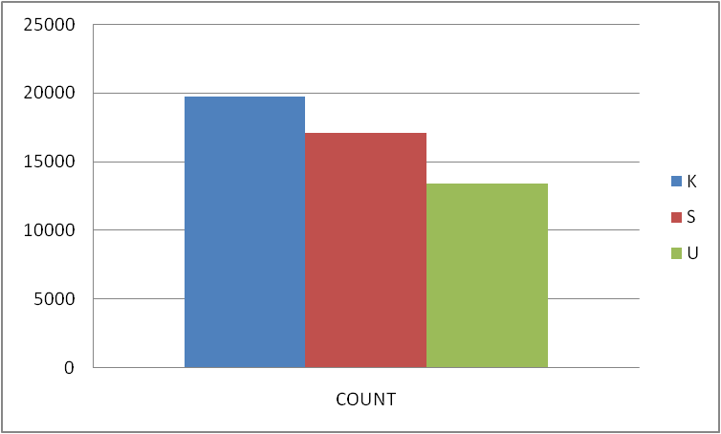
SAFIS Data Collection
Flexible mechanism
  On line
  PC based application
  Standardized file uploads

Slide 7
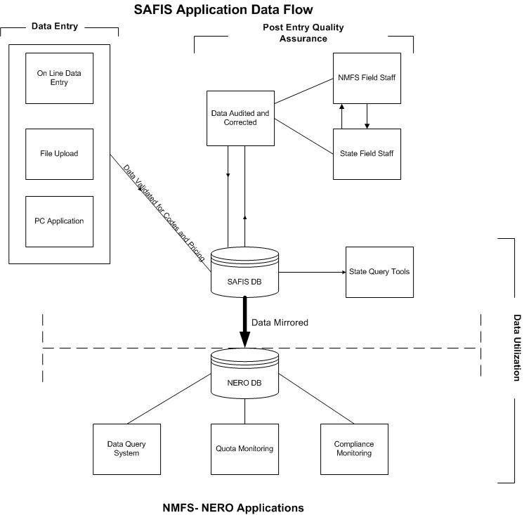

Slide 8
Recent Updates eDR
Expansion in the SE Region
  E-1Ticket
    Deployed in South Carolina and Georgia
  Florida and North Carolina data aggregated on SAFIS server

Slide 9
eTrips - Background
Initially envisioned as a multi-state system
Most NE states participated in the initial planning
Requirements developed over nearly a year

Slide 10
Base Requirements
Based on ACCSP trip reporting standard
  Single trip report
  Multiple efforts per trip possible
  Multiple catches per effort possible
Must use ACCSP coding standards
Must support both commercial and recreational trip reports

Slide 11
eTrips
Integrated into SAFIS
Initially deployed as a data entry tool for Partners
  Concern over resistance by fishermen
  Replaced various spreadsheets, dbases

Slide 12
Features
Integrated into eDR system
  Common tables
  Common codes
  Common references
Makes matching with dealer reports much easier

Slide 13
Additional Requirements
Some requirements went beyond the base standards
  Support of carring of animals
  Allocation of catch amongst fishermen
  Direct sales

Slide 14
eTrips - Expansion
Collecting 100% in
  Massachusetts
  Connecticut
Achieving near perfect matching with dealer reports
Collecting partial in
  Maryland
  New York
  Rhode Island
First charter/headboat deployment
  Maryland

Slide 15
eTrips Current
Deployment Status
eTrips
  Commercial
    MA, CT, NY, MD, RI
  Recreational
    MD
eLogbook
  NJ striped bass bonus fish
  MA multi-species

Slide 16
Recent Updates eTrips
Flexible collection options
  Upload
Continued expansion of scope
  Looking for 100% commercial reporting
Integrated with SE state reporting

Slide 17
eRec Background
New Jersey needed a mechanism to report Striped Bass
  Voluntary
  Awarded ‘Bonus Cards’ to fishermen
  Collected fisherman, effort and length data
Other states looking for voluntary reporting

Slide 18
eRec Requirements
Use as much of existing SAFIS structures as possible
  Permits
  Vessels
  Locations
  Coding schemes

Slide 19
eRec
Usually integrated into existing state web sites
First deployed in NJ
Second deployment in MA

Slide 20
Future Directions eRec
Integrate existing systems together
  Create a standard set of features
  Provide to any Partners with a need

Slide 21
2004
Atlantic Coast Data Collection Status
Pennsylvania lands very few marine species
ACCSP Compliant
ACCSP Compliant via SAFIS eDR
ACCSP Compliant via SAFIS eDR and/or eTRIPS or eREC
NMFS NE Deployed for all Federal Dealers in May
Notes:
For each of these slides, illustrate the new additions and how – eventually – the entire coast is covered. I know that DE had an implementation plan for 2008. So would implementation be 2008 or 2009. I think I will add a 2009/current slide.
You MAY get a question on the fact that federal dealers in all states were reporting via SAFIS from 1 May 2004 forward. – don’t change slides, just anticipate question or note the slides focus on STATE permitted dealers and fishermen.
ANN: In the future we can just do an animation where all of this is on one slide – but, every time you click more and more gets filled in – using a different color for each year – it keeps viewers from “thinking” more changes from each year than just the title – it gets twitchy watching it transition slides...i ca work on it this afternoon if you’d like.

Slide 22
2005
Atlantic Coast Data Collection Status
Pennsylvania lands very few marine species
ACCSP Compliant
ACCSP Compliant via SAFIS eDR
ACCSP Compliant via SAFIS eDR and/or eTRIPS or eREC
Notes:
MD

Slide 23
2006
Atlantic Coast Data Collection Status
Pennsylvania lands very few marine species
ACCSP Compliant
ACCSP Compliant via SAFIS eDR
ACCSP Compliant via SAFIS eDR and/or eTRIPS or eREC
Notes:
NJ, RI, CT

Slide 24
2007
Atlantic Coast Data Collection Status
Pennsylvania lands very few marine species
ACCSP Compliant
ACCSP Compliant via SAFIS eDR
ACCSP Compliant via SAFIS eDR and/or eTRIPS or eREC
Notes:
NY, MA, NH

Slide 25
2008
Atlantic Coast Data Collection Status
Pennsylvania lands very few marine species
ACCSP Compliant
ACCSP Compliant via SAFIS eDR
ACCSP Compliant via SAFIS eDR and/or eTRIPS or eREC
Notes:
ME SAFIS – NJ eTRIPS
partner start date # trips
New York 31-oct-2008 4149
Connecticut 23-mar-2009 2
Massachusetts 29-jan-2008 9613
New Jersey 25-mar-2008 886
Also – Maine went live in July 2007 – I doubt you will get a question and I support you using 2008 as the first FULL year where Maine was working more on reporting compliance. Maine dealers were mandatory MONTHLY reporting from 2004? To 2007.
No Need for a 2009 slide – just mention on the 2008 slide that DE is in the process of implementing (details just for you = looking into requiring their state only dealers to get permits, then start reporting.

Slide 26
2012
Atlantic Coast Commercial Data Collection Status
Pennsylvania lands very few marine species
Other Data Collection Systems
Edr Only
Edr and Etrips
E1Ticket and State Systems
All states have at least some pc trip ticket reporting
Notes:
ME SAFIS – NJ eTRIPS
partner start date # trips
New York 31-oct-2008 4149
Connecticut 23-mar-2009 2
Massachusetts 29-jan-2008 9613
New Jersey 25-mar-2008 886
Also – Maine went live in July 2007 – I doubt you will get a question and I support you using 2008 as the first FULL year where Maine was working more on reporting compliance. Maine dealers were mandatory MONTHLY reporting from 2004? To 2007.
No Need for a 2009 slide – just mention on the 2008 slide that DE is in the process of implementing (details just for you = looking into requiring their state only dealers to get permits, then start reporting.

Slide 27
Current Developments
Integration of HMS reporting
  Atlantic dealers will use SAFIS
    On line Edr
    PC based Trip Ticket
  Gulf and Caribbean dealers will use either Edealer (new HMS application) or PC based Trip Ticket

Slide 28
Current Developments
Alternate Reporting Methods
  Additional eTrips upload option
  Hand held option
    Iphone
    Ipad
    DROID

Slide 29
SAFIS Benefits
Near Real Time Data
  Raw data are available immediately
  Simplifies Quota Monitoring
Eliminates Redundant Reporting
  States accept Federal Reports
Readily Adapted
  Easily deployed
Modules Integrated
Automated Auditing

Slide 30

Fluke Quota in ME
BEFORE SAFIS
Inefficient quota tracking
A single vessel could put the fishery over quota
Once exceeded quota by the equivalent of 7 years
AFTER SAFIS
Automatic daily emails distribute information to track quotas and summarize data audits
ME can manage the fishery efficiently and prevent exceeding the quota
Notes:
Overages were very extensive and ME fishermen were being excluded from the fishery for years at a time.
ADD LOGO?
REMIND AUDIENCE THAT SAFIS IS ELECTRONIC DEALER REPORTING

Slide 31

SAFIS - Benefits in ME
ME is capable of timely and efficient management.
Fishermen are not excluded from the fishery due to previous quota overages.

Slide 32

Filling Data Gaps in MA
Prior to choosing to use the ACCSP systems the state of MA did not have a complete data set from which to determine the value of a fishery.
Now that gaps are filled, MA can:
  Provide legislators with fishery valuations.
  Provide NMFS with a more complete data set for Fisheries of the United States.
Notes:
ADD LOGO?
REMIND AUDIENCE OF SAFIS ELECTRONIC DEALER REPORTING

Slide 33
Data Gap Example – MA Shellfish
Species | 2006 | 2007 | Units
Soft Clam | 119,679 | 12,940 | Bushel
Soft Clam | 828,156 | 5,609,398 | Pounds
Soft Clam | 644 | 50 | Meat Pounds
Oyster | 11,855 | 1,123 | Bushel
Oyster | 143,468 | 8,686,593 | Count
Oyster | 10,208 | 219,188 | Pounds
N. Quahog | 303,305 | 26,363 | Bushel
N. Quahog | 476,266 | 21,991,925 | Count
N. Quahog | 48,890 | 777,092 | Pounds

Slide 34

eTRIPS – Benefits to NJ
Drastically reduce staff time spent entering harvest reports from paper
Expectation of gaining increased amounts of commercial landings data
Fisheries not part of any other database
Notes:
ADD LOGO?
REMINDER that eTRIPS is electronic fisherman reporting for state fishermen – Deployed June 2008?

Slide 35

eTRIPS - Benefits to NJ Fishermen
Allows fishermen to enter their own data, receive a receipt and save time and postage.
Allows fishermen opportunity to view previously reported data submissions.
Notes:
Fishermen enter immediately (big time saver because not always filling out paper reports)
Favorites portion (good, but users have to be careful with defaults)
Easier for fishermen – they want to do it federally
5 minutes/month
Good participation (blue crab pots, mini fyke net (eel))
May 1, 08 rollout

Slide 36

VA - Fishermen Compliance
Virginia does not have a staff member dedicated to compliance coordination.
SAFIS eDR allows VA to run queries, compare results to VA data and quickly generate a list of fishermen not reporting.
The alternative to SAFIS would involve sending staff to dealers to collect information for later analysis.
Notes:
ADD LOGO?

Slide 37
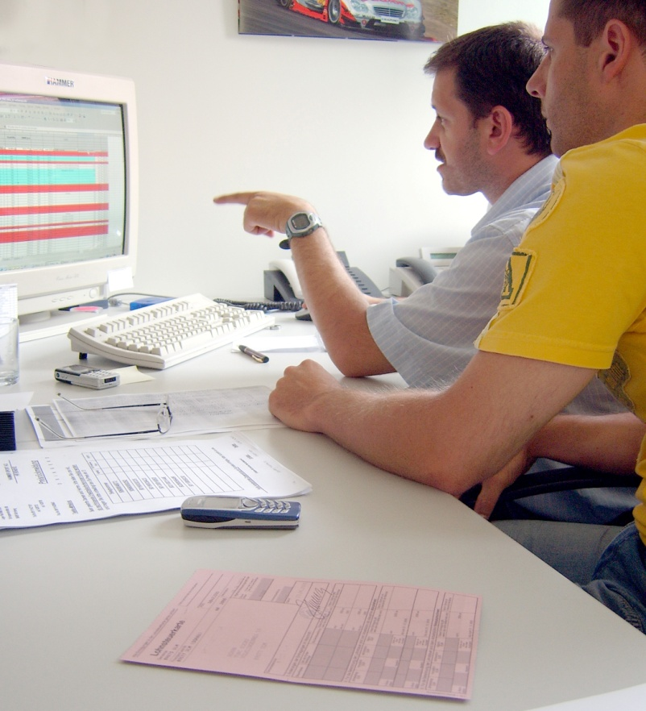
SAFIS - Benefits to VA
Allows VA to contact non-compliant fishermen in a timely fashion to request reports or ultimately take action.
Saves state resources (salary & time).

Slide 38
Benefits to NERO/NEFSC
Data are available almost immediately
Vastly improved data quality
  On entry validation prevents improper coding
  Post entry automated audit process provides consistent, repeatable review and correction process
More responsive quota management

Slide 39
Benefits to all
SAFIS is extremely cost effective
  Integrated into ACCSP budget
  Estimate $8M development cost avoidance coast wide
  Estimate recurring yearly cost avoidance $1M
Promotes cooperation and coordination
  Many more ‘eyes’ on data
  Joint state/federal review

Slide 40

Questions?
www.accsp.org

