Slide 1
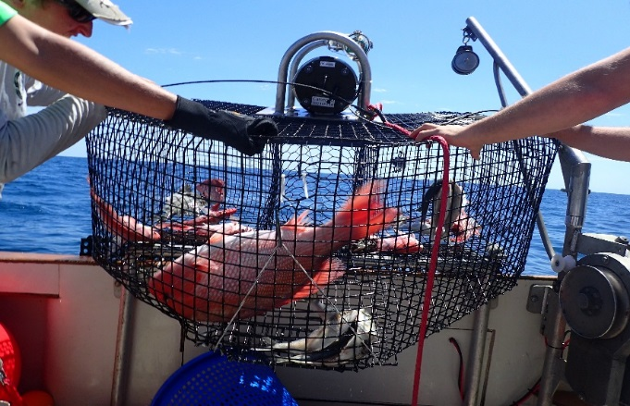
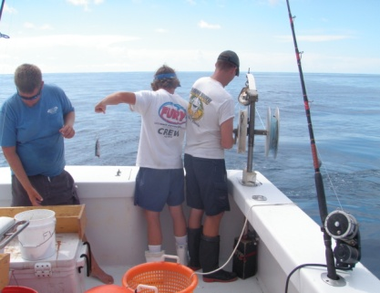
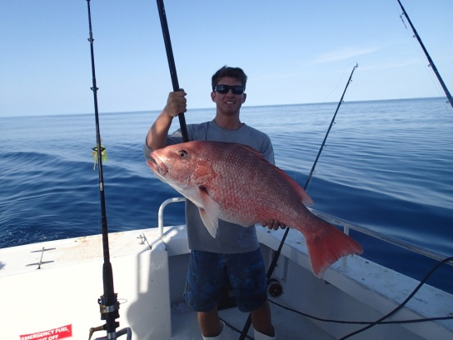
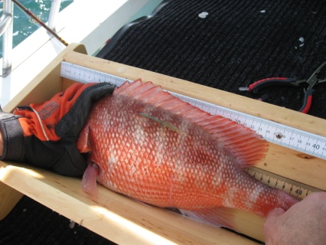
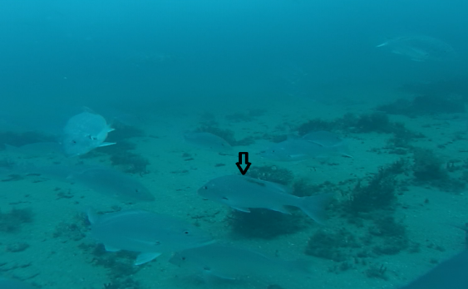
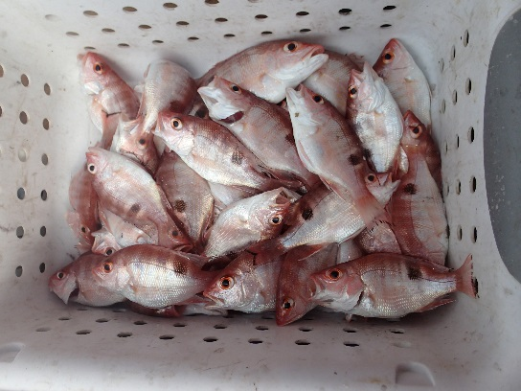
East Coast Fisheries-Independent Monitoring
Overview of Red Snapper Research (2011 – 2017)
September 2017
Florida Fish and Wildlife Conservation Commission
Fish and Wildlife Research Institute
Version 1

Slide 2
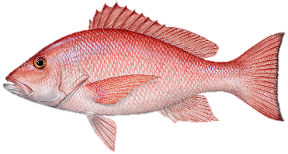
Introduction
FWC-FWRI has been conducting reef fish sampling projects off NE Florida (South Atlantic Red Snapper’s center of abundance) since 2011
Data collected over the last 6 years on Red Snapper abundance and age composition in this area could help supplement information used to evaluate condition of the stock and progress in rebuilding
Presentation summarizes data collected by different projects focused on different topics:
  Results need to be interpreted carefully
  Potentially more valuable from a qualitative perspective
Notes:
As we discussed, survey design and sampling gear differed year to year based on funding source and project objectives. So some trends as you said need to be interpreted carefully. I will annotate where I think potential issues may arise.

Slide 3
Timeline - Projects
 | 2011 | 2012 | 2013 | 2014 | 2015 | 2016 | 2017
Cooperative Tagging Study ª
FIM Hooked-Gear Pilot Study ^{b}
Spawning Aggregation Study ^{c}
Juvenile Red Snapper Study ^{d}
Selectivity Study ^{e}
Sportfish Study ^{f}
ª Unstandardized methods, unstandardized site selection, opportunistically January - December
^{b} Standardized hooked-gear methods, monthly stratified-random sampling (SRS) sampling design, April - October
^{c} Standardized and unstandardized hooked-gear methods, monthly SRS sampling design, targeted spawning locations and peak spawning months for Red Snapper, Gag, and Scamp, February - July
^{d} Standardized trawl and trap methods, yearly SRS sampling design, August - November
^{e} Standardized HNL, trap, camera methods, and unstandardized HNL methods, yearly SRS sampling design, April – August
^{f} Standardized HNL, yearly SRS sampling design, May – July
Notes:
Cooperative tagging study was largely focused on getting maximum number of red snapper with minimal ship time, so they often targeted sites near to shore.
Spawning aggregation study focused on sites with high likelihood of containing spawning red snapper and gag/scamp. Effort in 2014 in particular was focused on grouper spawning sites in the winter/spring. Regardless, somewhat of a deep bias.
Data from hooked-gear pilot study, selectivity study, and sportfish study used similar, SRS survey design, so are most comparable data.

Slide 4
Timeline – Sampling Gear
 | 2011 | 2012 | 2013 | 2014 | 2015 | 2016 | 2017
Unstandardized Captain’s Choice | a | a | a | b , c | c | d
Vertical Longline (12-Hook)
Bottom Longline (12-Hook)
Repetitive Timed-Drop (RTD; Standardized Active Fishing Methods)
Groundfish Trawl
Small-mesh Z Trap
Large-mesh Chevron Trap
Stereo Camera
GoPro Camera Array
ª Objective to capture and tag as many Red Snapper as possible
^{b} Objective to capture spawning Red Snapper not sampled by RTD
^{c} Objective to capture spawning grouper not sampled by RTD
^{d} Objective to compare RTD to unstandardized Captain’s Choice HNL
Notes:
Again, here the RTD (a series of repetitive team drops) is the most standard gear, although there were still some biases (e.g., larger hooks used more frequently during spawning agg study). Vertical longline was similar to that used for the Gulf, except all three hooks were on a single rig. Bottom longline was similar, although not effective if any current was present. The groundfish trawl gear is the same as Gulf SEAMAP. Z-traps are small traps with small mesh. Chevron traps are identical to those used by MARMAP/SEFIS, with the exception that a stereo camera was mounted on top of them.
Aside from unstandardized captain’s choice sampling, all other gears used cut Atlantic mackerel as bait with the exception of chevron traps – for those, we used whole menhaden to be comparable with the MARMAP/SEFIS group.

Slide 5
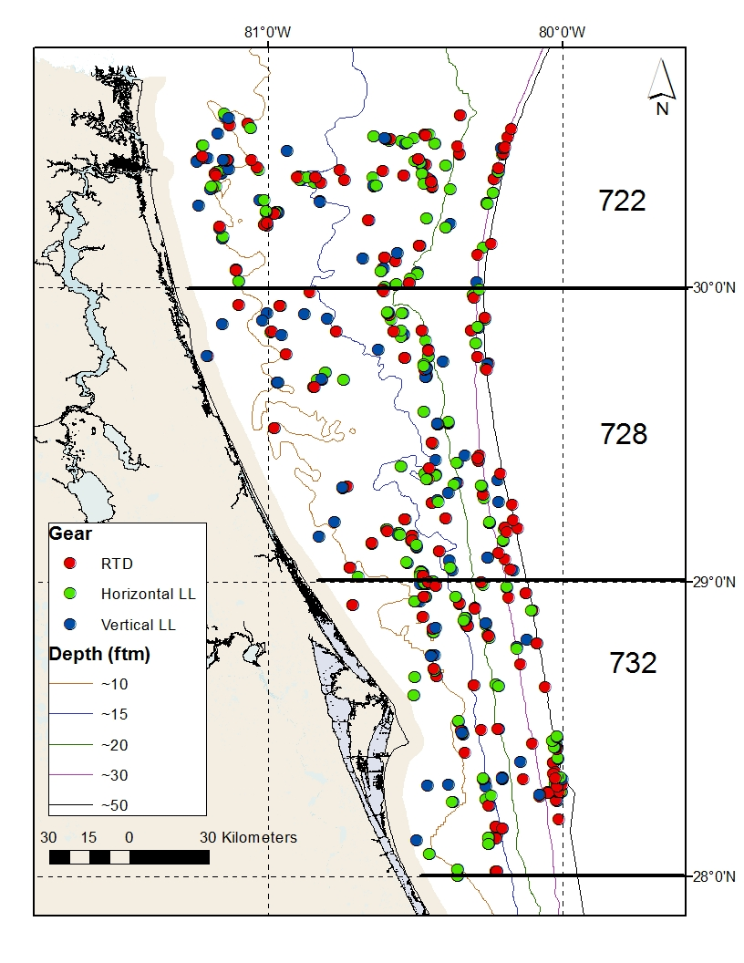
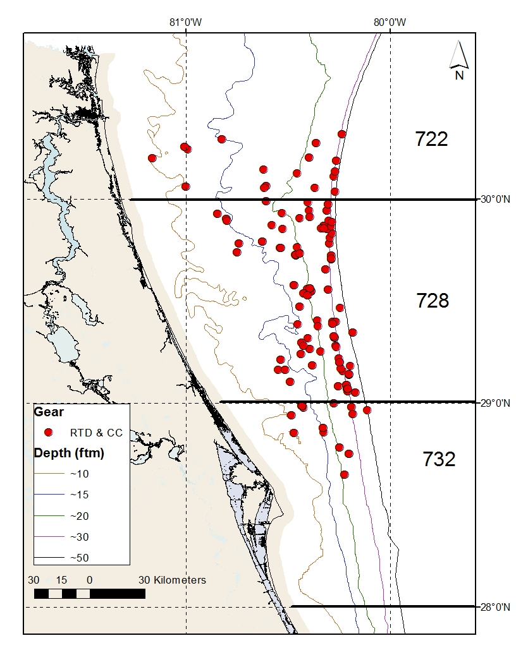
Project Sample Sites
2012 Study Map
2014/2015 Spawning Aggregation Study

Slide 6
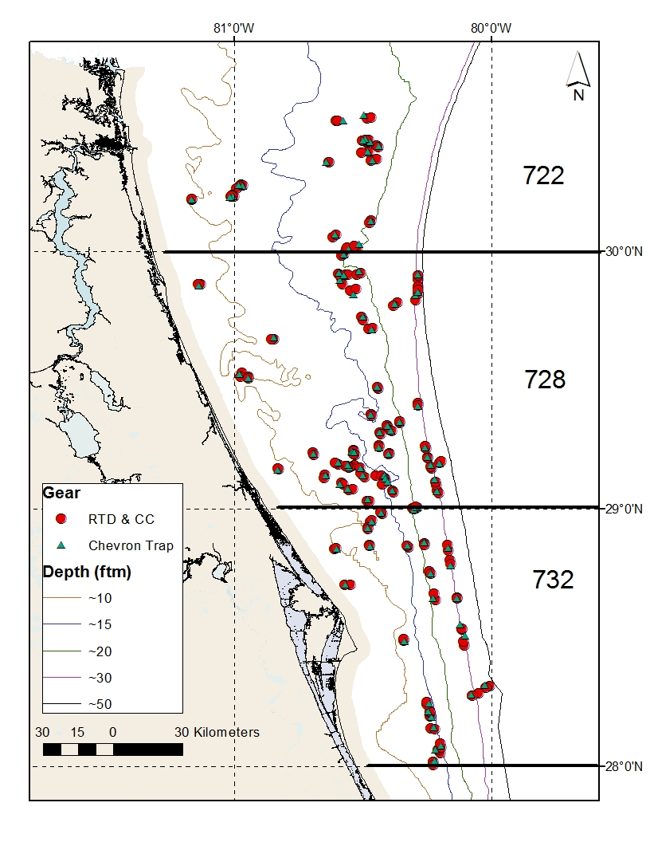
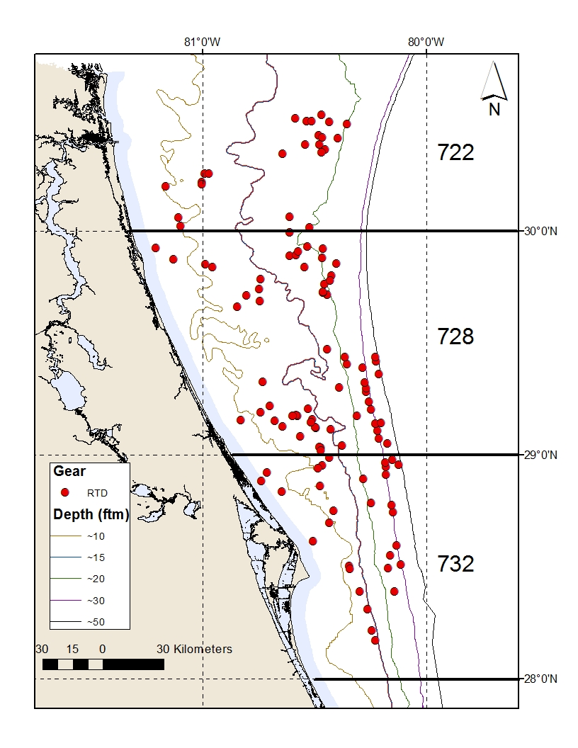
Project Sample Sites
2016 Selectivity Study
2017 Sportfish Study

Slide 7
Standardized Hook-Gears – CPUE Comparison
VLL = Vertical Longline
BLL = Bottom Longline
RTD = Repetitive Timed-Drop
Notes:
Notice increase in nominal CPUE for the RTD especially.

Slide 8
Standardized Hook-Gears – Size/Age Comparison

Slide 9
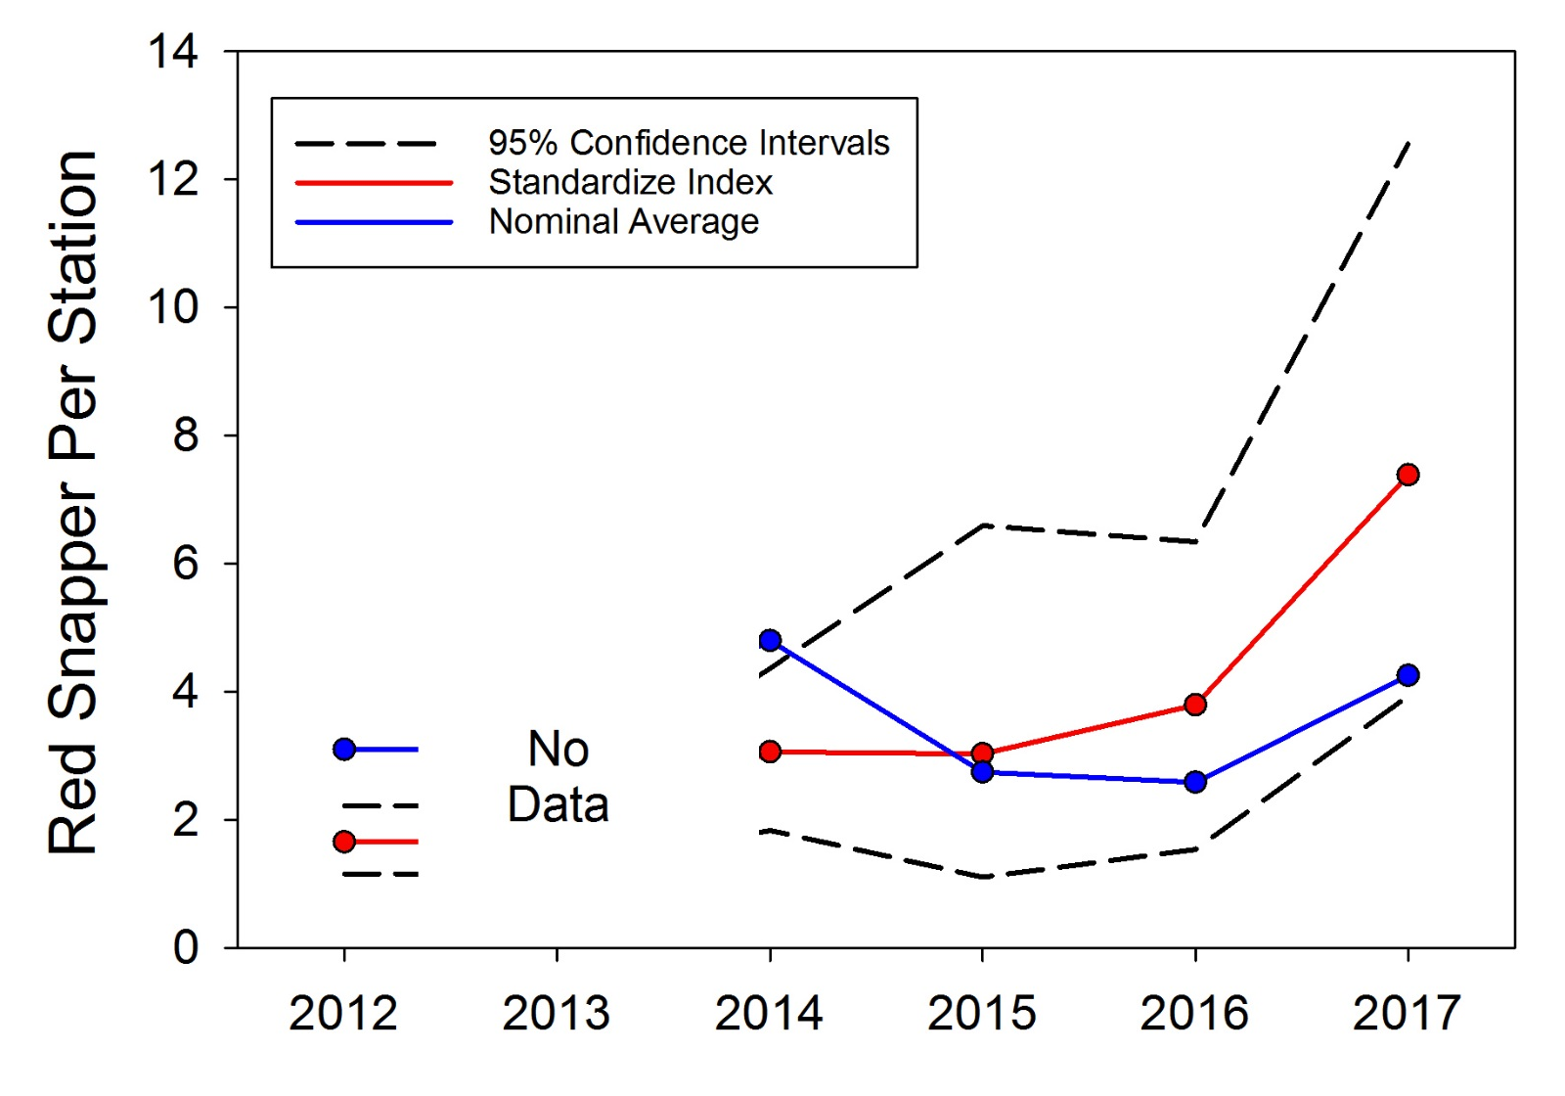
Index of Abundance – RTD Sampling
Notes:
Model was fit using generalized linear mixed model and the negative binomial distribution. Some factor that likely influence CPUE were not fit because they were not common across all years/studies (e.g., hook size, month sampled). Model does adjust for differences in effort (number of hooks deployed), depth, and latitude. Does a pretty good job of downweighting the biased red snapper spawning aggregation data for 2014.

Slide 10
Index of Abundance – Captains Choice Sampling Variability
Due to extremely high interannual variability in sampling methods, we were unable to construct an appropriate index for
Captain’s Choice data
Notes:
We explored constructing an index of abundance from captain’s choice data, but unfortunately they were too variable to model appropriately. Interannual variability in two important metrics (bait type and hook size) shown for comparison.

Slide 11
Selectivity Study – Size/Age Comparison
Notes:
Note that chevron traps capture smaller/younger fish than do either RTD or Captain’s Choice. Stereo data will be available soon.

Slide 12
Selectivity Study – CPUE Comparison
*
* = Data still being processed

