Slide 1
Atlantic Large Whale Take Reduction Plan
South Atlantic Fisheries Management Council
Protected Resources Committee
Southeast Regional Office
Protected Resources Division
Barb Zoodsma, Jessica Powell, and Laura Engleby
December 1 2014

Slide 2
Topics
Marine Mammal Protection Act
Atlantic Large Whale Take Reduction Plan and Team
2014 ALWTRP Amendment
Why Amendment was necessary
How Amendment was developed
Amendment Requirements

Slide 3
The Marine Mammal Protection Act
Primary objective: Maintain OSP¹ or immediately obtain OSP
OSP: number of animals that results in max productivity
Mandate: reduce bycatch SI and mortality to <PBR and eventually insignificant levels (10% of PBR)
PBR: maximum number of animals, not including natural mortalities, that may be removed from a marine mammal stock while allowing that stock to reach or maintain its OSP
NARW PBR: .9 per year (insignificant level is 10% of PBR)
NARW SI&M from fisheries bycatch continues to exceed PBR
TRT recommends to NMFS measures to reduce bycatch
NARWs are managed under a TRP (ALWTRP) because they are endangered, above PBR, and interacting with Category I and II fisheries
¹Optimum Sustainable Population
Notes:
MMPA
First, a primer on the Marine Mammal Protection Act –the MMPA is important because it’s what drives the goals of Take Reduction Teams/Plans. I’m not going to read all of this information, you can see it on the slide and/or consult the MMPA yourselves. However, the take home message is that the MMPA allows only .9 right whales to be seriously injured or killed from commercial fisheries each year. If we’re above PBR for an endangered marine mammal species and the species is interacting with Category I and II fisheries, the MMMPA mandates that we develop and implement Take Reduction Plans to get above PBR.
Take Reduction Team
Section 118 of MMPA specifies that members shall have expertise regarding the conservation or biology of the marine mammal species, or the fishing practices which result in incidental serious injuries or mortalities. Members shall include representatives from: Federal agencies, coastal states that have fisheries interact with the stock, regional Fishery Management Councils, interstate fisheries commissions, academic/scientific organizations, Environmental groups, all commercial fisheries that interact with the stocks.
NARWs are managed under the ALWTRP along with fin whales and humpback whales.

Slide 4
Take Reduction Plans
Goal of TRPs (per MMPA):
Reduce SI&M to below PBR w/in 6 months
Reduce SI&M to insignificant levels within 5 years
Process:
Notes:
Goal of Take Reduction Plans is to reduce serious injury and mortality to below PBR within 6 month of plan implementation and to reduce serious injury and mortality to insignificant levels within 5 years of plan implementation.

Slide 5
Timeline of ALWTRP
1997: ALWTRP takes effect
1999, 2000, 2001: Minor changes and updated gear modifications and effective dates
2002: Three Rules Published
1. Further modifications to commercial fishing gear
2. Dynamic Area Management (DAM)
3. Seasonal Area Management
2003: DAM Gear Modifications
2006: SE right whale (RW) emergency rule
2007: Expand the SE US Restricted Area and prohibit gillnet fishing or possession during RW season
2009: Sinking groundline rulle (plus other requirements)
2014: Closures, gear modifications/regulations, more gear marking
Notes:
Atlantic Large Whale Take Reduction Plan: effective in 1997 and amended several times since because the plan was not achieving the goals of the MMPA: reducing SI and mortality to below PBR. Regulatory efforts include broad-based gear modifications, time-area closures, and gear marking.
In addition to the regulatory efforts, we implement a number of non-regulatory programs, including: disentanglement efforts, extensive outreach efforts in key areas; research; and right whale surveillance programs.

Slide 6
Atlantic Large Whale Take Reduction Plan
Despite several amendments, the ALWTRP has not yet achieved PBR or insignificant levels of take for right whales.
2007-2011: min SI&M to NARWs from fisheries interactions was 3.25/year (MMPA goal: 0.9/year)
Notes:
Take home message: we have yet to achieve PBR. From 2007-2011, the number of known SI&M NARW cases from fisheries interactions was over 3/year. The ALWTRP was amended this year because we were above PBR.

Slide 7
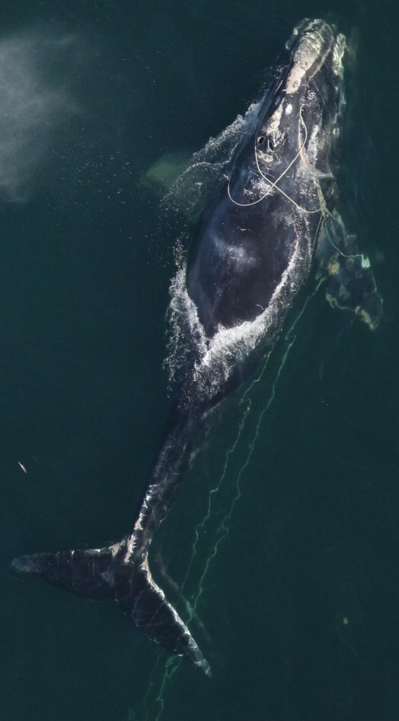
Development of 2014 Amendment (Vertical Line Rule)
In 2003, the Team agreed to tackle:
Groundlines
Vertical lines (endlines or buoy lines)
First, ALWTRT addressed groundlines
ALWTRP amended in 2009 –required sinking groundline throughout most of the east coast.
Then, ALWTRT addressed vertical lines
ALWTRP amended in 2014 –focused on reducing number of vertical lines and entanglement severity.
Photo Credit: FWCC
Notes:
The team took at two tiered approach to addressing large whale (and specifically RW) entanglements. There were two discernable types of problematic fishing gear which increased entanglement b/c this gear rises in the water column where whales swim or feed---these gear types included floating groundline and buoy lines. First, the team focused on groundlines which were addressed in the 2009 amendment and then they shifted efforts to addressing vertical line entanglement issues which were addressed in the 2014 amendment.

Slide 8
Development of 2014 Amendment (Vertical Line Rule)
Objective:
Reduce SI&M to below PBR w/in 6 mos
Reduce SI&M to insignificant levels within 5 years
Goal:
Develop measures to reduce the risk (number and severity) of vertical line entanglements
Analytical Approach:
Identified areas where vertical lines overlapped with whale sightings*
This approach allowed us to focus on high priority areas and customize measures (gear density, whale density, co-occurrence, whale life history).
*Also considered young calves, reproducing females, and live bottom habitat in Southeast U.S.
Notes:
The goal, recall, was identified by the TRT: to reduce the risk of vertical lines to endangered large whales (over PBR) –particularly, right whales.
The analytical approach included compiling data on vertical line and known right whale distribution. Those data were then combined to model the spatial and temporal overlap of vertical lines and right whales (similar to what Dr. Farmer did in his analysis of BSB gear and right whales). The co-occurrence of gear with whales was used as a proxy for entanglement risk. This approach allowed us to identify areas of high concern –as well as areas of low concern. However, the model was not the sole driving force for Southeast Region Management. We also considered the presence reproductive females, newborn calves, and juveniles.

Slide 9
Important Note: South Atlantic Black Sea Bass Pot Fishery
Annual BSB winter closures (Quota and Regulatory)
Resulted in little/no overlap between whales and BSB pot gear
Due to little/no signature in model, BSB fishery was “off the radar screen” of the ALWTRT and NMFS
Notes:
Proposed rule: The 2006 consultation on the South Atlantic Snapper-Grouper Fishery Management Plan, which includes the black sea bass fishery, and the 2007 consultation on the Southeast Coastal Migratory Pelagic Fishery Management Plan, which includes Southeast Atlantic gillnet fishery, both considered the effects of proposed measures under those fisheries management plans as well as those under the Plan. Those consultations pre-dated the vertical line strategy proposed in this action. However, changes within the black sea bass fishery have reduced risk to large whales. Today, fishermen are allowed a limited number of pots and must return pots to shore at the end of each trip. Most notably, the black sea bass fishing season has not co-occurred with the right whale season for the last four years

Slide 10
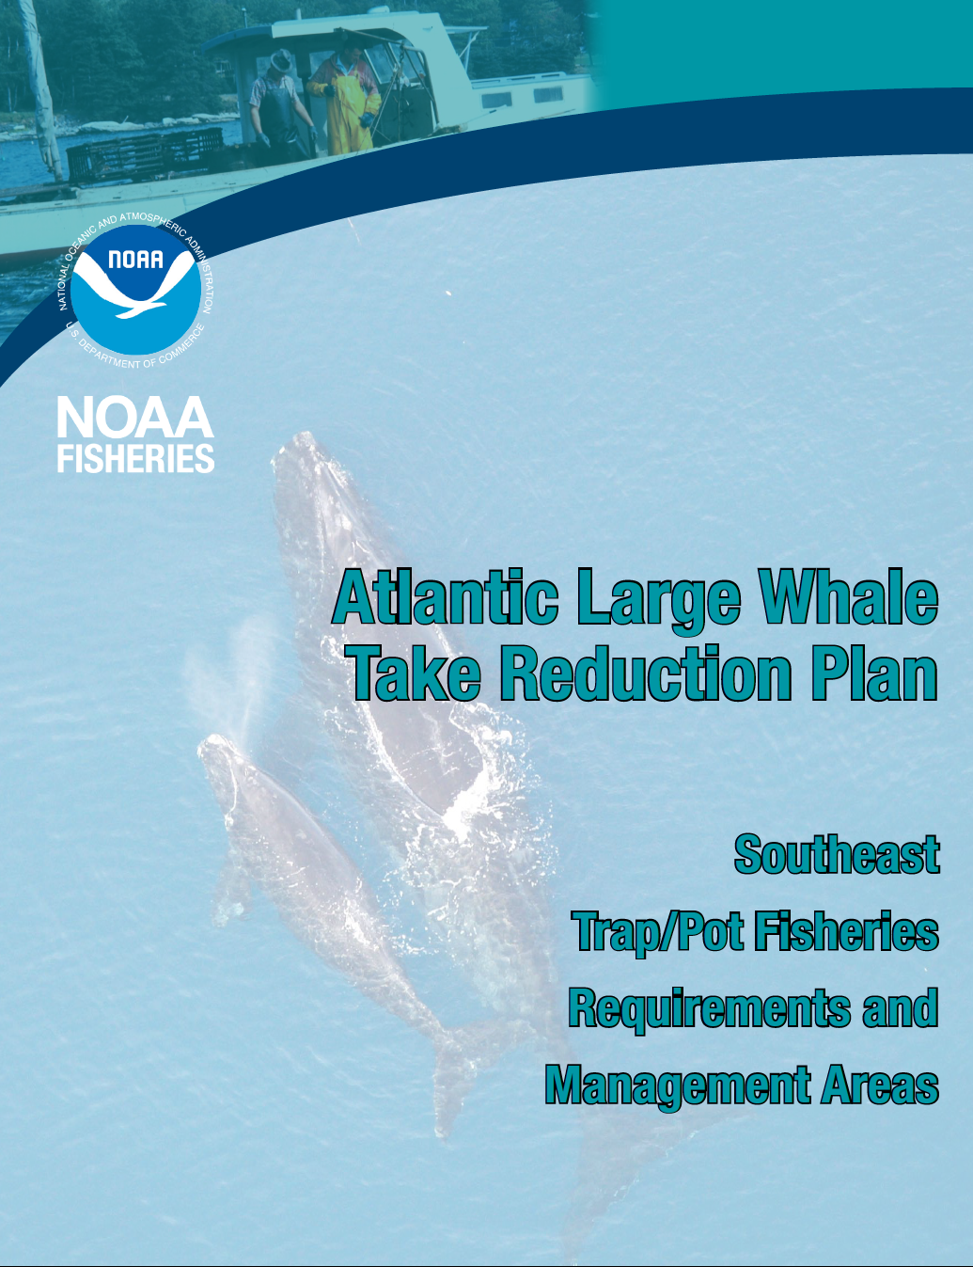
ALWTRP: 2014 Amendment
Notes:
Now an overview of requirements included in the 2014 amendments to the ALWTRP. First, I’ll talk about the area NC-FL, then I’ll finish by touching on some northeast requirements and information that I think you might be interested in.

Slide 11
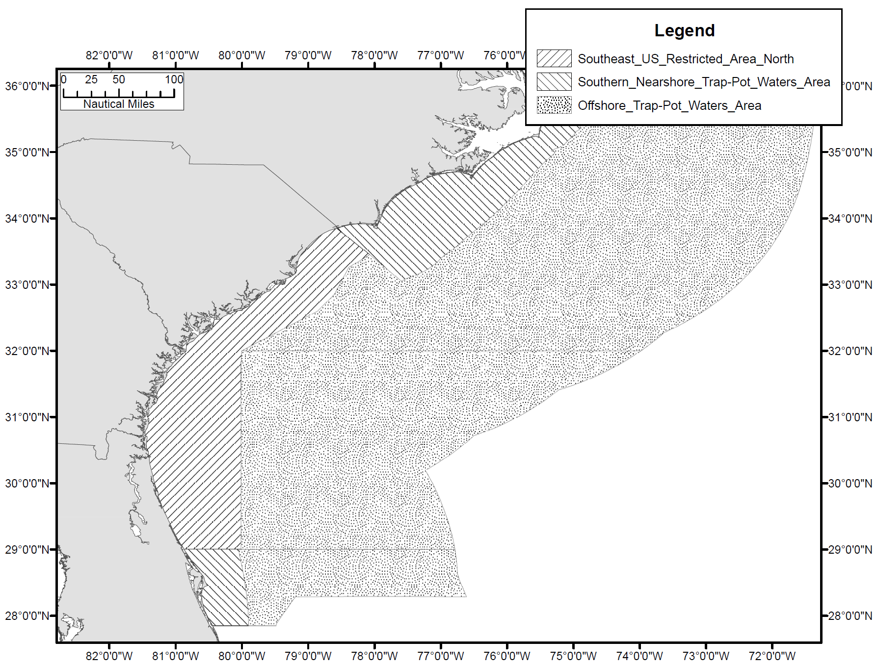
2014 ALWTRP Amendment
Requirements vary by geographic area
Increases Size and Frequency of Gear Marking
Notes:
The trap/pot gear requirements vary by geographic area. There are 3 trap/pot management areas from NC to FL.
These trap pot areas include:
The Southeast US Restricted Area North which extends from central/east FL through SC. (This area also regulates gillnet fishing under the ALWTRP). This area is regulated from Nov 15-April 15.
The Southern Nearshore Trap Pot waters area which includes areas within our region off NC and S. Florida. The portion off S. FL is regulated from Dec 1-March 31. The Portion off NC (which actually extends North through Connecticut) is regulated from Sept 1-May 31.
The largest area is the Offshore Trap Pot waters area (which also extends Northward) is managed from Sept 1-May 31.

Slide 12
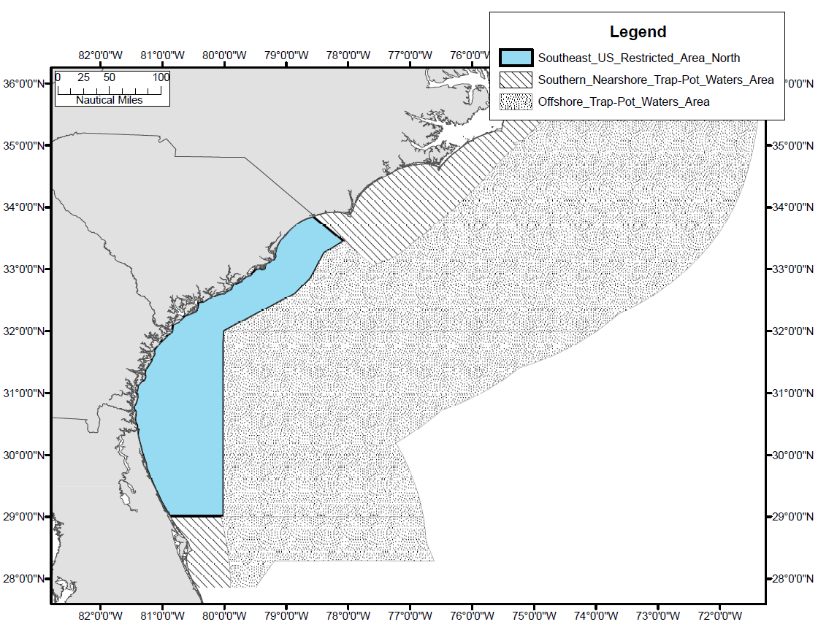
2014 ALWTRP Amendment
Establishes Southeast Restricted Area North
PLACEHOLDER: Map of SE RA North,
Southern Nearshore Trap/Pot Waters, and
Offshore Trap/Pot Waters (like p 13 of SE guide)

Slide 13
2014 ALWTRP Amendment SERA N
DATES | AREA | REQUIREMENTS
Nov 15- Apr 15 | Throughout SERA | Increased Size and Frequency of Gear Marking Maximum 1 trap per vertical line
 | FL State Waters | Weak links ≤ 200 lbs Vertical line breaking strength ≤ 1,500 lbs
 | SC/GA State Waters | Weak links ≤ 600 lbs Vertical line breaking strength ≤ 2,200 lbs
 | Federal Waters | Weak links ≤ 600 lbs Vertical line breaking strength ≤ 2,200 lbs Trap/pot gear must be brought back to shore at the conclusion of each trip
Notes:
Trap/pot trawls are prohibited in the SE Restricted area and all buoy lines must be made of sinking line.
Gear marking also applies to this area (as it does to the other areas shown earlier):
Surface Buoy Marking:
Markings on trap/pot surface buoys need to identify the associated vessel or fishery with one of the following:
• The owner’s motorboat registration number and/or U.S. vessel documentation number;
• The federal commercial fishing permit number; or
• Whatever positive identification marking is required by the vessel’s home-port state.
When marking is not already required by state or federal regulations, the letters and numbers to mark gear must be at least 1 inch (2.5 cm) in height, block letters or Arabic numbers, in a color that contrasts with the color of the buoy.
Buoy Line Marking:
Buoy lines are to be marked with three 12 inch (30.48 cm), colored marks: one at the top of the buoy line, one midway along the buoy line, and one at the bottom of the buoy line.
Each color code must be permanently affixed on or along the line and each color code must be clearly visible when the gear is hauled or removed from the water.
ORANGE: • Southern Nearshore Trap/Pot Waters.
BLACK • Offshore Trap/Pot Waters;
BLUE & ORANGE • Southeast Restricted Area North- state waters
GREEN & ORANGE • Southeast Restricted Area North- Federal watersust be permanently affixed on or along the line and each color code must be clearly visible when the gear is hauled or removed from the water.

Slide 14
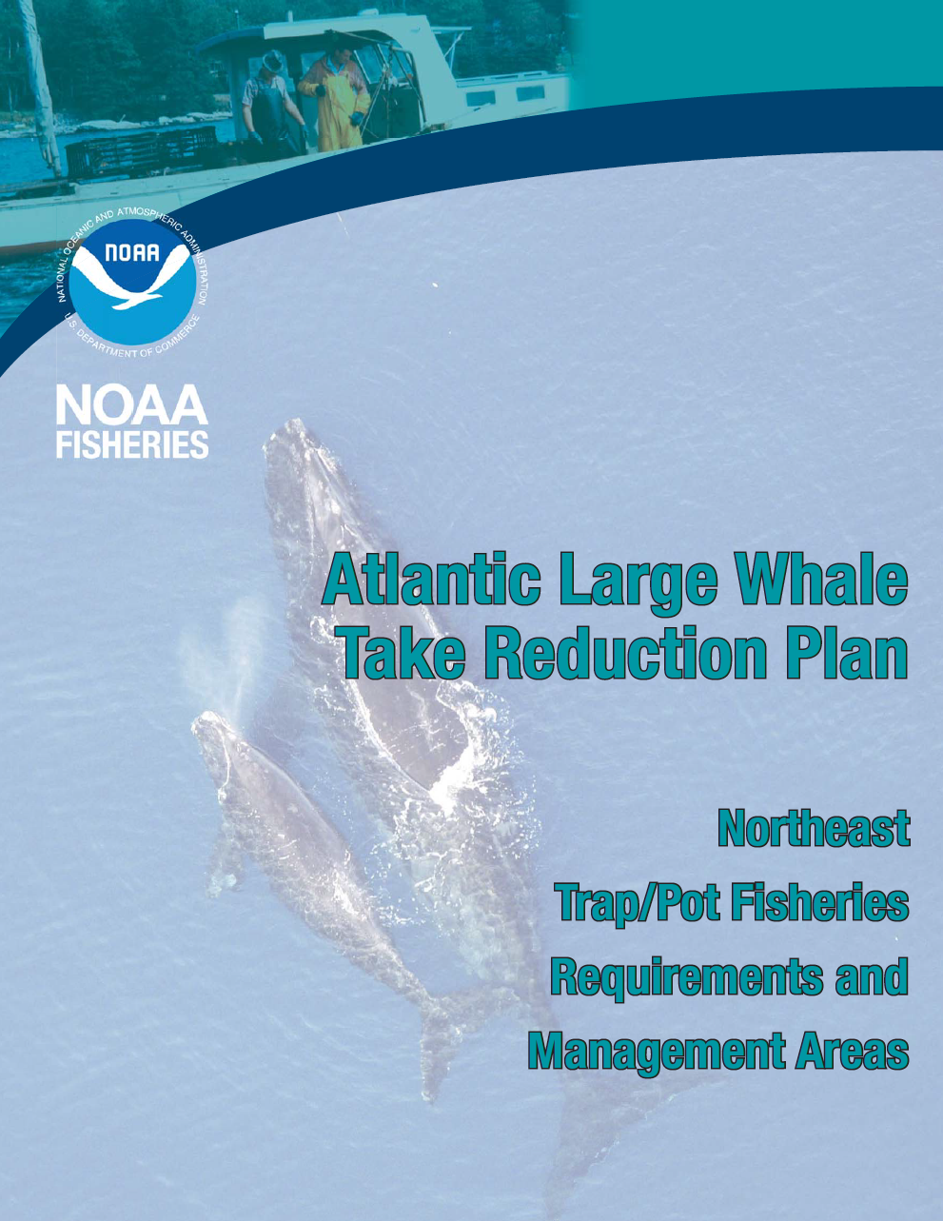
ALWTRP: 2014 Amendment
Notes:
Now, to briefly touch on a few measures in the Northeast. Like elsewhere along the East Coast, ALWTRP requirements (including 2014 measures) in the Northeast vary by season and area.

Slide 15
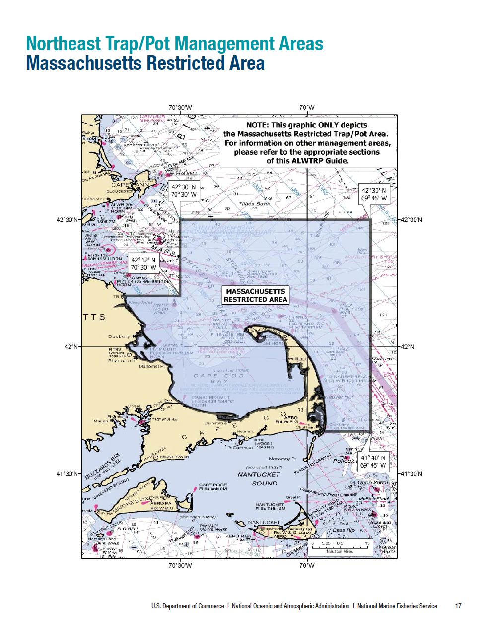
2014 ALWTRP Amendment: Northeast
Specifies minimum number of traps per trawls
Increases Size and Frequency of Gear Marking
Jan 1-Apr 30 Mass. Restricted Area Closed*
Lobster fishery was most economically affected ($1.5m to $3.6m)
*Changes proposed
Notes:
These are not all the NE measures; rather, just a few points that I thought you might be interested in.

Slide 16
Considering ALWTRP Exemptions/Modifications
6 proposals recently submitted for ALWTRT consideration:
5 proposals will be discussed at January meeting
1 proposal considered by the team and is in the proposed rule stage.
Proposals for consideration must address conservation equivalency relative to status quo
Notes:
Marine mammals are protected by the MMPA. Like the ESA, it has set a high bar in terms of protection.
Example of Conservation Equivalency: current proposed rule that team recommended move forward asked that the closed area to lobster fishing (currently closed from Jan 15-Mar 15) be changed to Feb 1 to Mar 31 due to weather and logistic concerns. (Note Length of time equivalent). As the “conservation equivalency,” the proposal expanded the closed area to protect right whales.

Slide 17
Conclusions
Marine Mammal Protection Act has set a high bar
The ALWTRP goal is to achieve MMPA mandate
NARW incidental bycatch in commercial fisheries exceeds levels established by MMPA
ALWTRP
requirements vary by time and space
Monitor results of 2014 ALWTRP amendments
ALWTRP Website: http://www.greateratlantic.fisheries.noaa.gov/Protected/whaletrp/
Notes:
Marine mammals are protected by the MMPA. Like the ESA, it has set a high bar in terms of protection.

Slide 18
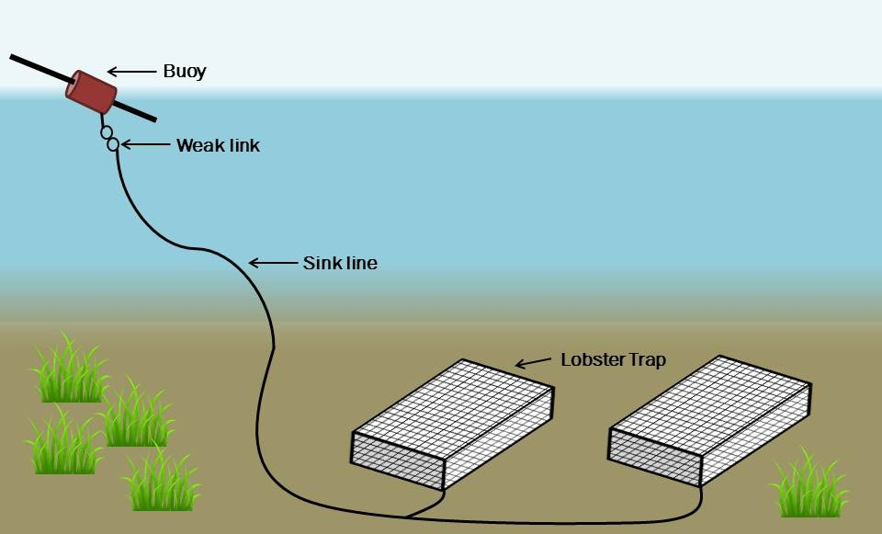
A Note About List of Fisheries and Atlantic Mixed Species Trap/Pot Fishery
Includes U.S. Mid- Atlantic and Southeast U.S. Atlantic Black Seabass Trap/Pot
Category II
Based on analogy with lobster trap/pot fishery (i.e. gear is similar: trap on substrate, buoy on surface, line between the two)
Notes:
Is this slide needed? Was trying to make direct link to SA BSB pot fishery.

