Slide 1
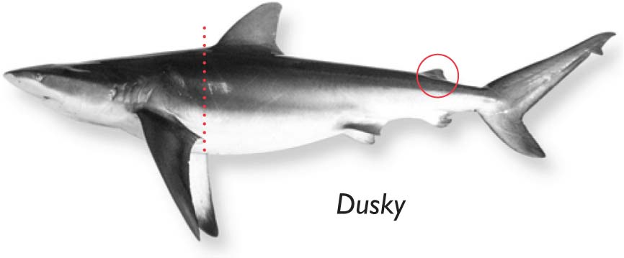
Atlantic Highly Migratory Species
Amendment 5b - Dusky Shark Management Measures:
Proposed Rule
Presented to
Regional Fishery Management Councils
and Marine Fisheries Commissions
Oct. – Dec. 2016

Slide 2
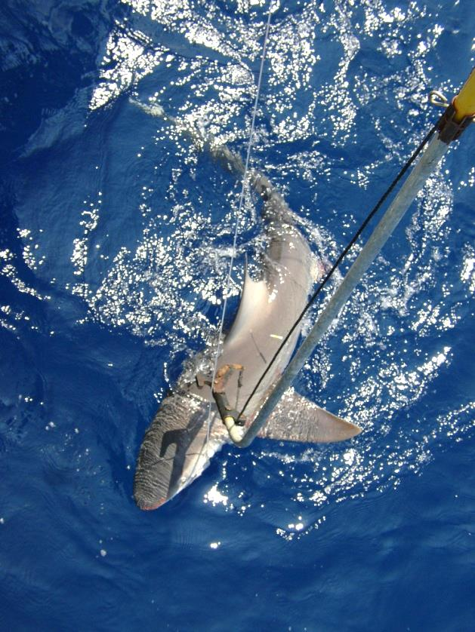
Outline
Background
Management History
SEDAR 21 Update and Addendum
Alternatives Considered
Recreational
Commercial
ACLs and AMs for Prohibited Species
Request for Comments

Slide 3
Management History
2000: Dusky sharks become a prohibited species
2006: First dusky shark assessment – overfished/overfishing
2008: Amendment 2 – rebuilding plan established (rebuild by 2108)
Aug. 2011: SEDAR 21 – still overfished/overfishing
Nov. 2012: Draft Amendment 5 & Proposed rule - multiple shark species
April 2013: Notice of Intent for Amendment 5b – dusky shark specific
March 2014: Amendment 5b Predraft released for comment
Oct. 2015: Oceana filed complaint regarding dusky shark management
May 2016: Settlement agreement reached --
Submit proposed rule to the Federal Register by 10/14/2016
Submit final rule to the Federal Register by 3/31/2017
Oct. 2016:
SEDAR Update and addendum results - still overfished/overfishing
Draft Amendment 5b and proposed rule released

Slide 4
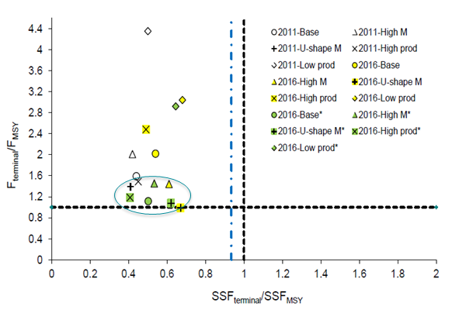
SEDAR 21 Update and Addendum
Status determination published 10/5/2016 (81 FR 69043)
Still overfished and experiencing overfishing
Need to reduce fishing mortality by 35%
Rebuild by 2107

Slide 5
The Preferred Alternatives
The preferred alternatives should:
End overfishing on dusky sharks by reducing fishing mortality levels by at least 35% relative to 2015 levels
Ensure that fishing mortality levels on dusky sharks are maintained at or below levels that would result in rebuilding by 2107
Preferred Recreational Alternatives
Alternative A2 Require HMS permit holders fishing for sharks recreationally to obtain a shark endorsement, which requires completion of an online shark identification and fishing regulation training course, plus additional recreational fisheries outreach.
Alternative A6a Require the use of circle hooks by all HMS permit holders fishing for sharks recreationally and when using natural baits and using wire or heavy (200 lb or greater test) monofilament or fluorocarbon leaders.
Preferred Commercial Alternatives
Alternative B3 Fishermen with an Atlantic shark limited access permit with pelagic longline gear onboard must release all sharks not being retained using a dehooker or cutting the gangion less than three feet from the hook.
Alternative B5 Require completion of a shark identification and fishing regulation training course as a new part of all Safe Handling and Release Workshops for HMS pelagic longline, bottom longline, and shark gillnet vessel owners and operators.
Alternative B6 Increase dusky shark outreach and awareness through development of additional outreach materials, and require HMS pelagic longline, bottom longline, and shark gillnet vessels to abide by a dusky shark fleet communication and relocation protocol.
Alternative B9 Require the use of circle hooks by all HMS directed shark permit holders using bottom longline gear.
Notes:
Pg 375 of DEIS

Slide 6
Other Recreational Alternatives Considered
Alternative A1: No action. Do not implement management measures to end overfishing and rebuild dusky sharks in the Atlantic recreational shark fishery
Alternative A3: Require HMS permit holders fishing for sharks recreationally to have a NMFS – approved shark identification placard onboard when fishing for and/or retaining sharks
Alternative A4: Prohibit retention of all ridgeback sharks, including oceanic whitetip, tiger, and smoothhound sharks, in the Atlantic recreational shark fishery
Alternative A5: Increase the recreational minimum size to 89 inches fork length for all sharks
Alternative A6b: Require the use of circle hooks by all HMS permit holders with a shark endorsement when fishing for sharks recreationally (when deploying natural bait while using a 5/0 or larger hook size)
Alternative A6c: Require the use of circle hooks by all Atlantic HMS permit holders participating in fishing tournaments when targeting or retaining Atlantic sharks
Alternative A7: Allow only catch and release of all Atlantic sharks by HMS permit holders. Anglers could fish for and target sharks but retention of all recreationally-caught sharks would be prohibited

Slide 7
Other Commercial Alternatives Considered
Alternative B1: No action. Do not implement additional management measures to end overfishing and rebuild dusky sharks in commercial HMS fisheries
Alternative B2: Fishermen with an Atlantic shark limited access permit and pelagic longline gear onboard would be limited to 750 hooks per pelagic longline set and no more than 800 assembled gangions onboard at any time
Alternatives B4a-h: Prohibit the use of pelagic longline gear in HMS fisheries in various hotspot closures – Charleston Bump, Hatteras Shelf, Mid-Atlantic Bight Canyons, Southern Georges Bank
Alternative B4i: Allow conditional access to dusky shark hotspot closure areas for HMS vessels fishing with pelagic longline gear
Alternative B4j: Implement dusky shark bycatch caps in the pelagic longline fishery
Alternative B7: Request that certain states (NJ, DE, MD, VA) and the ASMFC extend the end of existing Mid-Atlantic shark time/area closure from July 15 to July 31
Alternative B8: Close the Atlantic HMS Pelagic Longline Fishery
Alternative B10: Implement Individual Dusky Shark Bycatch Quotas (IDQs) for the commercial pelagic and bottom longline fisheries

Slide 8
Annual Catch Limits (ACLs) & Accountability Measures (AMs)
Draft Amendment 5b clarifies ACLs and AMs for the 19 prohibited sharks
ACL = 0
Basking | Dusky | Sand Tiger | Sevengill | Bigeye Sand Tiger
Bigeye Thresher | Galapagos | Whale | Sixgill | Bigeye Sixgill
Bignose | Longfin Mako | White | Narrowtooth | Smalltail
Caribbean Reef | Night | Atlantic Angel | Caribbean Sharpnose
Small amounts of bycatch are permissible where the ACL is set to zero and the bycatch is small and does not lead to overfishing
There is a small amount of bycatch and illegal landings of prohibited sharks; this bycatch is not causing overfishing for most species
For dusky sharks, the small levels of bycatch are causing overfishing
The measures proposed in Draft Amendment 5b are AMs
Additional AMs are not needed for dusky sharks and other prohibited sharks

Slide 9
Specific Request for Public Comments
Mortality reduction and rebuilding objectives based upon SEDAR 21 update
ACL and AM approach for prohibited sharks
Alternative A2
How can NMFS effectively implement the shark endorsement?
Appropriate effective date
Implementation strategy
Alternatives A6a and A6b
Will the circle hook approach ensure the measure applies to the shark fishery?
Should different indicators of the recreational shark fishery be adopted?
Are ≥ 200 lb test monofilament or fluorocarbon leaders good indicators?
Is 5/0 or greater size hook a good indicator?
Paperwork Reduction Act collection of information necessity

Slide 10
Request for Public Comments
Comment period closes on: December 22, 2016
Please submit comments to:
http://www.regulations.gov
Keyword - “NOAA-NMFS-2013-0070”
Comments can also be submitted via fax: 301-713-1917, Attn: Tobey Curtis
Or Mail: NMFS SF1, 1315 East-West Highway, Silver Spring, MD 20910
Please identify comments with NOAA-NMFS-2013-0070
For more information go to: http://www.nmfs.noaa.gov/sfa/hms/ or contact Tobey Curtis tobey.curtis@noaa.gov or Karyl Brewster-Geisz karyl.brewster-geisz@noaa.gov at (301) 427-8503

