Slide 1
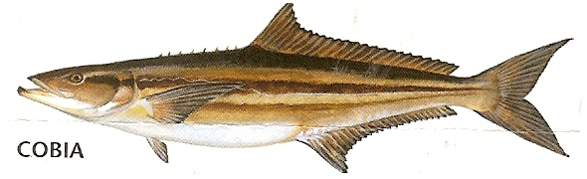
Federal Management for
Atlantic (GA-NY) Cobia
Prepared by: South Atlantic Fishery Management Council Staff
Presented by: Kari MacLauchlin
February 23, 2017
Notes:
test

Slide 2
Outline
South Atlantic Fishery Management Council
Mandates for federally managed stocks
Federal management of Atlantic cobia
2016 and 2017 recreational fishing seasons
Stock assessment (SEDAR)
Opportunities for public input
Contact info

Slide 3
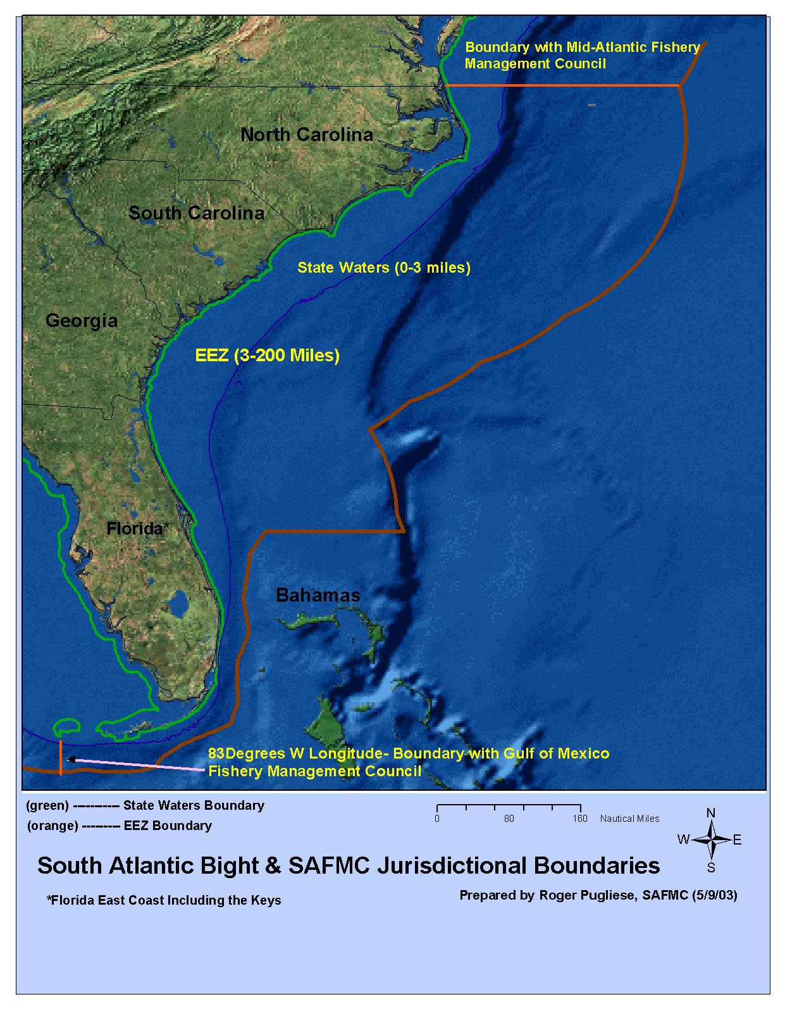
South Atlantic Fishery Management Council
Exclusive Economic Zone (EEZ): 3 - 200 nautical miles off the U.S. coast
In the South Atlantic Region – NC, SC, GA, and East FL (to FL Keys)
Management of Cobia/King & Spanish Mackerel in federal waters– S. Atl & Mid-Atl (thru NY) in joint management plan with the Gulf of Mexico Council

Slide 4
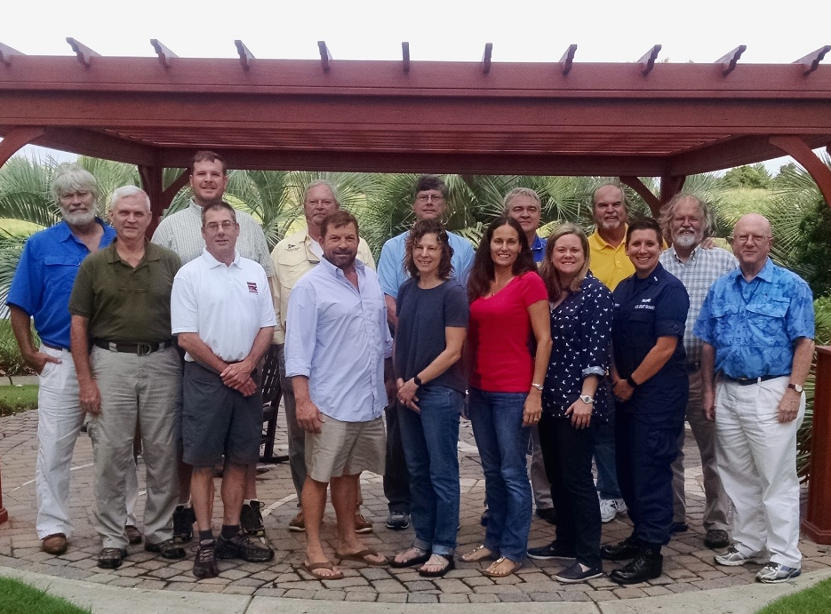
Council Members
Recreational and commercial fishermen
State marine agency representatives
MAFMC: 2 voting seats on Mackerel Cobia Committee
Federal partners: voting
NOAA Fisheries (NMFS)
Federal partners:
Vote on committees, not at full Council
US Coast Guard
USFWS
ASMFC
Department of State
Notes:
There are 17 members of the South Atlantic Fishery Management Council. Representatives from each of the state’s marine resources agencies, 2 representatives from each state, generally one commercial fishing representative and 1 recreational representative and federal partners (reference list). There are 13 voting members on the Council. Non-voting members include US Coast Guard, USFWS, ASMFC and the Dept. of State. All other members, including NOAA Fisheries Service may vote on various fisheries issues.
Each state’s marine resources agency is represented. NOAA Fisheries has one voting member, Dr. Roy Crabtree, the Regional Administrator for NMFS. Members of the US Coast Guard, US Fish & Wildlife Service, Atlantic States Marine Fisheries Commission and a representative from the Dept. of State are all non-voting members.

Slide 5
Federal Mandates
Stock status definitions and measures of those
  Overfished
  Overfishing
Annual catch limits
Accountability measures
Management measures (harvest limits, permits, etc)

Slide 6
Gulf and Atlantic Cobia
Joint fishery management plan (FMP) for coastal migratory pelagics (CMP) in the Gulf of Mexico and Atlantic region, implemented in 1982
Gulf Council manages Gulf cobia,
South Atlantic Council manages Atlantic cobia + Florida east coast
The stock boundary is at the GA/FL line.

Slide 7
Stock Status Definitions-
What does “overfished” mean and how is that determined?
Atlantic Cobia = Not Overfished
  A stock designated as ‘overfished’ has a population size that is too small.
  CMP FMP specifies metrics provided by the stock assessment to determine ‘overfished’ status
    If Spawning Stock Biomass < Minimum Stock Size Threshold, the stock is designated as ‘overfished.’
  If a stock is designated as overfished, federal mandate requires the Council to establish a rebuilding plan.
  SEDAR 28 (2012): Atlantic cobia stock is not overfished

Slide 8
Stock Status Definitions-
What does “overfishing” mean and how is that determined?
Atlantic Cobia = Overfishing did occur in 2015 and 2016
  ‘Overfishing’ of a stock occurs when the annual catch rate is too high.
  Overfishing can lead to an overfished stock.
  CMP FMP specifies metrics provided by the stock assessment to determine ‘overfishing’ status
    If Fishing Mortality > Maximum Fishing Mortality Threshold, the stock is designated as experiencing ‘overfishing.’
  Atlantic cobia ‘overfishing’ is also occurring if landings exceed the Overfishing Level (OFL), which is determined by the Scientific and Statistical Committee (SSC)
  If overfishing is occurring, Council must take corrective action.
  SEDAR 28 (2012): Overfishing is not occurring
  Overfishing occurred in 2015 and 2016 because landings >OFL

Slide 9
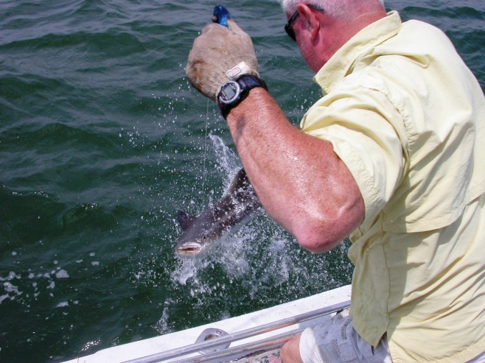
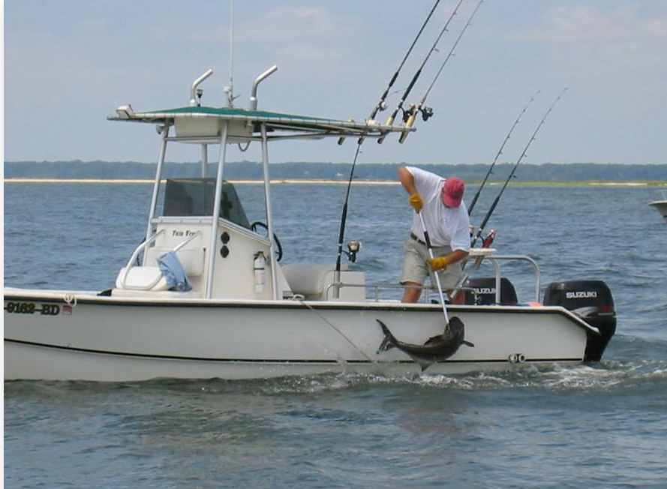
Annual Catch Limits
The amount of fish in numbers or pounds that can be harvested in a single year
Based on the Acceptable Biological Catch set by the Scientific and Statistical Committee, based on stock assessment (SEDAR 28 for cobia)
Accountability measures are required to prevent and mitigate overages
Photo Credit: SCDNR

Slide 10
Stock Boundary
Boundary between Gulf and Atlantic stocks is at the Georgia/Florida line
SEDAR 28 (2012) stock boundary
  Based on microsatellite DNA and supported by tag-recapture data
Amendment 20B (2015) revised stock boundary to be at the Georgia/Florida line to align management boundary with the SEDAR 28 boundary

Slide 11
Annual Catch Limits
Implemented through Amendment 20B on March 1, 2015
Atlantic Cobia (GA-NY):
  Stock ACL = 670,000 lbs for 2016 and subsequent years
    Recreational (92%) = 620,000 lbs
    Commercial (8%) = 50,000 lbs
Gulf Cobia:
  Stock ACL = 2.59 mp
  Gulf Zone ACL = 1.66 mp
  Florida East Coast Zone ACL = 930,000 lbs
    Recreational (92%) = 860,000 lbs
    Commercial (8%) = 50,000 lbs

Slide 12
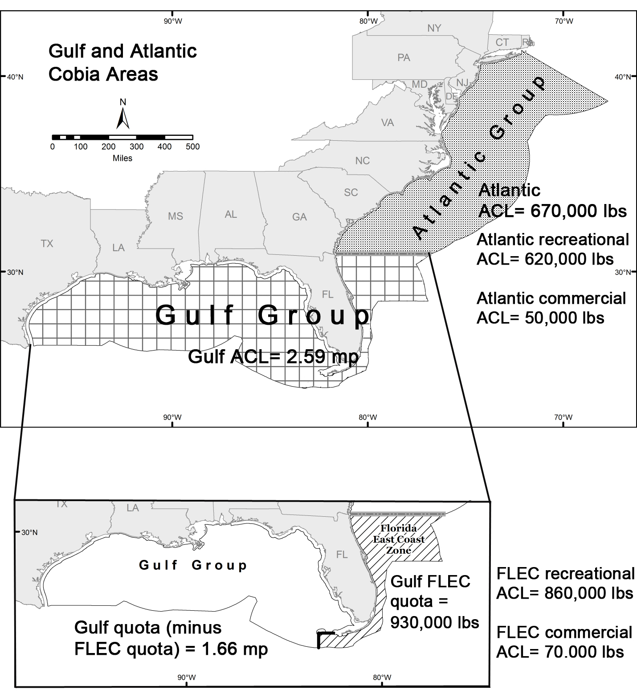
The Gulf and
Atlantic groups are
designated as two
different stocks.
Each stock has its
own annual catch
limit, which is based
on recommendations
from each Council’s
Scientific and Statistical
Committee.
The annual catch limit
applies only to cobia
caught within each stock’s
boundaries.
The quotas cannot be
moved between the two
stocks.

Slide 13
Accountability Measures
Accountability measures are required to prevent catch from exceeding the annual catch limits and to mitigate overages. This helps to stop/slow overfishing, and prevent a stock from becoming overfished.
Current AMs were implemented in Amendment 18 on January 30, 2012
Commercial AMs
  In-season closure if commercial landings reach (or are projected to reach) the commercial ACL.
  If landings exceed the ACL and Atlantic cobia are designated as overfished, next year’s commercial ACL will be reduced by amount of overage.
Recreational AMs
  If rec ACL and stock ACL are exceeded, the next year’s recreational season will be shortened so that landings reach the annual catch target but not exceed the rec ACL.
  If landings exceed the ACL and Atlantic cobia are designated as overfished, next year’s rec ACL will be reduced.
  Recreational landings evaluated as average of the most recent 3 years.

Slide 14
Accountability Measures
Proposed changes to Recreational AMs (Framework Amendment 4)
  If rec ACL and stock ACL are exceeded, the next year’s vessel limit will be reduced to no lower than 2/vessel. If this is not sufficient to keep landings from exceeding the ACL and to mitigate the overage, NMFS will also reduce the next year’s season length so that landings reach the annual catch target but not exceed the rec ACL.
  Recreational landings evaluated using only that year’s landings (remove the 3-year moving average for evaluation).
    A 3-year moving average was intended to capture the dynamics of the fishery. However, the Council decided that the 3-year moving average would be more likely to penalize fishermen because one year of high landings would be included in the evaluation for the next 3 years.
  This will stay in place: If landings exceed the ACL and Atlantic cobia are designated as overfished, next year’s rec ACL will be reduced.
Proposed rule for Framework Amendment 4 published on 2/21/17.
Expected implementation TBD, due to regulatory freeze in place.

Slide 15
Atlantic Cobia
Current management measures in the EEZ:
- 2/person possession limit (comm and rec)
- 33” inches fork length (FL) minimum size
- must be landed intact
- commercial cobia from EEZ must be sold to federal dealer
Proposed measures (Framework Amendment 4):
- Rec limit: 1/person and no more than 6/vessel
- Comm limit: 2/person and no more than 6/vessel
- 36” inches FL minimum size for recreational
- Also revised recreational AMs
- Proposed rule published 2/21/17, comment period closes 3/23/17.
http://sero.nmfs.noaa.gov/fishery_bulletins/2017/012/index.html
- Regulatory freeze may delay implementation of final rule

Slide 16
2016 and 2017 Fishing Seasons
2015 recreational Annual Catch Limit = 630,000 lbs
2015 recreational landings = 1,554,394 lbs
Triggered the Accountability Measure, so the 2016 fishing season closed on June 20, 2016, for federal waters
2016 recreational Annual Catch Limit = 620,000 lbs
2016 recreational landings = 1,346,193 lbs
Triggered the Accountability Measure, so the 2017 fishing season closed on January 23, 2017, for federal waters
NMFS had to assume that some states would keep state waters open, which would contribute to 2017 landings reaching the Annual Catch Limit

Slide 17
What is SEDAR?
Southeast Data, Assessment, and Review
  Data Stage
    Data are compiled, reviewed, evaluated
    Participants include state, agency and university researchers, data collectors, analysts, SSC and fishermen
  Assessment Stage
    Assessment models are developed and refined
    Participants include analysts, SSC and fishermen
  Review Stage
    Independent peer review of data, models and findings
    Reviewers include SSC and CIE representatives
      Center for Independent Experts – outside, independent scientists

Slide 18
SEDAR Activities for Cobia
SEDAR 28 completed in 2012, using data through 2011
Stock ID workshop (several species including cobia) cancelled
Research Track Assessment starts in 2018
  Develop models and methods to use in the operational assessment
  Examine stock structure (boundaries) and stock spawning biomass
  No evaluation of overfishing or overfished status
  No management advice
  Operational Assessment scheduled for 2020
  Determination of overfished/overfishing status
  Will result in management advice

Slide 19
Public Input Opportunities
SAFMC meeting in Jekyll Island, GA
March 6-10, 2017
Public comment session at 4:30pm on Wed Mar 8
Upcoming SAFMC meetings
Ponte Vedra, FL- June 2017
Charleston, SC- Sept 2017
Atlantic Beach, NC- Dec 2017

Slide 20
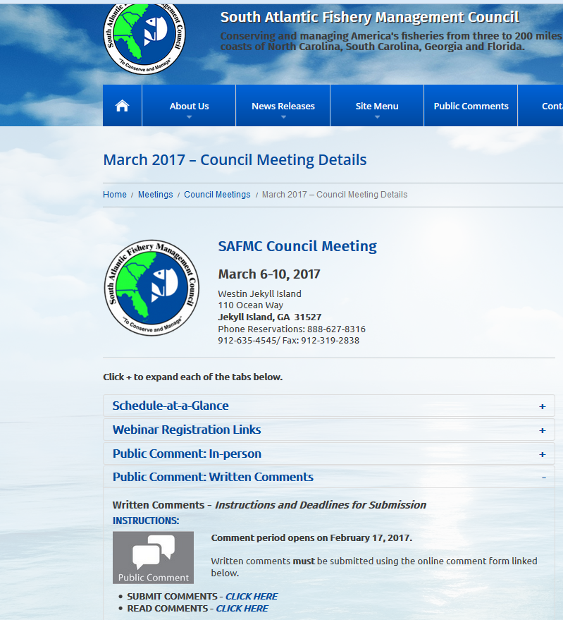
SAFMC March 2017 Meeting webpage:
http://safmc.net/safmc-meetings/council-meetings/safmc-meeting-march2017/
SAFMC meeting
March 6-10, 2017
Jekyll Island, GA
Public comment
session at 4:30pm
on Wed Mar 8
Cobia discussion
during Mackerel Cobia
Committee starts at
3:30 pm on Wed Mar 8
Tune in via webinar
Everyday!

Slide 21


Need more Information?
Want to Get Involved in the Process?
If you have questions about federal management of Cobia→
Kari MacLauchlin
843.302.8437 (office)
Kari.MacLauchlin@safmc.net
For general questions about the Council:
Kim.Iverson@safmc.net
Public Information Officer
www.safmc.net
www.facebook.com/SouthAtlanticCouncil
@SAFMC
Notes:
Picture is black sea bass from Gray’s reef NMS.

