Slide 1
Options
Atlantic King Mackerel Trip Limits
Staff Overview – not in briefing book; tracks material in the Decision Document
Notes:
For the most part, these staff overviews will not be provided to the Council. The information is usually included in the Decision Document. This allows staff the opportunity to brief the committee at the beginning of the committee meeting. In some instances, when new material is included, copies will be provided to the committee and posted to the Council’s website.

Slide 2
What the Council did in June
Reviewed potential options
Directed staff to provide options paper in September 2017
Notes:
Review what was done at the last meeting. Just to remind everyone of what was done.

Slide 3
Potential Timing
September 2017 Council reviews options and directs staff to start work on a framework amendment
December 2017 Council reviews the draft amendment, selects preferred alternative(s), modifies the document as necessary, and approves for public hearings
January 2018 Public hearings
March 2018 Council takes final action on framework amendment
April 2018 Framework amendment transmitted for Secretarial Review
Late 2018 Implementation
Notes:
Here is the timing you approved at the last meeting.

Slide 4
What needs to be done at this meeting to meet the potential timing:
Review options to adjust the Atlantic king mackerel trip limits in the Atlantic Southern Zone.
Direct staff to start work on the framework amendment, and approve alternatives to be included for analysis.
Notes:
Here is what needs to be done at this meeting to stay on schedule. If these items are not finalized, then the schedule will be delayed, which would impact other amendments.

Slide 5
Action: Modify the commercial trip limits of Atlantic king mackerel
Alternative 1 (No Action): The commercial trip limits for Atlantic king mackerel:
North of Flagler/Volusia line: 3,500 lbs year-round
South of Flagler/Volusia line:
      Season 1 (Mar - Sept)
        Mar 1-Mar 31: 50 fish
        Apr 1: 75 fish until 75% of the Season 1 quota is met, and then the trip limit is 50 fish until Sept
      Season 2 (Oct-Feb): 50 fish
        Starting Feb 1 through the end of Feb, if less than 70% of the Season 2 quota has been met, the trip limit increases to 75 fish.
Notes:
Hard to see a Vision. Confusing and difficult to grasp overall picture of what is being proposed. Council staff developed a potential alternative approach for the Committee to consider.

Slide 6
Action: Modify the commercial trip limits of Atlantic king mackerel
Alternative 2: Adjust the commercial trip limits for Atlantic king mackerel in the Atlantic Southern Zone for Season 1:
Season 1
March 1- March 31
  North of Flagler/Volusia line: 3,500 lbs
  South of Flagler/Volusia line: 50 fish
        April 1 – September 30
  North of Flagler/Volusia line: 3,500 lbs
  South of Flagler/Volusia line: : 75 fish until 75% of the Season 1 quota is met, and then the trip limit is 50 fish until Sept 30
Notes:
Hard to see a Vision. Confusing and difficult to grasp overall picture of what is being proposed. Council staff developed a potential alternative approach for the Committee to consider.

Slide 7
Action: Modify the commercial trip limits of Atlantic king mackerel
Alternative 3: Adjust the commercial trip limits for Atlantic king mackerel in the Atlantic Southern Zone for Season 1:
Season 1
North of Flagler/Volusia line: 3,500 lbs
South of Flagler/Volusia line:
March 1- March 30→ 50 fish
        April 1 – September 30→ 75 fish until 75% of the Season 1 quota is met, and then the trip limit is 50 fish until Sept 30
Notes:
Hard to see a Vision. Confusing and difficult to grasp overall picture of what is being proposed. Council staff developed a potential alternative approach for the Committee to consider.

Slide 8
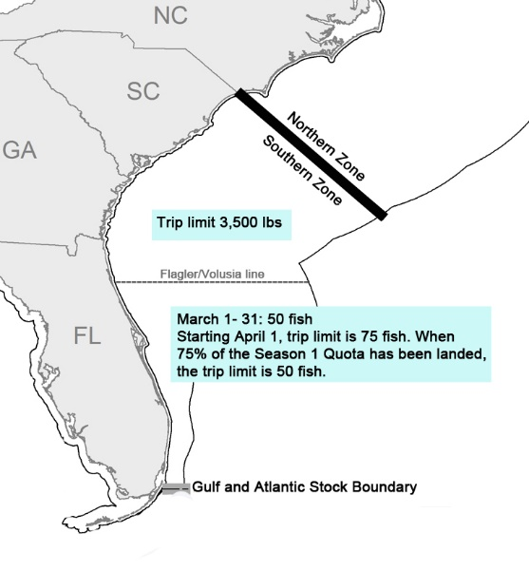
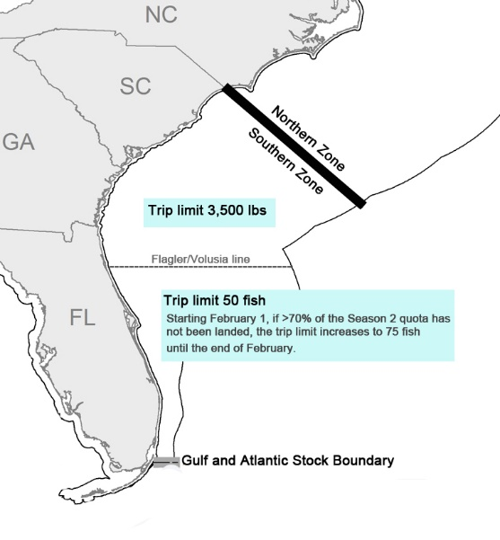
Alternative 1 (No Action). Trip limits established in CMP Amendment 26.
March 1 – September 30
October 1 – end of February
Season 1= March 1 through Sept 30
Season 2= Oct 1 through end of February
Notes:
Hard to see a Vision. Confusing and difficult to grasp overall picture of what is being proposed. Council staff developed a potential alternative approach for the Committee to consider.

Slide 9
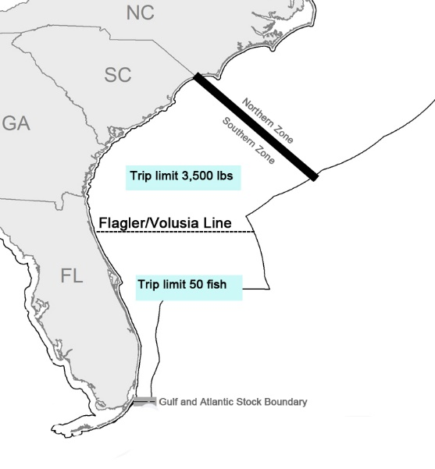
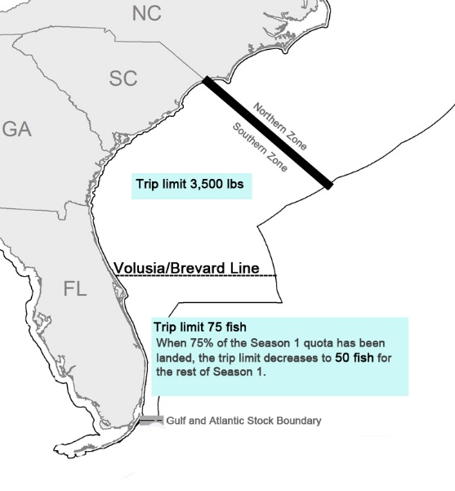
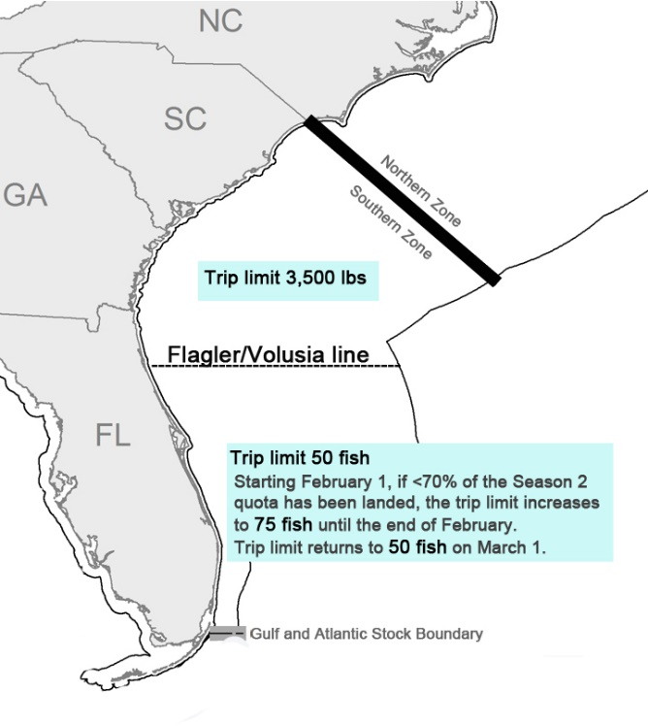
Alternative 2. Moves the boundary to Volusia/Brevard starting April 1
March 1 – March 30
Apr 1 – Sept 30
October 1 – end of February
Season 1= March 1 through Sept 30
Season 2= Oct 1 through end of February
Notes:
Hard to see a Vision. Confusing and difficult to grasp overall picture of what is being proposed. Council staff developed a potential alternative approach for the Committee to consider.

Slide 10
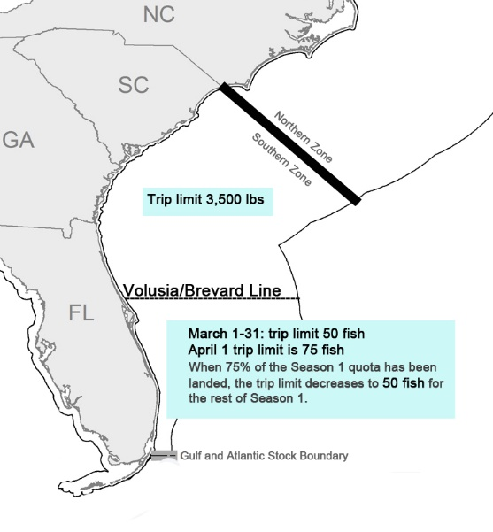
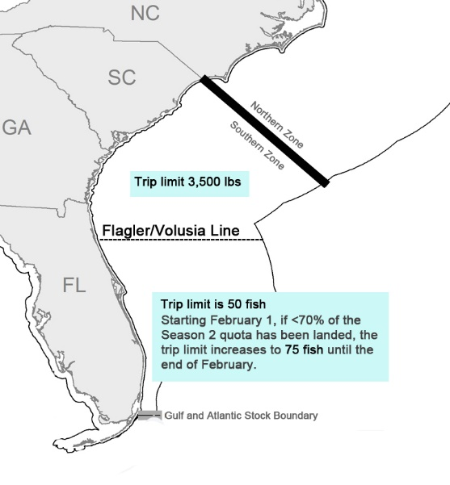
Alternative 3. Moves the boundary to Volusia/Brevard for all of Season 1
March 1 – September 30
October 1 – end of February
Season 1= March 1 through Sept 30
Season 2= Oct 1 through end of February
Notes:
Hard to see a Vision. Confusing and difficult to grasp overall picture of what is being proposed. Council staff developed a potential alternative approach for the Committee to consider.

Slide 11
Committee Actions
1) Modify the alternatives and add alternatives/sub-alternatives, if necessary.
2) ACCEPT ALTERNATIVES 1 THROUGH X
Notes:
The Alternative Approach would add one Council meeting to the process. Committee/Council to decide whether the additional clarity is worth the additional time and provide guidance on which approach to discuss today.

Slide 12
Any Adjustment to Timing?
September 2017 – Direct staff to start work on the framework amendment, and approve alternatives to be included for analysis.
Was this accomplished? If not revise timing.
December 2017 - Review/Finalize actions/alternatives and Purpose and Need; approve for public hearings
January/February 2018 – Public hearings
March 2018 – review public comment, modify document, and approve approve for formal review.
Notes:
The Alternative Approach would add one Council meeting to the process. Committee/Council to decide whether the additional clarity is worth the additional time and provide guidance on which approach to discuss today.

Slide 13
Comments
Important to have 75 fish in March not 50, would allow fishermen to take advantage of good prices and availability
- The stock is doing well and the 75-fish limit in March would not negatively affect the stock.
- 3,500 lb landing limit north of the Volusia/Brevard county line in months April 1- September 30
- Split season allocation 70/30
- Stacked permits (double or 1.5 trip limits)

