Slide 1
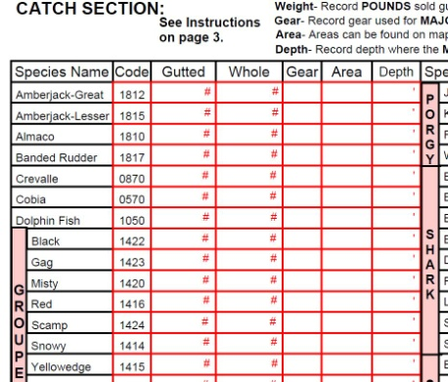
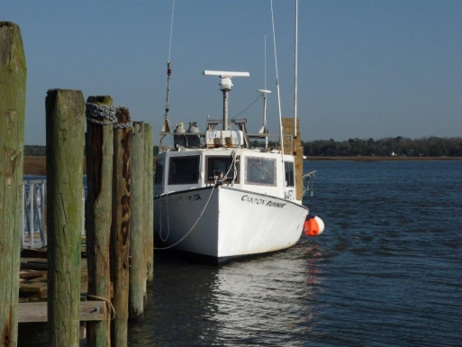
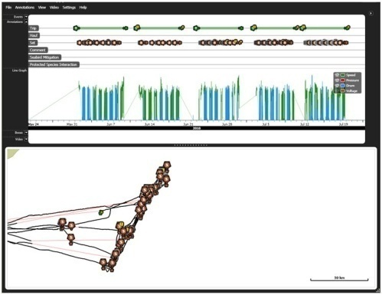




Opportunities and Challenges Associated with EM and VMS Data Use in the Snapper Grouper Commercial
M. Scott Baker Jr.,
N.C. Sea Grant Program, UNCW, Wilmington, N.C., 28409
bakers@uncw.edu / 910-962-2492
SAFMC Snapper Grouper Advisory Panel Meeting
N. Charleston, SC
April 23, 2013

Slide 2
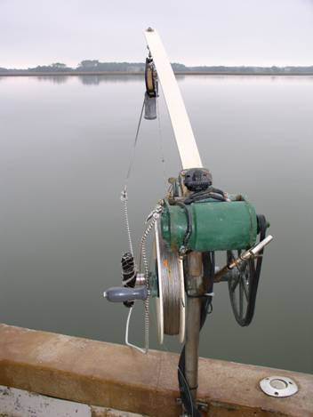
Presentation Outline
Updated results from 2010 EM pilot project
2012 survey results related to EM
Opportunities and challenges for
electronic data (EM, VMS, etc.)
usage to enhance fishing effort
documentation in the Snapper
Grouper fishery

Slide 3
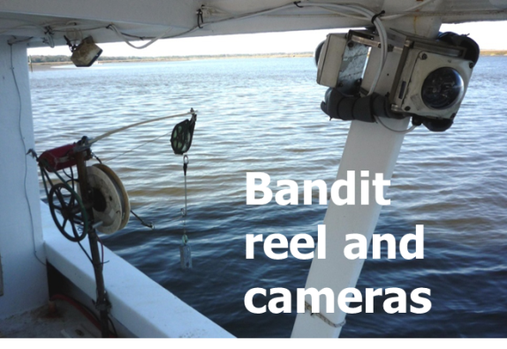
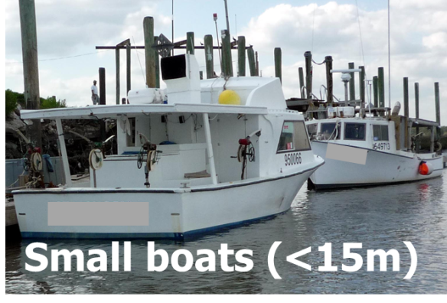
Main Objective of EM Pilot Study
Compare EM based catch counts and species identification success to that collected by an at-sea observer on 5 trips (4 vessels, 26 sea days)
Notes:
This study had 3 primary objectives. The first 2 will be discussed today.
Evaluate electronic monitoring as a tool to characterize fishing activities of the bandit fleet.
Validate content of self-reported logbooks through random sensor and video based audits.
In terms of costs, research has shown that an EM-based audit approach can be very effective at validating content of self-reported logbooks completed by fishermen. Because fishermen in the SA SG fishery are already required to complete federal logbooks – we felt that the best approach to consider would be an “audit-based approach.”

Slide 4
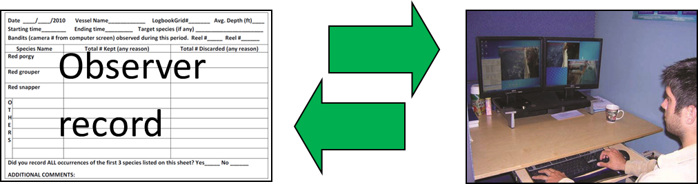
Methods
One camera installed per reel (max 4 cameras)
Observer recorded fishing activity at the hook
level.
Observer data used to define fishing events in
the EM record
EM viewer analyzed all video from observer’s
events
Notes:
This study had 3 primary objectives. The first 2 will be discussed today.
Evaluate electronic monitoring as a tool to characterize fishing activities of the bandit fleet.
Validate content of self-reported logbooks through random sensor and video based audits.
In terms of costs, research has shown that an EM-based audit approach can be very effective at validating content of self-reported logbooks completed by fishermen. Because fishermen in the SA SG fishery are already required to complete federal logbooks – we felt that the best approach to consider would be an “audit-based approach.”

Slide 5
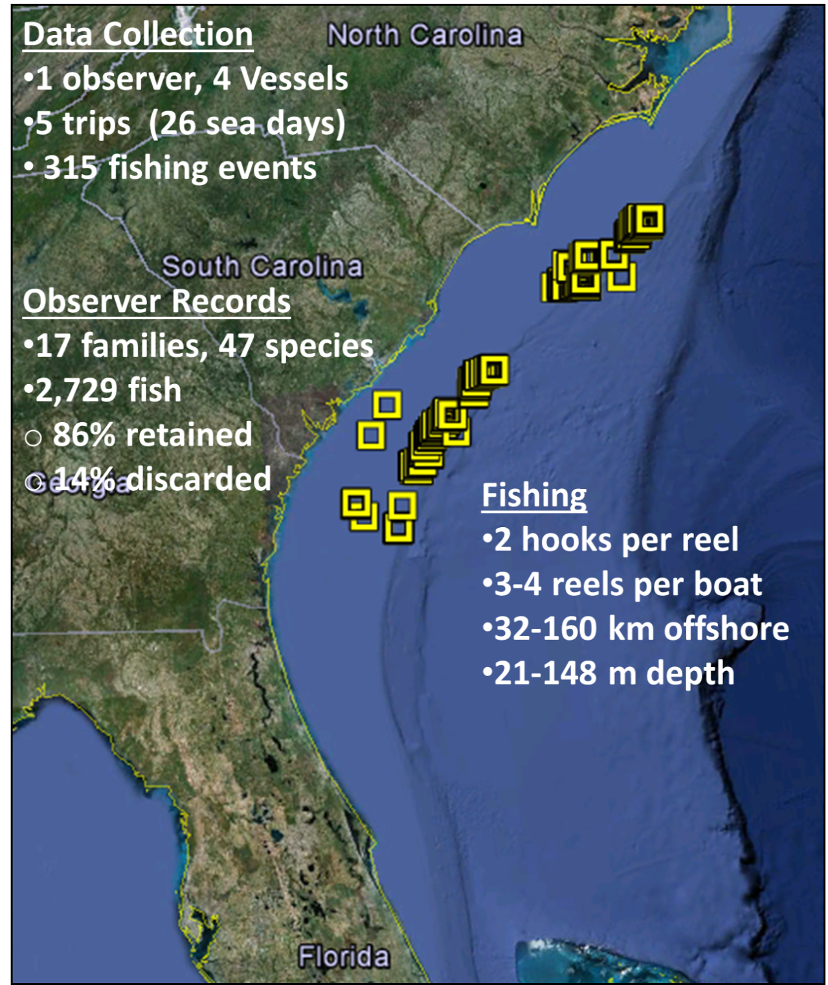

Study Area:
U.S. South
Atlantic off NC, SC and GA

Slide 6
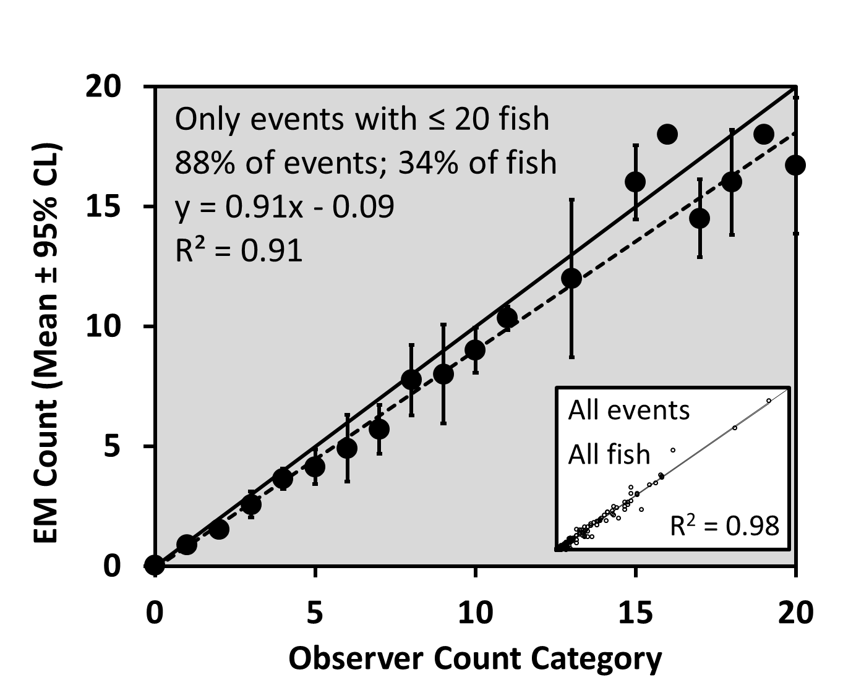
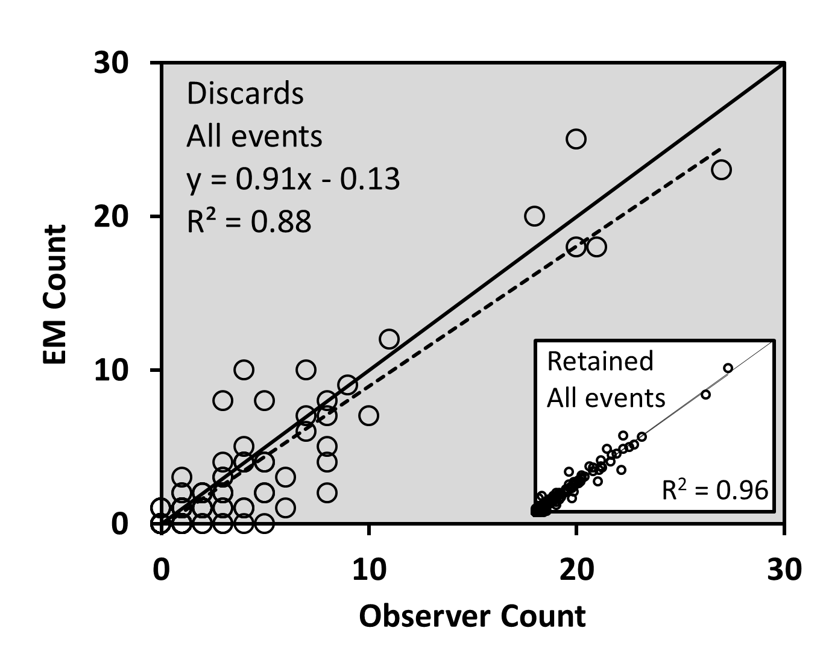
Fish Count Comparisons
Low catch numbers dominate most fishing events
EM viewer better at documenting retained than discarded catch

Slide 7
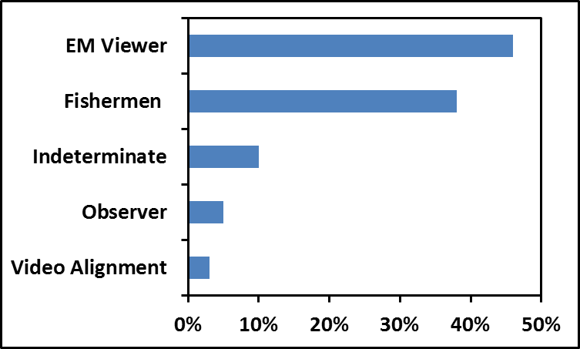
7% of Observed Hooks Missed by EM Viewer
Notes:
This was an ambitious project on many levels, and as expected, many problems were encountered.

Slide 8
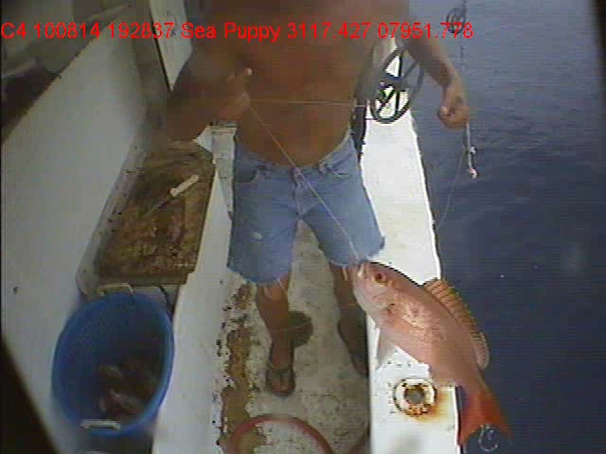
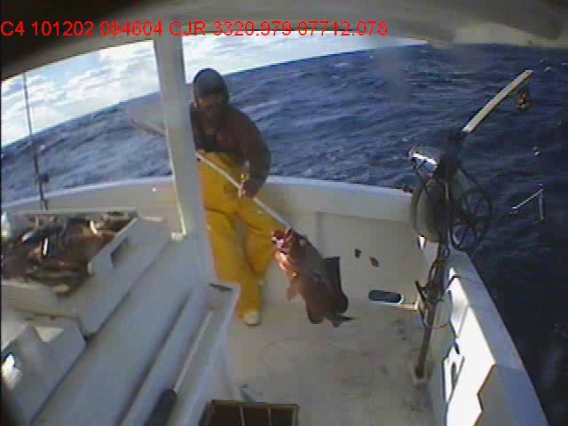

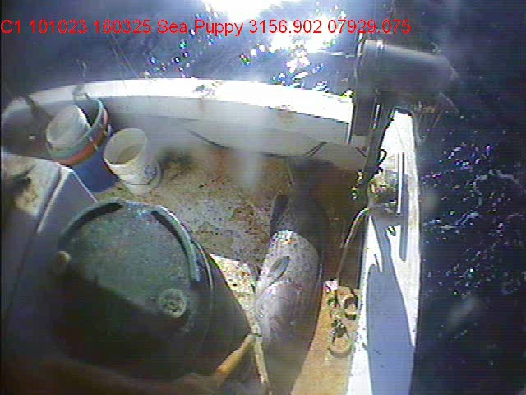
Species Identification by EM
Notes:
This was an ambitious project on many levels, and as expected, many problems were encountered.

Slide 9
Principle Challenges for EM Use
Fishermen incorrectly assumed multiple cameras would capture all activity – not so.
Lack of incentive in pilot projects for fishermen to adopt standardized fish handling procedures to improve on EM review process.
Clear management objectives of EM use need to be decided upon – can not be “do everything” – must prioritize.
Notes:
This was an ambitious project on many levels, and as expected, many problems were encountered.

Slide 10
Conclusions
Need to improve discard counts by EM viewer (14% of observer catch total).
Fixed EM camera positions and imagery obtained
were capable of recording most hooks fished.
EM viewer indicated that the largest impediment to
successful catch documentation was a poor view of
fish. Recommend catch handling procedures.
Explore use of incentives / disincentives – beyond
scope of this pilot study.
Design logbook to allow for EM audit-based
approach.
Notes:
This study had 3 primary objectives. The first 2 will be discussed today.
Evaluate electronic monitoring as a tool to characterize fishing activities of the bandit fleet.
Validate content of self-reported logbooks through random sensor and video based audits.
In terms of costs, research has shown that an EM-based audit approach can be very effective at validating content of self-reported logbooks completed by fishermen. Because fishermen in the SA SG fishery are already required to complete federal logbooks – we felt that the best approach to consider would be an “audit-based approach.”

Slide 11
Presentation Outline
Updated results from 2010 EM pilot project
2012 survey results related to EM
Opportunities and challenges for
electronic data (EM, VMS, etc.)
usage to enhance fishing effort
documentation in the Snapper
Grouper fishery

Slide 12
EM Survey Response = 15%
Notes:
This was an ambitious project on many levels, and as expected, many problems were encountered.

Slide 13
Q. Would you like to see additional cooperative research done testing and evaluating at-sea EM systems?
Notes:
This was an ambitious project on many levels, and as expected, many problems were encountered.

Slide 14
Open-ended responses to Question
Notes:
This was an ambitious project on many levels, and as expected, many problems were encountered.

Slide 15
Q. Do you support the concept of using a third-party data review method like EM to validate logbooks records?
Notes:
This was an ambitious project on many levels, and as expected, many problems were encountered.

Slide 16
Q. The video processing company we used suggesting adopted standardized guidelines for handling fish to make video review quicker and more cost effective. Do you support the adoption of standardized handling guidelines to improve the video review process?
Notes:
This was an ambitious project on many levels, and as expected, many problems were encountered.

Slide 17
Q. While actively bottom fishing (making more than a few test drops) do you typically leave the engine running or turn the engine off?
Notes:
This was an ambitious project on many levels, and as expected, many problems were encountered.

Slide 18
Q. On your vessel, what type of batteries do you use for your “house” bank? This bank of batteries would power auxiliary equipment like electric bandits, plotters, radios, lights, etc.
Notes:
This was an ambitious project on many levels, and as expected, many problems were encountered.

Slide 19
Conclusions
Greater industry not supportive of additional EM research, let alone EM implementation in this fishery. No specific Q asked about VMS…
Fishing styles and battery configurations on some boats may not be well suited for additional electronic loads like EM or VMS.
Anecdotal evidence suggests that newer and lighter “gel” batteries may be better suited to hosting EM and VMS equipment. Should be further explored.
Notes:
This study had 3 primary objectives. The first 2 will be discussed today.
Evaluate electronic monitoring as a tool to characterize fishing activities of the bandit fleet.
Validate content of self-reported logbooks through random sensor and video based audits.
In terms of costs, research has shown that an EM-based audit approach can be very effective at validating content of self-reported logbooks completed by fishermen. Because fishermen in the SA SG fishery are already required to complete federal logbooks – we felt that the best approach to consider would be an “audit-based approach.”

Slide 20
Presentation Outline
Updated results from 2010 EM pilot project
2012 survey results related to EM
Opportunities and challenges for
electronic data (EM, VMS, etc.)
usage to enhance fishing effort
documentation in the Snapper
Grouper fishery

Slide 21
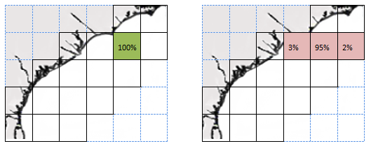
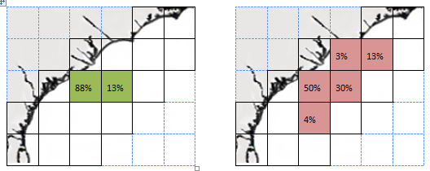
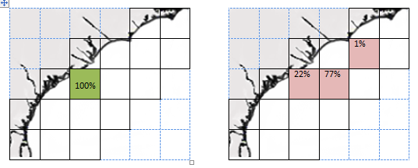
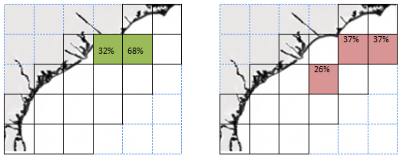
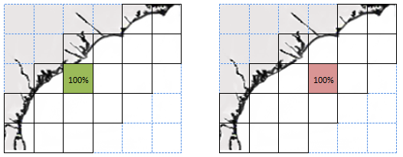
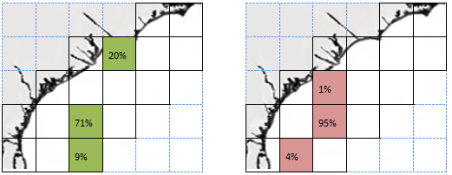
EM Data Can Validate Logbook Effort: Logbook (green) vs. EM (red) for 6 vessels (all trips)
Notes:
This was an ambitious project on many levels, and as expected, many problems were encountered.

Slide 22
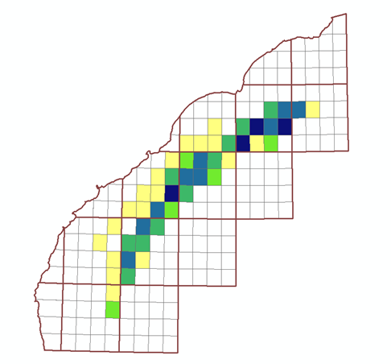
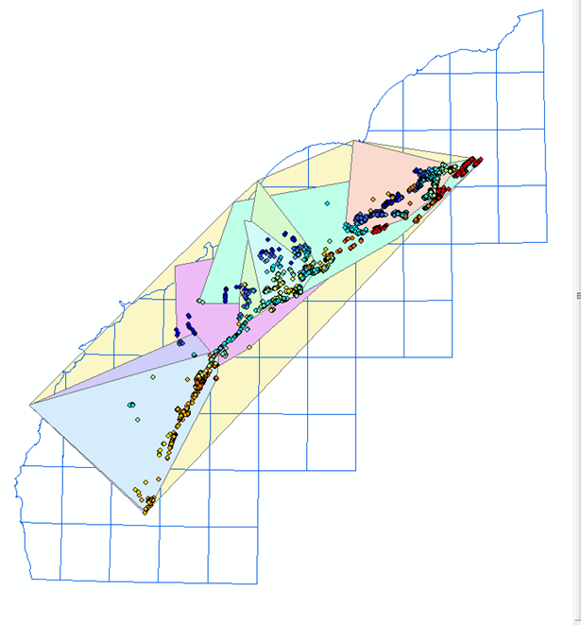
EM Data Can Refine Logbook Design
*
*
*
*
*
*
Eliminate non-fished areas
Vessel range
Notes:
This was an ambitious project on many levels, and as expected, many problems were encountered.

Slide 23
VMS Challenges:
Speed Alone Not a Good Indicator of Active Fishing
Notes:
This was an ambitious project on many levels, and as expected, many problems were encountered.

Slide 24
VMS Challenges:
Ping Rate Determines Resolution of Fishing Locations
Notes:
This was an ambitious project on many levels, and as expected, many problems were encountered.

Slide 25
VMS Opportunities:
Can VMS Points Replace Self-Reported Logbook Effort?
Notes:
This was an ambitious project on many levels, and as expected, many problems were encountered.

Slide 26
Other Monitoring Methods
Simple Electronic Data Loggers (<$500); lower cost alternative to VMS to track individual vessel movement; standard ping rate can be increased without cost
Drones (Fly-over of MPAs) and Satellite Imagery – only affects those users potentially breaking the law by being in MPA
Listening Buoys
Notes:
This study had 3 primary objectives. The first 2 will be discussed today.
Evaluate electronic monitoring as a tool to characterize fishing activities of the bandit fleet.
Validate content of self-reported logbooks through random sensor and video based audits.
In terms of costs, research has shown that an EM-based audit approach can be very effective at validating content of self-reported logbooks completed by fishermen. Because fishermen in the SA SG fishery are already required to complete federal logbooks – we felt that the best approach to consider would be an “audit-based approach.”

