Slide 2
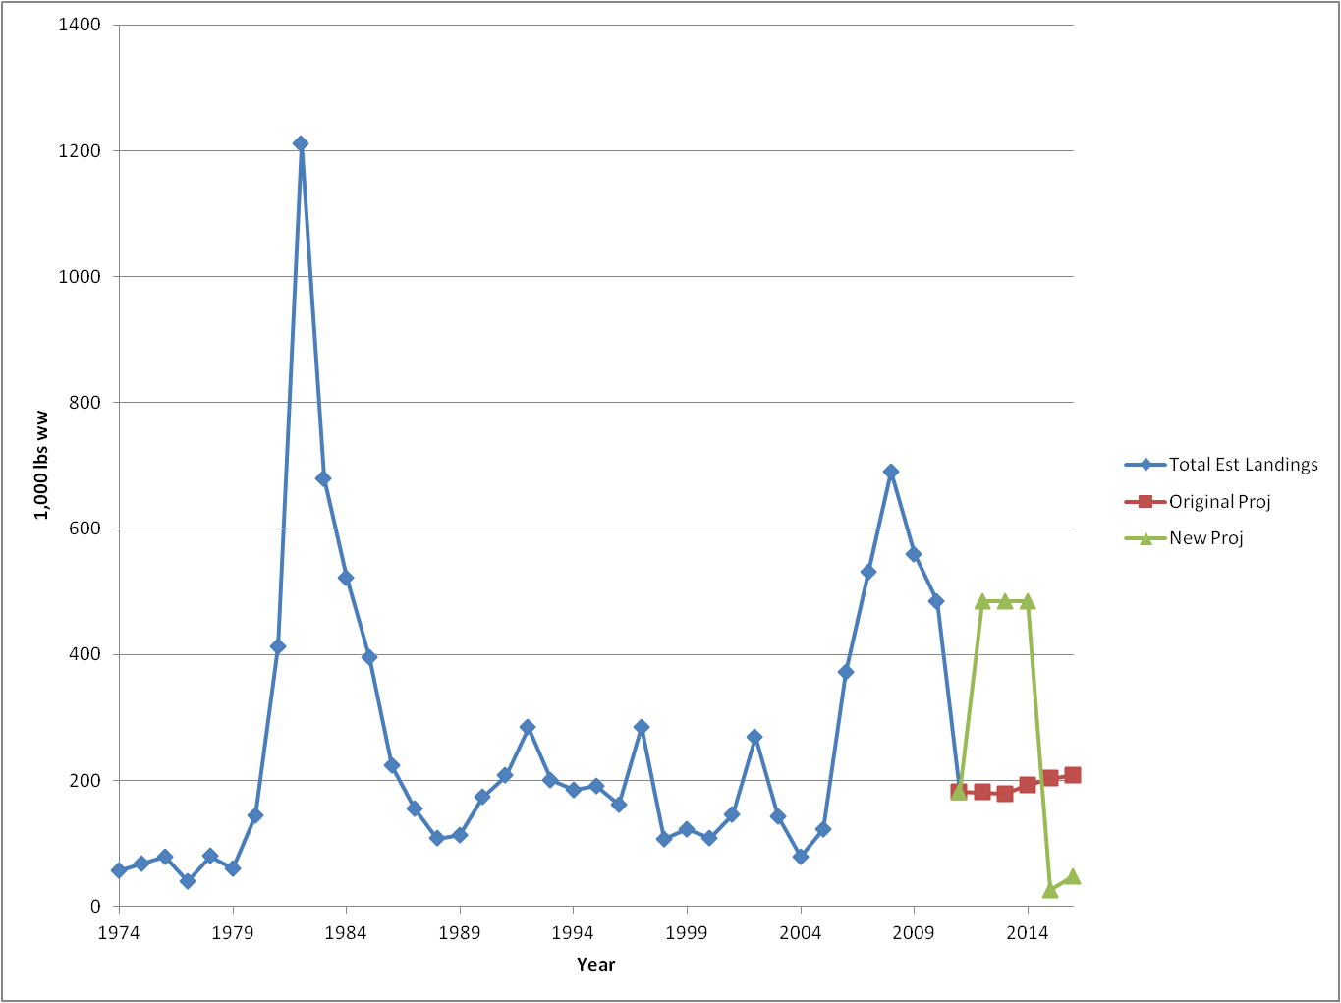
Blueline landings, past and future
New projections @ Fmsy
table 4 blueline_tilefish_pstar*
Include actual 2012 landings, per RW
Sum 2012-2014
1454
Sum 2012-2014
553

Slide 3
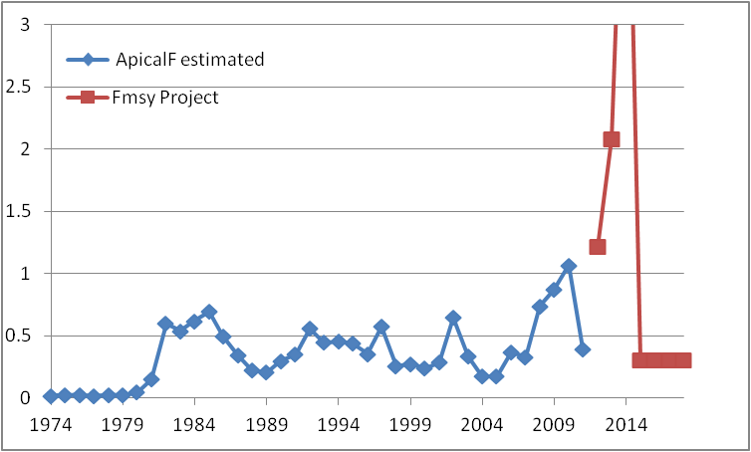
Fishing Mortality
goes to 5

Slide 4
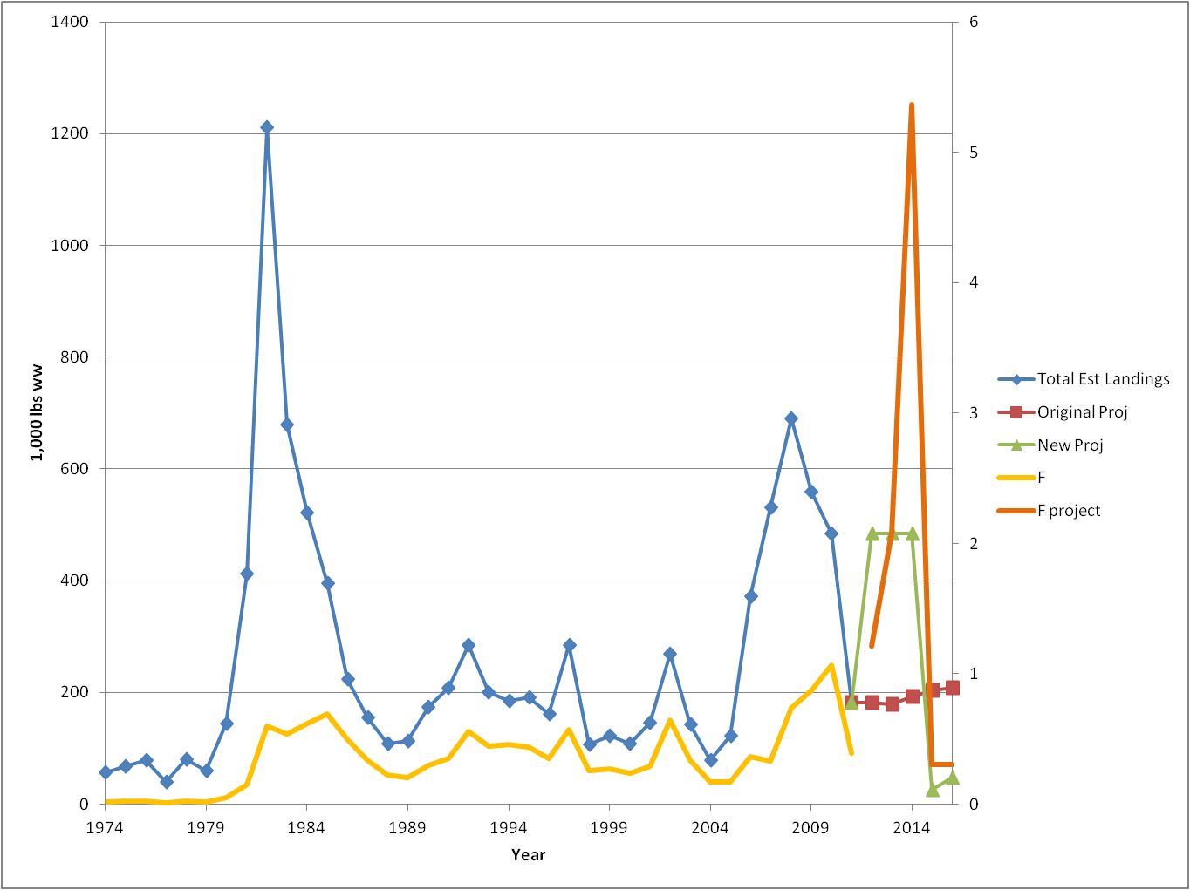
Both together

Slide 5
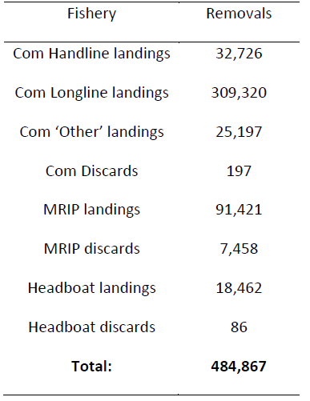
Landings, 2012 and 2013
2012 – Table 1 in projections
2013. Preliminary
Commercial, ACL monitoring (SERO)
Deepwater Complex = 268,921
(as of today)
Recreational (MRIP), as of Wave 4 (July/August), Type A + B1
212,548 Pounds
70,532 Fish
NOTE: landings used in assessment are typically greater than the basic MRIP query, due to adjustments for Monroe Co. and SEFSC weight estimation protocol. Years prior to 2004 differ due to MRIP:MRFSS conversion
MRIP query for 2012 = 66,539 POUNDS

Slide 6
What’s Wrong?
Not the assessment
Not the new projections – they reflect the current landings
Nothing really – it is a “known unknown”
How many fish were born annually since 2008?
Recruitment ‘deviations’ (from MSY level) estimated through 2009 (2008 cohort)
Rec fishery selects age 3+ (80%), Longline 6+
No Fishery Independent Indices
Retrospective pattern shows difficulty estimating recruitment until a cohort reaches age 4 or older
Higher recent landings may be supported by a good year class, but we have no information at hand to evaluate that, and ‘may’ carries a lot of risk.

Slide 7
What we know
The Current ABC/ACL is about 3x the MSY
If removals continue at the current rate, biomass will decline, future yield is at risk.
If there was a good year class sometime since 2008, recent landings exceeding MSY may not have caused damage to the stock
If there was NOT a good year class, recent landings have damaged the stock and jeopardized the fishery from 2015 – recovery.

Slide 8
What can we do (besides taking 2 years to end overfishing)
Immediately reduce ACL to the 75% FMSY level ? --for 2014 if possible!
Ask the SSC to review the latest projections
Request an update to determine if there is a good year class, and to inform an ABC with reduced uncertainty for 2015, 2016
Request updated projections with lower 2014 ACL (if the ACL is lowered)
Request an evaluation of the age composition of the 2012 and 2013 catch – may show evidence of a good year class.

