Slide 1
Black Sea Bass AM Triggers and How They Handle Paybacks

Slide 2
Data and Caveats
Landings obtained from NMFS SEFSC and SERO.
2010 landings are only from June 2010-Dec 2010.
2009 refers to the fishing year that goes from June 2009-May 2010.
Paybacks are calculated and imposed as an example. Remember these landings occurred under a certain quota, not a payback scenario so landings in real life may react differently.

Slide 3
Running Averages
3 year running average
Take the average of the current year’s landings and the previous 2 years’ landings.
3 year running average of ACLs
Same as above, but use ACLs instead of landings.
3 year running average reset the clock
When running averages first start, we use the current year’s landings. Next year we use the average of the first and second years. Third year on is the same as above.
If the ACL changes in this scenario, the clock as described previously is reset to the first year.

Slide 4
Overages
All overages are calculated by comparing the current year’s metric (landings, 3 year average) to the current year’s ACL with one exception.
The current ACL is the baseline ACL minus any overages from the previous year. If there are no overages, the baseline ACL is used.
Exception: When the 3 year average of ACLs is used, the 3 year average of landings is compared to this, not the current ACL.

Slide 5
New ACLs
Paybacks are calculated by subtracting last year’s overage from this year’s baseline ACL.
The resulting number becomes this year’s ACL.

Slide 6
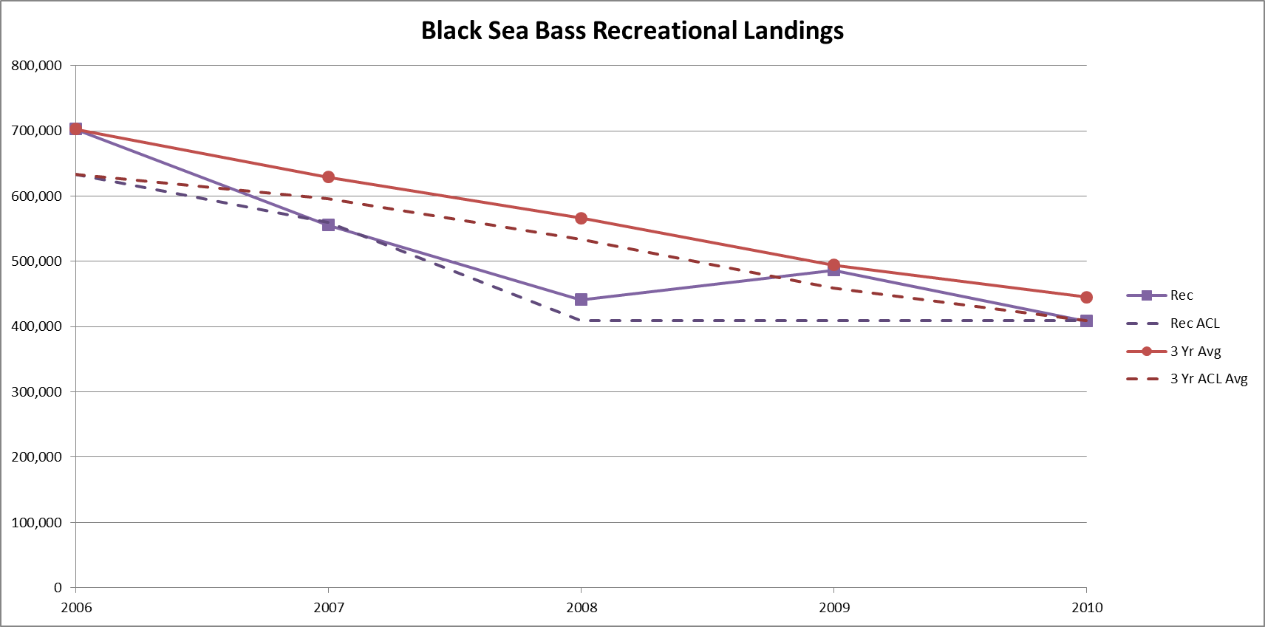

Slide 7
3 Year Running Average
3 yr avg is much higher than the actual landings estimates due to decreasing trend.
3 yr avg of ACLs helps to compensate for this difference in the landings and the 3 yr avg of landings.
This happens because the ACLs are also decreasing during this time period.

Slide 8
Paybacks
Paybacks Annual Landings
Year | Landings | Overage | Base ACL | New ACL
2006 | 702,426 | 69,426 | 633,000 | 633,000
2007 | 555,638 | 65,064 | 560,000 | 490,574
2008 | 440,992 | 97,057 | 409,000 | 343,936
2009 | 486,722 | 174,779 | 409,000 | 311,943
2010 | 408,189 | 173,968 | 409,000 | 234,221
2011 |  |  | 409,000 | 235,032
Paybacks 3 Year Average
Year | 3 Yr Avg | Overage | Base ACL | New ACL
2006 | 702,426 | 69,426 | 633,000 | 633,000
2007 | 629,032 | 138,458 | 560,000 | 490,574
2008 | 566,352 | 295,811 | 409,000 | 270,542
2009 | 494,451 | 381,262 | 409,000 | 113,189
2010 | 445,301 | 417,563 | 409,000 | 27,738
2011 |  |  | 409,000 | -8,563

Slide 9
Results
Comparing the overages, the 3 yr avg gives much higher overages than the landings estimates.
By 2011, the fishery would have closed down in this scenario.

Slide 10
Paybacks
Paybacks Annual Landings
Year | Landings | Overage | Base ACL | New ACL
2006 | 702,426 | 69,426 | 633,000 | 633,000
2007 | 555,638 | 65,064 | 560,000 | 490,574
2008 | 440,992 | 97,057 | 409,000 | 343,936
2009 | 486,722 | 174,779 | 409,000 | 311,943
2010 | 408,189 | 173,968 | 409,000 | 234,221
2011 |  |  | 409,000 | 235,032
Paybacks 3 Year Running Average
Year | 3 Yr Avg | Overage | Base ACL | New ACL
2006 | 702,426 | 69,426 | 633,000 | 633,000
2007 | 629,032 | 138,458 | 560,000 | 490,574
2008 | 566,352 | 295,811 | 409,000 | 270,542
2009 | 494,451 | 381,262 | 409,000 | 113,189
2010 | 445,301 | 417,563 | 409,000 | 27,738
2011 |  |  | 409,000 | -8,563
Paybacks 3 Year Running Avg. of Landings and ACLs
Year | 3 Yr Avg | Overage | Base ACL | New ACL | 3 Yr ACL Avg
2006 | 702,426 | 69,426 | 633,000 | 633,000 | 633,000
2007 | 629,032 | 67,245 | 560,000 | 490,574 | 561,787
2008 | 566,352 | 77,909 | 409,000 | 341,755 | 488,443
2009 | 494,451 | 106,645 | 409,000 | 331,091 | 387,806
2010 | 445,301 | 120,234 | 409,000 | 302,355 | 325,067
2011 |  |  | 409,000 | 288,766 | 307,404

Slide 11
Results
The ACL running average compensated for the lag in the landings running average.
Takes into consideration decreasing trend in ACLs.
Overages more similar to landings overages.

Slide 12
Total Overages
Only penalize sectors for total overages, not only for sector overages.
4 scenarios
Both sectors under, total under.
One sector over, total under.
One sector over, total over.
Both sectors over, total over.

Slide 13
Total Overages
What do we do?
If the total is under, no matter if one sector is over or not, no action is taken.
If both sectors are over, then each is penalized based on the sector overage.
If one sector is over and the total is over, penalize that sector based on the total overage, not the sector overage.

Slide 14
Total Overages
Paybacks Using Annual Total Overages
Year | Com Over | Base Com ACL | New Com ACL | Rec Over | Base Rec ACL | New Rec ACL | Total Over | Base Total ACL | New Total ACL
2006 | -33,998 | 477,000 | 477,000 | 69,426 | 633,000 | 633,000 | 35,428 | 1,110,000 | 1,110,000
2007 | -189,598 | 423,000 | 423,000 | 31,066 | 560,000 | 524,572 | -158,532 | 983,000 | 947,572
2008 | -1,172 | 309,000 | 309,000 | 31,992 | 409,000 | 409,000 | 30,820 | 718,000 | 718,000
2009 | -10,714 | 309,000 | 309,000 | 108,542 | 409,000 | 378,180 | 97,828 | 718,000 | 687,180
2010 | 14,181 | 309,000 | 309,000 | 97,017 | 409,000 | 311,172 | 111,198 | 718,000 | 620,172
2011 |  | 309,000 | 294,819 |  | 409,000 | 311,983 |  | 718,000 | 606,802

Slide 15
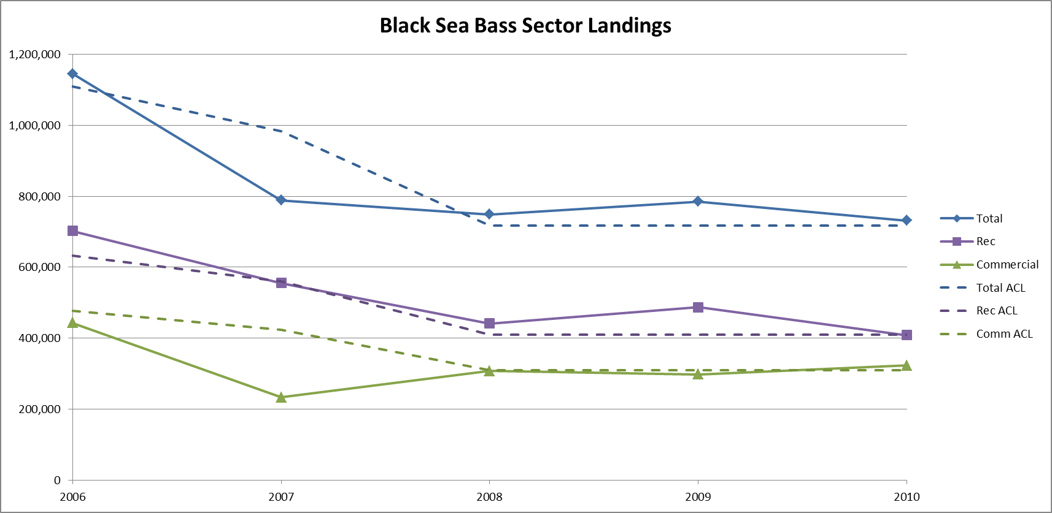

Slide 16
Results
When only one sector is over and the total is over, the payback for the sector that is over is reduced by the other sector’s underage.
If only one sector is over and the total is under, then no paybacks are required.
Win-win for everyone.

Slide 17
What’s best?
3 yr avg can fall apart in situations like those shown here.
3 yr avg of ACLs worked well here, but we must be wary.
With so many averages, not sure the correct poundage is being paid back to stay on track with rebuilding plan.
Total overages works well and offers some buffer for each sector as long as one stays under.
However, don’t get extra penalty if both go over.

Slide 18
Questions?

