Slide 1
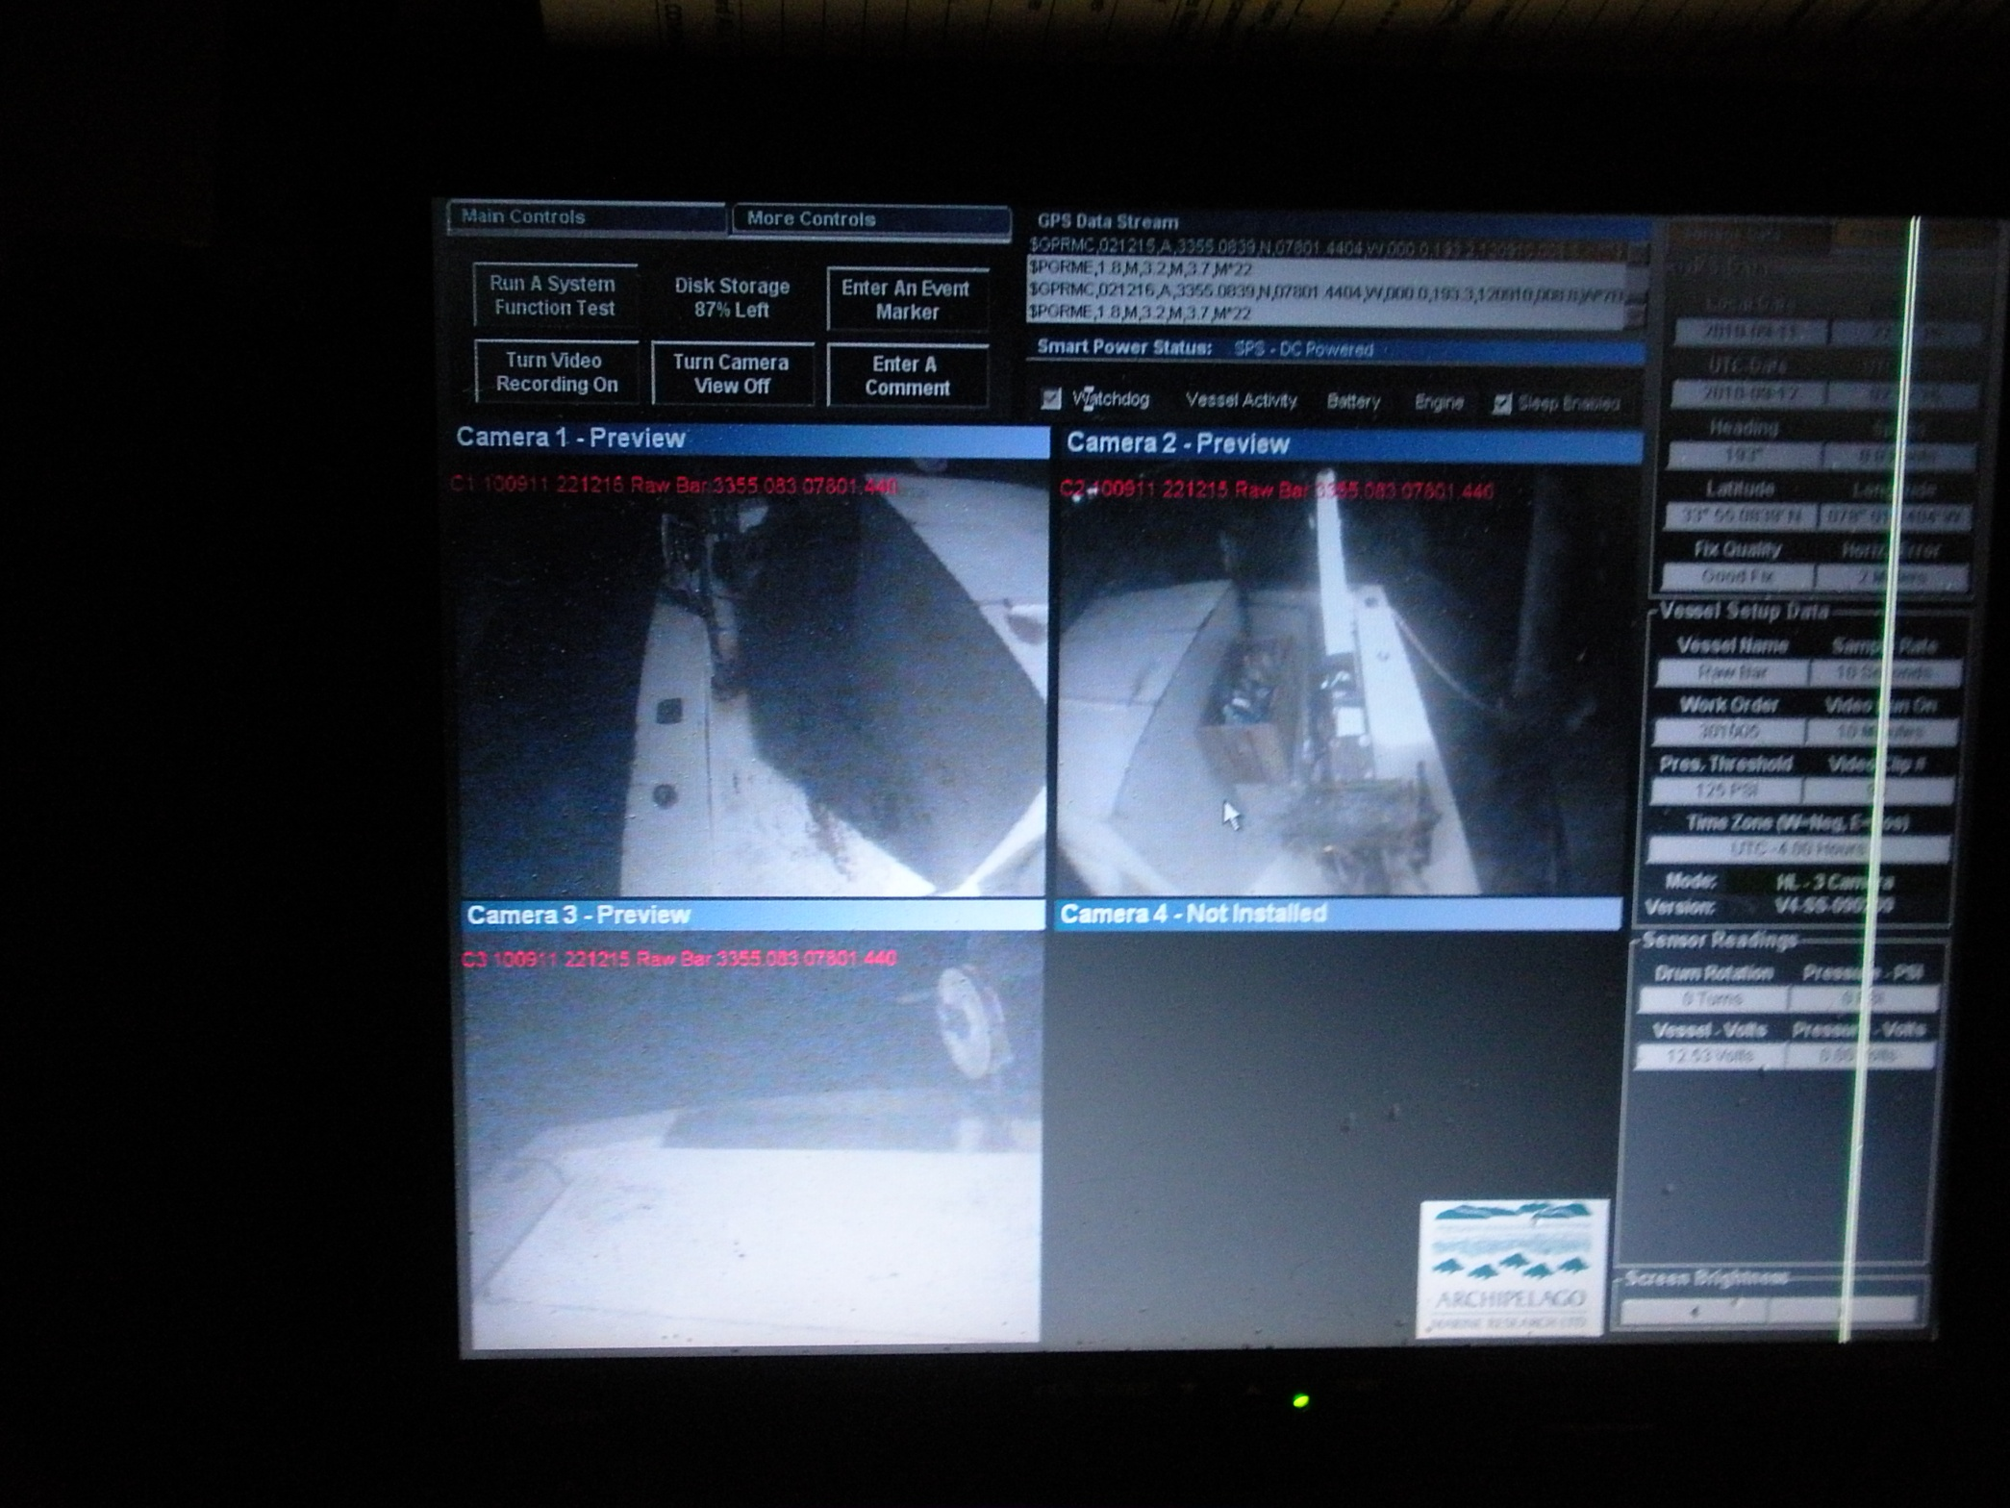

Slide 2
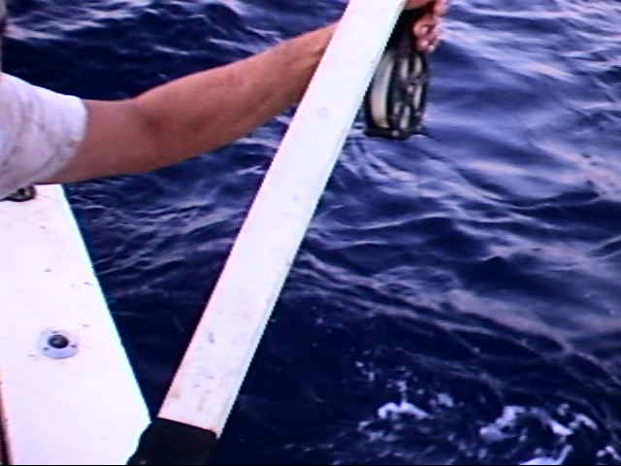

Slide 3
Red Snapper By-Catch Mortality
Fight time
Deck time (handling time)
Predatoration
Depth (Barotrauma)
Hook mortality

Slide 4
Red Snapper
78 Caught since May 2010
6 Gut hooked with J-Hook
2 Gut hooked with Circle-Hook
2 Floated away dead

Slide 5
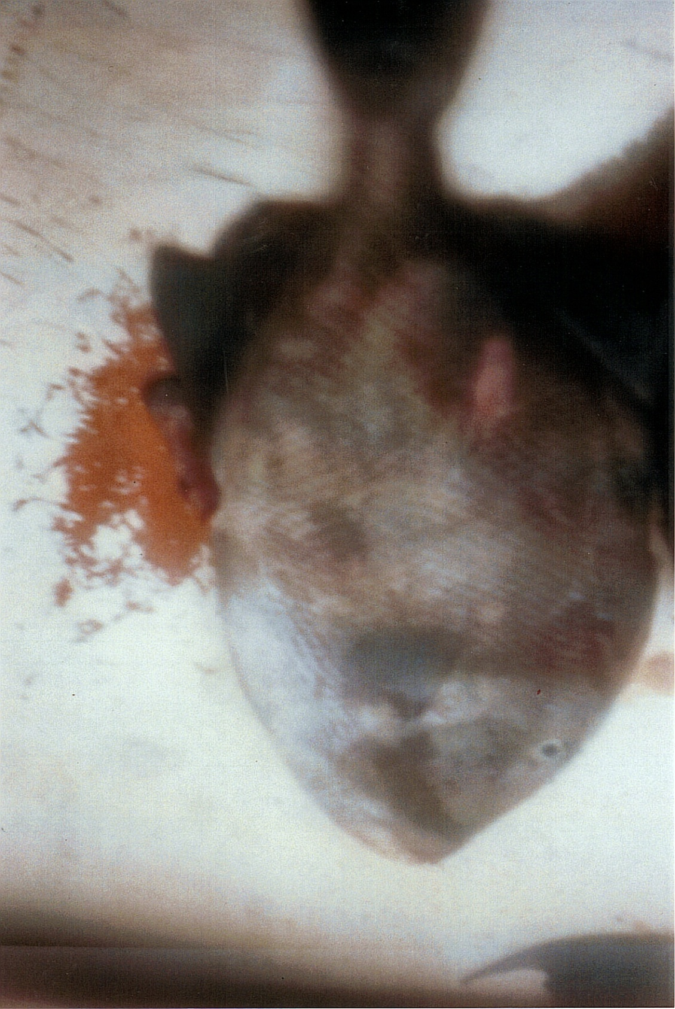

Slide 6
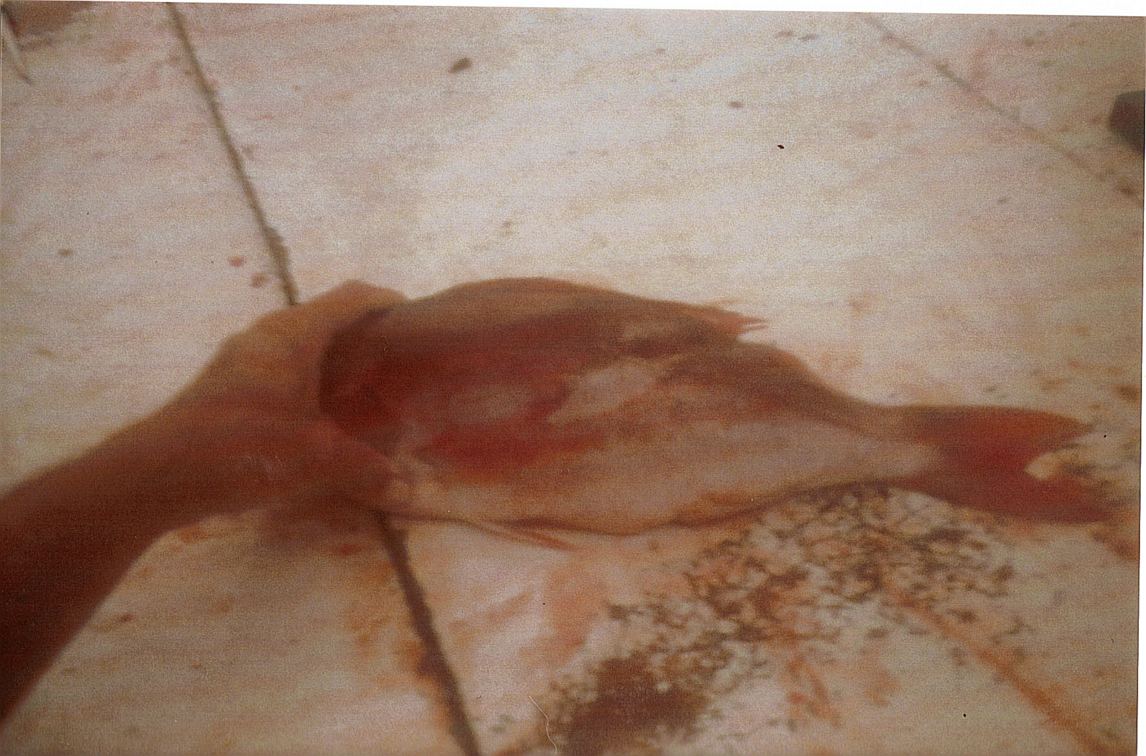

Slide 7
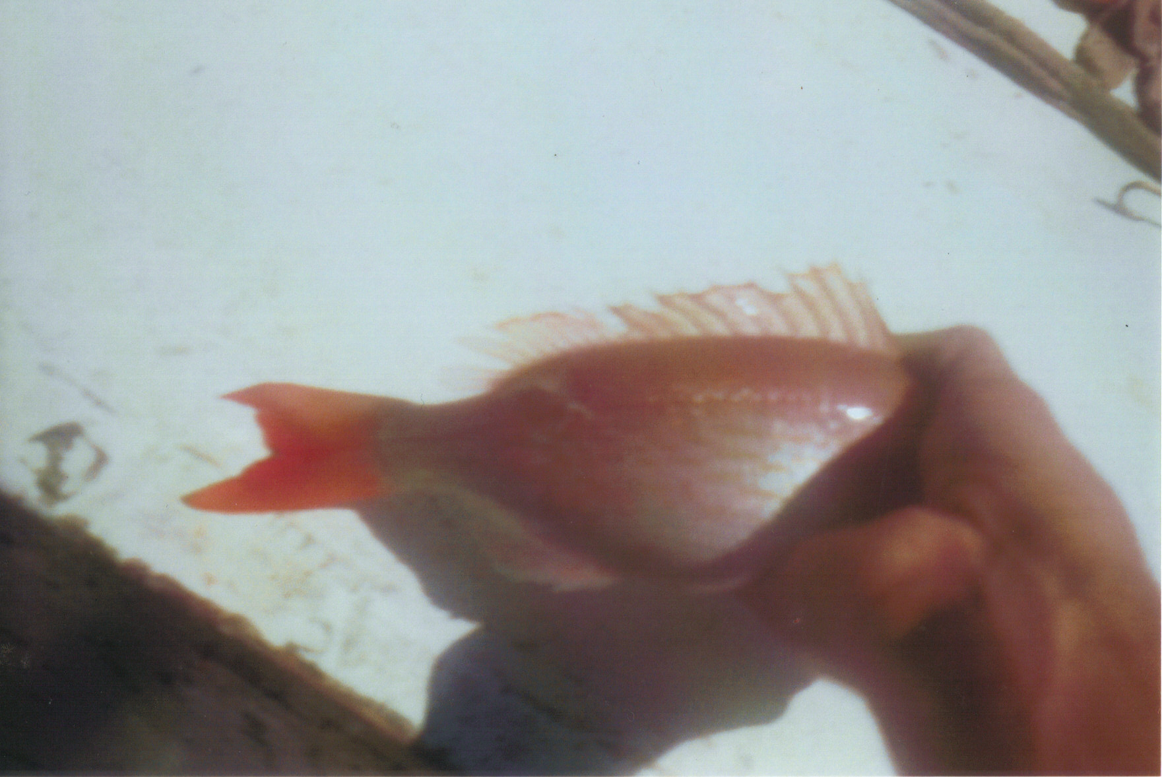

Slide 8
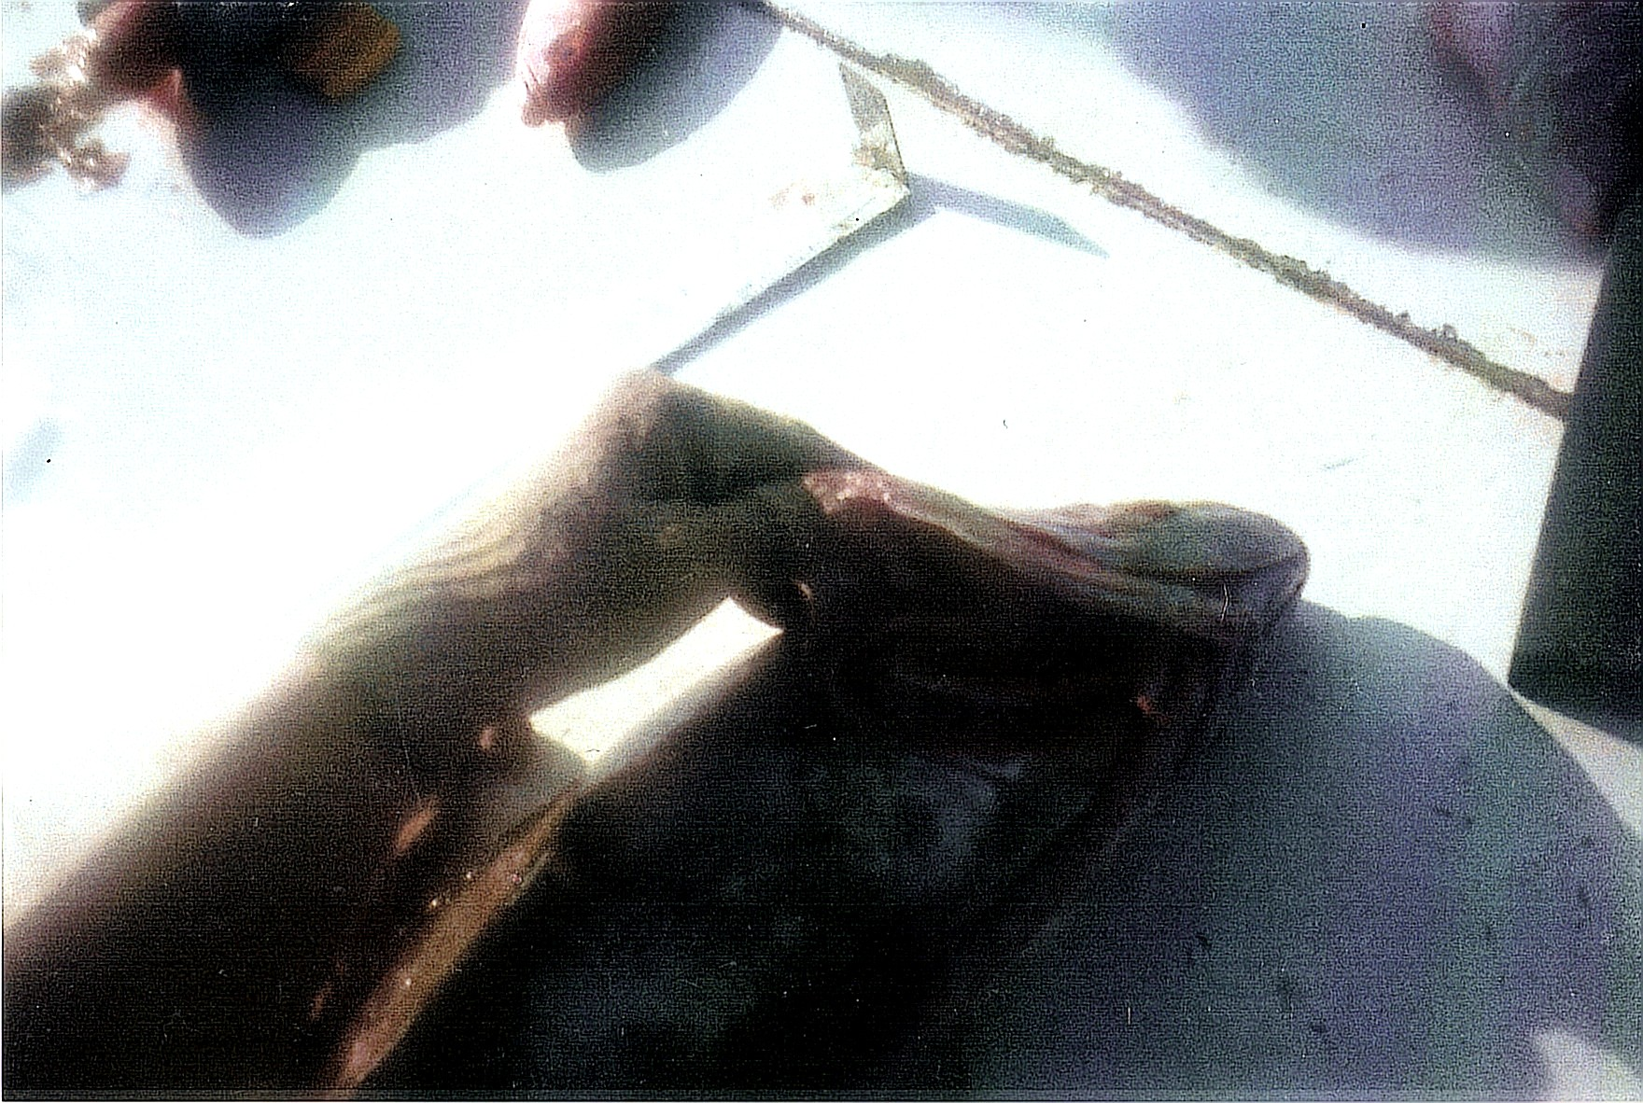

Slide 9
Landings 1996-2006
96] 97] 98] 99] 00] 01 ] 02 ] 03] 04 ] 05] 06]yr
43] 63] 106] 46] 29] 219]241]196] 13] 87] 77]lbs
Average 103 lbs a year.
17 trips (3day trip) since May 2010, 78fish caught. Average 6 lbs, total 468 lbs.

