Slide 1

SEDAR 28 Benchmark Assessment:
U.S. South Atlantic Cobia
(Rachycentron canadum)
Southeast Fisheries Science Center
SEDAR 28 SSC Review
April 10, 2012

Slide 2
Outline
Data
Assessment
  Model description
  Model output
  Uncertainty analysis
  Projections
  Alternative assessment methods
Review

Slide 3
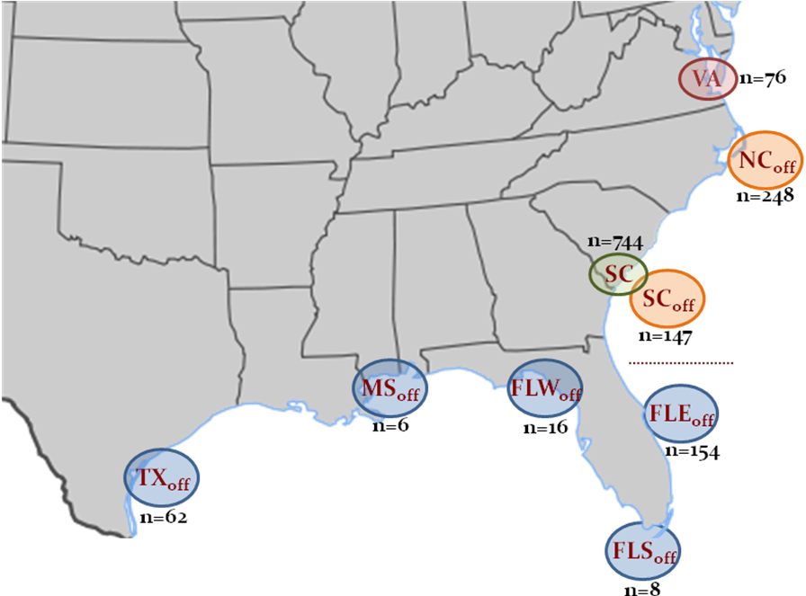
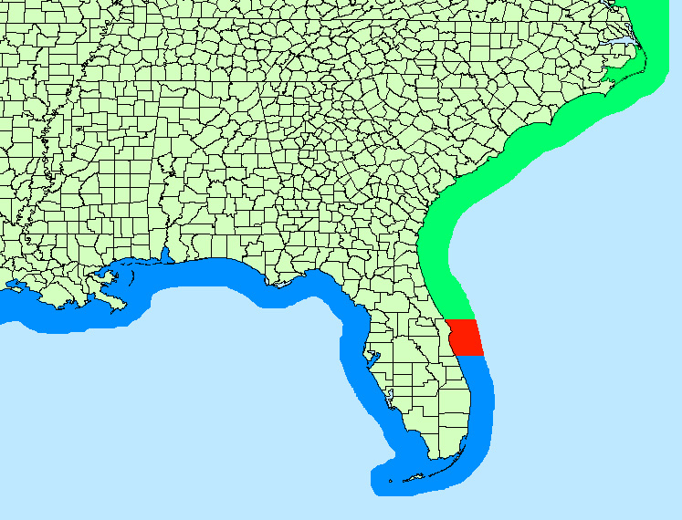
Stock Definition
Northern boundary: Through New York, northern extent of landings
Southern boundary: Florida-Georgia border
  Tagging data suggest a mixing zone off east coast of Florida
  Recent genetic (microsatellite) data suggest a boundary north of the proposed mixing zone, but not clear how far north
  Limited genetic data suggest some inshore-offshore structure of adult fish
Tagging data
Genetic data
S. Atlantic
Mixing zone
Gulf

Slide 4
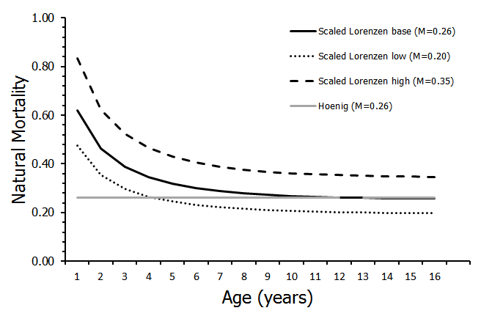
Natural Mortality
Sensitivities
Scaled to provide same fraction fish surviving to max age as for constant M
Age-based mortality assumed constant in time

Slide 5
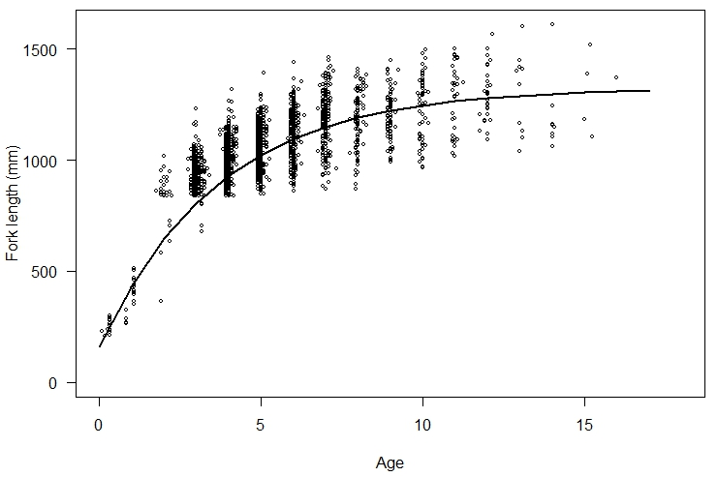
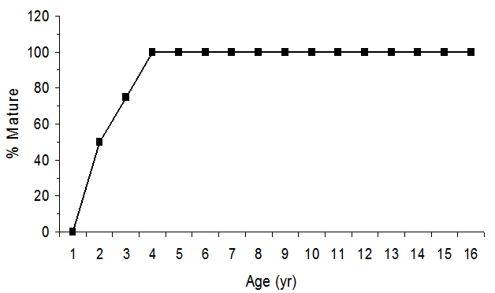
Other Life History Characteristics
Von Bertalannfy growth (L∞=1324 mm, k=0.27, t0=-0.47 yr)
Female maturity (A₅₀=2 yr; 0% at <1 yr, 100% at 4 yr)
Limited information on reproduction:
  Base run: mature female biomass as measure of spawning potential
  Sensitivity run: age-based female fecundity
    log(batch fecundity) vs. body weight (37 fish)
    Assume 4 mo. spawning period and 6 d spawning interval
50:50 sex ratio
  Ageing error matrix (Avg % agreement = 93.8%)

Slide 6
Fishing Fleets
Modeled two fishing fleets:
(1) General Recreational
  Charterboat, private recreational, shore (MRFSS/MRIP)
  Headboats (Southeast Regional Headboat Survey)
  >80% rec landings from private recreational mode
  Dead discards < 5% of landings
  pooled as recreational removals
(2) General Commercial
  Handlines (~35%)
  Gillnets (~25%)
  Pound nets (~25%)
  Seines, trawls, miscellaneous
  Dead discards <2.5% of landings
  pooled as commercial removals

Slide 7
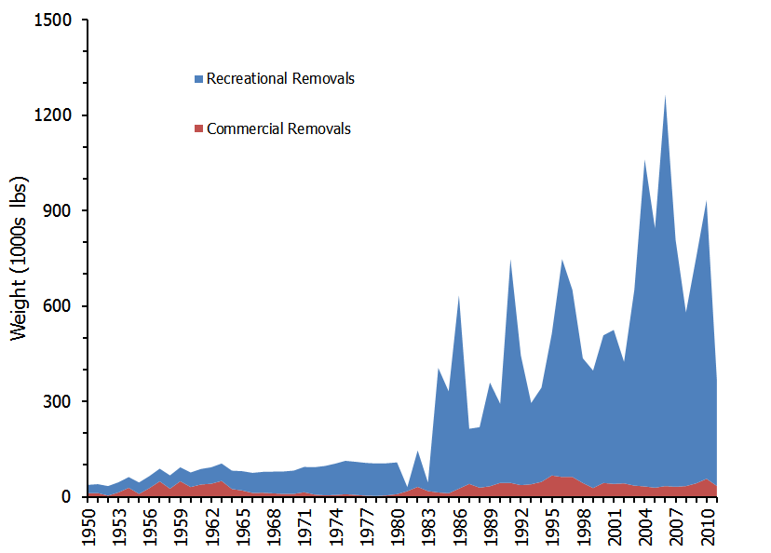
Recreational and Commercial Removals
Since 1981, 92% recreational and 8% Commercial
Pre-1981:
Commercial landings observed
Recreational landings hindcast

Slide 8
Management Regulations
Year |  | Recreational |  | Commercial
1983 Min. size limit |  | 33 in. ( 838 mm) FL |  | 33 in. ( 838 mm) FL
1990 Bag limit |  | 2 fish/person/day |  | 2 fish/person/day

Slide 9
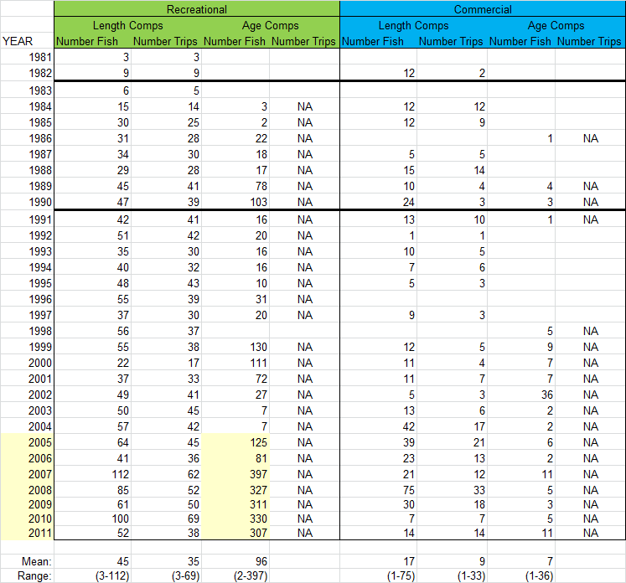
Age and Length Compositions
Annual recreational length and age comps
Pooled commercial length and age comps and weighted by sample size
33 in size limit
2 fish bag limit

Slide 10
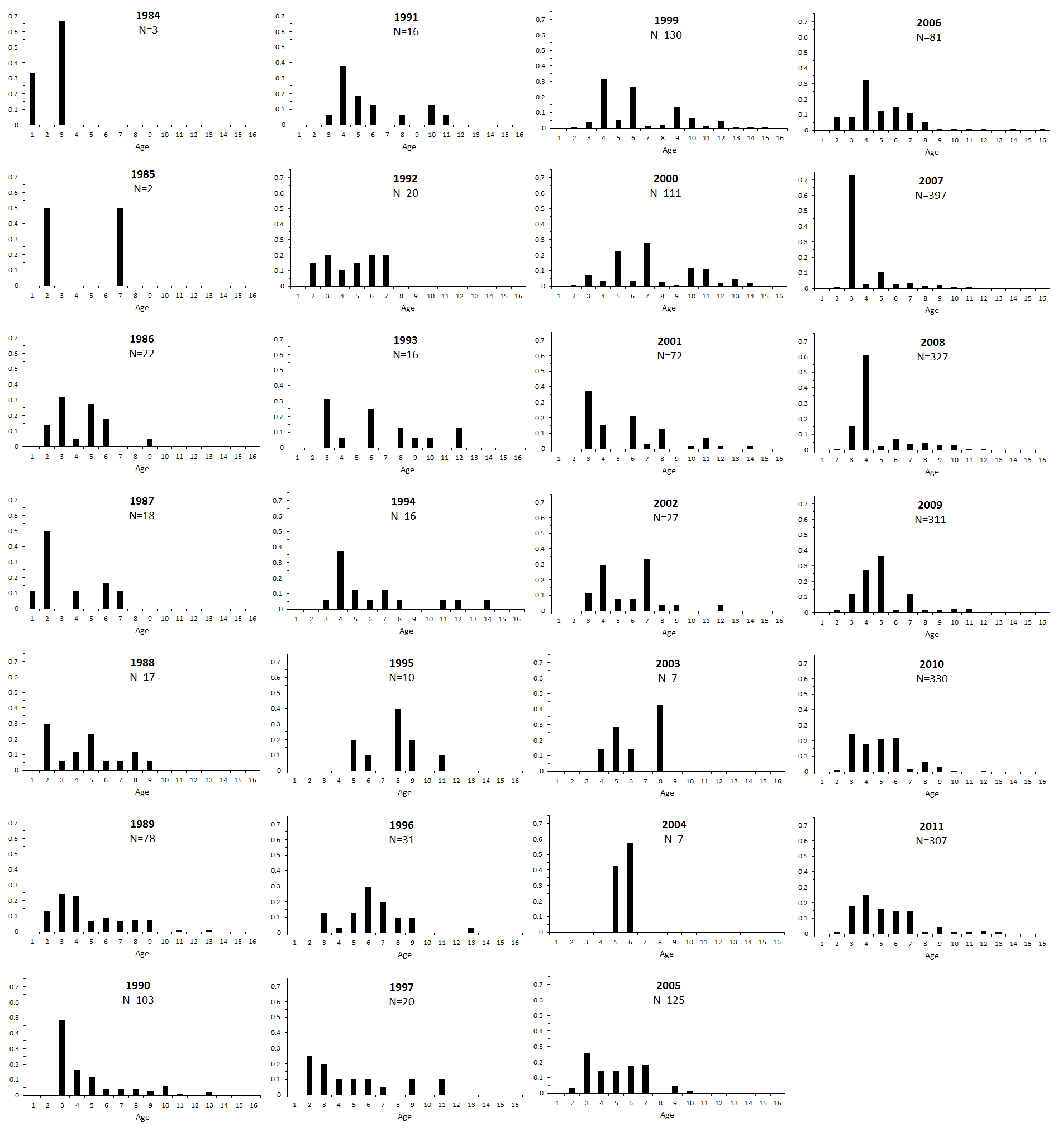

Slide 11
Indices of Abundance
  Three potential indices of abundance recommended by DW
    Headboat survey (1981-2011)
    MRFSS/MRIP survey (1985-2011)
    SC Charterboat logbook program (1998-2011)
  All indices are fishery-dependent, recreational hook and line gear
  All indices standardized using Delta-GLMs
    Most cobia (>80%) caught as single individuals
    Indices driven presence/absence (binomial component of delta-glm)

Slide 12
Indices
Index Correlations
Pearson Kendall’s Spearman
Headboat-MRFSS: 0.002 -0.026 -0.035
Headboat-SC log: -0.11 -0.011 -0.024
MRFSS-SC log: 0.19 0.11 0.12
95% Confidences intervals: ~ -0.35 – 0.35

Slide 13
Indices
  Three indices could not be fit simultaneously
  AW panel recommended exclusion of MRFSS index
  Basis:
    MRFSS survey may not adequately sample rare species (0.18% positives)
    Some concerns about changes in MRFSS sampling effort over time
    MRFSS index did not reflect strong year classes from age comps to same extent as other indices
    Evaluate consequences of excluding MRFSS via sensitivity analysis

Slide 14
? Data Questions ?

Slide 15
ASSESSMENT - Cobia
Beaufort Assessment Model (BAM)
Configuration
Model outputs
Fits to data (see report; available as needed)

Slide 16
BAM Configuration for Cobia
Assessment years: 1950–2011
Modeled ages: 1–12+ (max age=16 yrs)
Two Fleets: general recreational, general commercial; discards pooled with landings
Abundance Indices: headboat (HB), South Carolina Charterboat logbook (SC) (sensitivity)
Catchability: separate q for each fleet, assumed constant in time (sensitivity)
Selectivity: logistic functions for landings and indices. Constant in time (sensitivity)
Fishing mortality: annual estimates (free parameters) for each fleet. Age-specific F computed as product full F and selectivity at age
Initial numbers at age: computed from assumed equilibrium age structure and a historical fishing mortality rate (geo. mean F from 1950-52)
Spawner-recruit: Beverton-Holt curve with lognormal recruitment deviations; spawning potential based on mature female biomass (sensitivity)
Iterative re-weighting (Francis 2011) derive likelihood weights for data components (sensitivity)

Slide 17
BAM Estimated Parameters
Estimated Parameters (169)
S-R parameters (2): R0, sigma-R (steepness fixed)
Annual R devs (35): 1975-2009
Selectivity (4): Recreational (A50, slope)
  Commercial (A50, slope)
  A50 free; prior for slopes based on catch curves
Catchability (2): q for each abundance index (assumed constant in time)
Fishing mortality (126): average F + annual deviations for each fleet (landings and discards)
Length-at-age (1): CV of length-at-age conversion matrix
=======================================================
Could not estimate steepness; hit upper bound; prior with CV < 10% to move off bound
Key assumption: Steepness (h) fixed at 0.75

Slide 18
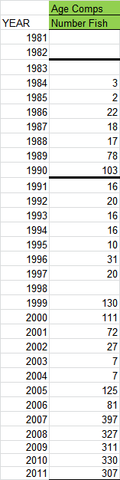
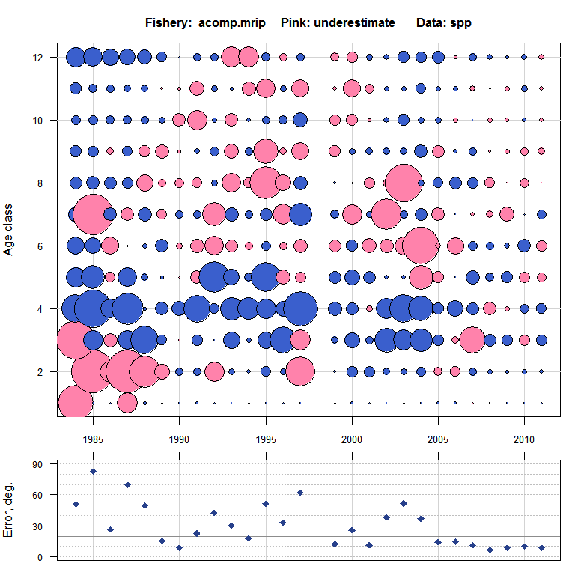
Model Fits: Recreational Age Comps
BAM Base Run
33 in. min
2 fish bag

Slide 19
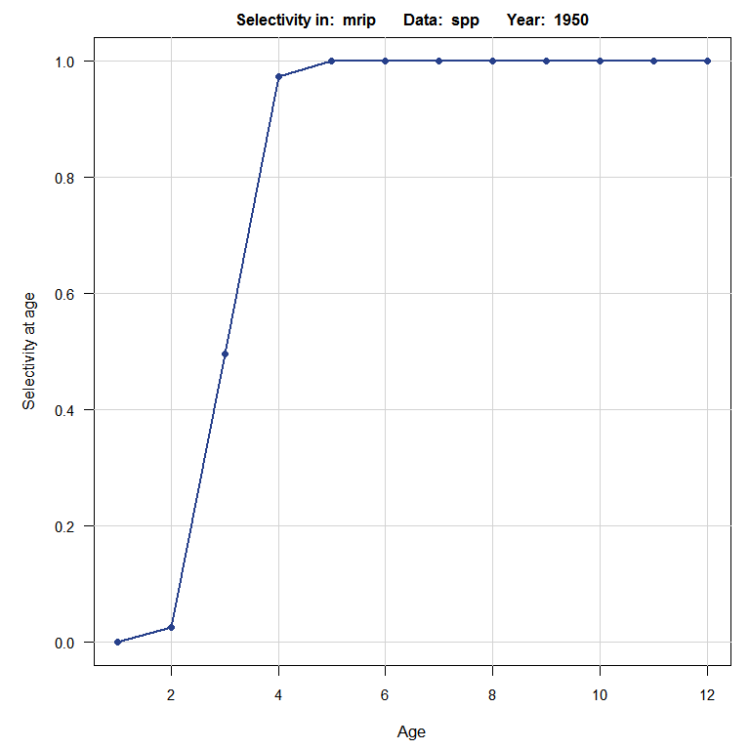
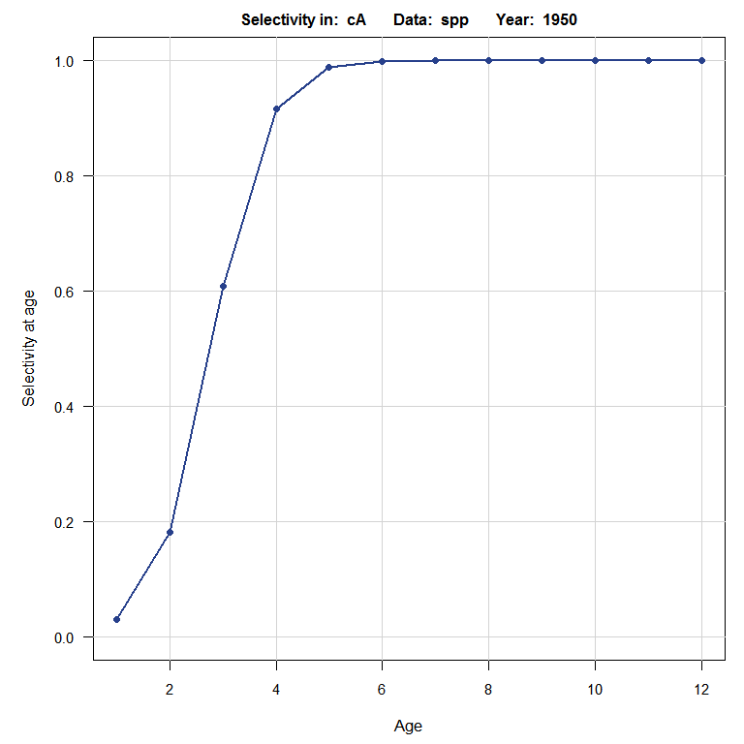
Model Outputs: Selectivity
BAM Base Run
Recreational
Commercial
A₅₀: 3.01 yr
Age at full selection: 5 yr
A₅₀: 2.77 yr
Age at full selection: 6 yr

Slide 20
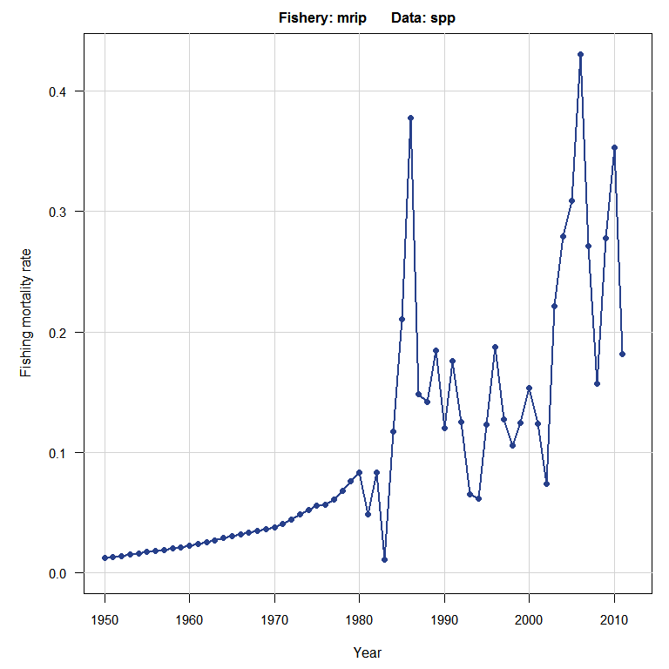
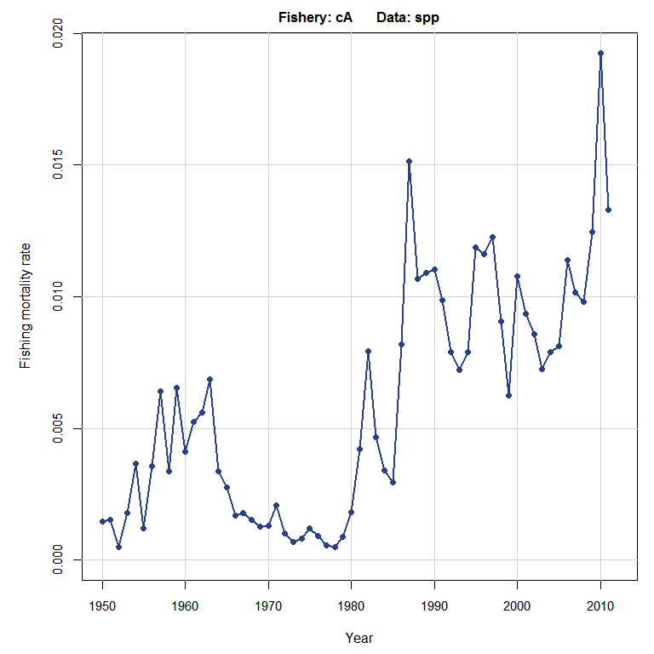
Model Outputs: Fishing Mortality
BAM Base Run
Commercial
Recreational
1980s:
F_{avg}=0.12
1990s:
F_{avg}=0.13
2000s:
F_{avg}=0.23
1980s:
F_{avg}=0.007
1990s:
F_{avg}=0.009
2000s:
F_{avg}=0.01

Slide 21
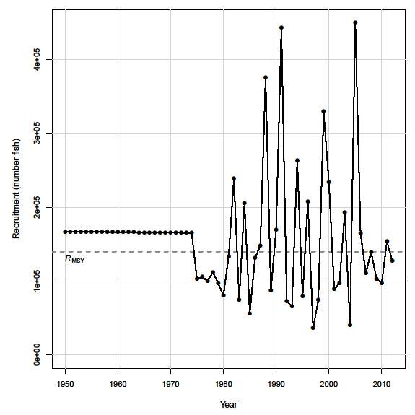
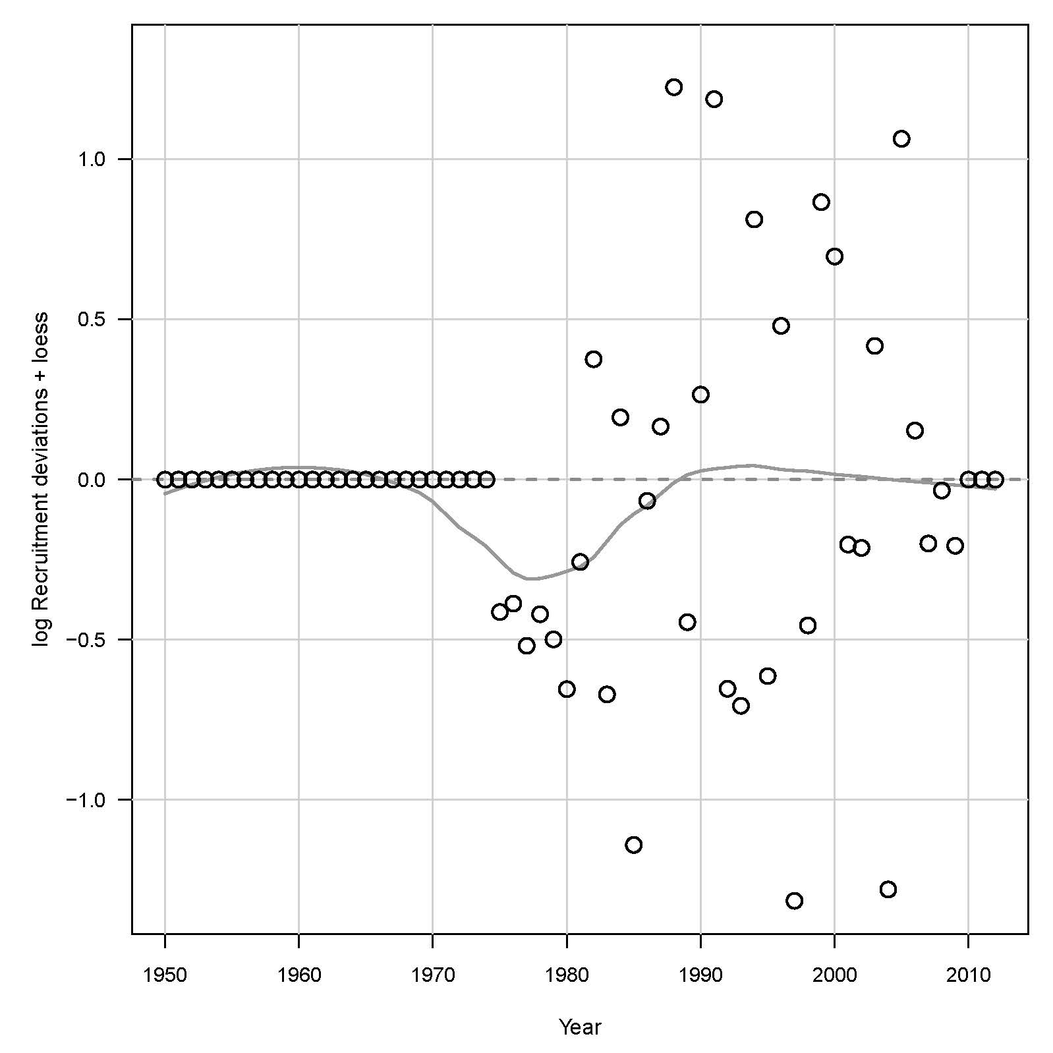
Model Outputs: Recruitment
BAM Base Run
Number Age-1 Recruits
Recruitment residuals

Slide 22
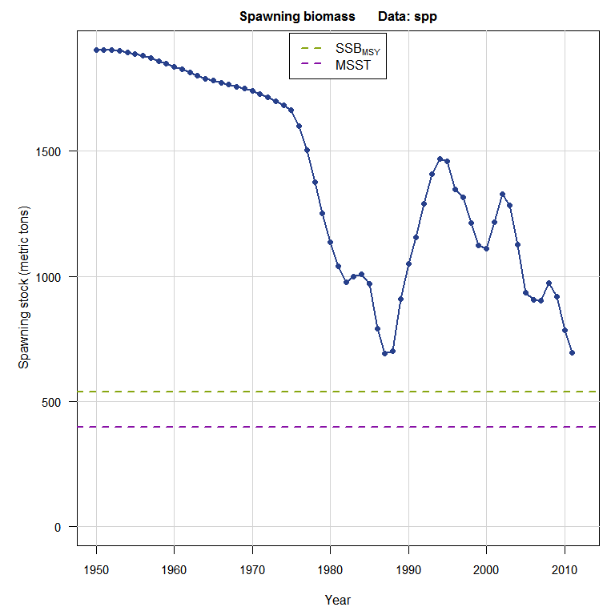
Model Outputs: Spawning Biomass
BAM Base Run

Slide 23
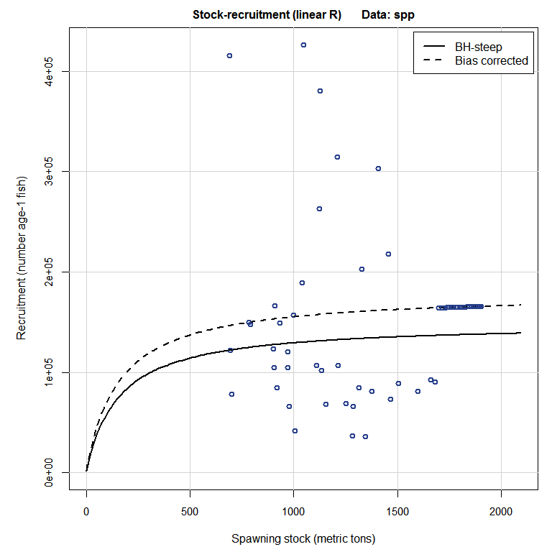
Model Outputs: Stock-Recruitment
BAM Base Run

Slide 24
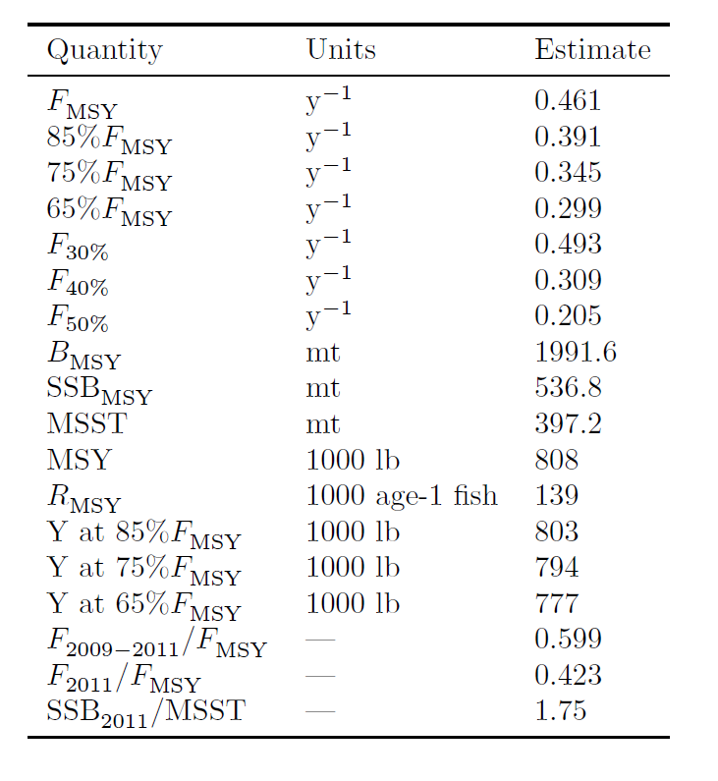
Model Outputs: Management Quantities
BAM Base Run

Slide 25
? Model Questions ?

Slide 26
ASSESSMENT - Cobia
Uncertainty Analysis
Sensitivity Analysis
Monte Carlo Bootstrap (MCB)

Slide 27
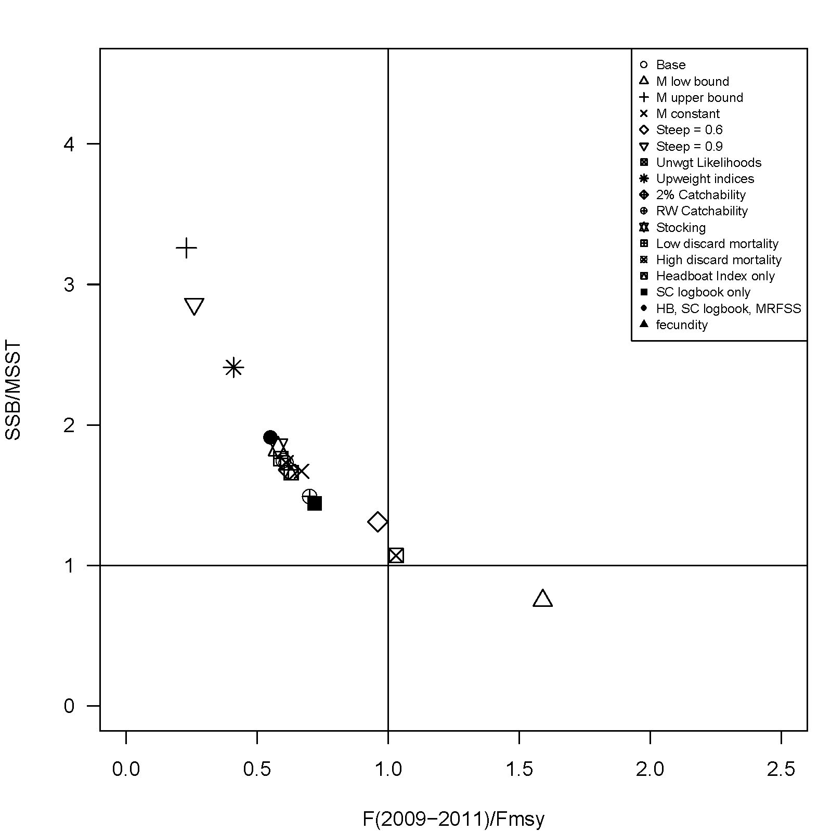
Model Diagnostics: Sensitivity Phase Plot
BAM Sensitivities
No Overfishing and not overfished
Overfishing but not overfished
“Biomass threshold”
Low steepness
Unwgt Likelihoods
Low M
No Overfishing but overfished
Overfishing and overfished
“Exploitation threshold”

Slide 28
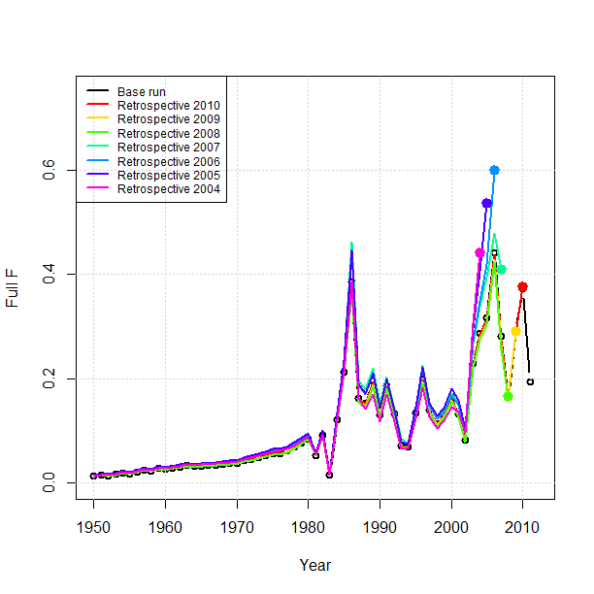
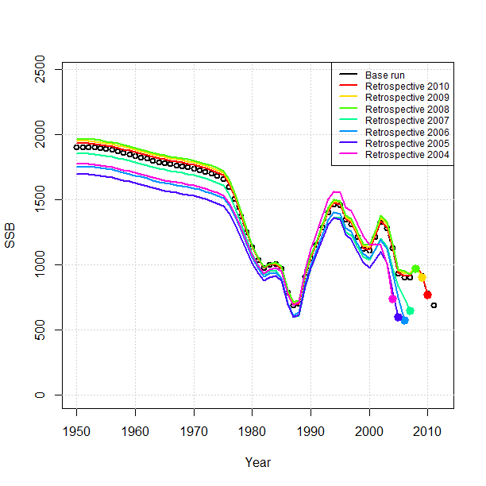
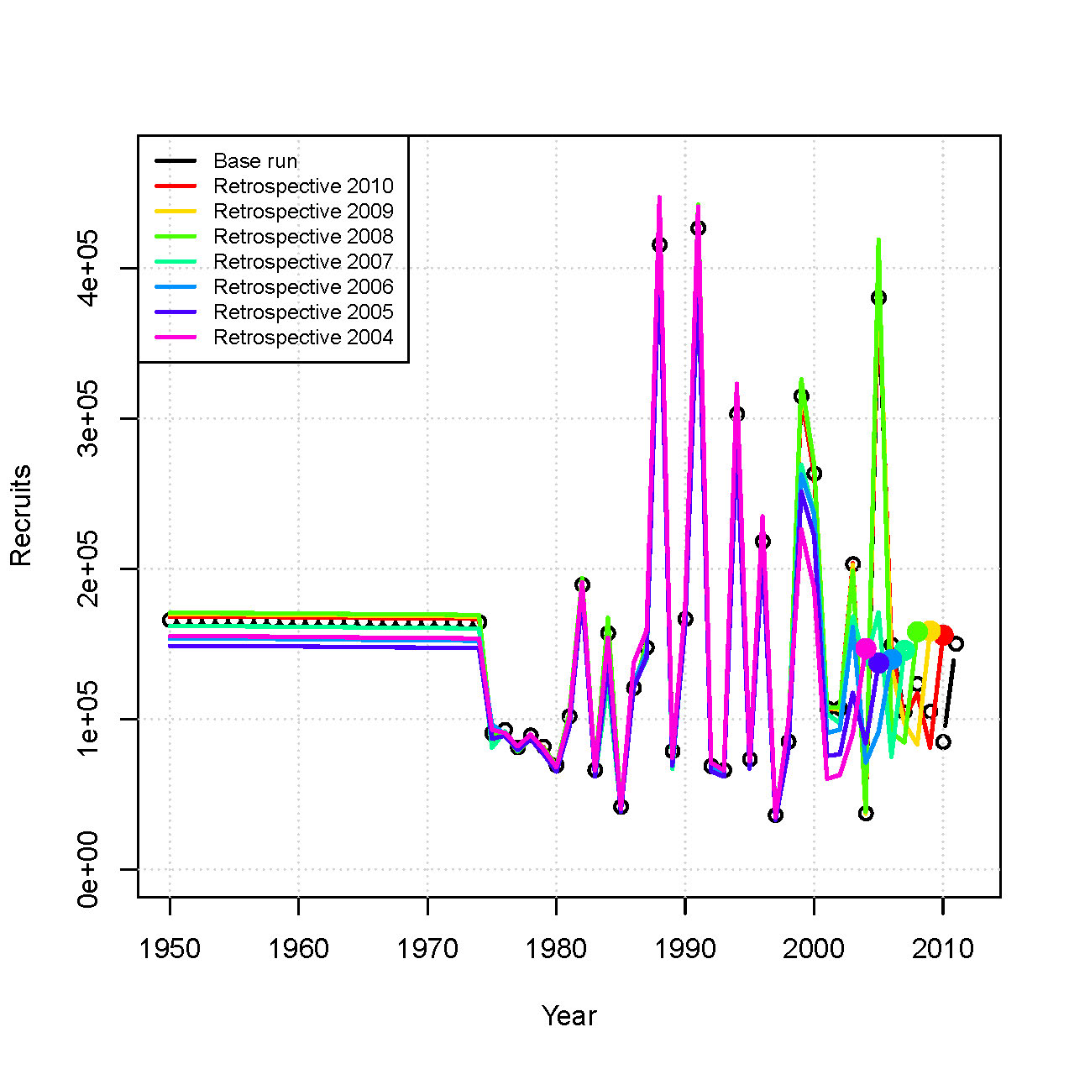
Model Diagnostics: Retrospective Analysis
7 yr Retrospective
Re-ran model with terminal yrs from 2004-2011
No strong retrospective pattern
Departure in 2006-07 associated with change in sampling intensity
Fishing Mortality
Spawning Biomass
Recruitment

Slide 29
Model Diagnostics: Uncertainty Analysis
Monte-Carlo Bootstrap (MCB)
Bootstrap Component:
Landings and Indices (Lognormal likelihood components): a parametric bootstrap of original data, with CVs as applied in the fitting procedure
Length and Age Compositions (Multinomial likelihood components): resample Nfish and assign them to bins with probabilities equal to those from original data
Monte-Carlo Component over key parameters:
Natural Mortality (M)
Steepness
Multiplier on ‘historical’ recreational landings
MCB trials:
n=3200 MCB trials attempted; n=3196 retained

Slide 30
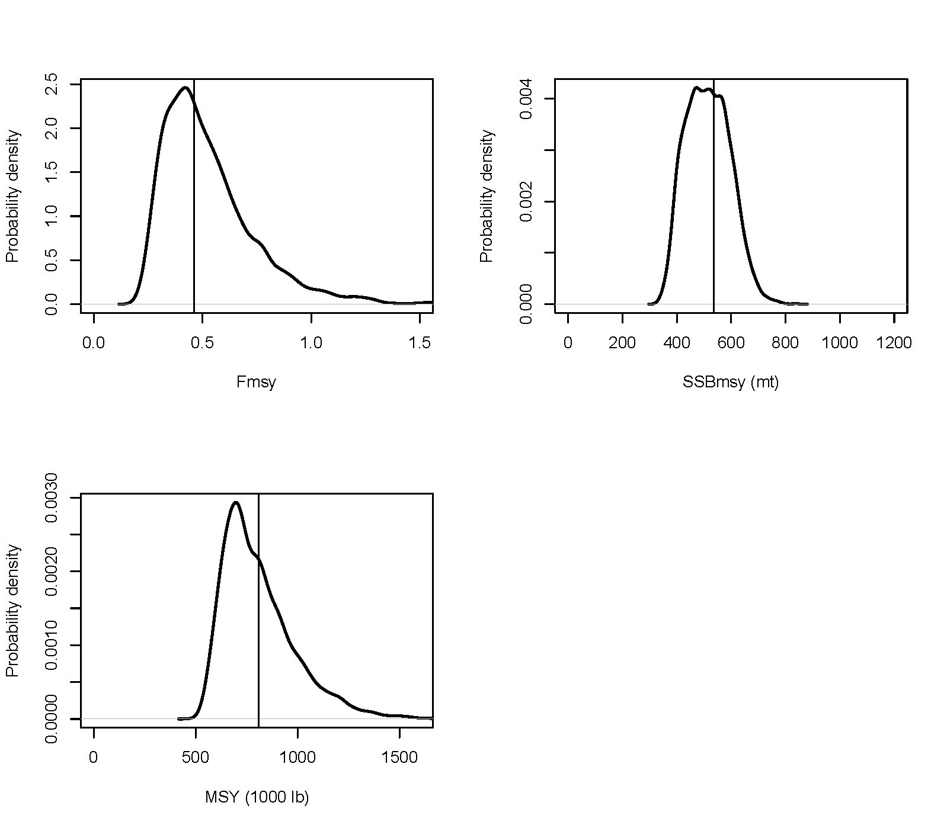
Model Diagnostics: MCB Results

Slide 31
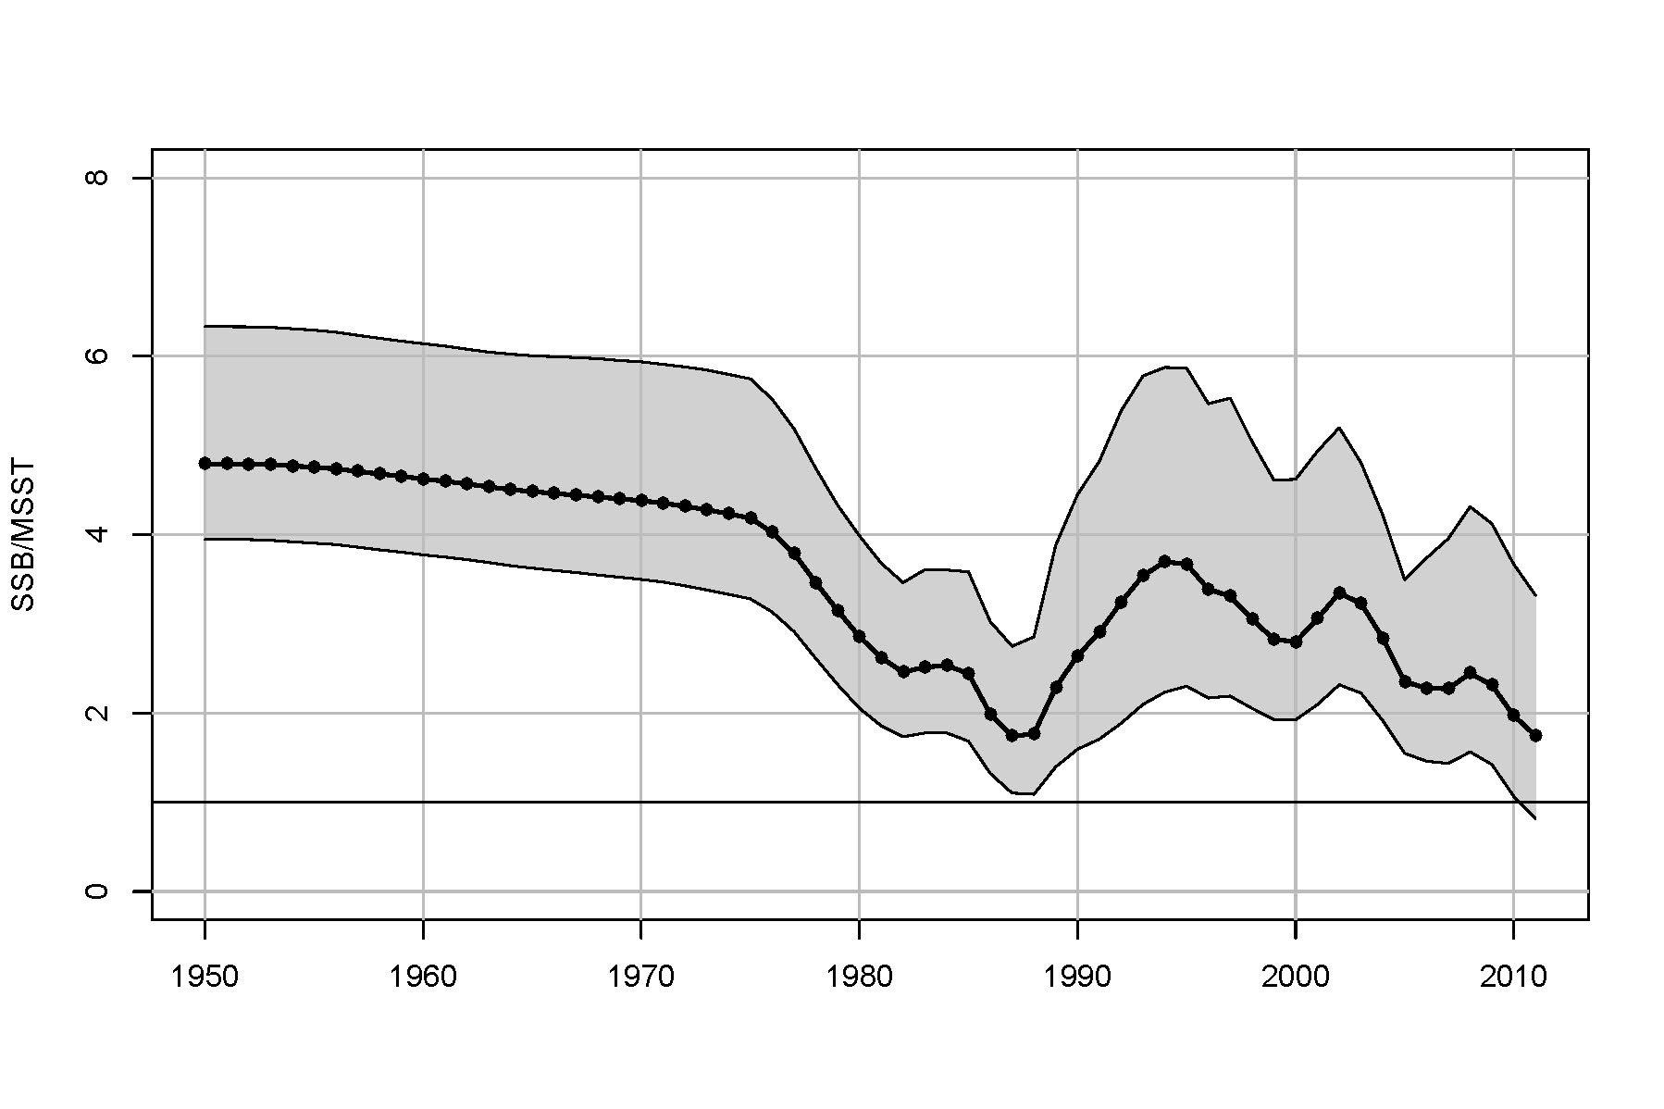
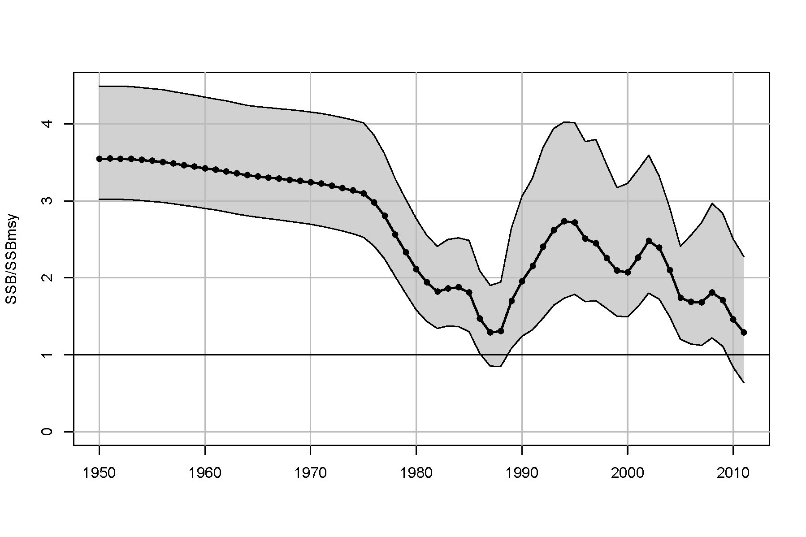
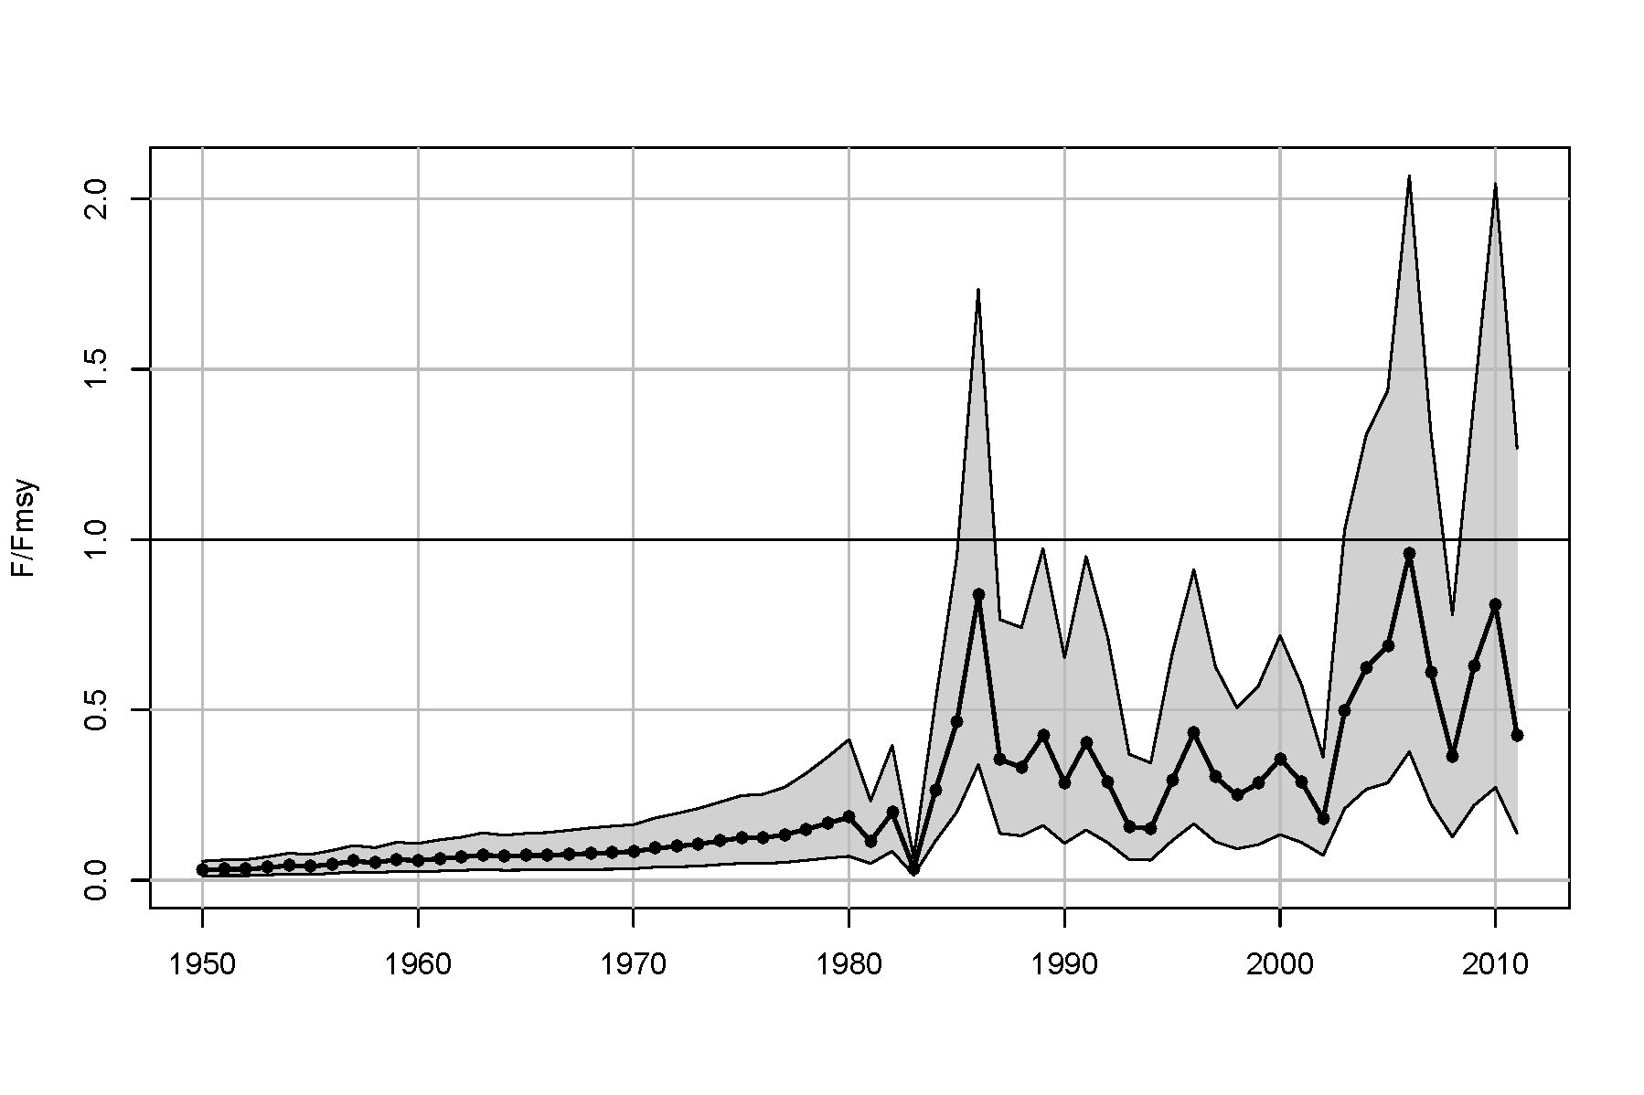
Model Diagnostics: MCB Results
Base run
5th & 95th %tiles of MCBs
Biomass Status
Exploitation Status
Notes:
2.5 fold range in biomass indicators across MCB runs; F/Fmsy ranges ~8-fold across MCB runs for several years in 2000s

Slide 32
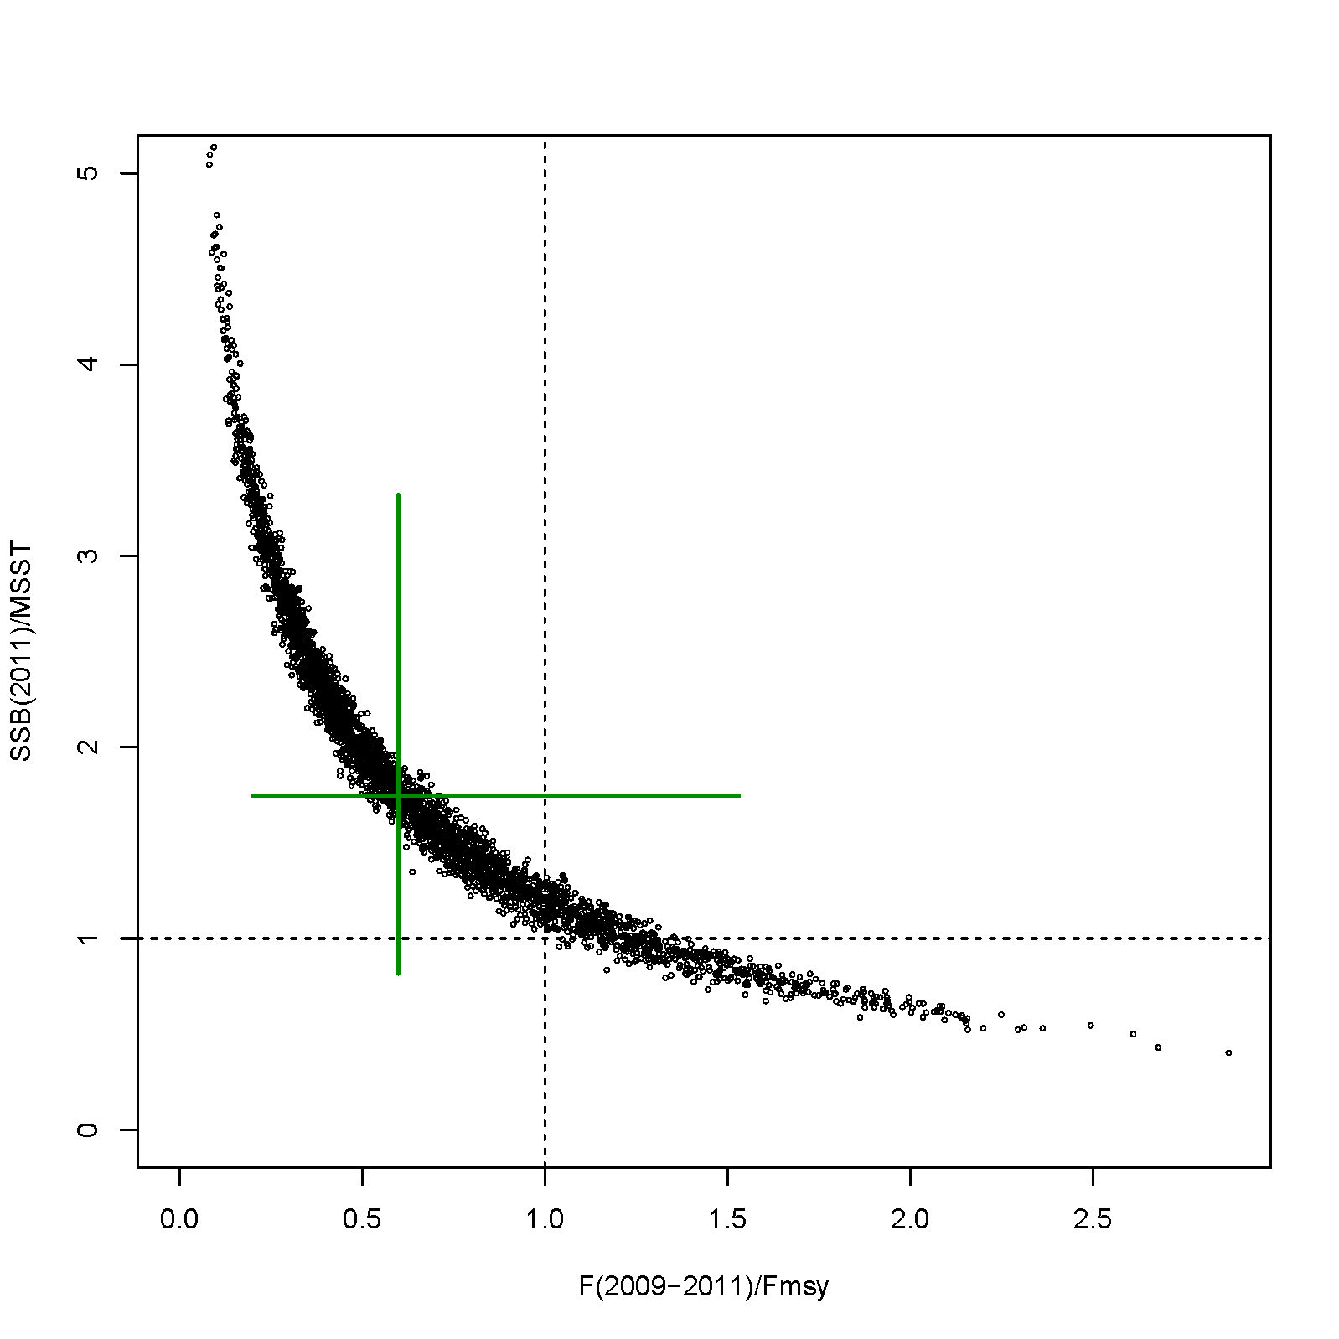
Model Diagnostics: MCB Results
No Overfishing and not overfished
Overfishing but not overfished
79%
11.4%
Overfishing and overfished
No overfishing but overfished
9.6%

Slide 33
? Questions About Uncertainty Analysis ?

Slide 34
Projections
Constant F Projections (in report)
F = F_{msy}
F = F_{current}
F = 65% F_{msy}
F = 75% F_{msy}
F = 85% F_{msy}
P* Analysis (not in report)
P* = 0.1
P* = 0.2
P* = 0.3
P* = 0.4
P* = 0.5

Slide 35
Projection Model
5 year projection (2012-2016)
Same structure as assessment model
New management assumed to start in 2013
No management uncertainty (total removals = ABC)
10,000 projected times series, each based on a single MCB run chosen at random
Carry forward uncertainties from MCB analysis:
  Data, natural mortality, steepness, historical recreational landings
  Initial (2012) numbers at age and recruitment
Show one example each of constant F and P* projections (others are available)

Slide 36
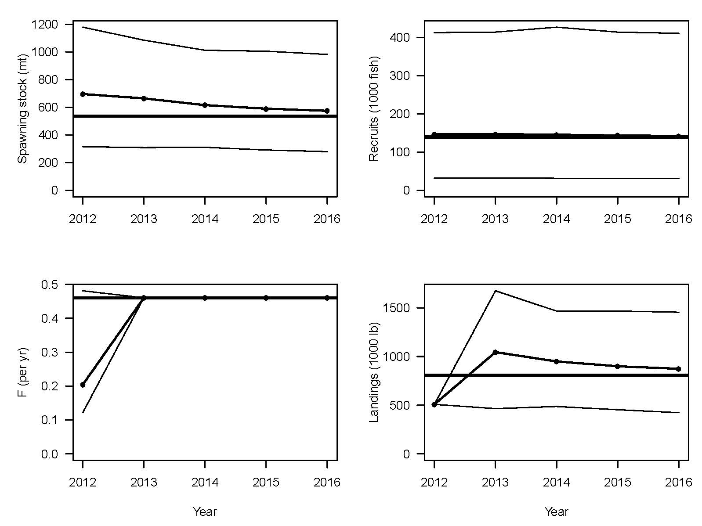
Projection Scenario F=F_{msy}
Spawning Stock (midyear)
Recruits
MSY quantity
Median
5th & 95th %tiles
Fishing Mortality Rate
Landings

Slide 37
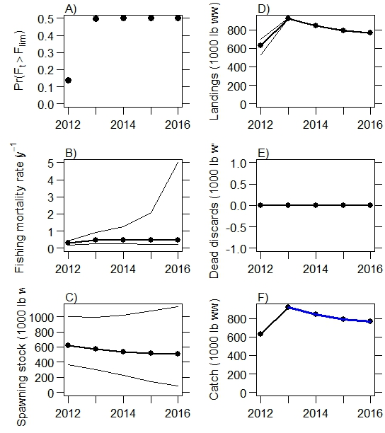
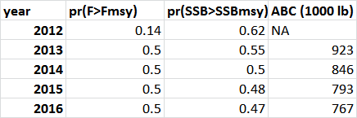
Example P* Projections (P*=0.5)
Pr(overfishing)
Median
5th & 95th %tiles
ABC
ABC

Slide 38
Alternative Methods

Slide 39
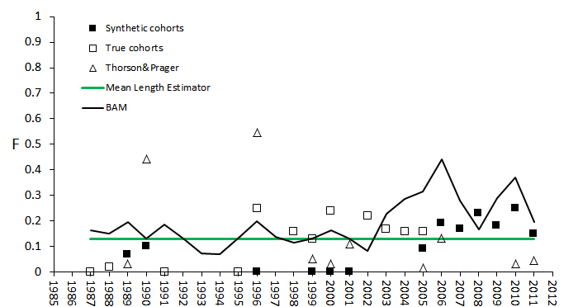
Total Mortality Estimation
(F computed as Z-M) where M=0.26
  Traditional catch curve analysis
  Thorson and Prager (2011) catch curves
  Mean length estimator (Gedamke and Hoenig 2006)

Slide 40
Surplus Production Model
Age-aggregated Surplus production model
  Graham-Schaefer logistic (nonequilibrium) formulation
  Conditioned on yield (landings and discards)
  Fit to headboat and SC logbook indices
  Implemented in ASPIC (Prager 1994)
Lack of contrast in data led to:
convergence problems
unrealistic estimates of B₁/K
AW panel recommended not pursuing further for this assessment
could fit under restrictive set of conditions (start date 1985)

Slide 41
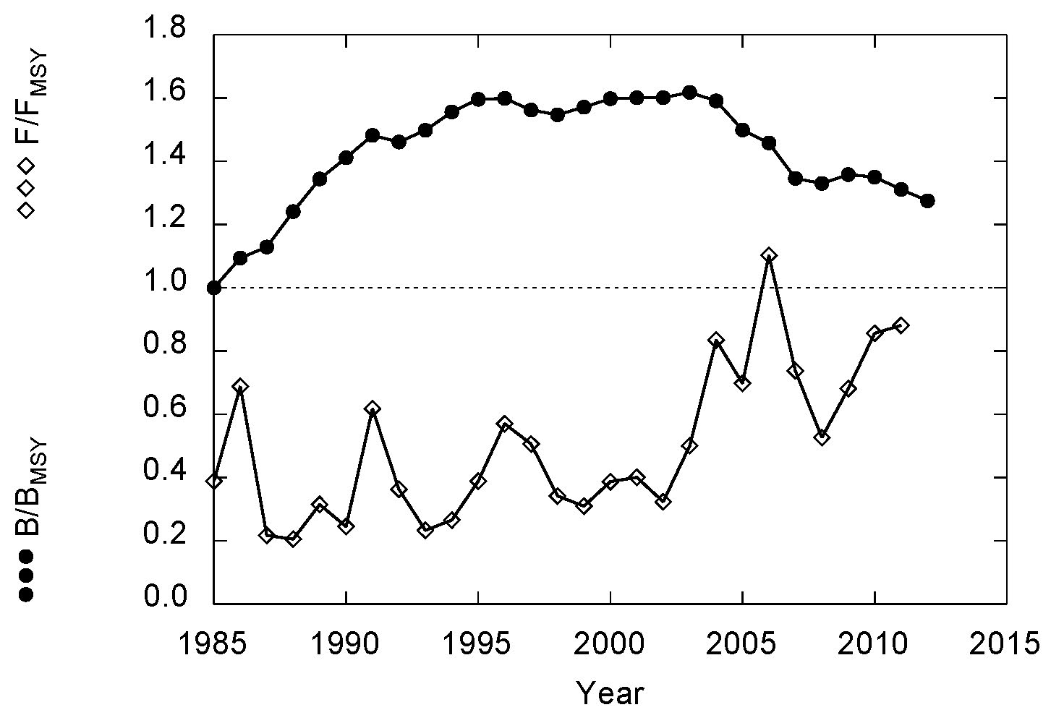
Surplus Production Model
BAM: B/B_{msy}=1.6
BAM: F/F_{msy}=0.6
B/B_{msy}
F/F_{msy}

Slide 42
Review Workshop (Oct 29-31, 2012)

Slide 43
Issues Addressed at Review Workshop
I. Dome-shaped selectivity
II. Time varying selectivity
III. Start date (1950 vs. 1981)
Ricker S-R model
Size-at-Age
Requested to better understand model behavior
No recommended changes to base run
Did not (qualitatively) affect status determination (i.e., overfished/overfishing)

Slide 44
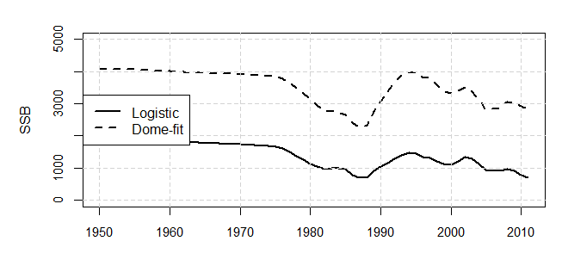
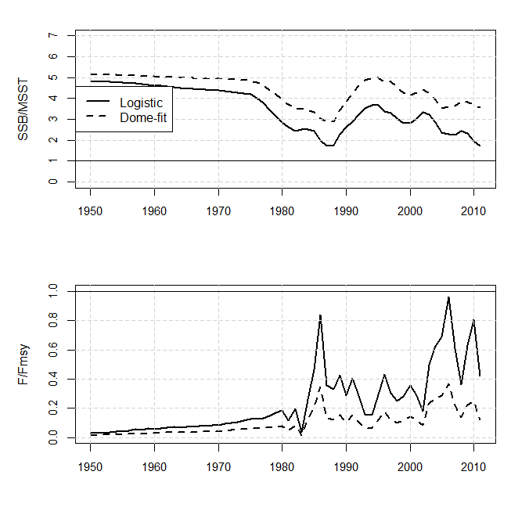
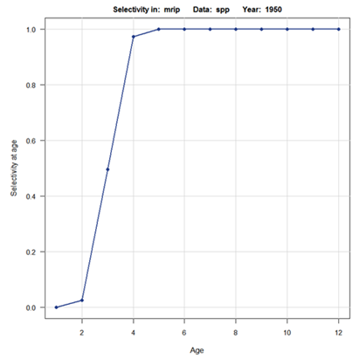
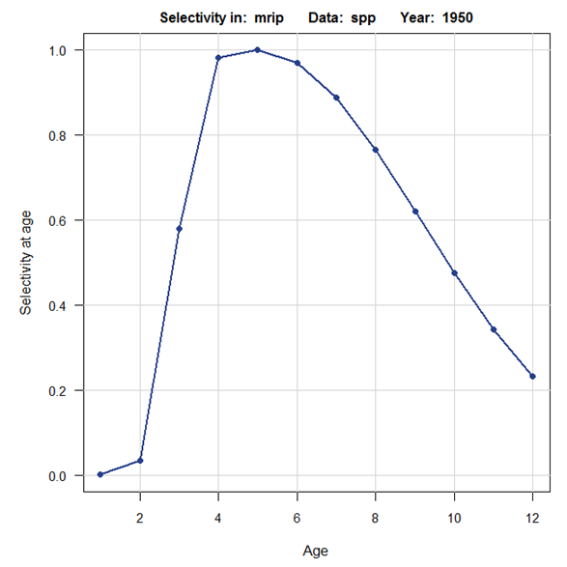
Dome-shaped Selectivity
Population
Status Indicators
Flat-topped
Dome-shaped

Slide 45
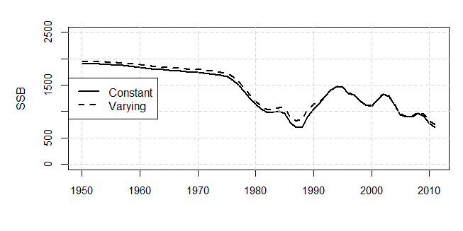
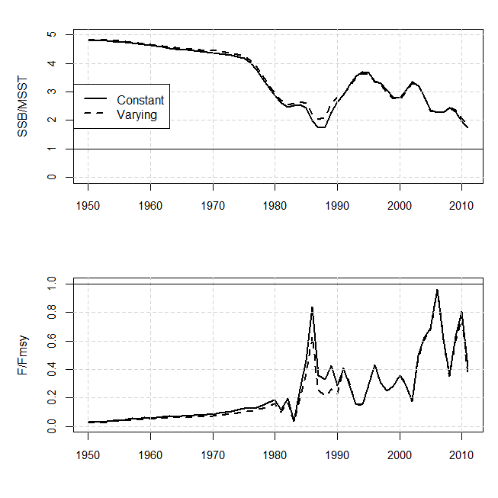
Time-Varying Selectivity
Population
Status Indicators
Period 1: 1950-1990
Period 2: 1991-2011
Based on:
2 fish/person bag limit &
Suggested change in mortality from one permutation of the mean length estimator

Slide 46
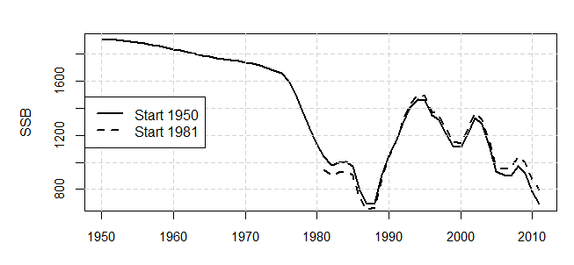
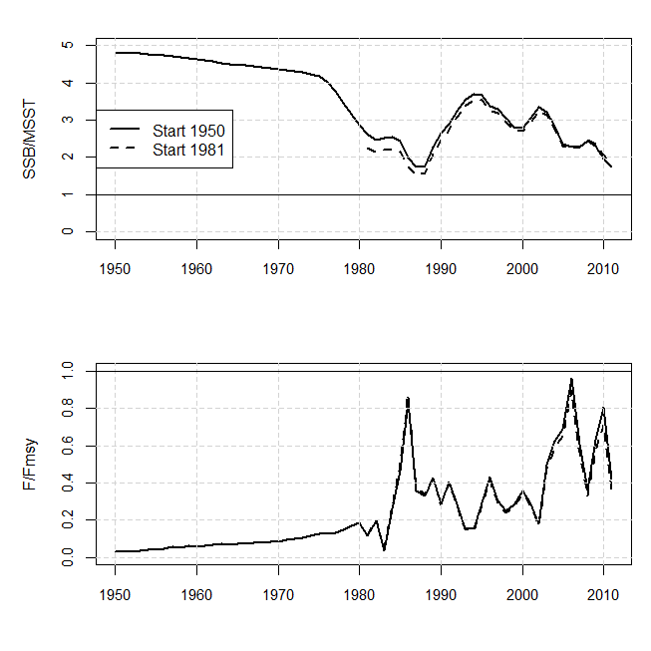
Model Start Date
Population
Status Indicators
Start date:
1950 (lightly exploited condition)
vs.
1981 (most data sources begin)

Slide 47
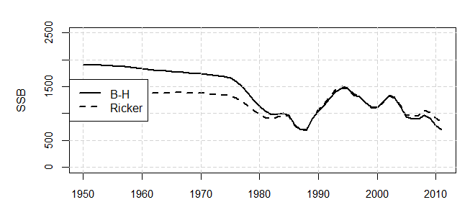
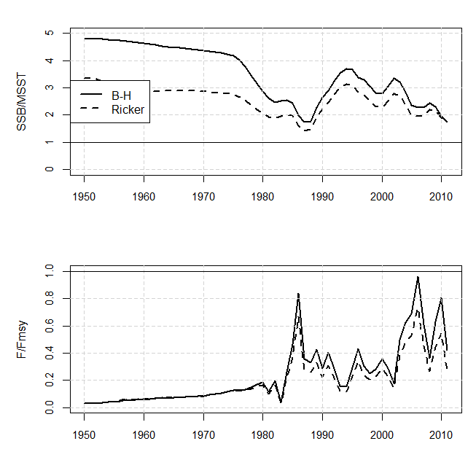
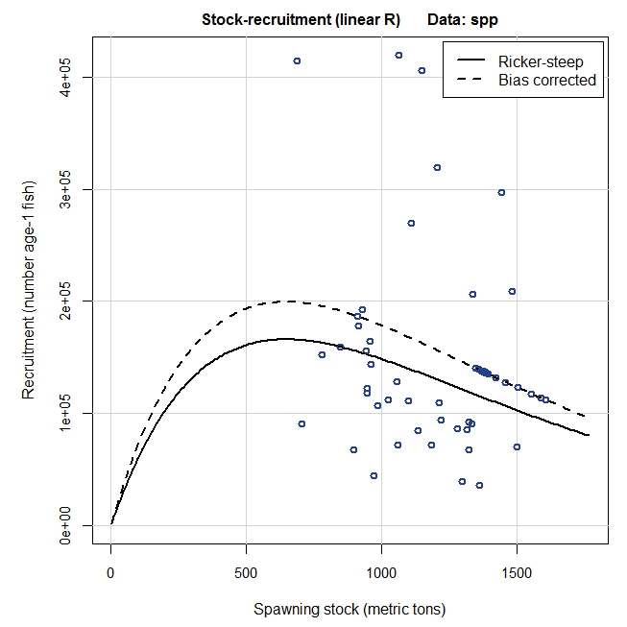
Ricker vs. BH Stock Recruitment
Population
Status Indicators
Ricker SR
Beverton-Holt SR

Slide 48
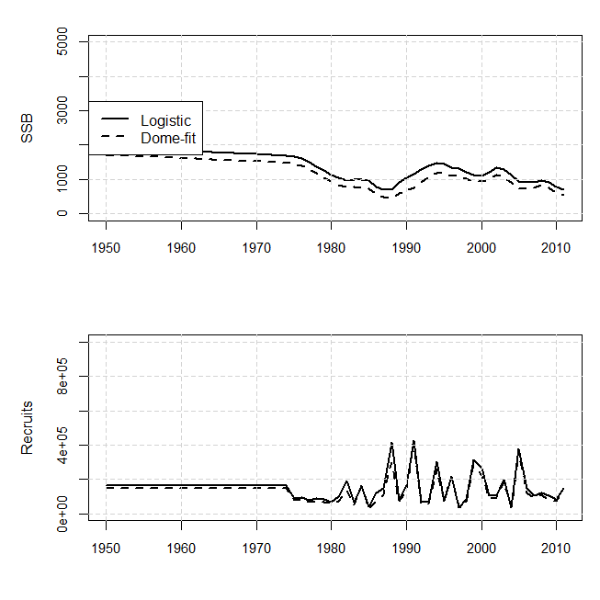
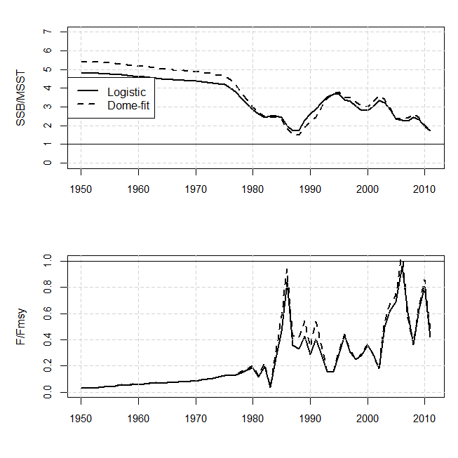
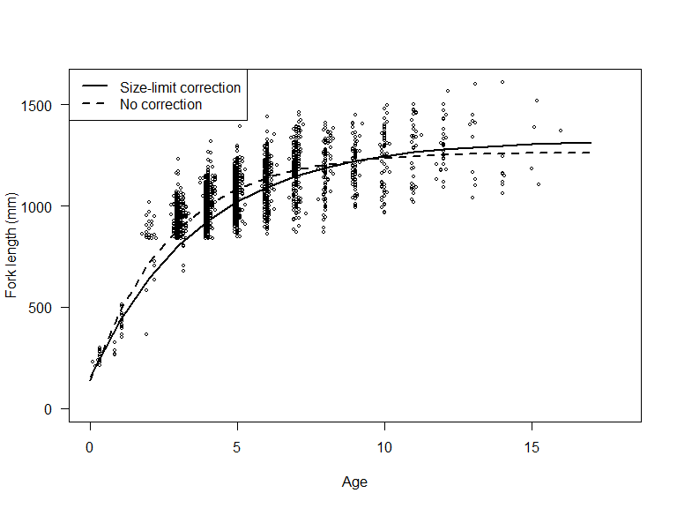
Size-at-Age
Population
Status Indicators
Single VB: solid line
Two VB: dashed line

Slide 49
Issues Addressed at Review Workshop
Additional Runs:
Requested to better understand model behavior
No recommended changes to base run
Did not (qualitatively) affect status determination (i.e., overfished/overfishing)

Slide 50
QUESTIONS?

Slide 51
P* projections
Carry forward uncertainties from MCB runs
  Uncertainties in initial (2013) abundance at age, spawner-recruit function, natural mortality, discard mortality, selectivities, recruitment deviations
Uncertainty in Fmsy uses distribution from MCB runs
Landings in 2013 equal to average from 2011-2012. New management assumed to start in 2013.
No management uncertainty (total removals = ABC)
Probability of overfishing P*=0.4 and P*=0.5

Slide 52
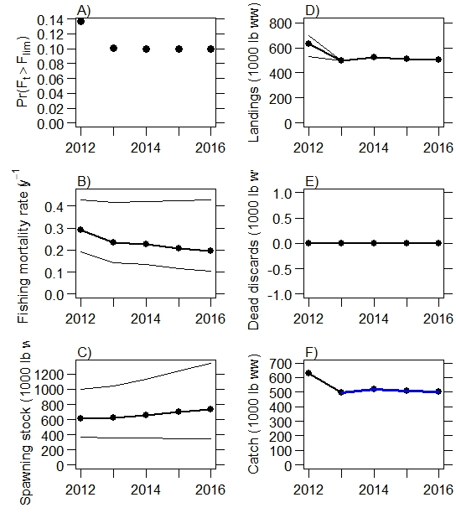
P*=0.1
Notes:
Pstar=0.1

Slide 53
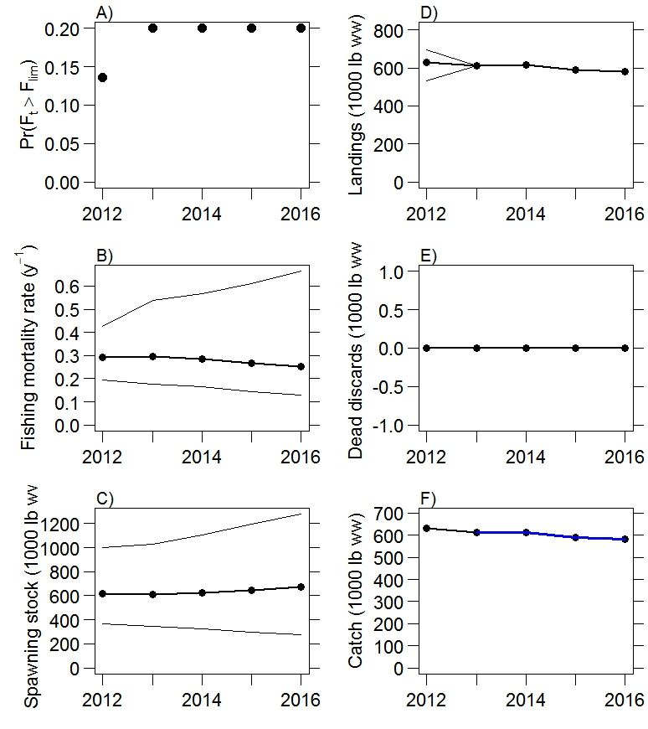
P*=0.2
Notes:
Pstar=0.2

Slide 54
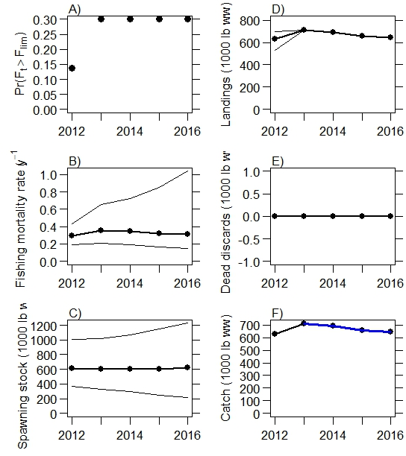
P*=0.3
Notes:
Pstar=0.3

Slide 55

P*=0.4
Notes:
Pstar=0.4

Slide 56
P*=0.5
Notes:
Pstar=0.5

Slide 57

Projection Scenario F=F_{current}
Spawning Stock (midyear)
Recruits
Fishing Mortality Rate
Landings

Slide 58
Projection Scenario F=F_{msy}
Spawning Stock (midyear)
Recruits
Fishing Mortality Rate
Landings

Slide 59

Projection Scenario F=65% F_{msy}
Spawning Stock (midyear)
Recruits
Fishing Mortality Rate
Landings

Slide 60

Projection Scenario F=75% F_{msy}
Spawning Stock (midyear)
Recruits
Fishing Mortality Rate
Landings

Slide 61

Projection Scenario F=85% F_{msy}
Spawning Stock (midyear)
Recruits
Fishing Mortality Rate
Landings

Slide 62


Model Fits: Fishery Landings
BAM Base Run
Recreational
Commercial

Slide 63

Model Fits: Length and Age Compositions
BAM Base Run

Slide 64

Model Fits: Length and Age Compositions
BAM Base Run

Slide 65

Model Fits: Length and Age Compositions
BAM Base Run

Slide 66

Model Fits: Length and Age Compositions
BAM Base Run

Slide 67

Model Fits: Length and Age Compositions
BAM Base Run

Slide 68


Model Fits: Recreational Length Comps
BAM Base Run
33 in. min
2 fish bag
Notes:
Point out measure of fit and link to sample size

Slide 69
Model Fits: Recreational Age Comps
BAM Base Run
33 in. min
2 fish bag

Slide 70


Model Fits: Commercial Compositions
BAM Base Run
Commercial Length Comps
Commercial Age Comps
1982-2011
Avg num trips: 9
Total num fish: 438
1986-2011
Avg num trips: 7
Total num fish: 120

Slide 71


Model Fits: Indices
BAM Base Run
Headboat
SC logbook

Slide 72


Model Outputs: Fishing Mortality
BAM Base Run
Landings by Fishery
F by Fishery
Commercial
Recreational

Slide 74


Dome-shaped Selectivity

Slide 75

Recreational Landings

Slide 76
Beaufort Assessment Model (BAM)
Forward projecting statistical catch-age model
Fit by maximum likelihood
  Robust multinomial for age and length composition data
  lognormal for landings and index data
  Plus priors and penalty terms
  Likelihood weights to control model fit (derived from iterative re-weighting)
AD Model Builder for optimization
Baranov catch equation to predict landings
Beverton-Holt spawner-recruit model, with annual deviations assumed to be distributed lognormally
Age-length conversion matrix assuming normal distribution of length at age with estimated CV
Catchability options: constant, linear change, random walk, density dependence
Selectivity options: logistic, double logistic, joined logistic, double gaussian
MSY-benchmarks from the expected spawner-recruit curve (bias corrected)

Slide 77
Model Outputs: Fishing Mortality
BAM Base Run
F by Fishery
Commercial
Recreational

Slide 78
BAM Likelihood Weights
  Iterative re-weighting (Francis 2011)
  Stage 1 weights based on characteristics of the data inputs:
    for indices are the CVs estimated from catch rate standardization
    for compositions are the effective sample sizes (number of trips, or number of fish)
  Stage 2 weights based on characteristics of the model run:
    Start with all stage 2 weights on data components set to 1.0
    Calculate SDNRs (standard deviation of normalized residuals)
    Re-compute weights as 1/SDNR for indices or 1/(SDNR)² for compositions
    Iterate until SDNRs approach 1.0
  Method accounts for potential correlations in the composition data (TA 1.8 in Francis (1011))
  Did not re-weight landings
  Commercial length and age comps given same weights as corresponding recreational data
  Evaluated weighting assumptions via sensitivity analysis

Slide 79
Example with P* = 0.30
Pr(overfishing)
MSY quantity
Median
5th & 95th %tiles

Slide 80
Projection Model
5 year projection (2012-2016)
Same structure as assessment model
Initialization:
  Initial (2012) numbers at age (2-12⁺) based on 2011 estimates discounted by Z
  Initial recruits (age-1 in 2012) computed from S-R curve and 2011 spawning biomass
  Terminal two years of recruitment did not deviate from S-R curve
  Lognormal stochasticity added to age-1 and age-2 abundance in 2011
  During initialization year (2012) fully selected F taken as geo. mean F 2009-2011
New management assumed to start in 2013
No management uncertainty (total removals = ABC)
n= 10,000 projected time series
Each time series based on a single MCB run chosen at random (includes uncertainty in data and parameter estimates)
Show one example each of constant F and P* (others are available)

Slide 81


Size-at-Age

