Slide 1
Public Information Document for Cobia
Presented at Public Meetings in Virginia, North Carolina, South Carolina and Florida
December 6-15, 2016

Slide 2
Presentation Summary
Review current status.
September 2016 SAFMC meeting.
Review SAFMC Framework 4 to the CMP:FMP to implement accountability measures to slow harvest in 2017.
Review PID and proposed management issues

Slide 3
Current Issues
The NMFS announced a closure to the AMG cobia effective June 20, 2016 for exceeding the ACL in 2015.
The ACL for AMG cobia in 2015 was 630,000 pounds while landings were 1,540,776 pounds.
The closure impacted the fishery throughout the range of the AMG cobia but impacts were greatest for the outer banks of North Carolina and all states from Virginia to the northern extent of the range.
Virginia and North Carolina reacted to the closures by implementing state specific regulations to lessen the impact of the closure.

Slide 4
Stock Status
2013 Cobia Benchmark SEDAR Assessment
Data through 2011
Assessment indicates stock is not overfished and overfishing is not occurring but does indicate an overall decline in biomass
Research track stock assessment scheduled for 2019
Operational stock assessment scheduled for 2020

Slide 5
Stock Boundaries
New cobia stock boundaries were established through SAFMC Amendment 20B (2014) beginning March 1, 2015: Atlantic Migratory Group cobia annual catch limits apply from Georgia through New York;
Cobia caught off the east coast of Florida are counted against the Florida East Coast allocation of the Gulf of Mexico cobia annual catch limit.
Cobia included in Stock ID workshop in 2017

Slide 6
Framework Action 4 proposed measures
Reduce recreational bag limit from 2 fish to 1 fish
Increase the minimum size limit from 33” to 36” FL.
Limit commercial harvest to 2 fish per person or 6 per vessel, whichever is more restrictive

Slide 7
Timeline (short term)
Oct 2016 – SA Board reviews PID for approval
Nov 2016–Jan 2017 - staff conducts public meetings and accepts public comment
Feb 2017- Board reviews public comments and directs FMP development

Slide 8
Management Issues for PID
ASMFC staff and the Plan Development Team reviewed and discussed the following management issues and questions for Board consideration.

Slide 9
Management Issue 1
COMPLEMENTARY MANAGEMENT WITH THE COUNCIL
Complementary management of cobia is intended to increase flexibility and management reaction time, while providing states the ability to more actively and adequately manage the fishery in their respective states.
Management Questions:
Should the Commission develop a complementary Cobia FMP to the SAFMC’s CMP FMP?
What federal management measures should be required in the Commission plan?
What states should be included in the management unit?
Given the upcoming genetic workshop in 2017, should the FMP provide the flexibility to make changes to management and stock units to reflect changes in the science?

Slide 10
Management Issue 2
MANAGEMENT OBJECTIVES AND GOALS
Provide a management plan that achieves the long-term sustainability of the resource and strives, to the extent practicable, to implement and maintain consistent coast wide measures, while allowing the states the flexibility to implement alternative strategies to accomplish the objectives of the FMP
Provide for sustainable recreational and commercial fisheries.
Maximize cost effectiveness of current information gathering and prioritize state obligations in order to minimize costs of monitoring and management.
Adopt a long-term management regime which minimizes or eliminates the need to make annual changes or modifications to management measures.
Management Question
What should be the objectives in managing the Cobia fisheries through the Commission?

Slide 11
Management Issue 3
COASTWIDE, REGIONAL, OR STATE-BY-STATE MANAGEMENT:
States currently manage their cobia fisheries independently. The Commission is considering coordinating the management of cobia in order to avoid states being disadvantaged based on where they occur along the migratory route, while maintaining harvest at the Council’s ACL level.
Management Questions:
Are consistent, state-specific management measures, coordinated by the Commission, needed for cobia?
Are there regional differences in the fishery and/or resource that need to be considered when implementing management measures?
Should the FMP require a coast wide closure if the Council ACL is met?
Should the FMP require a coast wide measures (e.g., size and bag limit)?
Should the FMP require regional measures?
Should the FMP develop a suite of options for the allocation of state-specific quotas and allow states to adopt unique size, bag, and season measures?

Slide 12
Management Issue 4
COMMERCIAL AND RECREATIONAL MANAGEMENT TOOLS
Potential management tools include: minimum size restrictions, maximum size restrictions, bag/trip/boat limits, seasons or gear restrictions. Currently, the commercial fishery is managed consistently throughout state and federal jurisdictions, while recreational management measures vary.
Management Questions:
What are the appropriate commercial and recreational measures for cobia?
Should the FMP consider gear restrictions, e.g. circle hooks for all live and dead bait fisheries for cobia or prohibition on gaffing cobia?
Are there other management options that should be considered (e.g., slot limits, spawning season closures, etc.)?
Should the FMP consider some level of de Minimis or threshold landings where cobia harvest is minimal or episodic

Slide 13
Management Issue 5
The public will be asked to comment on any other issues for consideration in the development of the Commission’s draft FMP for Cobia.

Slide 14
Issues raised by the PDT
Delay in stock assessment
Stock ID workshop timing

Slide 15
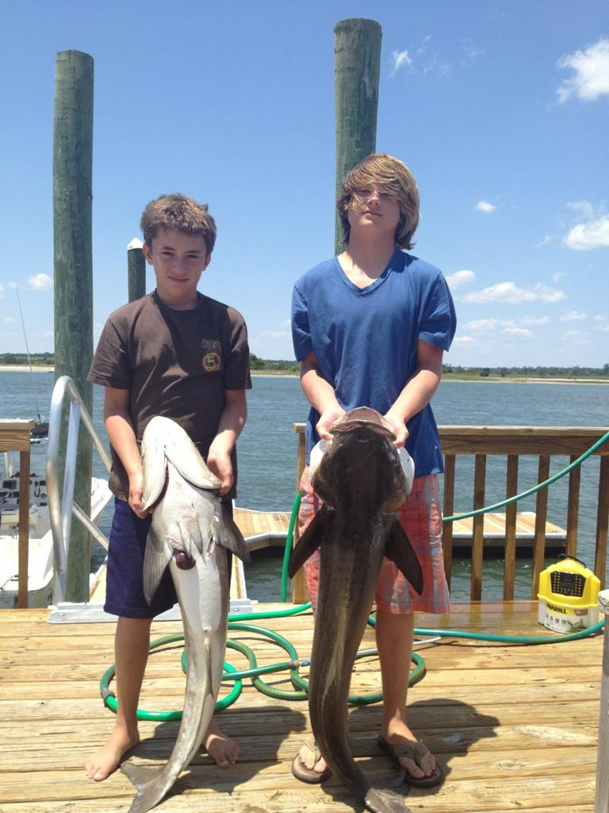
Questions

