Slide 1
Comp ACL AM Triggers
Pluses and Minuses of each Alternative

Slide 2
Data and Fisheries
All the landings data presented are from the SEFSC ACL datasets.
The example fisheries are Dolphin, Wahoo, and Gray Snapper.
The ACLs for Dolphin and Wahoo are the current preferred alternatives, not the new SSC recommendations for ABC.

Slide 3
Sector Allocations
Rec allocation for Dolphin and Wahoo:
$\frac{\left(50\% of avg. rec landings 99−08\right)+\left(50\% of avg. rec landings 06−08\right)}{\left(50\% of avg. total landings 99−08\right)+\left(50\% of avg. total landings 06−08\right)}$
Rec allocation for Gray Snapper:
$\frac{\left(50\% of avg. rec landings 86−08\right)+\left(50\% of avg. rec landings 06−08\right)}{\left(50\% of avg. total landings 86−08\right)+\left(50\% of avg. total landings 06−08\right)}$

Slide 4
Confidence Interval
90% CI
Used only the lower bound.
Calculated using MRFSS PSEs.
Landings –(1.645*Landings*PSE*.01)
The .01 converts the PSE from a percentage to a decimal.

Slide 5
Running Averages
3 year running average
Take the average of the current year’s landings and the previous 2 years’ landings.
Modified Mean
Also a running average.
Look back over 5 years. Find the highest and lowest landings. Drop those years. Take the average of the remaining 3 years.

Slide 6
Caveats
2010 Wahoo landings are just a simple estimate, not true landings.
These ACLs and AMs were not present in fisheries, however ACLs were imposed over historic data in order to illustrate how these AM triggers work. Landings may respond differently in real life.

Slide 7
Caveats: PSEs
All landings are from NMFS. NMFS uses a different algorithm to convert #s to weight than MRFSS, so the PSEs differ from MRFSS PSEs
Error estimates from SEFSC were not available. MRFSS PSEs were used instead.

Slide 8
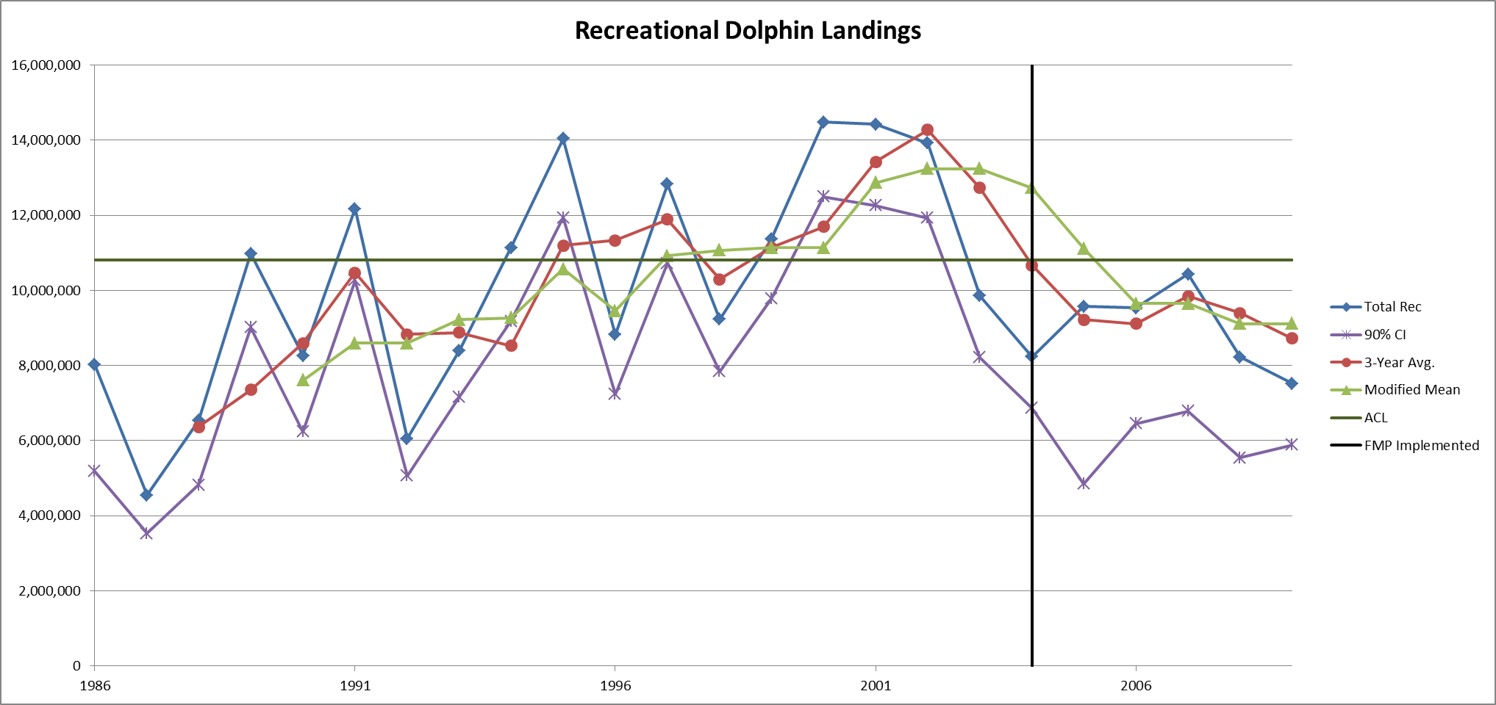

Slide 9
Dolphin
Both running averages display lags when there is a trend in the landings.
How do we justify taking action when average is over ACL but landings are under it?
Using only CI to track landings can be dangerous because the lower says we are 90% confident landings are above this point.
What do we do if estimate is over but CI is under? What if CI is close to ACL but not over?

Slide 10
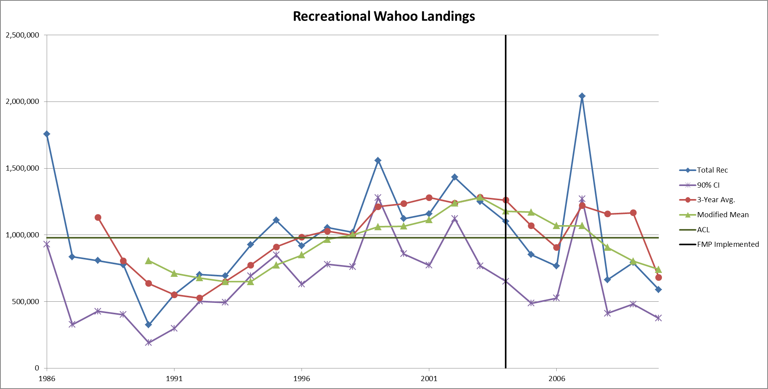

Slide 11
Wahoo
Averages show same lag problem.
Also see 3 year average is very affected by spikes.
2007 spike keeps 3 yr avg over the ACL for 3 years.
Mod mean can smooth those spikes, but has a worse lag than the 3 year average.
Same problems exist for the CI.
What happens when the running average is outside of the CI?

Slide 12
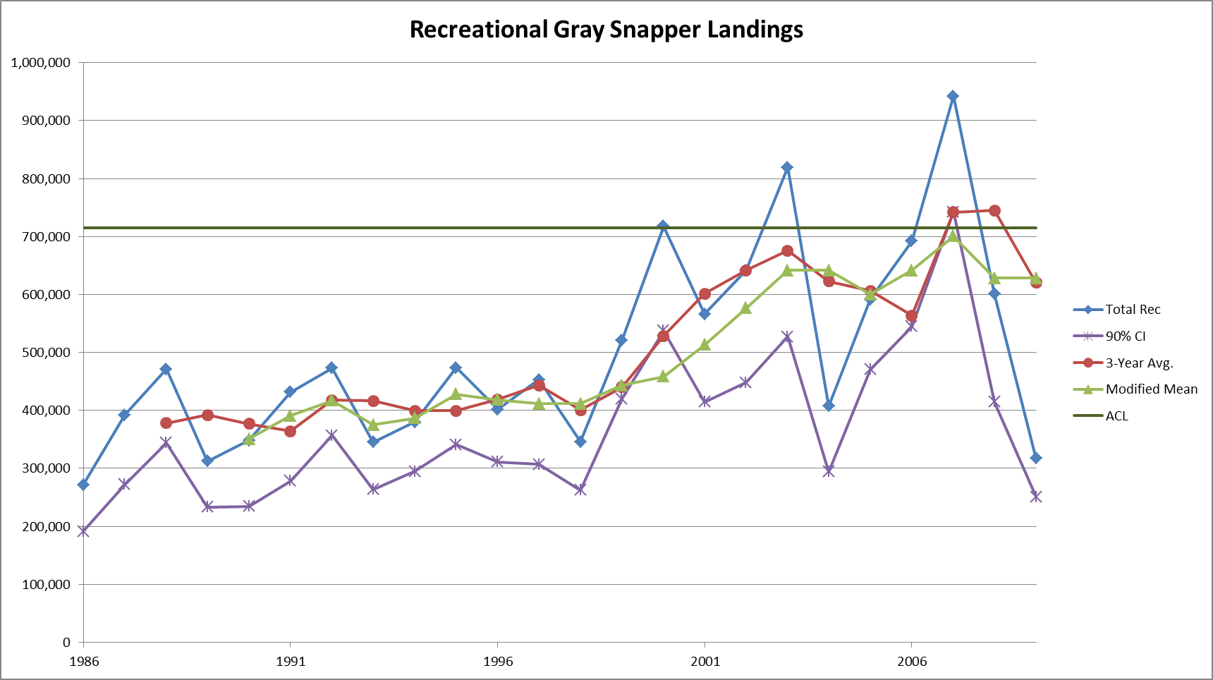

Slide 13
Gray Snapper
One of the few species where the averages work fairly well.
Why? Because there is no real trend in the data at any point. Landings fluctuate around a central tendency.
There is still some evidence of lagging and peaks affecting the 3 yr avg, though.

Slide 14
What works best?
After careful analysis, all of these AM triggers have weaknesses in certain situations, making none of them ideal.
One possible solution is to use a combination of metrics.
If CI is over the ACL, taker immediate action.
If CI is under but estimate is over, look at the running average.
If it is over, take action. If not, monitor in-season in the next year.

Slide 15
Possible Solutions
Another possible solution is to simply use the landings estimates from each year.
Remember, new MRIP methods in the future should reduce PSEs.
Will still have to look at trends in data.
Perhaps if over in one year, monitor in-season in the next to see if fishery is on track to stay above of fall below the ACL
Take action as necessary.

Slide 16
Questions?

Slide 17
Using Total Overages for AMs
Instead of simply tracking each sector completely separately.

Slide 18
Explanation
Only penalize sectors for total overages, not only for sector overages.
4 scenarios
Both sectors under, total under.
One sector over, total under.
One sector over, total over.
Both sectors over, total over.

Slide 19
Explanation
What do we do?
If the total is under, no matter if one sector is over or not, no action is taken.
If both sectors are over, then each is penalized based on the sector overage.
If one sector is over and the total is over, penalize that sector based on the total overage, not the sector overage.

Slide 20
Dolphin and Wahoo Examples
Dolphin Overages
Year | Comm | Rec | Total
1986 | -341,333 | -2,782,191 | -3,123,523
1990 | 165,539 | -2,535,635 | -2,370,096
2002 | -180,261 | 3,123,383 | 2,943,122
2000 | 136,947 | 3,678,021 | 3,814,968
Wahoo Overages
Year | Comm | Rec | Total
1989 | -4,939 | -202,582 | -207,521
1990 | 9,862 | -653,397 | -643,535
1986 | -19,874 | 776,817 | 756,943
2007 | 13,323 | 1,062,624 | 1,075,946

Slide 21
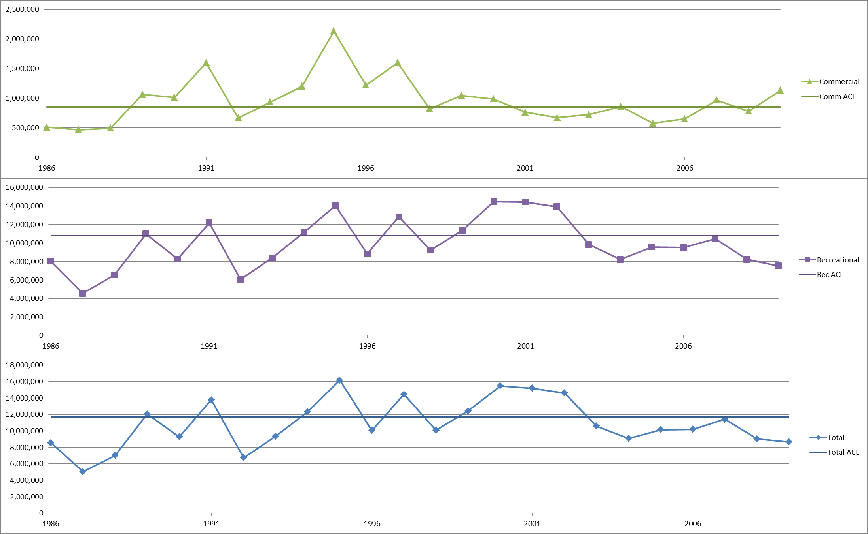
Dolphin Sector Landings

Slide 22
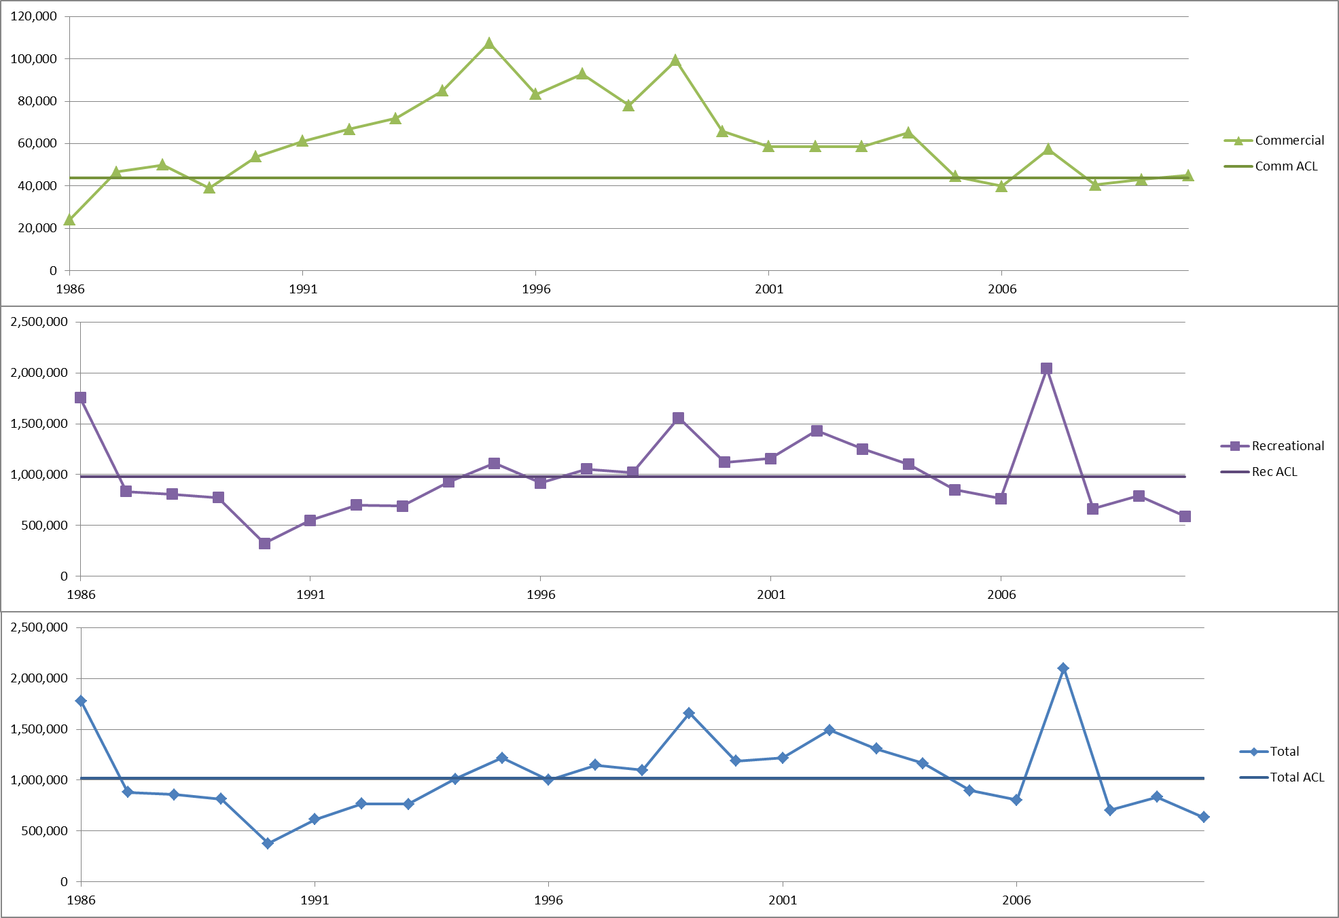
Wahoo Sector Landings

Slide 23
Conclusions
Makes biological sense. Want to keep fishery under total ACL.
For paybacks, one sector’s overage is buffered by the other sector’s underage.
No one is penalized for being under their ACL.
Only helps in overage situations.

Slide 24
Questions?

