Slide 1
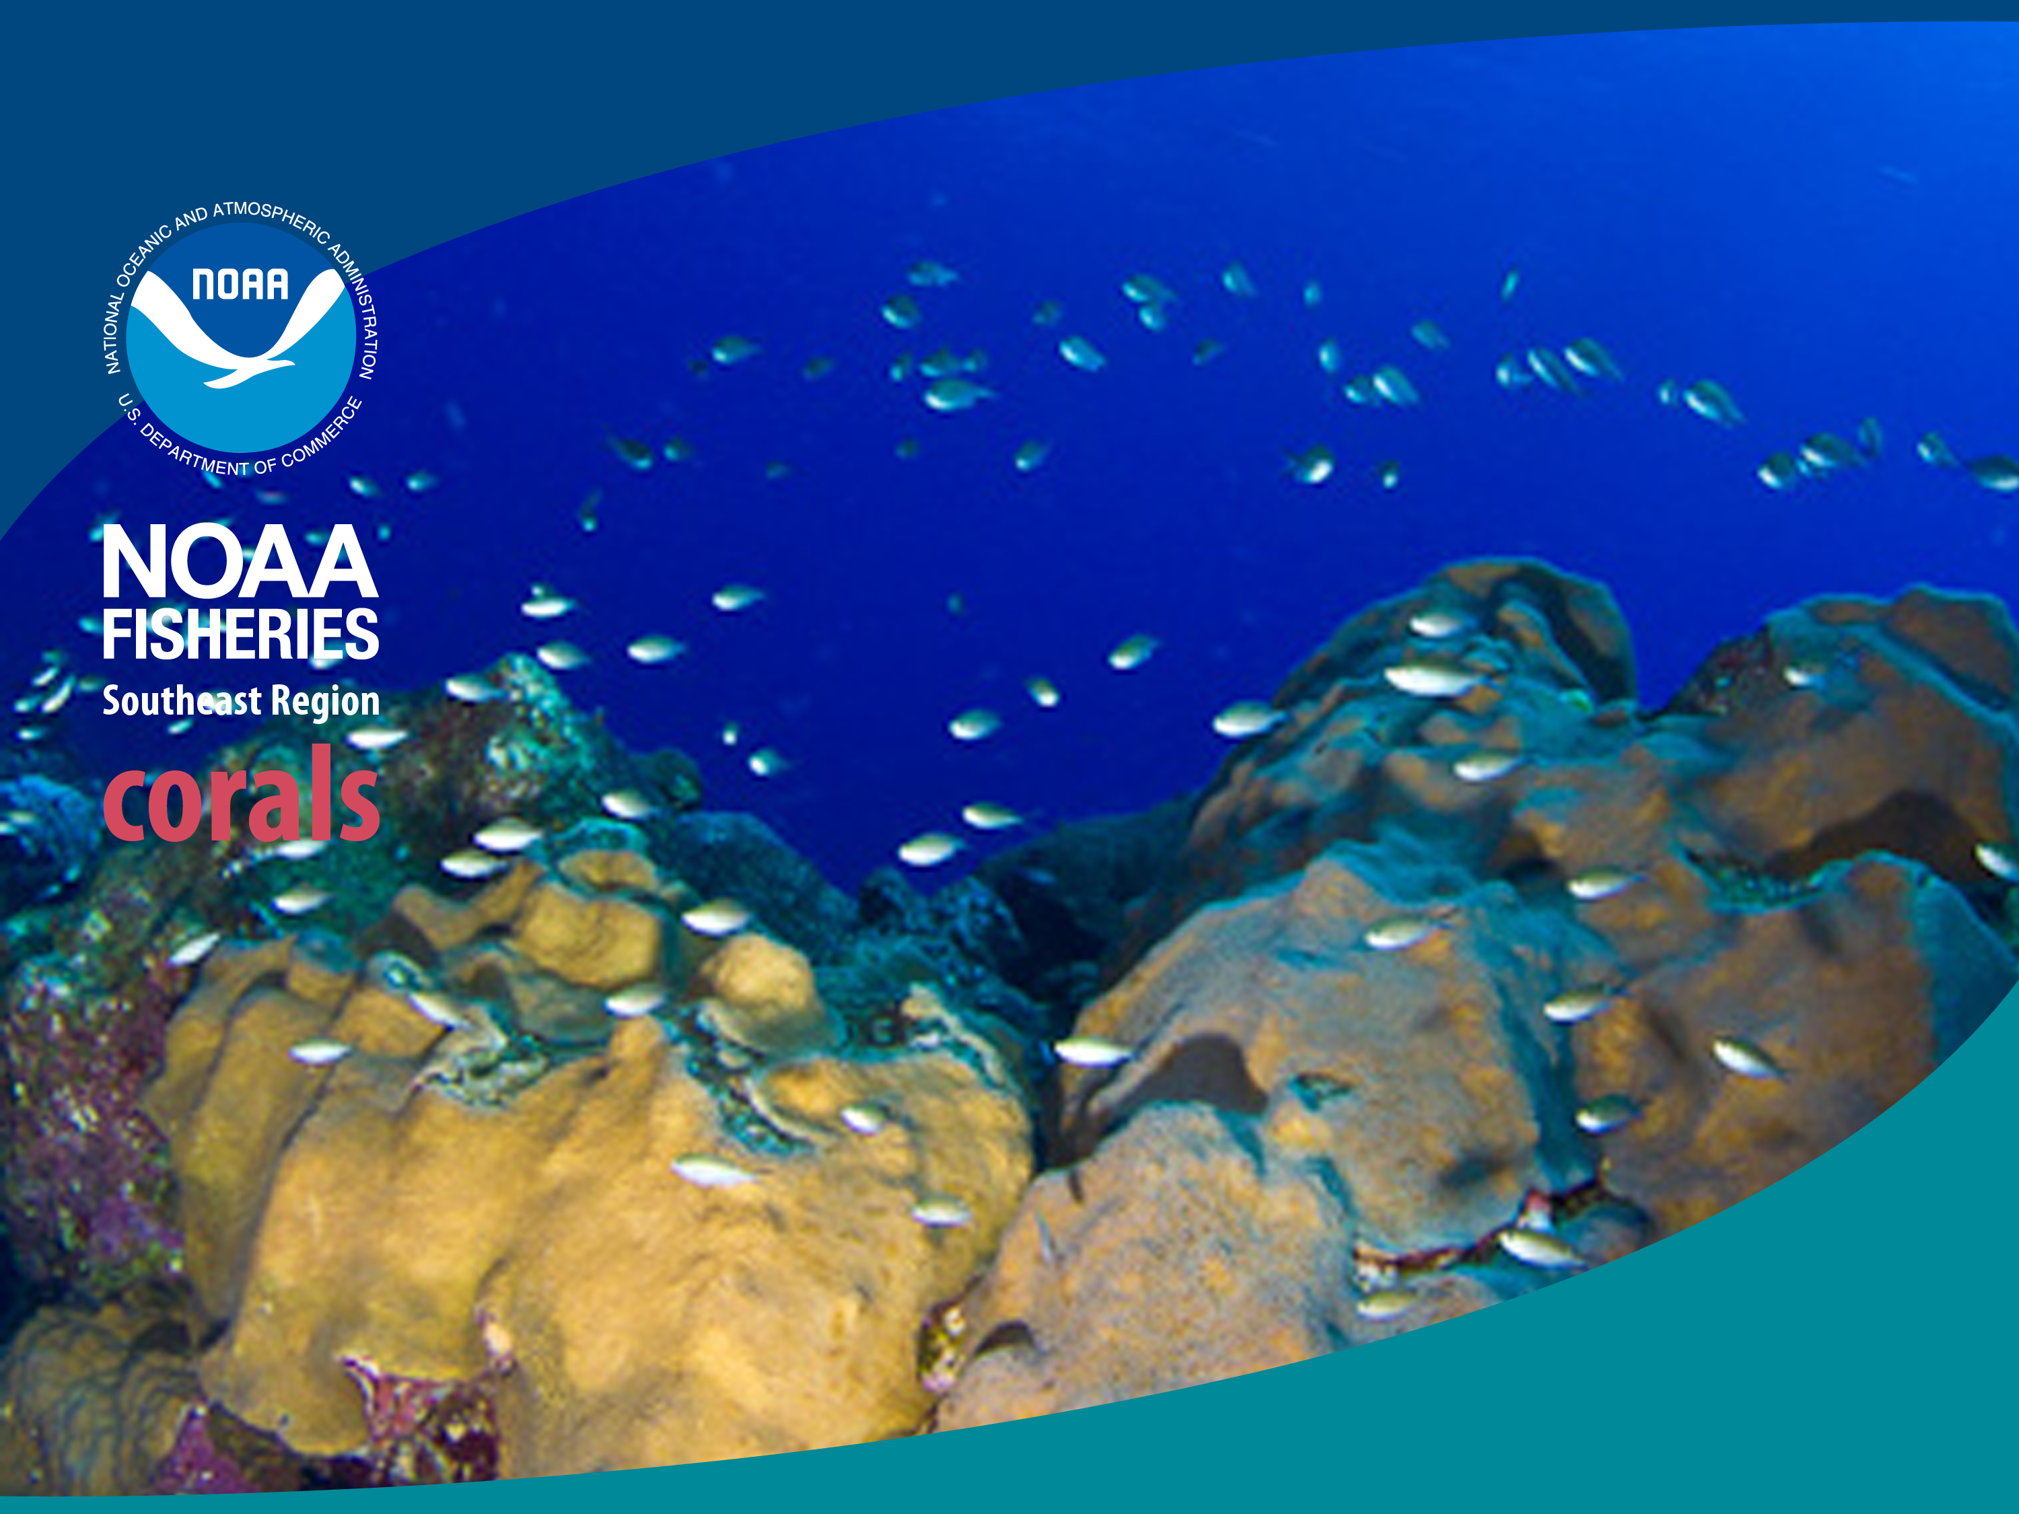
Update on Proposed ESA Listing Determinations for 82 Coral Species
Jennifer Lee
Fishery Biologist/Management Council Liaison
Protected Resources Division
May 07, 2014

Slide 2
Process
Petition received
Oct 2009
83 spp.
“Not Substantial”
90-day Finding
“Substantial” 90-day Finding
Feb 2010
1 sp.
82 spp.
Status Review and
Draft Management Report
Public Engagement
Summer
2012
82 spp.
Doesn’t Support Listing
12-month Finding
16 spp.
66 spp.
+
2 spp.
Proposed Rule Published
Dec 2012
68 spp.
Public Comment
Apr 2013
68 spp.
6-mo Extension and Data Solicitation
Fall 2013
68 spp.
Final Rule Published
Jun 2014

Slide 3
What did we propose?
NOAA proposed listing 66 coral species and reclassifying two under the ESA
  Of the 66 species, 54 are proposed as threatened and 12 as endangered
  16 of the 82 species contained in the original petition are not warranted for listing under the ESA
  2 Caribbean species – elkhorn and staghorn corals – are being proposed for reclassification from threatened to endangered

Slide 4
Species Proposed for Listing by: Jurisdiction
Jurisdiction | # Proposed Endangered | # Proposed Threatened
Florida | 7 | 2
Puerto Rico | 7 | 2
US Virgin Islands | 7 | 2
Hawai’i | 0 | 3
Guam | 0 | 27-30
CNMI | 1 | 28
American Samoa | 3 | 41-43

Slide 5
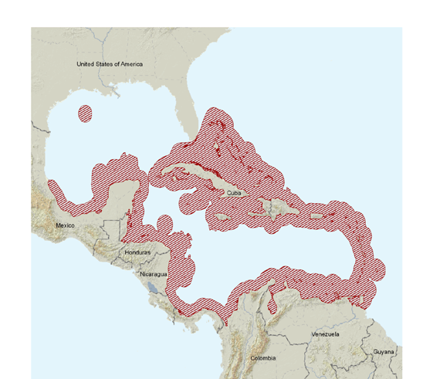

Southeast Coral Proposals
Proposed Endangered Species
Staghorn coral (Acropora cervicornis)*
Elkhorn coral (Acropora palmata)*
Pillar coral (Dendrogyra cylindrus)
Lobed star coral (Montastraea annularis)
Mountainous star (Montastraea faveolata)
Knobby star coral (Montastraea franksi)
Rough cactus coral (Mycetophyllia ferox)
Proposed Threatened Species
Lamarck's sheet coral (Agaricia lamarcki)
Elliptical star coral (Dichocoenia stokesii)
*Presently listed as threatened

Slide 6
Basis of Proposed Rule
Status Review Report: Drafted by the Biological Review Team to provide 82 species-specific status reviews. The peer-reviewed report summarizes general threats to corals, their life history and ecology, and provides species assessments for each of the 82 species.
Management Report: Drafted by the regional offices to provide the basis for determining whether existing laws, conservation efforts, and other regulatory mechanisms are adequate to protect the species.
Supplemental Information Report: Provides summary of new information collected from NOAA’s Public Engagement process in April-July 2012 (approximately 400 scientific articles and 42,000 public comments)

Slide 7
Participants
NOAA Fisheries’ Southeast Regional Office and Pacific Islands Regional Office
NOAA Fisheries’ Southeast Fisheries Science Center, Pacific Islands Fisheries Science Center, and the Coral Biological Review Team
NOAA Fisheries’ Office of Protected Resources
NOAA Fisheries’ Office of Habitat Conservation and the NOAA Coral Reef Conservation Program

Slide 8
Major Themes in Public Comment
Interpretation of the data relating to extinction risk and proposed species’ listing statuses.
The sufficiency and quality, or lack thereof, of the species-specific information used for each species’ proposed listing determination.
The accuracy of the methods used to analyze the available information to assess extinction risk (including NMFS’s ‘‘Determination Tool’’) and derive listing statuses for each of the proposed species.
The ability of corals to adapt or acclimatize to ocean warming and acidification.
The reliability, certainty, scale, and variability of future modeling and predictions of climate change.
The effect local management efforts have on coral resilience.

Slide 9
Major Themes in Public Comment
Lack of analysis of physical complexity of global threats, like spatial and temporal variability in ocean warming and acidification, so didn’t account for high uncertainty about where and when global threats will occur.
New info provided, esp. on worsening of global threats, ocean warming hiatus since 2000, spatial variability in global threats, high uncertainty wrt effects of global threats on corals, and coral trade and mariculture.
Use of the year 2100 for the foreseeable future isn’t supportable because it’s too far into the future, and thus too uncertain, so the T proposed listings aren’t supportable.
E proposed listings aren’t supportable because extinction isn’t imminent due to: life histories that reduce extinction risk, Caribbean threats aren’t imminent, large ranges of all species, and lack of species-specific info.
A vast amount of new species-specific info was received, and a large number of highly-relevant scientific papers are continually being published that contribute to the best available info.

Slide 10
NEW INFORMATION
For general coral habitat, many new papers on the emerging field of mesophotic habitat (>30 m depth) in the Caribbean and Indo-Pacific;
For general coral biology:
  in the Indo-Pacific, many public comments from coral experts regarding taxonomic and species identification uncertainties;
  in the Caribbean, a new report from a group of scientists on trends in corals and coral reefs from 1970 to 2012;
For climate change threats, the IPCC’s new Fifth Assessment Report, a 2,300 page synthesis of the current physical science of climate change;
For species-specific information:
  a new report from coral expert Charlie Veron on the distributions and abundances of 66 of the 68 proposed species
  >1,000 new papers the distributions, abundances, threat vulnerabilities, and life histories of the proposed species.

Slide 11
What If corals are listed?
 | Endangered | Threatened
Increased protection from impacts from federal activities
Restrictions on removal, harm, transport, or sale
Development of Recovery Plans
Potential funding for State, Territorial, and Commonwealth fisheries & wildlife agencies
✔
✔
✔
*
✔
✔
✔
✔

Slide 12
Listing does NOT automatically:
PROHIBIT recreation around coral reefs.
BAN fishing around coral reefs.
PREVENT boating near coral reefs.
STOP research on coral reefs.

Slide 13
Contact Information
Jennifer Lee
Fishery Biologist and Fishery Management Liaison
Southeast Region
Jennifer.Lee@noaa.gov
Jennifer Moore
ESA Coral Listing and Recovery Coordinator
Southeast Region
jennifer.moore@noaa.gov
http://sero.nmfs.noaa.gov/pr/esa/82CoralSpecies.htm

Slide 14
Questions?

