Slide 1
Commercial ACL Monitoring 2015
SEFSC
March 2015

Slide 2
Commercial Landings Monitoring System 2015 SA Reporting
Reporting weeks are defined as Sunday through Saturday.
Dealers are required to electronically submit a weekly report by midnight the following Tuesday.
Dealers can check their reporting status online:
http://www.sefsc.noaa.gov/drsr/DealerReportingStatus.jsp
The percent of late trips has decreased since implementation in 2014, but still remains high.

Slide 3
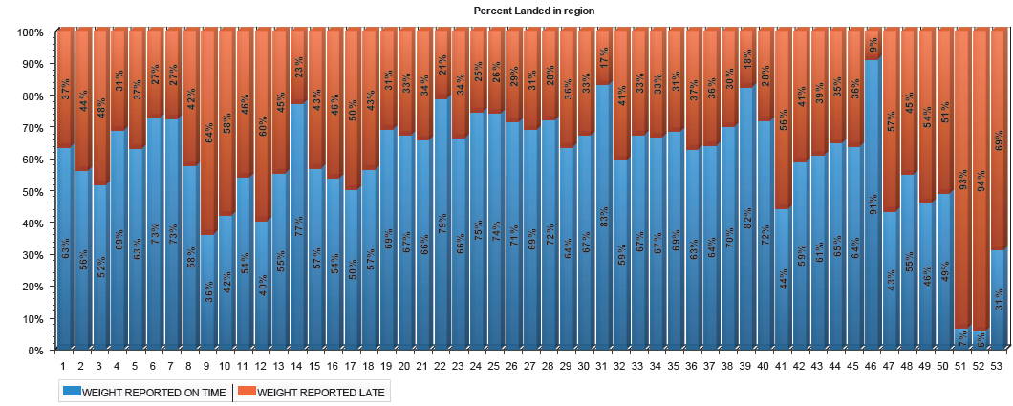
Commercial Landings Monitoring System 2015 SA Reporting
Notes:
X-axis is week of year. Certain weeks have more late reports, eg around the Dec. holidays.

Slide 4
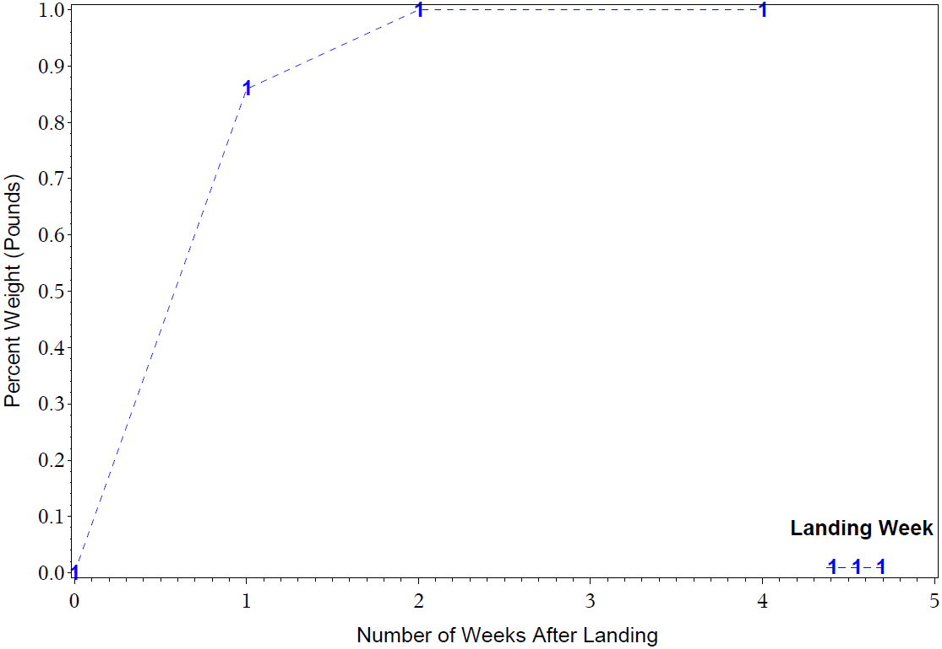
Commercial ACL Monitoring Vermilion Snapper Jan – Jun 2015
Reports Due
Notes:
This plot and following plots shows how late some of the weight is reported.
This plot shows weight landed on the first week of the season as it’s reported through time.
Reports are required by 1 week after landing.

Slide 5
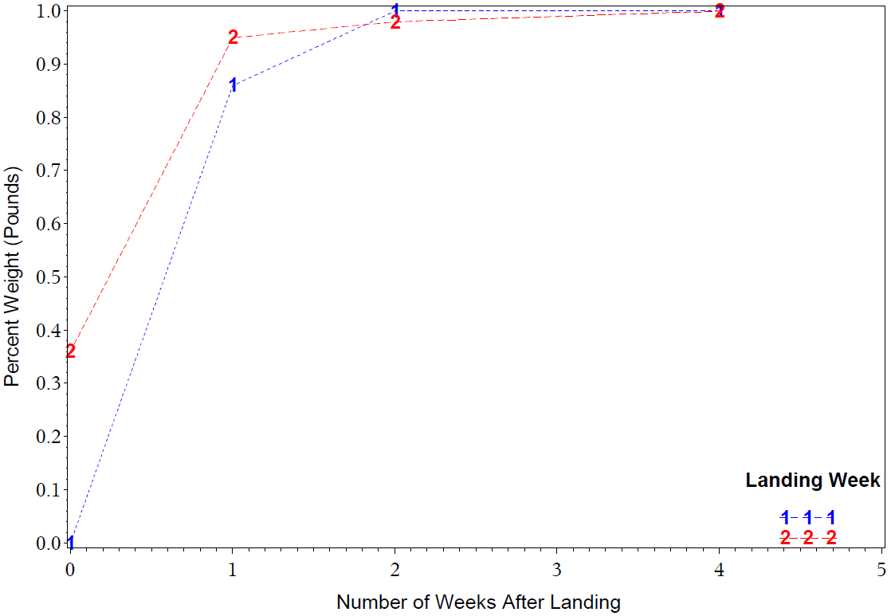
Commercial ACL Monitoring Vermilion Snapper Jan – Jun 2015
Reports Due
Notes:
Blue #1 refers to weight landed the first week of the season.
Red # 2 refers to weight landed the second week of the season.

Slide 6
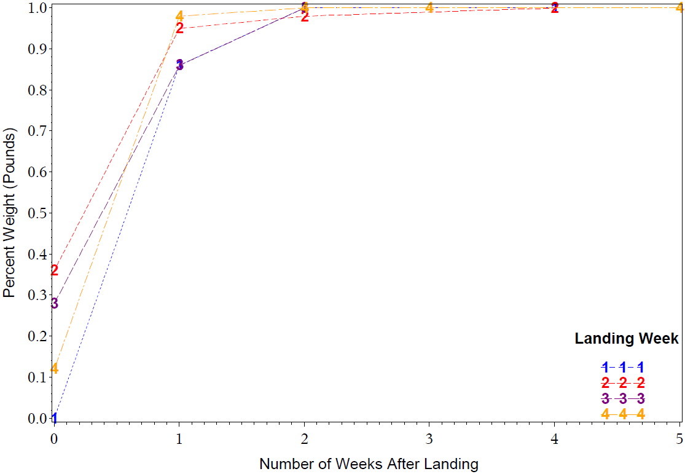
Commercial ACL Monitoring Vermilion Snapper Jan – Jun 2015
Reports Due

Slide 7
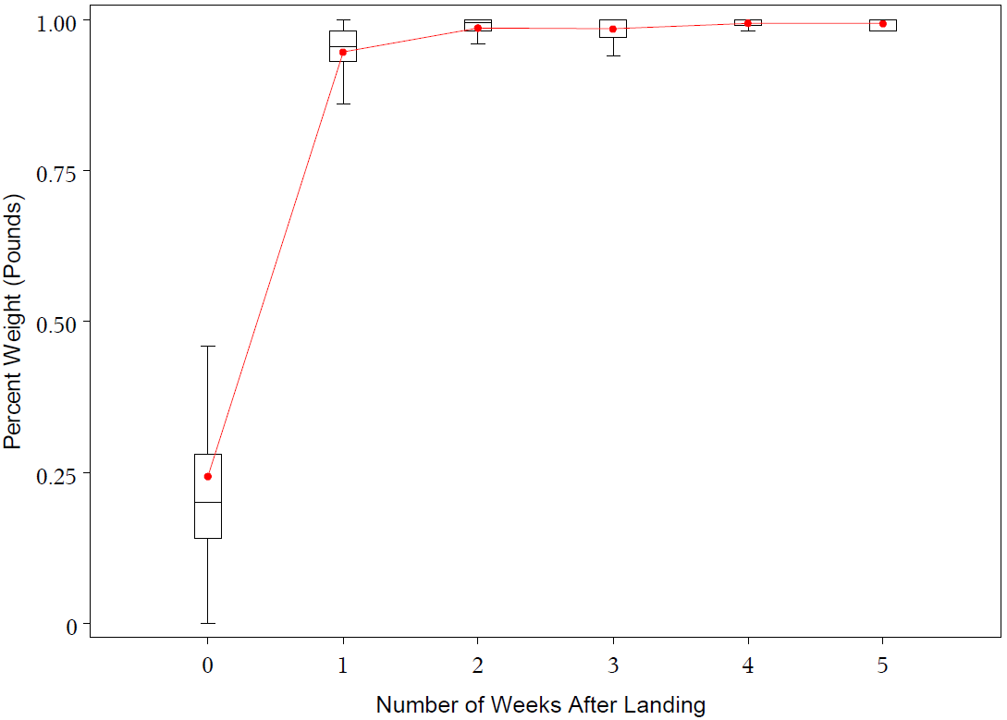
Commercial ACL Monitoring Vermilion Snapper Jan – Jun 2015
Reports Due
Maximum observation below 1.5x Interquartile Range
75th Percentile
Mean (connected between weeks)
Median
25th Percentile
Minimum observation above 1.5x Interquartile Range
Notes:
Most box plots HAVE INFORMATION REMOVED FOR CLARITY. Data points outside of the whiskers are not shown except for slide 10 which shows late reporting by about 150 days for jacks. (those removed points can influence the location of the mean (shown in red)
Key to what the boxplot represents is to the right. This key applies to other boxplots displayed in following figures.

Slide 8
Commercial ACL Monitoring 2015
Notes:
Different quotas have different patterns of compliance. Red box highlights when a report should be submitted.

Slide 9
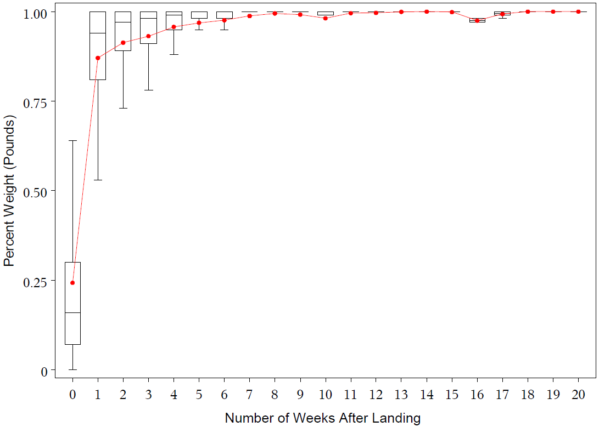
Commercial ACL Monitoring All South Atlantic ACLs, 2015
Reports Due
Notes:
While reporting for a period becomes mostly complete within 3-4 weeks, we are still getting reports 20 weeks after landing for some periods

Slide 10
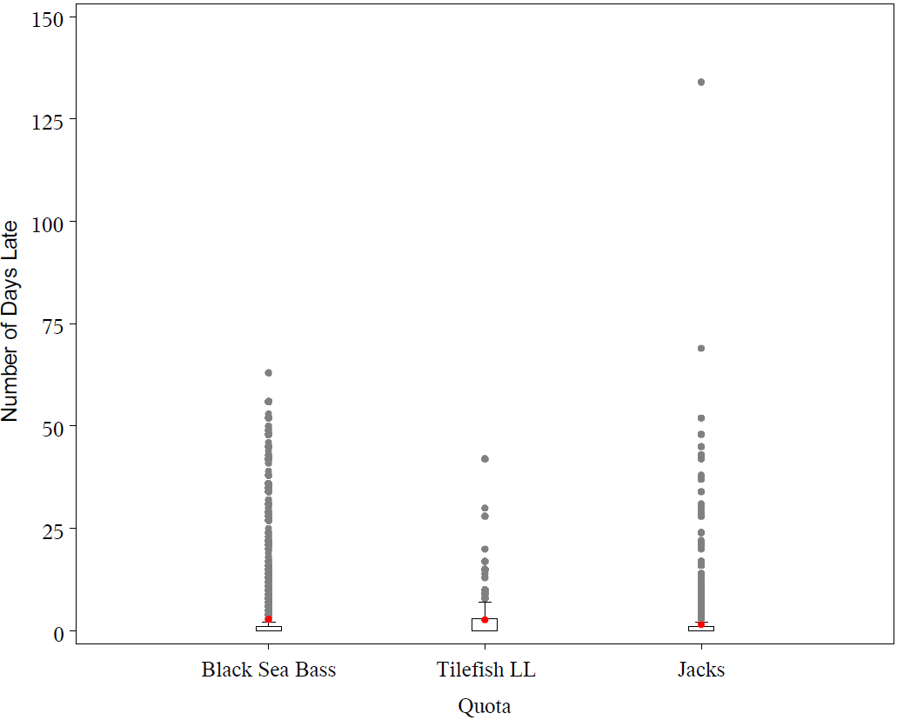
Commercial ACL Monitoring Number of Days Late, 2015
Notes:
We know of at least one dealer who has not reported at all for 2015, thus more points will be added perhaps > 150 days. We expect to be receiving those reports as the dealer attempts to become compliant (wanting to renew permit for the next 12 months). This problem is being reduced through outreach and permit renewal requirements
These plots can not reflect late reports which have not yet been received
Y-axis is number of days after a report is required to be submitted. Full range of values on y-axis, including some extremely late reports. Red dots=mean
Median = 0 because of the % reported on time.

Slide 11
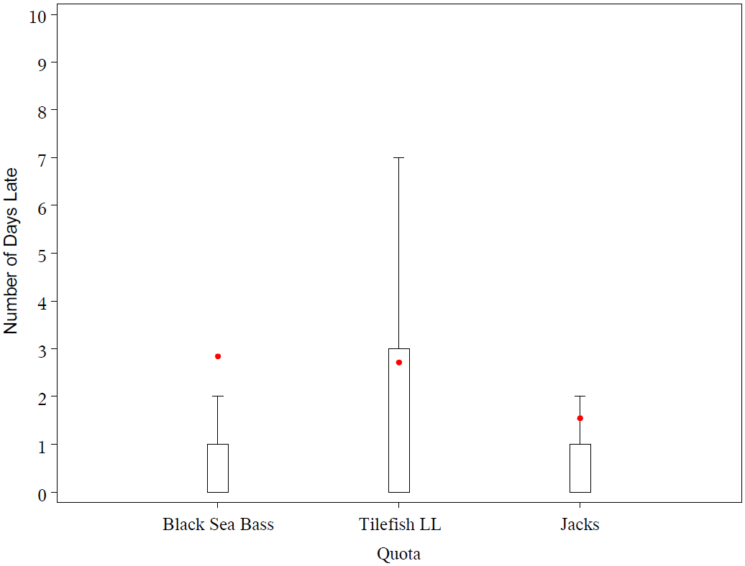
Commercial ACL Monitoring Number of Days Late, 2015
Notes:
So if median is on time and 75th percentile is 1-3 days late, shy do we need a 2 week lag?
Answer: reporting period length and data processing delays
Example:
Landed on Monday
Reported 8 days later at midnight (~ 9 days later) on Tuesday
We receive data final set of data Friday early morning (11 days after fishing occurred)
Thus we need a 2 week lag.
Y-axis is number of days after a report is required to be submitted. Constrained range of values on y-axis to show more detail in the means and median values. Red dots=mean.
Median = 0 because of the % reported on time.

Slide 12
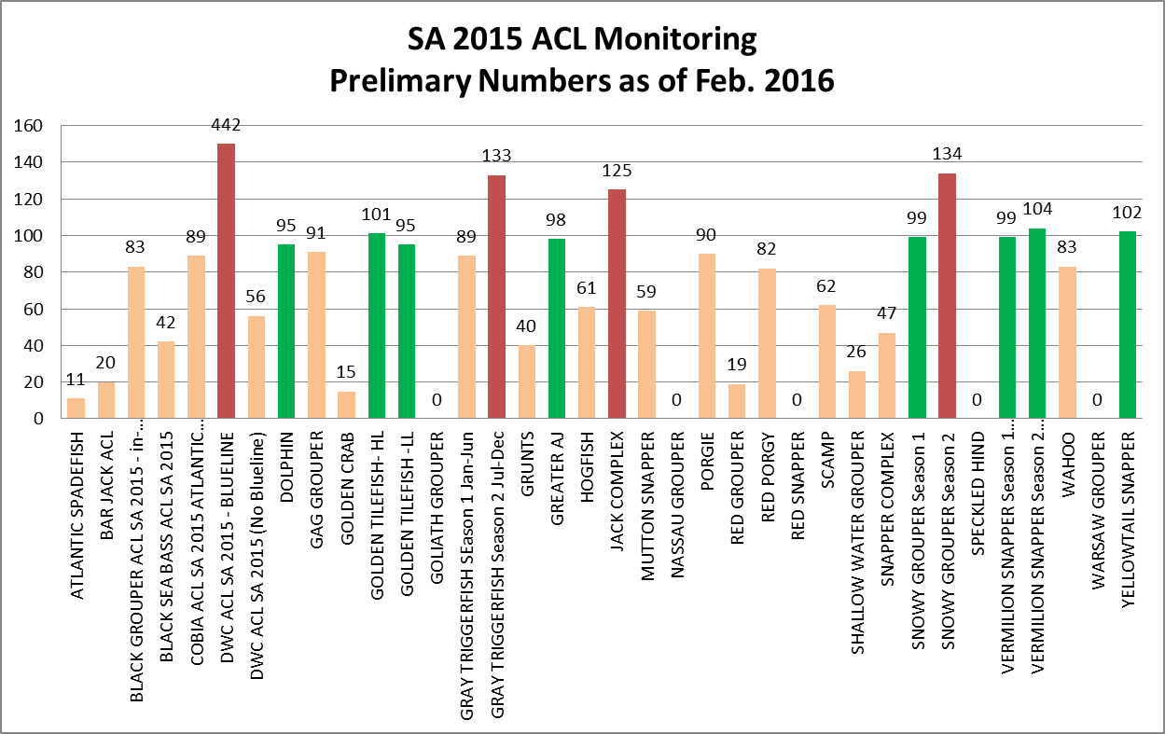
Commercial ACL Monitoring 2015
0- 94% of ACL
95-105% of ACL
>105% of ACL
Percent of ACL
450
Notes:
8 Fisheries within 5% of target ACL
4 Fisheries over target ACL
a) Bluelin tilefish ACL was established in late March at 17,841 lb after more than 60,000 lb had been landed. Fishery was closed in early April.
b) Two new ACLs (Snowy Grouper Season 2 and Gray Triggerfish Season 2) established mid year in 2015. Without past history to use as guidance and with small quotas which are taken quickly, it is difficult to provide accurate advice.
c) Jack complex. Dealers continue landing fish labeled ‘amberjack’ after the jack closure. ‘Amberjack’ (general code for 2 species, lesser and greater) is included in the jack complex. ‘Greater amberjack’ has its own ACL and is not included in the jack complex ACL. Greater amberjack quota (March-Feb management year) remains open many months after the jack complex is closed. Most dealers reporting ‘amberjack’ are from NC and the NC data system apparently does not have codes for lesser amberjack and greater amberjack, only amberjack. Dealers will argue that these fish are greater amberjack and that they should not be penalized because NC does not have the proper code. Turner’s opinion is that the fishery should be closed when the jack complex is closed. SEFSC has not done extensive outreach on this issue.
We’ve done well managing quotas despite late reporting because we anticipate the late reporting demonstrated in the previous figures. Beginning in Oct. 2015, we started assuming that the current week and 2 previous weeks contained partial weight information and have altered our calculations accordingly.

Slide 13
Commercial ACL Monitoring
Reported Landings Quality Control:
We run checks for duplicate landings to ensure a trip ticket wasn't accidentally reported more than once.
We identify unreasonably large landings and work with the dealer through a port agent to confirm the value was reported correctly or to correct the mistake.
We spot check dealer reports against vessel logbooks.

Slide 14
Commercial ACL Monitoring
For Delinquent Reporting:
We work with port agents and state partners to identify businesses with reporting issues.
We send reminder emails (sometimes letters) to dealers who are behind in reporting.
In 2015 we contacted 201 dealers and sent a total of 1201 letters and/or emails.
We work with SERO to place holds on permit renewals for dealers missing reports.
Notes:
Letters sent only if email bounces back or if no email address on file (email address recently became mandatory part of permit application / renewal)

Slide 15
Commercial ACL Monitoring Delinquent Report Uncertainty
Currently, there are some instances where uncertainty exists about whether a report is truly missing.
Permit information from multiple sources (4 states, ACCSP, SERO). Inconsistencies may make identification of the source of a dealer report uncertain.
Data management. 5 entities are involved (Bluefin Data Inc, GulfFIN, ACCSP, SERO, SEFSC). Occasional problems at any point in the chain can impact accuracy of compliance information.
Once a process is developed to avoid these problems we can start producing compliance reports that can be shared with OLE

