Slide 1
Recovery Plan for Elkhorn and Staghorn Corals
Jennifer Lee
Fisheries Biologist, Fisheries Management Council Liaison
NMFS Southeast Regional Office
Protected Resources Division
June 8, 2015

Slide 2
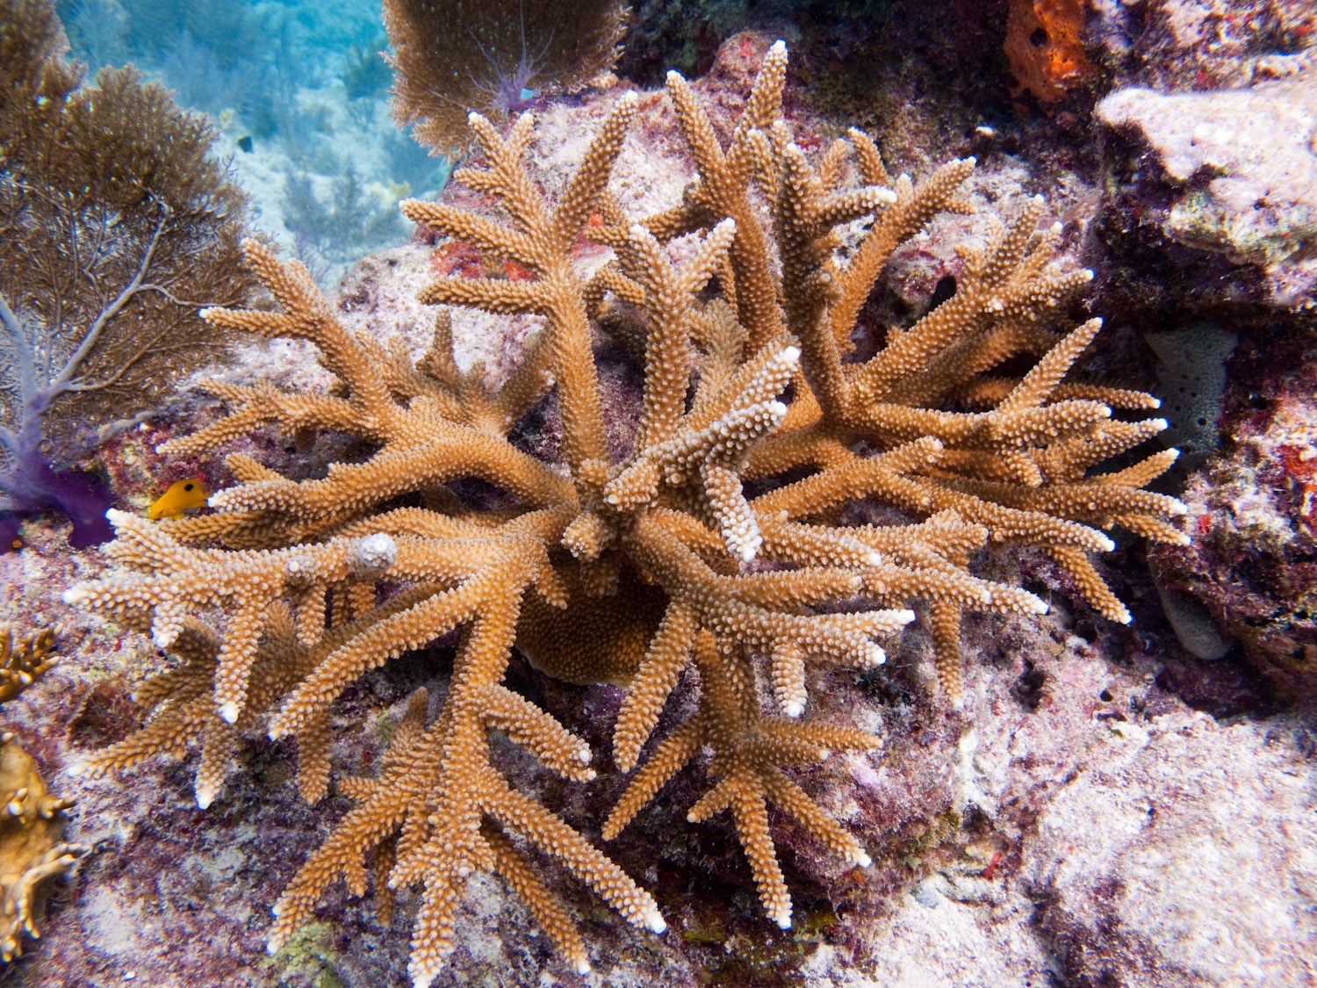
What is a Recovery Plan?
Mandated by the ESA unless it will not promote conservation of the species
Roadmap to species recovery that lays out where we need to go and how to get there
Guidance document, not regulatory
Staghorn coral

Slide 3
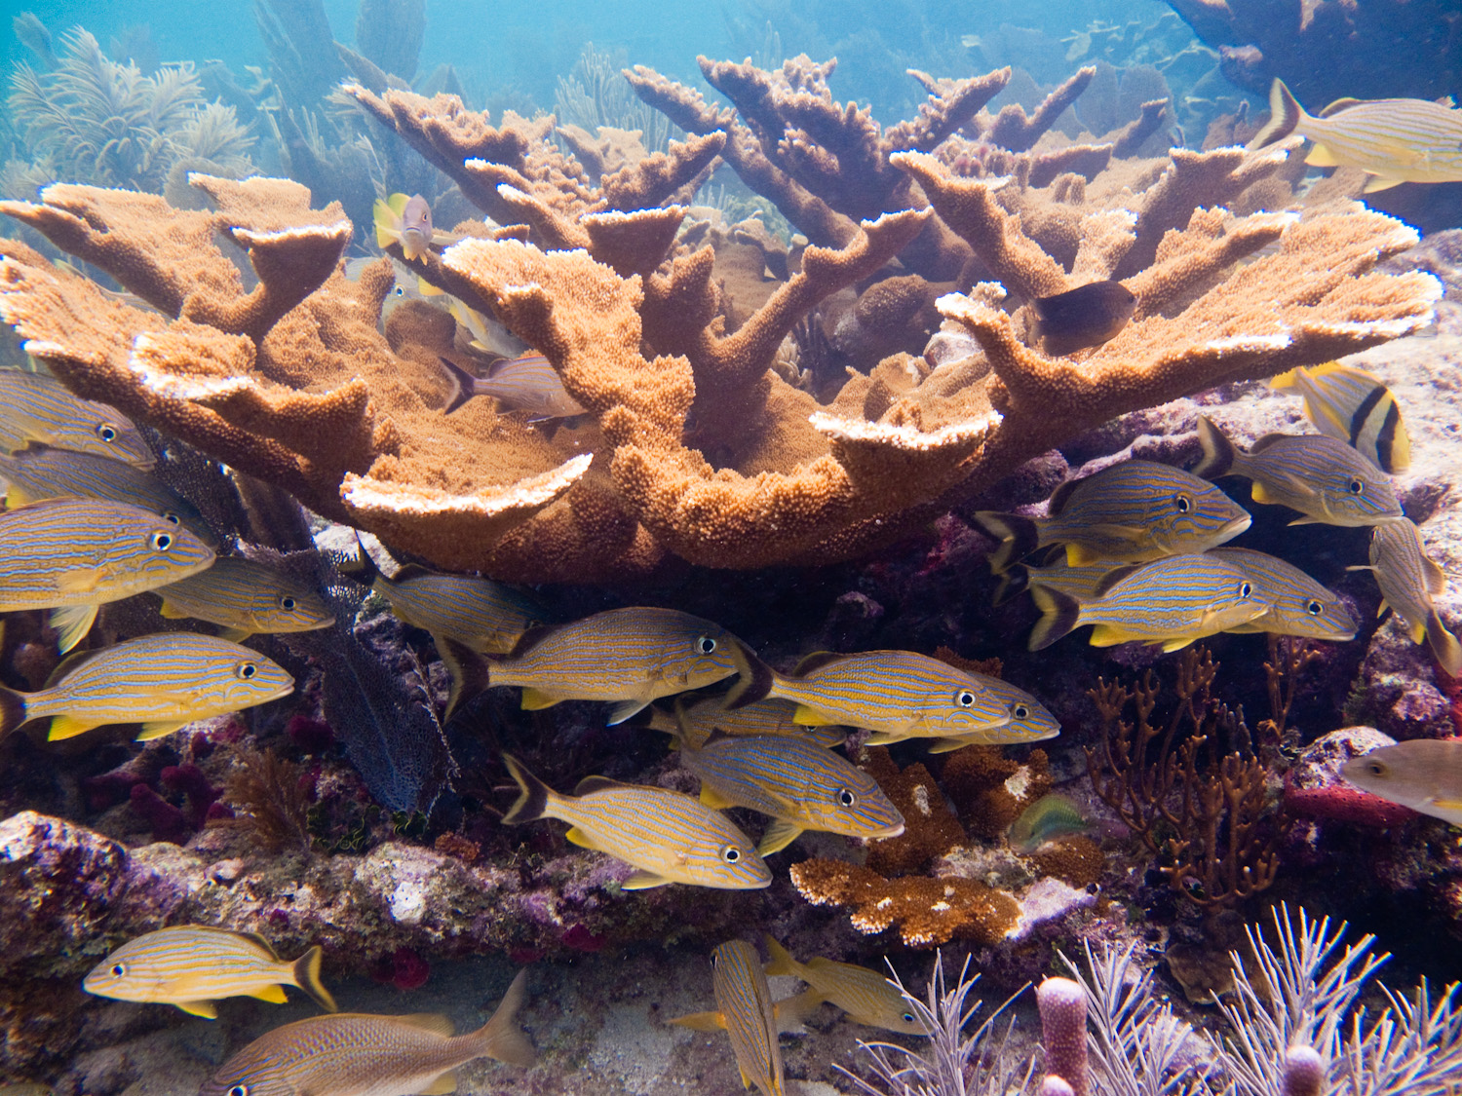
Components of a Recovery Plan
  Objective, measurable criteria
  Site-specific management actions
  Estimates of the time and the cost
Elkhorn coral

Slide 4
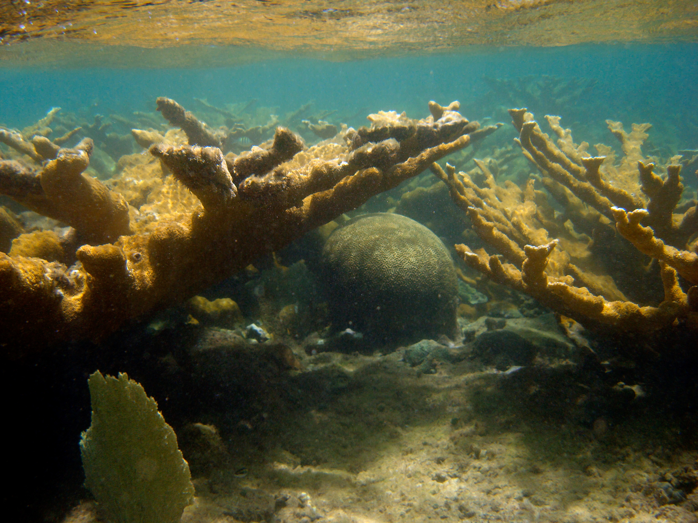
Goal - Acropora Recovery Plan
To increase the abundance and protect the genetic diversity of elkhorn and staghorn coral populations throughout their geographical ranges
Sufficiently abate threats to warrant delisting of both species.

Slide 5
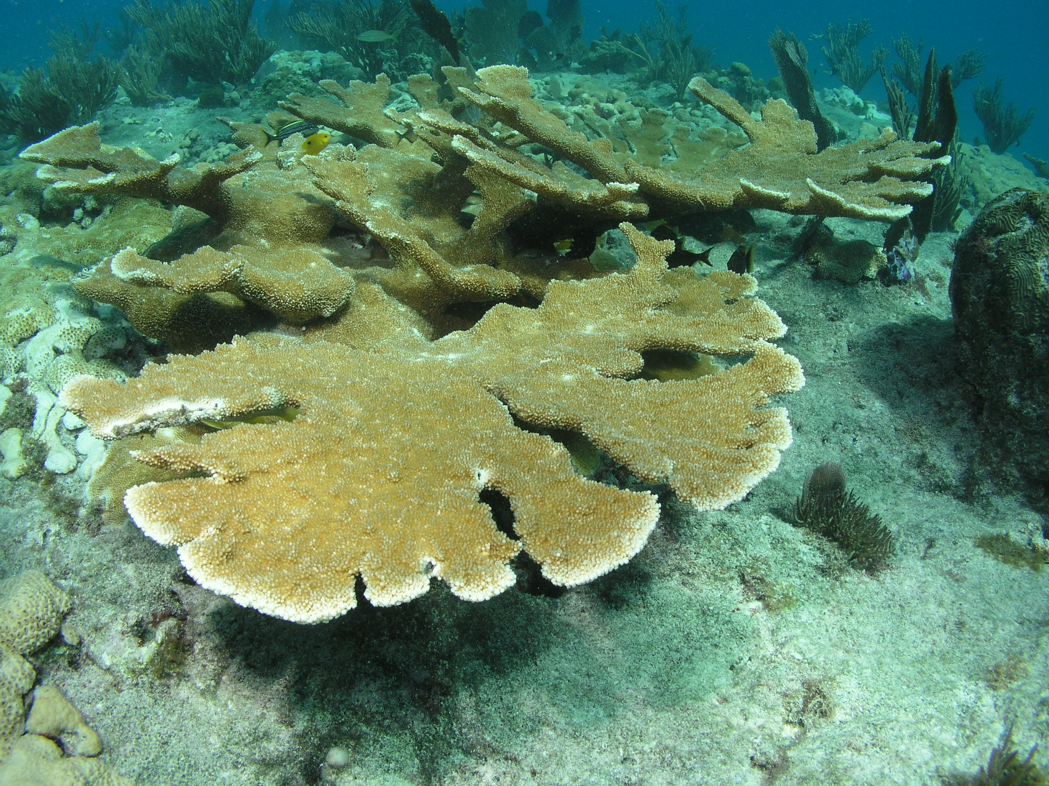
Acropora Recovery Plan
Population-Based Criteria
  Abundance
  Genetic diversity
  Recruitment
Threat-Based Criteria
  Disease (Interim)
  Ocean Temperature and Acidification
  Loss of Recruitment Habitat
  Land-Based Sources of Pollution (Interim)
  Regulatory Mechanisms
  Abrasion and Breakage
  Predation (Interim)

Slide 6
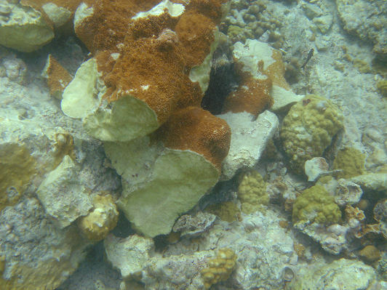
Abrasion and Breakage Criterion
Appropriate and effective regulatory, response, restoration, and enforcement mechanisms are in place domestically and internationally for both planned and unplanned impacts.
For planned impacts (e.g., marine construction), project planning should ensure no net loss of listed corals.
Where natural or anthropogenic impacts do occur, an effective and complete response plan, including appropriate compensatory and site restoration, is executed.

Slide 7
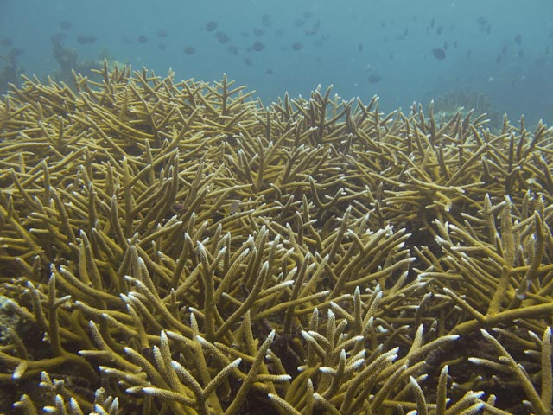
Recovery Approach
24 Recovery actions
Research and monitoring
Reduction or elimination of threats
Population enhancement

Slide 8
Recovery Actions – Threat Reduction
Three Recovery Actions For Address Abrasion and Breakage:
  Respond to 50 Percent of Known Physical Disturbance Events (Action 19)
  Reduce Impacts from Planned Physical Disturbances — No Net Loss from Development Projects (Action 20)
  Implement Protective and Preventative Measures to Reduce Physical Impacts (Action 21)

Slide 9
Recovery
Removal from the list of threatened and endangered species can only occur if the species are recovered throughout their ranges.
Estimated cost > $255 million dollars for actions in US jurisdiction
  Severe underestimate due to costs of actions in foreign countries, and costs of some actions are undeterminable
Estimated 400 years to achieve recovery

Slide 10
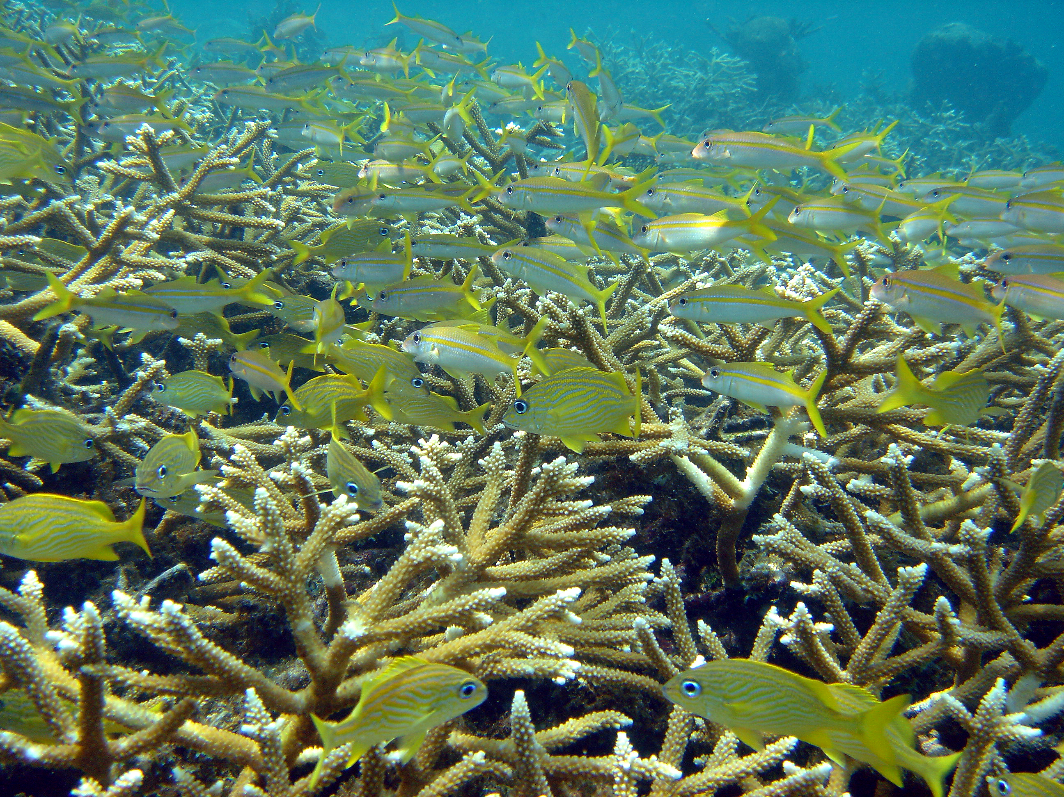
Next Steps
Assemble recovery implementation teams
  Prioritize actions
  Identify entities and funding sources to carry out actions
International collaboration
Track recovery actions

Slide 11
More Information
Website
http://sero.nmfs.noaa.gov/protected_resources/coral/
Contact
Alison Moulding
Alison.Moulding@noaa.gov
727-551-5607
Jennifer Moore
Jennifer.Moore@noaa.gov
727-551-5797

