Slide 1
COVID IMPACTS to
SOUTH ATLANTIC STATES
June 2020 SAFMC MEETING

Slide 2
North Carolina – Steve Poland

Slide 3
North Carolina Covid-19 impacts
Coastal Recreational Fishing License sales dropped by 18,892 compared to previous 3yr avg. (January through May)
  Largest monthly drop – April
  Unified Inland/Coastal Licenses saw largest increase
  Nonresident Licenses and Subsistence waivers saw largest decrease
Department of Environmental Quality

Slide 4
North Carolina Covid-19 impacts
Changes in commercial landings (lbs) and value (dollars) for SA fisheries from March and April 2020 estimated based on Trip Tickets from the previous 5yrs (2015-19)
  CMP – March and April Landings increased 1,200 lbs (9%) and 7,00 lbs (19%); values increased $6,500 (19%) and $27,000 (29%)
  Snapper Grouper – March and April decreased 15,000 lbs (82%) and 6,500 lbs (60%): values decreased $42,000 (82%) and $25,000 (84%)
  **Caveats: Values based on avg. reported price data from 2015-19 and reported values from 2020 rounded to whole dollars; data is still preliminary; summarized to lowest level that allows for confidentiality**
Landings and value of State fisheries decreased an 434,000 lbs and $1.2-2 million
Marine Patrol Citations and Warnings dropped 50% compared to previous 3yr avg. for March and April
  Officers report increased boating activity since March

Slide 5
South Carolina – Mel Bell

Slide 6


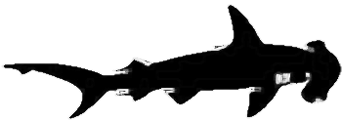


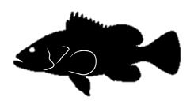
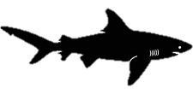



SC Fisheries - COVID 19 Impacts
(Preliminary Data)
SCDNR Office of Fisheries Management
June 2020
Notes:
Current role
Since 1999
Thank MARMAP, Inshore Fisheries, and fellow OFM staff for their input for this presentation

Slide 7
Saltwater Recreational Fishing
(Private Boat & Shore-based)
License Sales (March - May 2020 vs 2019)
Residents + 31%
Non-residents - 16% (drop in 14-day sales)
License Revenues + 19% (“outdoor” activities allowed)
Impacts due to various Executive Orders regarding restrictions on hotels, rentals, social distancing, group activities, and boat landing access
Notes:
Current role
Since 1999
Thank MARMAP, Inshore Fisheries, and fellow OFM staff for their input for this presentation

Slide 8
Recreational Boating and Fishing Activity
Boating (March - May 2020; SCDNR LE Assessment)
  Boating activity above average
  Landings and beach access points very crowded at times
  Number of anchored vessels above average
  Boat traffic higher in populated areas
  Increased LE contacts, but fewer fishing citations issued
Fishing (March - May 2020; SCDNR LE Assessment)
  Fishing activity above average in general
  Fishing activity from anchored boats and shore-based anglers higher due to adjustments to compensate for Executive Order restrictions
Charter Trips (SC Charterboat Logbook Data)
  SERO Species-focused Trips - 76%
  Conducted internet-based survey of 531 licensed captains (results pending)
Notes:
Current role
Since 1999
Thank MARMAP, Inshore Fisheries, and fellow OFM staff for their input for this presentation

Slide 9
SERO Managed Commercial Fisheries Impacts
(Mar - May 2020 vs Previous 5 Year Avg)*
Total Trips - 47%
Total Pounds Landed - 26%
Total Ex-vessel Value - 20%
* Does not include confidential data
Notes:
Current role
Since 1999
Thank MARMAP, Inshore Fisheries, and fellow OFM staff for their input for this presentation

Slide 10
Commercial Fisheries - SERO Species (Effort in Trips)
Month | Deep-water Complex | Shallow-water Complex | All other SERO Species | Dolphin/Wahoo | CMP
March 2020 | 34 | 0 | 52 | 11 | Conf
March 5-year avg | 40 | Conf | 56 | 13 | 4
April 2020 | 21 | Conf | 35 | 20 | 4
April 5-year avg | 30 | Conf | 43 | 22 | 6
May 2020 | 16 | 30 | 34 | 43 | 13
May 5-year avg | 45 | 58 | 78 | 78 | 27
Notes:
Current role
Since 1999
Thank MARMAP, Inshore Fisheries, and fellow OFM staff for their input for this presentation

Slide 11
Commercial Fisheries - SERO Species (Whole Pounds Landed)
Month | Deep-water Complex | Shallow-water Complex | All other SERO Species | Dolphin/Wahoo | CMP
March 2020 | 20,246 | 0 | 56,171 | 1,098 | Conf
March 5-year avg | 42,896 | Conf | 48,057 | 1,704 | 408
April 2020 | 4,320 | Conf | 38,746 | 1,986 | 99
April 5-year avg | 15,864 | Conf | 35,615 | 3,483 | 729
May 2020 | 3,328 | 20,622 | 32,448 | 131,593 | 2,333
May 5-year avg | 28,518 | 11,767 | 60,703 | 170,689 | 1,876
Notes:
Current role
Since 1999
Thank MARMAP, Inshore Fisheries, and fellow OFM staff for their input for this presentation

Slide 12
Commercial Fisheries - SERO Species (Ex-Vessel Value)
Month | Deep-water Complex | Shallow-water Complex | All other SERO Species | Dolphin/Wahoo | CMP
March 2020 | $80,245 | $0 | $166,713 | $3,627 | Conf
March 5-year avg | $172,058 | Conf | $153,208 | $5,732 | $782
April 2020 | $21,568 | Conf | $136,673 | $6,761 | $160
April 5-year avg | $71,775 | Conf | $127,730 | $12,824 | $1,676
May 2020 | $17,096 | $124,419 | $268,720 | $373,850 | $4,748
May 5-year avg | $54,789 | $159,140 | $217,208 | $521,352 | $5,979
Notes:
Current role
Since 1999
Thank MARMAP, Inshore Fisheries, and fellow OFM staff for their input for this presentation

Slide 13
For Hire Fisheries - SERO Species (Effort in Trips)
Month | Snapper/Grouper Complex | Dolphin/Wahoo | CMP
March 2020 | 78 | Conf | 12
March 5-year avg | 154 | 5 | 5
April 2020 | 24 | 3 | 12
April 5-year avg | 260 | 53 | 90
May 2020 | 77 | 39 | 80
May 5-year avg | 305 | 177 | 326
Notes:
Current role
Since 1999
Thank MARMAP, Inshore Fisheries, and fellow OFM staff for their input for this presentation

Slide 14
QUESTIONS?
Notes:
Current role
Since 1999
Thank MARMAP, Inshore Fisheries, and fellow OFM staff for their input for this presentation

Slide 15
Georgia – Carolyn Belcher

Slide 16
Georgia Covid-19 Impacts
Commercial
March and April value 42.89% decrease as compared to March and April the previous 5 years.
Recreational
SIP permits increased 7.7% for March and April compared to previous 3 years
Overall recreational fishing license sales increased 37.21% March and April compared to previous 3 years

Slide 17
Florida – Jessica McCawley

Slide 18


Survey of Florida Marine Industry
UF/IFAS Extension
Commercial
51% remained in operation
  97% of closed expected to reopen
92% indicated decreased revenue
Seafood Wholesale Dealer
84% remained in operation
  86% of closed expected to reopen
92% indicated decreased revenue
Charter/For-hire
49% remained in operation
  96% of closed expected to reopen
100% indicated decreased revenue
Marine Recreation Support
82% remained in operation
  100% of closed expected to reopen
83% indicated decreased revenue
***Results are preliminary and are subject to change***
Notes:
UF/IFAS Extension conducted a set of online surveys to assess the impacts of COVID-19 on Florida’s marine industries.
326 for-hire charter responses
71 seafood wholesale dealer responses
319 commercial harvester responses
127 marine recreation support responses
“Marine Recreation Support” includes boat storage, boat rentals, and grocery/apparel sales.

Slide 19
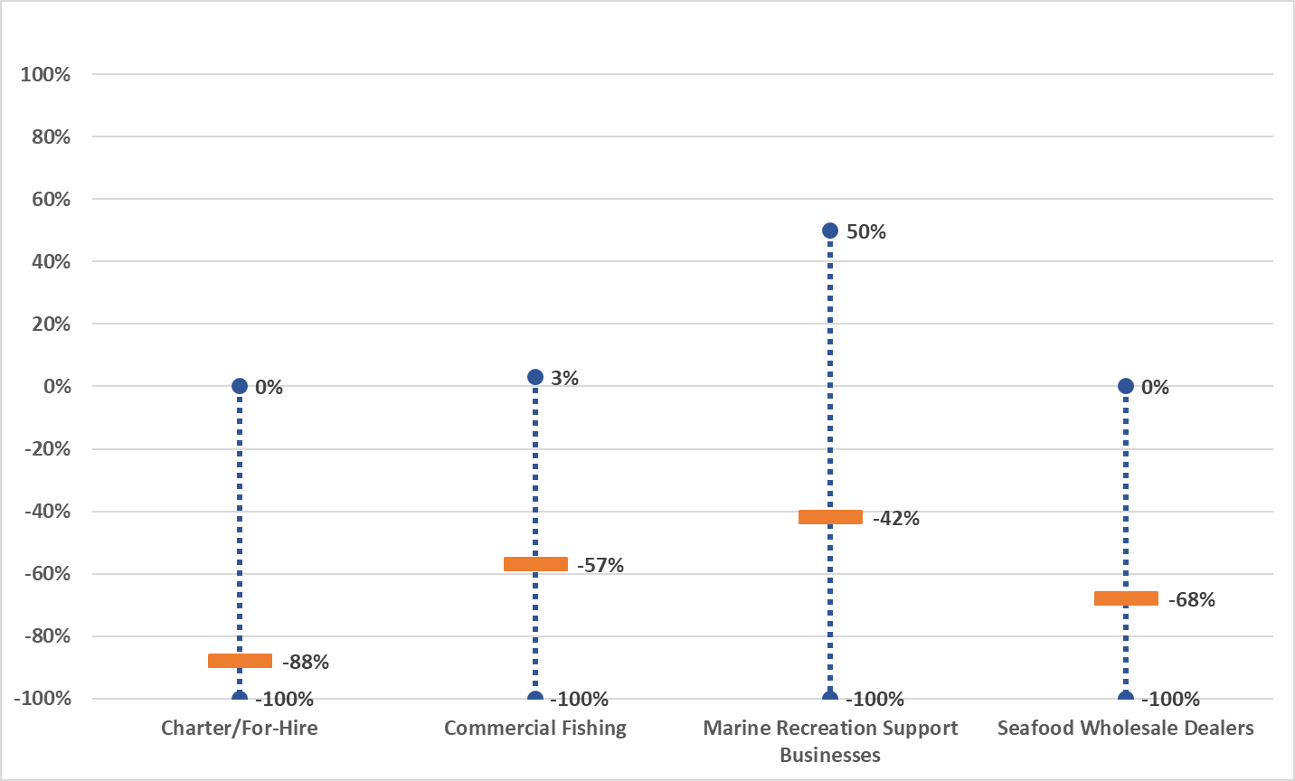
Florida Marine Industry Sales Revenues Declined
UF/IFAS Extension
Change in sales revenues compared an average year
Average reported sales revenue change
Full ranges of answers provided by respondents
***Results are preliminary and are subject to change***

Slide 20

Florida Saltwater Commercial Fisheries

Slide 21
FWC Recreational License Sales for March and April
Notes:
This license sales graph includes annual resident and non-resident saltwater fishing licenses and combination licenses.

Slide 22
FWC Law Enforcement Observations
Northeast Florida
Increased fishing and boating activity on weekdays and weekends
  Estimate 30% increase in vessel traffic
Increased fishing effort inshore and offshore
East Central Florida
Increased recreational fishing effort
Reduced commercial fishing effort
South Florida
Closures of boat ramps and marinas caused decrease in recreational fishing effort
Monroe County (the Florida Keys) was closed to non-residents
Notes:
Observations provided by FWC Law Enforcement officers. The comparisons are between 2020 and recent years.

