Slide 1
Marine
Recreational
Information
Program
FES Transition Update
Dr. Ned Cyr, Director
Office of Science & Technology

Slide 2
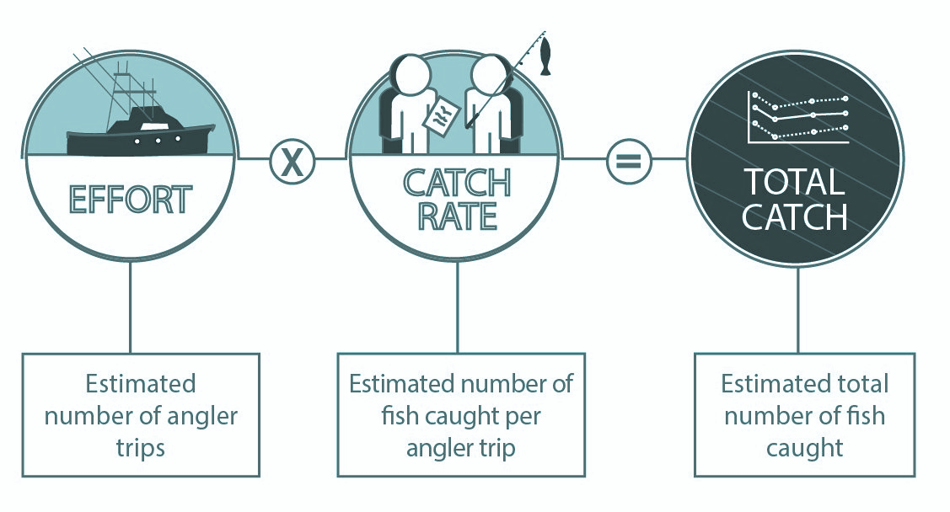
Estimating Total Recreational Catch

Slide 3

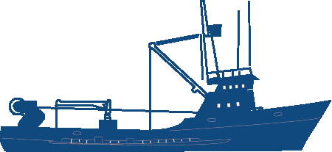
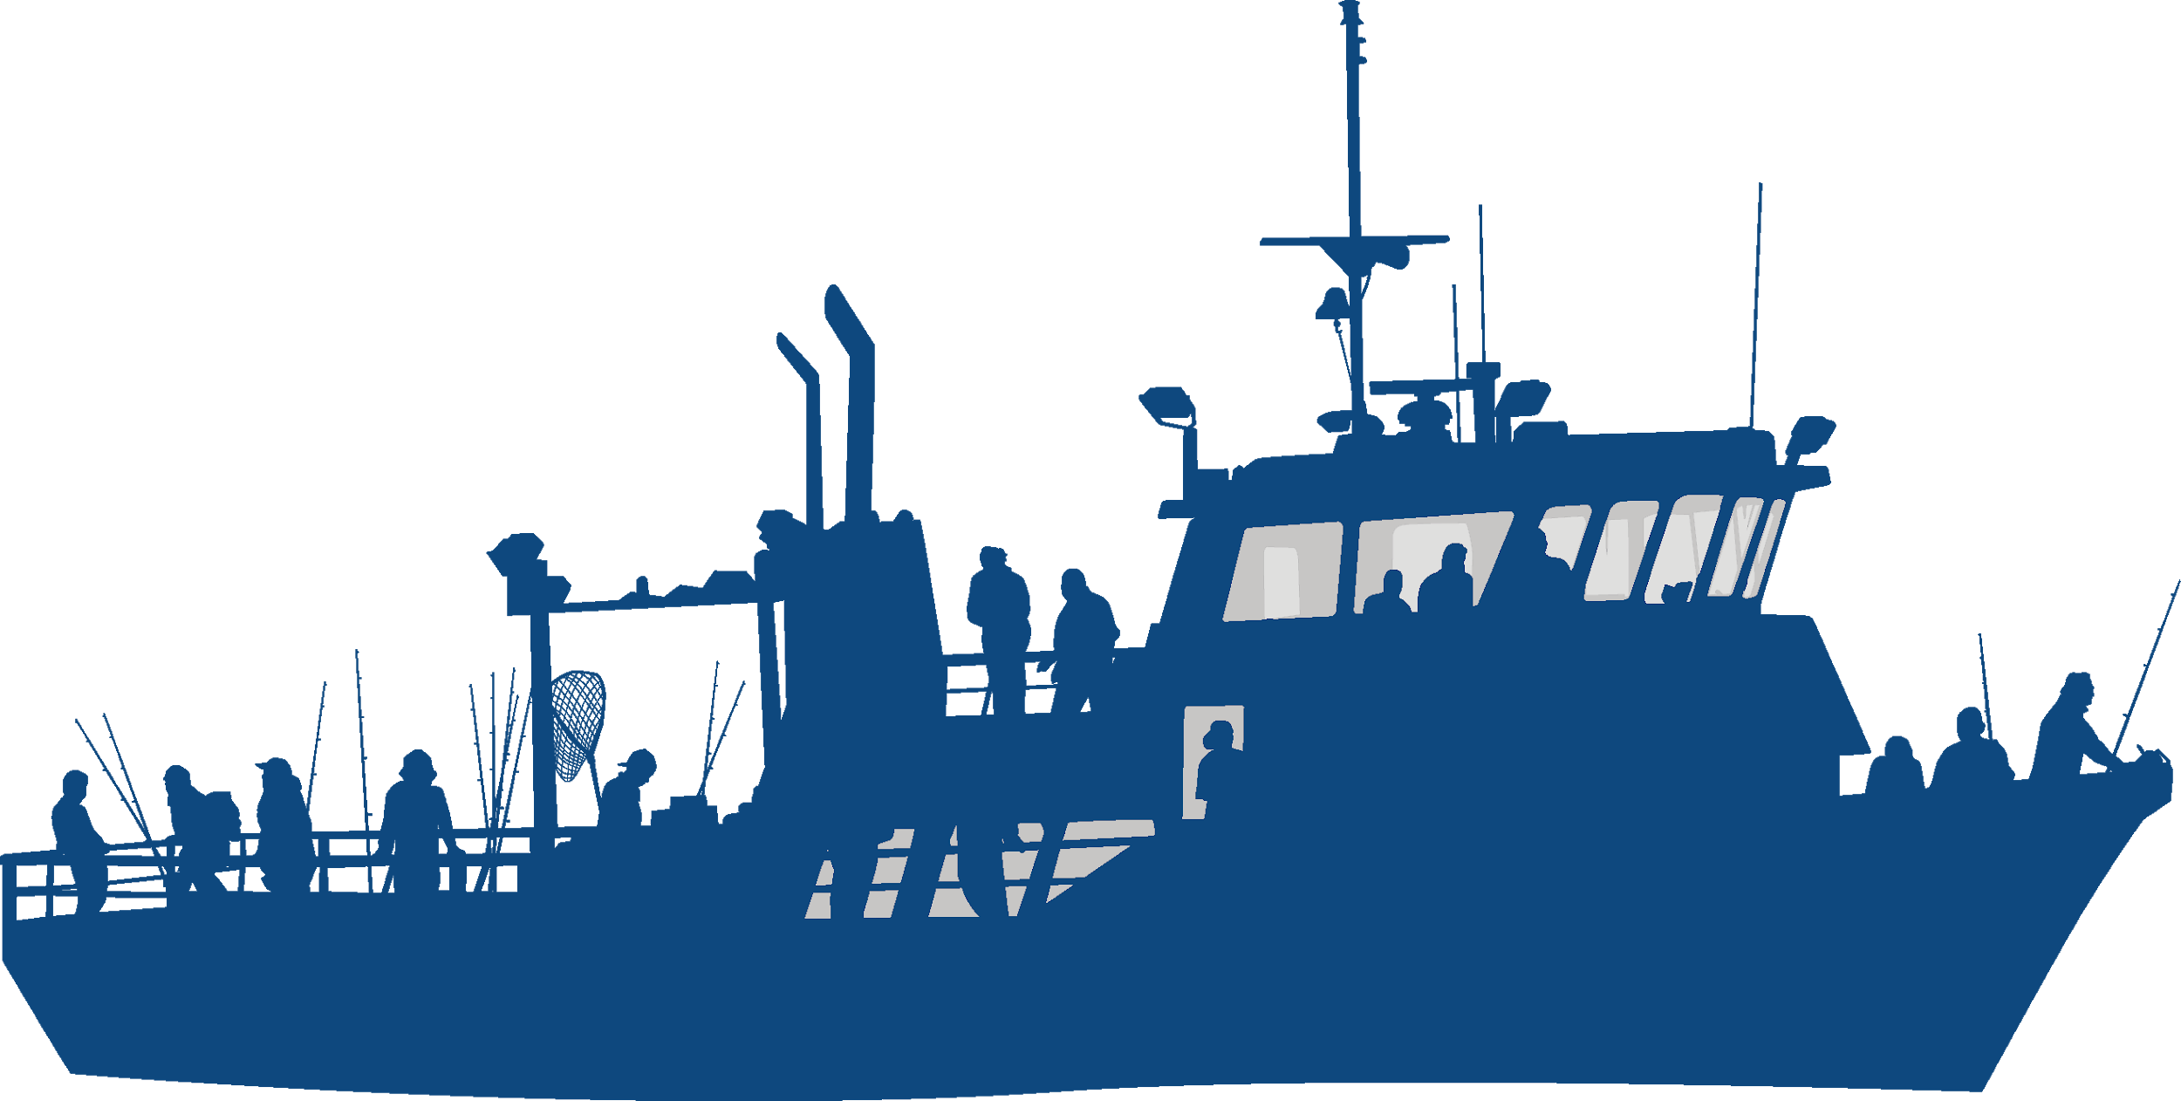

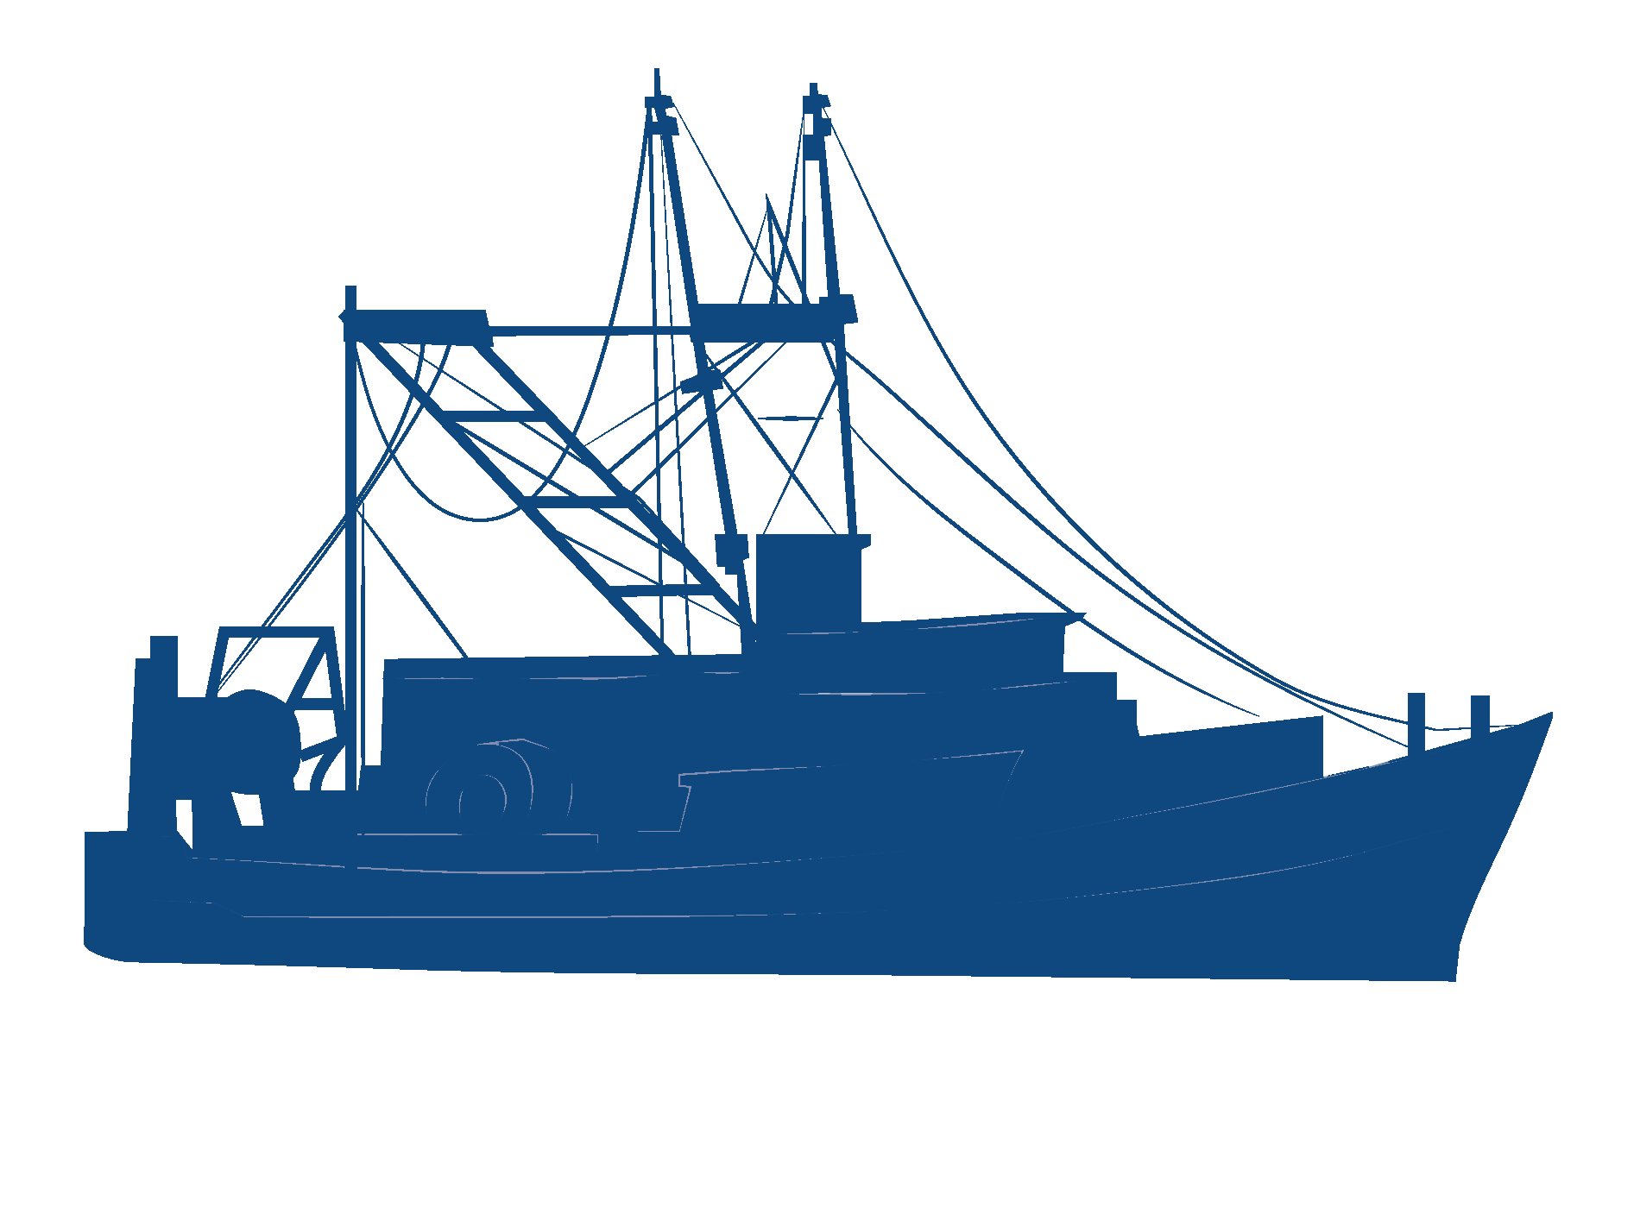

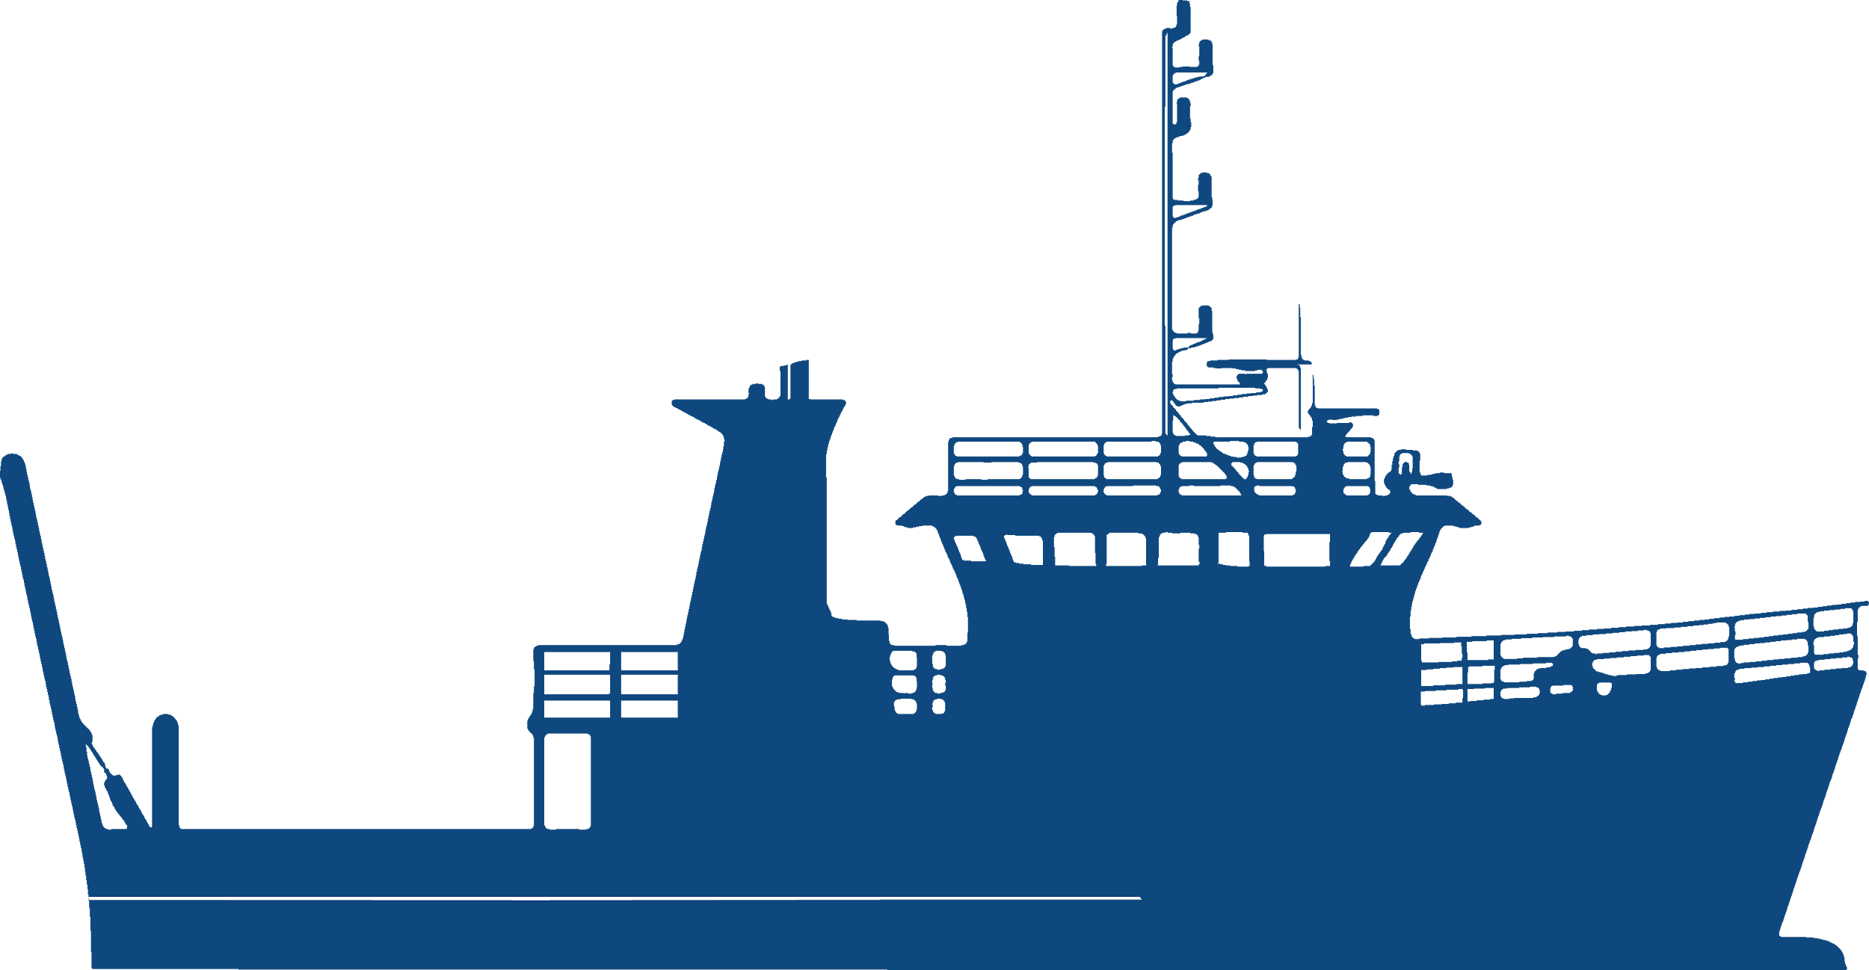


Assessing the Health of Fish Stocks
Stock Assessments

Slide 4
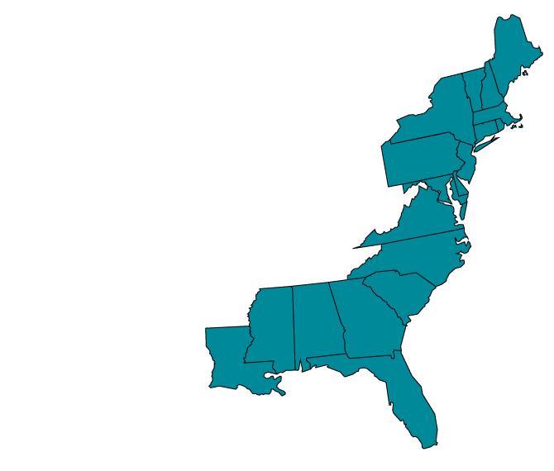
Fishing Effort Survey
T
  Replaces Coastal Household Telephone Survey.
  Uses USPS records and
  state-based license and
  registration information.
  Provides more accurate
  estimates.
Private Boat
Shore

Slide 5





More Accurate Estimates
T
Improved questionnaire.
We’re reaching more anglers.
Surveys get into the right hands.
More complete answers.
Three times the response rate.

Slide 6

Extensive Testing and Peer Review
T
“The [FES] methodologies, including the address-based sampling survey design, are major improvements.”

Slide 7
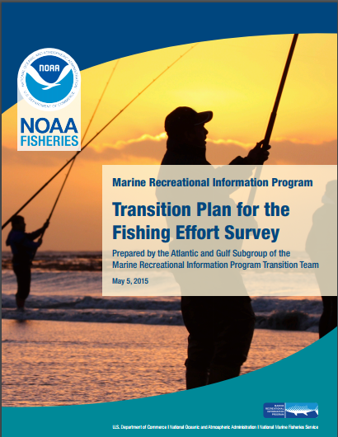

Implementing the FES
T
  Three-year Transition Plan.
  Developed by NOAA, states,
  councils, commissions.
    Side-by-side benchmarking.
    FES calibration model.
    APAIS adjustments.
    Re-estimation.
      Stock assessments.
      Management decisions.

Slide 8
Side-by-Side Benchmarking
T
  FES estimates are several times higher than CHTS.
    Vary by mode, state, and wave.
    Does not necessarily
    mean overfishing
    has been or is
    occurring.
Private Boat
3.3 x higher
on average
Shore
6.1 x higher
on average

Slide 9


FES Calibration Model
T
  Developed with independent consultants.
  Peer-reviewed.
  Will create common effort currency for 1981-2017.
  Not indicating a recent increase in effort.
    Calibrated estimates will be higher back through 1981.
CHTS
FES

Slide 10
APAIS Adjustment Model
  Developed with independent consultants.
  Peer review workshop March 20-22, 2018.
  Accounts for survey design improvements implemented 2013.
Access Point Angler Intercept Survey Adjustments
2013
Ongoing
1981-2012

Slide 11
Re-Estimation
T
  Will be completed July 1, 2018.
Re-Estimated Effort Numbers
Adjustments for Catch Rate Estimates
X
Calibrated Total Catch
Stock Assessments

Slide 12
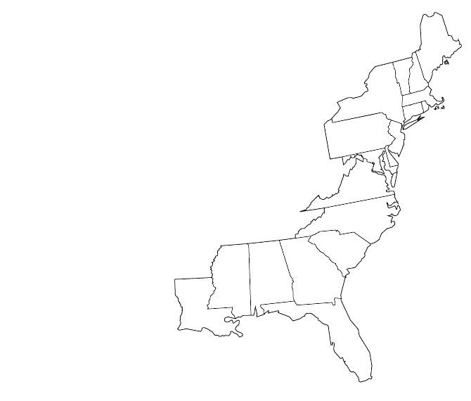
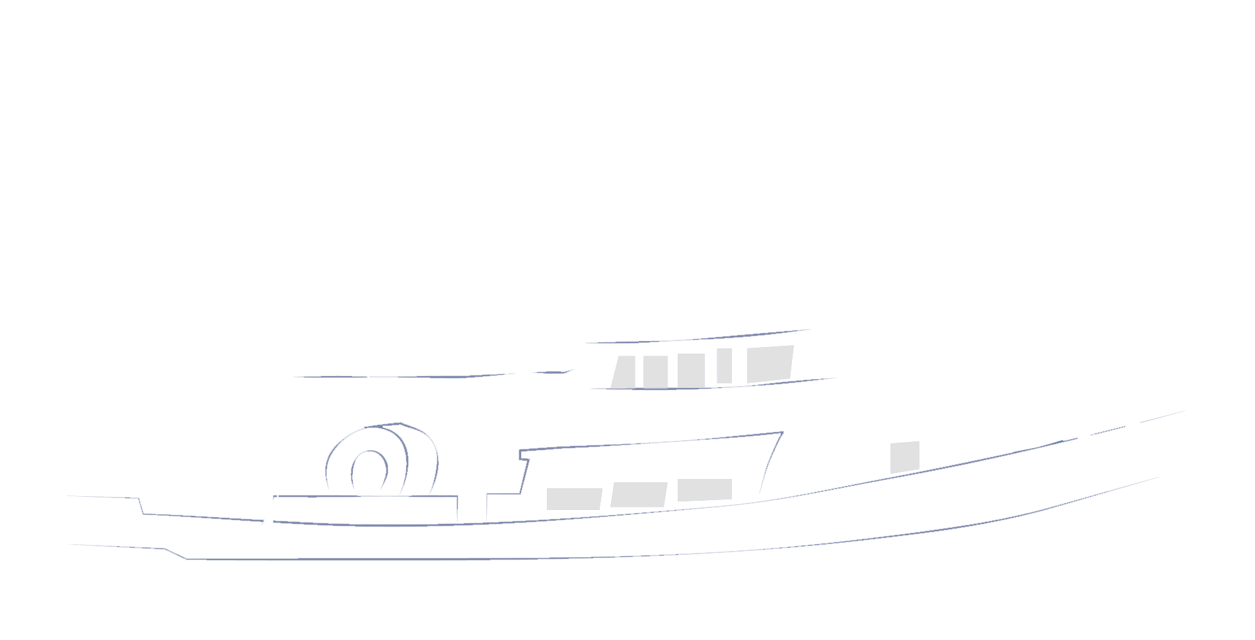

FES and Recreational Fishing
T
Stock-by-Stock Assessment
Stock Status
Annual Catch Limits
Allocation Decisions

Slide 13
2018 Annual Catch Limits
T
2018 ACLs set using CHTS estimates
FES
CHTS
Calibration model converts both directions
Year-end estimates in same currency
Notes:
So how exactly will this work for annual catch limits?
For 2018, all the ACLs for recreational fisheries have been set using the CHTS estimates.
We will be using the FES in 2018 to collect effort information.
The calibration model I’ve described allows us to convert that catch information that we get in 2018 back into the CHTS currency.
So the numbers we use to evaluate the annual catch limit at the end of 2018 will be an apples-to-apples comparison.

Slide 14

Summer Flounder
T
Currently undergoing stock assessments using CHTS estimates.
Will inform 2019 ACLs.
Will be re-assessed later this year using calibrated catch rate and effort estimates.
May lead to 2019 ACL adjustments.
Will be incorporated for 2020 and beyond.

Slide 15
What’s Next
T
Revised total catch estimates available July 1 for use in planned stock assessments.
2018
Preliminary management changes may be made for re-assessed stocks.
Calibrated statistics incorporated into additional stock assessments.
2019
Based on new stock assessments, management changes could occur for a number of species.
2020

Slide 16
What have you heard?
What do you need?

