Slide 1

Improvements to For-Hire Reporting for federal charter/headboat permitted vessels
Public Scoping, April-May 2025
Snapper Grouper
Dolphin Wahoo
Coastal Migratory Pelagics
Myra Brouwer
John Hadley
Notes:
This recorded public scoping presentation goes over possible changes the South Atlantic Council is considering to for-hire reporting. This applies to federal charter or headboat permit holders participating in the Snapper Grouper, Dolphin Wahoo, or Coastal Migratory Pelagics fisheries.
My name is Myra Brouwer. My colleague John Hadley and I are the Points of Contact for this amendment.
First, I will tell you a little bit about the Council, then I will explain the scoping process, and then go over the suite of possible changes in detail.
At the end of the presentation, there will be information on how to provide your comments.

Slide 2
ABOUT THE COUNCIL
1 of 8 regional fishery management Councils
Jurisdiction:
  Exclusive Economic Zone (EEZ) ranges from 3-200 miles
  South Atlantic Region: NC, SC, GA, East Coast of FL
  Council Makeup:
    Include recreational and commercial fishermen, state marine agency reps, and federal partners
    17 members, 13 voting, 4 non-voting
  The Council provides recommendations to NOAA Fisheries
Notes:
The South Atlantic Council is 1 of 8 regional management Councils that were created in 1976 to manage fisheries in the US. The South Atlantic Council’s area of jurisdiction is the Exclusive Economic Zone (which is the waters from 3 to 200 miles) off the coasts North Carolina through the Florida Keys.
Council members include recreational and commercial fishery stakeholders, state agency representatives, and federal agency representatives. The 13 voting members include the agency representative from each state, 2 citizen representatives from each state, and the Southeast Regional Administrator of NOAA Fisheries. The Council’s role in the management process is to develop management plans for South Atlantic fisheries and recommend regulations to NOAA Fisheries.
NOAA Fisheries considers the Council’s recommendations and implements and enforces fishery regulations in federal waters.

Slide 3
WHAT IS SCOPING?
Early step in the amendment development process
Council: Informs the public of management issues that may require regulatory changes
Public: Informs the Council of what changes should be considered in an amendment to address management issues
Notes:
Scoping is the first phase of developing an amendment. The Council informs the public of management issues that may need to be changed and asks for the public’s input.

Slide 4
WHAT IS SCOPING?
Amendments include:
  Actions – the types of regulatory changes being considered; For example: “Change the reporting frequency”
  Alternatives – specific options under each action
    For example: “reporting is required at the end of every trip”
Goal of scoping: Identify what actions and alternatives are “on the table”
Later… Public hearings will ask which of the alternatives should be selected for implementation
Notes:
Amendments to a Fishery management Plan include actions that describe the types of changes being considered and alternatives, which are options under each action.
For example, requiring reporting at the end of the day, or after every trip, are potential alternatives under the action to change the frequency of reporting.
The goal of scoping is to identify what actions and alternatives will be “on the table” for consideration in an amendment. After these have been fleshed out, there will be another opportunity for public input, when the Council will ask for feedback on which alternatives should be selected for implementation.

Slide 5
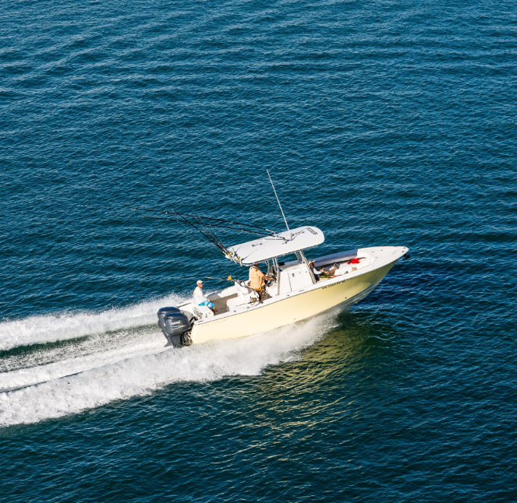
WHAT IS BEING SCOPED?
Changes needed to improve reporting for the federal for-hire fleet so that:
  Compliance improves
  Collected data can be used directly in management
  The reporting burden is minimized
Notes:
The Council is considering changes to the for-hire reporting requirements of federally permitted vessels to:
improve compliance with reporting
while also increasing the accuracy of the information and
minimizing burden to for-hire captains.
This amendment would cover three Fishery Management Plans: Snapper Grouper., Dolphin Wahoo, and Coastal Migratory Pelagics. Again, changes would apply to charter and headboat vessels that hold permits in these three fisheries.

Slide 6
BACKGROUND
In 2017, the Council submitted an amendment to put in place reporting requirements for federally permitted charter vessels. The amendment also modified the reporting frequency for headboats.
The Southeast For-Hire Integrated Electronic Reporting (SEFHIER) Program was launched in the South Atlantic in 2021 with the implementation of the Comprehensive For-Hire Electronic Reporting Amendment.
Notes:
The Comprehensive For-Hire Reporting Amendment put in place reporting requirements for federally permitted charter vessels in the snapper grouper, dolphin wahoo, and coastal migratory pelagics (mackerels) fisheries.
The amendment also modified the reporting frequency for headboats
The amendment resulted in the creation of the Southeast For-Hire Integrated Electronic Reporting, or SEFHIER. Program run by NOAA Fisheries. There are two components of SEFHIER: one for the Gulf and one for the South Atlantic. The Gulf;s SEFHIER program was halted in February 2023 after a court order. So, the Gulf Council is working on an amendment to re-establish and revamp the program.

Slide 7
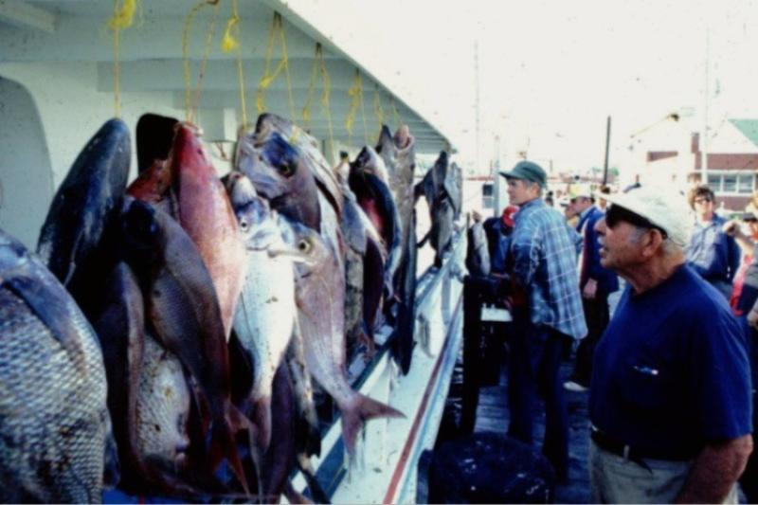
BACKGROUND
Data are collected form the headboat component of the for-hire fleet through the Southeast Region Headboat Survey.
This survey has been in place since 1972.
Notes:
Another component of for-hire data collection is the Southeast Region Headboat Survey, which has been operating in the region since the early 70s. This program collects data from all federally permitted headboats in the South Atlantic and the Gulf.

Slide 8
WHY ARE CHANGES NEEDED?
In June 2024, the Council started an amendment to improve compliance with reporting requirements for federally permitted headboat and charter vessels and make improvements to the reporting programs.
The Gulf Council and the Highly Migratory Species Division of NMFS are also revamping reporting requirements for federally permitted for-hire vessels.
It is important to maintain consistency in reporting requirements to minimize the reporting burden on permit holders.
At the same time, the collected data need to be useable for management.
Notes:
Now let go over why the Council is considering changes.
Since the SEFHIER program was stood up, the Council has been receiving updates. In late 2023, the Council was told there was low compliance with reporting requirements and changes would be needed to improve compliance and the way the information is collected to be able to use that information in management.
So, in June of 2024, the Council began thinking about what needed to change.
By this time, the Gulf Council was already working to re-establish for-hire reporting.
Also, the Highly Migratory Species Division of NOAA Fisheries is going through the process of changing reporting requirements changes.
The Council would like to maintain consistency as much a possible in the reporting requirements to lessen the burden on for-hire permit holders. At the same time, the information collected needs to be useable for management.

Slide 9
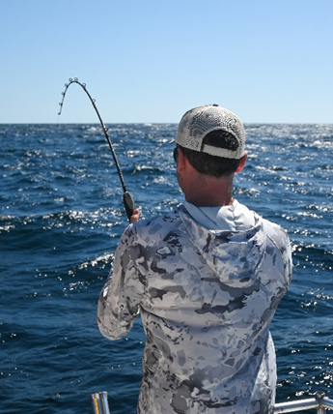
POTENTIAL ACTIONS
Modify the reporting frequency and timing of report submission
Require trip notification
Establish approved landing locations
Require participation in a validation and estimation survey
Revise reporting of economic data for charter vessels
Modify existing “Did Not Fish” report requirements
Notes:
Ok, now we will get into the possible changes. You can see what they are on this slide. I will go over each individually.

Slide 10
Modify the reporting frequency and timing of report submission
Currently: Federally permitted charter and headboat vessels must report all fish harvested and discarded for each trip and submit weekly.
Alternatives:
Require reporting for each trip and:
  Require report submission within 30 minutes of arriving at landing location. If fish are harvested, require reporting prior to landing.
  Require report submission within 1 hour of arriving at landing location. If fish are harvested, require reporting prior to landing.
Require electronic reporting daily, and:
  If fish are harvested, require reporting prior to landing.
Notes:
Right now, all permit holders participating in the for-hire component (charter and headboat) of the snapper grouper, dolphin wahoo, or coastal migratory pelagics fisheries have to report data for each trip and submit all reports by the Tuesday of the following week.
The reporting frequency could change to daily (every 24 hours) or twice daily (every 48 hours) or some other frequency.
The main thing this action could do to improve the data being collected is to require reporting before arriving at the offloading location.
here could be a time requirement associated with this too (for example an hour before offloading passengers, etc) .
This action would be coupled to a trip notification requirement that I will talk about next.
But first, here is a table…

Slide 11
What are the frequency and timing requirements on other programs?
South Atlantic (SA), Southeast (SE) Headboat Survey, Gulf of Mexico (GOM), Greater Atlantic Region (GAR) Vessel Trip Report (VTR), and Highly Migratory Species (HMS)
 | SA SEFHIER and SE Headboat Survey | GOM SEFHIER | GAR VTR | HMS
Existing | Weekly | N/A | Generally 48 hours after entering port. For recreational tilefish: 24 hours after end of trip. | Electronic report, telephone, or other means like catch cards.
Proposed | ? | Prior to offload of catch, within 30 minutes of completion of the trip, or each trip daily. | No proposed changes. | Electronic report 24 hours after end of trip.
Notes:
This table summarizes the current requirements under the various program that collect for-hire data.
For SEFHIER and the Headboat Survey, reporting is required weekly as you can see on the far left.
In the Gulf, there are no requirements right now but the Gulf Council is looking at the same suite of options the South Atlantic Council is considering.
In the Greater Atlantic region, there are requirements to submit electronic vessel trip reports, or VTRs, daily or every 48 hours.
And for HMS species, there are a couple of ways to report currently (electronically, by telephone or using catch cards) and the proposed change is to require electronic reporting 24 hours after the end of each trip.

Slide 12
Require trip notification
Currently: There are no trip notification requirements.
Alternatives:
Require trip notification for federally permitted charter/headboat vessels engaging in activities that involve paying passengers (e.g., for-hire fishing, sunset cruises, eco-tourism).
Require trip notification for federally permitted charter/headboat vessels engaging in any type of activity (e.g., bait fishing, commercial fishing, private recreational fishing) or anytime the vessel leaves the dock.
Notes:
Ok, so the trip notification goes hand in hand with the reporting prior to arriving at the landing locations. For that to be possible, captains would have to report that they are going on a for-hire trip or returning from a trip, or maybe both. The options here are to determine which trips would require this notification: all trips involving fishing, or also trips involving paying passengers that aren’t fishing trips, like sunset trips or dolphin watching cruises.
A trip notification requirement would help with enforcing reporting requirements and to get better effort data.

Slide 13
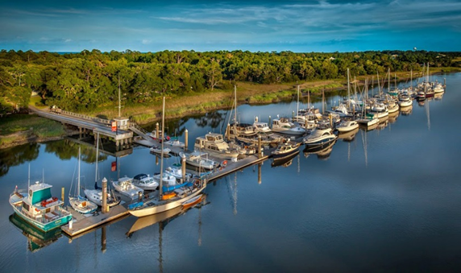
Establish approved landing locations
Currently: there is not requirement to offload fish or passengers at pre-approved locations.
Alternative: Require that federally permitted charter or headboat vessels land at already approved locations or submit a landing location in advance for approval.
Notes:
The Council may require approved landing locations. Having a list of locations where for hire-vessels are offloading support enforcement and monitoring for compliance with reporting; can help to improve sampling intercepts; and facilitate validation of the reported data.
A landing location is the street address location where fish and passengers are expected to be offloaded. It can be a public or a private location.

Slide 14
Require participation in a validation and estimation survey
What is validation and why is it important?
Validation is “the action of checking or proving the validity or accuracy of something.”
A validation survey would be used to check the accuracy of the information reported.
Without validation, there is no way to measure how accurate the reported data are.
Notes:
Validation refers to the action of checking or proving the validity or accuracy of something. In this case, a validation survey would be used to check the accuracy of the information reported.
Validating self-reported data is important to allow managers to measure the accuracy of the reported data.

Slide 15

Require participation in a validation and estimation survey
Currently: There is no requirement to participate in a validation survey.
Alternative:
Make participation in a survey for federally permitted for-hire vessels mandatory.
Notes:
There is currently no requirement to participate in a validation survey; that is, fishermen have the option of answering survey questions from a port agent or not. This action would make it mandatory for those holding federal charter/headboat permits to participate in a survey if they are approached by a port sampler.

Slide 16
Revise reporting of economic data for charter vessels
Currently: Reporting the charter fee, fuel usage, and fuel price for each trip is required for all federally permitted charter vessels.
Alternative: Require reporting of economic information only if selected. Annually, a sample of permitted vessels would be selected to report economic data.
Notes:
This requirement is already in place for both headboats and charter vessels that hold permits in the three fisheries.
A small portion of the for-hire fleet participating in the three fisheries is homeported outside the South Atlantic Council’s jurisdiction, in the mid-Atlantic or New England.
Because those vessels have southeast permits, they are still required to report economic data to be able to participate in the fishery and to renew the permits each year.
This action would narrow the scope of that participation to only a sample of all for-hire permits.
So, it would go from a census approach to a sampling approach. The idea is to encourage compliance and get better data.

Slide 17
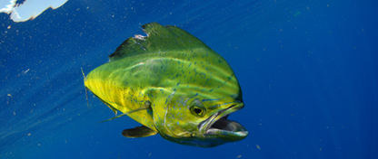
Modify existing “Did Not Fish” report requirements
Currently: “Did Not Fish” (DNF) reports are already a requirement for Southeast federally permitted charter and headboat vessels. They are submitted weekly and can be submitted up to 30 days in advance.
Does this requirement need to change?
Notes:
Did Not Fish reports are already a requirement. They can be submitted up to 30 days in advance to allow for-hire captains more flexibility when they know they won’t be scheduling trips for a while, or when the vessel is out for repairs.
The feedback the Council has received from NMFS is that DNF reports are helpful so there may not need to be any changes to this requirement.

Slide 18
Are DNF reports required in other programs?
South Atlantic (SA), Southeast (SE) Headboat Survey, Gulf of Mexico (GOM), Greater Atlantic Region (GAR) Vessel Trip Report (VTR), and Highly Migratory Species (HMS)
 | SA SEFHIER and SE Headboat Survey | GOM SEFHIER | GAR VTR | HMS
Existing | Weekly. Limit to no more than 30 days in advance | N/A | Not required | Not required
Proposed | ? | Monthly | Not required | Monthly. No limit to how far in advance.
Notes:
This table shows what is in place and what is being proposed under the various data collection programs regarding DNF reports.

Slide 19
WHERE ARE WE IN THE PROCESS?
Timing | Council action
March – December 2024 | Gather information on current reporting programs
January & February 2025 | Convene new ad hoc For-Hire reporting Advisory Panel and Law Enforcement Advisory Panel
March 2025 | Approve for scoping (online)
April 2025 | Convene Snapper Grouper, Mackerel Cobia, and Dolphin Wahoo Advisory Panels
June – September 2025 | Develop the amendment
December 2025 | Approve for public hearings
March 2026 | Review public hearing comments
June 2026 | Approve for submission to NMFS
2027/2028 | Regulation changes become effective
Notes:
So, here is where we are in the amendment process. At the beginning of the presentation, I explained what scoping is. Basically, a heads up that the Council may be making some changes and an opportunity for the public to weight in.
If the Council decides to continue with his amendment, they would be approving it for public hearings at the end of this year. This would be another opportunity for the public to give feedback. By then, the Council will have narrowed down the list of actions and the alternatives within each action. If things continue on track, we’d be looking at changes becoming effective in sometime in 2027 or early 2028.

Slide 20
What are your thoughts?
The Council wants to hear from you!
1) Reporting Frequency: What do you think is the appropriate timeframe for requiring submittal of a for-hire trip report?
2) Trip Notification: What are your thoughts on requiring a trip notification when a for-hire permitted vessel leaves the dock for a fishing trip?
  When engaging in fishing activity?
  When engaging in other for-hire activity (sunset cruise, dolphin watching, etc.)?
3) Do you have general feedback for the Council on changing for-hire reporting requirements?
  Reporting frequency?
  Requiring a trip notification?
  Landing at approved landing locations?
  Requiring participation in a validation survey if selected?
  Revising reporting of economic data?
  Changing Did Not Fish reports requirements?
Notes:
So, to summarize, the Council is looking for feedback on whether to change the frequency of reporting and the timing of the reports, when a trip notification should be required, and general input on other elements I’ve covered in this presentation.

Slide 21
WAYS TO PROVIDE COMMENTS
Written comments: Use the online form available from the Improvements to For-Hire Reporting Amendment page on the Council’s website (www.safmc.net). Submit by 5:00 PM on May 8, 2025.
Comments by mail: Send comments to John Carmichael, Executive Director, SAFMC, 4055 Faber Place Drive, Suite 201, N. Charleston, SC 29405
Comments by fax: 843-769-4520
Myra Brouwer
843-302-8436
Myra.Brouwer@safmc.net
John Hadley
843-302-8432
John.Hadley@safmc.net
Notes:
This scoping process is being conducted online through a document posted to the Council’s website and this recorded presentation. There will be no live webinar or meeting for this process, but feel free to re-watch this presentation and reference the document as needed. Additionally, if you have clarifying questions about this process or Council discussions about the topics thus far, please feel free to contact me, Myra Brouwer, or John Hadley, using the information shown on this slide.
Written comments can be submitted online, from the Improvements to For Hire Reporting Amendment page. Written comments can also be submitted via mail or fax, using the information shown on the screen. All comments must be submitted by 5:00 pm on May 8.
This concludes the recorded presentation. Thank you for your time, attention, and interest in South Atlantic Council fisheries management.

