Slide 1

Gag
Southeast Fisheries Science Center
SEDAR-10 update assessment
April 30, 2014

Slide 2
Outline
Background
Data
  Review of data sources from SEDAR10
  Updates/modifications
Assessment methods and results
  Review of SEDAR10 model
  Modifications in this update
  Results
Projections

Slide 3
Background

Slide 4
Background
This is an “update assessment” under the current SEDAR definition
  Modeling done by the SEFSC, with help from other data providers
  SSC conducts the review
Goals of this update
  Update the model on which management was based (BAM)
  Strike a balance between fidelity to SEDAR10 and modifications intended to improve the assessment

Slide 5
Background – summary of regulations
Year effective | Recreational | Commercial
1992 | 20in; 5-grouper aggregate bag | 20in
1999 | 24in; 5-grouper aggregate bag | 24in
2010 | 24in; 3-grouper aggregate bag | 24in; Seasonal quota
2011 | Same | 24in; Seasonal quota; trip limit
2012 | Same | 24in; Fall closure due to quota
Size limits in TL; Quotas and trip limits in gutted weight; Spawning season (Jan-April) closure starting in 2010

Slide 6
Background – summary S10 results
Two models of catchability (q) in S10: one constant and one increasing with time
  Constant q model was used for management, and that is the model used for this update
Overfishing: F2004/Fmsy=1.3
Not overfished: SSB2005/MSST=1.1
A new definition of MSST is currently under consideration in Reg Amendment 21: MSST=75%SSBmsy

Slide 7
Data

Slide 8
Data fit by the assessment
Note: terminal yr of SEDAR10 was 2004
Landings
  Commercial handline (1962–2012, 1000 lb gutted weight)
  Commercial diving (1976–2012, 1000 lb gutted weight)
  Recreational headboat (1962–2012, 1000 fish)
  General recreational (1962–2012, 1000 fish)
Discards
  Commercial handline (19992–2011 1000 fish)
  Recreational headboat (1981–2012, 1000 fish)
  General recreational (1981–2012, 1000 fish)

Slide 9
Landings and discard mortalities (in numbers)

Slide 10
Age and length compositions
Landings: Ages and lengths
  Commercial handline
  Commercial diving
  Combined headboat and general recreational
Discards: none

Slide 11
Indices of abundance
Fishery dependent
  General recreational (1981–2004)
  Commercial handline (1993–2011)
  Headboat (1973–2012)
Fishery independent: none

Slide 12
Indices of abundance

Slide 13
Other features, as in SEDAR10
Life-history characteristics
  Natural mortality: Lorenzen age-based curve, scaled to M=0.14
  Somatic growth: length and weight at age; von Bert parameters estimated
  Female maturity at age; all males assumed mature
  Time-varying sex ratio at age
Discard mortality
  Headboat and general recreational: 0.25
  Commercial handlines: 0.40

Slide 14
Modifications/updates to data
In most cases, eight additional years were added to the end of the time series, using current or SEDAR10 methodology
Exceptions:
  GLMs (commercial discards) and Delta-GLMs (indices) were refitted using all relevant data, thus earlier years were subject to modification. Same methods as SEDAR10.
  General recreational index not updated
  Commercial index extended only to 2011, because recent management measures make its ability to track abundance questionable.
  Data from the general recreational fleet were previously based on MRFSS methodology. Here, 2004–2012 estimates were based on MRIP methodology, and earlier MRFSS estimates were rescaled based on MRIP:MRFSS.
  Age comps fitted to ages 1-12+, rather than 0-20+
  Effective sample size of compositions based on number of trips rather than number of fish

Slide 15
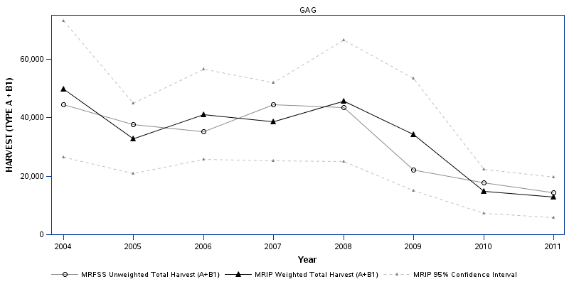
Comparison of MRFSS and MRIP estimates
Plot generated by MRIP website

Slide 16
Assessment methods and results

Slide 17
BAM: same basic model as in SEDAR10
Catch-age formulation, fit to data using maximum likelihood
Beverton-Holt spawner recruit model, with lognormal error
Age-based natural mortality
Age-based selectivities, allowed to vary across regulation blocks
  Logistic (flat-topped) for dominant fleets
  Dome-shaped for commercial diving and all discards
Baranov catch equation
Spawning stock based on total mature biomass (males+females)

Slide 18
Modifications to the SEDAR10 model (1 of 2)
Initialization
  Equilibrium age structure in 1962, given Finit=0.03
  Recruitment deviations start in 1972
Ages modeled: 1-16+; S10 modeled 0-20+
Normal priors on selectivity, von Bert, and σ_{R} parameters
  S10 BAM did not have this capability
Constant (estimated) CV of size at age, rather than age-dependent
Different function to model dome-shaped selectivity
  S10 applied double logistic
  Update applied negative exponential on the descending limb

Slide 19
Modifications to the SEDAR10 model (2 of 2)
Data component weights
  S10 applied external weights to data components
  The update applied iterative re-weighting to age and length comp data
Negative log-likelihood applied to spawner-recruit deviations
  Sum of squares penalty (in log space) used in S10
  NLL used in the modern version of BAM
  NLL approach requires additional parameter, σ_{R} (prior=0.6)
Steepness fixed at 0.84
  S10 attempted to estimate h, but it was at the upper bound
Bias correction for estimating benchmarks
Output: Total F’s computed as apical F, rather than sum of full F’s by fleet
Uncertainty estimated through Monte/Carlo Bootstrap (MCB) approach
  In S10, uncertainty in benchmarks was estimated through bootstrapping spawner-recruit residuals only
  MCB approach recommended by SEDAR Uncertainty Workshop, and is now standard practice with the BAM

Slide 20
Effects of modifications
Model
Model and steepness
Model, steepness, and data

Slide 21
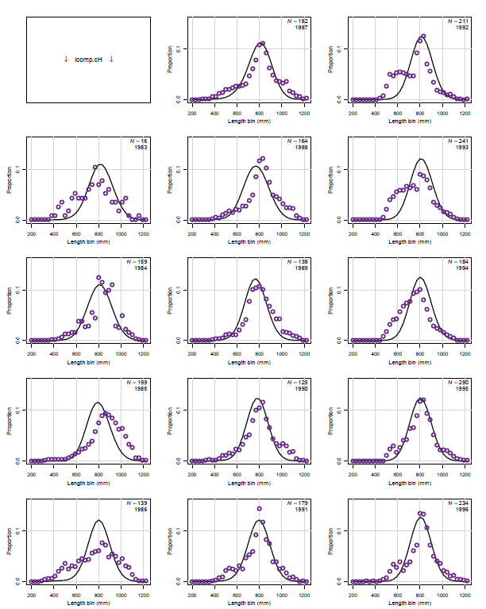
BAM base run – fits to data

Slide 22
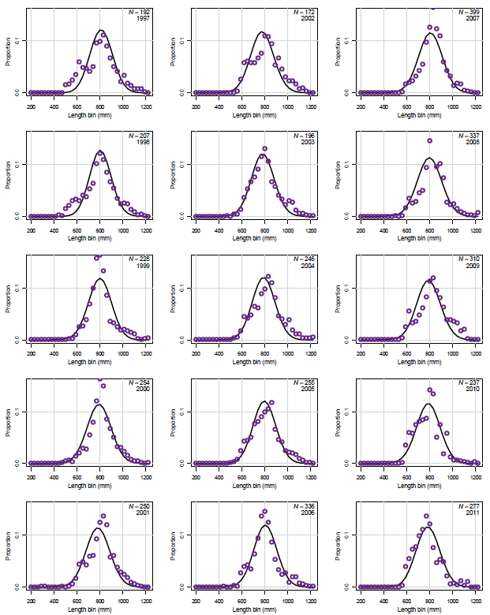
BAM base run – fits to data

Slide 23
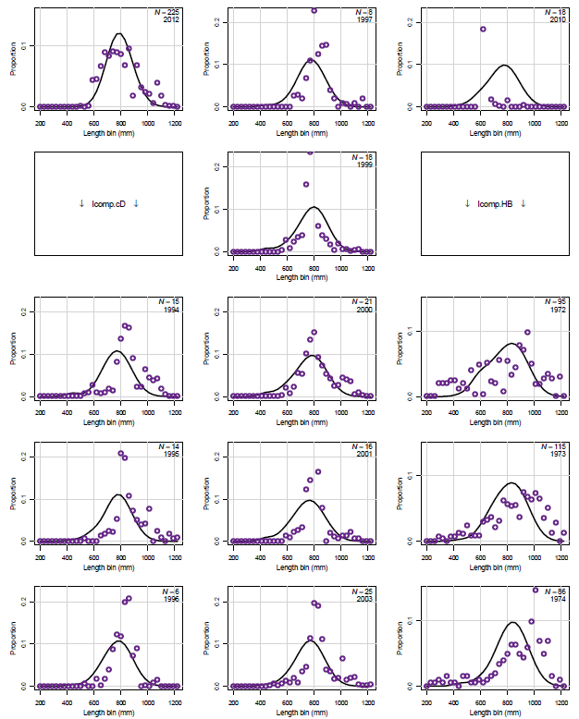
BAM base run – fits to data

Slide 24
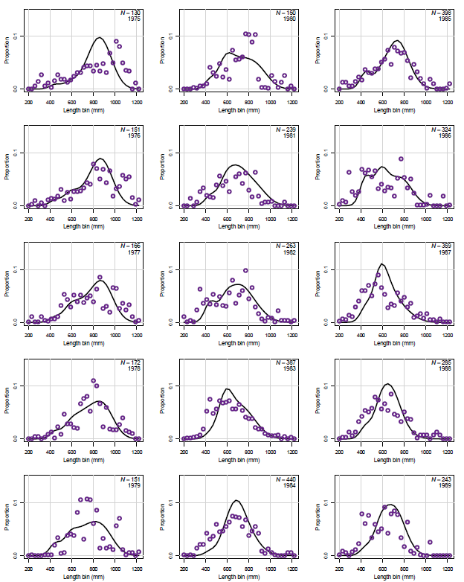
BAM base run – fits to data

Slide 25
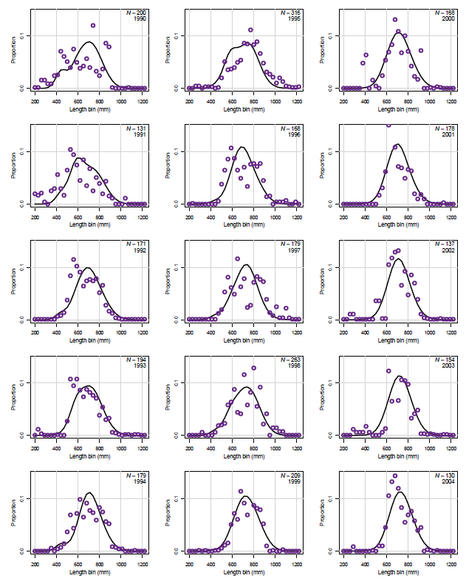
BAM base run – fits to data

Slide 26
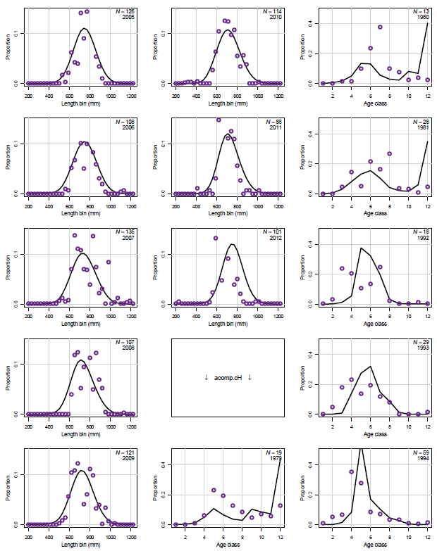
BAM base run – fits to data

Slide 27
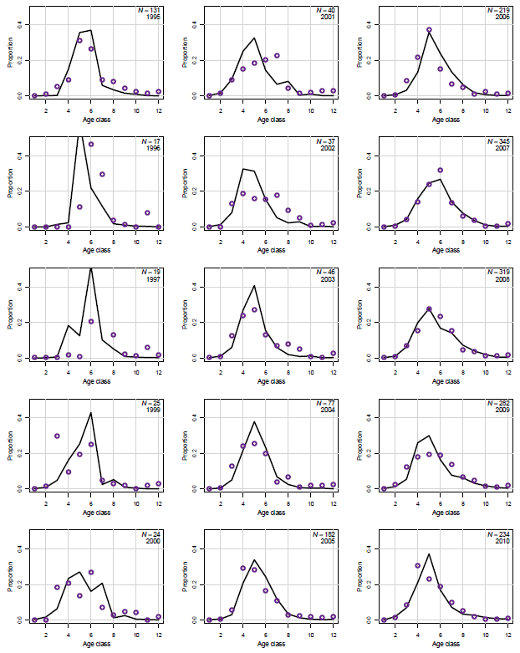
BAM base run – fits to data

Slide 28
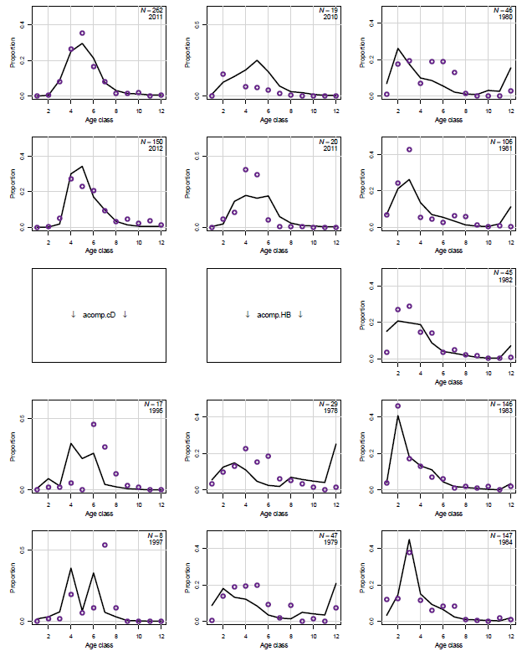
BAM base run – fits to data

Slide 29
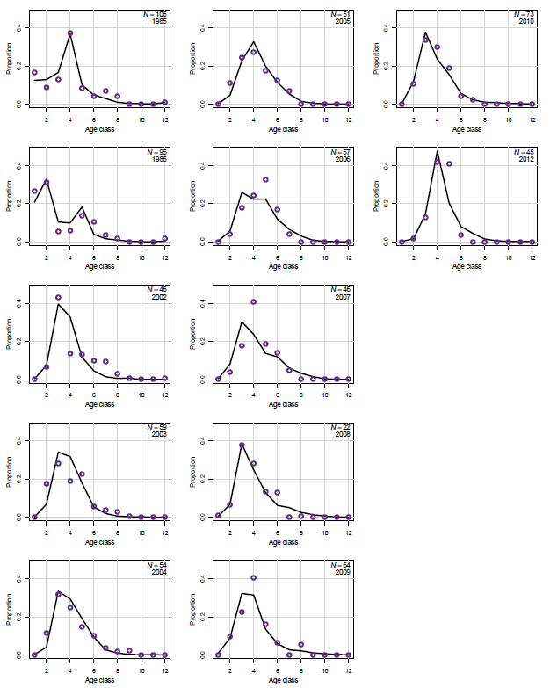
BAM base run – fits to data

Slide 30
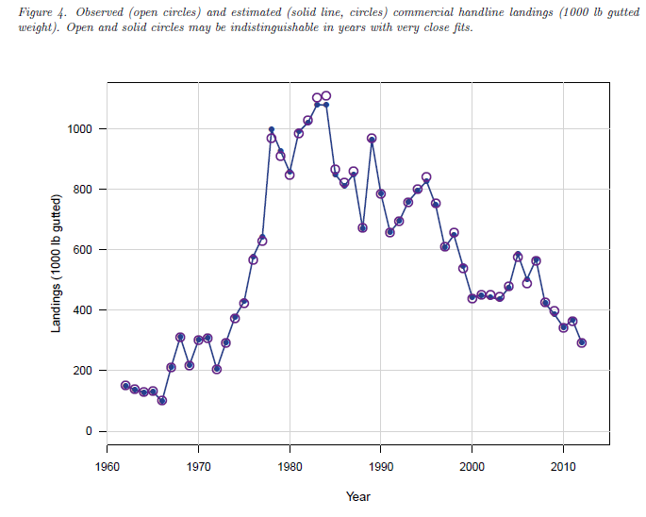
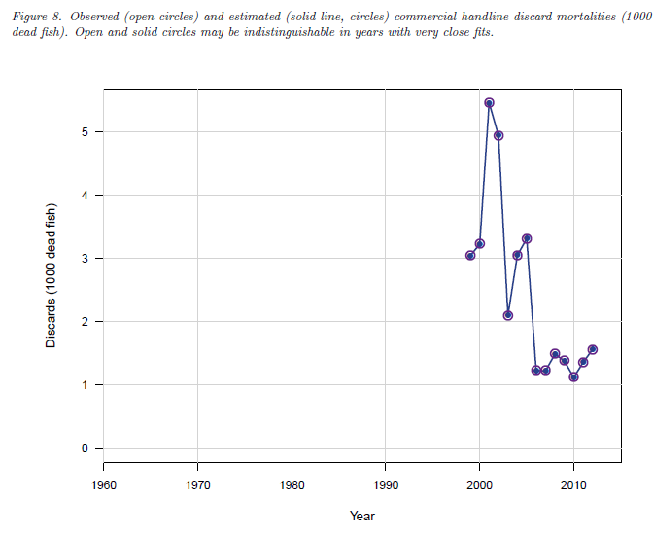
BAM base run – fits to data

Slide 31
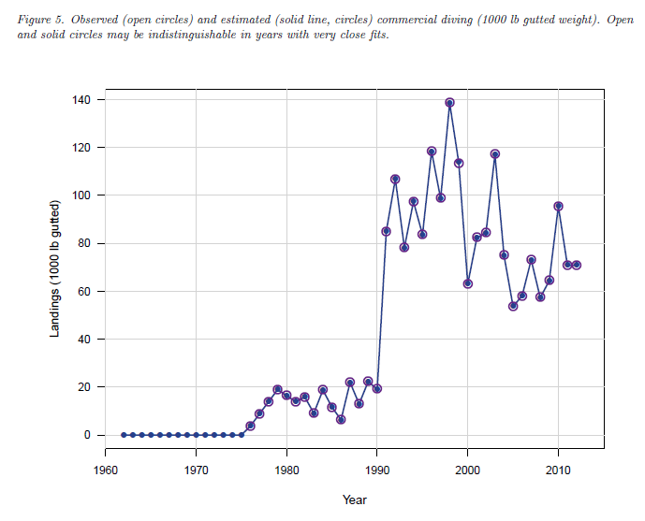
BAM base run – fits to data

Slide 32
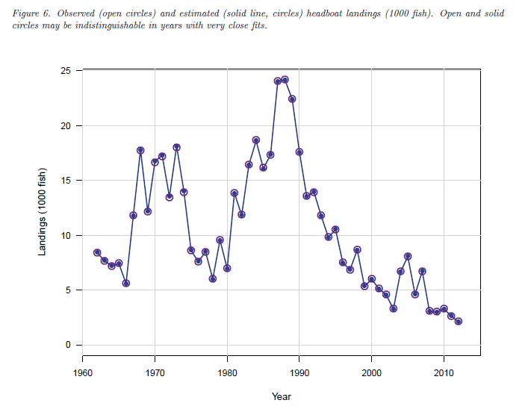
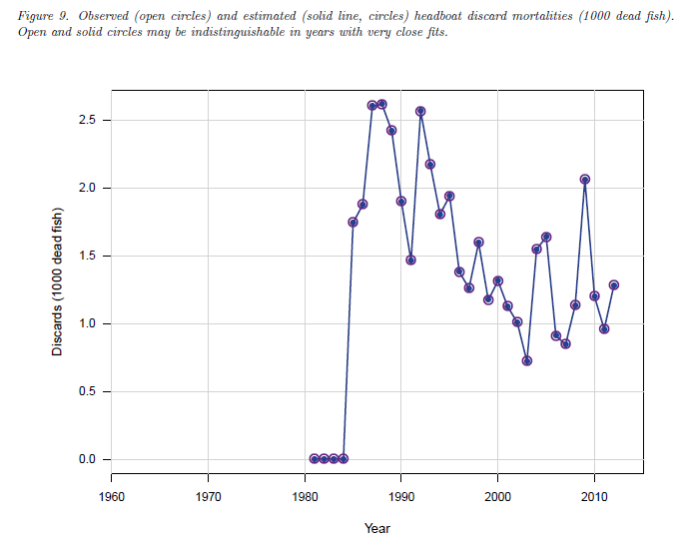
BAM base run – fits to data

Slide 33
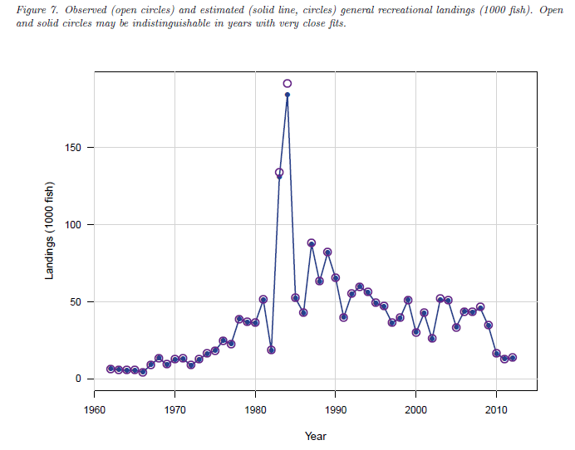
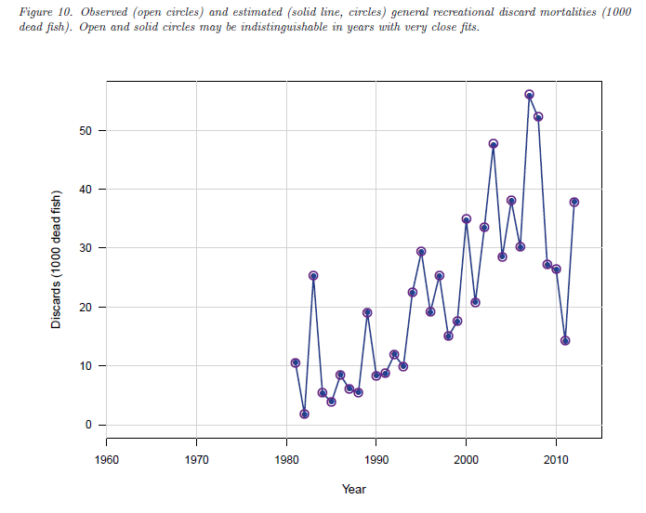
BAM base run – fits to data

Slide 34
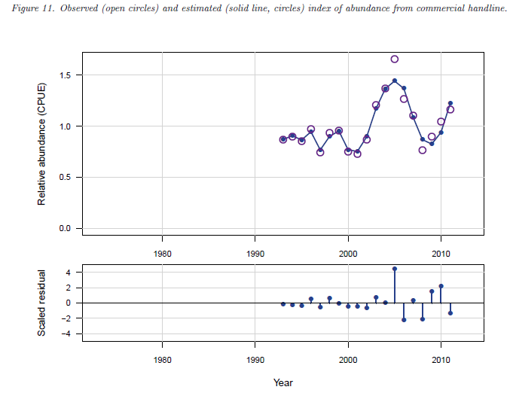
BAM base run – fits to data

Slide 35
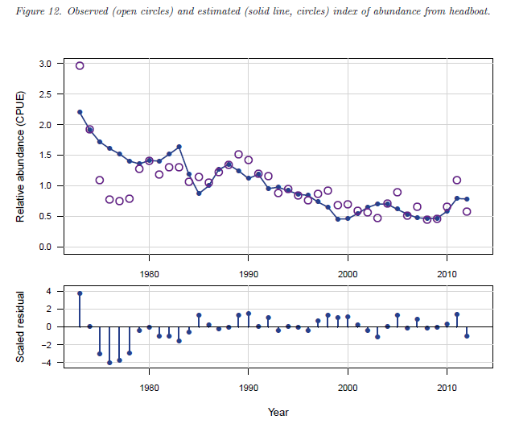
BAM base run – fits to data

Slide 36
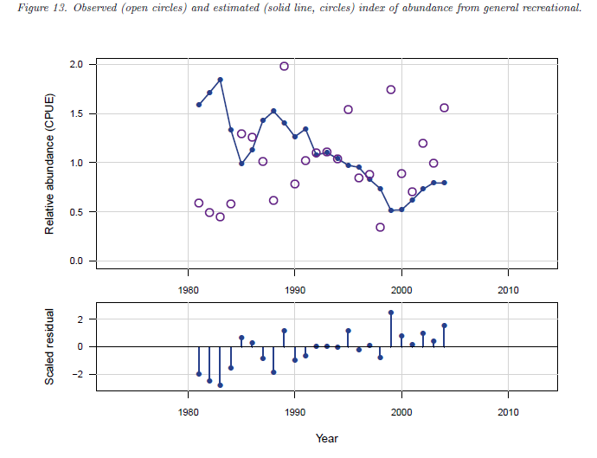
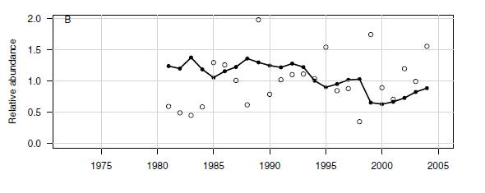
BAM base run – fits to data
From SEDAR10

Slide 37
BAM base run – SSB

Slide 38
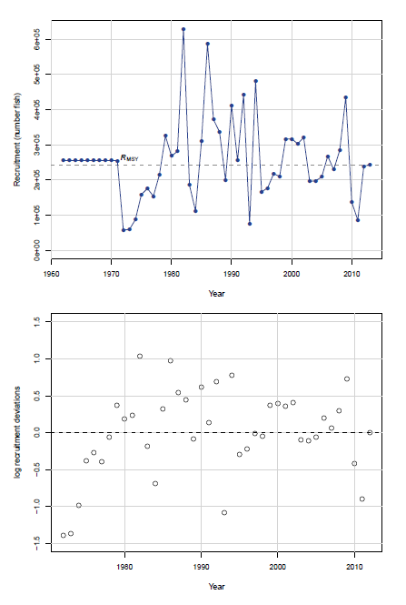
BAM base run – Recruitment

Slide 39
BAM base run – Spawner-recruit curve

Slide 40
BAM base run – Fishing mortality

Slide 41
Uncertainty – Combined Monte Carlo and Bootstrap (MCB) approach
n=4000 MCB trials attempted; n=3775 retained
Bootstrap components:
  Lognormal likelihood components (landings, discards, indices): a parametric bootstrap to original data, with CVs as applied in the fitting procedure
  Multinomial likelihood components (length, age comps): resample Nfish and assign them to bins with probabilities equal to those from original data

Slide 42
MCB approach
Monte Carlo components:
  M: drawn from a uniform distribution, with mean equal to base value (0.14), and bounds [0.10, 0.18]. Chosen value scales age-based Lorenzen M.
  Steepness: drawn from a truncated beta distribution with expected value of 0.84 and bounds [0.32, 0.99]
  Finit: drawn from a uniform distribution, with mean equal to Finit=0.03 and bounds at ±50% [0.015, 0.045]

Slide 43
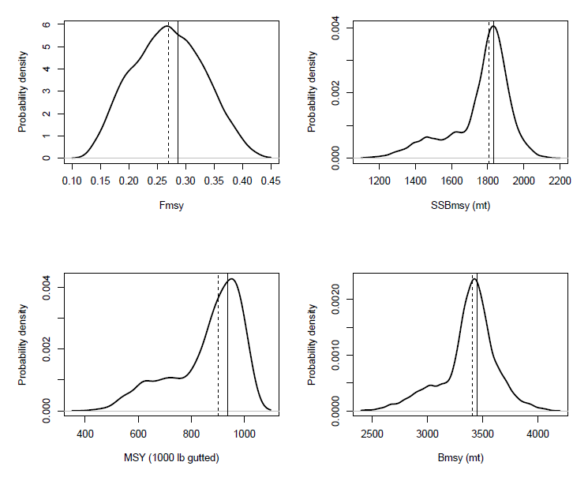
MCB – uncertainty in benchmarks
Solid=MLE (base)
Dash=Median

Slide 44
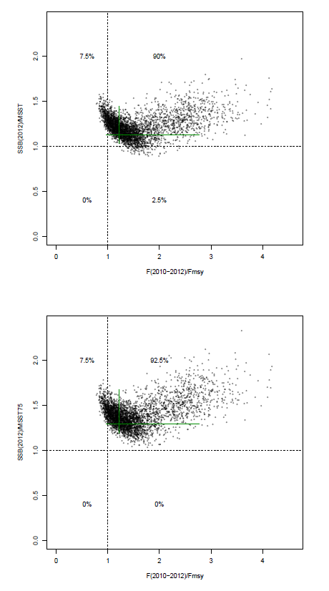
MCB – stock and fishery status

Slide 45
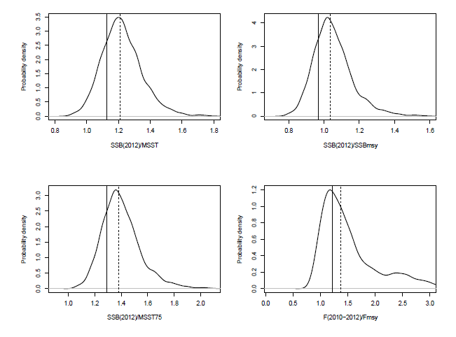
MCB – stock and fishery status
~97.5% of distribution
exceeds 1.0 (i.e., not overfished)
Solid=MLE (base)
Dash=Median
~92.5% of distribution
exceeds 1.0 (i.e., overfishing)

Slide 46
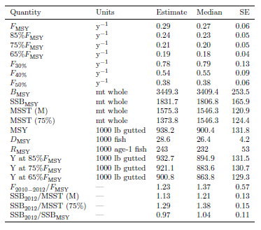
BAM results – Management quantities

Slide 47
Projections

Slide 48
Projections
Carry forward uncertainties from MCB runs
  Uncertainties in initial (2013) abundance at age, spawner-recruit function, natural mortality, discard mortality, selectivities, recruitment deviations, growth parameters
Uncertainty in Fmsy uses distribution from MCB runs
10-year projections: 2013-2022
F in 2013-2014 equal to average from 2010-2012. New management assumed to start in 2015.
Two types of projections
  Constant F: F=Fcurrent, Fmsy, 75%Fmsy
  P*: Probability of overfishing P*=0.3 and P*=0.5

Slide 49
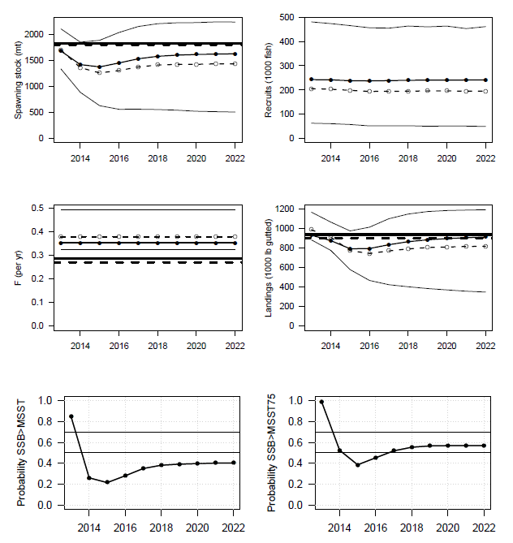
Example projection (F=Fcurrent)
Thick solid=base benchmark
Thick dash=median benchmark
Thin solid, closed circles=deterministic
Thin dash, open circles=median
Thin solid=5th and 95th percentiles

Slide 50
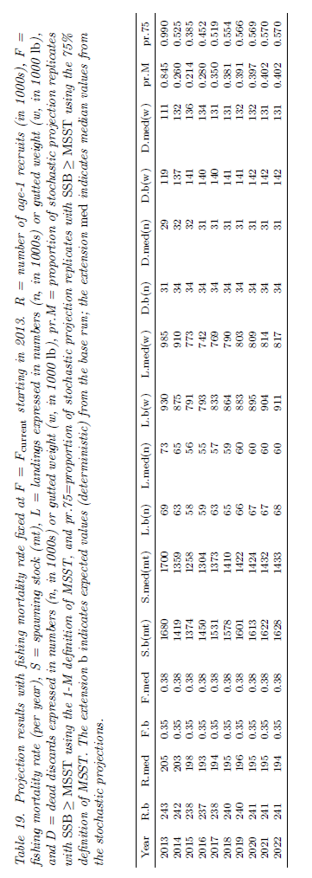
Projection results: F=Fcurrent

Slide 51
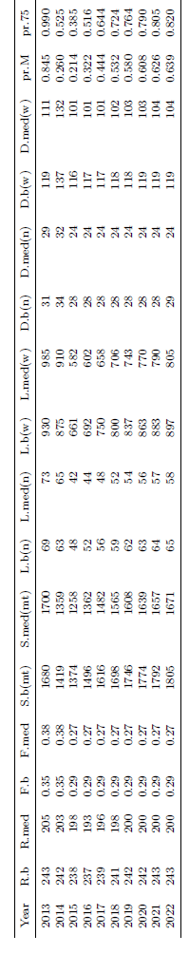
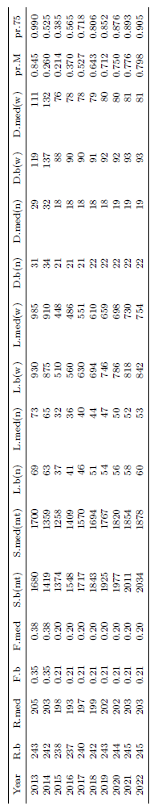
Projection results: F=Fmsy
Projection results: F=75%Fmsy

Slide 52
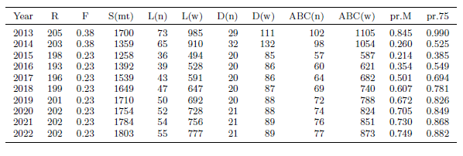
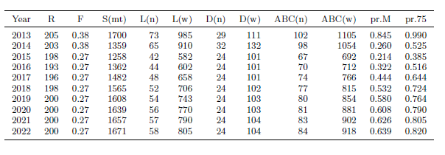
Projection results: P*=0.3
Projection results: P*=0.5

Slide 53
Questions

