Slide 1
HEAP Responses to Spawning Special Management Zones Survey
Developing Recommendations for the SSMZ Evaluation
Chip Collier, SAFMC Staff

Slide 2
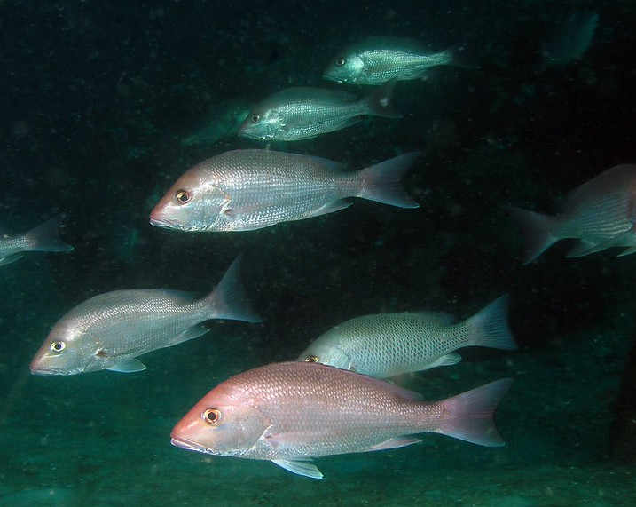
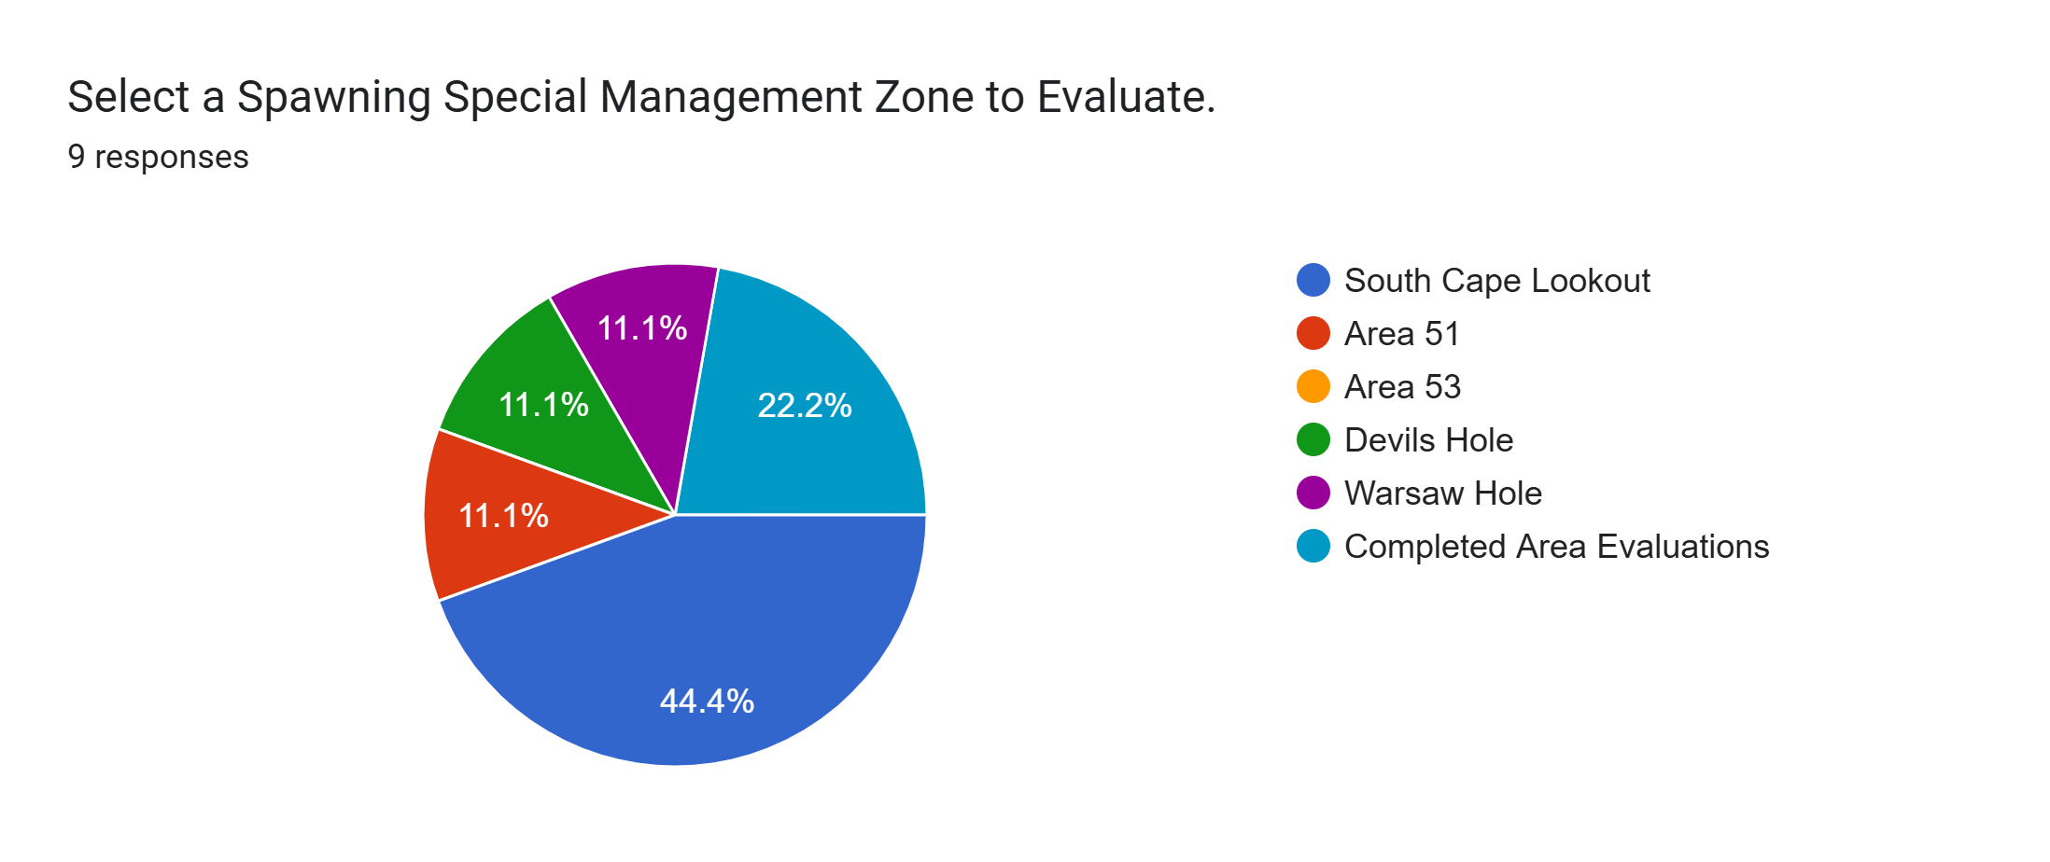
Thank you
The survey is challenging.
Used responses from 7 am
All responses and discussion will be added in report
Strongly Disagree/Note Evident
Disagree/Weakly Evident
Neutral/Somewhat Agree
Agree/Evident
Strongly Agree/Clearly Evident
NA/Insufficient Information
Credit: FWC

Slide 3
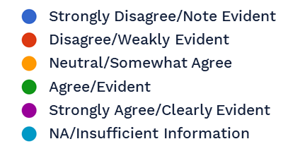
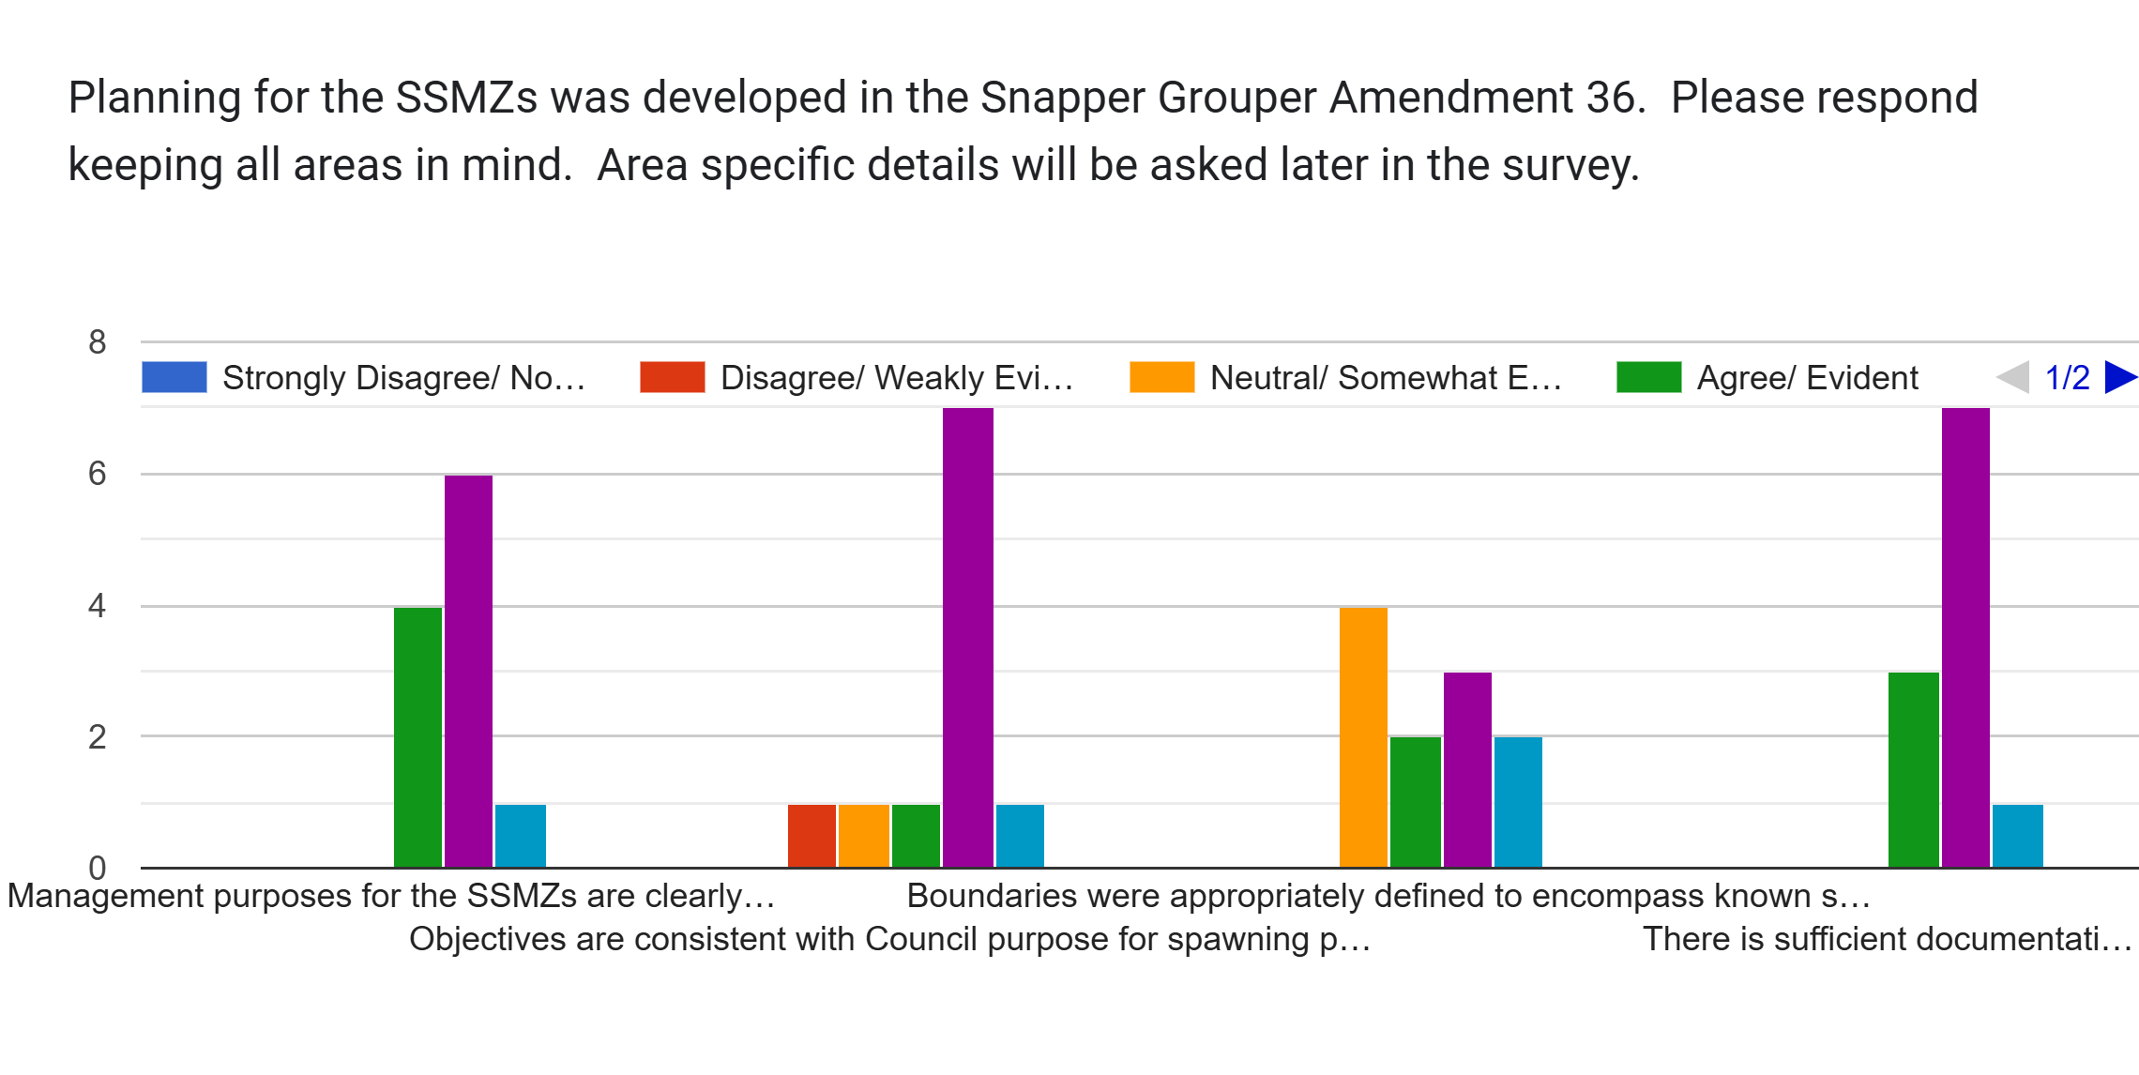
Planning

Slide 4
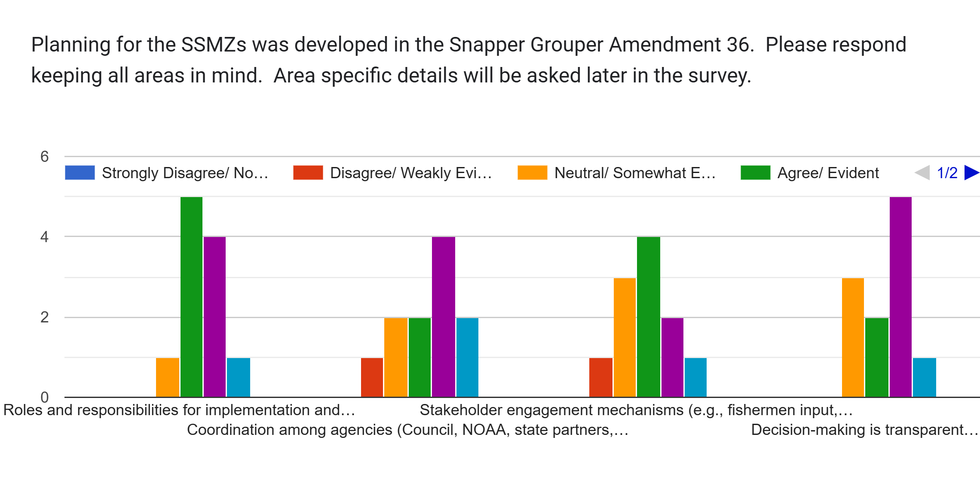
Planning

Slide 5
Areas Evaluated

Slide 6
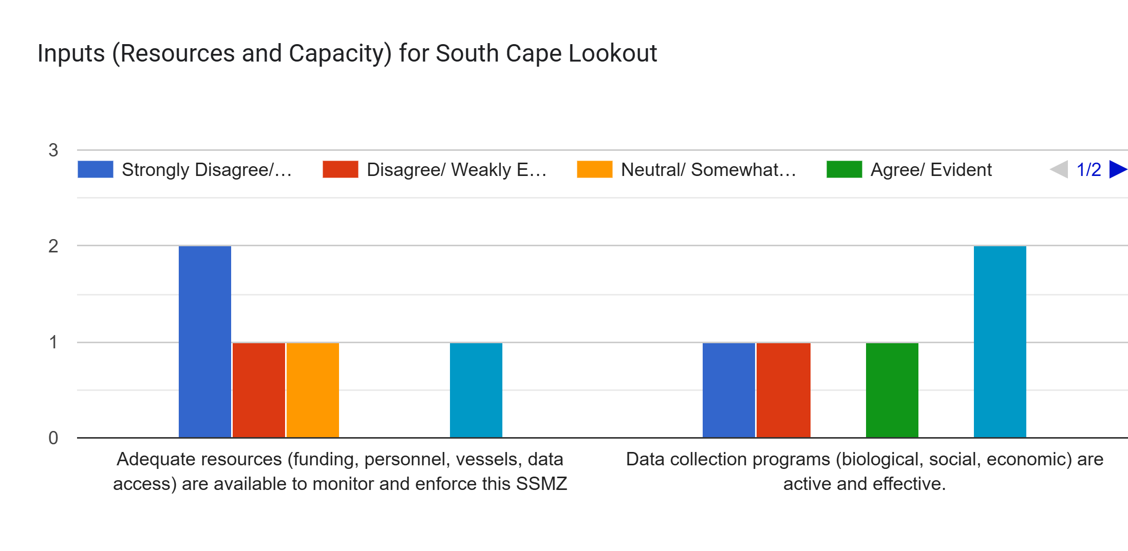
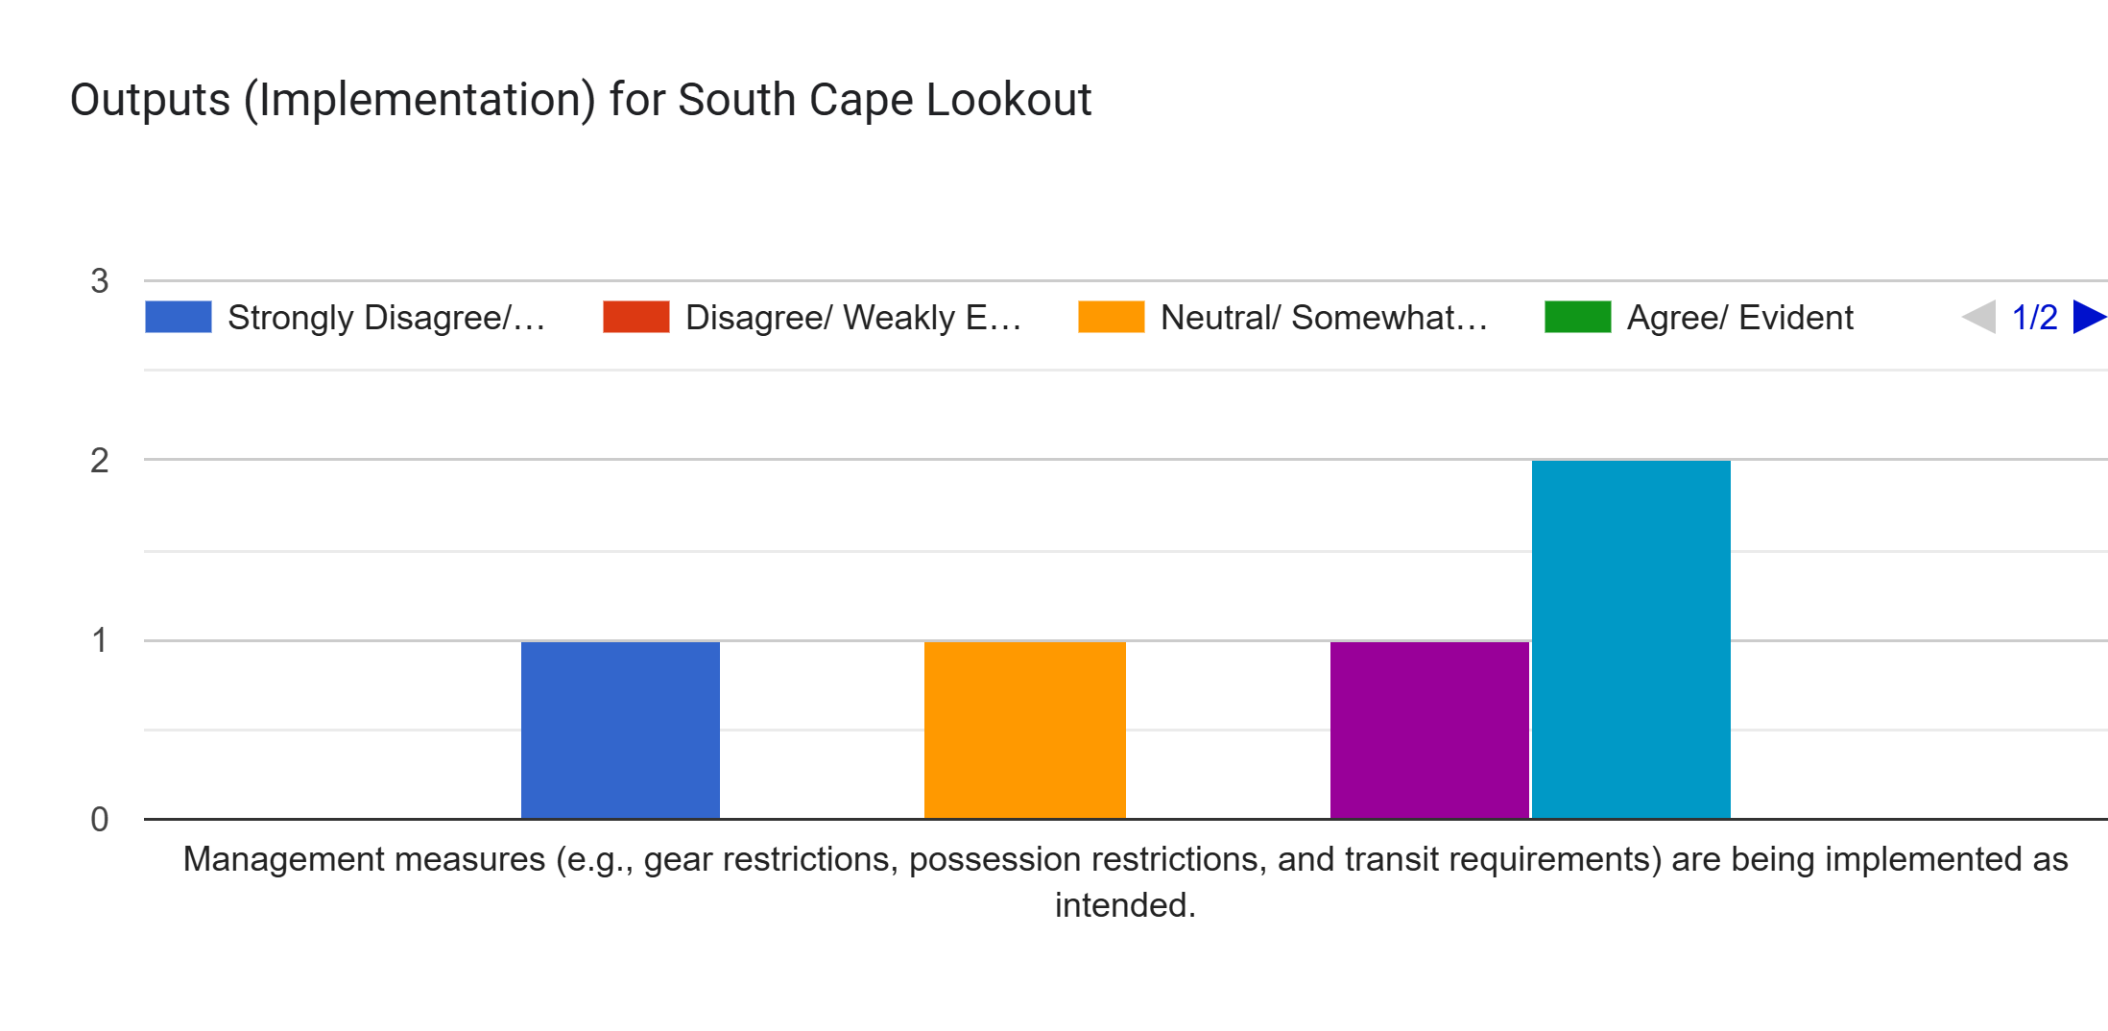
South Cape Lookout

Slide 7
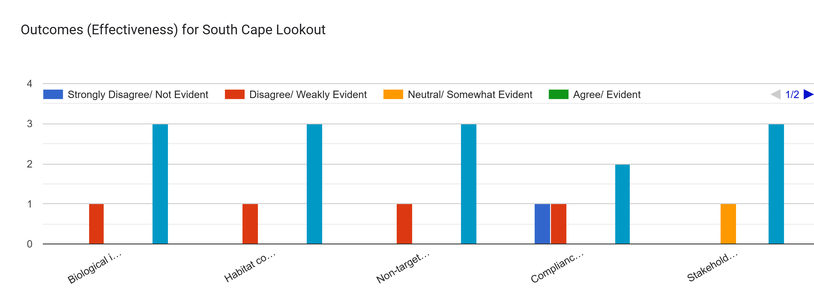
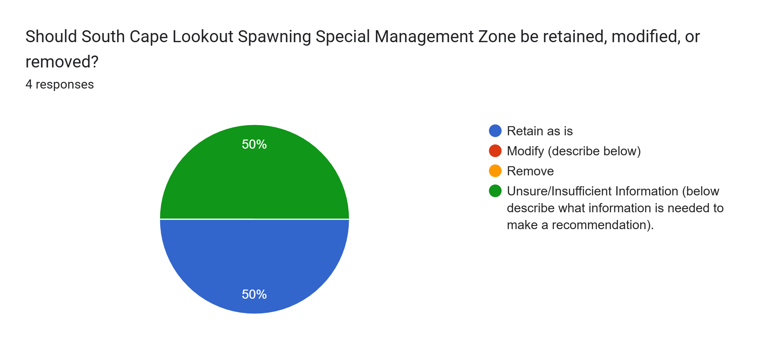
South Cape Lookout

Slide 8
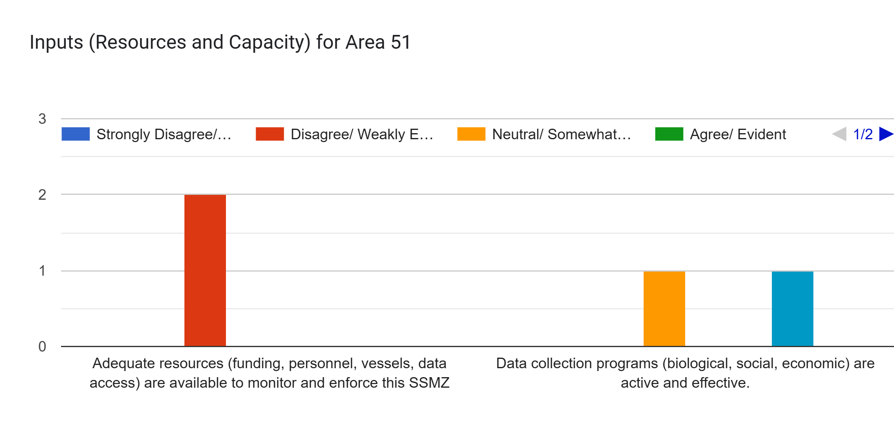
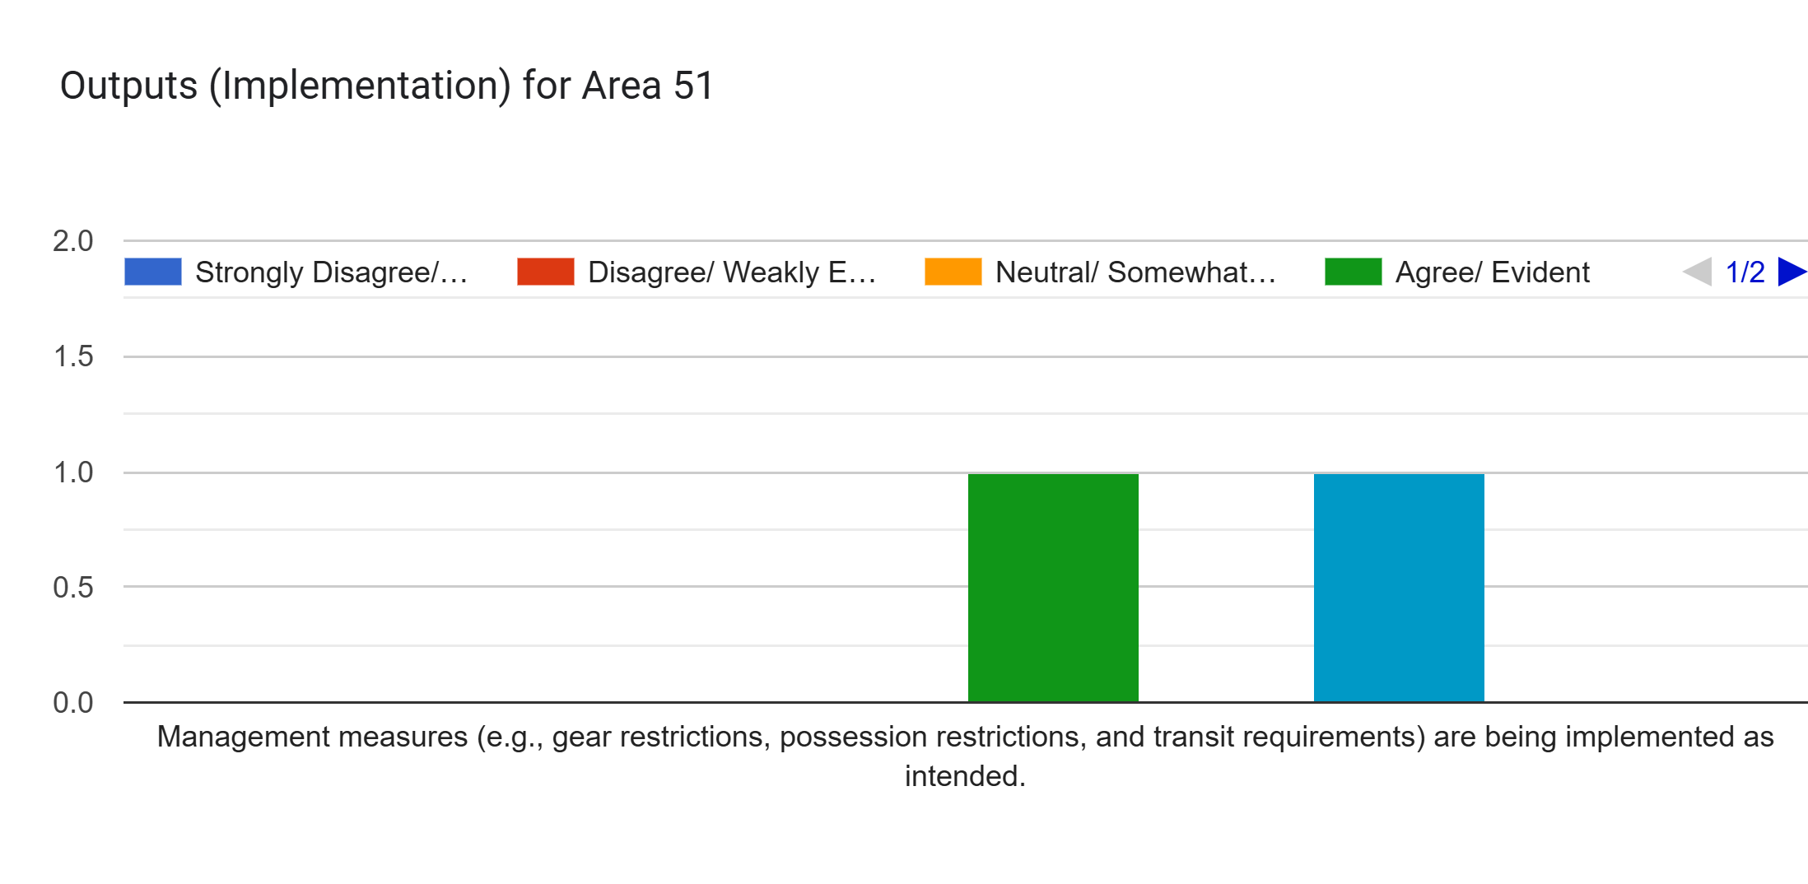
Area 51

Slide 9
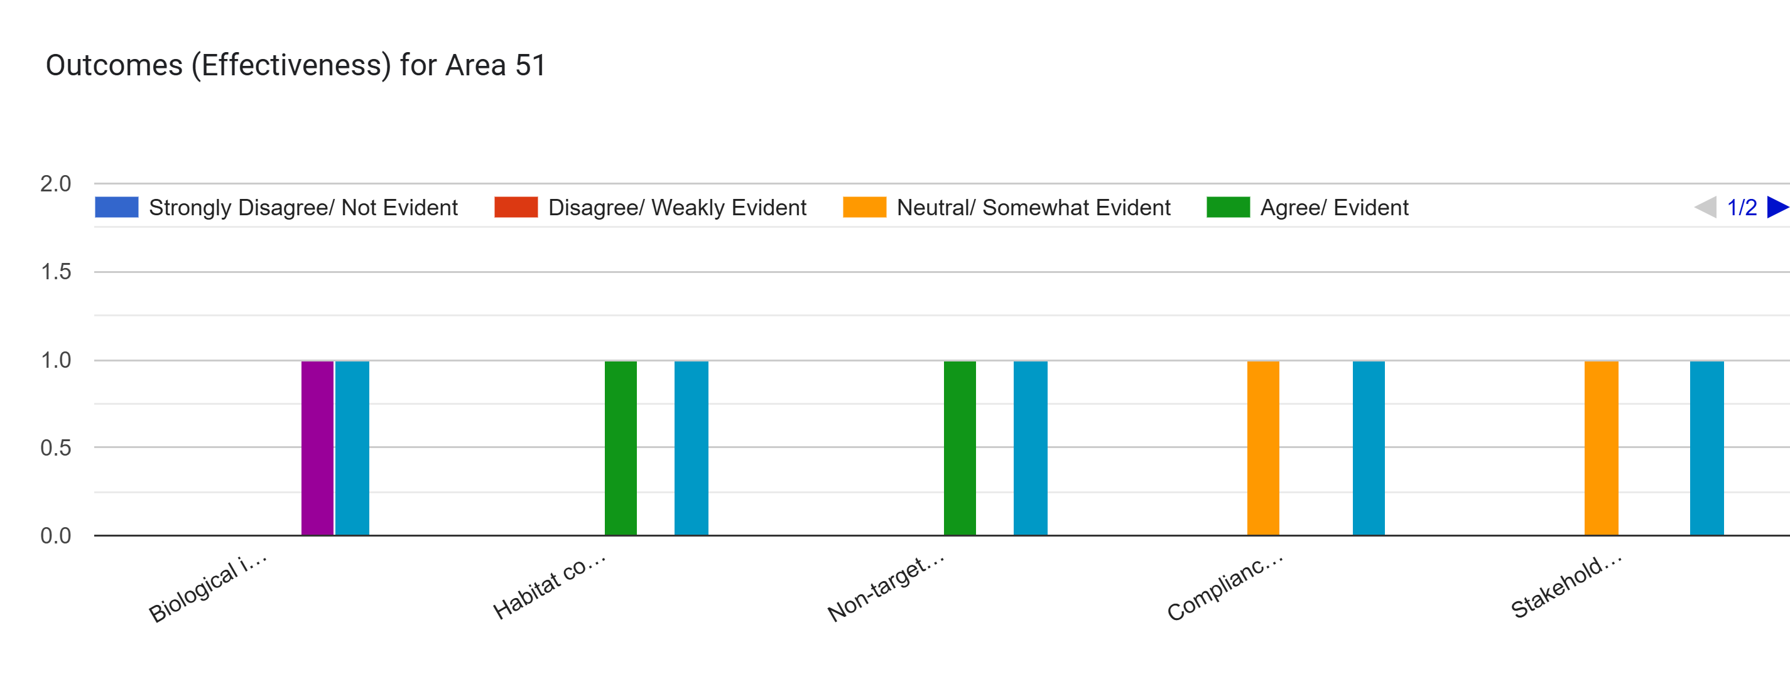
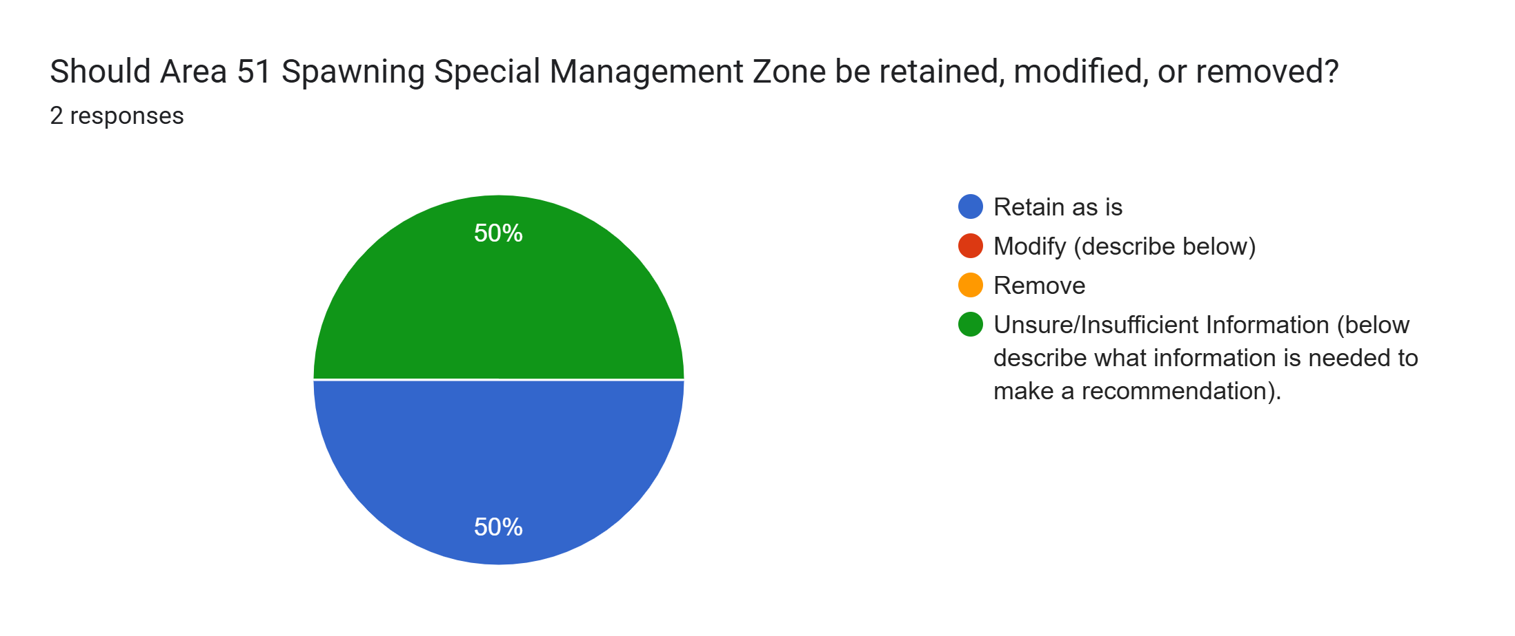
Area 51

Slide 10
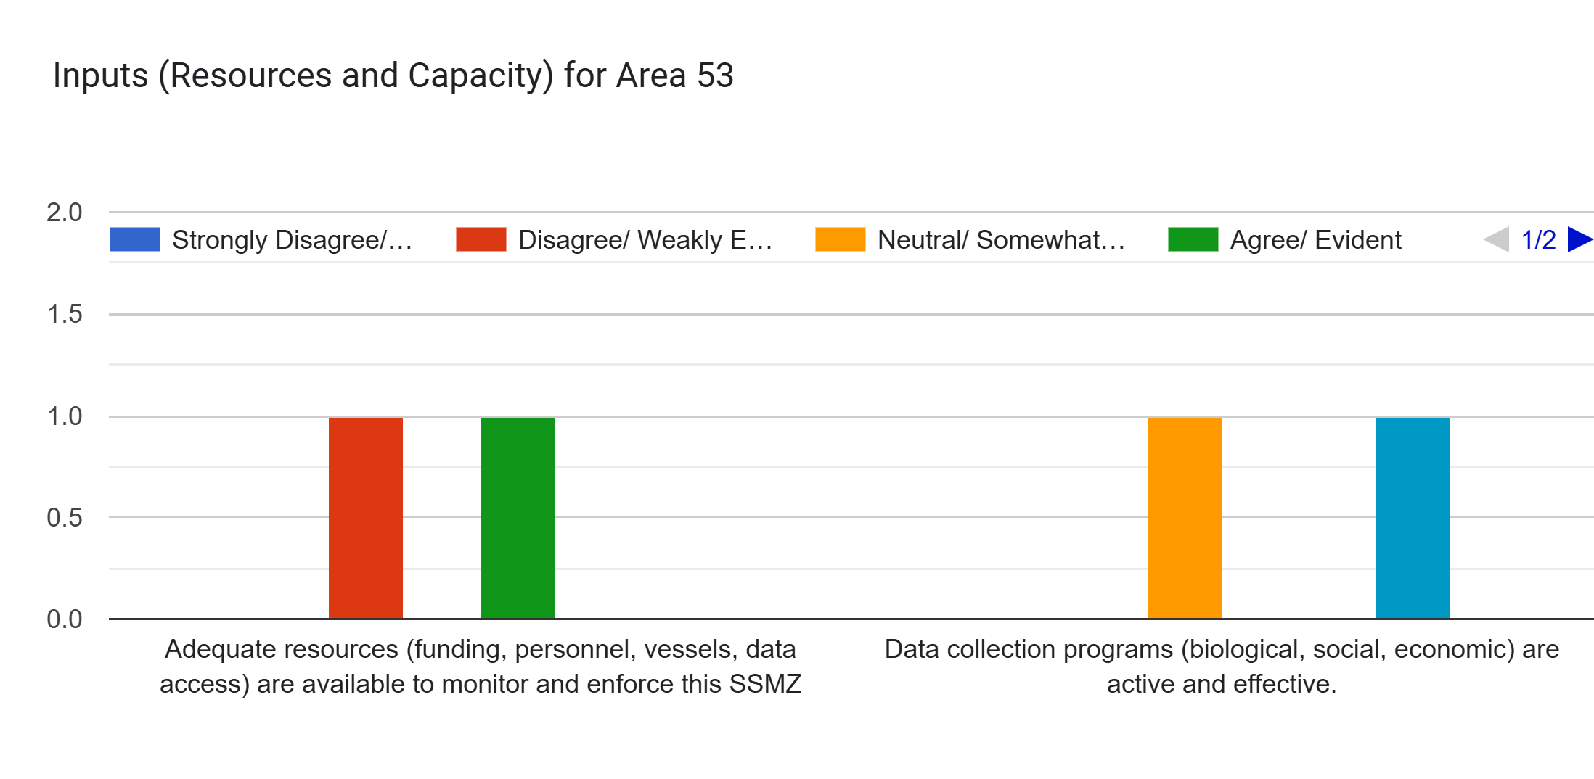

Area 53

Slide 11
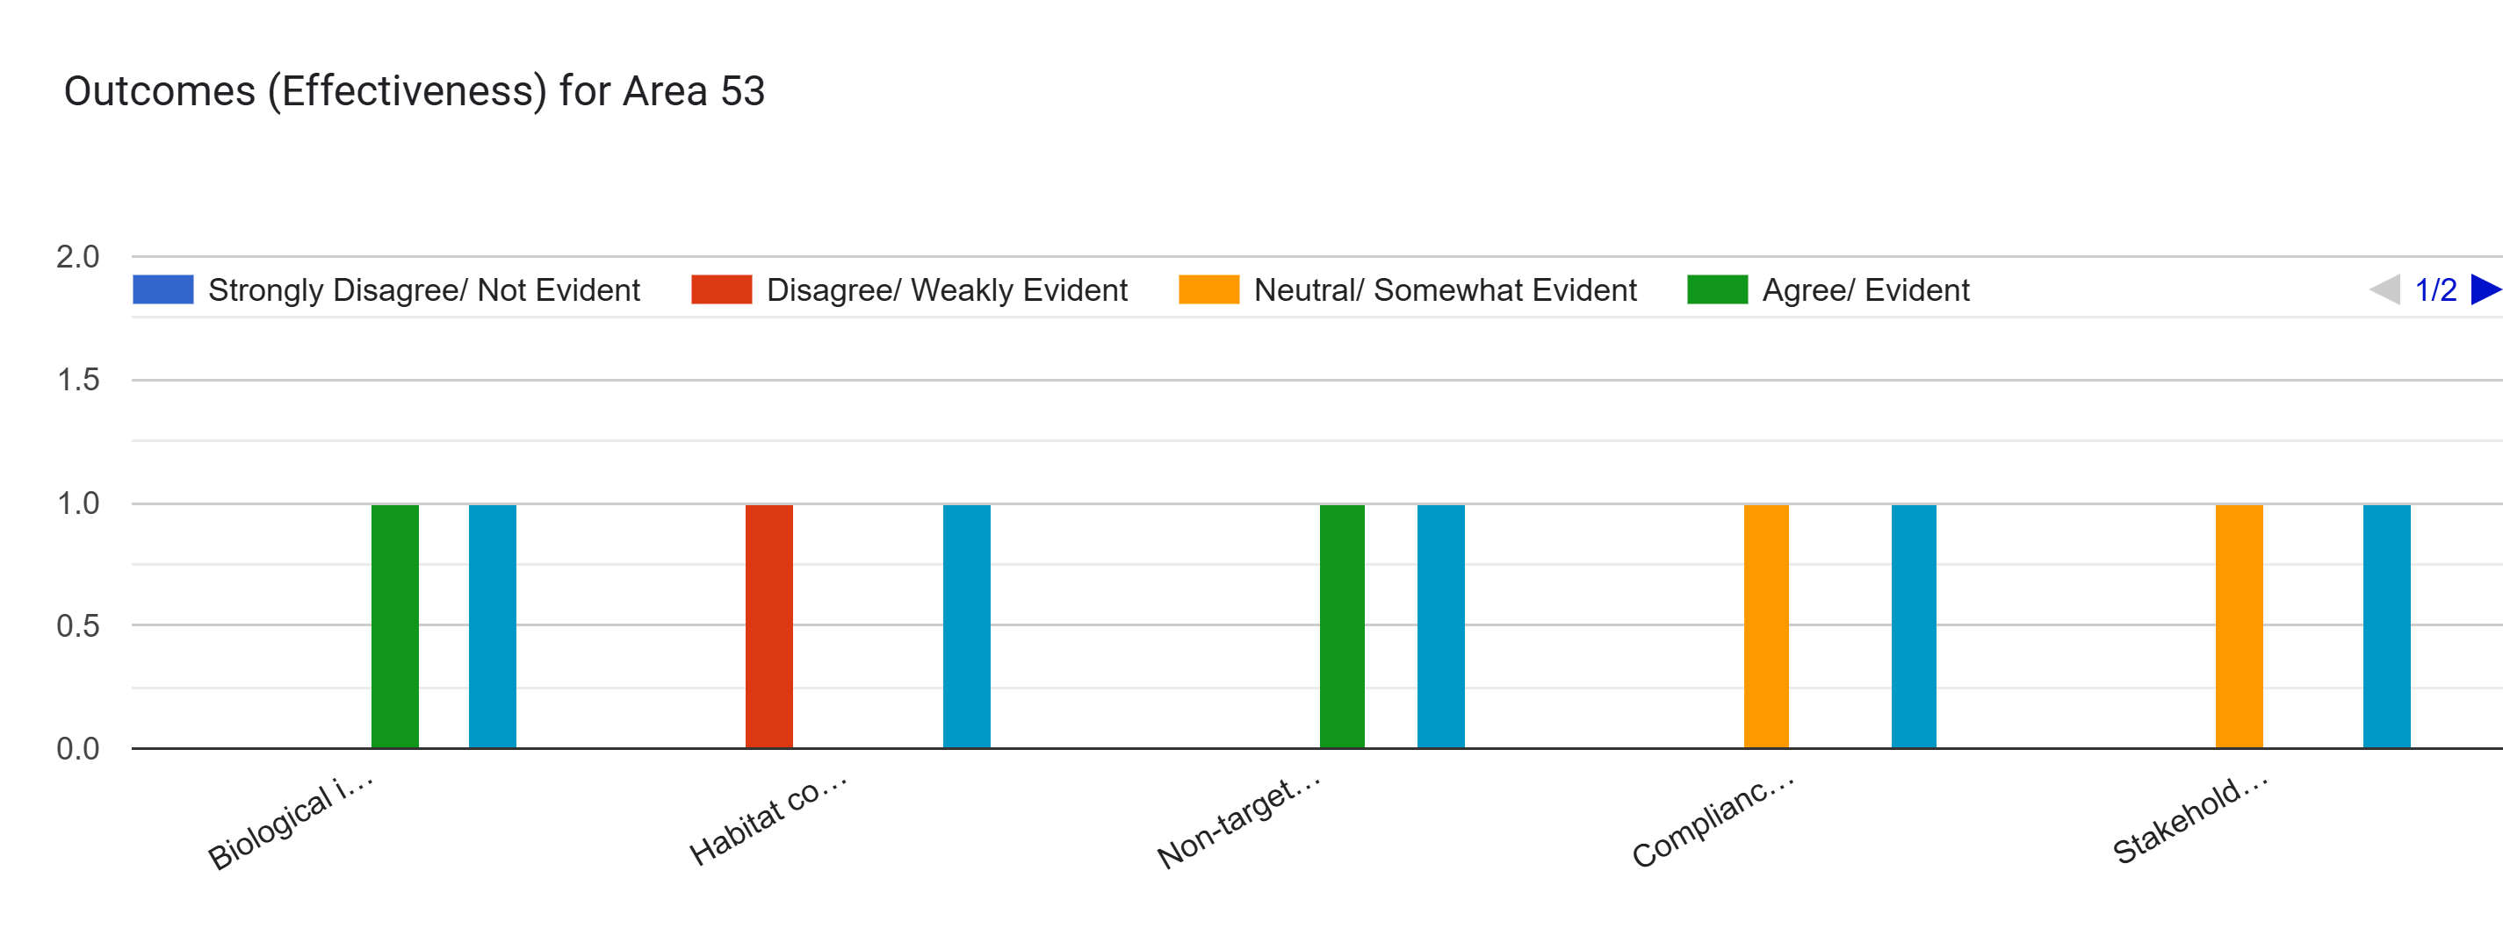

Area 53

Slide 12
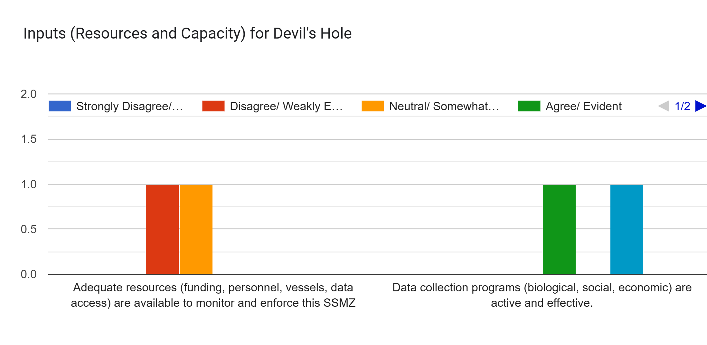
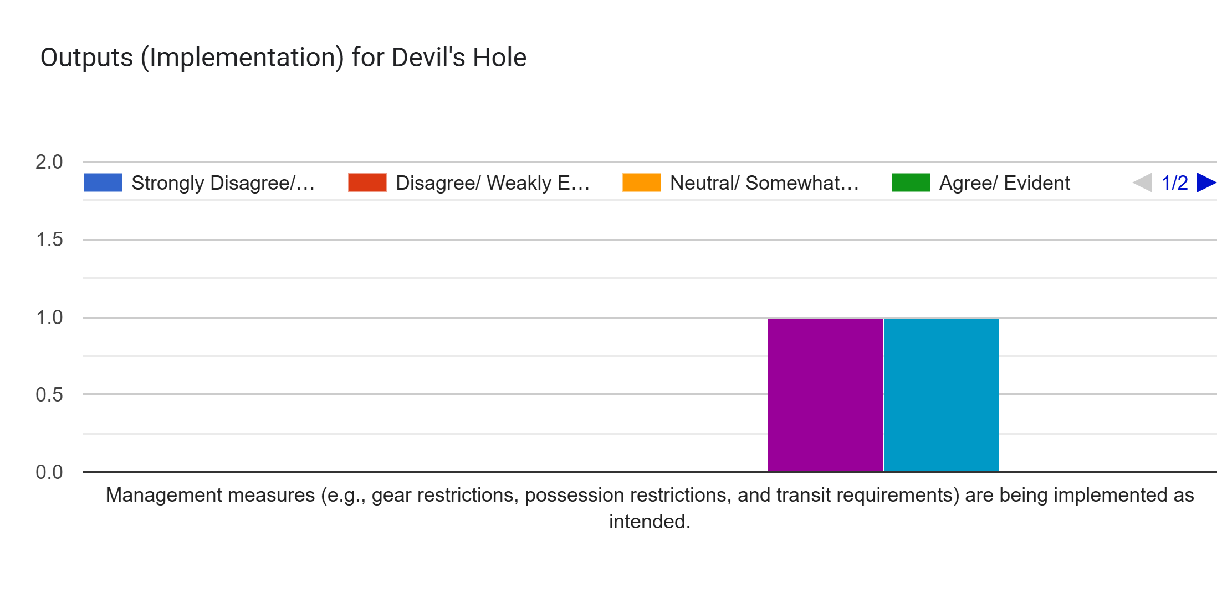
Devil’s Hole

Slide 13
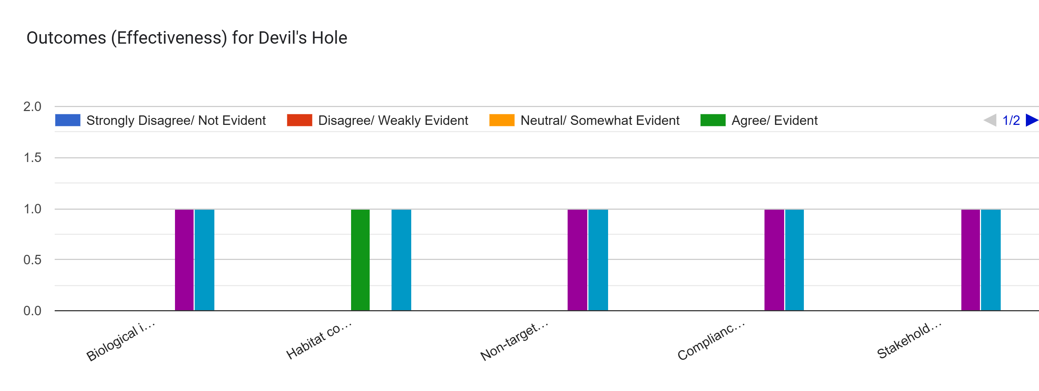

Devil’s Hole

Slide 14
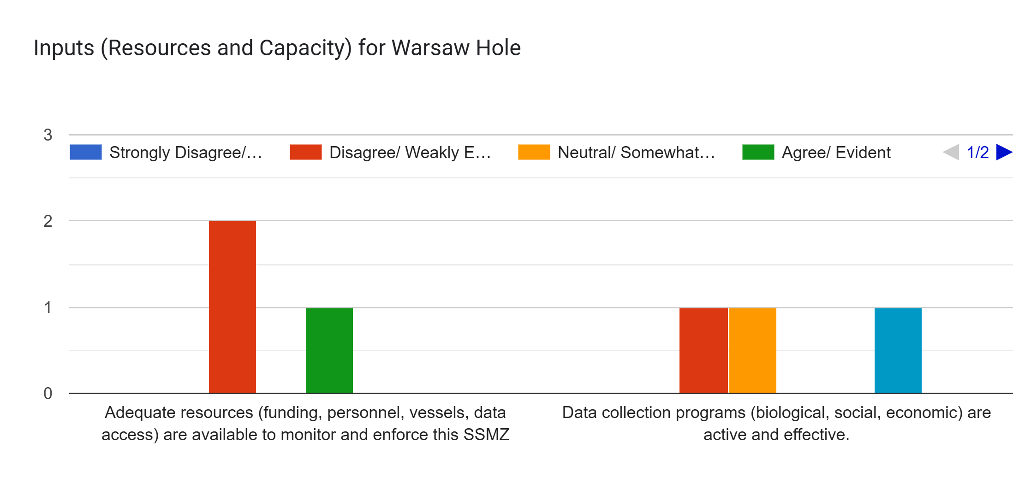
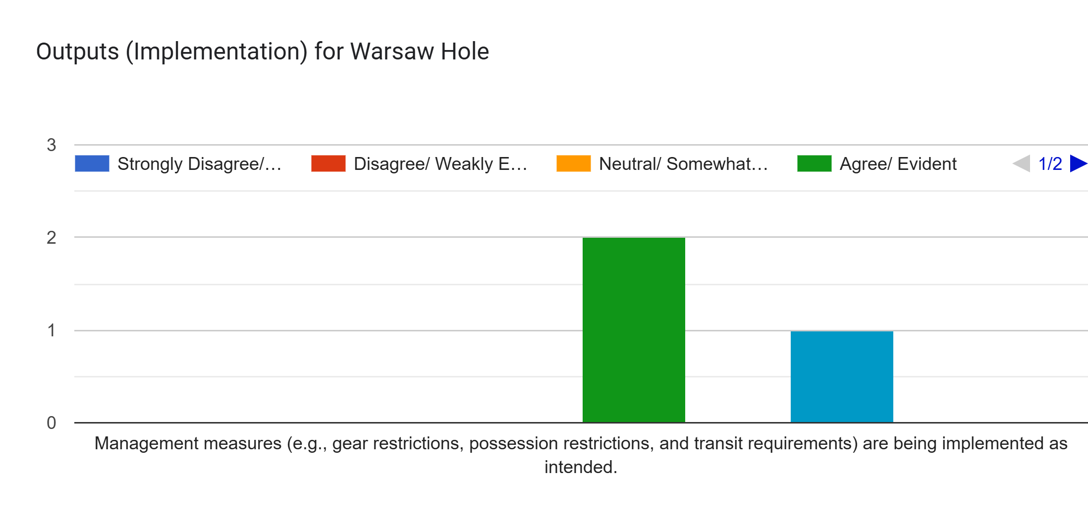
Warsaw Hole

Slide 15
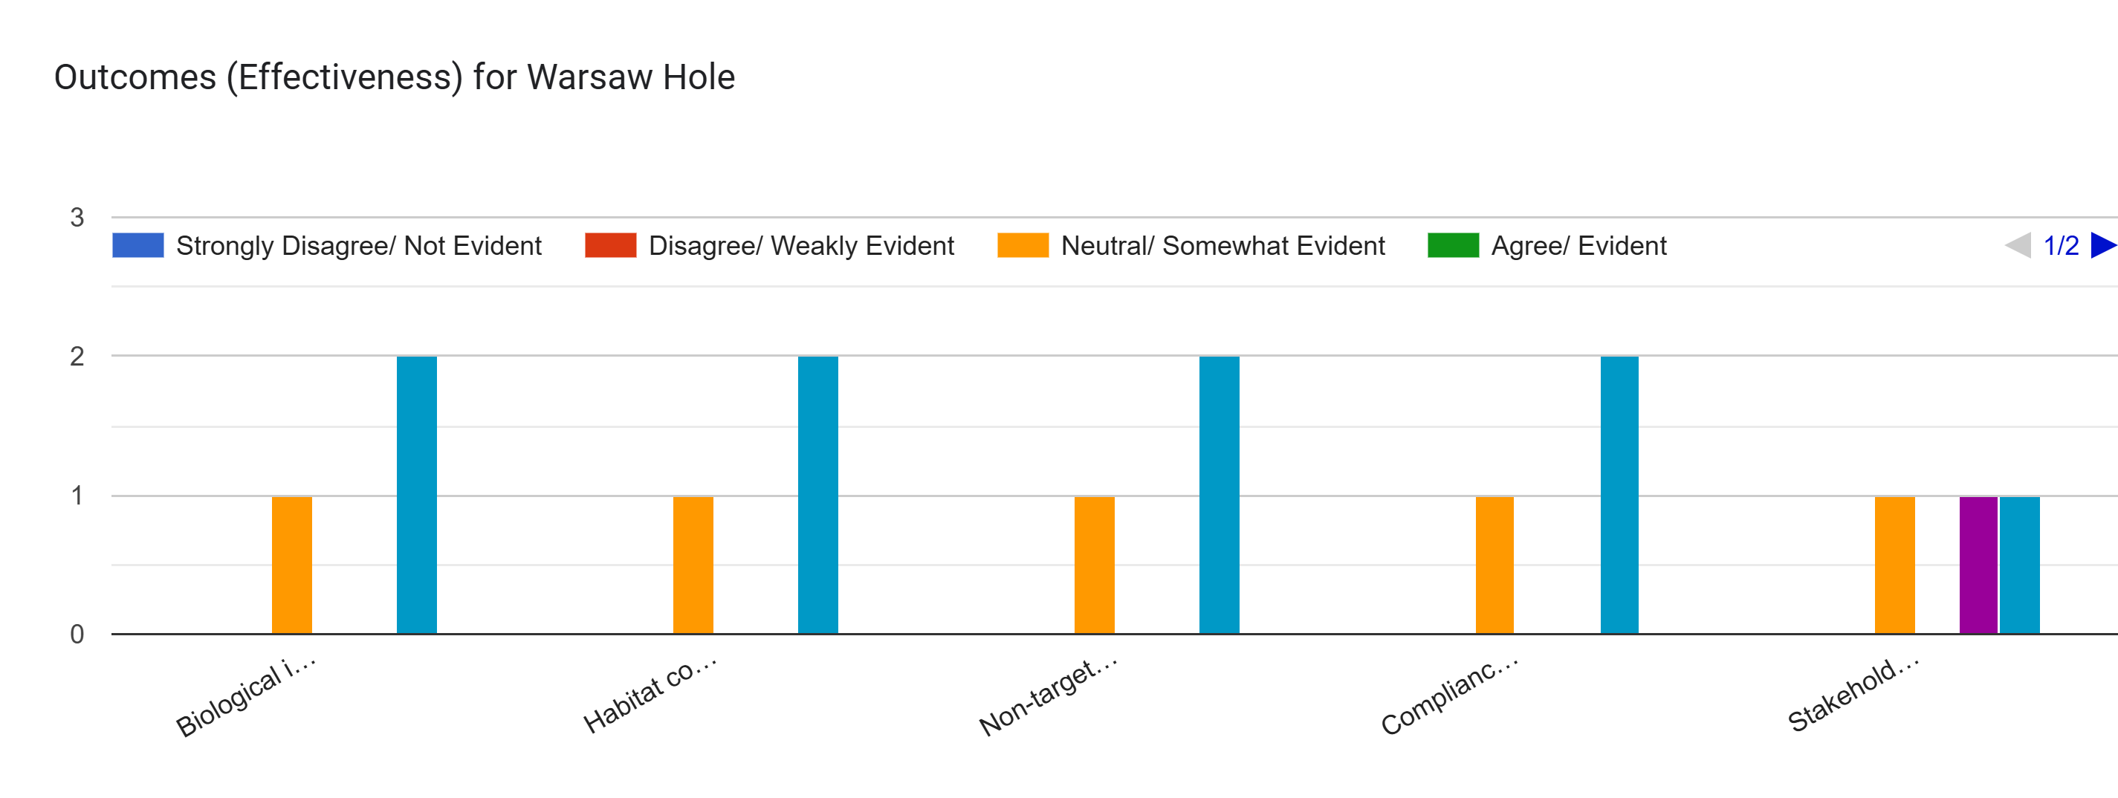
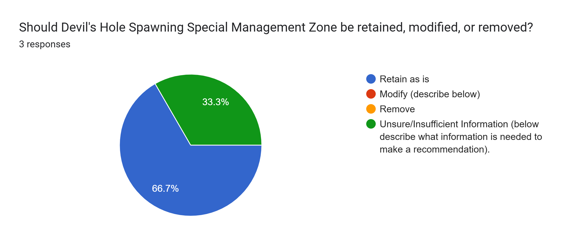
Warsaw Hole

Slide 16
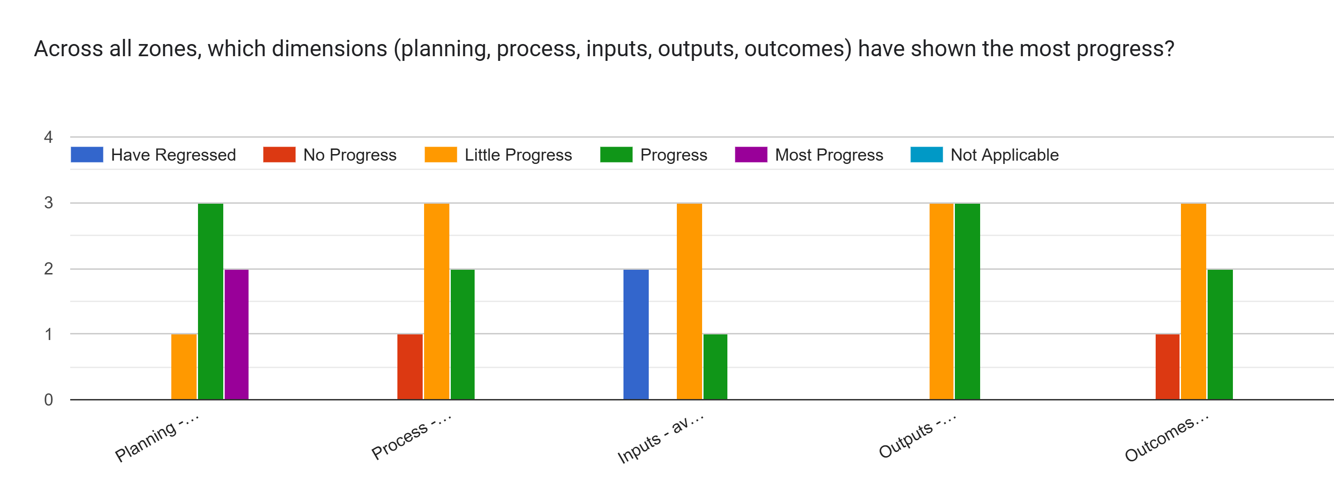
Cross Area Comparison

Slide 17
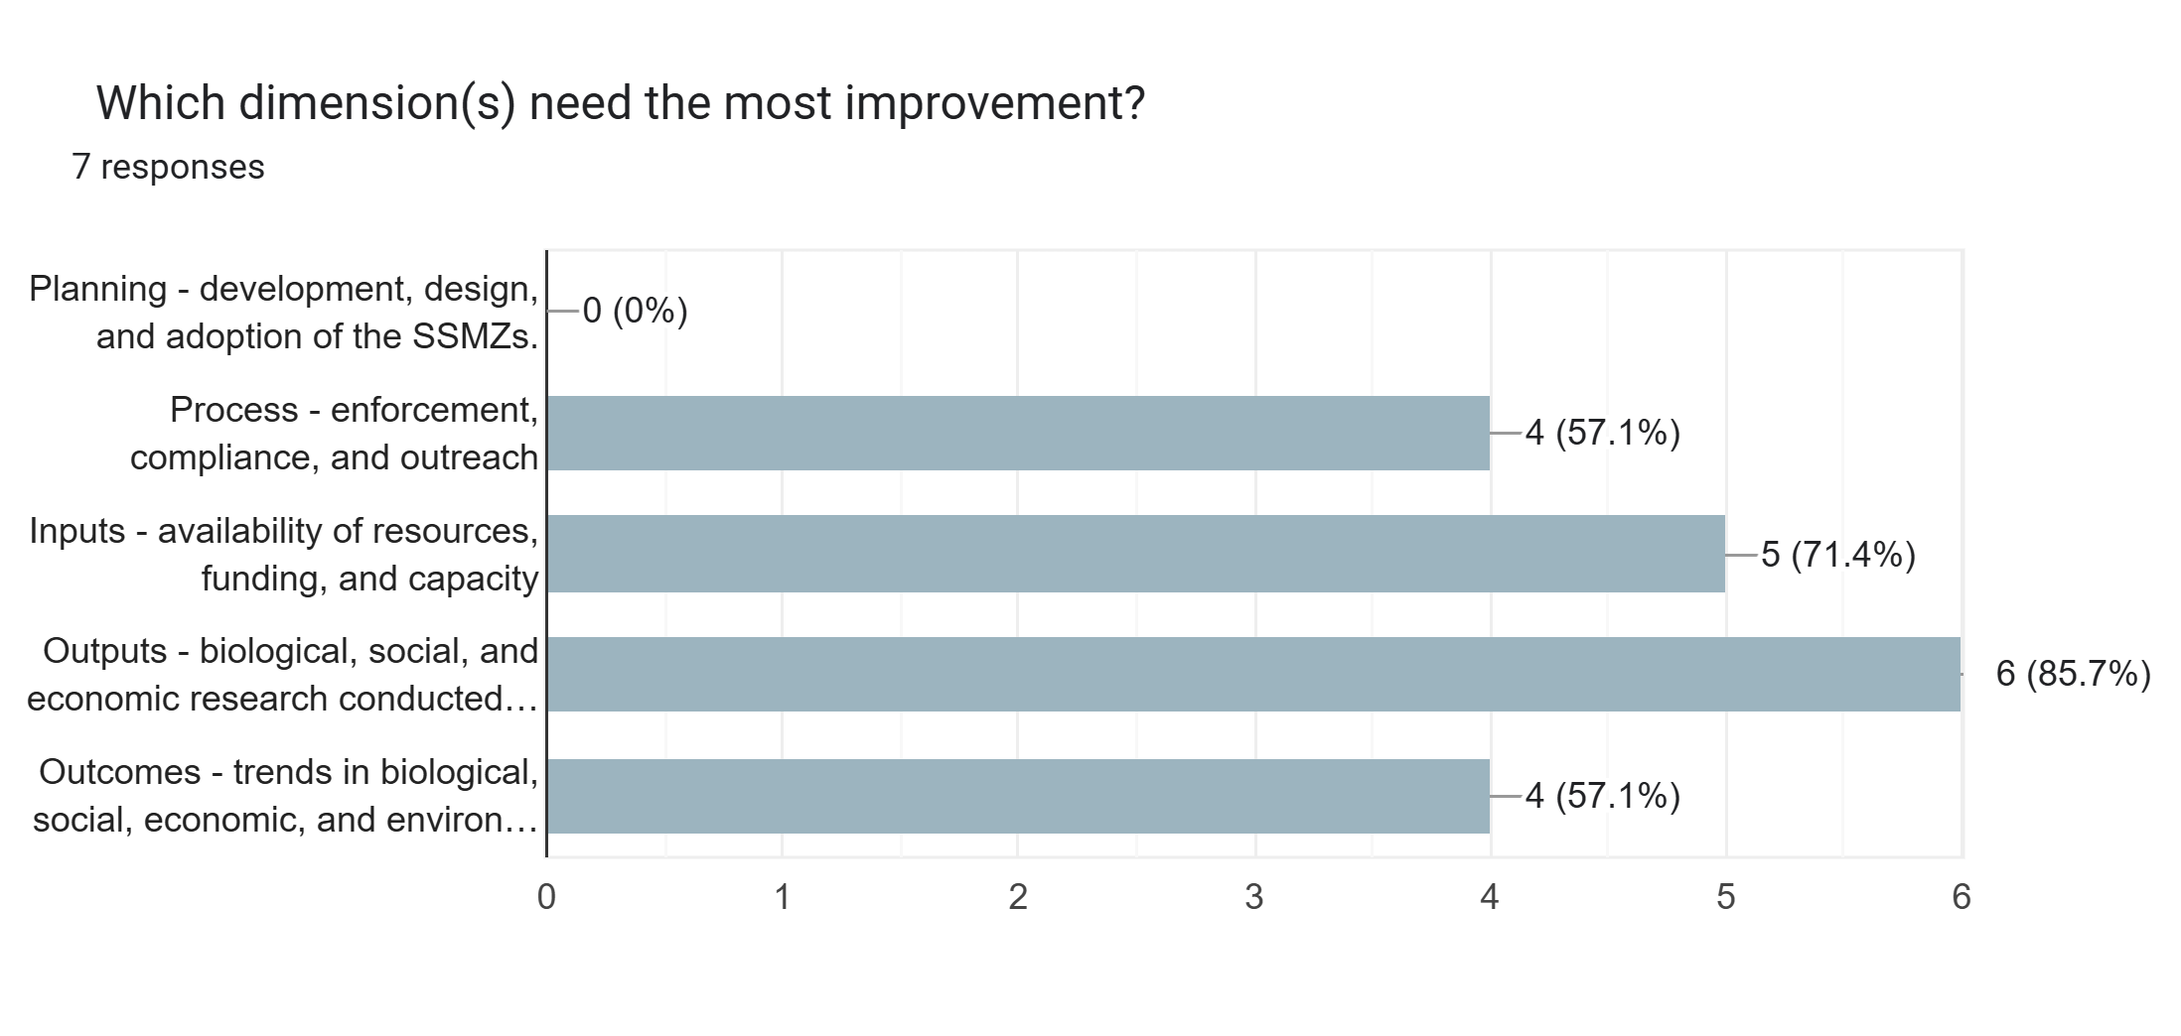
Cross Area Comparisons

Slide 18
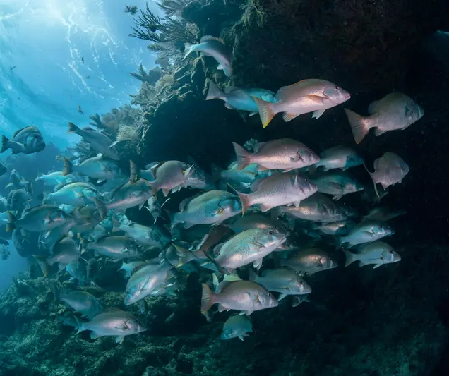
Reasons for Improvement
Areas are isolated
Insufficient information
  Compare with other nearby areas
  More data will increase interest
Priorities
  Funding for data collection/monitoring
  Enforcement and Compliance
  Outreach and Education
Credit: SC Sea Grant Consortium

Slide 19
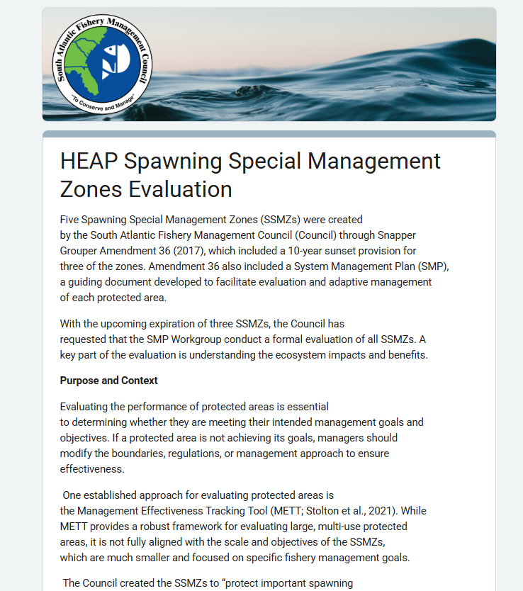
Next Steps
Work with SMP to complete full evaluation
Gather information from other advisory groups
Develop a report that includes input from all advisory groups
Present to Council

