Slide 1
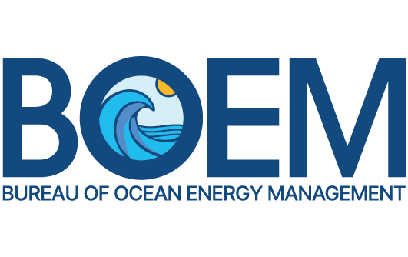
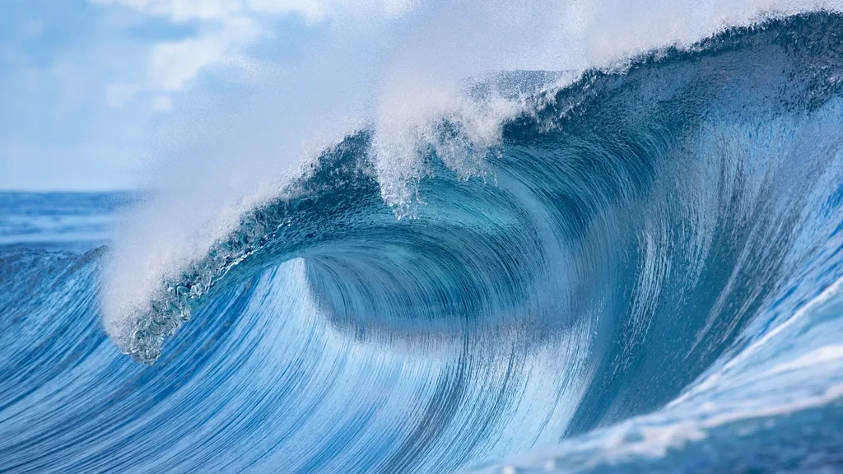
Offshore Development Review
Dr. Christian Commander
Marine Ecologist, BOEM

Slide 2
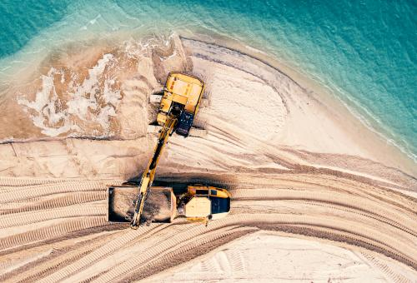
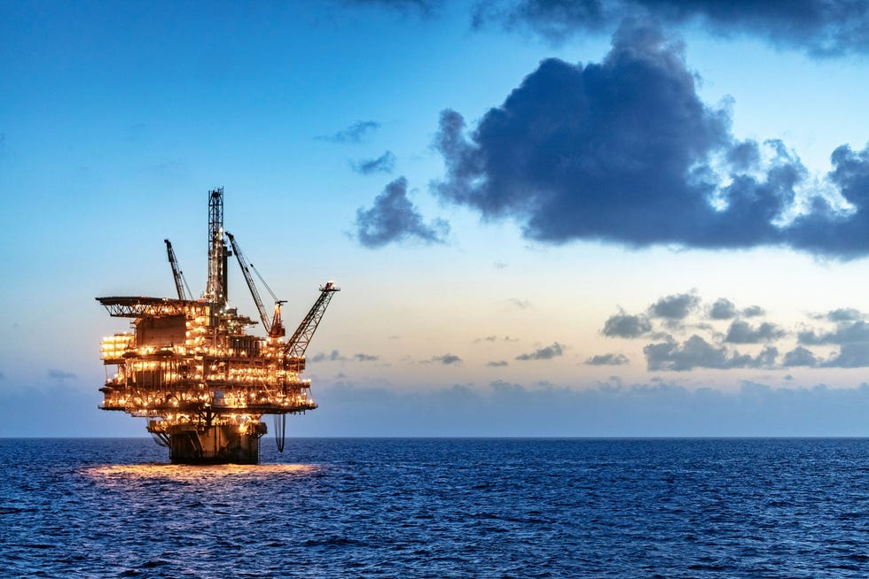
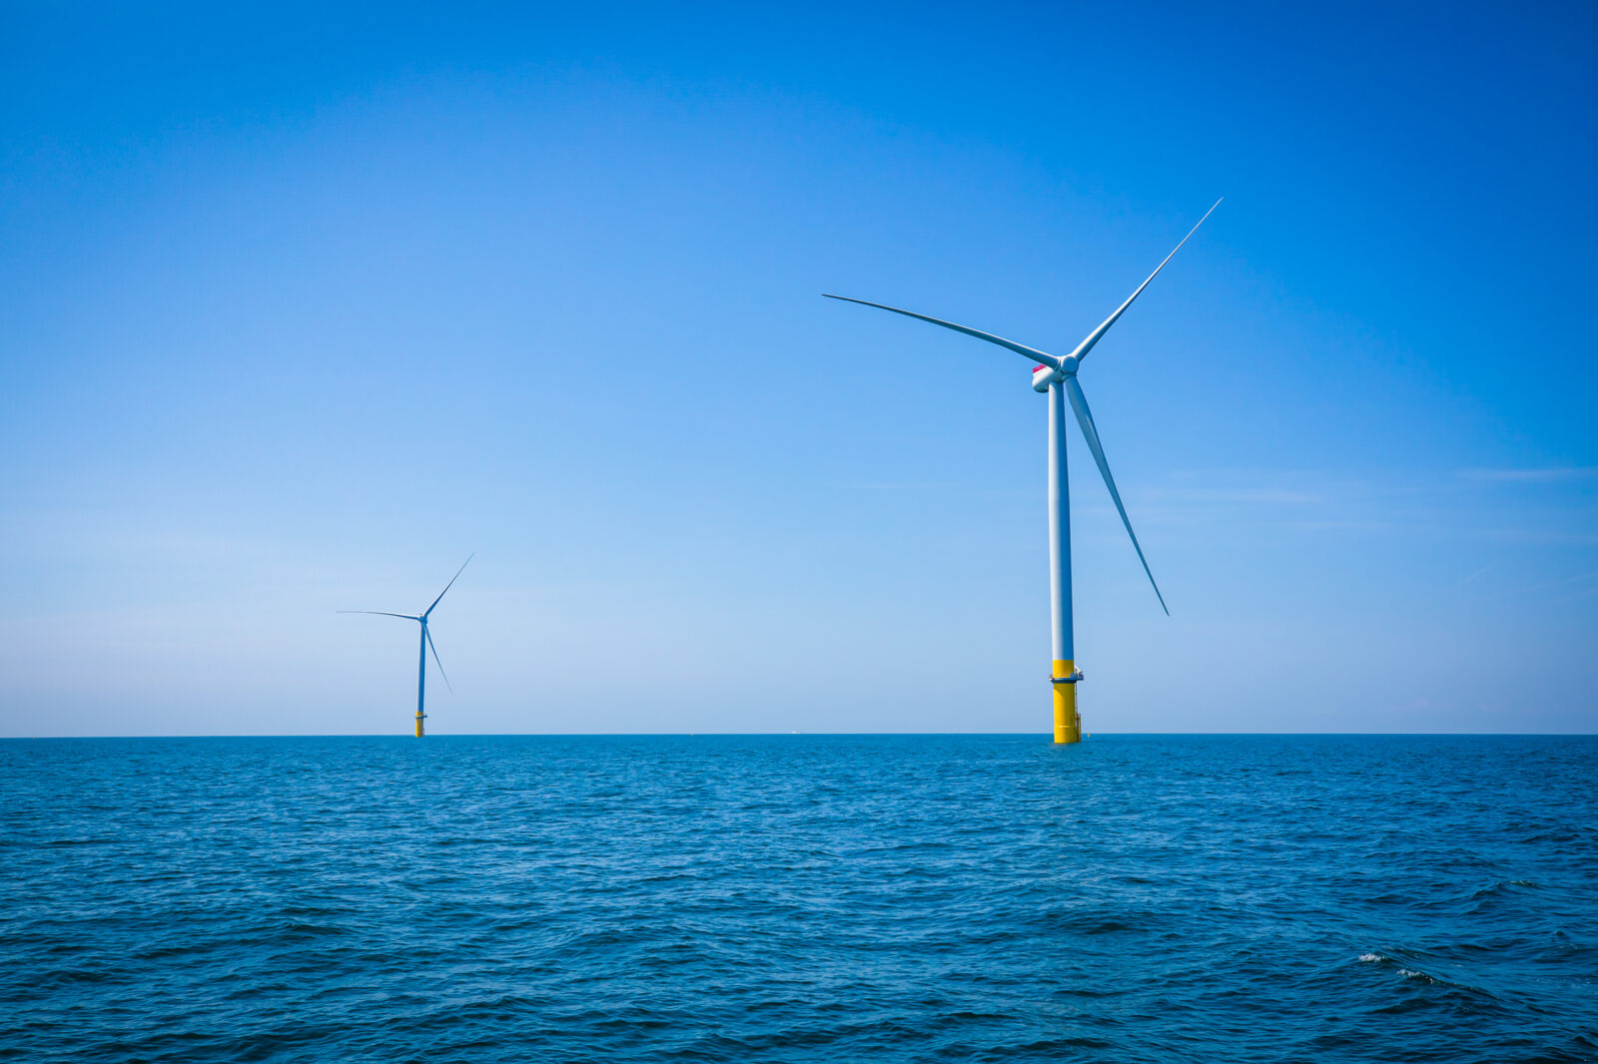
Outline
Recent updates and current research:
  Marine Minerals
  Oil & Gas
  Offshore Wind

Slide 3
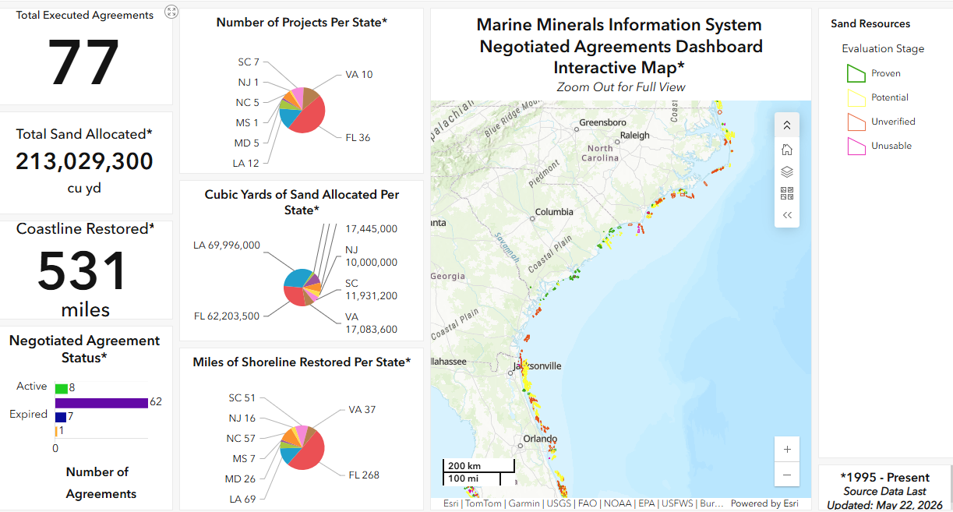
Marine Minerals – Overview

Slide 4
Marine Minerals – Recent Requests and Active Projects
Project | Applicant(s) / Party(ies) | Project Area | Volume Requested (cubic yards) | Status
Sandbridge Beach Erosion Control and Hurricane Protection Project | City of Virginia Beach, VA and USACE | 5 miles | 2,350,000 | Recent Request
Town of Oak Island Renourishment Project | Town of Oak Island, NC | 8.9 miles | 2,900,000 | Active Project – Has Begun
South Ponte Vedra Beach Nourishment Project | St. Johns County, FL | 5.5 miles | 2,100,000 | Active Project – Not Started

Slide 5
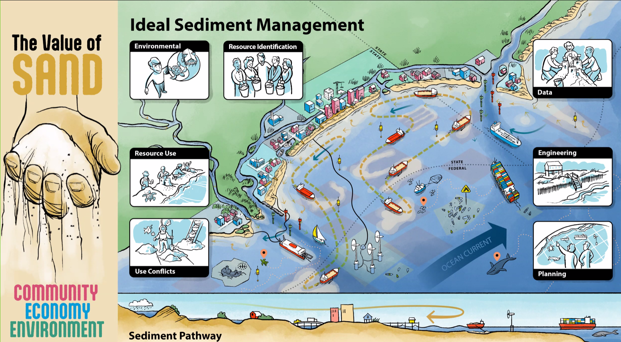

Slide 6

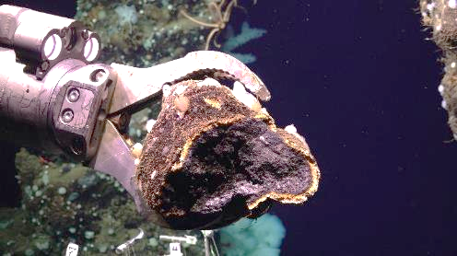
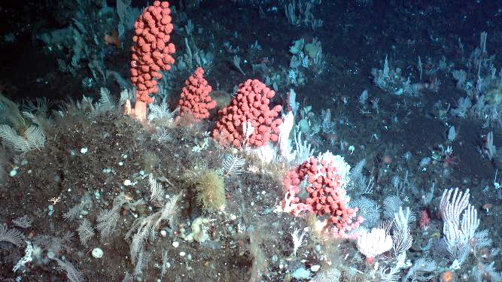
Marine Minerals – Research
National Academy of Sciences Study
Developing a Critical Minerals Environmental Assessment Framework for critical minerals activities
Co-Partner: NOAA
Status:
  Committee selection complete
  Final Report due ~Jan. 2027

Slide 7
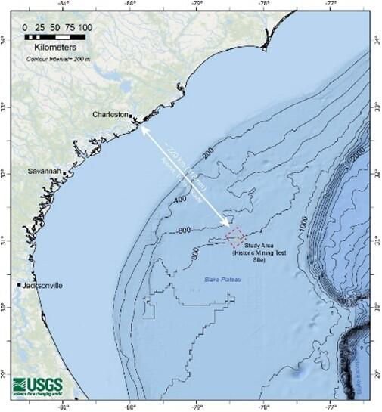
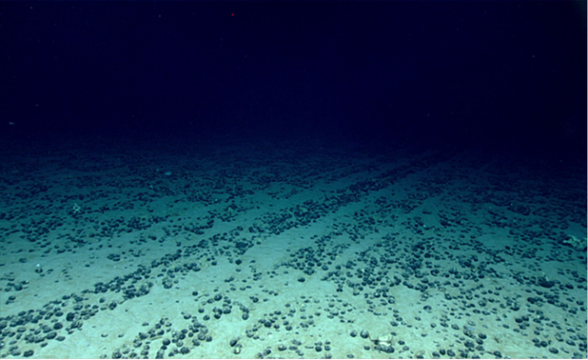
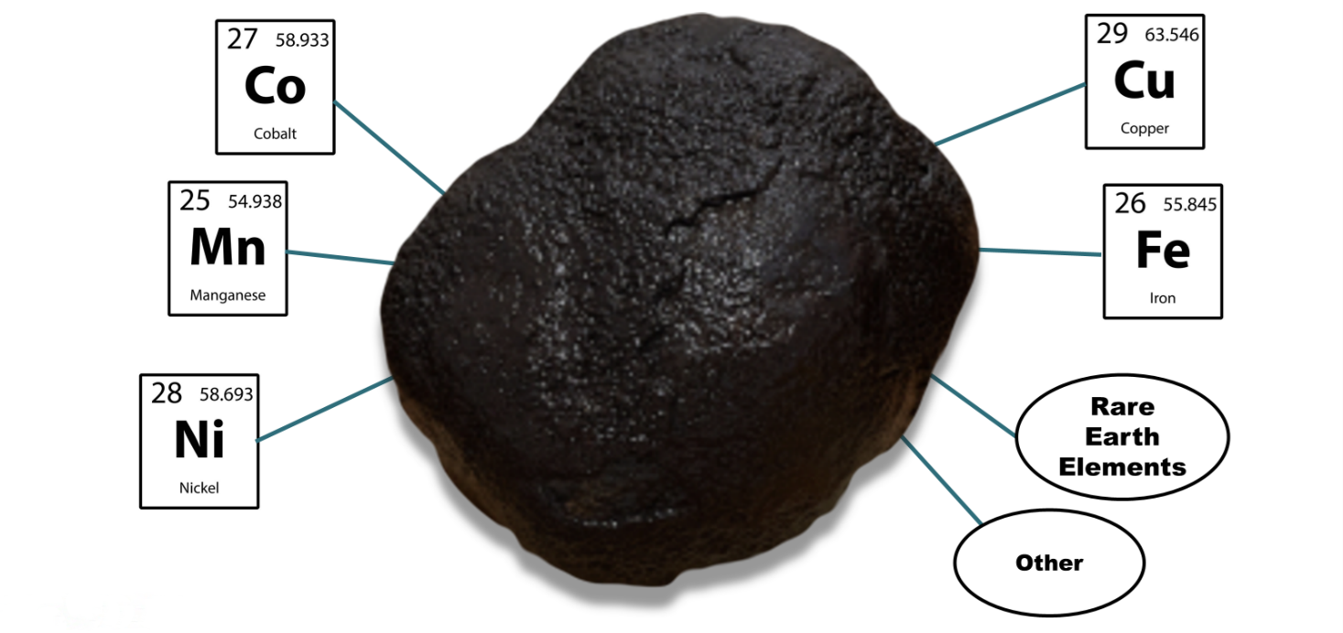
Marine Minerals – Research
Analysis of an historic deep-sea mining test site on the Blake Plateau
  Past polymetallic nodule harvesting
Opportunity to study long-term environmental impacts of deep-sea mining-related disturbance
ROV sampling: water characterization, geological sampling, biological sampling (eDNA, ecological community analysis)
Expedition in 2026 or 2027

Slide 8
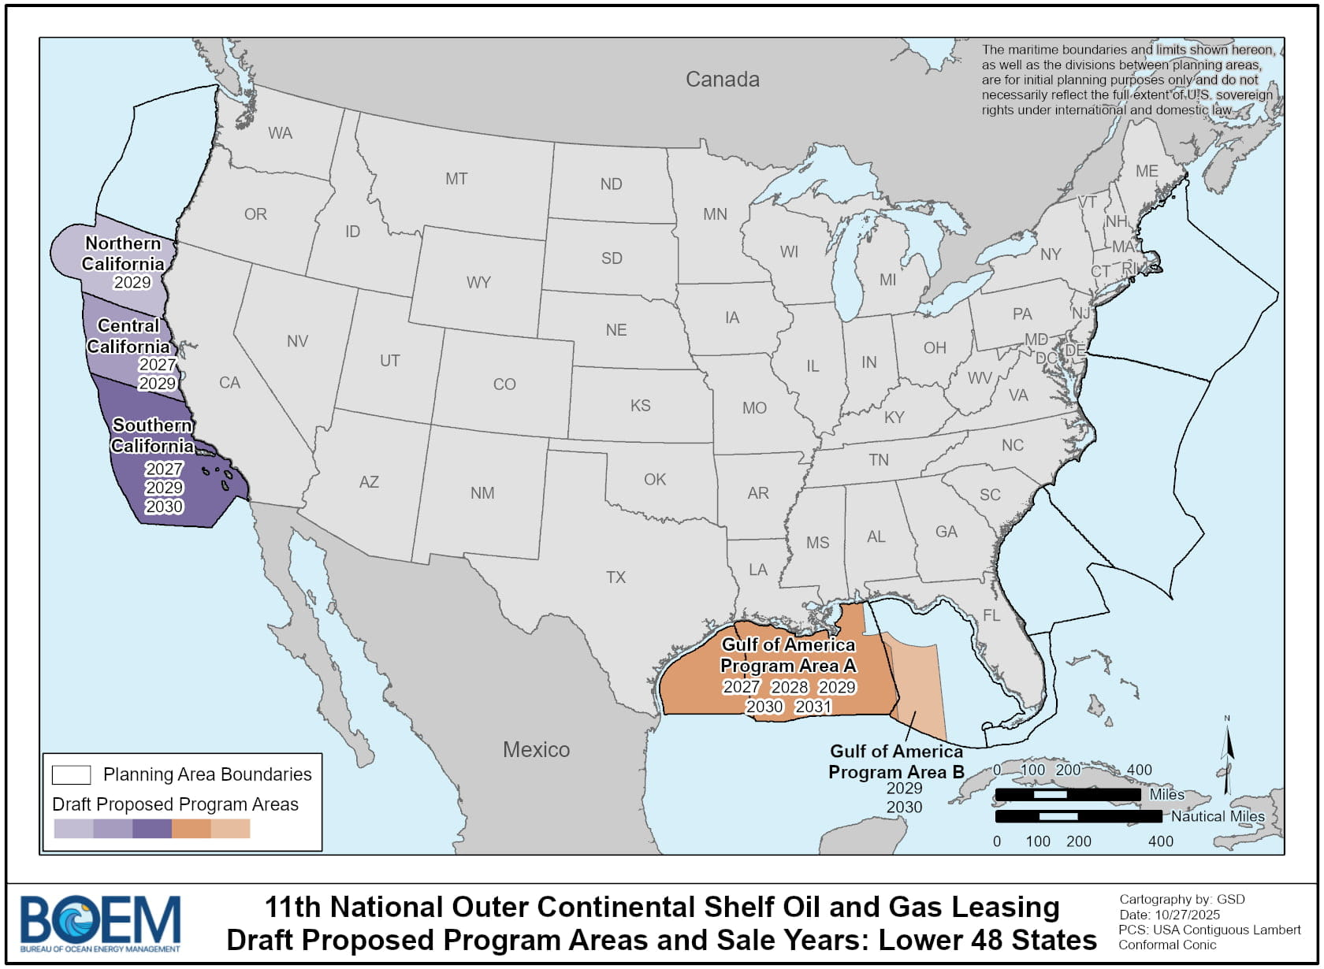
Oil & Gas – Development of the 11th National Oil and Gas Leasing Program
d
Request for Information and Public Comments – June 2025
  RFI for all 27 planning areas
1st Analysis & Proposal (Draft Proposed Program) – Jan. 2026
  Analysis of all 27 planning areas
2nd Analysis and Proposal (Proposed Program) – Pending
  Presents analysis of the 1st Proposal
More info at: www.boem.gov/oil-gas-energy

Slide 9
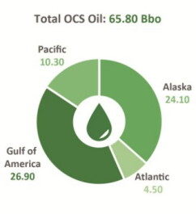
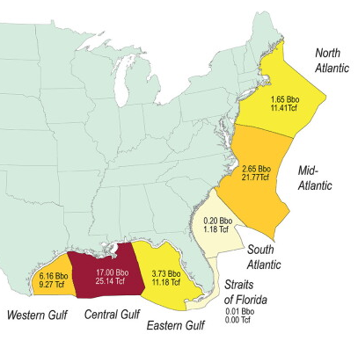
Oil & Gas – Research
National Assessment of Undiscovered Oil and Gas Resources on the OCS
  Released March 2026
  Represents BOEM’s current understanding of the distribution of undiscovered oil and gas resources
  Provides an updated technical reference for ongoing OCS planning activities
  More detailed information available in separate regional reports
More info at: www.boem.gov/oil-gas-energy

Slide 10
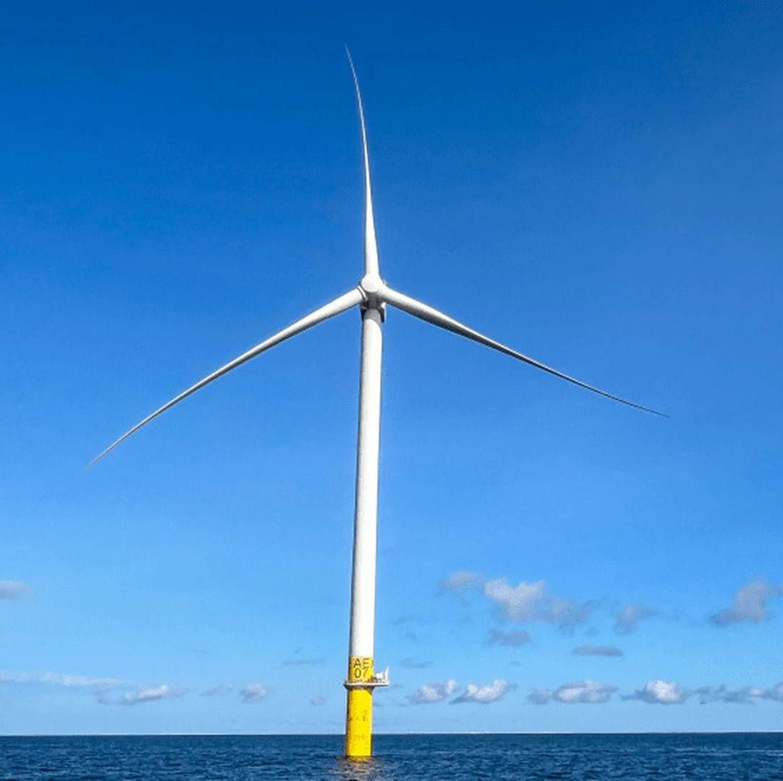
Offshore Wind – Project Overview
Carolina Long Bay (CLB)
  Project cancelled via settlement agreement between the U.S. and TotalEnergies
Kitty Hawk Wind
  Kitty Hawk North cancelled and sold to Dominion Energy
  Kitty Hawk South environmental review and permitting status paused
Coastal Virginia Offshore Wind Project (CVOW)
  Wind turbine foundation installation complete

Slide 11
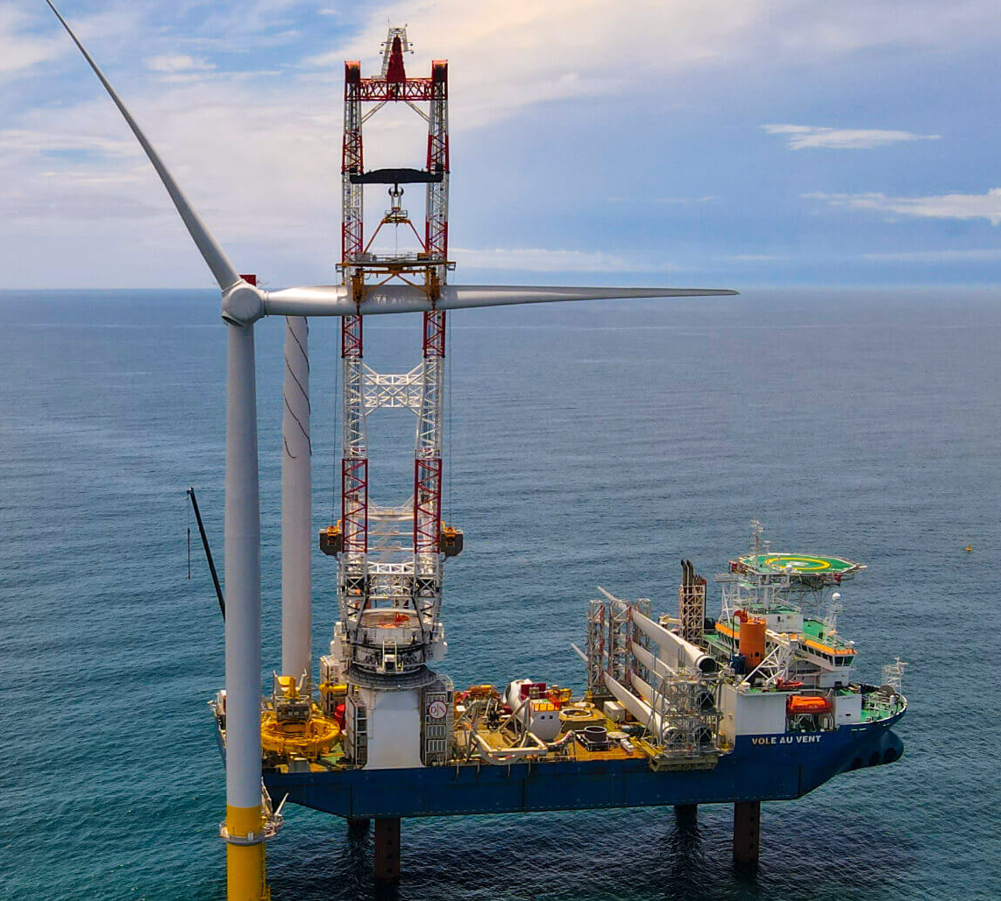
Offshore Wind – CVOW
In September 2025, CVOW finished installing the last of its wind turbine foundations
Will be the largest offshore wind farm in the U.S.
  176 wind turbines (2.6 GW)
Began delivering power to the grid on March 23, 2026
Project completion expected in early 2027

Slide 12
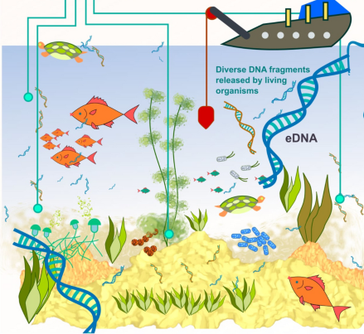
Offshore Wind – Research
Develop eDNA protocols for measuring biodiversity in areas associated with offshore energy development
Develop near-real time species detection and scalable at-sea collections
Build eDNA database
Produce pipelines for targeted species identification
Assess ecological community structure

Slide 13
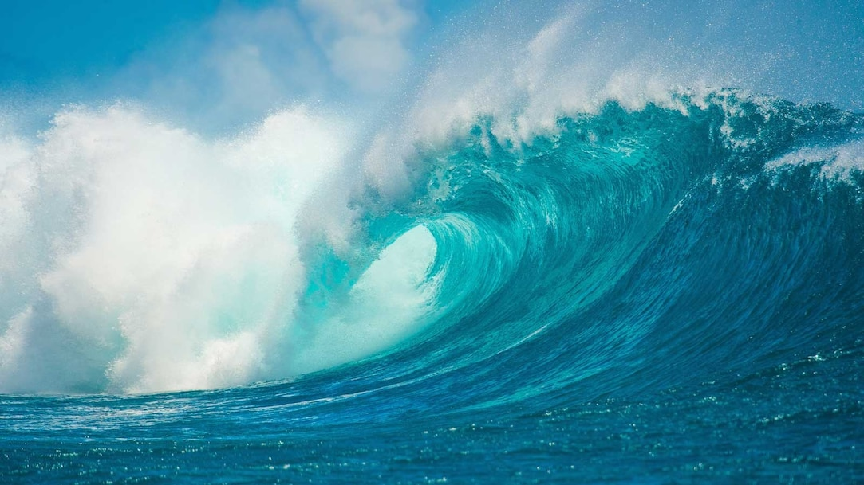
Thank You

