Slide 1
Information and Education Advisory Panel
October 10th and 11th
Kathleen Cook Hollowell Howington Kathleen.Howington@safmc.net
864-431-3005
843-571-4366

Slide 2
Electronic Reporting Amendment - Overview
Outreach for For-Hire Captains
Outreach for Law Enforcement Officers
Project Activities
Future Steps
Notes:
The Council has to implement regulations to end overfishing immediately and rebuild the stock.

Slide 3
Electronic reporting: What and Why
E-Reporting: when fishermen self report daily fishing efforts via electronic devices
Federal Charter fishermen in the Southeast US
do not currently have a reporting system:
Marine Recreational Information Program (MRIP)
Uncertain management decisions
Better data means better understanding of species, more accurate models, and more informed management decisions.
Electronic reporting has been shown to:
Increase accuracy of data by removing estimates
Near real time data can be available
No legibility issues that are common to paper forms
No recall bias due to quick reporting time
Confidence in data is improved
Notes:
Add in image http://www.nmfs.noaa.gov/op/snippets/em_er_discussion_draft_august_2013.pdf, https://www.accsp.org/sites/default/files/ACCSP_ValueofElectronicReporting.pdf,

Slide 4
Amendment 39 to the Fishery Management Plan for the Snapper Grouper Fishery of the South Atlantic Region
Amendment 9 to the Fishery Management Plan for the Dolphin and Wahoo Fishery of the Atlantic
Amendment 27 to the Fishery Management Plan for the Coastal Migratory Pelagics Fishery of the Gulf of Mexico and Atlantic Region

Slide 5

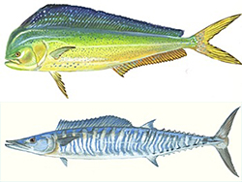

All charter vessel operators with a federal for-hire permit
Snapper Grouper Dolphin Wahoo Coastal Migratory Pelagic
Will be required to report fishing data via a NMFS certified reporting tool
On a Weekly basis
Amendment approved by Council – Dec 2016
Under Review by NMFS – in progress
Anticipated implementation – 2018

Slide 6
Future Reporting Requirements
Captain ID | Vessel ID
Start and end date of trip | Start and end time of trip
Start and end location (port) | Hours within the trip fished
Number of crew | Number of anglers
Average depth fished (can be a range) | Location of fishing
Target Species (can be categories or groups) | All species caught
Number of each species kept | Number of each species released
Gear used | Charter fee
Fuel used | Cost of fuel (per gallon)
Did not fish days

Slide 7
Objectives of the outreach project: Year 1 objectives
Develop partnership with ACCSP, States, and Harbor Light Software, Inc.
Develop Outreach Targeting For-Hire permit holders/captains
Training toolkit
tablet-based app
online video training modules
fact sheets
user’s manual
Project webpage
Pre-implementation training
quarterly webinars
in-person sessions
Develop Outreach for Law Enforcement Officers on Electronic Reporting
Electronic Reporting compliance mobile app
Quarterly webinar training

Slide 8
Objectives of the Outreach project: Year 2 objectives
Continue Outreach
Continue quarterly training sessions
for-hire captains
law enforcement officers
Develop a 24/7 Help Desk for captains to troubleshoot reporting issues
SAFMC Fishermen Forum discussion board

Slide 9
eTrips Mobile Application Pilot Project
ACCSP, Harbor Light Software, and states
Tablet Based application for trip reporting
Data collection from actual trips has begun and is ongoing
As of 9/25/17
Possible NMFS Approved application
State | Participants | Trips Logged
NC | 5 | 150
SC | 4 | 49
GA | 3 | 77
FL | 6 | 84
Total | 18 | 360

Slide 10



eTrips

Slide 11
Project Activities to date- Training Toolkit
Video testimonials from captains in pilot - coming soon to project webpage
Online video training modules – coming soon to Council’s YouTube channel and project webpage
User’s Manual – How-To-Guide for using eTrips; coming soon to project webpage
Fact Sheets – under development
Other Resources – Laminated tally sheet

Slide 12
Webpage
http://safmc.net/satl-federal-for-hire-electronic-reporting-outreach/

Slide 13
Finished Trainings
September 18th webinar
7 registrants
5 attendees
Purpose
provide information about the amendment
tablet application trainings
setting up user accounts
Lessons learned
Make the webinar registration more obvious on webpage (1 registrant did not attend due to inability to find link)
Emphasize inperson training dates

Slide 14
Future Trainings
In person Trainings
SC: 3, October 24-26th
Murrels Inlet
Cahrleston
Bluffton
GA: 2, November 14th-15th
Brunswick
Savannah
NC: 3, TBD
FL: 4, TBD

Slide 15
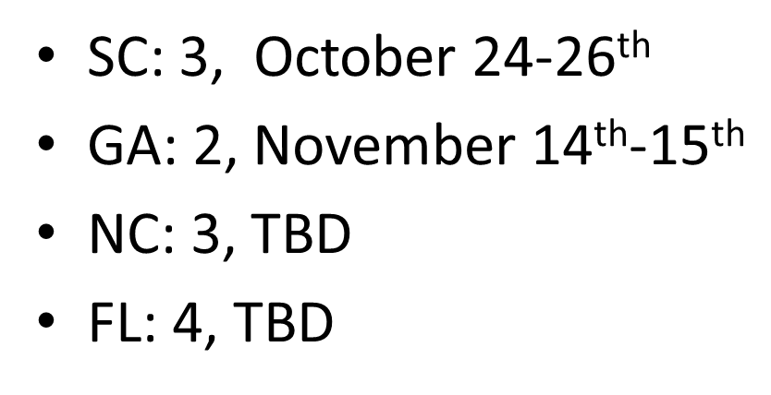
In Person Training Content
Technical assistance
Account assistance
Amendment background
Updates on amendment approval
eTrips
SAFIS
State representative input (content will vary)
Hands on trainings with tablets and computers

Slide 16
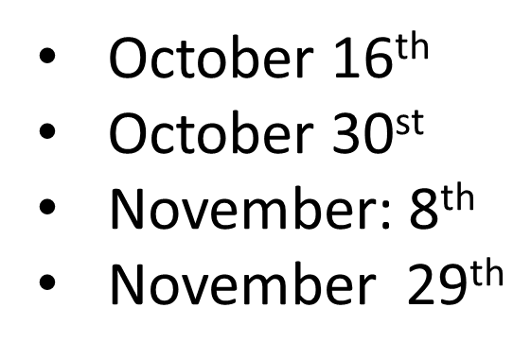
Webinar Content
Amendment background
Updates on amendment approval
eTrips
SAFIS
Question and Answer

Slide 17
Future Objectives of the outreach project
Continue outreach via webinars and electronic resources
Continue quarterly training sessions for for-hire captains
Law enforcement
Application is in development
Finalize app
Get feed back from Law enforcement officials
Develop training materials for electronic reporting compliance mobile app
Pre-implementation training via monthly video webinars
Develop a 24/7 Help Desk for captains and law enforcement to troubleshoot reporting issues
SAFMC Fishermen Forum discussion board

Slide 18
AP Input – Suggestions for Outreach
Any additional outreach materials needed?
Social media – how to connect?
State specific needs?
Incentives for attending training?

