Slide 1
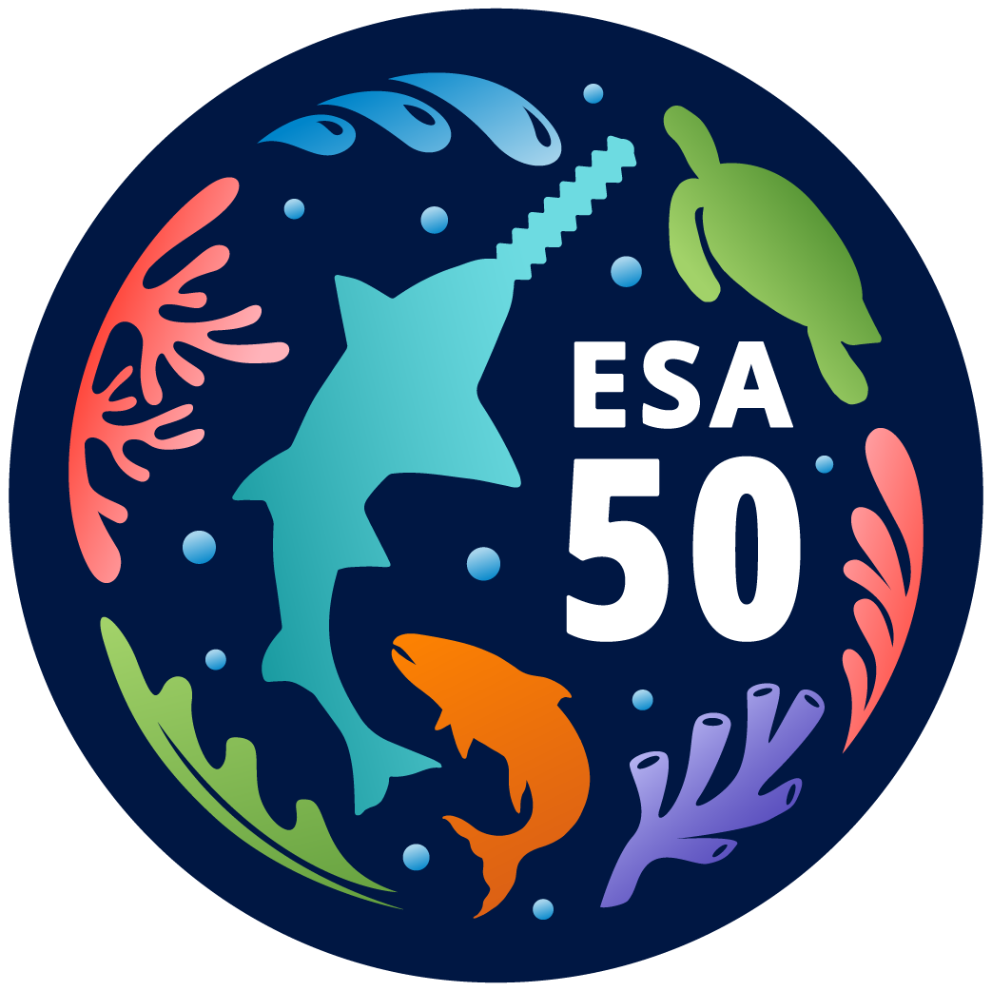
Reinitiation of ESA Section 7 Consultation
on the Authorization of the Southeast U.S. Shrimp Fisheries in Federal Waters:
Giant Manta Ray and Shrimp Trawl Interactions
South Atlantic Fishery Management Council Deepwater and Penaeid Shrimp APs Meeting
April 25, 2024
Jennifer Lee
Southeast Regional Office
Protected Resources Division (PRD)

Slide 2
Presentation Overview
The 2021 Biological Opinion
Reinitiation of Section 7 Consultation
Requirements/Reasons/Scope
Giant Manta Ray Species Primer
Giant Manta Ray Trawl Effects, Bycatch Data, and New Information
Smalltooth Sawfish Species Primer
Smalltooth Sawfish New Information
Next Steps and Timing
What You Can Do Now?

Slide 3
The 2021 Shrimp Biological Opinion
Analyzed effects of ESA “TED regs” and authorization of southeast US. shrimp fisheries managed under the Magnuson-Stevens Act (i.e., the proposed action)
Determined the proposed action is not likely to jeopardize the continued existence of sea turtles, sturgeon, giant manta ray, and smalltooth sawfish.
Issued an incidental take statement (ITS) specifying the amount of anticipated incidental take for listed species over 5- year monitoring periods.
*Giant manta rays and smalltooth sawfish 5-year takes:
*Highly uncertain estimates. Smalltooth sawfish extrapolated from 17 sawfish captures over 12 years; assumed 50% mortality rate. Giant manta ray were extrapolated from 8 captures in one year; no giant manta ray mortalities anticipated because there were no lethal records at that time (Carlson 2020).

Slide 4
Section 7 Reinitiation Requirements
Reinitiation of ESA formal Section 7 consultation required if discretionary involvement or control over the action has been retained (or is authorized by law) and:
The amount or extent of the taking specified in the ITS is exceeded.
New information reveals effects of the action that may affect listed species or critical habitat (when designated) in a manner or to an extent not previously considered.
The identified action is subsequently modified in a manner that causes an effect to listed species or critical habitat that was not considered in the biological opinion.
A new species is listed or critical habitat designated that may be affected by the identified action.

Slide 5
Reasons For Reinitiation and Scope
The amount or extent of the taking specified in the incidental take statement is exceeded
Since the 2021 Shrimp Opinion was completed, giant manta ray mortalities have been observed.
Lethal takes have only been confirmed in the Gulf of Mexico, but take records in the South Atlantic Region include several giant manta rays caught where the disposition was unknown.
New information reveals effects of the action that may affect listed species in a manner or to an extent not previously considered
Recent take data may constitute new information revealing effects of southeast shrimp fisheries on giant manta rays not considered in the 2021 Shrimp Opinion.
New publications contain information revealing effects of southeast shrimp fisheries on giant manta rays and smalltooth sawfish not considered in the 2021 Shrimp Opinion.
SCOPE: At this time, no triggers have been met for any of the other species, so consultation limited to addressing only the above two species and their management under the Gulf and South Atlantic Shrimp FMPs and their implementing regulations.

Slide 6
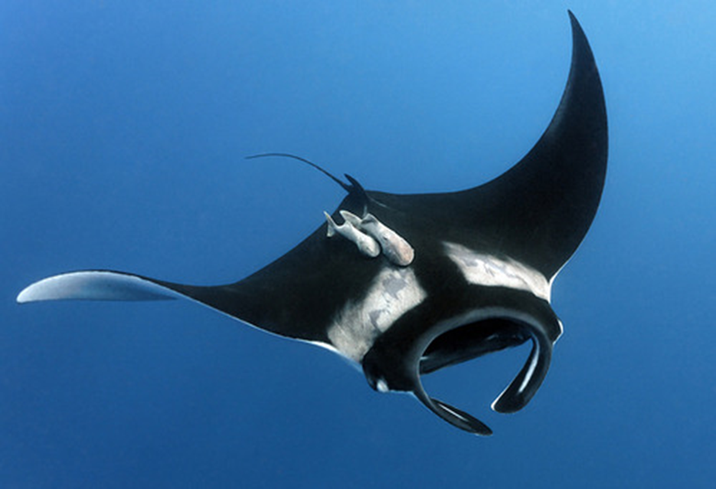
Giant Manta Ray
Life History
Largest ray in the world with wingspans up to 29 feet (8.8 m) wide. Average size 13 ft (4 m).
Sexual Maturity estimated 8-10 yrs.
Low fecundity, 1 pup every 2-3 years.
Juvenile nursery areas: Flower Garden Banks National Marine Sanctuary (Stewart et al. 2018); coastal Southeast Florida (Pate et al. 2020).
Population Status and Size
Listed as Threatened under the ESA in 2018 (83 FR 2916) - Overfishing (foreign) and bycatch are major threats contributing to the decline. Low reproductive output make them inherently vulnerable to depletions, with low likelihood of recovery.
Global population size is unknown (3 published regional total abundance estimates: 600 Mozambique, 1,875 Raja Ampat, and 22,000 in Ecuador/Peru).

Slide 7
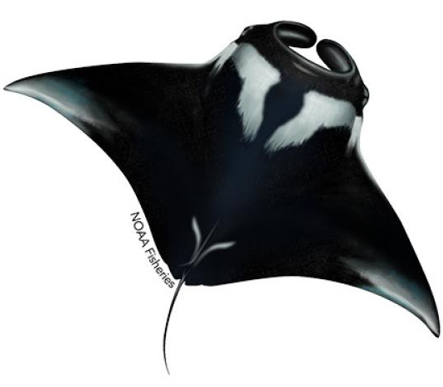
Giant Manta Ray
Feeding Habits and Habitat
Planktivorous / Filter-feeders.
Unique feeding strategies (e.g., barrel rolling, creating feeding chains).
Aggregate in various locations in groups usually ranging from 100-1,000.
Function as feeding sites, cleaning stations, or sites where courtship interactions take place.
Wide use of water column, including feeding at the surface and night descents from 200-450 m depths; capable of diving to depths exceeding 1,000 m.
Distribution and Movements
Distributed in tropical, subtropical, and temperate oceans.
Low degree of interchange between ocean basins.
Commonly observed offshore in oceanic waters and in nearshore highly productive coastal areas; water temperatures generally between 20°C and 30°C.
Movements correspond with the zooplankton abundance, current circulation, seasonal upwelling, seawater temperature, and possibly mating behavior.

Slide 8
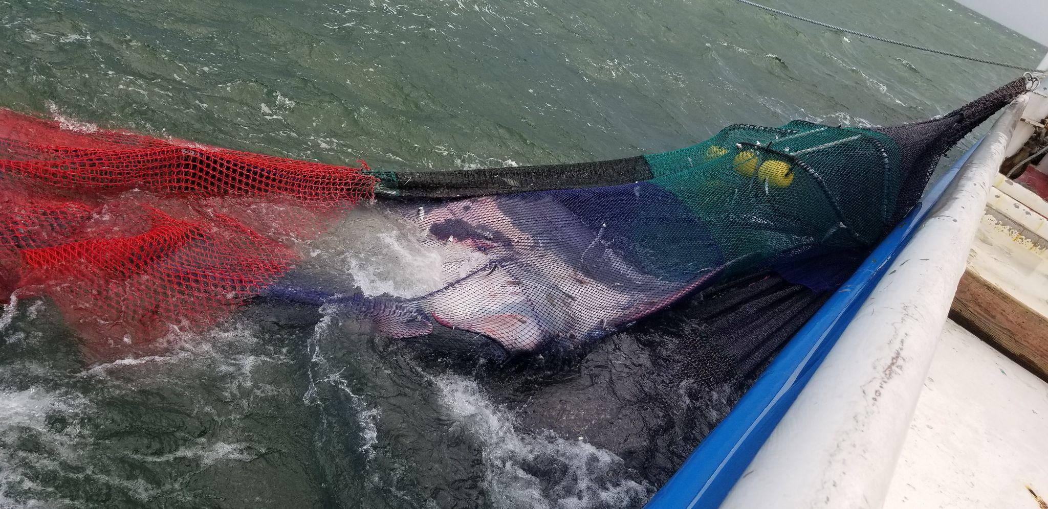
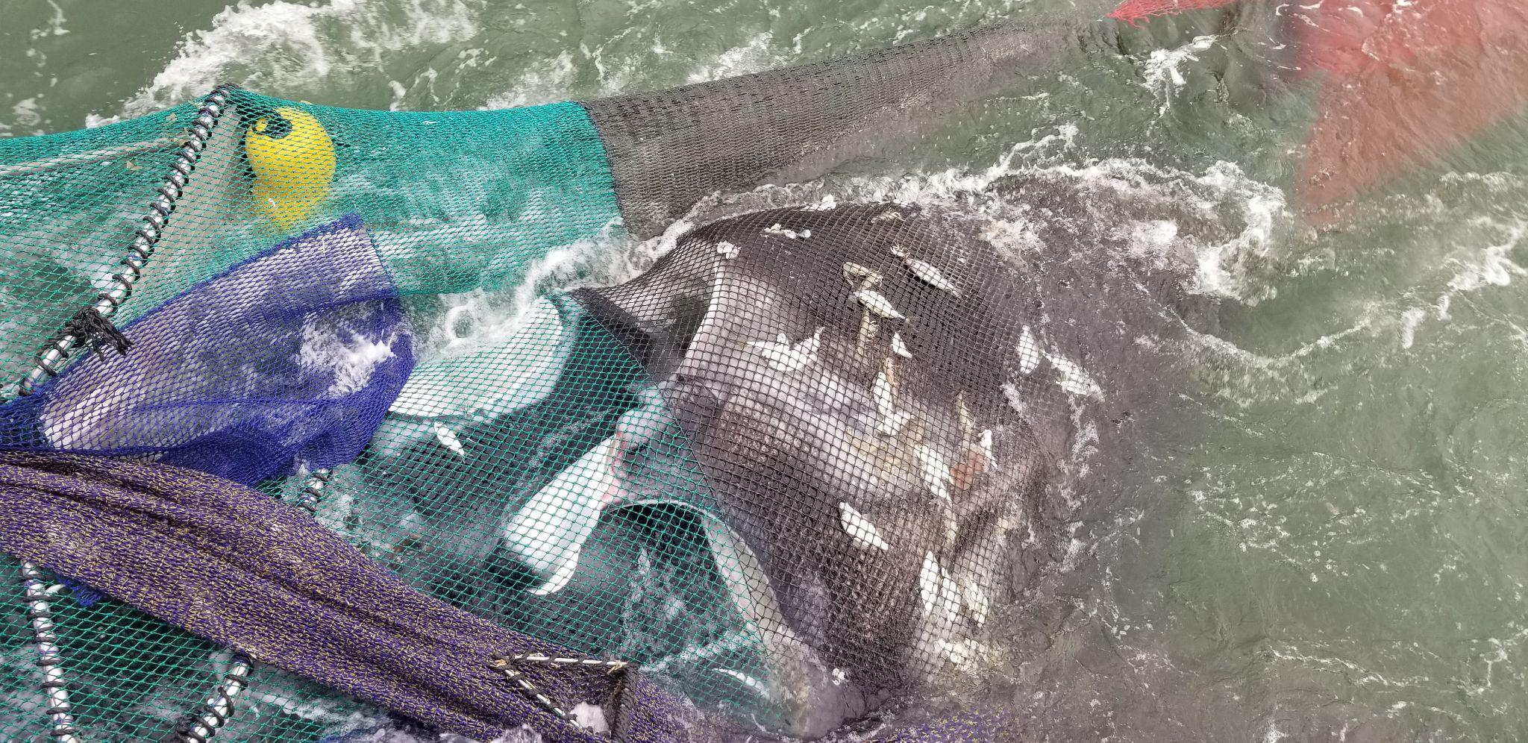
Giant Manta Ray & Trawl Effects
Mortality resulting from asphyxiation:
Obligate ram-ventilator requires constant movement to pass water over gills.
Capture in trawls severely restricts movement and respiration resulting in asphyxiation.
Injury/Stress resulting from capture:
Can directly influence ability to survive post release.
Compacted against netting or TED by weight of catch, coupled with impaired respiration decreases likelihood of survival post release.
Post release mortality is unknown.

Slide 9
Bycatch Data
Year | Disposition | Total
2019 | Released Alive | 4
2019 | Unknown | 4
2020 | Released Alive | 3
2021 | Released Alive | 5
2021 | Mortalities | 2
2022 | Released Alive | 8
2022 | Unknown | 2
2023 | Released Alive | 6
2023 | Mortalities | 2
2023 | Unknown | 1
2024 | NA | 0*
Observer Coverage = < 2%
Observed Takes (2019 – April 2024*)
26 Alive; 4 Mortalies; 7 Unknown
=Total: 37 (29 GOM; 8 SA)
Immediate Mortality Estimate
2021 Shrimp Opinion assumed no mortality based on 2019 data.
10.8% immediate mortality rate (4/37=10.8) based on approx. 5 years of data
Spatial and Temporal Observations
Gulf of Mexico interactions are occurring offshore Louisiana (n=26), followed by Alabama (n=2), and Texas (n=1). North Atlantic interactions occurred offshore Georgia (n=6) and East Coast Florida (n=2).
Most interactions occurring in Spring and Fall.
Multiple interactions occurring on a single trip and at night.
Majority of interactions at depths <100 ft.

Slide 10
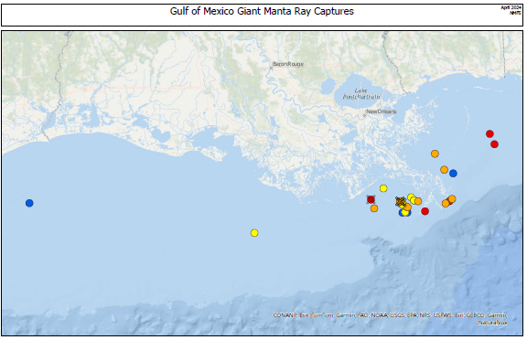

Slide 11
South Atlantic Region Shrimp Trawl Captures and Data
Importance of shore and nearshore Georgia and north-central Florida
Migration (March - May) but also observed year round
Courtship behavior, mating scars and foraging documented
Southeast Florida Juvenile Nursery Area described based on frequent observations, high site fidelity, and extend use over multiple years.
Low interactions may be a function of low observer coverage.

Slide 12
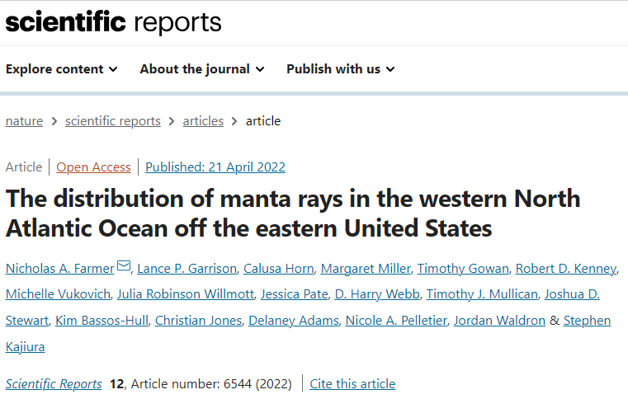
Giant Manta Ray New Information
Farmer et al. (2022):
Integrated decades of sightings and survey effort data into species distribution modeling.
Predicted the highest occurrence around the Mississippi River Delta April - June and Oct - Nov.
Predicted highest occurrence during April off Northeastern Florida, leading north to North Carolina from June - Oct, then south to Georgia from Nov - March with cooling temps.
The seasonal occurrence and location of shrimp trawl interactions are consistent with predictions made in Farmer et al. 2022.

Slide 13
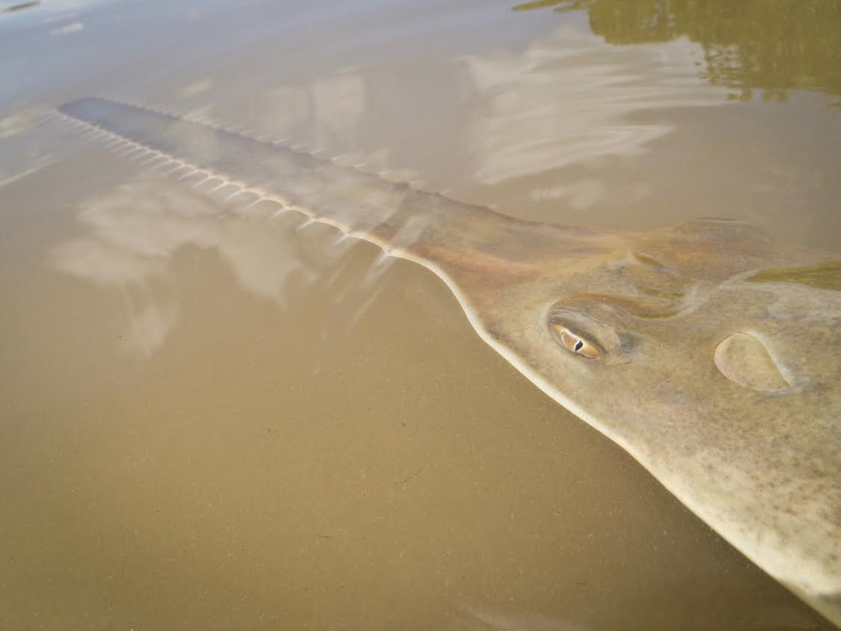
Smalltooth Sawfish (US DPS)
Life History
Live birth of 7–14 young every other year
Parturition site fidelity (mothers return to same birthing sites)
Sexual maturity estimated 7-11 yrs at length of ~12 ft
Relatively slow growing with maximum size of ~16 ft
Long lifespan ~30 years
Range
Florida - Most commonly between Peace River and Florida Keys to depths of 120 m
Population Status and Size
Listed as Endangered under the ESA in 2003 (68 FR 15674) - Bycatch and habitat loss contributed to the decline. Limited reproductive output make them inherently vulnerable to depletions and slow to recover.
Population decline during second half of 20th century (1950s–1970s)
US population size is unknown, but currently being evaluated

Slide 14
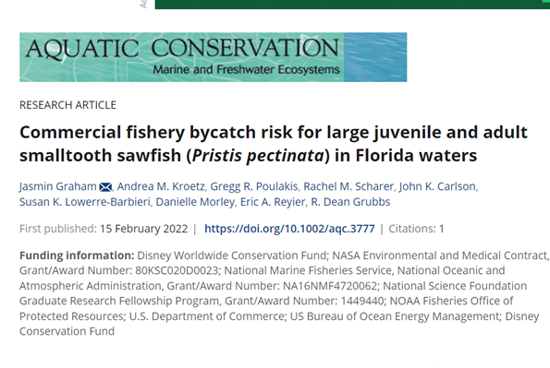
Smalltooth Sawfish New Information
Graham et al (2022)
High overlap with Shrimp fishery
Female sawfish are at a higher risk - depth
Suggestions to minimize sawfish capture and mortality:
Year-round closure of shrimp trawling off much of the Southwest Florida
Increased observer coverage
Electronic monitoring
Tow time restrictions
Feldheim et al. (2017) & Smith et al. (2021)
Only 126 individual females have birthed the majority of juveniles caught in sampled nurseries between 2000 and 2015

Slide 15
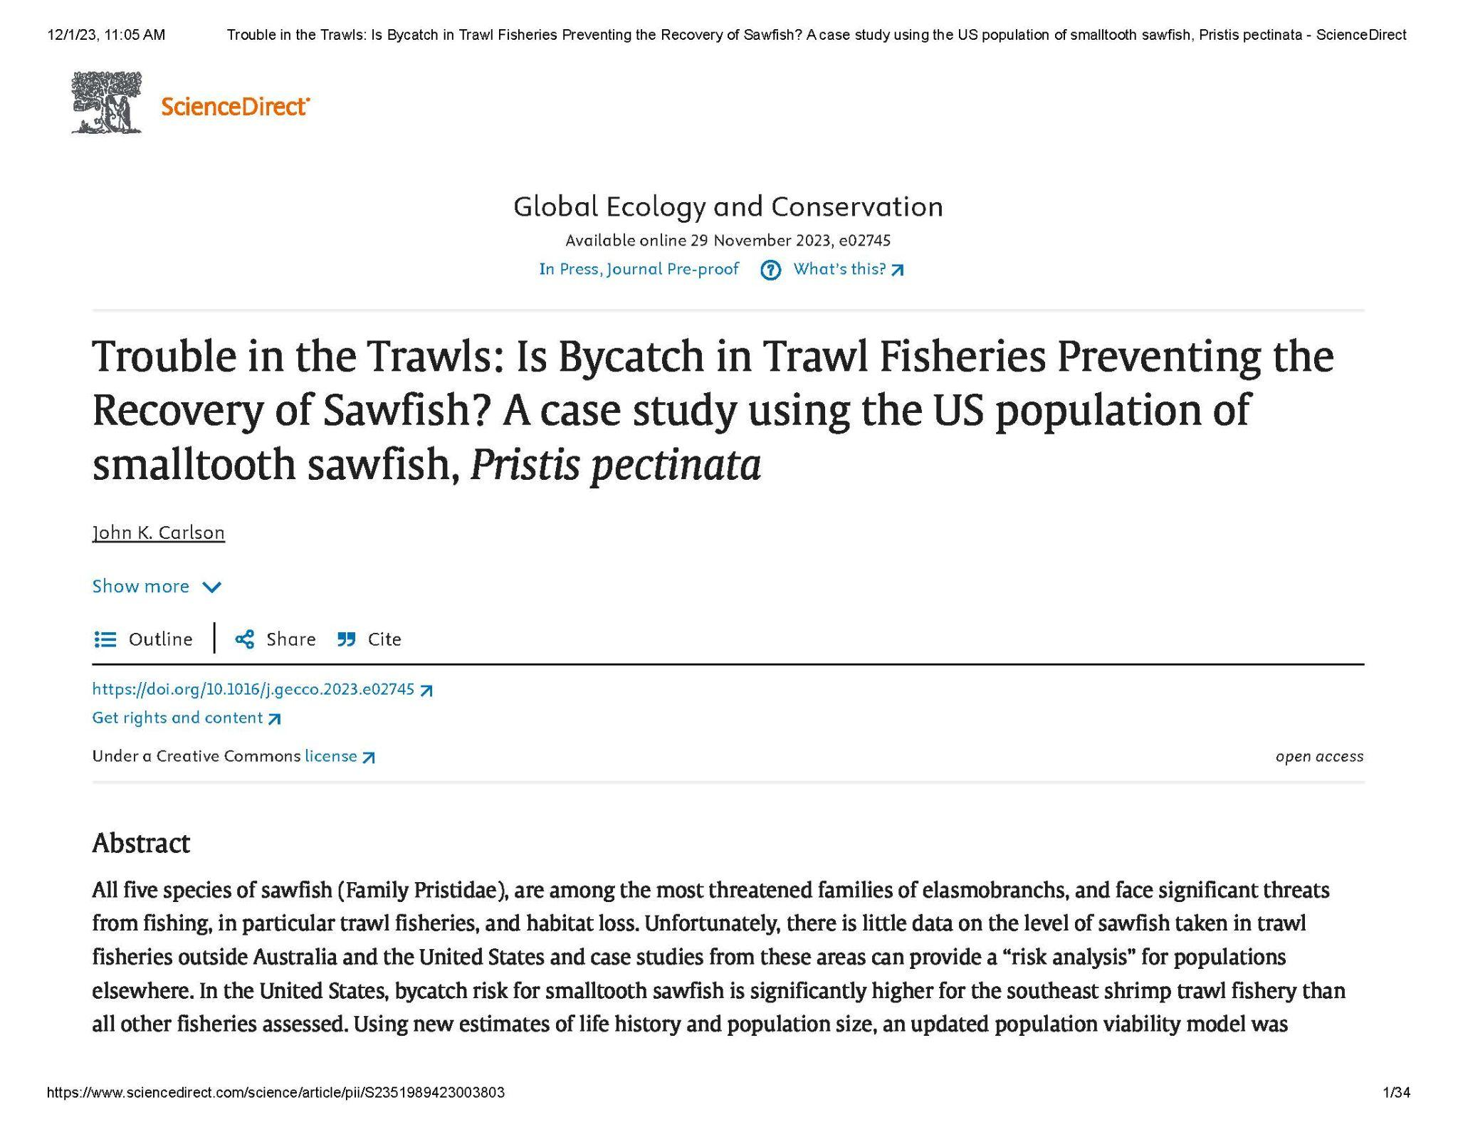
Smalltooth Sawfish New Information (cont.)
Smith 2021
Effective population size - 650 individuals (95% CI = 268-2,358)
Number of breeding adults - 284 (95% CI 1-1,425)
Carlson 2023 - Population Viability Analysis
Considers multiple scenarios of population response to bycatch threats
Bycatch risk for smalltooth sawfish is significantly higher for the southeast shrimp trawl fishery than all other fisheries assessed.
Considers multiple scenarios of population response to bycatch threats; high uncertainty in scenario outcomes
Highlights importance of improving our understanding of sawfish life history, captures in fisheries and their associated post-release mortality.
Ongoing Sawfish Mortality Event (next slide)
*Full presentation available here
https://gulfcouncil.org/wp-content/uploads/10.-Population-viability-Analysis-Presentation_Carlson.pdf

Slide 16
Ongoing Smalltooth Sawfish Mortality Event in the Florida Keys
Strange sawfish behavior and deaths in the lower Florida Keys since late January.
Reports of smalltooth sawfish swimming erratically, thrashing in the shallows, and beaching themselves
Affected sawfish are larger juveniles and adults, generally ranging in size from 10-14 ft
As of April 23, we’re aware of 199 unique sawfish reports with 43 confirmed as mortalities (confirmed = necropsied, so the total mortality is expected to be significantly higher).
Cause is currently unknown but under investigation.
Given concern over the high mortality of sawfish, NOAA and partners developed a rescue and rehabilitation effort and made the first rescue on April 5th. The rescued sawfish has been transported to Mote in Sarasota where is is receiving care.
Notes:
As of 4/23 there has been 179 affected sawfish and 43 confirmed mortalities (recovered carcasses).

Slide 17
Section 7 Consultation Next Steps and Timing?
The initial target date for having all of the information needed for PRD to have a complete initiation package and conduct the consultation was April 2024.
Shrimp effort data availability has pushed back the schedule. SERO has requested bycatch estimates and analyses based on effort data through 2022, now available, by June, and through 2023 when effort data are anticipated available later this year.
PRD will evaluate the new data once received and
SERO will also need to consider any proposed Shrimp FMP-driven actions and any shrimp actions the Gulf or South Atlantic Councils consider in response to key data as it becomes available.
SERO will continue to share information with the Councils and Shrimp APs as it becomes available.

Slide 18
What Can You Do Right Now?
Ensure fishers are using the release guidance for giant manta ray and smalltooth sawfish. (Now in English, Spanish, and Vietnamese)
https://www.fisheries.noaa.gov/southeast/endangered-species-conservation/sea-turtle-smalltooth-sawfish-and-giant-manta-ray-release
In addition to any required reporting, share data through:
For Sawfish: 1-844-4SAWFISH (1-844-472-9347)
For Manta rays: Email our Regional Giant Manta Ray Species Coordinator: Calusa.Horn@noaa gov or manta.ray@noaa.gov

Slide 19
