Slide 1
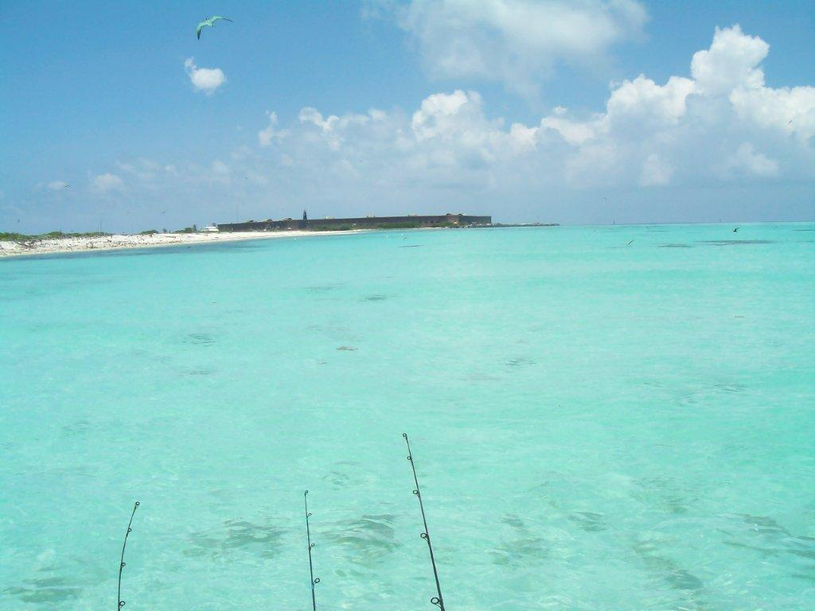
Addressing Fisheries Management in the South Florida Region
Notes:
1

Slide 2
Catalyst for Action
Motion at the June 2011 South Atlantic Council Meeting:
Send a letter to the Gulf Council and the NMFS requesting the formation of an ad hoc joint committee (South Atlantic and Gulf councils) to consider the development of a joint management plan for south Florida fisheries. The ad hoc committee would also discuss with the State of Florida delegation of management for some species to the State of Florida.

Slide 3
Timeline
July-Aug. 2013: FL FWC Hosted Scoping Meetings
June 2011: Motion at SAFMC Meeting
Jan. 2014: Meeting of the Joint South FL Committee
Jan. 2015: Meeting of the Joint South FL Committee
Feb. 2013: Organizational Webinar
Spring 2014: SAFMC Visioning Process Port Meetings
July 2014: Meeting of Joint South FL Committee
June 2015: Joint Meeting of Councils

Slide 4
Rationale
From South Atlantic Council Meeting in June 2011:
Fishermen consistently express confusion and frustration with the multiple jurisdictional boundaries and regulations in the Florida Keys
From FWC-hosted Scoping Meetings:
Consistency between state and federal rules is needed
South Florida’s ecosystem and fisheries are unique
From South Atlantic Council Visioning Process Port Meetings:
Fishermen express concern over inconsistent regulations between Florida state waters, Gulf federal waters, and Atlantic federal waters (e.g., size limits, bag limits, and seasons)

Slide 5
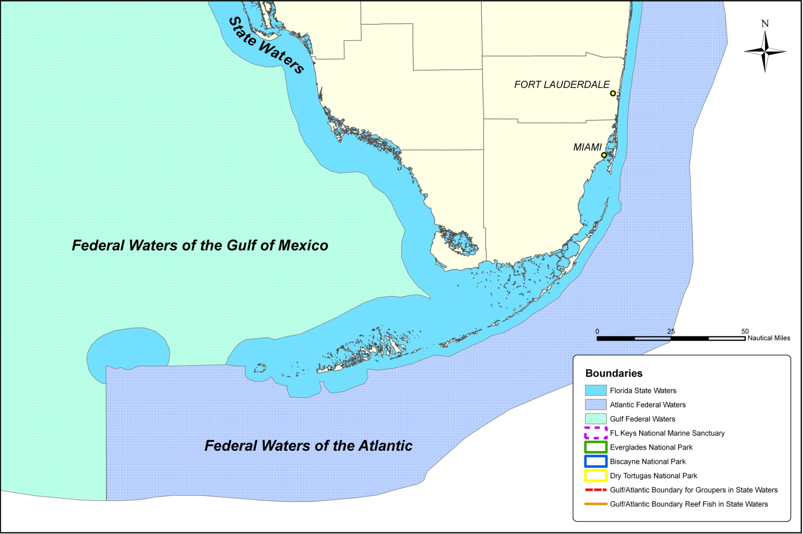

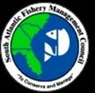

Slide 6
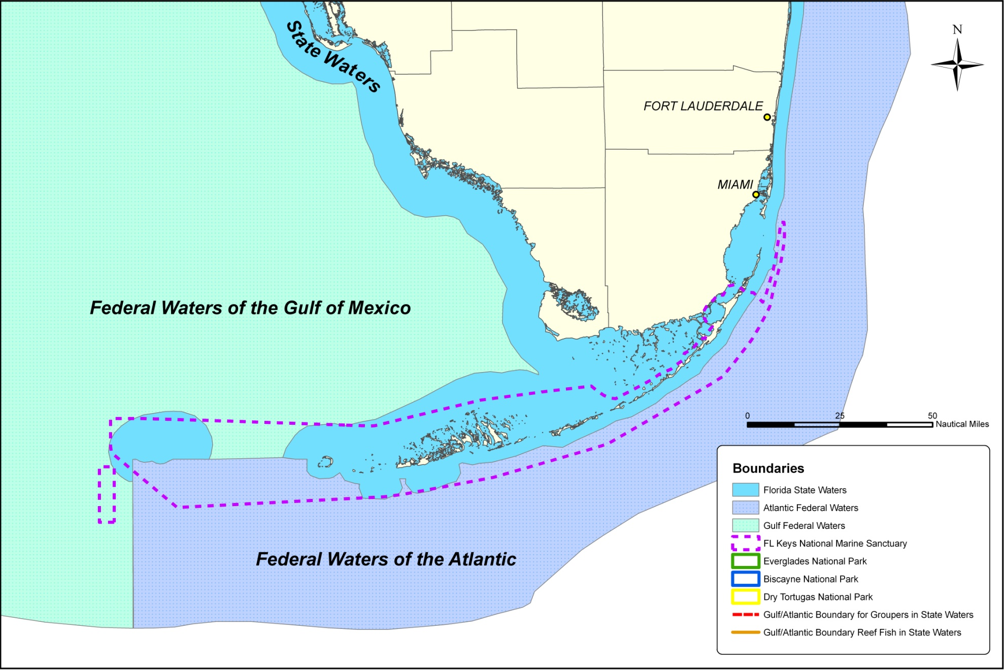

Slide 7
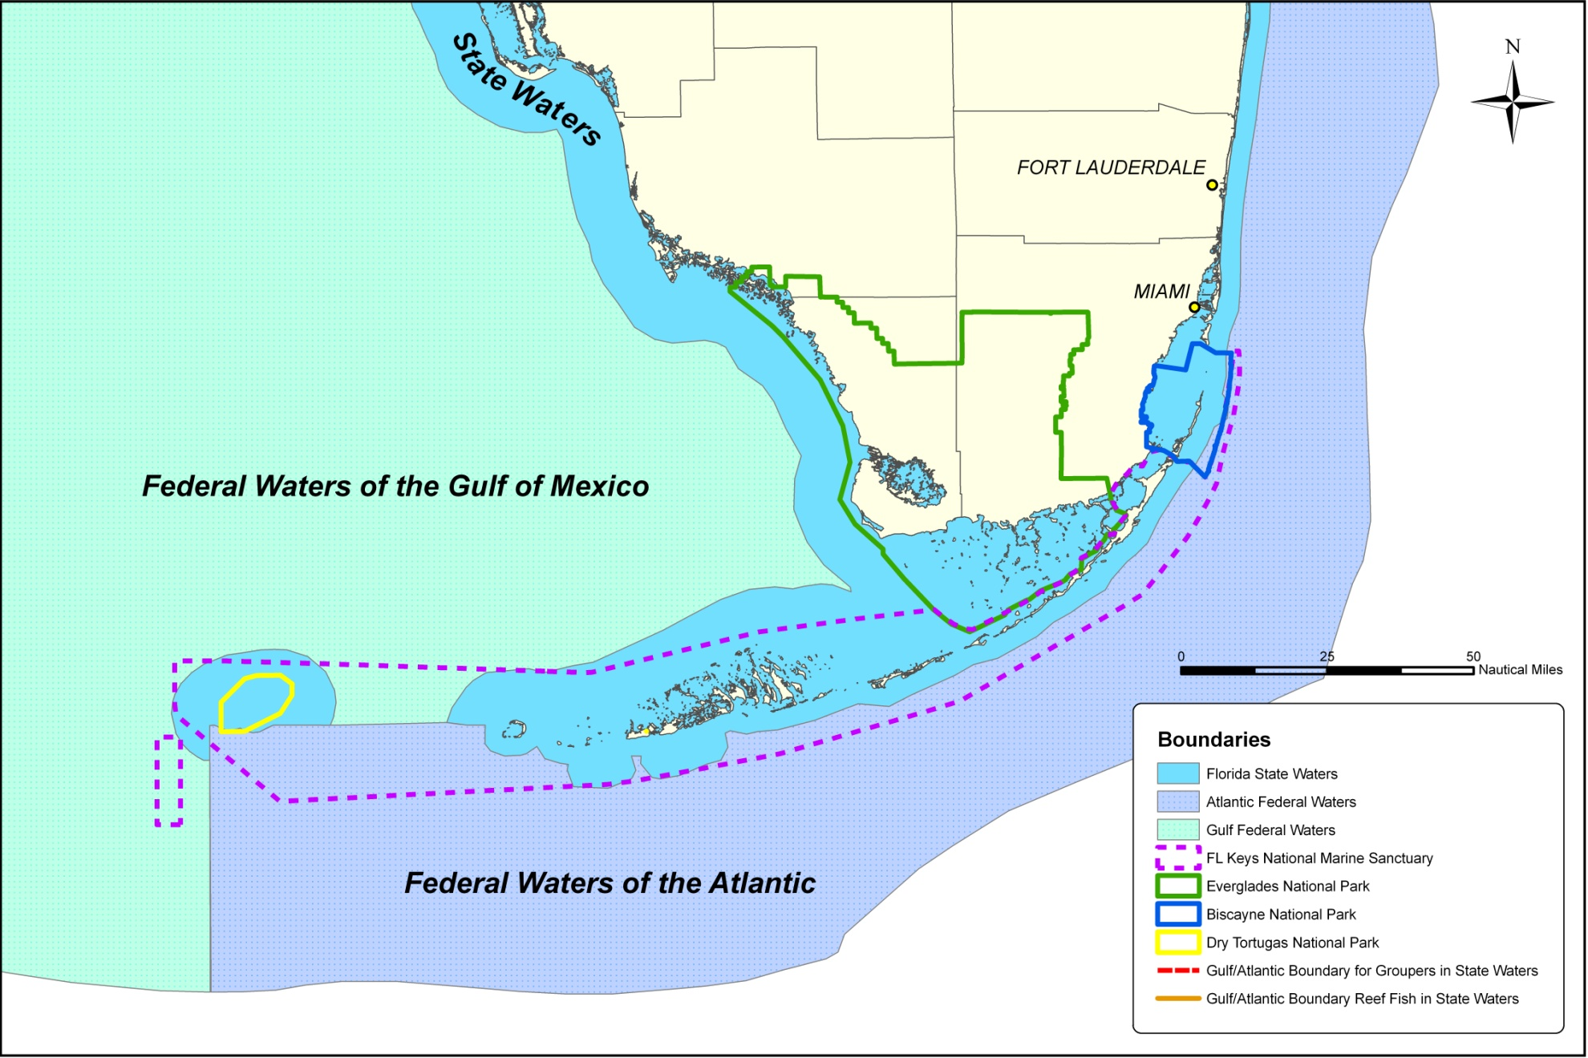

Slide 8
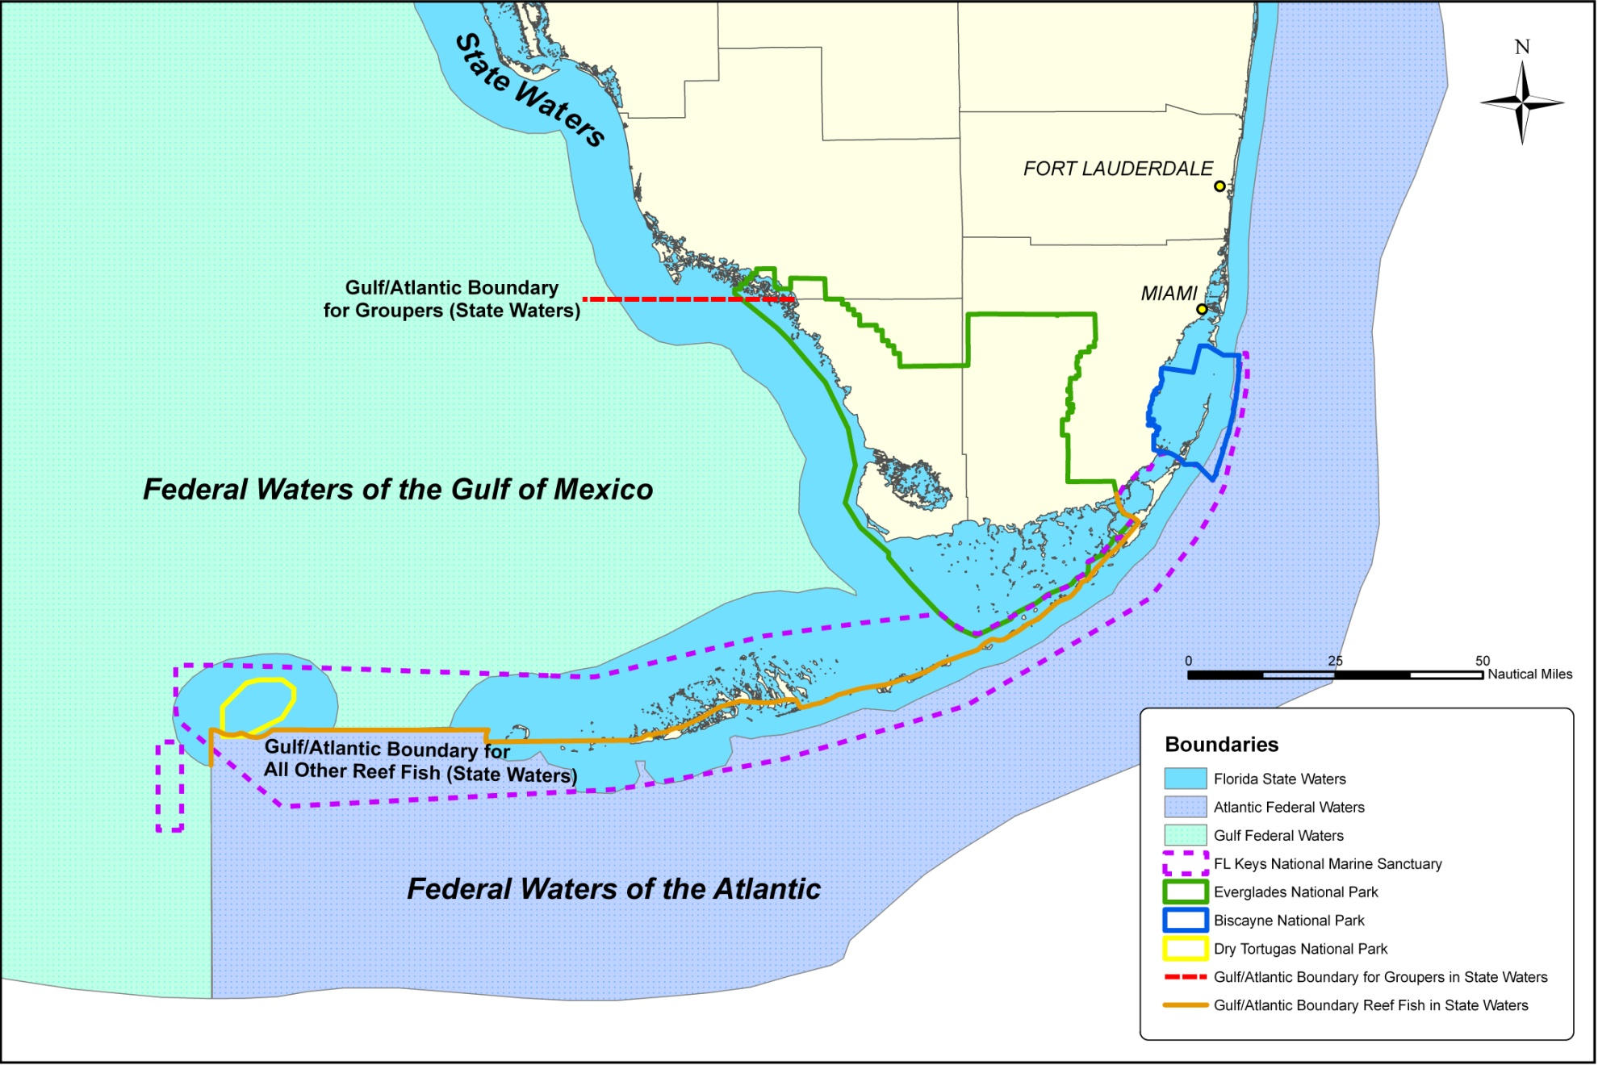

Slide 9
Strategy Suggestions from FWC/Council Scoping Workshops
Develop regional management for species common to south Florida
Create a regional management council for the Keys or south Florida
Develop a regional FMP modeled after Caribbean “Island” FMPs
Place all of the Keys under the jurisdiction of either the South Atlantic or Gulf Council
Manage fisheries based on species not on boundary lines
Species that were specifically addressed
  Yellowtail snapper
  Mutton snapper
  Mangrove snapper
  Red snapper
  Snowy grouper
  Groupers (general)
  Hogfish
  Jacks
  Lobster

Slide 10
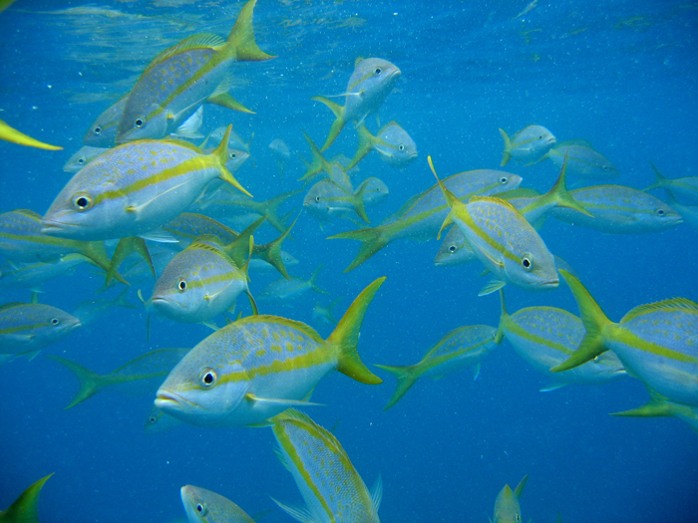
Yellowtail Snapper Comments
Manage the stock as a single unit in Atlantic and Gulf with one quota
Transfer management authority to Florida FWC
Change the fishing year to minimize disruptions to the fishery when quotas are met
Implement a spawning season closure during the summer
Circle hook requirement
  Exempt the fishery from the requirement in the Gulf
  Maintain the requirement

Slide 11
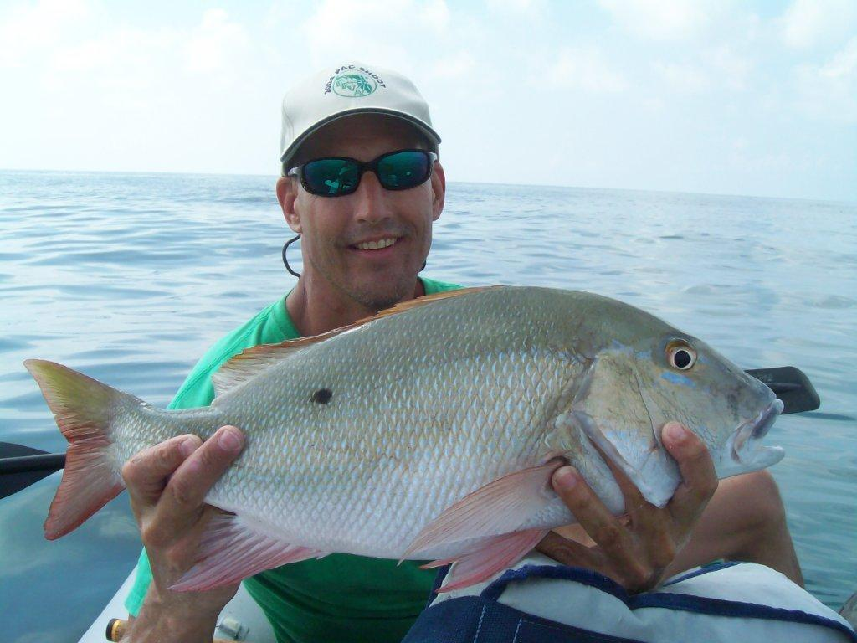
Mutton Snapper Comments
Protect spawning fish by:
  Implementing a spawning season closure
  Lowering bag limits
Grouper Comments
Develop consistent regulations between Atlantic and Gulf waters
The Atlantic shallow-water grouper closure:
  Unnecessary because there are few gag grouper in south Florida
  Shift the closure from Jan-Apr to Mar-May

Slide 12
How Has the Committee Proposed Addressing these Concerns?
Delegate authority over specific management items in federal waters off Florida to the State of Florida for yellowtail snapper, mutton snapper, and black grouper
Jointly set the ABC and ACL for yellowtail snapper, mutton snapper, and black grouper
Modify recreational bag limit and commercial trip limit for mutton snapper in federal waters
Modify the shallow-water grouper species compositions, seasonal closures, bag limits, and size limits in federal waters
Modify the black grouper seasonal closure and bag limits in federal waters
Change the circle hook requirements
Set uniform accountability measures for yellowtail snapper, mutton snapper, and black grouper

Slide 13
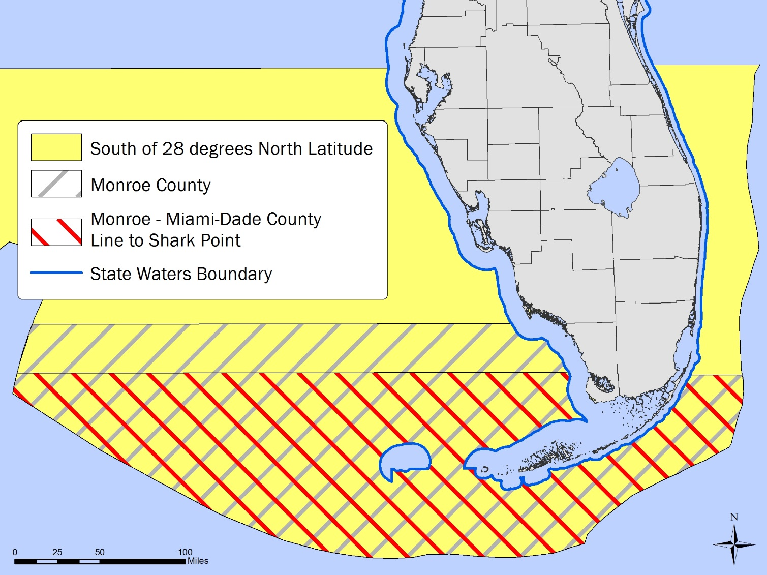
What Constitutes South Florida?
Some proposed actions are being considered to apply only to a sub-area off south Florida:

Slide 14
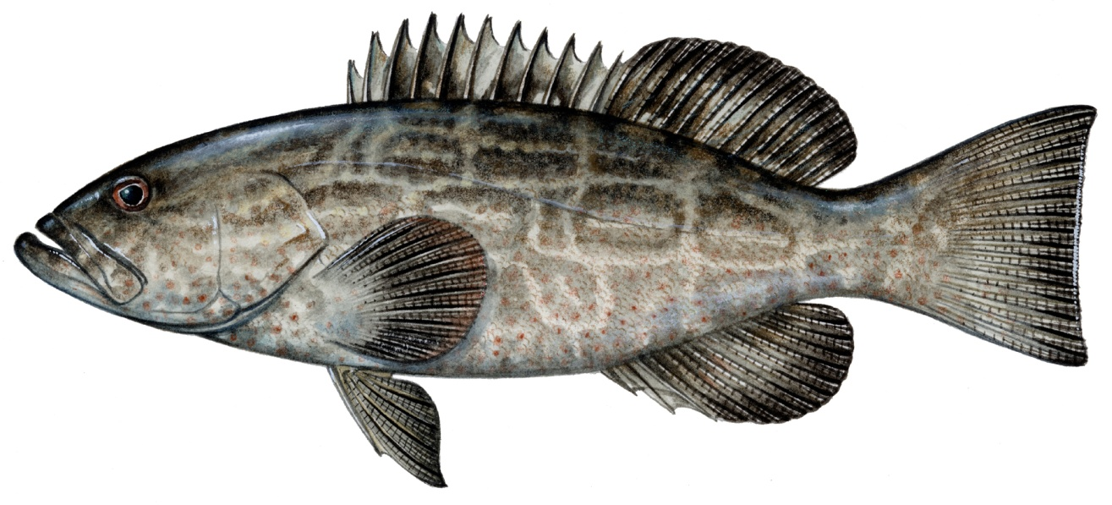
How Each Council’s Approach has Differed
South Atlantic Council:
This amendment can be an opportunity to address broader issues in management of snapper and grouper species throughout the Council’s jurisdiction:
  e.g., Seasonal closures for shallow-water groupers
  Modifications on seasonal closures in south Florida could have a cascading effect throughout the Council’s jurisdiction
Gulf Council:
Keep the focus of the amendment solely on issues pertinent to south Florida area

