Slide 1
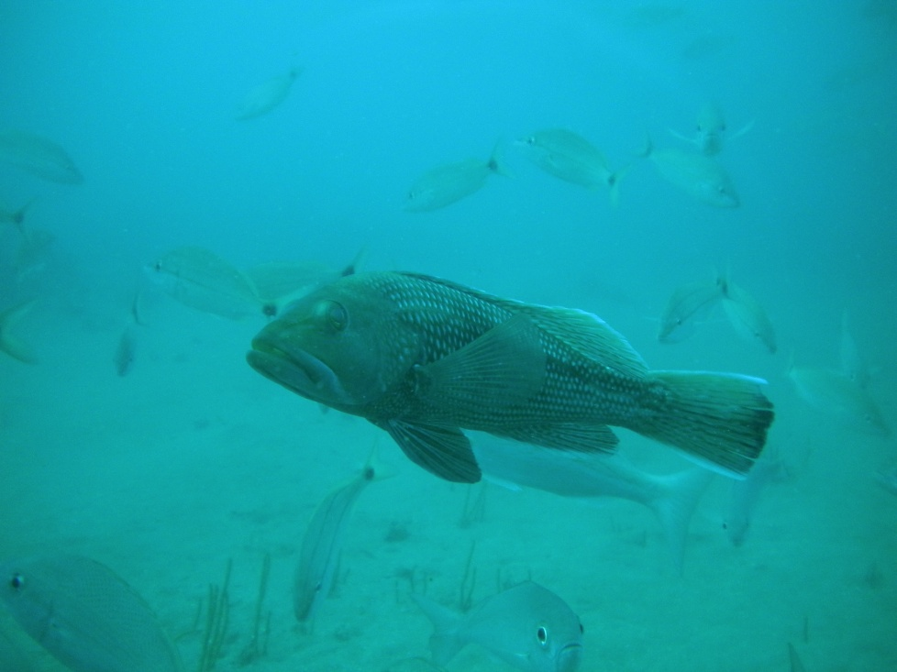
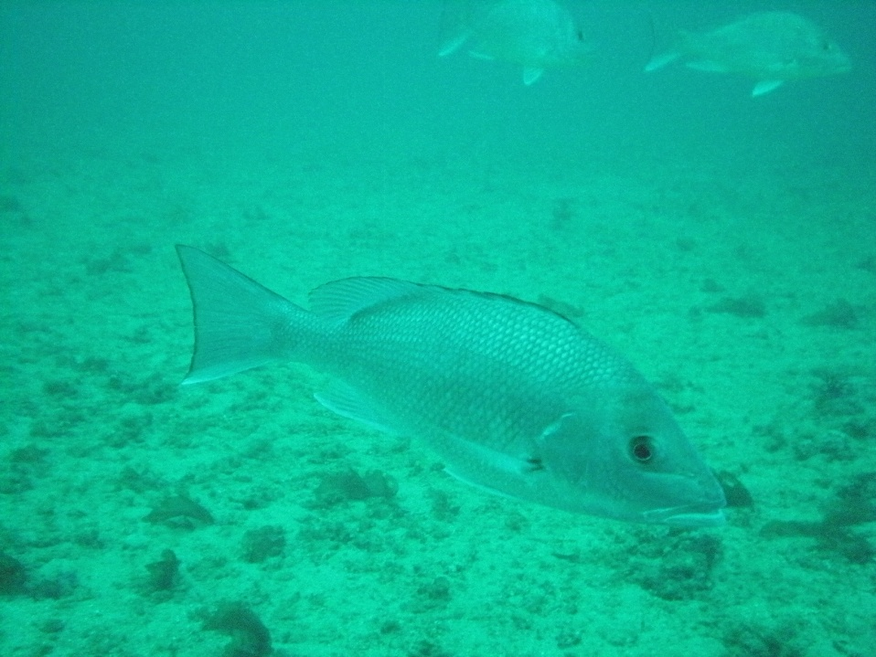
Summary of fishery independent survey
chevron trap CPUE data
for black sea bass and red snapper
1990 - 2011
Prepared by:
Marcel Reichert
Joseph Ballenger
Tracey Smart
DNR

Slide 2
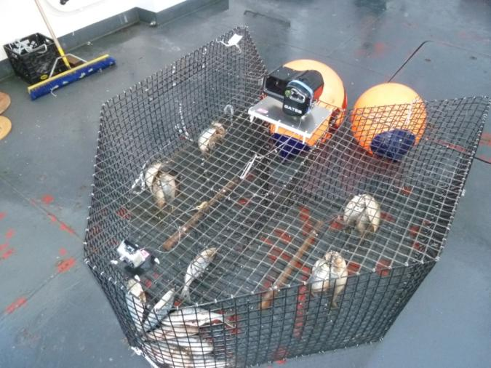
Introduction
Overview of black sea bass and red snapper
Data sources: MARMAP, SEAMAP Reef Fish Survey and SEFIS
Gear: Chevron trap only (no other gears, including video)
Stations: Only monitoring stations included (No reconn.)
Period: 1990 – 2011 (note 1990 year after Hugo)
Catch: No catch, catch with finfish, and catch without finfish
Soak time: 45 – 150 minutes (mostly ± 90 minutes)
Depth: Range over which 100% of all fish are collected
Black Sea Bass: 10 – 69 m
Red Snapper: 15 – 74 m
CPUE: # fish / trap * hr
nominal and standardized delta-GLM

Slide 3
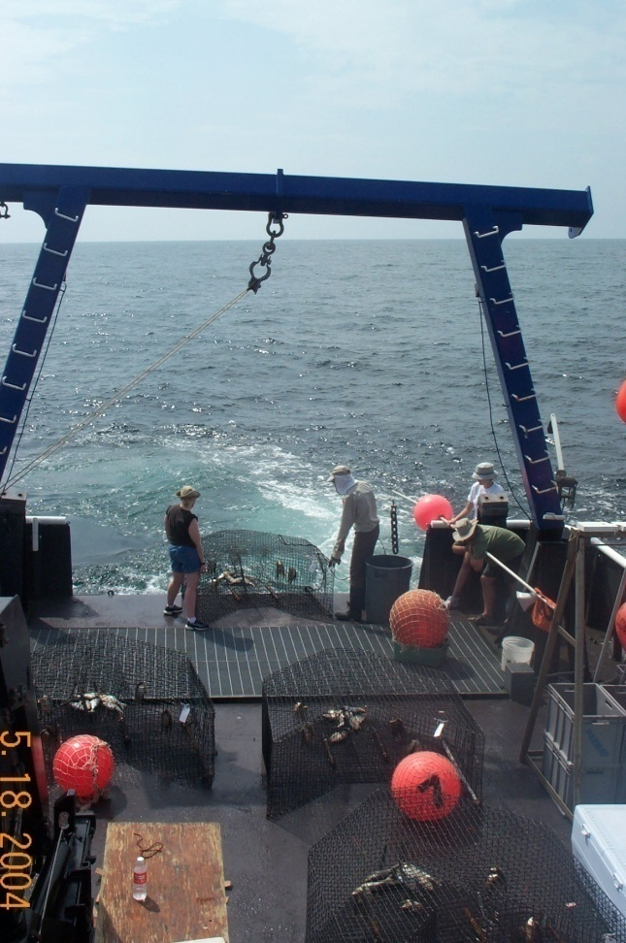
Nominal CPUE
CPUE Unit: fish/ trap*hr.
Geometric mean of all traps
No correction for variability in sampling
(depth, location, temp. etc.)
All chevron trap data can be used

Slide 4
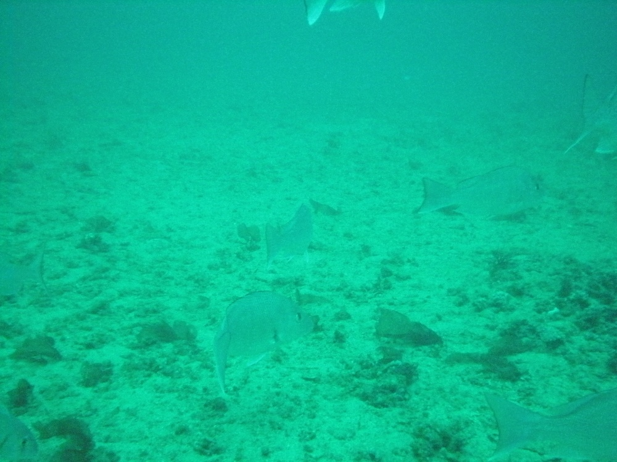
Delta-GLM standardization
Technique commonly used in fisheries research to model CPUE
CPUE in # fish/trap*hr
Corrects CPUE for variability in sampling
year (always included)
location (lat-long)
depth (m)
date / season
bottom seawater
temperature (⁰C)

Slide 5
Delta-GLM
How is this an improvement over nominal CPUE estimates?
Models the effect of sampling and environmental variables
Why is accounting for these variables important?
Corrects annual CPUE estimates for differences in sampling effort and environmental variables from year to year.
Nominal CPUE – assumes changes in CPUE directly reflects a change in abundance
Delta-GLM standardized CPUE – addresses effects of environmental factors and shifts in sampling effort, leaving a signal more reflecting true changes in abundance

Slide 6
Delta-GLM CPUE Calculation
Always include Year as a variable (year to year changes)
Other environmental variables included:
location, depth, date/season, bottom seawater temperature
Treated all covariates as discrete variables (discrete strata or bins). Allow for non-linear changes in the effects of variables on CPUE est.
If any variable data (e.g. T, depth) for a given trap is missing ,
that trap data is excluded from analysis
If <2 observations (traps that caught species) remained: year was excluded
For comparisons, CPUE series were normalized to long term average.

Slide 7
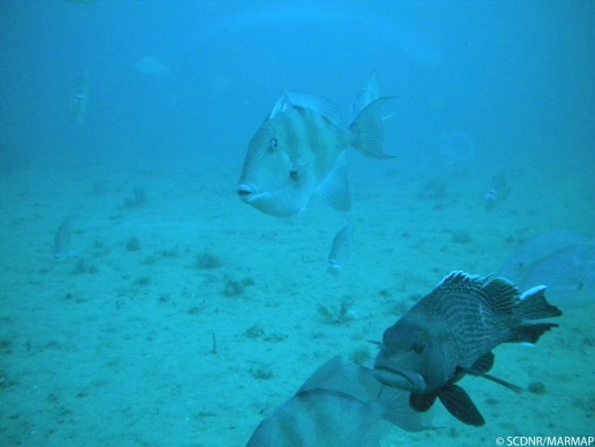
Black sea bass
Extensive data set.
Used for recent SEDAR.
Treatment of data different from SEDAR.
Black Sea Bass data used: 10 – 69 m range
Delta-GLM analysis:
Location (lat-long):≤29°, 30° ….. 33°, ≥34° (6 strata)
Depth: <20m, 20-24, …….55-59, ≥60m (10 bins)
Bottom water temperature: ≤ 20°C, 21-25°C, >25°C (3 bins)
Date / season: Spring and Summer (2 bins)

Slide 8
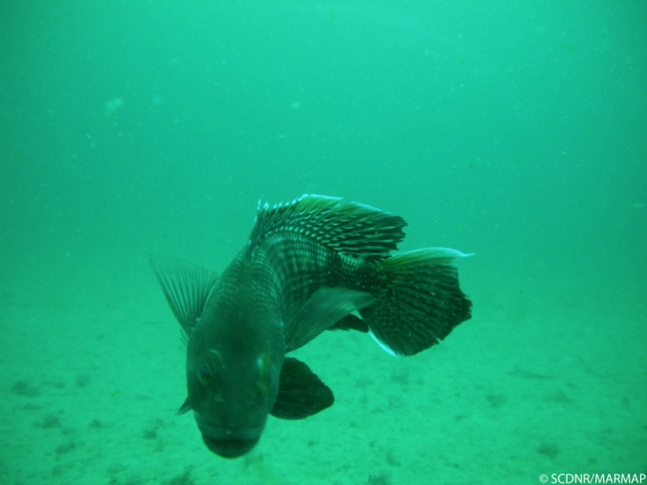
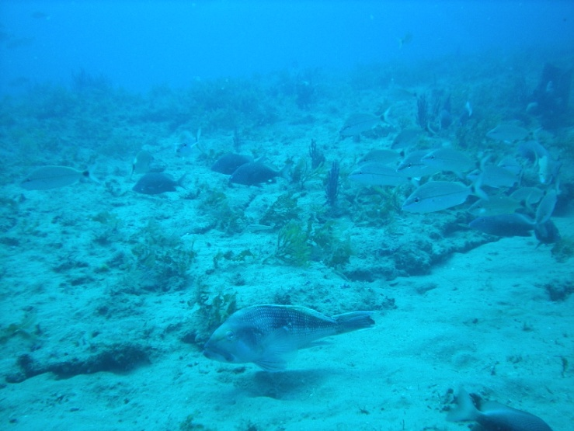

Slide 9
General increase in CPUE in recent years.
Additional years of data and further analysis clarify significance of stand. CPUE value in terminal year.
(focus on trend rather than
2011 value)

Slide 10
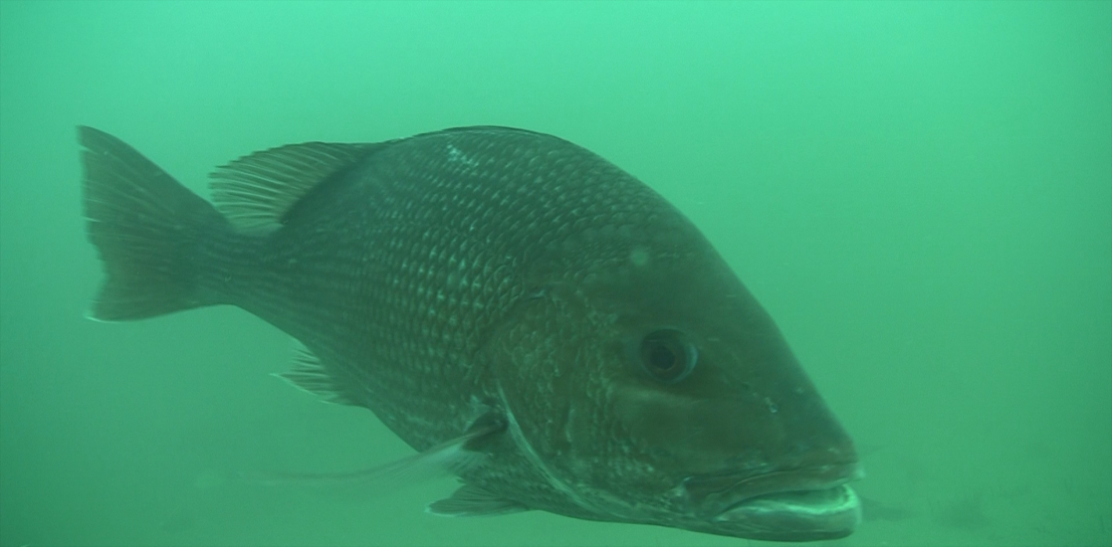
red snapper
Relatively low numbers
MARMAP data not used for most recent SEDAR assessment due to low catches and associated high variability.
Red Snapper: 15 – 74 m
Delta-GLM analysis:
Location (lat-long): 6 strata: ≤29°, 30°… 33°, ≥34° (6 strata)
Depth: <25m, 25-29, …….55-59, ≥60m (9 bins)
Bottom water temperature: ≤ 20°C, 21-25°C, >25°C (3 bins)
Date / season: Spring and Summer

Slide 12
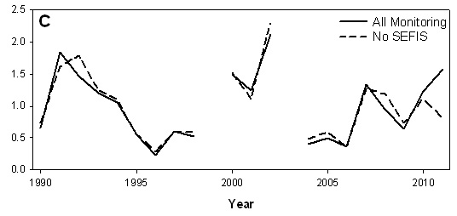
Red snapper normalized CPUE
Effect of SEFIS sampling on standardized (Delta-GLM) CPUE.
Increase in effort important for Chevron trap CPUE for red snapper.
New efforts will also provide video CPUE.

Slide 13
Caveats
This is a summary overview.
Constraints and stratification for CPUE may be different from those used in SEDAR assessments.
Not an update of stock status
Such update would require
update of all indices,
update of age compositions for all data streams, and
assumption that all other parameters remained the same as in the last assessment.

Slide 14
MARMAP/SEAMAP/SEFIS updates
A “Trends Report” is being completed and will include summaries of 3 gears and 24 species.
FI surveys can provide annual update of trap (and long-line) CPUE and mean length in January/March of year following sampling.
Age composition and reproductive parameter updates for selected species could be provided by May of the year following collection.
Video CPUE requires more processing time.

Slide 15
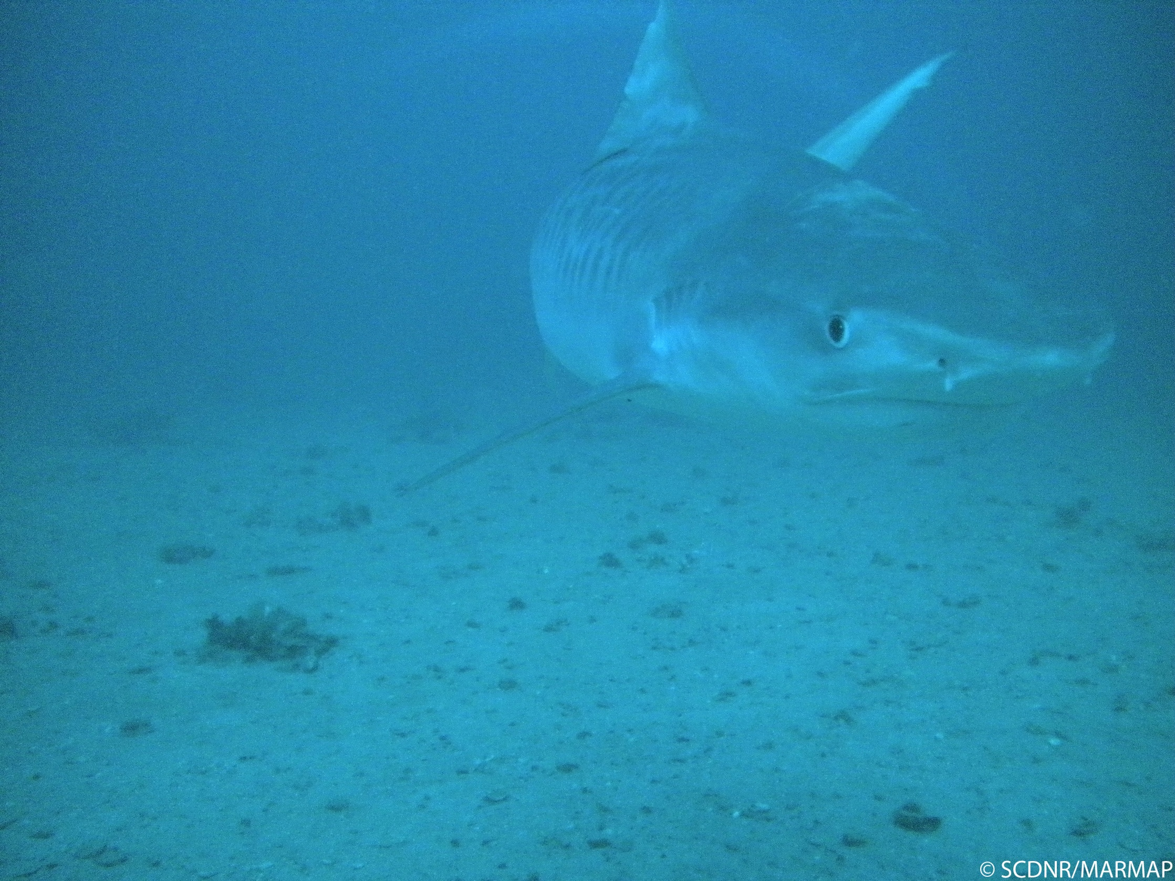
Questions ?

