Slide 1
Oculina Experimental Closed Area Background on SAFMC Management Actions
Oculina Evaluation Team Webinar
March 12th, 2014

Slide 2
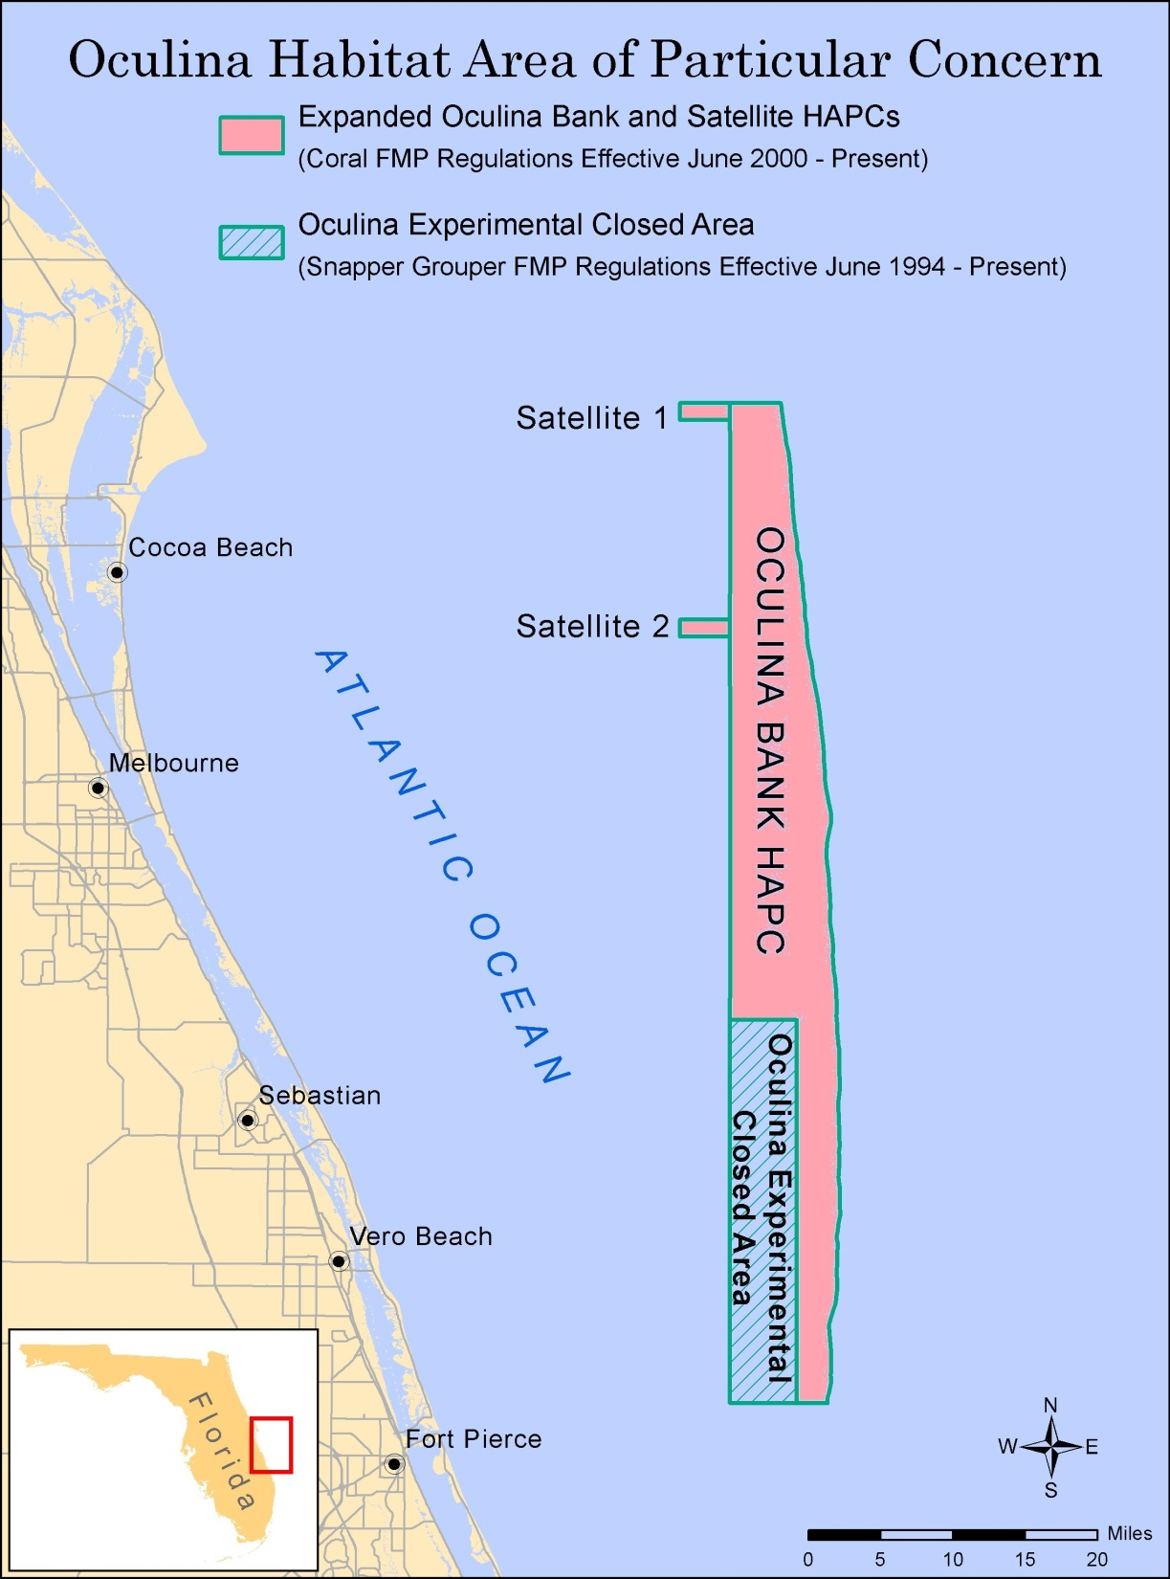
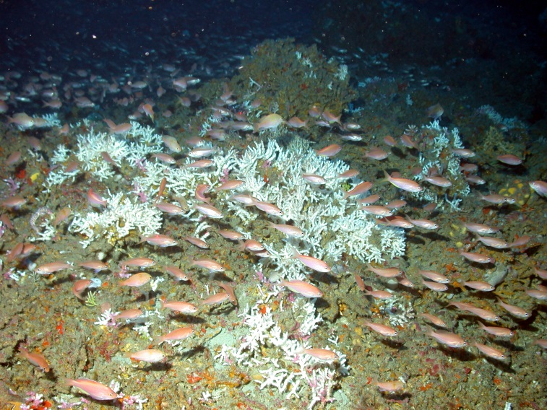
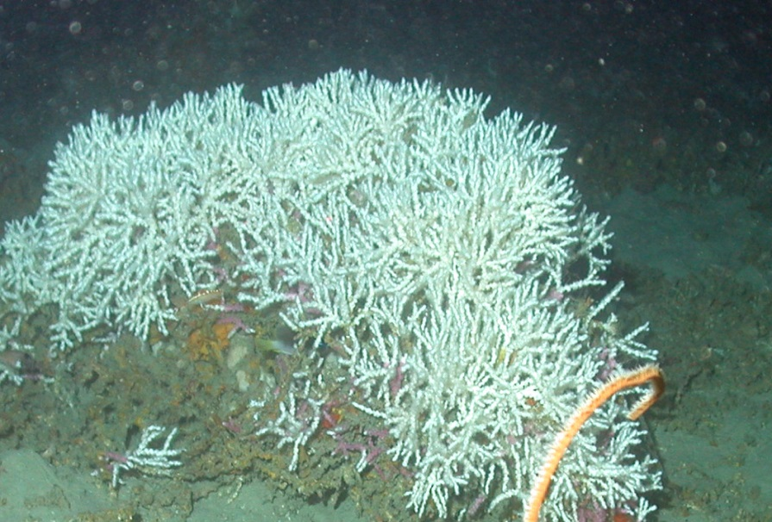

Slide 3
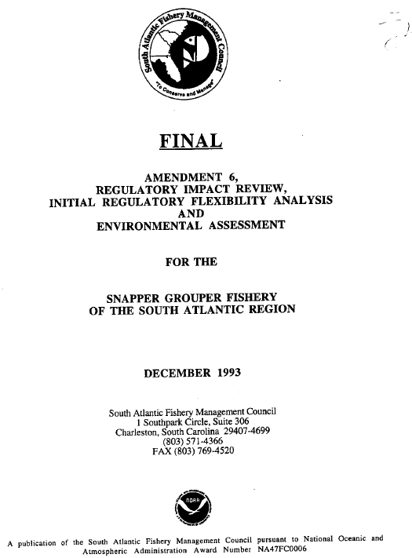
Timeline of Plan Amendments
92 mi² of Oculina Bank designated as an HAPC (Coral FMP - 1984)
Snapper Grouper Amendment 6 (1994) – prohibited anchoring by vessels fishing for SG species and prohibited fishing for/retention of SG species within the HAPC. Area became OECA.
Coral Amendment 3 (1995) – prohibited all vessels from anchoring in HAPC
Trawling for rock shrimp prohibited east of 80°W longitude (between 27°30’N and 28°30’N latitude), in depths less than 100 fathoms. (Shrimp Amendment 1 - 1996)

Slide 4
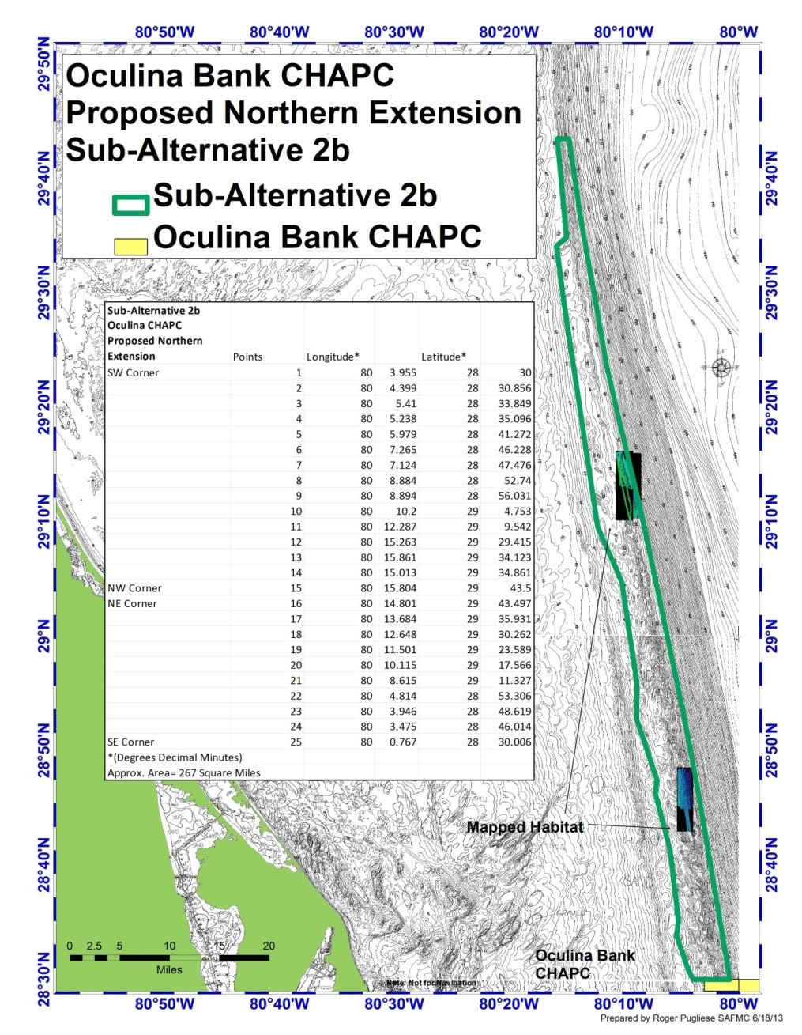
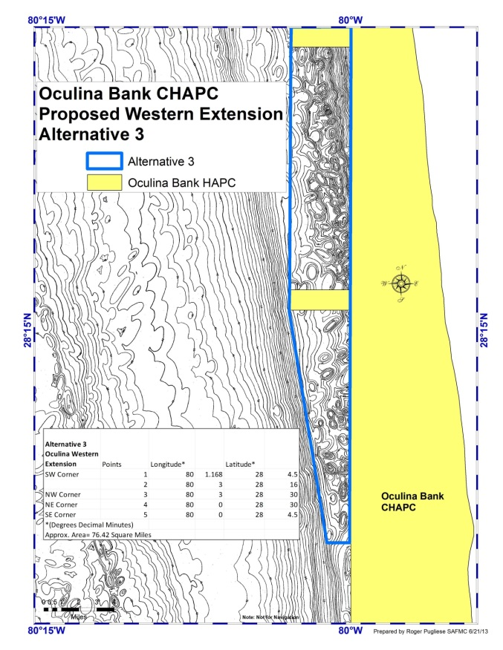
Other Amendments
Oculina HAPC expanded to include rock shrimp closed area (Coral Amendment 4; Comprehensive EFH Amendment – 1998)
Shrimp Amendment 5 (2003) –required use of VMS for rock shrimp fleet
Coral Amendment 8 (approved by SAFMC in 2013; under NMFS review) extends northern and western Oculina Bank HAPC by 343 mi²

Slide 5
Snapper Grouper Amendment 13A
Purpose of action in 13A was to provide continued protection of snapper grouper populations and associated Oculina coral.
The need was to provide a hedge against high degree of scientific uncertainty associated with SG species, reduce the possibility that these stocks may fall below sustainable levels and help rebuild stocks already below sustainable levels. Also, provide high level of protection to Oculina.
From Reed et al 2007

Slide 6
Scope of Alternatives
Alternative 1 (Preferred). Extend regulations within the OECA that prohibit fishing for and retention of SG species for an indefinite period with a 10 year re-evaluation by the Council. The Council will review the configuration and size of OECA within 3 years or the publication date of the final rule.
Alternative 2. Extend regulations within OECA that prohibit fishing for and retention of SG species for an additional 10 year period.
Alternative 3. “ ” …for an additional 20 year period.
Alternative 4. “ ”…for an additional 50 year period.
Alternative 5. “ ”…for an indefinite period.
Alternative 6. No Action. Regulations within OECA would sunset on 6/27/04.

Slide 7
The Preferred Alternative…
Species appear to have begun to recover within the affected area; if opened, any gains during previous decade would be lost
Alternative 1 provides most biological, social and economic benefits while allowing adaptive management
Evaluation Plan may result in increased public support and more protection of SG species and Oculina coral and result in a decrease in illegal fishing
Outreach
Enforcement
Research & Monitoring

Slide 8
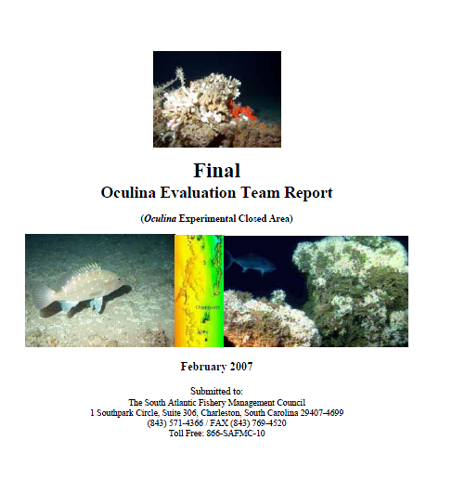

Slide 9
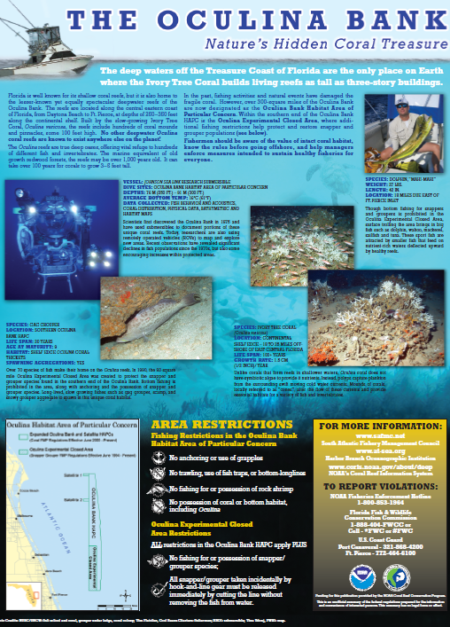
2005 Evaluation Plan
Outreach Plan
SAFMC I&E Committee
Draft proposal developed in 2003 for HAPC by research partners (NOAA, UNC-W, SEFSC)
Informal meetings around Ft. Pierce and Port Canaveral in 2004
Identified 4 primary objectives
Support development of Outreach Plan
Focused outreach campaign targeting fishermen
Broad media campaign
Evaluation

Slide 10
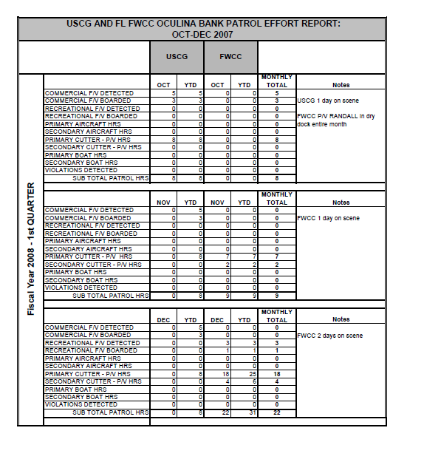
2005 Evaluation Plan
Enforcement Plan
Council motion passed in March 2003 stating the OECA closure to be a priority and requested NOAA GC revise the penalty schedule
Special Agent assigned to area
LE Committee & AP established 5 enforcement principles
Oculina Bank Enforcement meeting was held (December 2004)
VMS
Cooperative Enforcement
Increase Presence
Enforcement Reports
Outreach & Education

Slide 11
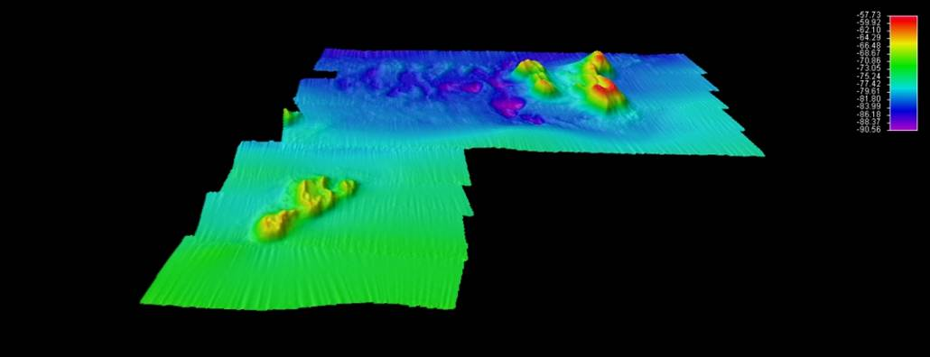
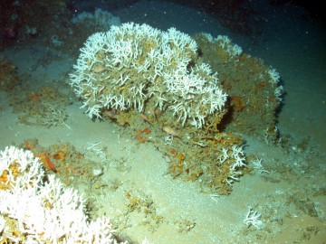
2005 Evaluation Plan
Research & Monitoring Plan
2004 Deepwater Coral Research and Monitoring Workshop in Cape Canaveral
Identified 7 objectives
Habitat recovery
Effect on fish distribution and status
Population structure of corals
Stressors affecting OECA
Key trophodynamic groups
Physical/chemical paramaters that define a healthy ecosystem
Research on coral feeding ecology
NURC, Chapman’s Reef
Live Oculina varicosa coral colonies
NURC, A.Shepard

