Slide 1
MPA Expert Working Group
DRAFT ANALYSIS:
Impacts of Suggested MPAs on Speckled Hind and Warsaw Grouper

Slide 2
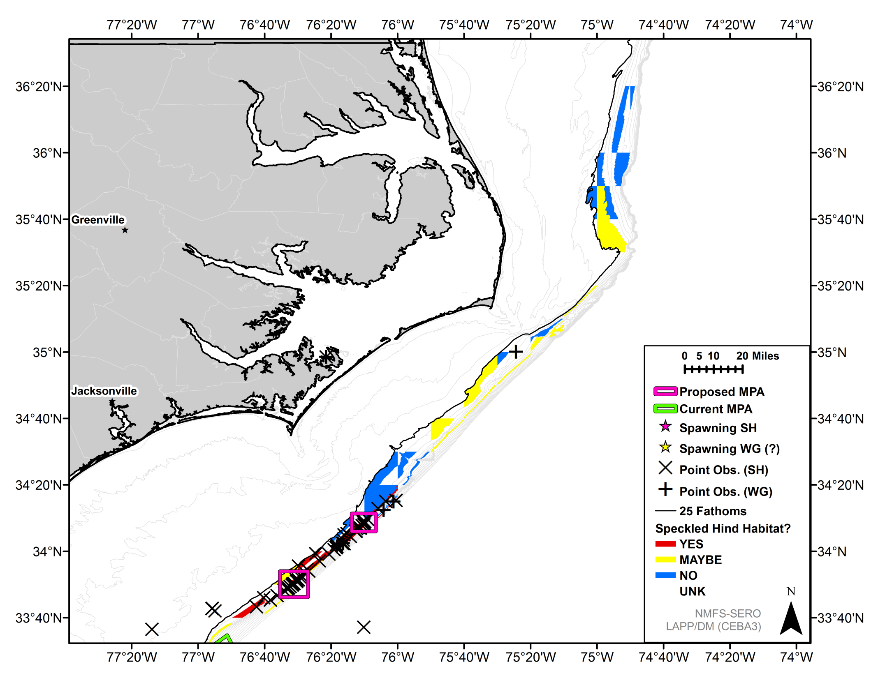
North Cape Lookout
South Cape Lookout

Slide 3
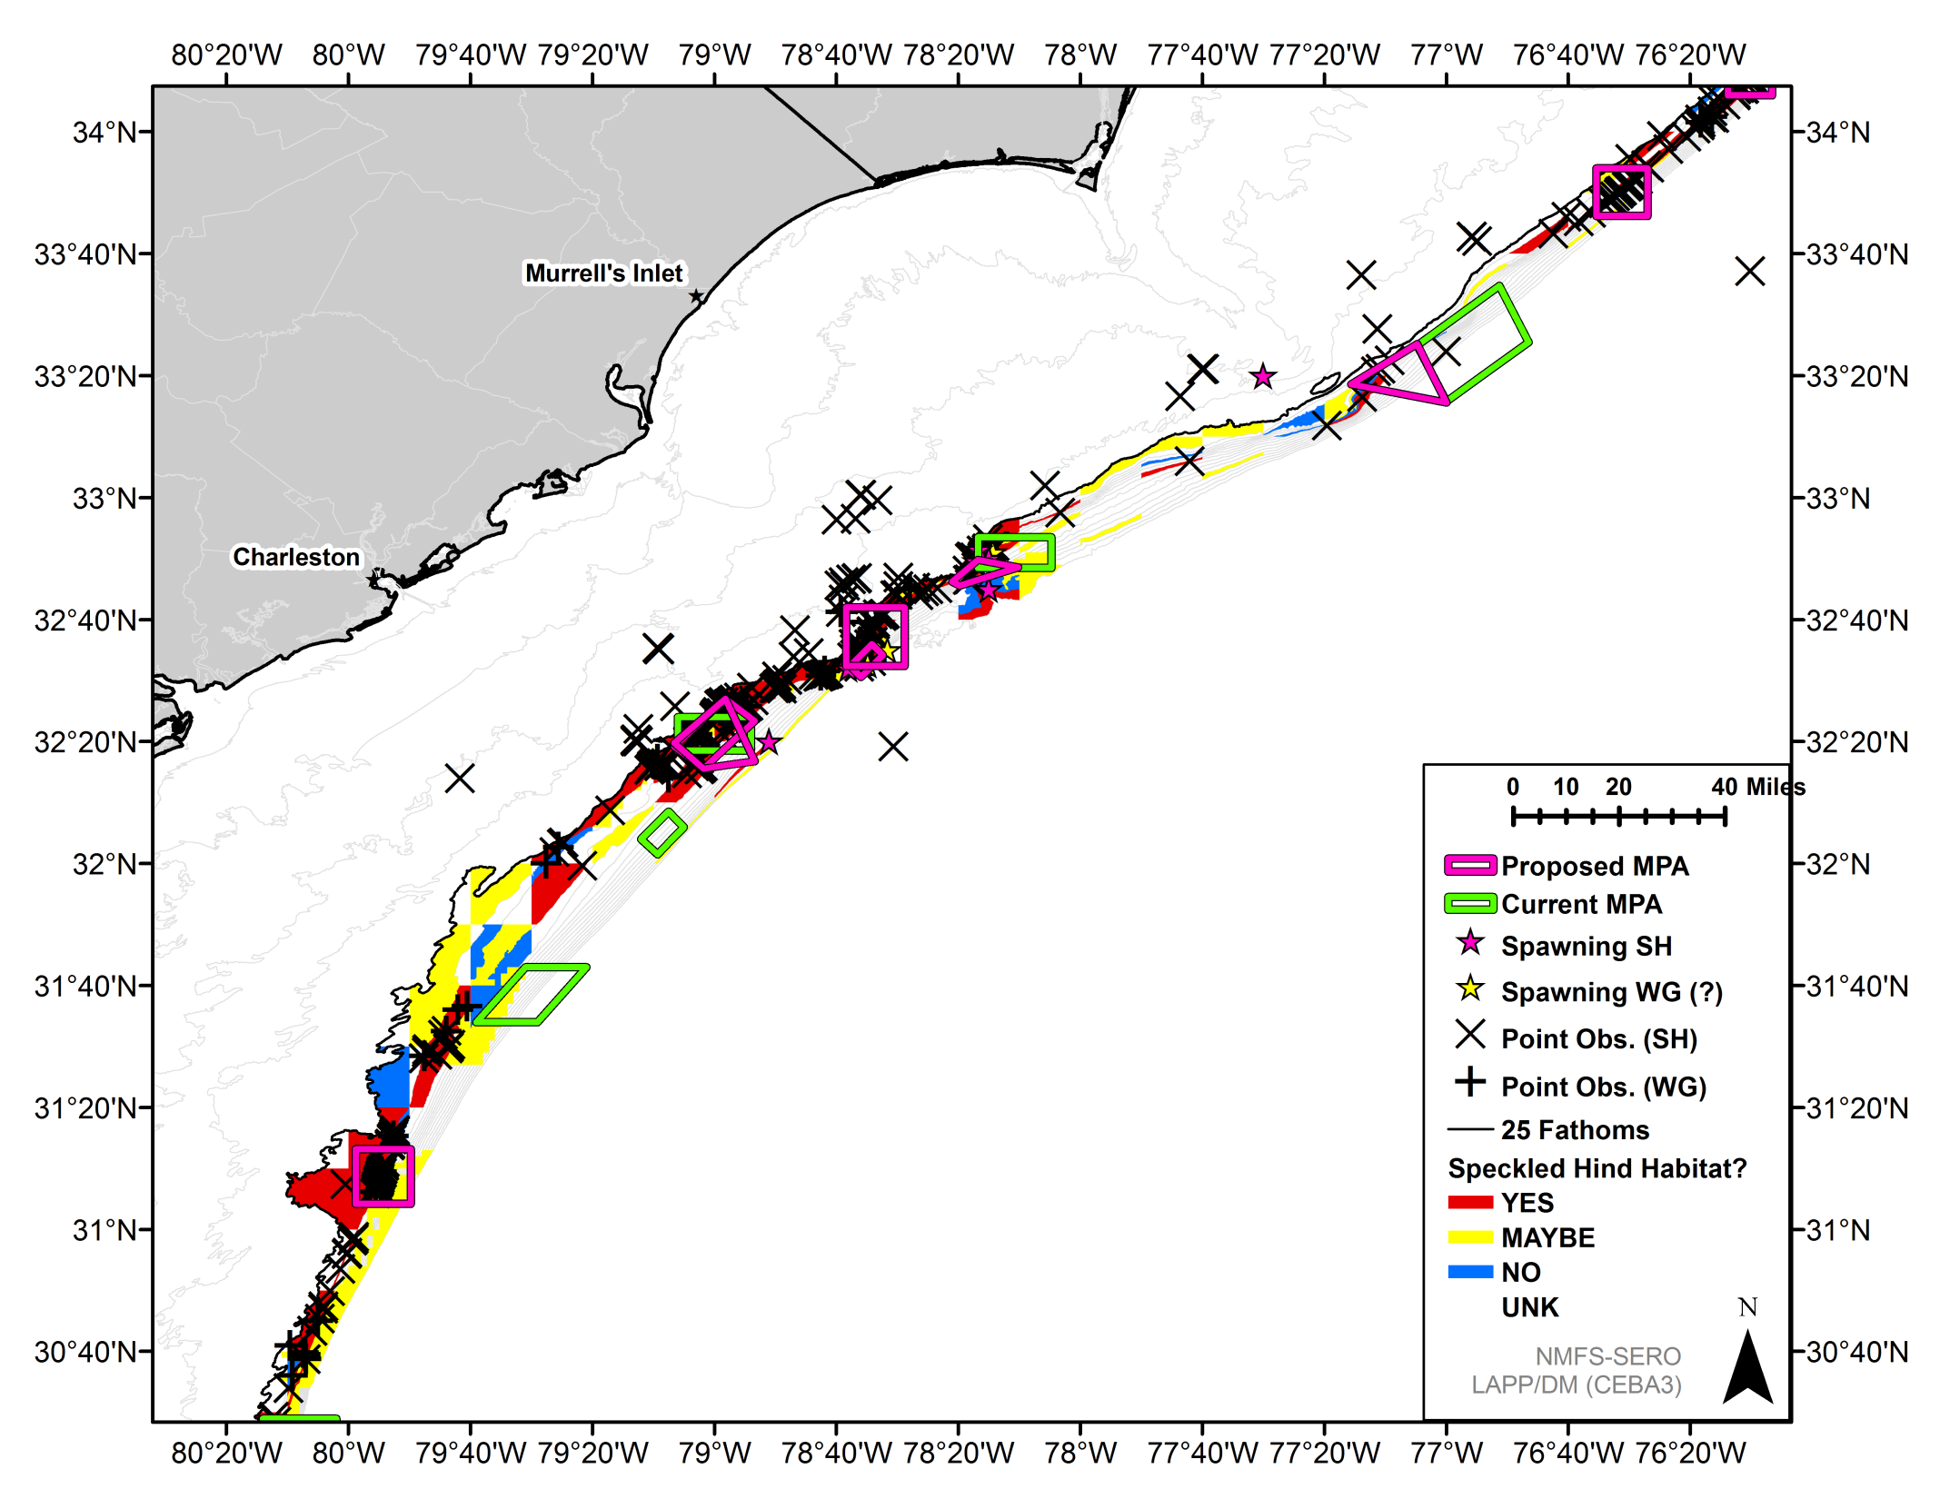
Snowy Wreck Extension
Devils/
Georgetown Hole
Northern SC Extension
Edisto Reconfigurations
St. Simons

Slide 4
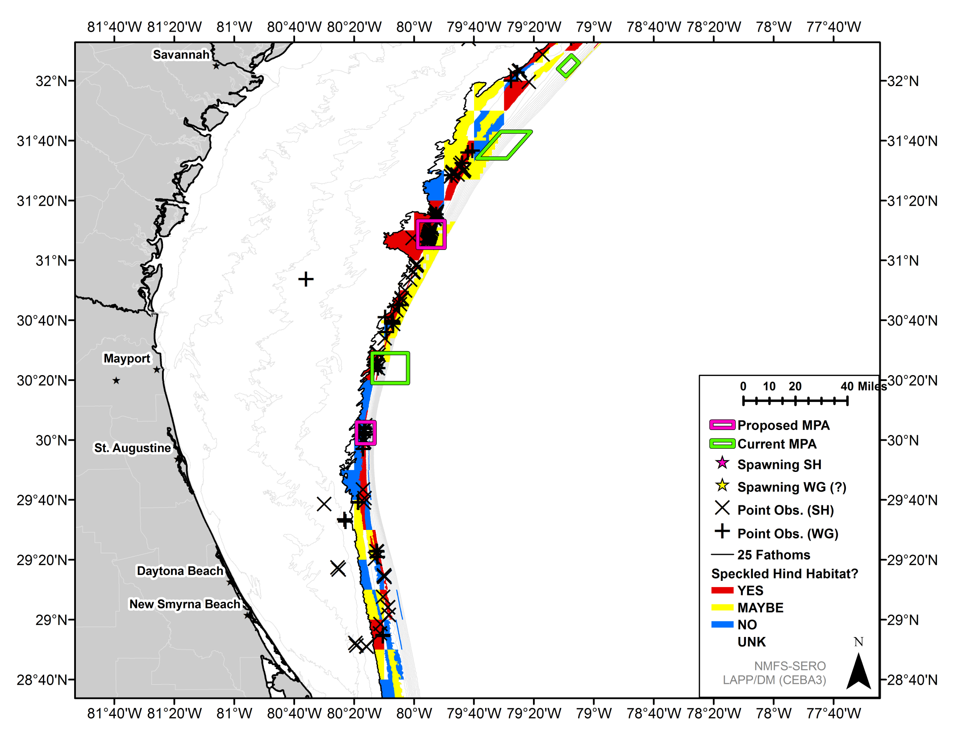
St. Simons
St. Augustine

Slide 5
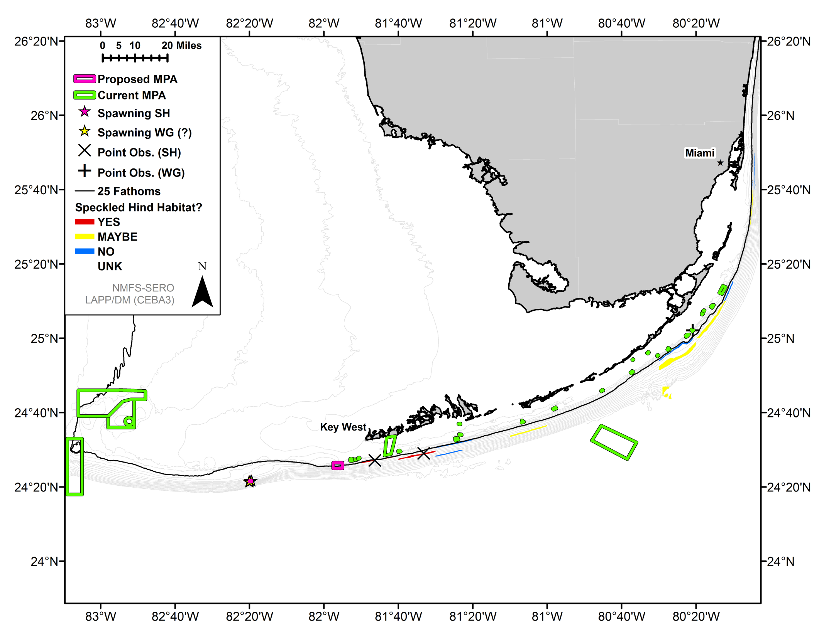
Warsaw Hole
Western Dry Rocks

Slide 6
 | POINTS |  |  | %YES |  | %YES+MAYBE |  | FID 'CPUE' |  | FD 'CPUE'
MPA | SH | WG | sites | SH | WG | SH | WG | SH | WG | SH | WG
Charleston Deep | 0 | 0 | 1 | 0.0% | 0.0% | 0.0% | 0.0% |  | 0.0% | 0.0% | 0.0%
Edisto | 29 | 1 | 393 | 4.3% | 4.5% | 2.1% | 1.9% | 5.4% | 0.3% | 23.1% | 0.0%
Georgia | 0 | 0 | 28 | 0.0% | 0.0% | 1.0% | 1.3% | 0.0% | 0.0% | 0.0% | 0.0%
North Florida | 8 | 11 | 1128 | 1.8% | 2.0% | 1.1% | 0.9% | 2.2% | 1.6% | 0.1% | 0.4%
Northern SC | 22 | 1 | 370 | 1.8% | 1.3% | 2.0% | 2.2% | 2.7% | 0.0% | 30.3% | 0.0%
Oculina EAC | 10 | 1 | 38 | 2.2% | 0.6% | 1.0% | 0.2%
Snowy G. Wreck | 2 | 0 | 24 | 0.2% | 0.0% | 0.1% | 0.0% | 0.0% | 0.0% | 25.0% | 0.0%
Edisto Reconfig 1 | 67 | 1 | 808 | 5.5% | 4.1% | 2.7% | 2.0% | 5.9% | 0.1% | 22.9% | 0.0%
Edisto Reconfig 2 | 56 | 1 | 727 | 5.1% | 4.1% | 2.5% | 1.9% | 5.4% | 0.2% | 22.1% | 0.0%
First Devils Hole | 174 | 12 | 403 | 0.7% | 0.5% | 0.5% | 0.6% | 0.0% | 0.0% | 15.6% | 21.9%
Georgetown Hole | 203 | 14 | 591 | 3.2% | 4.2% | 1.9% | 2.3% | 1.2% | 0.0% | 14.3% | 22.4%
N Cape Lookout NC | 13 | 0 | 45 | 0.9% | 0.6% | 0.4% | 0.2% | 12.1% | 0.0% | 50.0% | 0.0%
Northern SC Ext | 5 | 0 | 36 | 0.7% | 0.0% | 0.5% | 0.4% | 0.0% | 0.0% | 14.3% | 0.0%
S Cape Lookout NC | 19 | 0 | 77 | 0.9% | 0.0% | 0.9% | 0.6% | 25.7% | 0.0% | 0.0% | 0.0%
Snowy Wreck Ext | 5 | 0 | 96 | 0.5% | 0.0% | 0.3% | 0.1% | 22.2% | 0.0% | 0.0% | 15.7%
St Augustine | 6 | 6 | 211 | 0.5% | 1.7% | 0.2% | 0.5% | 1.8% | 1.2% | 50.0% | 0.0%
St Simons | 33 | 3 | 270 | 4.0% | 9.2% | 3.2% | 4.4% | 2.6% | 0.5% | 10.9% | 0.5%
Warsaw Hole | 0 | 2 | 2 | 0.0% | 0.0% | 0.0% | 0.0%
Western Dry Rocks | 0 | 0 | 194 | 0.0% | 0.0% | 0.0% | 0.0%
FID: Equally-weighted average SEFIS Trap, SEFIS Video, MARMAP.
FD: Equally-weighted average RFOP and HBS

