Slide 1
Outreach Overview South Atlantic Deepwater Marine Protected Areas
Kim Iverson
Public Information Officer
South Atlantic Fishery Management Council
December 2013 SAFMC Meeting
Wilmington, NC

Slide 2
MPA Outreach: The Early Years
1992 – Public scoping meetings held for input on MPAs.
Large areas identified as “no-take” zones for MPAs.
Council reconsiders Top-Down approach

Slide 3
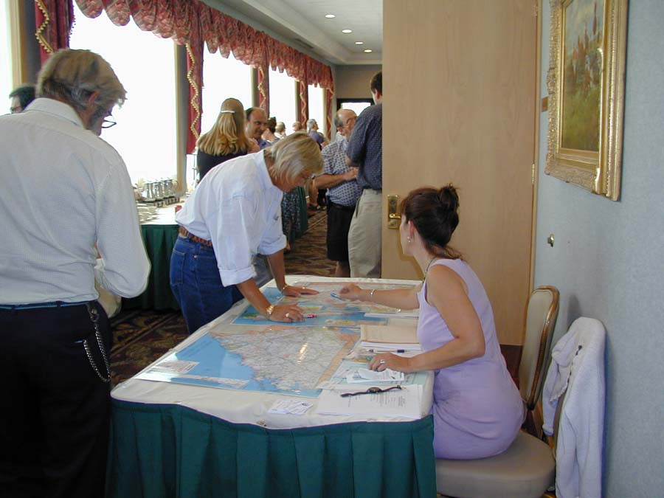
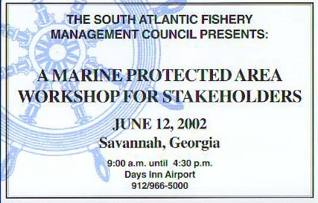
MPA Outreach – the Early Years
New Approach:
Marine Protected Area Advisory Panel formed
2000 – “Mega Advisory Panel Meeting” – multiple APs meet to develop approach
2002 - MPA Stakeholder Workshops

Slide 4
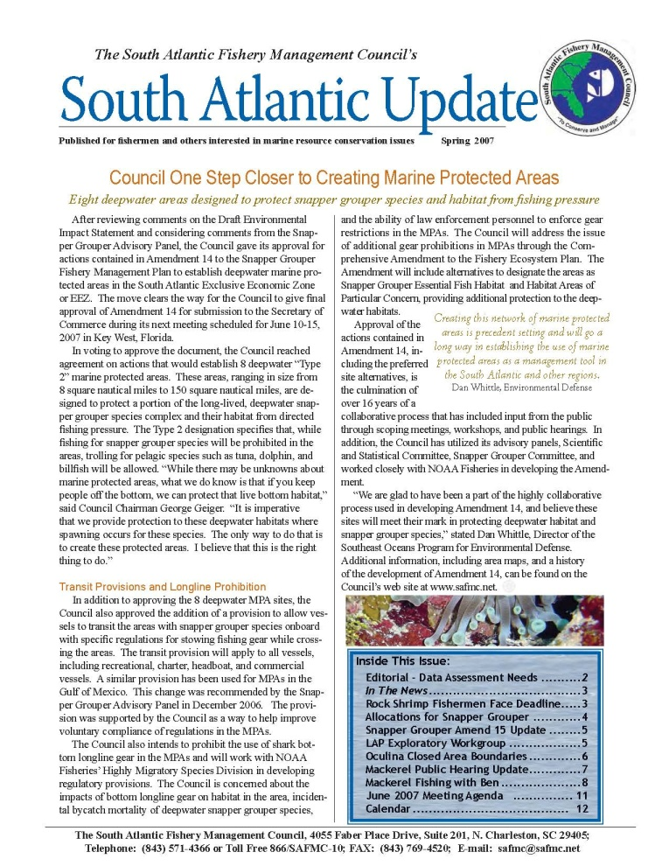
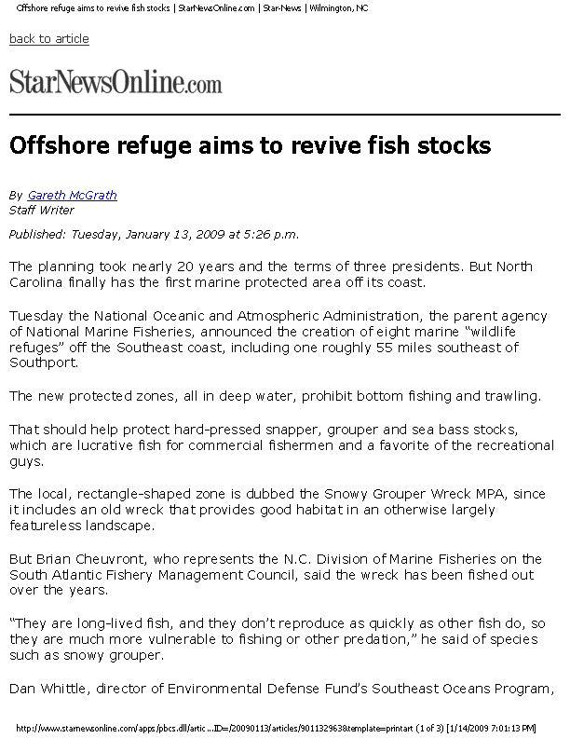
Outreach During MPA Development Process:
News Releases
Newsletters
Public hearings
Extensive media coverage
Notes:
Several rounds of public scoping and public hearings were held as MPAs were being considered in Amendment 14. Media interest was high during the development process.

Slide 5
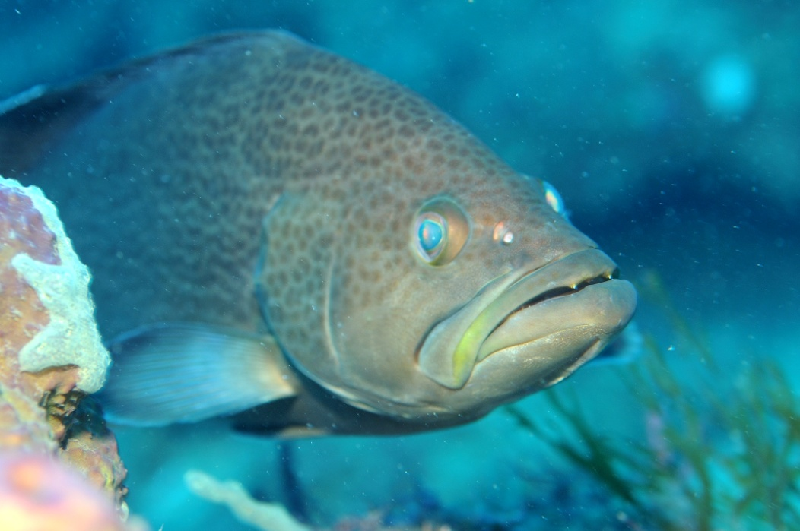
Amendment 14 – Deepwater MPAs
Eight Deepwater MPAs Implemented Effective February 12, 2009
Amendment Includes:
Outreach
Research and Monitoring
Law Enforcement
Notes:
After more than 16 years, Amendment 17 implemented 8 deepwater MPAs in February 2009. The amendment included outreach, research and monitoring, and law enforcement components.

Slide 6
Amendment 14 - Outreach
Outreach component similar to Oculina Experimental Closed Area Evaluation Plan
Goal: Increase awareness and understanding of deepwater Type 2 MPAs to the fishermen, citizens, and visitors of central eastern Florida and the U.S. Public.

Slide 7
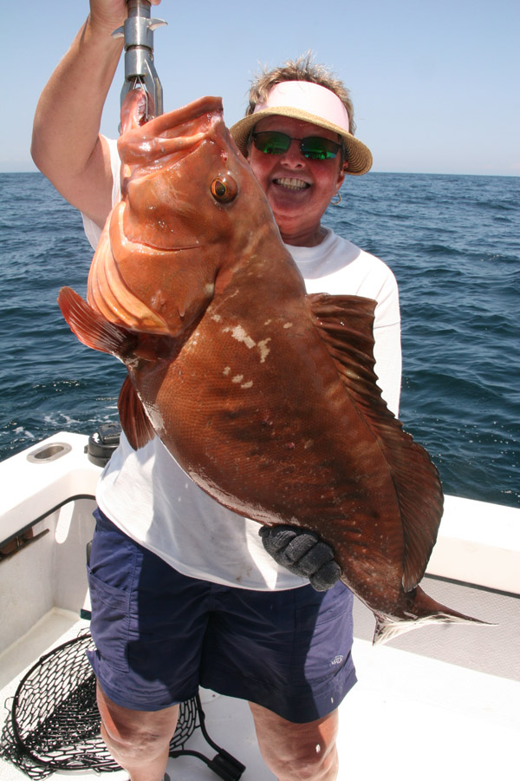
MPA Outreach Projects
Provide SAFMC Regulations to fishermen
Work with fishing chart manufacturers
News releases
Develop powerpoint presentation
Poster and rack cards
Expand website
Television documentaries

Slide 8
Project 1: Regulations to Fishermen
2009 – Publication: Regulations for Deepwater Marine Protected Areas in the South Atlantic
Created in partnership with SC Sea Grant Consortium
40,000 copies distributed and available online

Slide 9
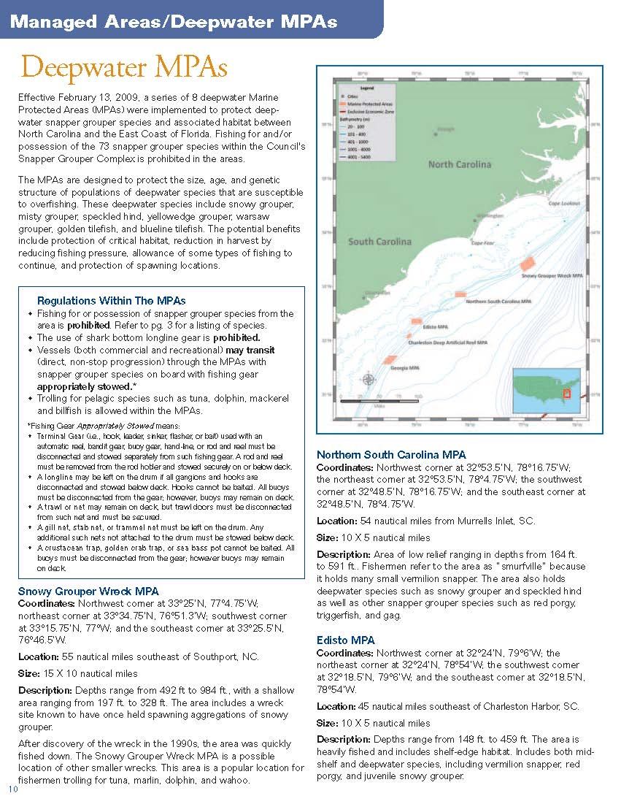
MPA Regulations to Fishermen
2010 – Reprint Fishing Regulations for SA Federal Waters
40,000 copies distributed to state and federal agencies, businesses, and individuals

Slide 10
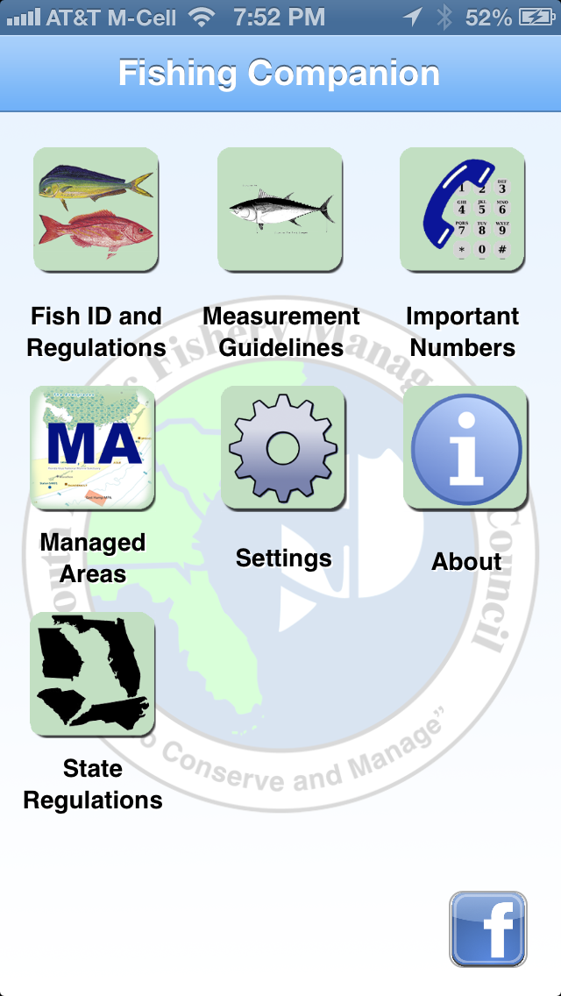
MPA Regulations to Fishermen
2013: Smartphone Regulations App with MPA Regulations
Available in both Android and Apple platforms

Slide 11
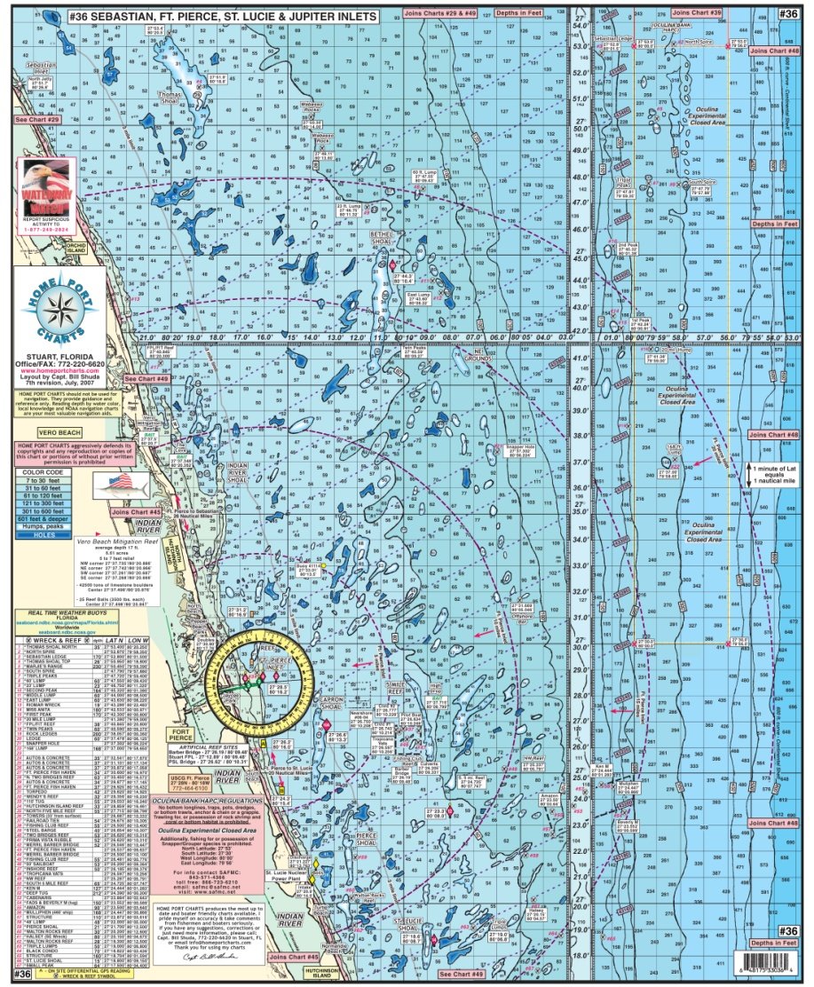
Project 2: Fishing Charts
Contacted local chart manufacturers and improved references to MPAs on printed charts
Need: Follow up with electronic chart manufacturers

Slide 12
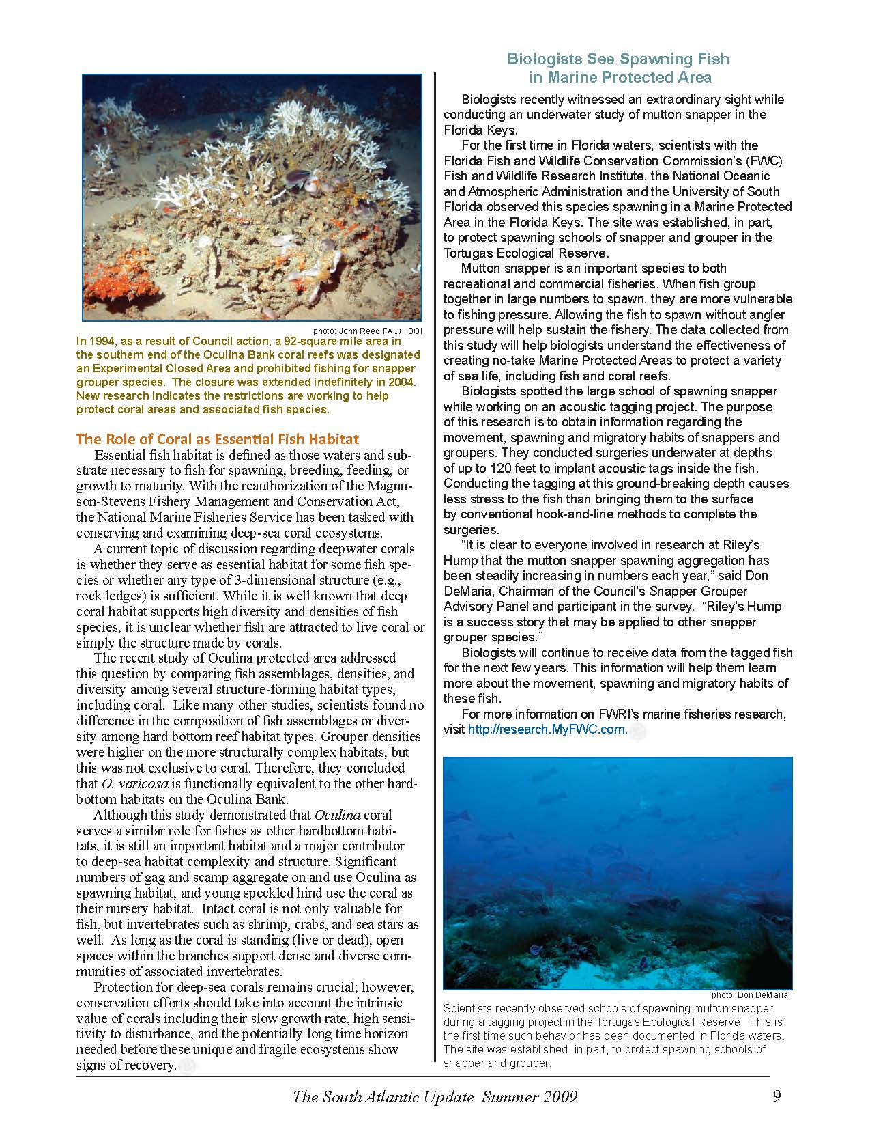
Project 3: News Releases
Target news releases in conjunction with law enforcement and research and monitoring activities
SA Update Newsletter featured articles

Slide 13
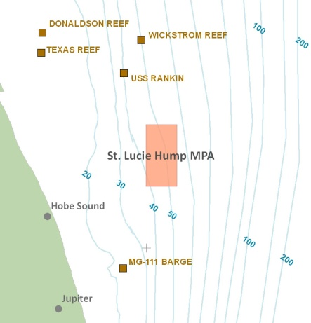
Projects 4 and 5: Powerpoint Presentation and Poster/Rack Cards
Powerpoint presentation has not been developed – identified as a “low priority” outreach item
Deepwater MPA Regulations brochures distributed similarly to rack cards used for OECA

Slide 14
Project 6: Expand Website
MPAs featured on new SAFMC website:
Regulations and Fish ID
Managed Areas
Includes Regulations brochure (PDF)
Latest information on MPA Expert Workgroup and current considerations
Notes:
Each MPA is featured on the new website with maps, coordinates and additional information similar to the information available in the DW MPA Regulation brochure. The brochure is also available in a downloadable format.
In addition, the website now includes updated information on the MPA Expert Workgroup meetings including briefing book materials and workshop reports.

Slide 15
Project 6: TV Documentaries
“Revealing the Deep” film features protected areas and deepwater habitat but not MPA specific
Film cost prohibitive and TV distribution difficult
Explore partnerships and other options, e.g., YouTube
Notes:
Note Will Hayman’s video presentation presented at the Snapper Grouper AP meeting in November. Possibility of working in partnership to produce an updated film or YouTube video.

Slide 16
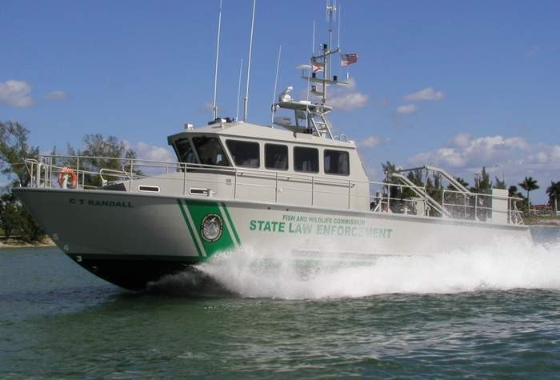
Outreach Summary
Amendment 14 Outreach Projects primarily targeting fishermen have been addressed
Needs:
Follow up with electronic chart mfg. to assess current information and improvements if necessary
Coordinate with research and monitoring and law enforcement activities to increase public awareness
Explore options for using YouTube and other social media outlets to increase awareness
Evaluation??

Slide 17
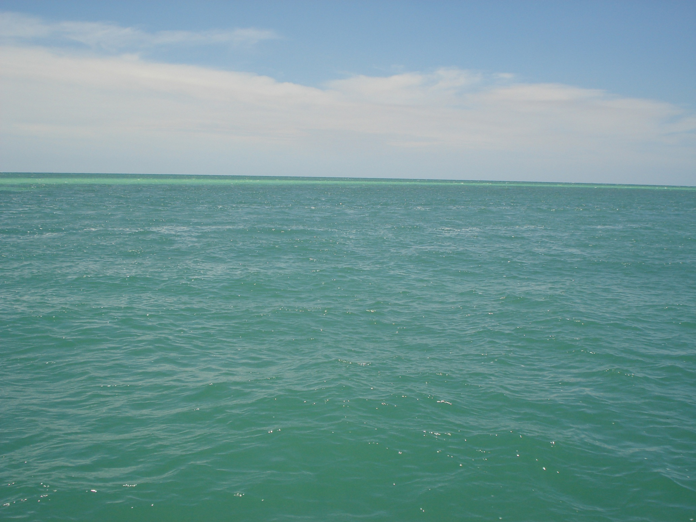
Questions?
Notes:
Additional outreach efforts:
Anna noted the CRCP funded project – Surveillance and Enforcement of Federal Fisheries in the Southeast.
Council staff participated in the July 2011 Workshop and provided input on outreach efforts.

