Slide 1
Marine Resources Education Program - Southeast
Update
Partners:
Gulf of Maine Research Institute
NOAA Fisheries
South Atlantic Fishery Management Council
Gulf of Mexico Fishery Management Council
Caribbean Fishery Management Council
December 2013
Notes:
Title slide

Slide 2
Marine Resources Education Program (MREP)
Gulf of Maine Research Institute
  Administrative partner and facilitator
Workshop-based Program
  Originated in New England
Designed to foster new relationships and increase knowledge and understanding of:
    Fisheries Science
    Fisheries Management
  “A program developed by fishermen for fishermen”
Notes:
Running slide

Slide 3
MREP Goals
To bring fishermen, scientists and managers together in a neutral setting outside the regulatory process.
To increase the number of people at work in the region’s fisheries who are comfortable working with the fishery data and management systems.
To help policy makers and scientists become more familiar with the inner working of the fishing community.
To increase the number of fishermen involved in collaborative research and pursuit of best available science.
To develop leadership and promote trust.

Slide 4
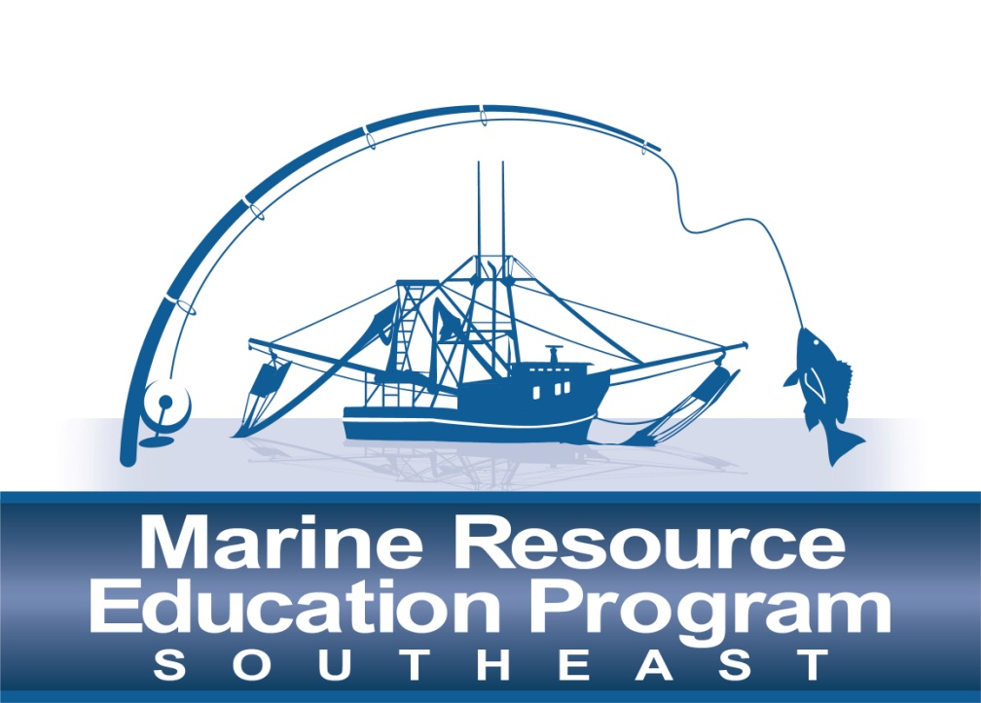
MREP Southeast Workshops
Joint South Atlantic, Gulf and Caribbean Workshops in 2013:
  Introduction to
  Fishery Science
  April 2-4, 2013
  Introduction to
  Management
  September 24–26, 2013
Regional Workshops
in 2014 and beyond

Slide 5
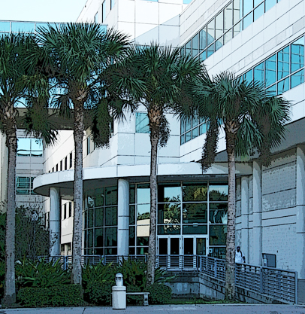
Intro to Fishery Science Workshop
Held April 2-4, 2013
FWC – Fish and Wildlife Resources Institute
Gulf, South Atlantic and Caribbean Participants:
  Recreational fishermen
  Charter/for-hire
  Commercial fishermen
  Industry representatives
  Media
Notes:
Steering Committee members were recommended by PIOs from each Council and Kim Amendola at NMFS Regional Office. Participants were recommended based on their participation in the management process and respect from within the fishing community.

Slide 6
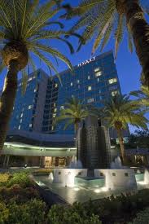
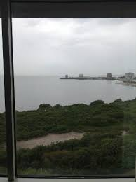
Intro to Management Workshop
Held September 24-26, 2013
Tampa Grand Hyatt Hotel
Gulf, South Atlantic and Caribbean Participants:
  Recreational fishermen
  Charter/for-hire
  Commercial fishermen
  Industry representatives
  Media
Notes:
Refer to a copy of the Workshop Agenda in the briefing book under Attachment 5. Workshop began with classroom presentations from Luiz Barbieri from FWC and Gordon Colvin from NOAA Fisheries MRIP, focusing on data collection.

Slide 7
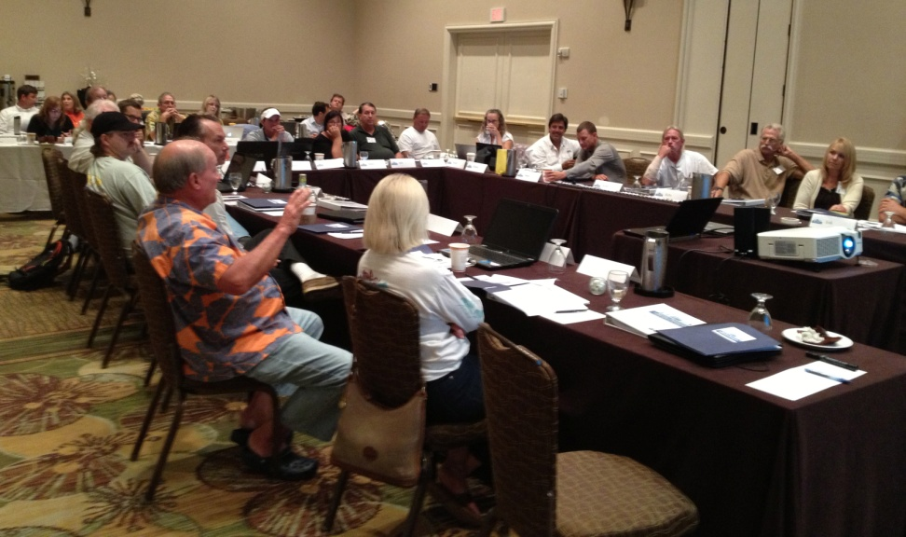
Management Agenda Highlights
Council Process
Role of Science and Management
How to Get Involved
Legal Framework
Enforcement

Slide 8
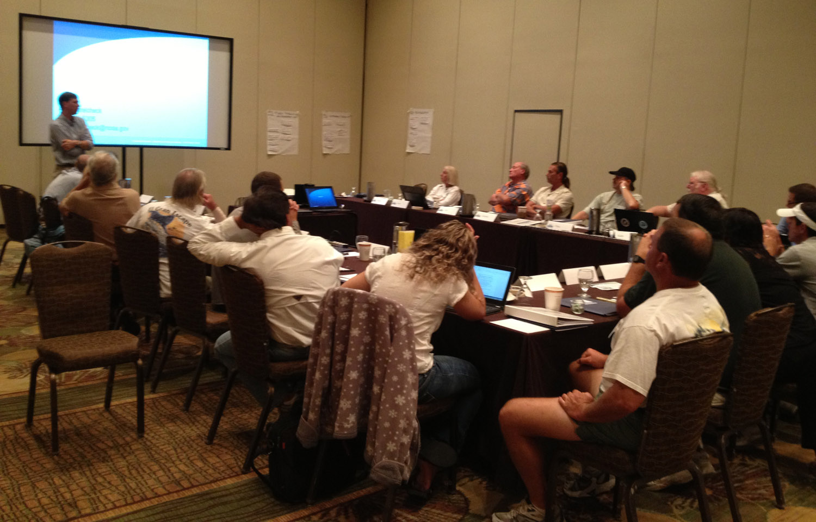
Management Agenda Highlights
Role of Congress and Judiciary in Management
Sustainable Fisheries, Visioning and Current Issues
Mock Council Meeting

Slide 9
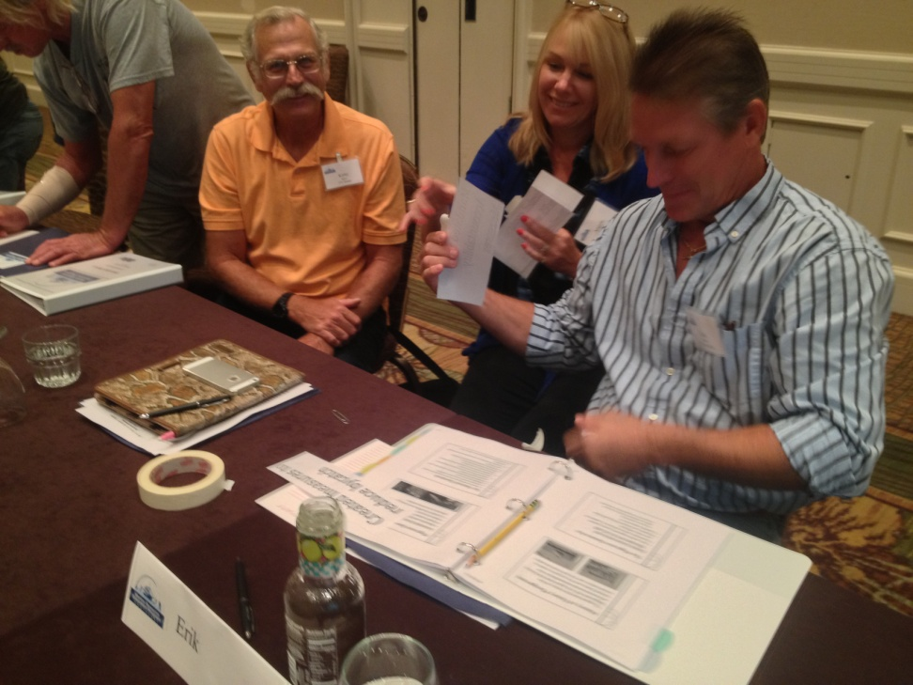
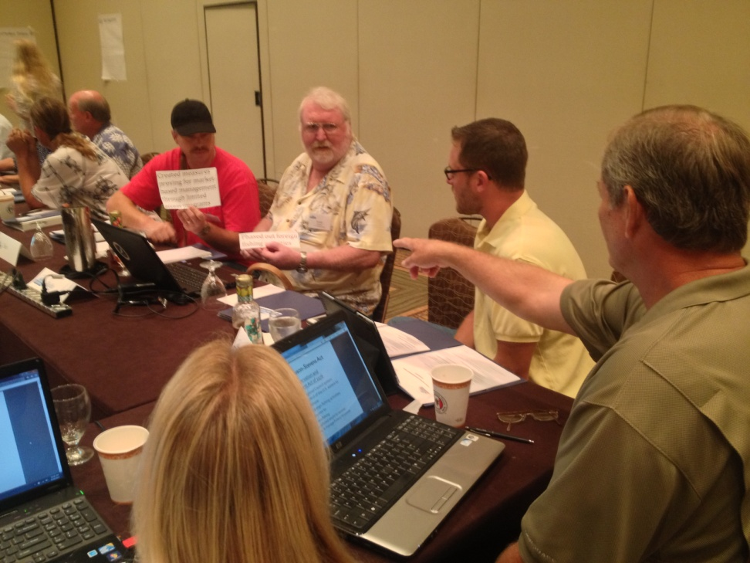
Mock Council Meeting

Slide 10
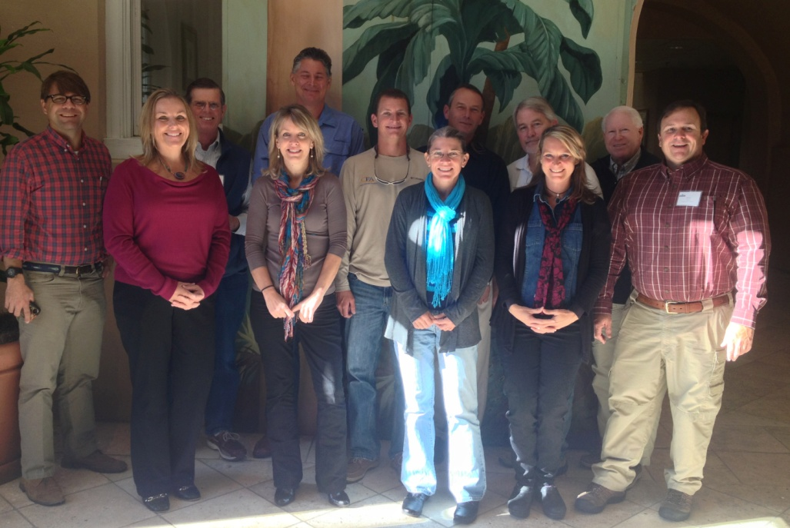
MREP Steering Committee Meeting
November 12 – 13, 2013
Charleston, SC
Agenda
  Program achievements
  Curriculum and presentations
  Evaluations
  Recommendations
  Kenny Fex – Steering Committee Member
Science Workshop April 22-24, 2014
St. Petersburg, FL

Slide 11
Questions?
Additional Program Information
www.gmri.org

