Slide 1
Marine Resources Education Program - Southeast Update SAFMC June Meeting June 17, 2016
Partners:
Gulf of Maine Research Institute
NOAA Fisheries
South Atlantic Fishery Management Council
Gulf of Mexico Fishery Management Council
Caribbean Fishery Management Council
Notes:
Title slide

Slide 2
Marine Resources Education Program (MREP)
Gulf of Maine Research Institute
Administrative partner and facilitator
Workshop-based Program
Fisheries Science
Fisheries Management
“A program developed by fishermen for fishermen”
Notes:
Running slide

Slide 3
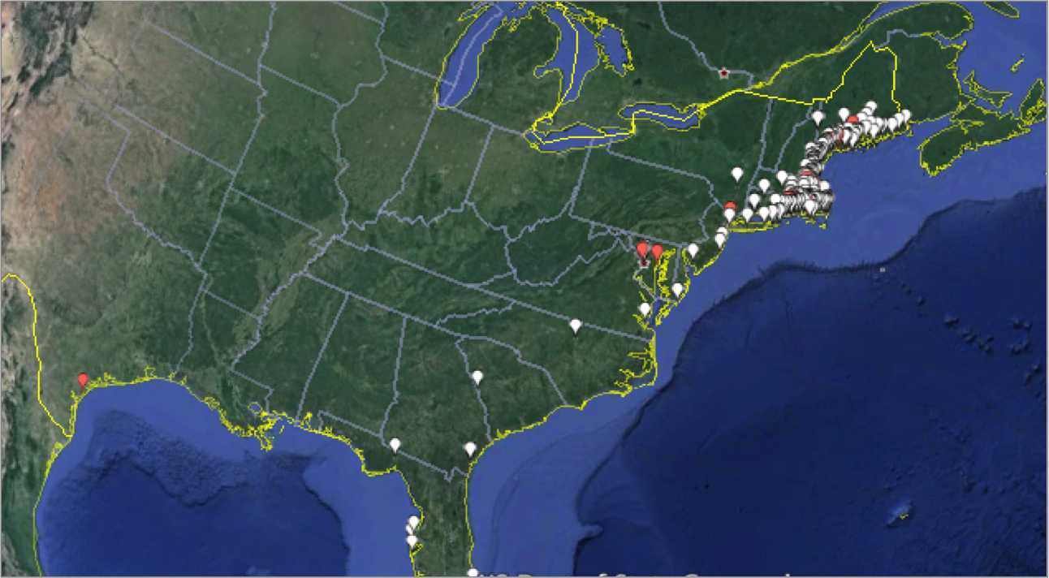

Slide 5
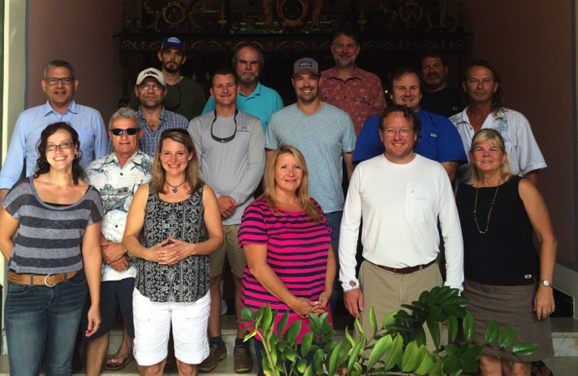
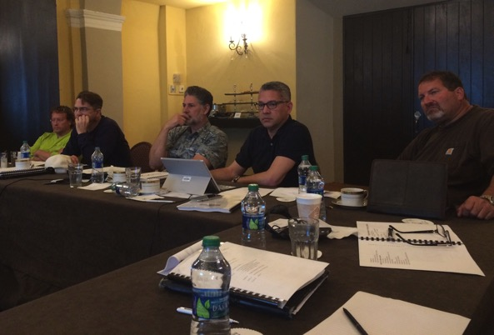
MREP Steering Committee
Meeting in San Juan PR - September 2015
Program Review
Curriculum Review
Recommendations
Notes:
Note Amber’s presentation on Visioning and Ben’s

Slide 6
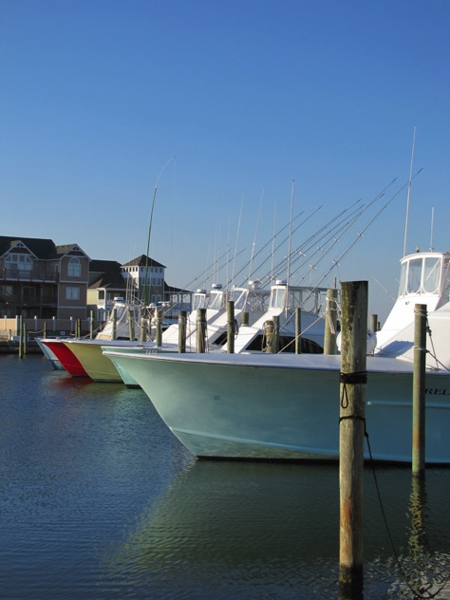
2016 MREP Southeast Workshops
Science Workshop
St. Petersburg, FL – FWC FWRI
April 19-121, 2016
Management Workshop
Tampa, FL
October 4-6, 2016

Slide 7
MREP Southeast 2016: Participants
Publicized in early 2016 by GMRI via:
Steering Committee
Post card mailings to permit holders
Councils
Website announcement
Post card distribution
MREP SE Website

Slide 8
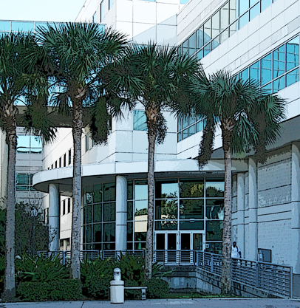
Intro to Fishery Science Workshop
Held April 19-21, 2016
FWC – Fish and Wildlife Resources Institute
30 Participants from Gulf and South Atlantic:
Recreational fishermen
Charter/for-hire
Commercial fishermen
Industry representatives

Slide 9
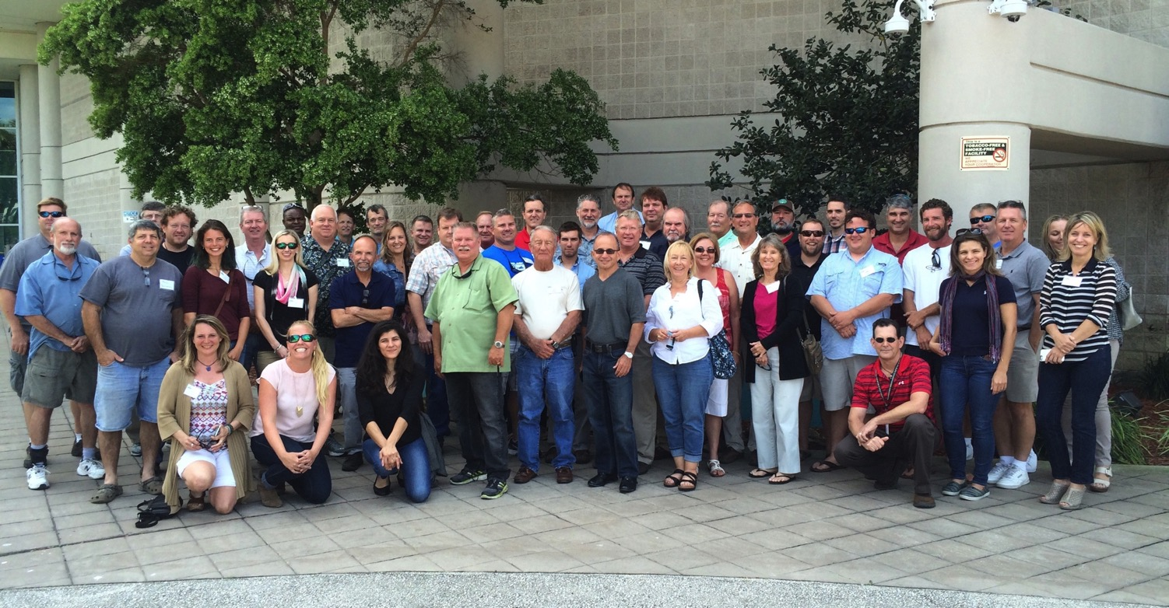
MREP Southeast Science Workshop Participants 2016

Slide 10
Science Workshop Curriculum
Sampling and Survey Methods
Fishery Dependent and Fishery Independent Data
Stock Assessments
Data Collection and analysis

Slide 11
Science Workshop Curriculum
Population Biology Rotate Stations at FWRI
Wet Lab
Age and Growth
Sampling Gear

Slide 12
Wet Lab – Aging and Otoliths
Notes:
Allison Amick - FWRI

Slide 13
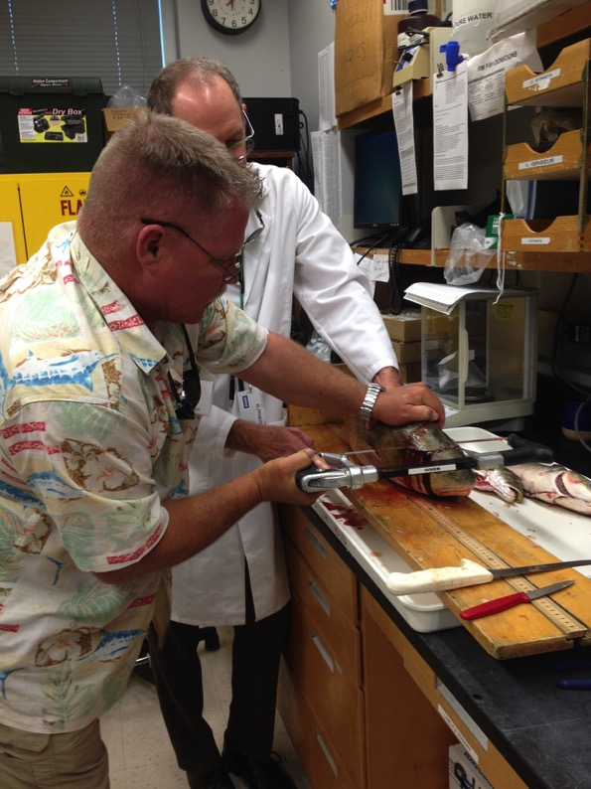
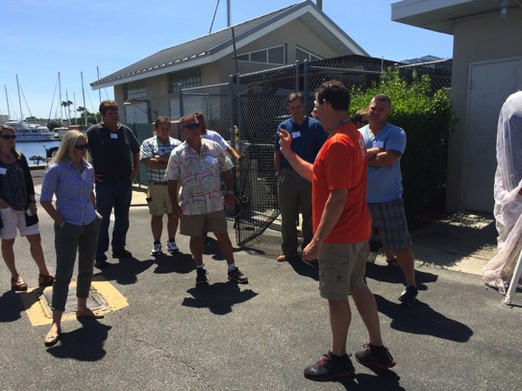
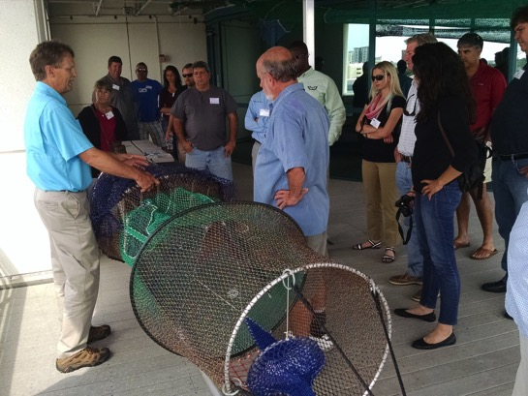
Otolith and Gonad Collection, Sampling Gear and Techniques
Notes:
Demonstrations were given by Sarah Walters at FWRI on removal of otoliths and other body parts including gonads for determining sexual maturity.

Slide 14
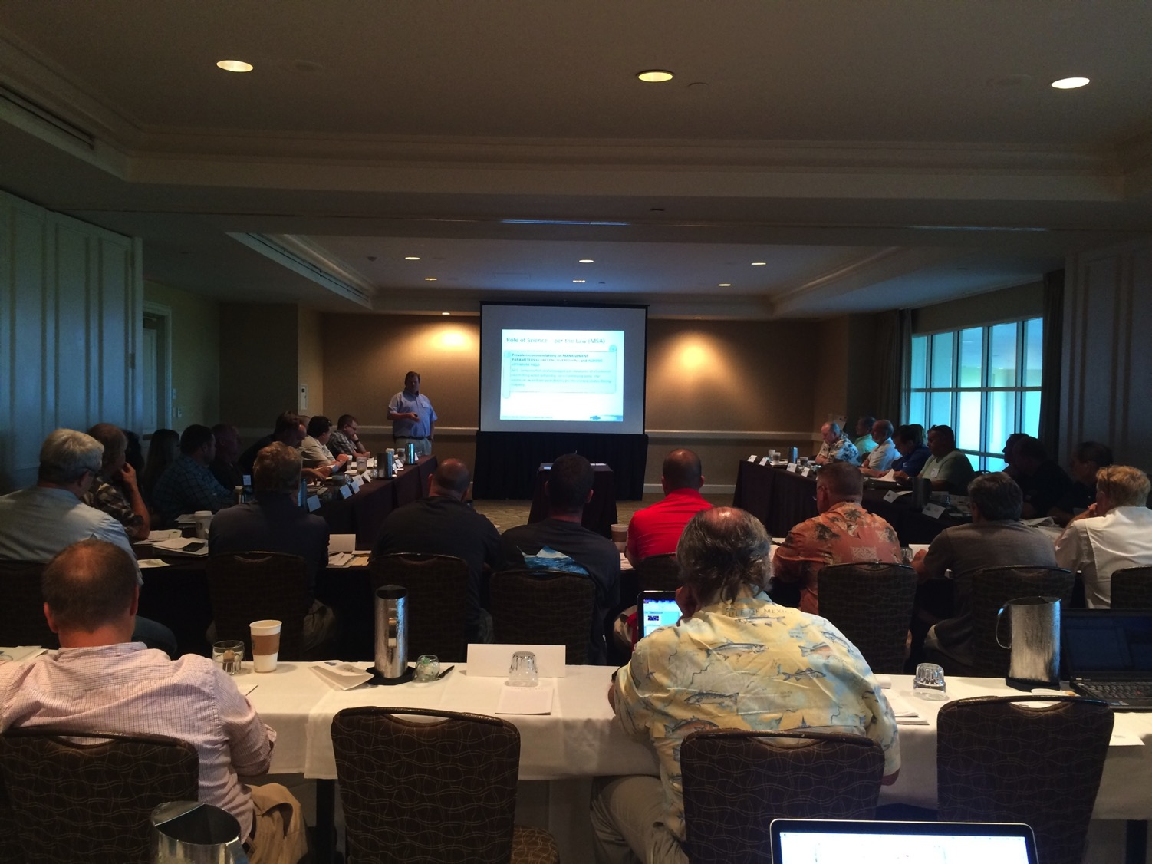
2016 MREP Southeast Fisheries
Management Workshop
October 4-6, 2016
Notes:
Participants are attentive, even during lectures and long days!

Slide 15
Evaluations
Evaluations are distributed at the end of each workshop
Evaluations continue to be positive
Instructors ranked highly
2016 Science Workshop highest ranking to date!
Notes:
Supply details from Evaluations including comments

Slide 16
2016 MREP Evaluations
“I like how fishermen were moderating the session rather than scientists, managers, etc.”
“I realize now the value of reporting accurate information to the government is vital to the process of stock assessments”
“I met and interacted with many participants from every sector. We educated and informed each other and hope for better interaction.”
Notes:
MREP Southeast Science workshop participants will be invited to attend the second workshop as part of the series. Additional participants from earlier applications may also be considered.

Slide 17
2016 MREP Evaluations
“12 years since I left my career behind to focus on fisheries management advocacy. This is the best thing I have yet to do. If this had run me a couple hundred dollars for ‘tuition’, I would have felt I got my money’s worth.”
“This is such a valuable program. Fisheries management is better understood through this lens.”

Slide 18
What’s Next
Steering Committee
Continue review of program objectives and priorities
Evaluation
Follow up
Continued Funding and Council Support

Slide 19
New!
MREP West Coast
Workshops Scheduled for 2016
Santa Cruz, CA and
Portland, OR

Slide 20
Questions?
Additional Program Information
www.gmri.org
Notes:
Note that there are now 26 presenters involved in the two workshops!! Importance of

