Slide 1
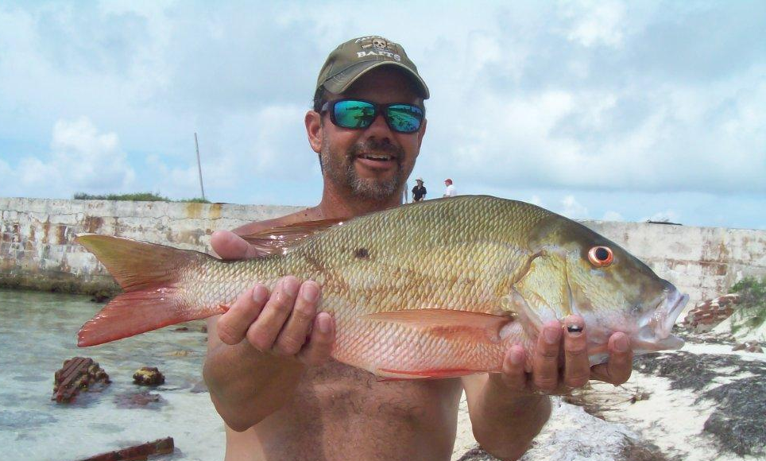
Mutton Snapper
Review and Discussion
November 18, 2015
Florida Fish and Wildlife Conservation Commission
Division of Marine Fisheries Management
Version 2
Notes:
This is a review and discussion of current mutton snapper regulations, public concerns about the regulations, and a request for direction on holding public workshops to collect input on potential changes to mutton snapper management.
Authors: Erika Burgess, Jessica McCawley, and Martha Bademan
Report date: November 14, 2015

Slide 2
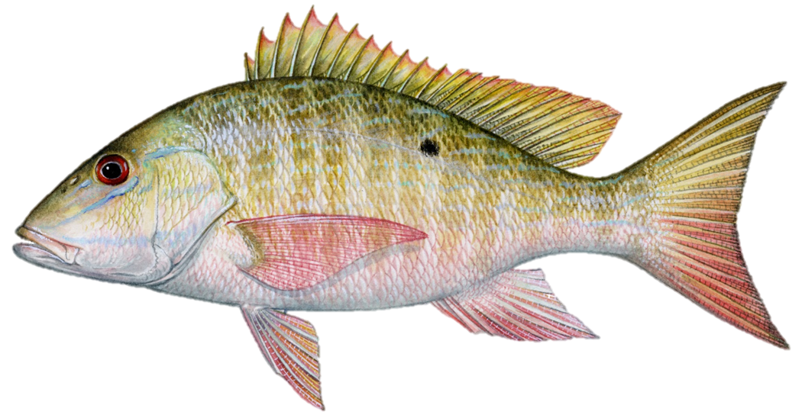
Background and Outline
Stock assessment positive, but new estimates show a smaller overall stock size, thus quota reduction is necessary
Gulf and South Atlantic Councils considering quota decrease and management measures to respond to stakeholder concerns
Since 2007, stakeholders have regularly expressed concerns about mutton snapper recreational bag limits and commercial trip limits, and the amount of harvest during the spawning season
FWC has opportunity to take the lead in the management changes for this fishery
Today:
Review stock status, stakeholder concerns, and suggested management measures
Notes:
Staff is bringing mutton snapper before the Commission for review and discussion for two main reasons. First, the recent stock assessment conducted by FWRI was positive, but the new and improved biomass estimates show the stock is not a large as previously estimated, thus a reduction in the federal quota is necessary. The Gulf and South Atlantic Councils are considering decreasing the quota based on the assessment, as well as other changes to address concerns expressed by stakeholders.
These stakeholder concerns are the second reason mutton snapper is being brought before the Commission. Since 2007, stakeholders have expressed concerns about mutton snapper. Staff has regularly heard comments about recreational bag limits and commercial trip limits, and received requests to reduce those limits. Stakeholders are particularly concerned about how many mutton snapper are harvested during the spawning season.
The Florida Fish and Wildlife Conservation Commission (FWC) has the opportunity to take the lead on management changes for this important Florida fishery and address stakeholder concerns.
Today, staff will review the status of the stock, the management framework for mutton snapper, and mutton snapper spawning and spawning area protections. Staff will also review stakeholder requests for rule changes and seek guidance from Commissioners on gathering public input on these possible management changes through public workshops.

Slide 3
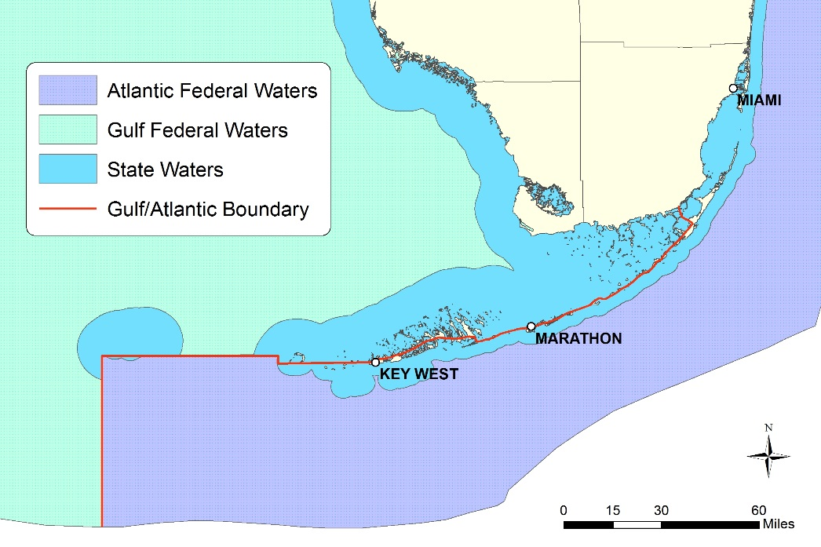
Mutton Snapper Status and Management
2015 stock assessment
Stock is not overfished, overfishing not occurring
Estimate of adult population is smaller than previous assessment
Recommends a reduction in quota
Mutton snapper management framework
Managed in state waters by FWC
Managed in federal waters by Gulf and South Atlantic Councils
Considered by Joint South Florida Committee
FWC has the opportunity to take the lead on any proposed regulatory changes
Notes:
All mutton snapper in U.S. waters comes from a single stock. The most recent stock assessment for mutton snapper was completed in 2015 by FWRI, which found that the stock is not overfished and overfishing is not occurring. The previous FWRI stock assessment, completed in 2008, had the same findings. However, based on improvements to the modeling, the 2015 assessment estimated a smaller adult population compared to the 2008 assessment. Because of this finding the assessment recommends a lower quota to maintain sustainable harvest. The stock’s quota is split between the Gulf (18%) and South Atlantic (82%). The Councils will consider federal rulemaking to reduce their quotas in response to the assessment.
For several south Florida reef fish, including mutton snapper, there are management issues directly tied to the convergence of three jurisdictional boundaries in the Florida Keys. FWC manages mutton snapper in state waters and the the Gulf and South Atlantic Councils manage mutton snapper within their respective jurisdictions of federal waters. In 2011, the FWC and the South Atlantic and Gulf Councils formed a Joint South Florida Committee in order to address problems unique to the region, including mutton snapper. However, at the most recent joint meeting of the South Atlantic and Gulf Councils, the two bodies decided to independently address mutton snapper because they were unable to reach a joint agreement on several other issues.
While the assessment does not indicate that management changes beyond quota reduction are needed at this time, the Councils will also be considering changing recreational and commercial mutton snapper bag and trip limits. Even though they are working separately, the Councils have indicated that they would like to create consistent regulations and that they would also like to avoid creating discrepancies between federal and state rules. The Gulf Council expressed a desire to track the South Atlantic Council’s rule development because most of the quota is allocated to the South Atlantic. The South Atlantic Council expressed support for FWC taking the lead in regulatory changes because the fishery operates almost exclusively off Florida. Based on the length of time required for federal rulemaking and the expressed intention of the Councils to create uniform regulations, there is an opportunity for FWC to take the lead in proposing changes to mutton snapper regulations and addressing stakeholder concerns.

Slide 4
Mutton Snapper Spawning Aggregations
Solitary, non-schooling fish that forms large spawning aggregations around the full moon from April – August
Peak occurs May – July
Individual fish spawn multiple times per season
Aggregations occur at predictable locations
Closed area to protect spawning aggregation at Riley’s Hump in Tortugas
Successfully increased number of spawning fish
Other spawning aggregations open to harvest
Western Dry Rocks
Notes:
Adult mutton snapper are normally solitary; however, from April to August, they form large spawning aggregations timed with the full moon. Spawning peaks from May through early July. These aggregations are highly predictable and they occur at the same locations from year to year. Individual fish may spawn multiple times each year, and they transit between spawning and non-spawning locations between full moons. Models indicate that currents transport larvae produced by these aggregations in the Keys to waters off mainland Florida.
There are several known spawning locations for mutton snapper near the Tortugas. The Florida Keys National Marine Sanctuary established a closed area to protect mutton snapper at one of these sites, known as Riley’s Hump. Since its closure in 2001, researchers have documented a 400% increase in the number of spawning fish at Riley’s Hump, which demonstrates that the area closure has been successful. FWRI researchers have also documented migration corridors through which mutton snapper transit from the Keys to the Tortugas in order to spawn.
Western Dry Rocks is another known mutton snapper spawning aggregation site. Fishing is allowed at this location. Throughout the spawning season fishermen converge on Western Dry Rocks to catch mutton snapper. The photo is an aerial shot of boats at Western Dry Rocks when mutton snapper were aggregated.

Slide 5
Current Mutton Snapper Regulations
Harvest Regulations by Area |  | All State Waters | South Atlantic Federal Waters | Gulf Federal Waters
Recreational | Size Limit | 16 inches TL
 | Bag Limit | 10 fish within snapper aggregate (per person/day)
 | Closed Season | None
Commercial | Size Limit | 16 inches TL
 | Harvest Limits | July-April: no restrictions; May-June: 10 fish/person/day or trip |  | None
 | Closed Season | None
 | Allowable Gears | Hook and line and spearing |  | Hook and line, spearing, and bottom longline
*Riley’s Hump is closed year-round to all harvest
Notes:
As was previously mentioned, mutton snapper are jointly managed by FWC and both federal Councils. Their jurisdictional boundaries converge in the Keys, which is where the majority of mutton snapper harvest occurs. While many of the mutton snapper regulations are similar across all three jurisdictions, there are key differences. In all state waters and Atlantic federal waters, commercial harvesters are limited to 10 fish per person per day or trip, whichever is more restrictive, during May and June. During the rest of the year, there are no commercial trip limits. In Gulf federal waters, commercial harvesters may use long-line gear, which is a gear prohibited for use to harvest any fish in state waters and to harvest mutton snapper in Atlantic federal waters. All harvest of reef fish, including mutton snapper, is prohibited at Riley’s Hump year-round.

Slide 6
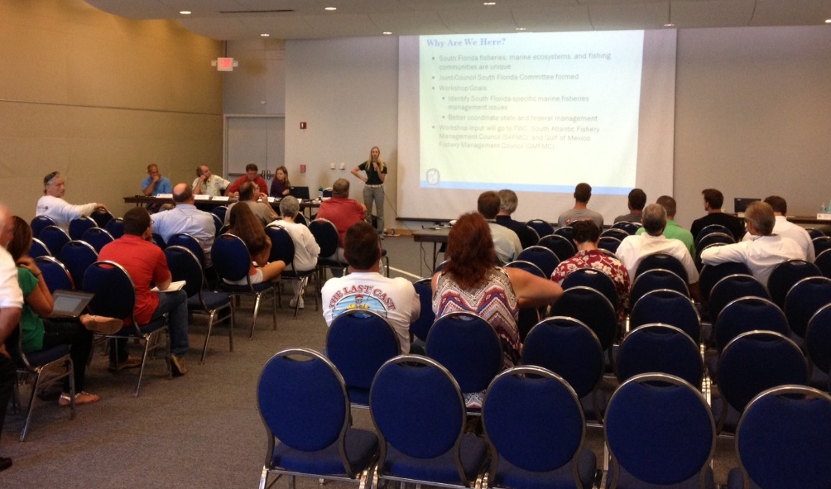
Stakeholder Concerns and Requests
The year-round recreational bag limit is too high and should be reduced
There should be a trip limit for the commercial fishery throughout the year
Regulations should be uniform across all management boundaries
Mutton snapper are easy to target during the spawn and too many are harvested, so during peak spawning season:
Reduce commercial and recreational per person limits
Establish commercial and recreational vessel limits
Prohibit harvest of mutton snapper
Notes:
Stakeholders have persistently expressed concern about mutton snapper recreational bag and commercial trip limits at FWC workshops, and South Atlantic and Gulf Council public hearings. Members of the public have been most vocal at meetings in south Florida. Stakeholders have requested regulatory changes to address their concerns. Staff heard these comments most recently at the 2015 Division of Marine Fisheries Management statewide workshops.
Concerned stakeholders believe that a reduction in recreational bag and commercial trip limits throughout the year is warranted. They would like to lower the number of mutton snapper that can be harvested within the recreational 10-fish snapper aggregate limit. This would still allow anglers to harvest 10 individual snapper a day, but they could not all be mutton snapper.
While there are seasonal trip limits for some commercial harvesters, the only year-round constraint on the amount of mutton snapper commercially-harvested is the federal quota. Some stakeholders believe a year-round trip limit for commercial harvesters is appropriate.
Those who fish in south Florida have asked for uniform regulations across all management boundaries, especially in the Florida Keys, where fishermen can fish in several jurisdictions on a single fishing trip.
Generally, stakeholders believe that harvest pressure is too intense during the spawning season when the normally solitary fish aggregates and becomes an easy target for both recreational and commercial harvesters. Stakeholders requesting changes see intense fishing pressure on spawning aggregations as a precursor to overexploitation. Many suggest reducing recreational and commercial harvest during the peak spawning season through reduced bag and trip limits and implementation of a vessel limit. Establishing a vessel limit could address concerns that even at a reduced per-person limit, too many fish could be harvested. A less commonly heard request is to ban harvest during the peak spawning season.

Slide 7
Average Florida Recreational Harvest, Gulf and South Atlantic Combined, by 2-month Wave
Notes:
Over 99.9% of all U.S. mutton snapper landings, recreational and commercial, occur in Florida. This graph shows the average number of mutton snapper harvested by recreational anglers by two-month wave for the years 2004 to 2014. (Data for 2015 are incomplete and are not included.) It does appear that recreational harvest increases during the May – June portion of the spawning season, as suggested by stakeholders. However, more individual fish are harvested in July and August. There is also a relatively high level of landings in January and February, which may be attributed to an increase in effort during the tourist season.

Slide 8
Average Monthly Florida Commercial Landings by Gear, 2004-2014
Notes:
This graph depicts average Florida mutton snapper commercial harvest from state and federal waters by month and gear, based on data from 2004 to 2014. Florida’s commercial mutton snapper harvest is over 97% of all U.S. commercial harvest. Unlike recreational harvest, commercial mutton snapper harvest is highest during May and June, despite a seasonal trip limit of 10 fish per person in all state waters and Atlantic federal waters. Long-line landings are higher than hook-and-line landings year-round; however, hook-and-line landings exceed long-line landings during the spawning months.

Slide 9
Staff-proposed Mutton Snapper Changes for Workshops
Recreational
Regular season (July/August – April): 5 fish within 10-fish snapper aggregate bag limit
Spawning season (May – June/July): 2 fish per person within the 10-fish snapper aggregate bag limit and a maximum of 12 fish per vessel
Commercial
Regular season (July/August – April): consider separate gear limits for hook and line and longline; possibly 300 lbs. per trip for hook and line and another limit to allow bycatch on long-line vessels in Gulf federal waters
Spawning season (May – June/July): 2 fish per person and a maximum of 12 fish per vessel
Seek feedback on timing of spawning season regulations
Notes:
If the FWC takes the lead in this process, staff recommends gathering public input on specific changes for mutton snapper recreational bag and commercial trip limits. Staff has compiled recommendations provided at past public meetings, as well as the changes discussed by the Joint Committee, and developed a proposal for Commission consideration.
For the recreational fishery, staff proposes lowering the regular season (July/August – April) bag limit from 10 fish to five fish within the 10-fish snapper aggregate bag limit. This would address concerns that a 10-fish limit is too high for mutton snapper harvest outside of the spawning season. During the spawning season (May – June/July), staff proposes further reducing the recreational bag limit to two fish within the 10-fish snapper aggregate bag limit and establishing a vessel limit of 12 fish. This would address the most commonly heard concern that anglers take too many mutton snapper during the spawning season. A vessel limit of 12 fish may also discourage recreational anglers from attempting to sell their recreational bag limits, which is illegal.
For the commercial fishery, staff recommends considering separate gear-specific trip limits during the regular season (July/August – April), such as 300 pounds per trip for hook-and-line vessels and some other limit for long-line vessels that operate in Gulf federal waters. Staff also proposes reducing the current commercial limit from 10 fish per person to two fish per person and a maximum of 12 fish per vessel during the spawning season. Setting the commercial harvest limit equal to the recreational bag limit during the spawning season would discourage commercial fishermen from directly targeting spawning aggregations of mutton snapper while allowing incidentally-caught mutton snapper to be retained, thus reducing potential regulatory discards.
Staff also recommends gathering feedback on the timing of spawning season regulations for mutton snapper. The current 10-fish bag limit for the commercial fishery during the spawning season occurs during May and June only, but peak spawning occurs from May through July.
If FWC workshops are held, workshop feedback would be shared with the Councils for their consideration.

Slide 10
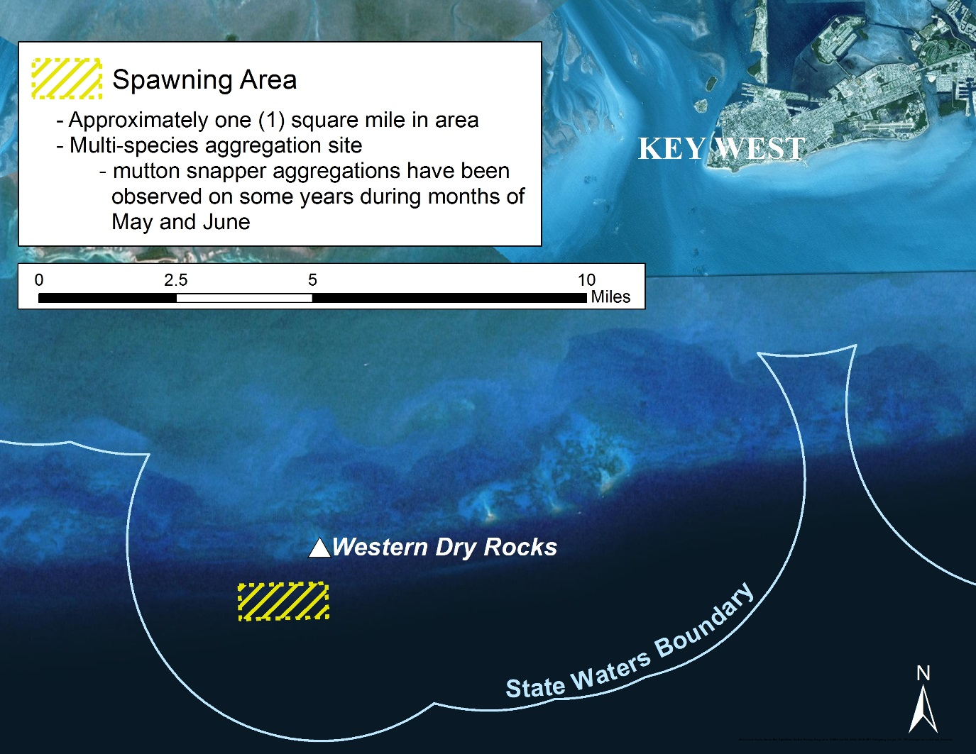
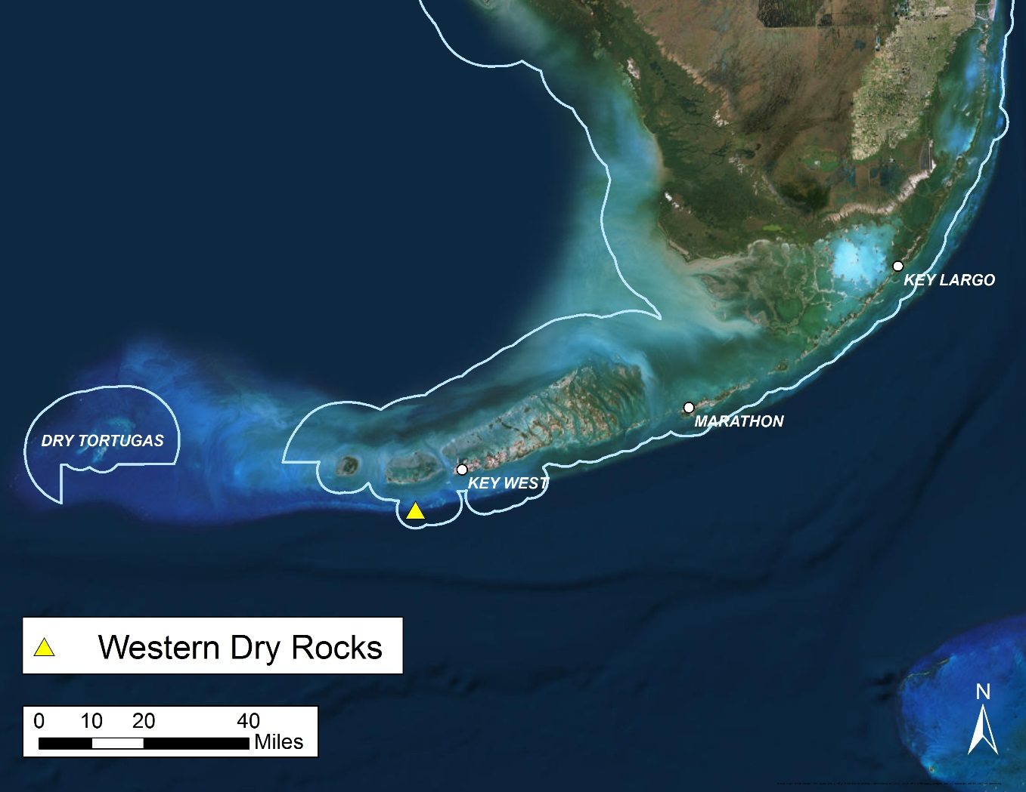
Spawning Area – Western Dry Rocks
Notes:
A spawning site for mutton snapper exists near Western Dry Rocks. Mutton snapper have been observed aggregating on full moons during the months of May and June, known times of spawning activity for this species. The general spawning site covers approximately one square mile, and is roughly 11 miles southwest of Key West.

Slide 11
Timeline
Public workshops
Collaboration between FWC and South Atlantic Council
Proposed for February 2016
Locations: Stuart, Ft. Lauderdale, Key Largo, Key Colony Beach, Key West, Naples, and a webinar
FWC rulemaking
Return with draft rule in April 2016
Federal rulemaking
Council final action anticipated spring or summer 2016
Notes:
Should the FWC take the lead in the process of changing recreational bag limits and commercial trip limits for mutton snapper and soliciting public comment, staff would work in coordination with the Councils to maximize public input on the issue.
FWC could hold public workshops along with the South Atlantic Council in February 2016. The South Atlantic Council will hold three public hearings in south Florida during this time. Staff recommends FWC hold three additional public workshops. Between the South Atlantic Council and FWC, public meetings could be held in Stuart, Ft. Lauderdale, Key Largo, Key Colony Beach, Key West, and Naples. FWC staff would also hold a state-wide webinar on the issue. The Gulf Council will take public comments on mutton snapper during their regularly scheduled Council meetings.
If directed, staff could return with a draft rule and stakeholder input from public workshops for Commission consideration in April 2016.
The South Atlantic and Gulf Councils will likely take final action on mutton snapper changes in spring or early summer of 2016.

Slide 12
Staff Recommendation
FWC take the lead on mutton snapper and conduct public workshops on:
Reducing recreational bag limits
2 fish per person within the 10-fish snapper aggregate bag limit and 12 fish per vessel during the spawning season
5 fish per person within the 10-fish snapper aggregate the rest of the year
Setting the commercial limit equal to the recreational limit during the spawning season
Establishing a gear-specific commercial trip limits
Timing of spawning season regulations and ideas about Western Dry Rocks
If directed, staff will return with stakeholder feedback and a draft rule at the April Commission meeting
Notes:
Staff recommends that FWC take the lead in addressing concerns expressed by stakeholders about harvesters exploiting mutton snapper spawning aggregations and current year-round mutton snapper recreational bag limits and commercial trip limits.
To accomplish this, staff recommends conducting public workshops on specific potential management changes to reduce mutton snapper harvest both during the spawning season and throughout the year. These changes would reduce the recreational bag limit during the spawning season to two fish per person and implement a new vessel limit of 12 fish. During the rest of the year, mutton snapper recreational bag limits would be reduced from 10 fish within the 10-fish snapper aggregate bag limit to five fish within the snapper aggregate. This would reduce the legal bag limit for mutton snapper, while retaining anglers ability to harvest 10 snappers in total. Commercial harvest changes would include matching the proposed recreational bag limit of two fish per person and 12 fish per vessel during the spawning season, as well as considering gear-specific commercial trip limits during the rest of the year. These gear-specific limits could be 300 pounds per trip for hook-and-line vessels and some other limit for long-line vessels in Gulf federal waters that would allow long-line vessels to retain mutton snapper caught as bycatch. Staff would also seek feedback on the timing of spawning season regulations.
During this process, staff would collaborate with the South Atlantic and Gulf Councils to maximize public input on this issue and to advocate for uniform regulations across jurisdictions.
If the Commission directs staff to proceed with workshops, staff will return with stakeholder feedback on these items and a draft rule at the April 2016 Commission meeting in south Florida.

Slide 13
The following slides are considered backup material and are not anticipated to be part of the actual presentation

Slide 14
Number of Commercial Trips by Pounds Landed per Trip for the Regular Season, 2004-2014
Area Fished | Pounds Landed per Trip
 | ≤100 | 100-200 | 200-300 | 300-400 | 400-500 | >500
Atlantic State Waters | 7,479 | 175 | 25 | 11 | 3 | 3
Atlantic Federal Waters | 9,061 | 525 | 147 | 66 | 38 | 181
Gulf State Waters | 1,800 | 76 | 20 | 7 | 2 | 6
Gulf Federal Waters | 2,303 | 364 | 167 | 99 | 53 | 319
Notes:
Based on landings from 2004 through 2014, most commercial trips that landed fish outside of the spawning season landed fewer than 100 pounds per trip. Only 10% of total trips taken over that 11-year period landed more than 100 pounds. Fewer than 3% of all trips landed more than 300 pounds per trip. Although trips landing over 300 pounds are not as common, they did contribute 55% of total landings by weight (804,405 pounds) during this time period.

Slide 15
Number of Commercial Trips by Number of Fish Landed in the Spawning Season, 2004-2014
Notes:
This graph depicts the number of commercial trips by the amount of fish they landed (numbers) during the spawning season from 2004 through 2014. Most trips landed two or fewer fish. Eighty-five percent of trips landed 12 fish or less in May and June for the 11-year period.

