Slide 1
National Bycatch Report Update
Fishery Management Council Presentation
Sumer/Fall 2012

Slide 2

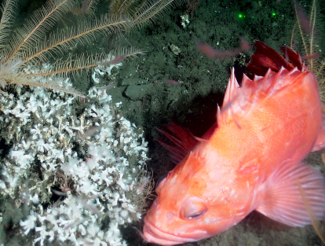
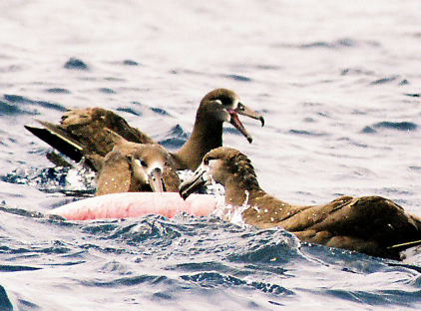
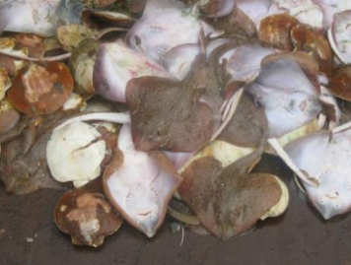
National Bycatch Report Objectives
First in a planned series of national bycatch reports designed to track and report on NMFS’ efforts to monitor bycatch.
The National Bycatch Report will serve as a cornerstone, aiding NMFS in meeting bycatch reduction mandates and stewardship obligations by identifying trends in bycatch, guiding policy, and setting priorities for bycatch data collection.
Future NBR updates and comprehensive reports will adhere to these objectives.
Photos: NMFS

Slide 3
First Edition: Key Accomplishments
Report published September 22, 2011.
Detailed bycatch estimates for 81 fisheries, 480 fish stocks, and 94 protected species.
Comprehensive documentation of bycatch data sources and analytical estimation methods.
Four new tracking tools:
  Tier Classification System;
  Key Stocks;
  Fisheries of Focus; and
  Bycatch Estimation Improvement Plans.
Photos: NMFS

Slide 4
First Edition Performance Measures
Tier System: quantitative means to evaluate the quality of bycatch data and estimation procedures. Tier scores range from 0 (worst) to 4 (best) based on quality of:
  Observer data;
  Supplemental data; and
  Database/IT considerations.
Key Stocks: stocks with high bycatch levels or special importance to management. Based on:
  Bycatch level of the stock;
  Management importance of the stock or population; and
  Overall stock or population status.
  All ESA listed species are Key Stocks.

Slide 5
First Edition Monitoring Trends
Fisheries of Focus: fisheries with one or more key stocks as bycatch and/or high bycatch levels.
  Based on frequency analysis of all fishery bycatch ratios in which the median bycatch ratio was 0.17.
  Fisheries with bycatch ratios >0.17 were considered Fisheries of Focus.
Bycatch Estimation Improvement Plans: were developed for all Fisheries of Focus. Include information on:
  Current tier scores;
  Deficiencies in bycatch data collection and estimation; and
  Recommendations for improving bycatch data collection and estimation.

Slide 6
Progress Toward Future Editions
NBR Steering Committee and Regional Teams appointed December 2011.
Steering Committee met February 29-March 1, 2012.
NMFS plans to provide:
  Biennial bycatch updates beginning in 2013 based on 2010 data;
  Comprehensive Bycatch Reports every six years beginning in 2017; and
  A workshop to examine methods for the National Bycatch Ratio.
Bycatch estimates for next update due this fall.
Council briefings: occurring now; another set of briefings when updates are complete.

Slide 7
Contents of Biennial Updates
Bycatch estimates for fish, sea turtles, marine mammals, seabirds, and invertebrates (in observed fisheries);
A short national summary document for each update;
Updated data tables similar to ones in the NBR’s First Edition (including any newly-observed fisheries and newly-listed protected species);
Regional summaries, including progress on addressing NBR recommendations; and
Cross-references to regional Bycatch Implementation Plans.
Photos: NMFS

Slide 8
Content of Comprehensive Reports
Bycatch estimates for fish, sea turtles, marine mammals, seabirds and invertebrates for the two years following the last NBR update;
Updates for bycatch performance measures in the first edition of the NBR (e.g.,Tier Scores, Key Stocks);
Synthesis text for all years of data presented since the last comprehensive report;
Summary of progress since First Edition in 2005;
Updated recommendations for improving bycatch data collection and estimation; and
Appropriate footnotes for changes that have occurred since the most recent report.

Slide 9
Schedule for NBR Updates and Comprehensive Reports
Year | Document Type | Data Years Included
2011 | Comprehensive Report (First Edition) | 2005
2013 | Online Update | 2010
2015 | Online Update | 2011-2012
2017 | Comprehensive Report (Second Edition) | 2013-2014 + Synthesis of 2010-2014
2019 | Online Update | 2015-2016
2021 | Online Update | 2017-2018
2023 | Comprehensive Report (Third Edition) | 2019-2020 + Synthesis of 2015-2020

Slide 10
Review, Clearance, and Publication
Updates/reports will be reviewed and cleared by NMFS.
Updates will be provided to Fishery Management Councils for comment.
Final updates/reports will be posted on the NMFS Bycatch webpage http://www.nmfs.noaa.gov/by_catch/index.htm.
Summary documents will be published as hard copies; data tables will be online and on CD with the summary document.
Photos: NMFS

Slide 11
Approximate Timeline for Providing an Update in FY13 (2010 Data)
 | FY2012 |  |  |  |  |  |  |  |  |  |  | FY2013
Task | Nov | Dec | Jan | Feb | Mar | Apr | May | Jun | Jul | Aug | Sep | Oct | Nov | Dec | Jan | Feb | Mar | Apr | May | June | July | Aug | Sep | Oct
Appoint Steering Committee and Regional Teams
Steering Committee Meeting
Regional teams to compile and/or update information on bycatch estimates
Progress Report for Fishery Management Councils
Regional teams submit bycatch estimates
General text sections for the first update
Face to face meeting of Steering Committee
Finalize the first biennial update
Progress Report to Fishery Management Councils
Response to comments on the update
Review and clearance of the first biennial update
Post first biennial update on the National Bycatch page

